Slide 1

Transform
POWER WORKSHOP SERIES

Slide 2



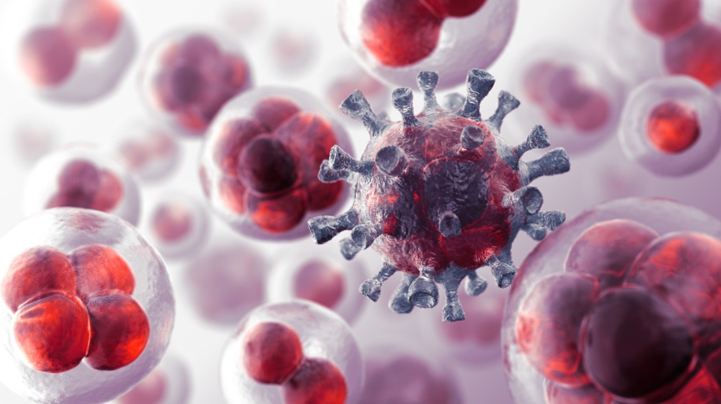
The
anti
code
cancer

Slide 3
The Wonders Of The Human Body
You are composed of 80 trillion cells
You make a new body every 7 years
Your body is designed to live to 120
We are dying on average at age 80
Cancer is the leading cause of death today

Slide 4
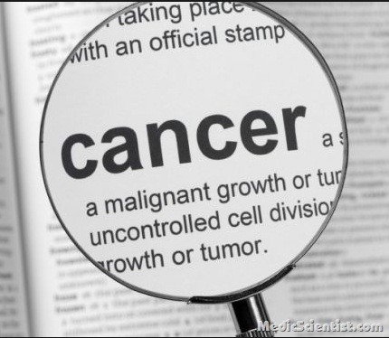
Notes:
Defined, cancer is simply a malignant growth or tumor (Latin for swelling) or uncontrolled cell division that can have many different causes…both environmental and internal, mostly from what we eat.

Slide 5
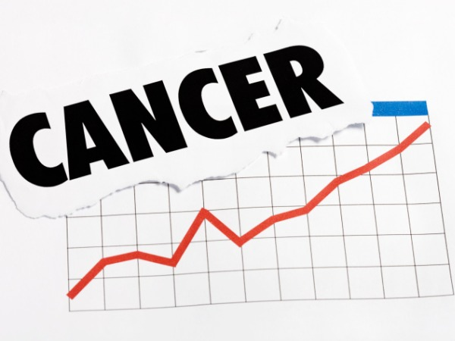
Notes:
The rise in worldwide cancer rates is alarming to everyone, affecting friends, family members and colleagues. This presentation is designed to educate on lifestyle changes to slow the growth and prevent life threatening cancer. There is a misconception as to the treatment and prevention of cancer. Cancer today is preventable and treatable through natural means.

Slide 6
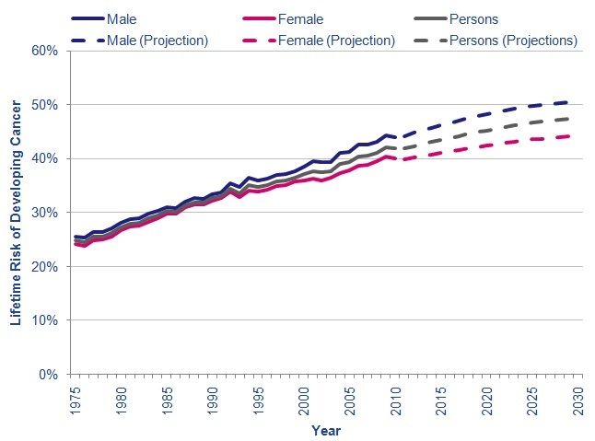
Notes:
REFERENCE:
Office for National Statistics. Projection of number of deaths to 2030, by age and sex. (Reference 000316). Accessed August 2012.
Office for National Statistics. 2008 Population projections.

Slide 7
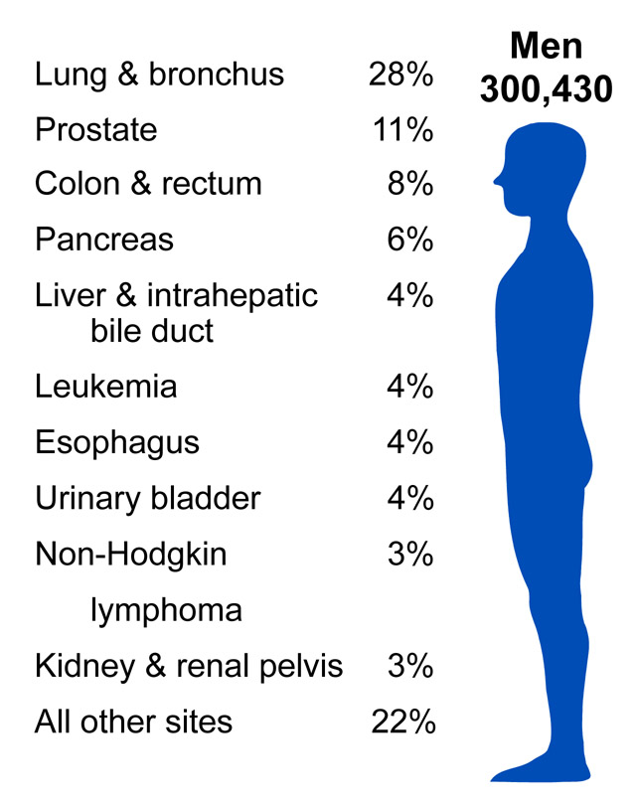
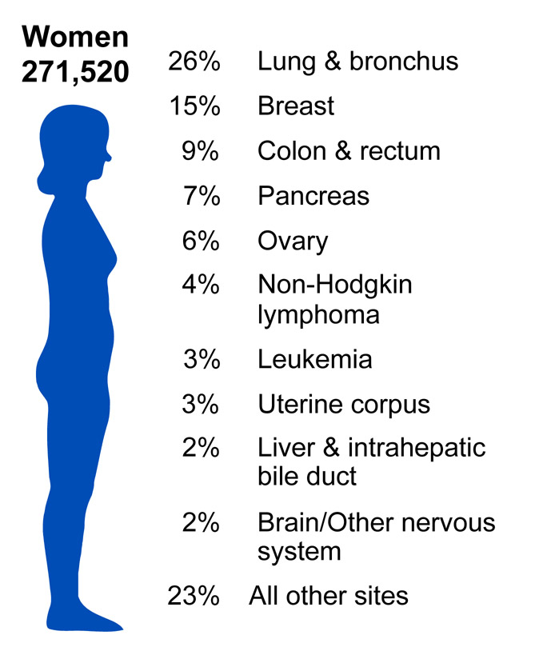
#1 Cancer Is Lung
Notes:
There are many types of cancer. The most common is lung in both sexes, followed by breast in females and prostate in males. As of 2014, 1 out of 2 people will be diagnosed with some form of cancer in their lifetime.
REF: Wayne W. Lamorte, MD, Phd, MPH Boston University School Of Public Health

Slide 8
HEALTH CARE QUIZ True or False
It is possible that a person could have cancer and yet not feel a symptom?
TRUE or FALSE?
2) When a person has no symptoms from cancer, he or she is then on the road to good health?
TRUE or FALSE?
Notes:
Cancer or tumors can be silent killers, growing in your body for decades, before you feel a symptom. ANSWER = TRUE
There is no research that shows that you are healthy once void of symptoms. ANSWER = FALSE

Slide 9

Causes Of Cancer
Toxicities – tobacco, pollution
Nutritional deficiencies
Epigenetics
Free radicals – sun, radiation
Man made products - foods, amalgams, additives, alcohol
Notes:
Cancer is developed at a cellular level. It’s critical that we supply our bodies with proper nutrients, cleanse it periodically, and protect from free radical damage. Epigenetics will be explained below.

Slide 10
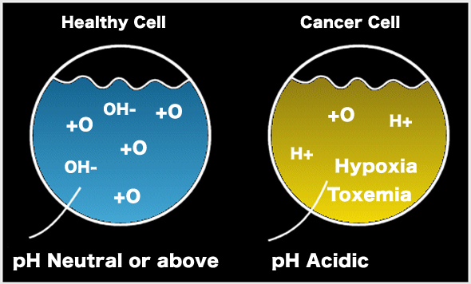
Healthy Cells Require
Proper nutrients
Water
Oxygen
Proper pH
Nerve impulse

Slide 11
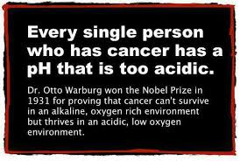
Notes:
This fact was known back in the 1930’s. Yet most of our diets are extremely acidic. This fact is also well known by the food and medical industries.

Slide 12
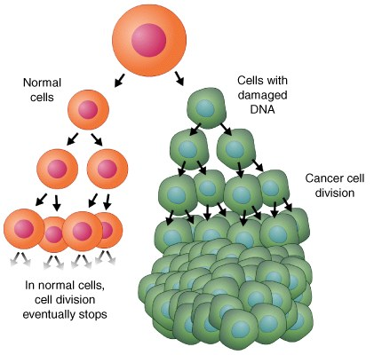
Normal Cell Replication Requires
Essential fatty acids
Antioxidants
Amino acids
Vitamins & minerals
Water
Notes:
EFA’s are critical for cell health as it allows a transport membrane for oxygen and nutrients. Without oxygen, a cell can become toxic and acidic. Anti-oxidants scavenge free radicals preventing DNA damage.

Slide 13
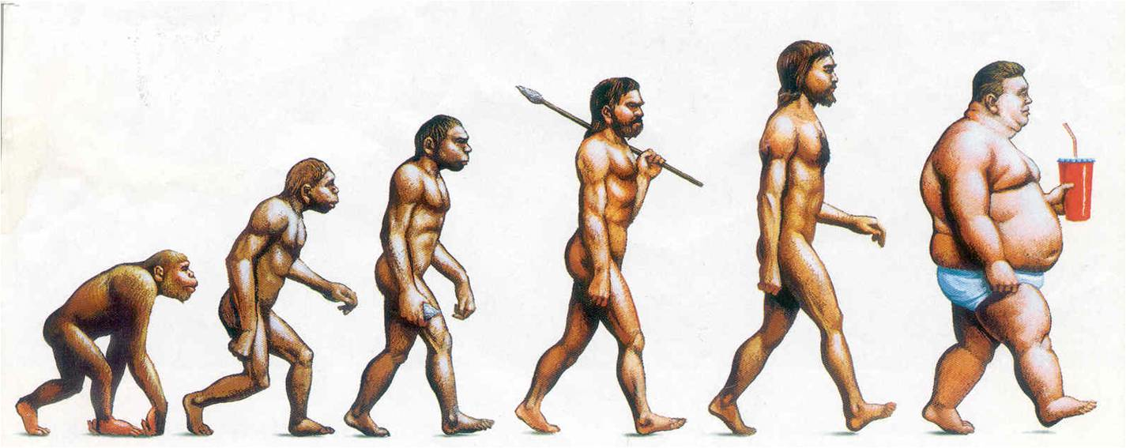
THE SHAPE OF OUR EVOLUTION
Notes:
In modern times, our diet, or lack of proper nutrition, is being linked as a causative factor in cancer through epigenetics

Slide 14
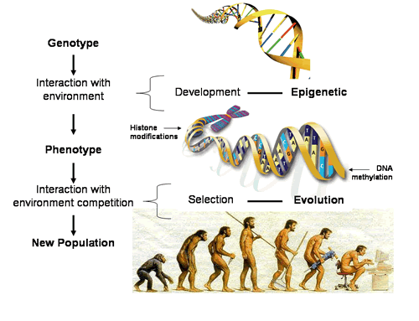
Notes:
Our external environment can influence our genetic expression. Only about 1%-10% of today’s cancers can be linked to genetics. The statement, “If my mother had breast cancer, then I will also suffer from it as well”, is not necessarily true. Today’s research is leaning more towards our environment or epigenetics, how external stimuli can change, modify or trigger genetic mutations.

Slide 15
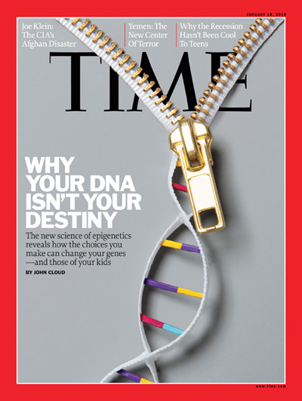
Notes:
Quite simply, our environment can change our biological markers through stimuli. The foods we eat, the air we breathe. These markers or epigenomes can be carried for a generation and be turned on...or off, depending on the stimulus on these markers that can be expressed in our genes. TIME Magazine.

Slide 16
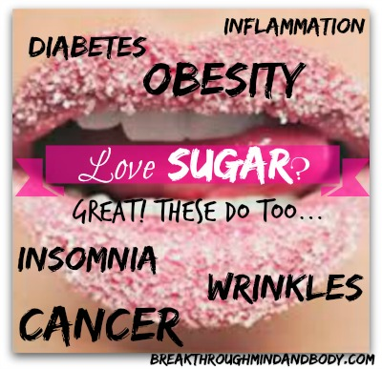
Notes:
It is clinically proven that the rising and excessive consumption of sugar is the main culprit, being linked to a host of health issues including obesity, diabetes, heart disease and CANCER. Sugar consumption is on the rise to a whopping 130 lbs. of sugar per person per year in North America. REF: “Fifth Estate. www.cbc.ca/.../News/ID/2410324126/ - 41k - 2014-07-03

Slide 17
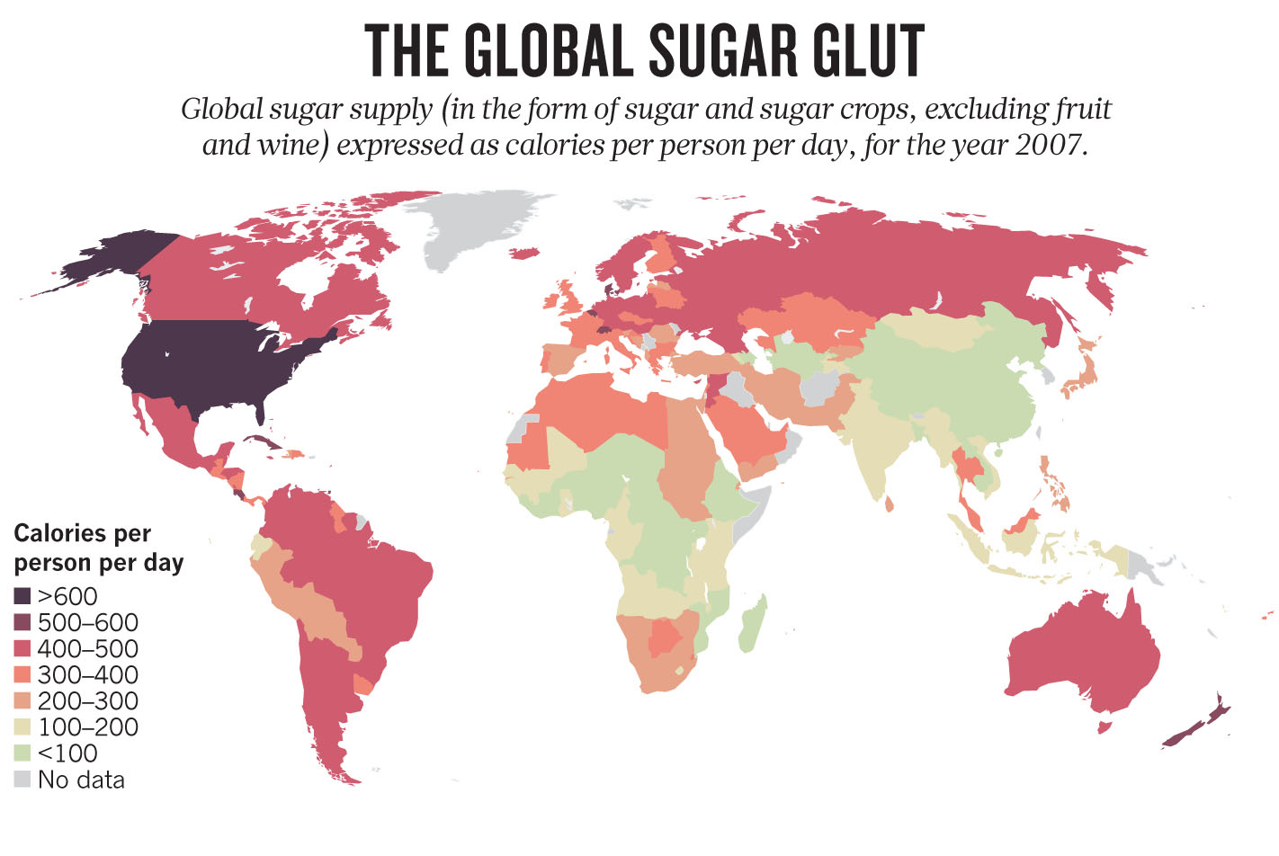
Notes:
The U.S. leads in the consumption of over 600 calories per day per person. The result. Diabetes, obesity, cancer, and inflammatory diseases. Cancer cells use sugar for fuel.

Slide 18
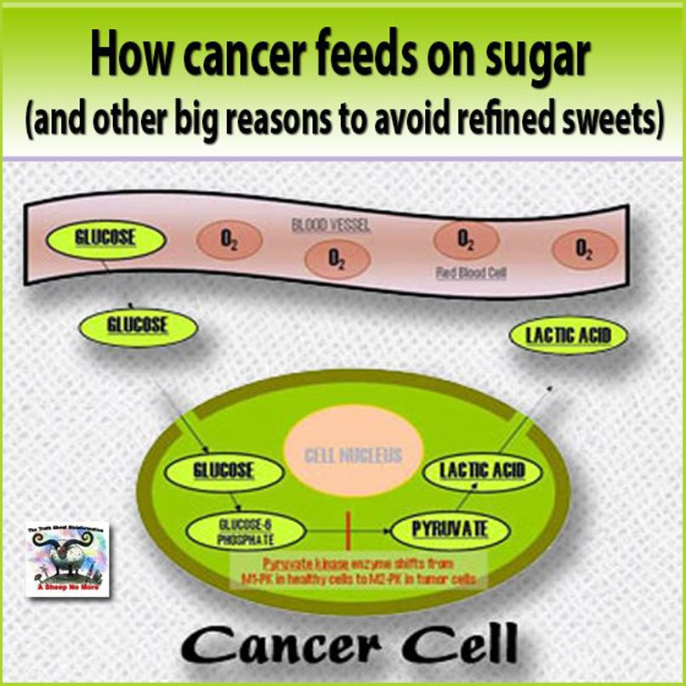
Notes:
Cells will convert glucose (sugar) to lactic acid, reducing oxygenation and making the cell acidic

Slide 19
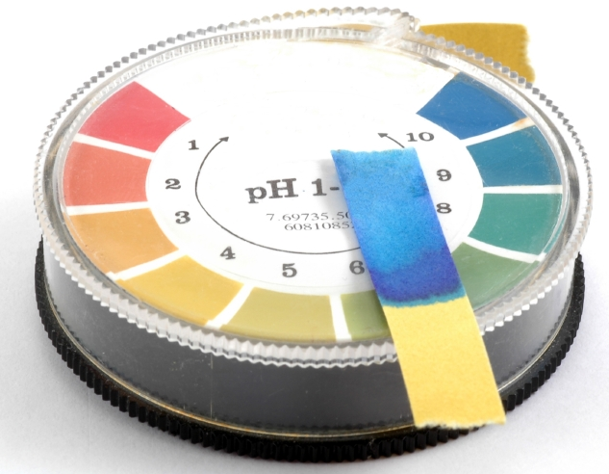
What Is Your PH?
Notes:
DOCTORS – GET OUT YOUR pH STRIPS AND TEST YOUR PATIENTS. A salivary pH check will help determine the acidity of a patient’s environment. You can purchase these through Greens First. Cancer cannot exist in an alkaline environment. Optimal pH is 7.0 to 7.4, for cells to function at their optimal best and for proper replication. If your cells are acidic, then they are a breeding ground for cancer. A separation by one pH level is considered a 10 X increase in pH. When the pH is low, the body with buffer itself up, by absorbing calcium from bones, thus making us osteopenic.

Slide 20
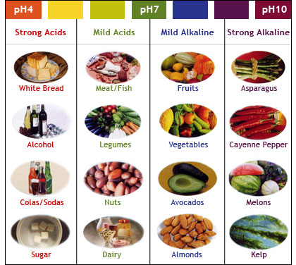
Notes:
There are many foods that can offset an acidic pH. Many of these are live, energy rich greens and fruits. Man made foods such as salt, white flour, dairy, caffeine, refined foods, additives, SFA, artificial sweeteners lowers ones pH, making you acidic.

Slide 21

Notes:
How can we create a cancer free zone. Diet, an alkaline environment, sleep, and a better functioning immune system through chiropractic.

Slide 22
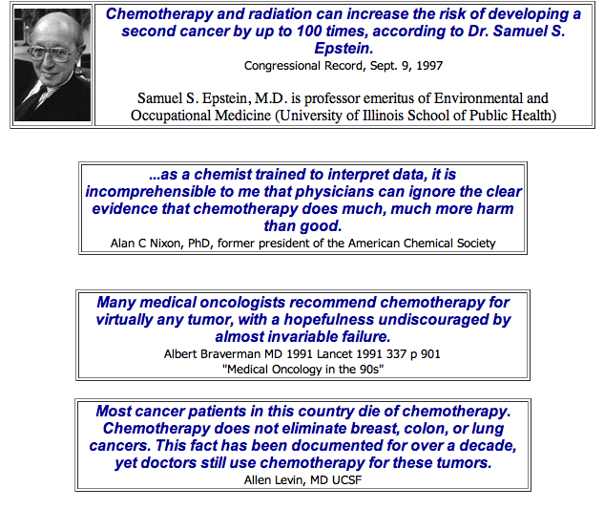
What Are The MD’s Saying?
Notes:
Part of the challenge lies in “Organized Medicine” and “Big Pharma”, where the treatment of cancer is a multi-billion dollar industry and the suppression and media lies of natural remedies and cancer curing foods is common place.

Slide 23
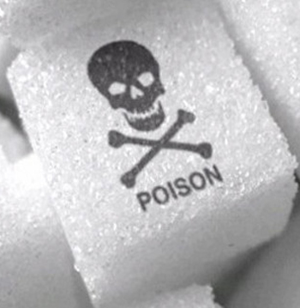
9 Ways Sugar Impacts Cancer
Stimulates mitosis
Increases DNA damage
Increase inflammation
Fortifies glutathione in cancer cells
Increases metastasis (cell spreading)
Inhibits immune function
Increases angiogenesis (blood supply)
Increase growth factor preventing cancer cell death
Increases estrogen levels
Notes:
Sugar is a man made product (from natural sugar cane) that is consumed in excessive quantities, thus having a devastating effect on human health.

Slide 24
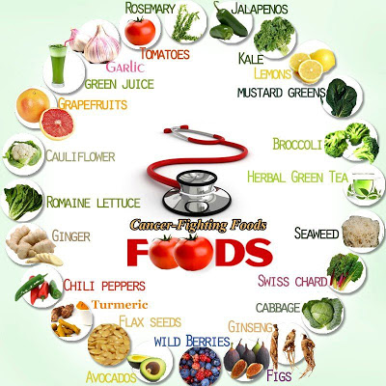
Notes:
In today’s global movement towards healthier diets, there are numerous immune boosting foods and alkaline enhancing foods that can change your internal environment and prevent cancer. Many of these foods are rich in anti-oxidants, balanced pH water content, and are full of vitamins, like B17. Live, energy rich foods nourish and provide life giving fuel to the cell. Most man made and cooked food is deficient in nutrient value and often contain additives and is void of any energy rich content

Slide 25
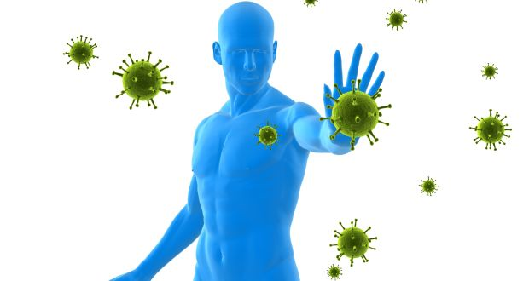
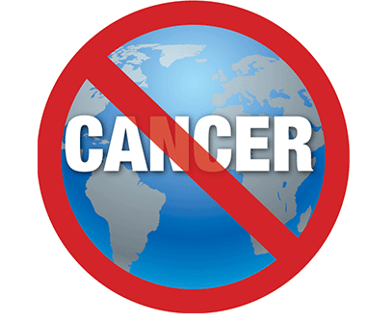
Notes:
Of most importance is a strong immune system, which can be instrumental in the war on cancer.

Slide 26

60% Less Hospital Admissions
59% Less Days In Hospital
62% Less Outpatient Visits
85% Less Pharmaceutical Costs
Notes:
There are many benefits to being under chiropractic care. The research is overwhelming, showing chiropractic patients are some of the healthiest people in the world!

Slide 27
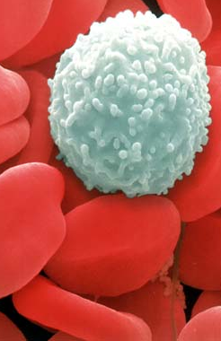
Chiropractic & Your Immune System
Over the 6 month period of the study, the control group experienced a 7.96% decrease in CD4 counts, while the adjusted group experienced a 48% increase in CD4 cell counts over the same period.
Selano JL, Hightower BC, Pfleger B et al: The effects of specific upper cervical adjustments on the CD4 counts of HIV positive patients.
Chiropractic Research Journal 1994; 3 (1):32
DR: 90
Notes:
CD4=White Blood Cell

Slide 28
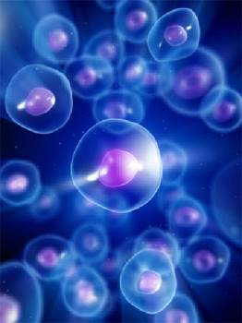
BOOSTING YOUR IMMUNITY THROUGH CHIROPRACTIC
Chiropractic patients had a 200% greater immune competence than those who had not received chiropractic and a 400% greater immune competence than those with cancer or other serious diseases.”
Dr. Ronald Pero, Ph.D.
Chief of Cancer Prevention
New York’s Preventive Medicine Institute
Notes:
REF: The Pero Study from New York’s Preventive Medicine Insititute

Slide 29
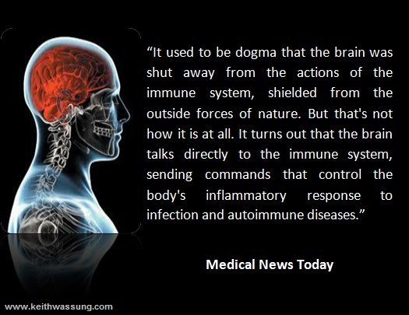

Slide 30
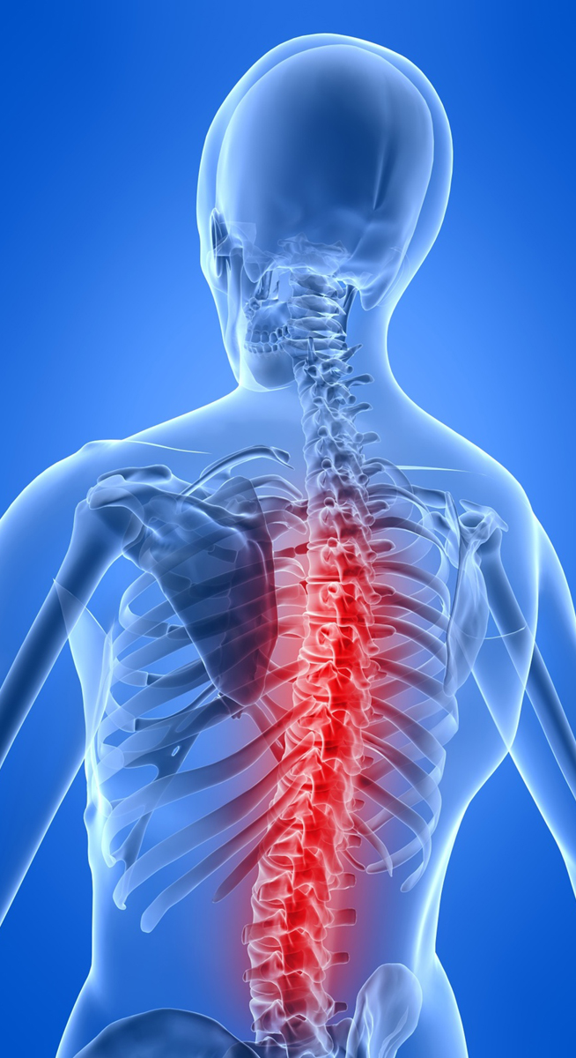
HEALTHY NERVOUS SYSTEM
Coordinates The Function Of Every Cell, Tissue And Organ In The Body.

Slide 31
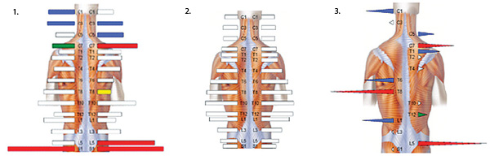
Measuring How Your Body Is Truly Functioning?
DR: 122

Slide 32
Health Care Approach
Promote Wellness Prevent Disease Fight Disease
Pre-Cancerous State
Cancer
Optimal Health
Average Health
Declining Health
Poor Health
Traditional Medicine
Which do you want for you and your family?

Slide 33

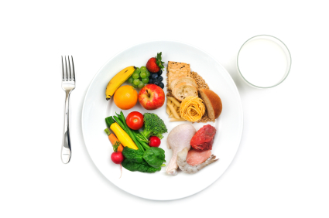


4 DIMENSIONAL MODEL
BE FIT {PHYSICAL} Exercise Proper Posture
EAT RIGHT
{NUTRITION}
Supplementation
Detoxification
Body’s PH
GET ADJUSTED {CHIROPRACTIC}
G.A.P.
THINK WELL
{EMOTIONAL}
Stress, Fatigue & Sleep
Notes:
More and more people are looking for natural, drug-free healthcare. This is why we are seeing a wellness revolution happening. In order to master wellness, you need to master each of the four components – Physical, Mental and Chemical. The healthiest people on the planet are those that are embracing and optimizing the physical, nutritional and emotional aspects of their health. And includes regular chiropractic care.

Slide 34
Your Cancer Free Checklist
Eat live, energy and water rich foods
Stay alkaline with Greens First – pH of 7.4
Supplement with multi–vite, Cal Mag, EFA’s
Hydrate with pure spring water
Avoid all man-made products where possible
Detoxify once or twice per year
Avoid sugar
Sleep 6-8 hours per night
Exercise daily
Get adjusted regularly

Slide 35

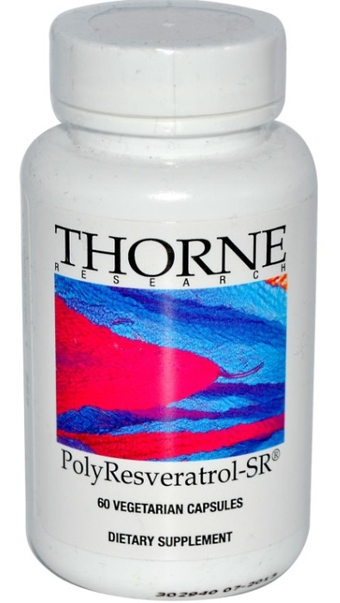


Our Recommendation For Your
Anti-Cancer Code
Notes:
You will have access to the Proprietary Vitalize Nutritional Supplements which is one of the top rated supplements in North America and only available through our center.

Slide 36
Special: 15% Off
Supports Blood Vessel Health
Enhances SIRT-1 (The Longevity Enzyme) Activity
Supports The Body's Normal Inflammatory Response
Enhances Liver Function And Detoxification
Promotes Normal Cell Proliferation
Regularly: $_____ Now ONLY: $____
XX.XX
XX.XX

