Slide 1

Transform
MONTHLY POWER WORKSHOP SERIES

Slide 2

5 SECRETS TO HARNESS 10x’s MORE ENERGY

Slide 3
Energy Is One Of The Primary
Traits Of Greatness!
Allows You To Wake Up In The Morning Energized!
Allows You To Be Your Greatest Self!
You Can Accomplish More!

Slide 4
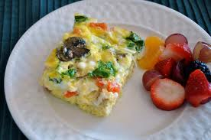
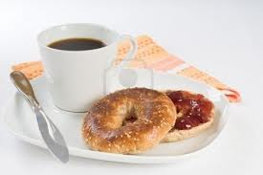
Most People Start Their Day With
ENERGY BUSTERS
Coffee
Bagels,
Cereals,
Energy Bars
Sugar Laden Foods
Notes:
Start your morning with a low-fat muffin or cereal and you’re due for a mid-morning energy crash. Instead, make breakfast healthy protein shake.
which balances blood sugar to keep you full and focused for hours. To maintain that steady energy all day, load your plate with lean protein, good fats like avocado and olive oil, leafy greens, and slow-release high-fiber carbs.

Slide 5

  Write Down Your Goals In Detail
Notes:
You plan for a trip: Car rental, airfare, hotel, activities, restaurants……. You need to do the same for your life. Where are you going? How will you get there?
You need to create a clear picture. So much of our day and energy is spent just trying to figure out what we want. If you know exactly what you are working towards, what you standards are, it is easy to avoid the things in life that are energy and time zappers. When you have clarity on what you want in life, you become more hopeful and energized. Clarity Precedes Success!!!

Slide 6

Writing Down Your Goals Creates A Road Map For What You Want Out Of Life!

Slide 7
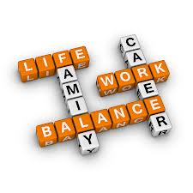
3 Areas of Life To Set Goals In
Personal
Family
Career

Slide 8

Every time you hit the snooze button you are saying NO to your energy and your goals and YES to someone else’s!!!
The early bird gets the worm!
2. Get Up Early!

Slide 9
Your Energy Charging Hour!
Read / Listen To Something Inspirational/ Motivating
Journaling
Meditate/Pray (Look At Vision Board)
Success Statements/Affirmations
Spend Time In Nature
Visualize / Vision Board
Personal Philosophy / Goals

Slide 10

Go to bed by 11pm!
Don’t Burn The Candle At Both Ends

Slide 11
When you are sleep deprived, your body decreases production of leptin, the hormone that tells your brain there is no need for more food. At the same time it increases levels of ghrelin, a hormone that triggers hunger.
Result = Weight Gain And Sluggishness!

Slide 12
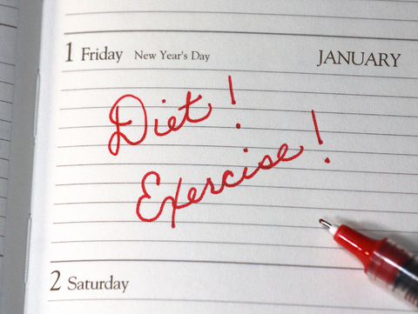
3.

Slide 13
A minimum of 30-60 minutes exercise or consistent
Movement 5 days per week focusing
various dimensions of fitness:
Balance
Flexibility
Cardiovascular Endurance
Muscular Endurance
Power / Plyometrics
Speed

Slide 14
Mitochondria are known as the "powerhouse" of the cell because they are responsible for producing the body’s primary source of energy.
Exercise not only reduces the decline of skeletal muscles and energy loss but A 2011 study published in the Journal of Applied Physiology showed that exercise training increased mitochondrial biogenesis in the brains of mice, which opened the door to the possibility that exercise may reduce or reverse age-associated declines in cognitive function, especially those related to inactivity

Slide 15
Eat To FUEL Not To Get FILL
Drink Lots Of Water
Eat All Of The COLORS Of The Rainbow
Reduce/Eliminate Intake Of Processed Foods
Say No To Sodas
Limit Coffee/ Caffeine To 1 Cup Per Day

Slide 16




Notes:
Additional supplementation is needed due to the lack of nutrients in our foods these days!

Slide 17

4.
Personal Improvement Markers
& Reflection

Slide 18
MEASUREMENT MARKERS & REFLECTION
Review Your Goals And See If You Are On Track With Meeting Them On A Regular Basis.
You Need To Hold Yourself Accountable For Making Progress, Learning From Mistakes, And Staying Focused On The Desired Outcome.

Slide 19
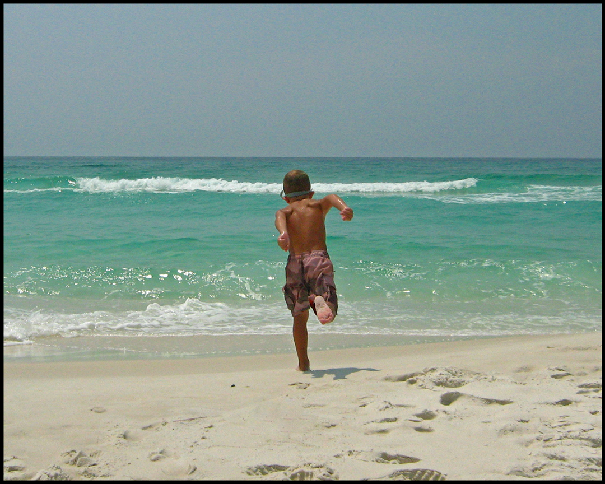
5.
Adventure & Fun
DIVE INTO LIFE!

Slide 20
Prolonged stress not only decreases energy but also also leads to diabetes, hypertension, & high cholesterol.
Notes:
Managing stress has been a major area of interest for me because it has been my own biggest health challenge. Stress affects all aspects of a patient’s body, mind, and spirit. The “Stress Response” is a biochemical and physiologic reaction to a real or perceived threat. It evolved in primitive times so that our forerunners could either “fight or flee” from threatening situations. This reaction causes a release of hormones and chemicals, predominantly adrenaline also known as epinephrine, and cortisol. These hormones go to all the parts of the body including the organ systems and cells to get the body ready to fight or flee causing temporary increases in heart rate, blood pressure, respiratory rate. In addition, the pupils in the eyes dilates to see better, and blood is diverted away from the genitals and stomachs, to the large muscles in our legs and arms. Cortisol causes stored sugar and fat in our bodies are released to provide the energy to fight or flee. The danger of the stress response is if it is occurring frequently in a person’s life. The consequences of chronic stress are many—including a weakened immune system, high blood pressure, heart disease, high cholesterol, diabetes, hair loss, and possibly cancer, to name a few.

Slide 21

Have Fun In The Sun & Get Your D.
Sunshine Helps Regulate Your Circadian Rhythm And Improve Energy Levels.
Notes:
Studies show among its many problems, vitamin D deficiency contributes to fatigue. Ask your doctor to test your D levels and aim for 60 – 80 ng/ ml. Once you’ve hit that mark, I recommend 5,000 IUs of vitamin D as a maintenance dose. And get out: even 10 minutes of sunshine can boost your D levels.

Slide 22

The Things That Get Scheduled Are The Things
That Get Done!
Notes:
Do not leave your life to chance! Schedule all of these things! Just as you know when you have to be at work, when the kids need to be to school, you need to make these things SCHEDULED into your daily life!

Slide 23
Link everything that you do to your goals…to your VISION!
Everyday should be a platform to work towards your GOALS!
Law Of Linkage

Slide 24
Success Is Created By The Consistent Practicing Of Simple Fundamentals

Slide 25

Get Guidance &
Accountability Partners!

Slide 26
You Are More Likely To Become Similar To The
6 People You Are With The Most!
Choose To Only Spend Time With Positive Like Minded People!

Slide 27
Write Down Your
Top 5 Goals On A Note Card & Read Them Consistently!

Slide 28
Awareness 4 Choice4 Action4 Results
IT TAKES 14 DAYS TO CREATE A HABIT

Slide 29
Stop Waiting For Tomorrow
Start Living Your Life To Its Fullest Today!

Slide 30


28-Days To
THRIVE
Detox &Weight-Loss Wellness Challenge
Jul. 14th – Aug. 12th

Slide 31

If you want to THRIVE ...
JOIN THE DETOX & WEIGHT-LOSS WELLNESS CHALLENGE!
STEP 1:
MAXIMIZE YOUR THRIVE WEIGHT LOSS
THRIVE
MEAL PLANS
  Meal Plans
  Recipes
  Shopping Lists

Slide 32

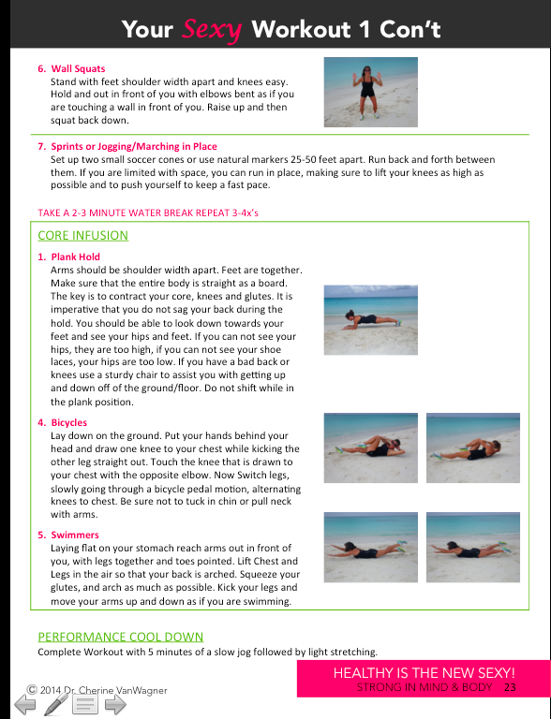
If you want to THRIVE ...
JOIN THE DETOX & WEIGHT-LOSS WELLNESS CHALLENGE!
GET LEANER FASTER
STEP 2:
THRIVE
INTERVAL WORKOUTS
  3 Beginner Workouts
  3 Advanced Workouts
  Supportive Advice to Maximize Your Fitness
Notes:
These workouts were designed by Dr. Cherine VanWagner. They focus on the importance of balance within the body to create freedom with modifications for limitations and help to prevent overuse and u=injury. The will give your patients the best results possible in the shortest amount of time. Your patients can look forward to burning up to 600 calories per workout. These workouts will support their chiropractic care and make their adjustments hold longer!

Slide 33

If you want to THRIVE ...
JOIN THE DETOX & WEIGHT-LOSS WELLNESS CHALLENGE!
INCREASE YOUR ENERGY
STEP 3:
GREENS FIRST
SUPER FOOD DRINK MIX
Balance Your Nutrition
Alkalize Your Body
Get 15+ Servings Of Fruits & Vegetables Per Serving
Notes:
1 month Greens First Should be included in their program as well as Dream Protein

Slide 34
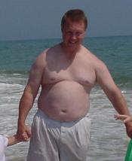
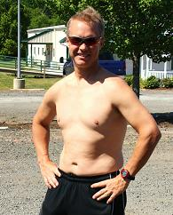
If you want to THRIVE ...
JOIN THE DETOX & WEIGHT-LOSS WELLNESS CHALLENGE!
Before
After

Slide 35
If you want to THRIVE ...
JOIN THE DETOX & WEIGHT-LOSS WELLNESS CHALLENGE!
GET STARTED TODAY
STEP 5:
SEE THE FRONT DESK
FOR MORE INFORMATION &
TO RESERVE YOUR SPOT TODAY!

Slide 36

If you want to THRIVE ...
JOIN THE DETOX & WEIGHT-LOSS WELLNESS CHALLENGE!
THRIVE
WEIGHT- LOSS
CHALLENGE
Buy 1
Get 1
50% Off!
Buy 2
Get 1 FREE!
If You Sign Up Today!
Only 30 Spots Available

Slide 37
28-Days To
THRIVE
With Detoxification & Weight-Loss

Slide 38

Questions?

