Slide 1
Model Year 2021
Paul Sherwood Project Engineer
Date: 07/30/2020

Slide 2
Agenda
285CQT Interior Materials
420OR Paddleboard H/T Rack
420OR Visor Update
Black PowderCoat Frames
Factory Installed Batteries
Stainless Steel Cupholders
Whaler White Speakers
Sport Upholstery

Slide 3


285CQ Interior Materials
Scope: Refresh the 285CQ interior materials palette to match the new 325CQT interior.
Counter top corian - Lava Rock
Cabinet veneer – Walnut
Upholstery – Dwell Sandpiper
Interior Arts Rancho Walnut
Head Bulkhead and Door; Cabinetry
Corian Lava Rock
Interior counter tops and shower floor

Slide 4
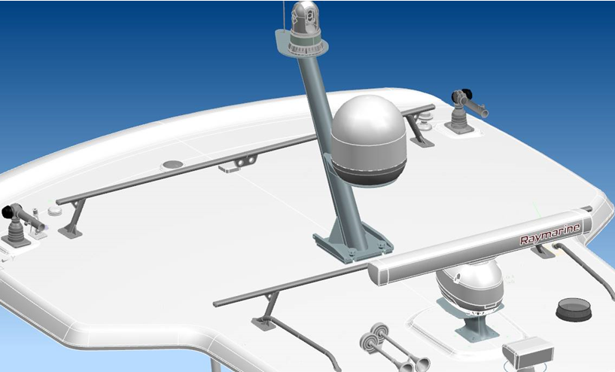
420OR Paddle Board Rack
Scope: Hard top mounted roof rack
Compatible with sun roof
Compatible with electronics
Not compatible with upper station.

Slide 5
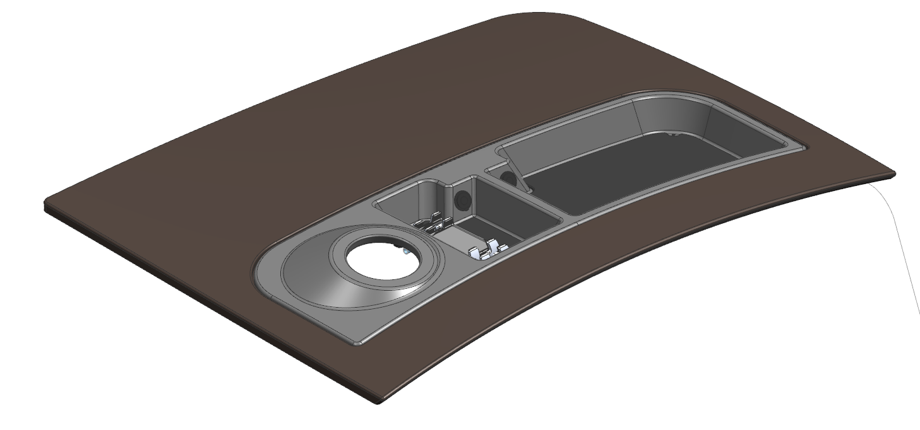
420OR Visor Update
Scope: Updated visor to add storage space and USB outlets
Chuck space
USB outlets
Wireless Charging

Slide 6
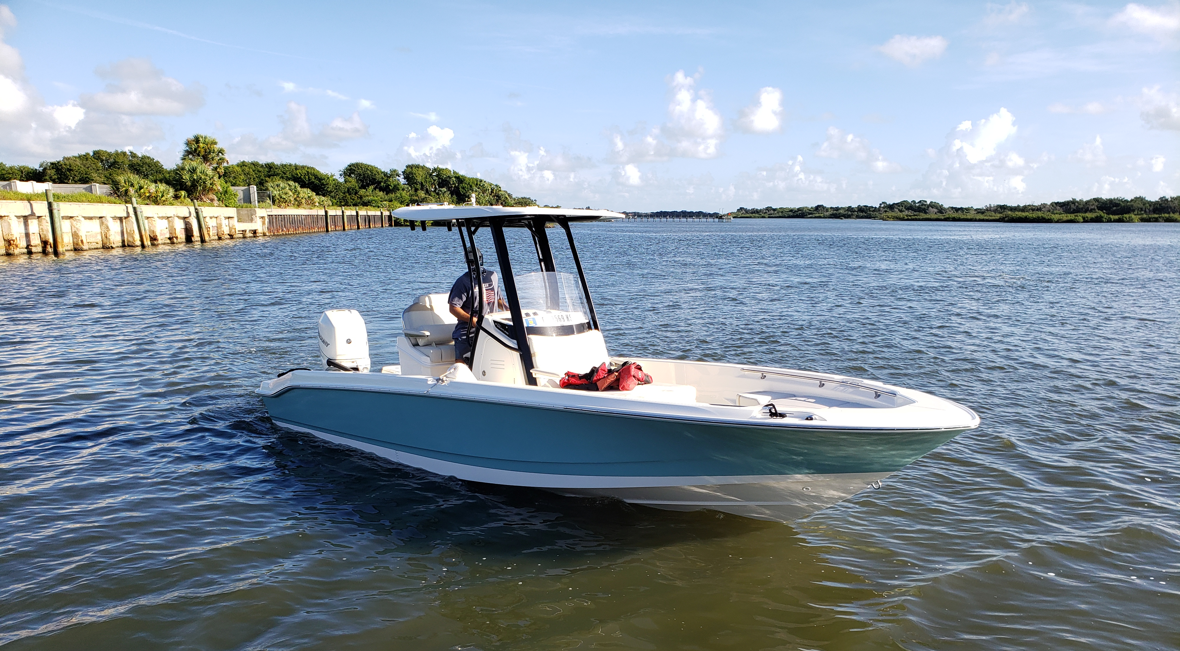
Black Powdercoated Frames
Scope: Added color selection for H/T, T-Top and other frames
All models with either standard or optional frames
Includes Hard Tops, T-Tops, tow arches, activity towers
Does not include upper stations

Slide 7
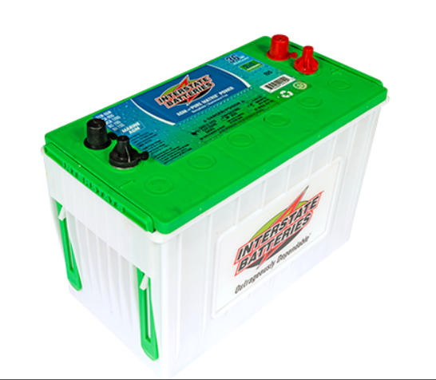
Factory Installed Battery Options
Scope: Factory installed batteries
230OUT and larger
Options that require separate batteries will now include those batteries
Interstate GR31 AGM

Slide 8
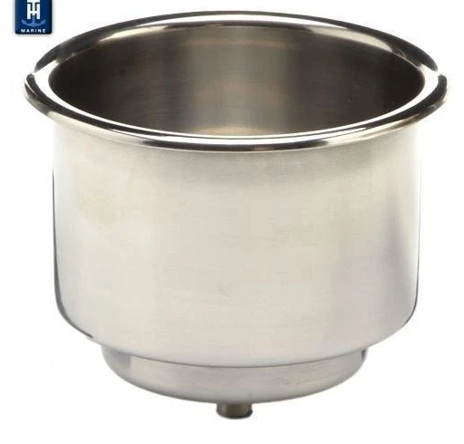
Stainless Steel Cup Holders
Scope: Replace all standard size plastic cupholders with stainless
Affects mainly core product
Low profile cupholders were not affected

Slide 9
Whaler White Speakers
Scope: Speaker bodies have been color matched to Boston Whalers white gel-coat
Speakers now match gel coat color!
Before:
After:

Slide 10
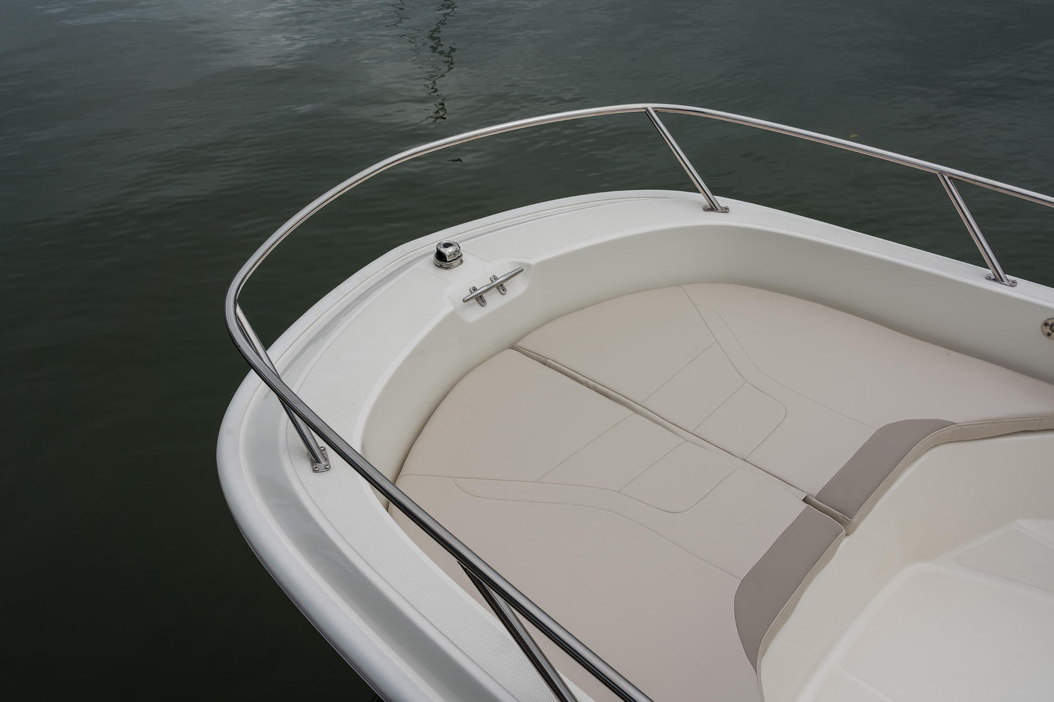
Sport Upholstery
Scope: Sport upholstery available in white and tan
Factory installed options
Ship loose options
Accessory order from Land n Sea
White options
Tan options

