Slide 1
280 Vantage Product Review
Spencer Traynom

Slide 2
Insights – Vantages
After collecting all of the data, identifying patterns, and using models to rearrange the data there were some significant insights that were noticed. These insights provide the key areas to focus around in order to provide a product that meets the consumers needs.
Notes:
Update with Charlie and Tracy K.

Slide 3
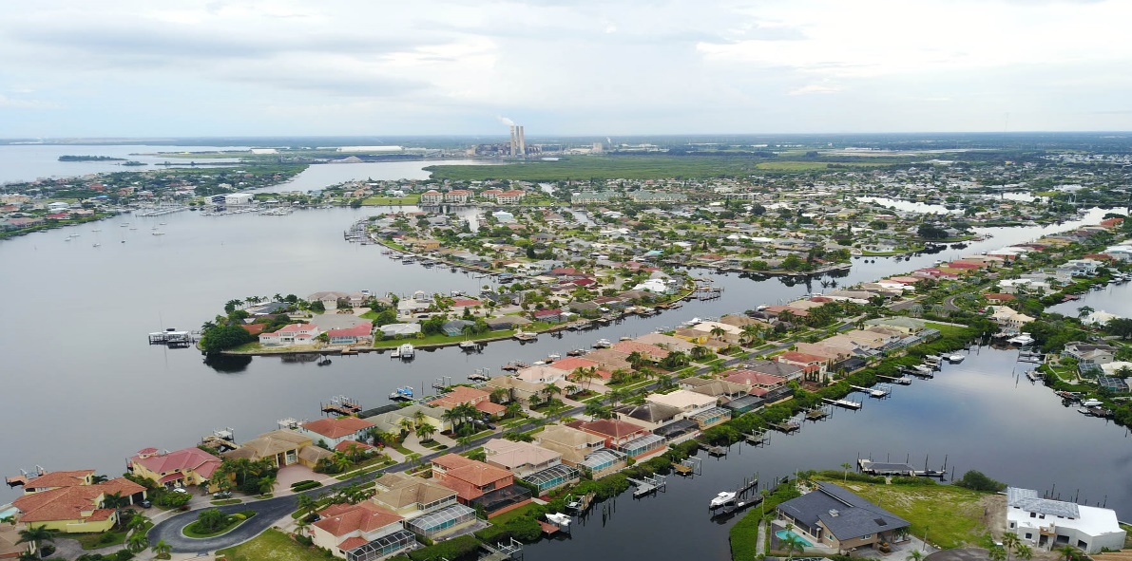
Vantage Usage
Stay in bays/not much offshore
Fair-weather boaters
Cruise, socialize, visit restaurants
Some watersports, some fishing
Taking friends & family out

Slide 4

Activities - % of time

Slide 5
Where do owners take their Vantage?
Vantage models are used primarily on smaller bodies of water. The 230 model is used for shorter distance, while the larger 270 is used more often on larger water territory and longer distance.

Slide 6
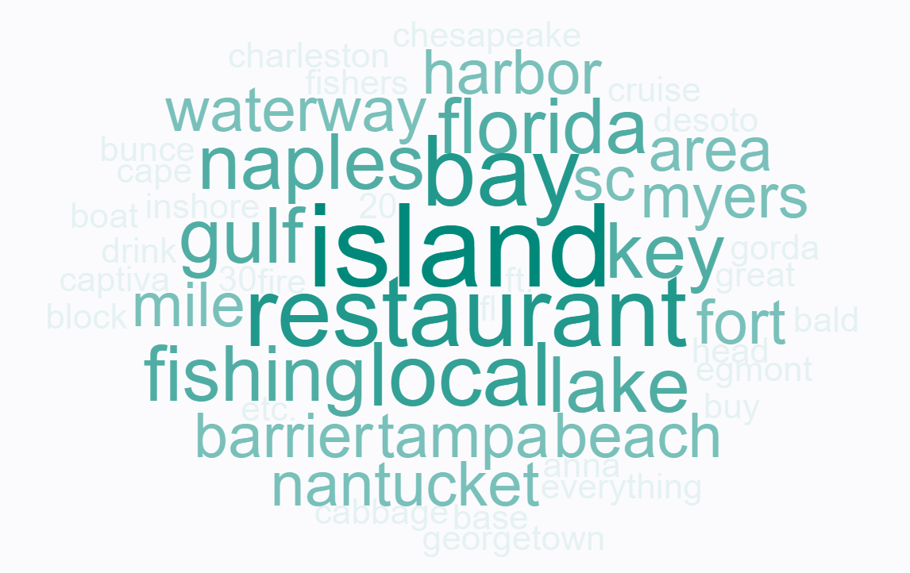
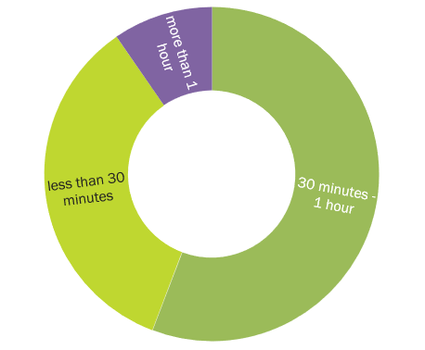
Vantage Day Trips
Travel time to
Destination
Destinations

Slide 7

Age Range

Slide 8
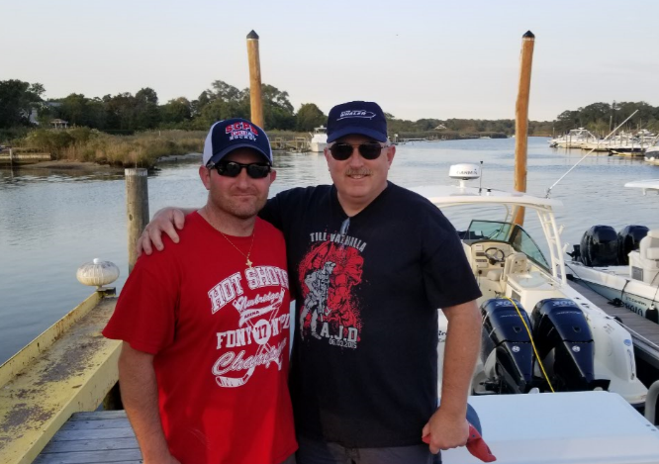
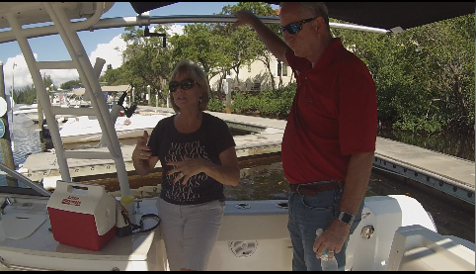
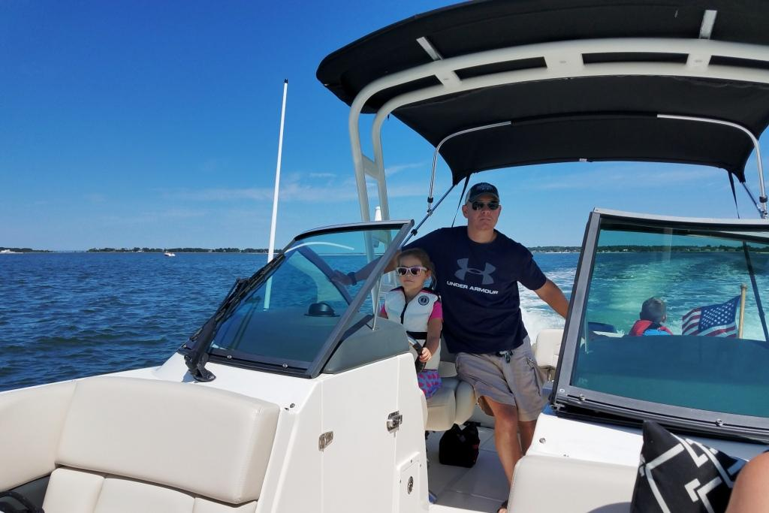
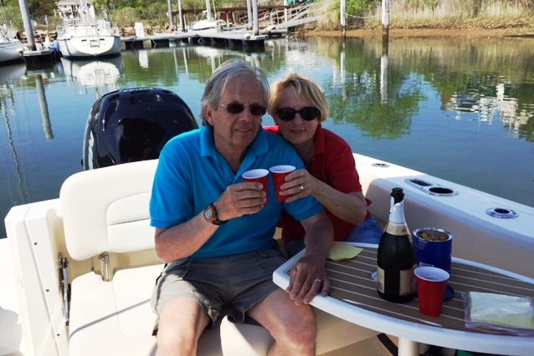
Vantage Lifecycle
Fishing
Learning how to use
Bonding
Taking teen/friends out
Entertaining friends
Taking grandkids/entire family out
Adults with kids/teens
Young Family
Empty Nest
Grandparents with family
Exposure to boating
Watersports for kids
Alone time
Entertaining friends
Social boat

Slide 9
THEMES

Slide 10
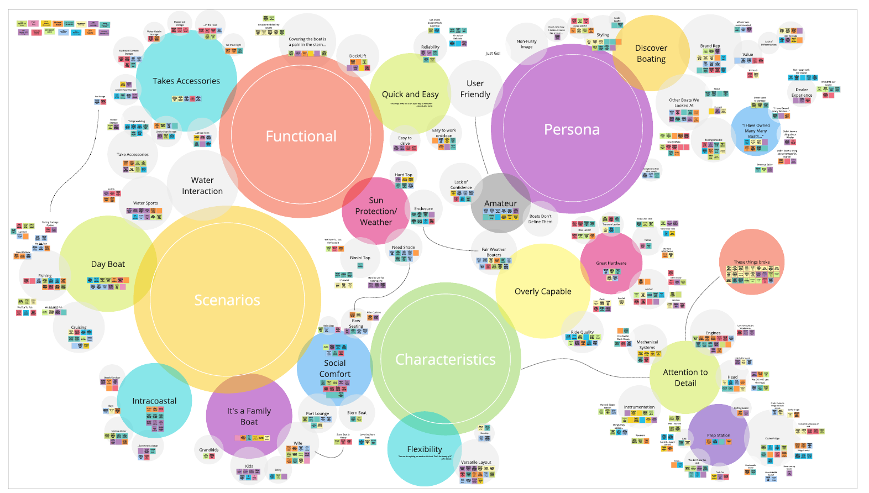
Vantage Themes

Slide 11
“Just get in, turn your key and GO!
John Pannozzo, 230 Vantage
Simplicity
The Vantage is simple to operate, clean,
no complicated systems
It doesn’t require much maintenance, easy care, easy to drive
No complex systems to deal with – just simple

Slide 12
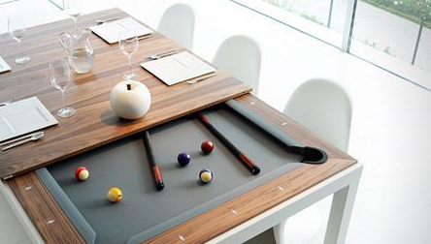
Defined Multi-use
The Vantage can be used for several activities.
Most owners see it as a do-anything boat. They aren’t limited to fishing, not limited to cruising….it is a very adaptable boat.
They define the boat’s usage.
“Wanted a boat we could fish/ cruise/ waterski.”
Steve McMullen, 230 Vantage

Slide 13

Adaptable
The Vantage allows owners to do whatever they are in the mood for… whether it is throwing in a line to see if they can catch anything… if not, they can go to the beach to swim or lounge. There are many options of how to use the Vantage
“You can do anything you want on this boat – that’s the beauty of it!”
- John Caputo, 270 Vantage

Slide 14

Quick & Easy
The Vantage makes it quick and easy to get out on the water and enjoy. It is easy to wash-down when you get back from a day on the water. Not a high-maintenance boat.
“I needed a boat that is easy to use – works every time.”
- Julien Gimbrere, 230 Vantage

Slide 15
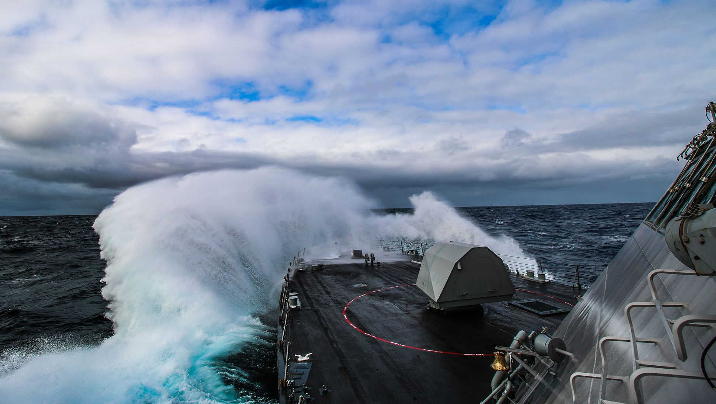
Overly Capable
Owners recognize that the Vantage is highly capable of providing safety for their family and friends. They feel at ease that the boat will be more capable than others while out on the water. However due to the lack of confidence in their own ability they need reassurance.
“I have super confidence in this boat.”
- John Betsch, 230 Vantage

Slide 16
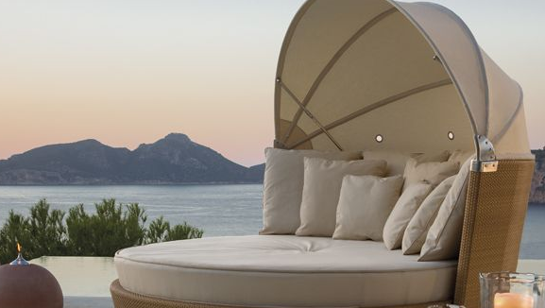
Social Comfort
The Vantage provides the creature comforts to be able to entertain or relax on board. The comfort and amount of seating provides guests with a smooth enjoyable outing.
“Lots of creature comforts for a boat this size.”
- John Pannozzo, 230 Vantage

Slide 17
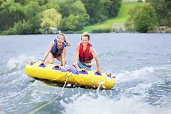

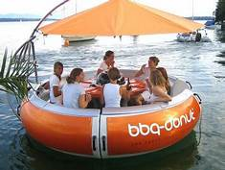
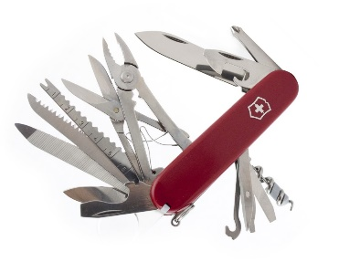
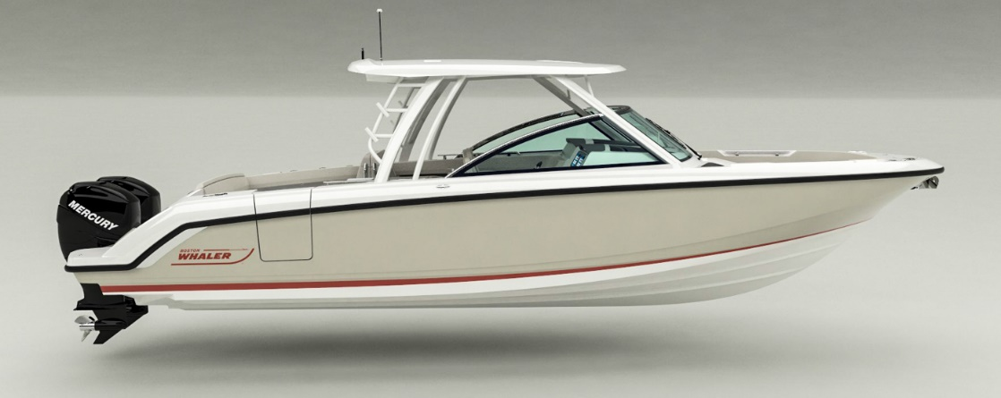
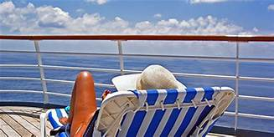
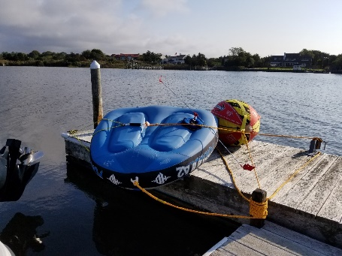


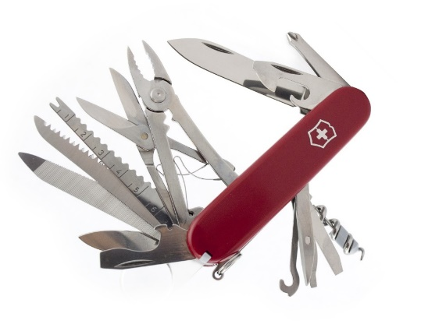
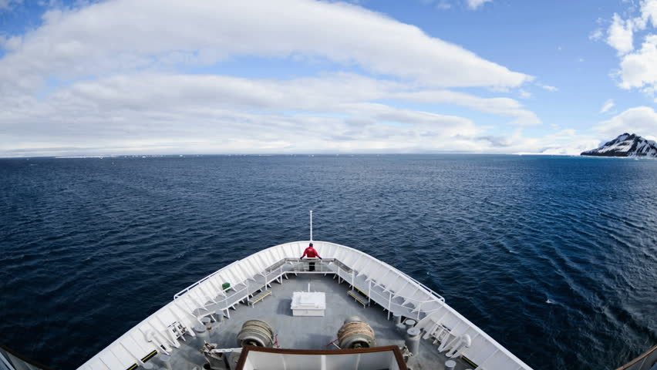

Slide 18
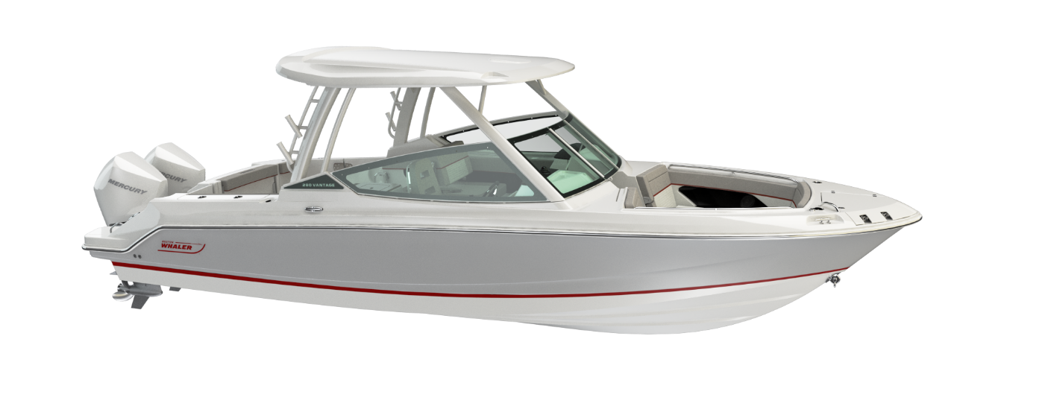
All-New 2020 Model Year: 280 Vantage

Slide 19

What’s New for the Vantage Platform: Exterior features
Keel Up Re-design
LOA to 27’ 9” from 26’ 10”
Bow flare with additional 2” in cockpit depth and addition of bone style line
Restyling of windscreen with welded aluminum integrated Hard-Top frame
Electric cockpit Sureshade
Combination telescoping bow swim ladder and anchor windlass compatibility
Anchor Windlass with rode, chain and anchor
Integrated Port side dive/boarding door
T-250 Mercury Power
Transom Livewell

Slide 20
Comparison between new and old
280 Vantage
270 Vantage
New Model
LOA: 27’ 9” (8.45 m) (On centerline, bow to engine mounting location) +11”
LOA with platforms: 29’ 1” (8.86 m) +10”
Beam: 9’ 6” (2.74 m) +6”
Draft: 21” (0.53 m) +1”
Weight (dry, no engine): 6,700 lbs (3039 kg) +1500 lbs
Weight (w/engine, fuel and water): 9,320 lbs (4227 kg) +1500 lbs
Maximum Weight Capacity: 3,702 lbs (1,679 kg)
Swamped Capacity: 5,000 lbs (2268 kg)
Persons Capacity: 12
Maximum HP: 800 hp (596 kW) +200 hp
Minimum HP: 500 hp (373 kW) +100hp
Maximum Engine Weight: 1,400 lbs (635 kg)
Transom Height: 25” (0.64 m)
Deadrise at Transom: 21º +1 degree
Fuel Capacity: 185 gallons (700 L) +10 gal.
Water Capacity: 20 gallons (76 L)
Waste Capacity: 6 gallons (23 L)
Livewell Volume: 19 gallons (71.9 L)
Bridge Clearance with Hardtop: 9’ 1” (2.77 m)
Old Model
LOA: 26’ 10” (8.18 m) (On centerline, bow to engine mounting location)
LOA with platforms: 28’ 3” (8.61 m)
Beam: 9’ 0” (2.74 m)
Draft: 20” (0.51 m)
Weight (dry, no engine): 5,200 lbs (2359 kg)
Weight (w/engine, fuel and water): 7,503 lbs (3,403 kg)
Maximum Weight Capacity: 3,702 lbs (1,679 kg)
Swamped Capacity: 5,000 lbs (2268 kg)
Persons Capacity: 12
Maximum HP: 600 hp (448 kW)
Minimum HP: 400 hp (298 kW)
Maximum Engine Weight: 1,400 lbs (635 kg)
Transom Height: 30" (0.76 m) single/ 25” (0.64 m) dual
Deadrise at Transom: 20º
Fuel Capacity: 175 gallons (662 L)
Water Capacity: 20 gallons (76 L)
Waste Capacity: 6 gallons (23 L)
Livewell Volume: 19 gallons (71.9 L)
Bridge Clearance with Hardtop: 9’ 1” (2.77 m)

Slide 21

280 Vantage: Top 4 new key features
Integrated hard-top and
windscreen for better visibility
Standard dive door
100 hp standard power increase
Redesigned hull for improved seaworthiness

Slide 22
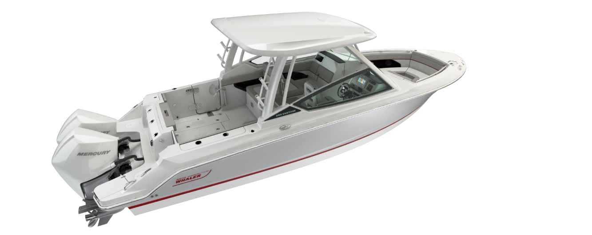
280 Vantage: Aft cockpit changes
Standard port dive door for lateral entry
Standard Livewell
(Lid will be clear)
Standard in-floor
fish boxes

Slide 23
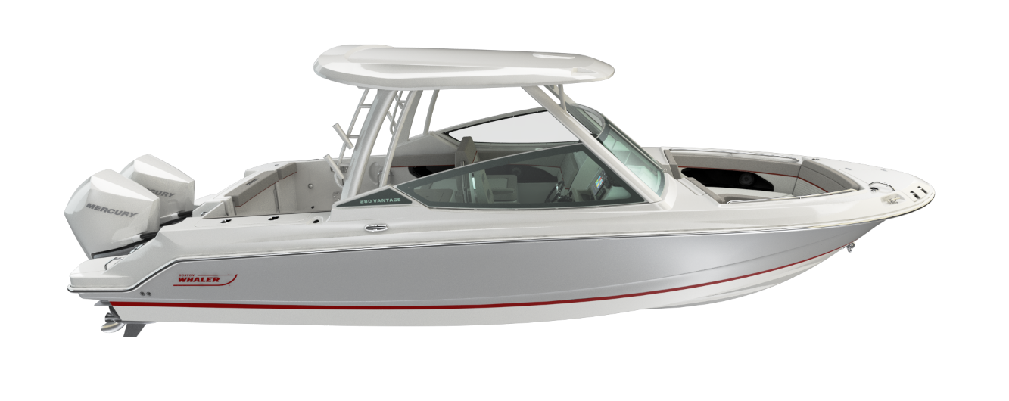
280 Vantage: Fiberglass Hardtop
Hardtop features:
Grab rails- located on centerline, stainless steel (3)
Navigation light
Rod holders (4)
Tow bit
Welded aluminum integrated
Powder coated frame with
tempered glass windshield

Slide 24
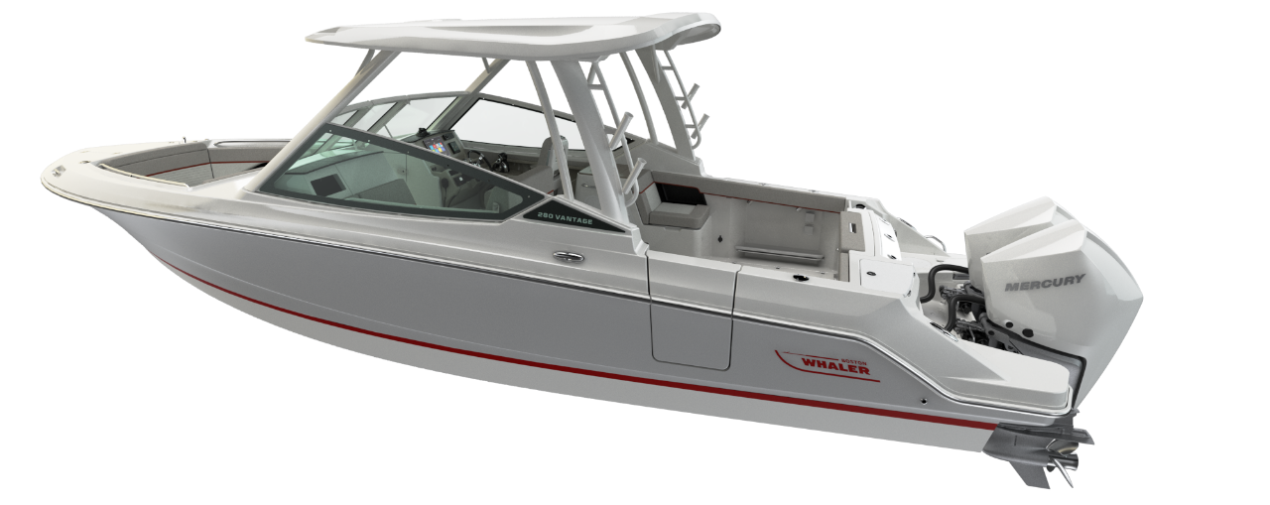
280 Vantage: Port side

Slide 25
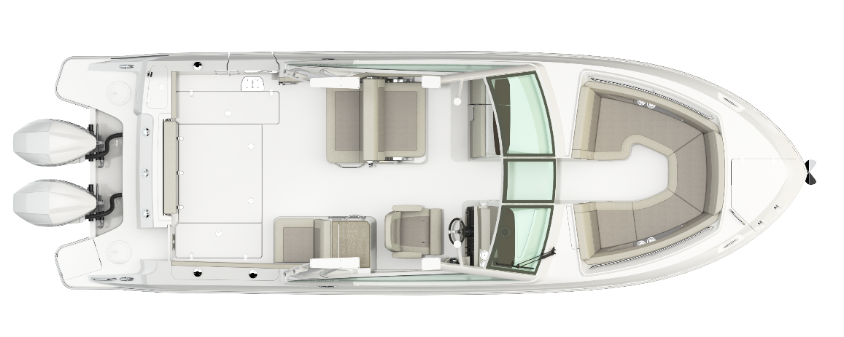
280 Vantage: Cockpit view

Slide 26
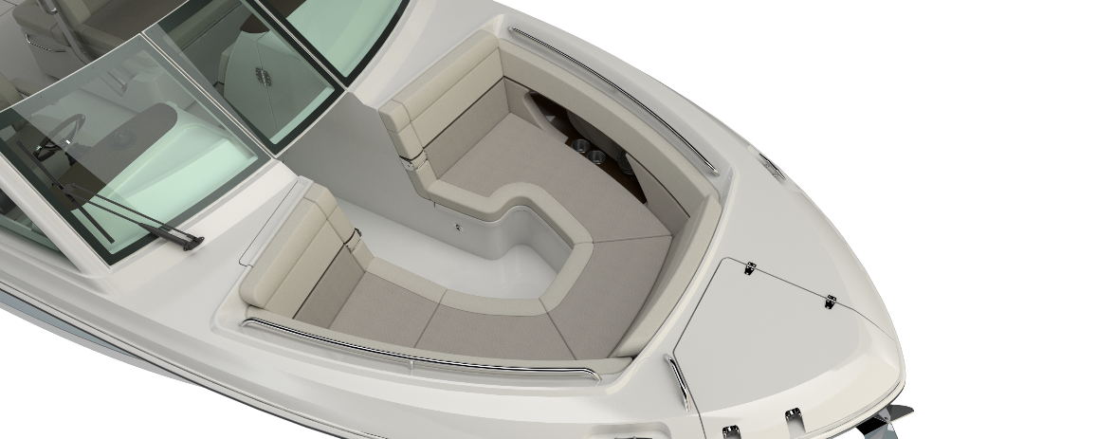
280 Vantage: bow area
Recessed storage / cup holder compartment
Bow bolster
Bow walkthrough block off panel
Drink holders (4)
Fiberglass lids with latches (3)
Welded stainless steel forward side rails
Integrated centerline
bow cooler (12 gallon)
Standard anchor
windlass
Lockable rod storage:
Starboard console OPT

Slide 27
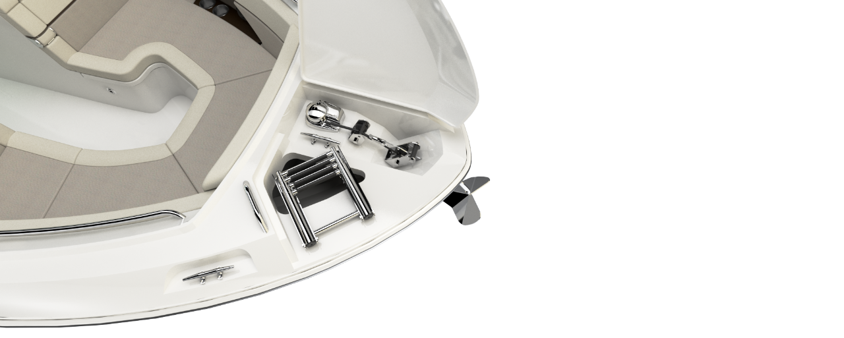
280 Vantage: Bow
Combination telescoping bow swim ladder and anchor windlass compatibility
Standard anchor windlass- concealed.
200’ Rode, chain and anchor

Slide 28
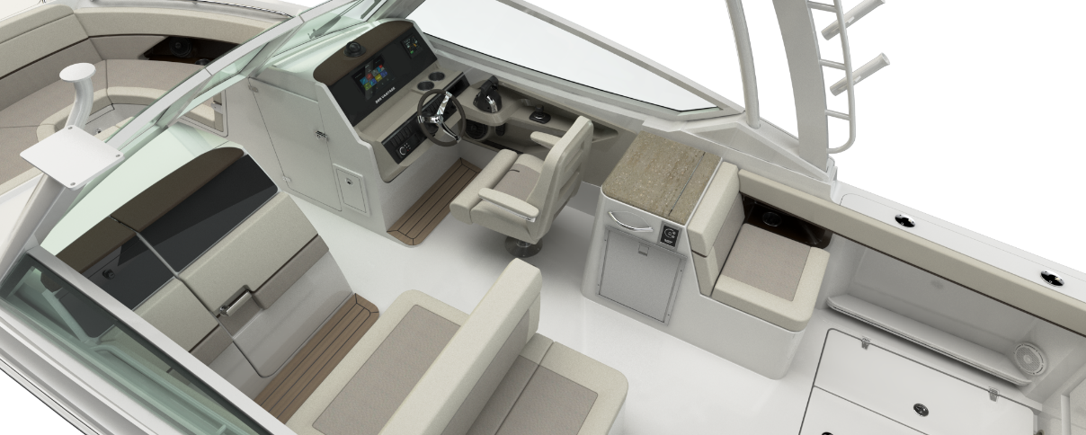
280 Vantage: Helm and port side seating
Deluxe custom adjustable
helm seat
Starboard aft facing
seat
with integrated cooler (11 gallons)
Convertible port lounge seat with storage

Slide 29
280 Vantage: cockpit dash
Three electronic package options:
Single 9” Raymarine Axiom Pro RVX
Single 12” Raymarine Axiom Pro RVX
Deluxe Helm Electronics
  Port and Starboard custom black acrylic dash and switch panels
  12” Raymarine Axiom RV
  Nav. Pack with GPS, chart plotter, fisher finder, RealVision 3D, Down Vision, Side Vision and Chirp transom transducer
  Premium Audio Stereo System
  VesselView 4” display
  Port console glovebox

Slide 30
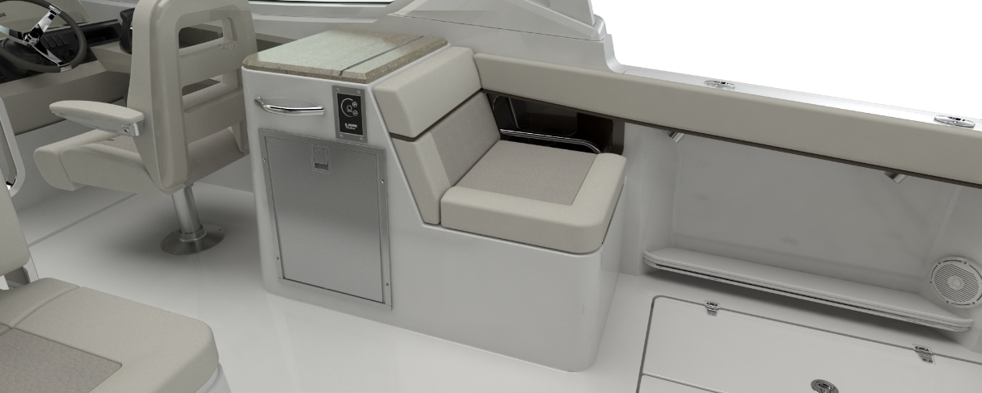
280 Vantage: starboard side console
Standard sink with freshwater faucet
Summer Kitchen option:
12V refrigerator
Corian counter top
Electric grill (deletes sink)
Optional stand alone
refrigerator also available

Slide 31
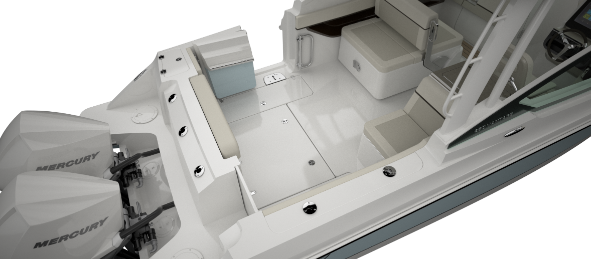
280 Vantage: Aft cockpit, with dive door
Optional cockpit table
28” cockpit depth
19 gallon livewell
with clear lid and
interior light
Fold-out stern seat
with backrest
2 insulated in floor fish
boxes with pump-out
(25 gal)

Slide 32
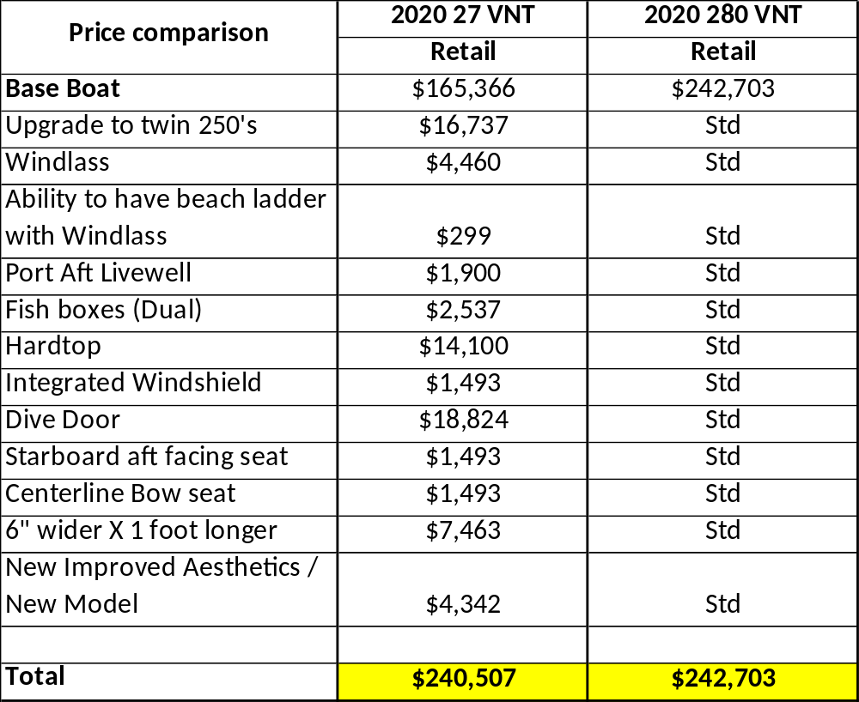
280 Vantage: Price equalization comparison

Slide 33
Key Selling Features:
Standard Features:
    Keel up redesign with improved aesthetics
      Longer (approx. 10”) and deeper in the bow
    Integrated and standard dive door
    Fishability!!!
      Standard livewell port corner
      Deck fishboxes
    Windlass is standard
    Hardtop standard
    Bow centerline seat with storage underneath (vs. previous)
    Aft facing seating at starboard prep station
Optional Features:
    Compatibility of beach boarding ladder
    Weather curtain ease of use improved with integrated hardtop
Notes:
The specific verbiage of new length is 12” overall (this includes the nuggets at the transom) or +5” on hull centerline
10’8” Beam
300 Gallons Fuel

