Slide 1
250 Dauntless
Sales Training

Slide 2
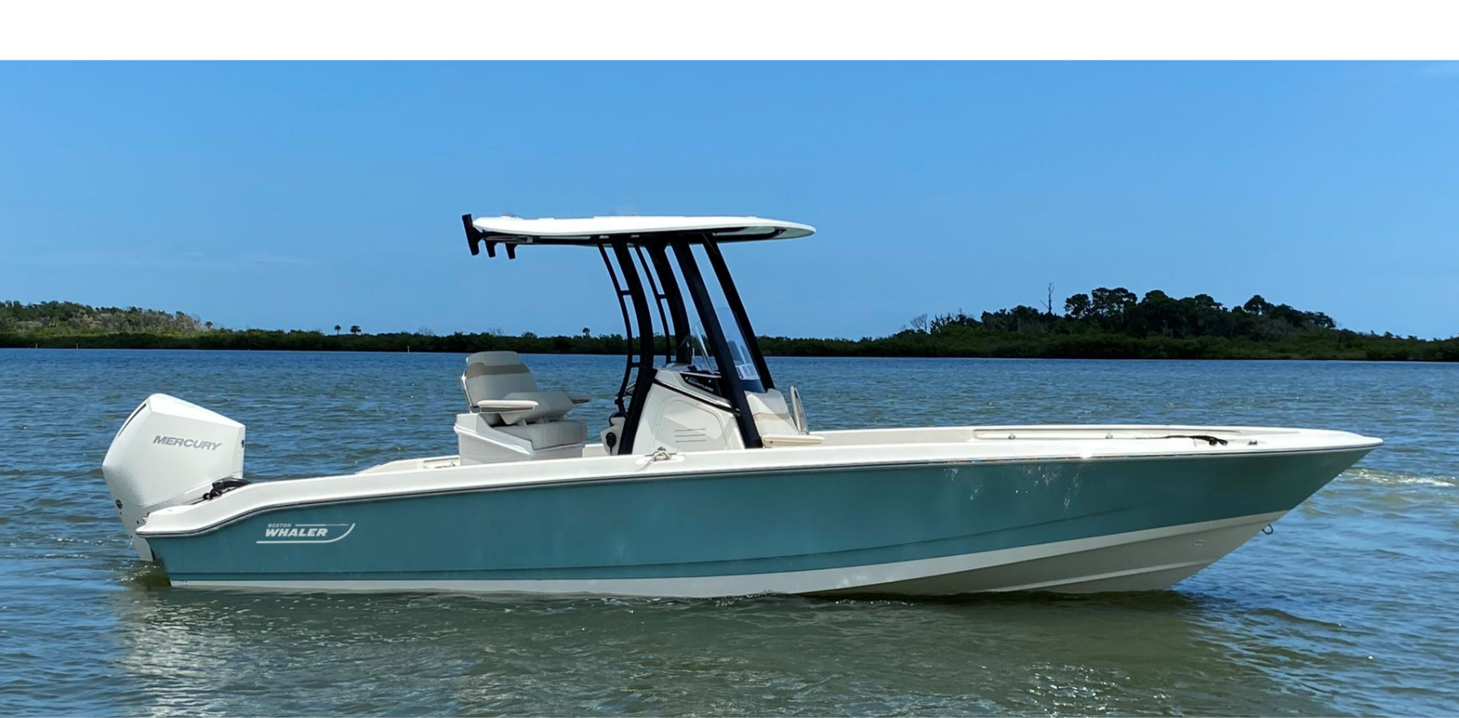
All-New : 250 Dauntless
2021 Model Year
Standard engine: 250 hp V8 DTS Black Mercury Verado engine with hydraulic power steering
Notes:
The new profile makes a huge statement of being a much more sea capable hull over its predecessor .

Slide 3
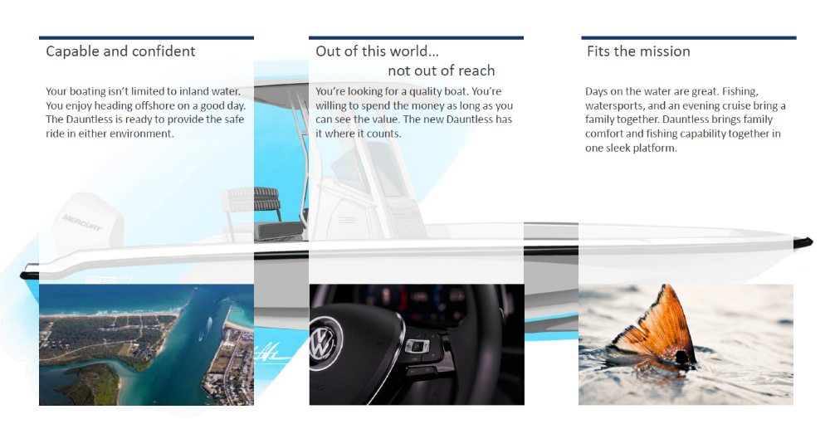
*LOA: (on centerline, from bow to engine mounting location)

Slide 4
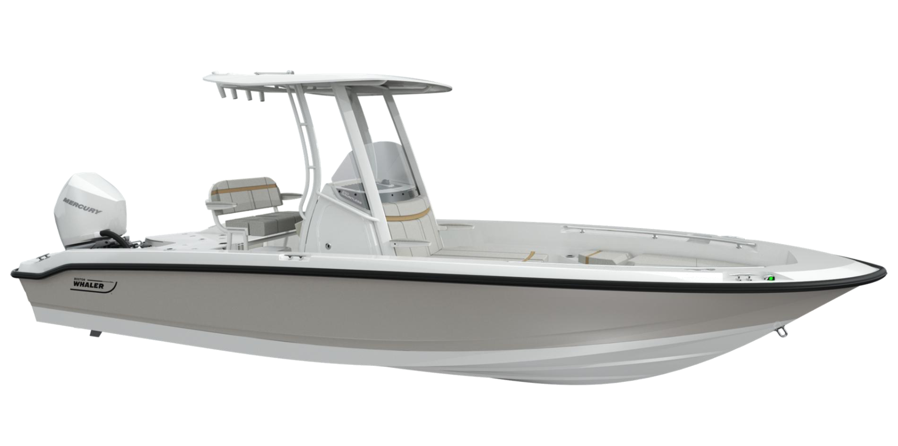
250 Dauntless Sales Training
Spec Sheet
Hull Changes
NEW Bow Layout
Features / Benefits
Notable Options
Performance
Top 5 selling features

Slide 5
SPECIFICATIONS: Comparison between new and old models
240 Dauntless
250 Dauntless
LOA: 23' 11" (7.29 m) (on centerline, from engine to bow mounting location)
LOA: 24’ 8" (7.52m) (with platforms)
Beam: 8' 6" (2.59 m)
Draft: 14" (0.36m)
Weight (dry, no engine): 3,300 lbs (1497 kg)
Weight (w/engine, fuel & water): 4,654 lbs (2,722 kg)
Maximum Weight Capacity: 3,000 lbs (1361 kg)
Swamped Capacity: 6,000 lbs (2722 kg)
Persons Capacity: 9
Maximum HP: 350 hp (261 kW
Minimum HP: 250 hp (186 kW)
Maximum Engine Weight: 700 lbs (318 kg)
Transom Height: 25" (.64 m)
Deadrise at Transom: 16º
Fuel Capacity: 90 gallons (341L)
Bridge Clearance: 5’ 9” (1.75 m)
Bridge Clearance with T-Top: 7’ 9” (2.36 m)
Package boat specs (base boat on trailer, engine up:) 32’ 4” X 8’ 6” X 8’ 5”
LOA: 24' 9" (7.32 m) (on centerline, from engine to bow mounting location) 10” Longer
LOA: 25’ 8 " (7.62 m) (with platforms) 12” Longer
Beam: 8' 6" (2.59 m)
Draft: 15" (0.38m) 1” Deeper
Weight (dry, no engine): 3,390 lbs (1538 kg)
Weight (with engine, fuel, and water): 4,740 lbs (2150 kg)
Maximum Weight Capacity: 3,400 lbs (1,542kg)
Swamped Capacity: 5,600 lbs (2,540 kg)
Persons Capacity: 10 One Additional Person
Maximum HP: 400 hp (298 kW) 50 hp More
Minimum HP: 250 hp (186 kW)
Maximum Engine Weight: 720 lbs (326 kg)
Transom Height: 30" (.76 m) 5” Taller
Deadrise at Transom: 18º 2° Steeper
Fuel Capacity: 90 gallons (341L)
Bridge Clearance: 6’ 1” (1.85 m) 2” Taller
Bridge Clearance with T-Top: 7’ 11” (2.41 m) 2” Taller
Package boat specs (base boat on trailer, engine up:) TBD
*LOA: (on centerline, from bow to engine mounting location)

Slide 6
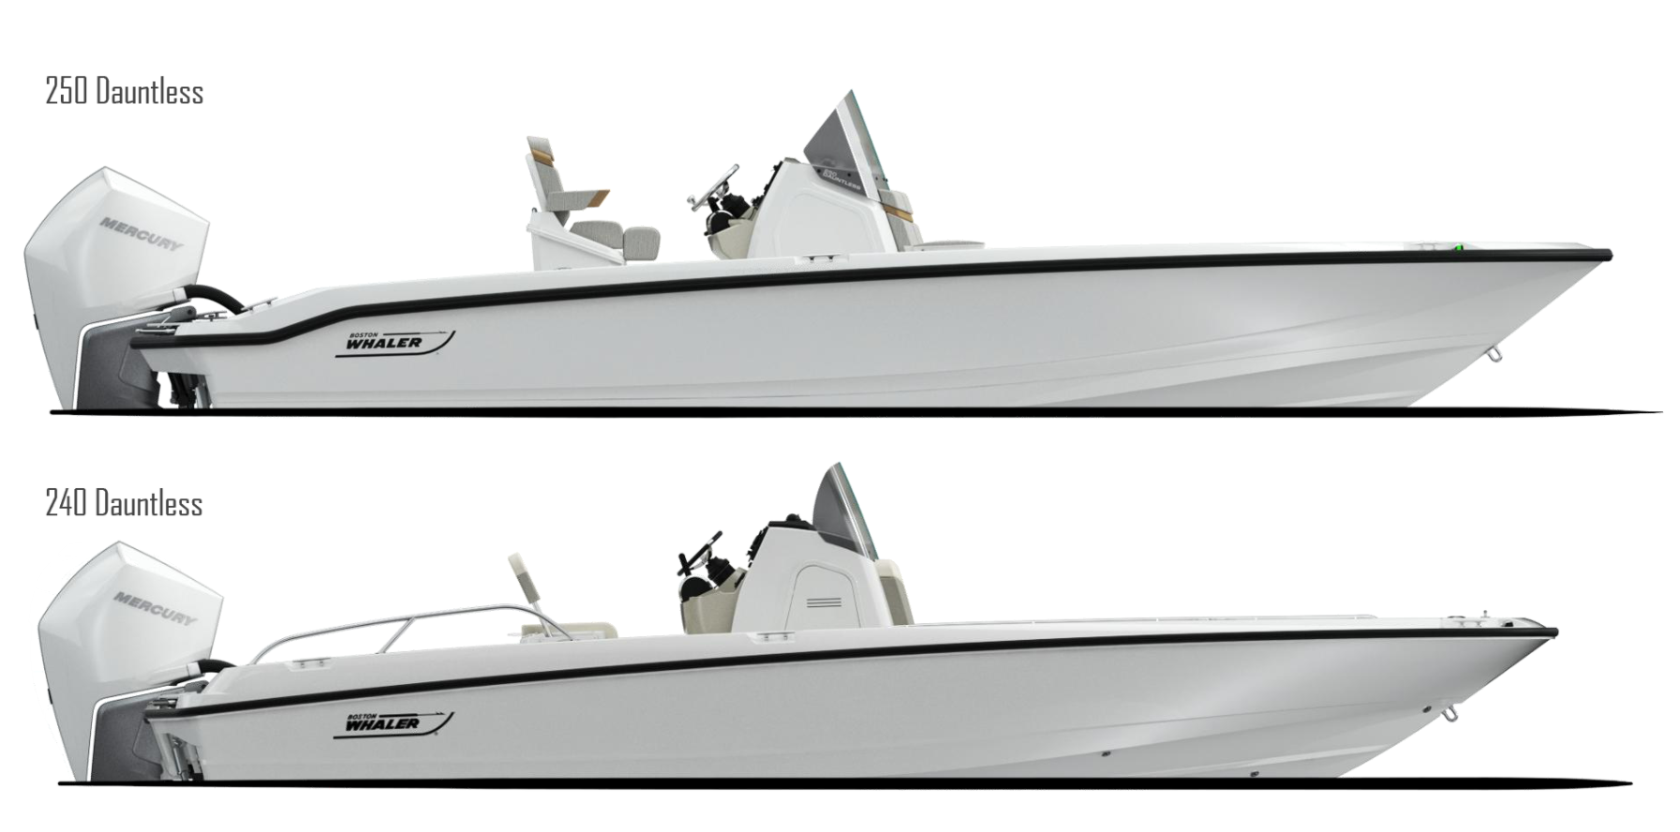
What’s new for the Dauntless Platform
Keel Up Re-design
  More capable and seaworthy- Increased deadrise 18°, sharper bow entry with Increased flare
  Increased freeboard- 2” more cockpit depth
  Increased LOA to 25’ 8” from 24’ 8”

Slide 7
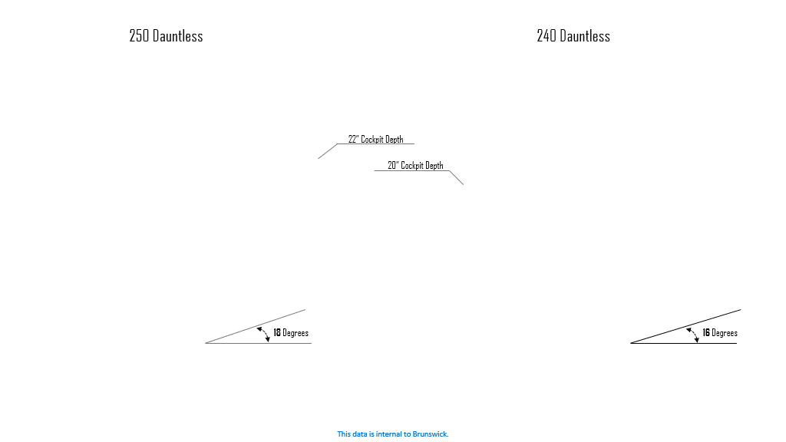
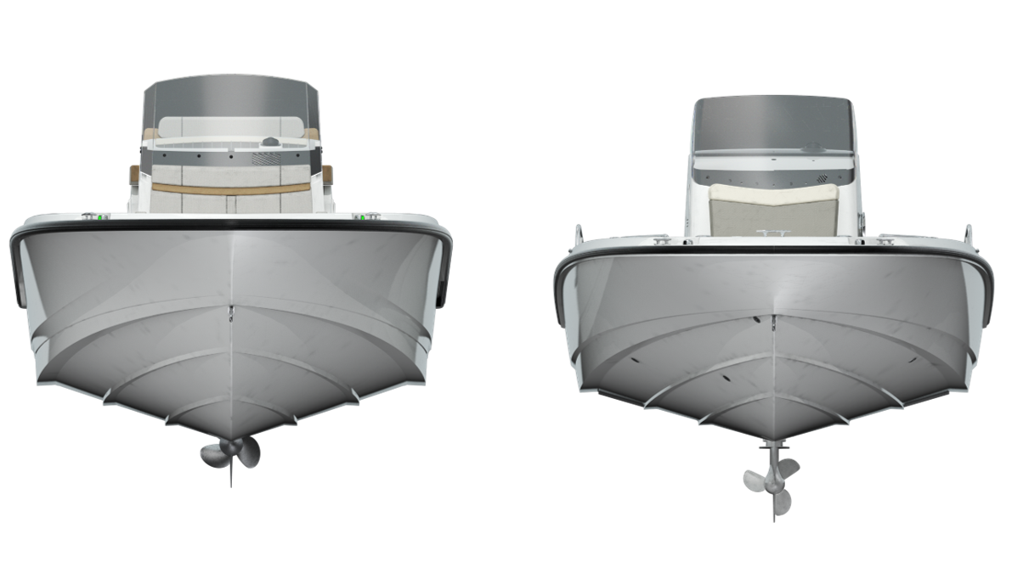
What’s new for the Dauntless Platform
Notes:
Increased deadrise and higher gunwales make this a more capable and more seaworthy hull.

Slide 8
Hull changes
- Pointed bow with increased flare: Provides a softer, drier ride with increased capability
Length over all 1’ longer
18 degrees of deadrise
Gained 2” cockpit depth
Sample Image
SAMPLE IMAGE

Slide 9
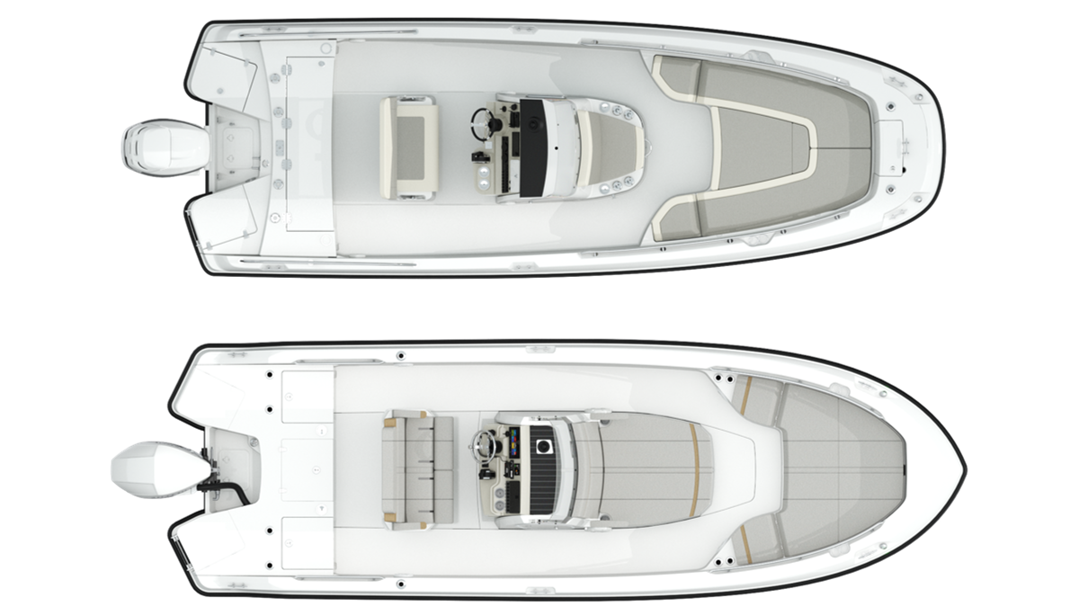
What’s new for the Dauntless Platform
More versatility for the whole family
  More standard fishing options
    Standard aft livewell
    Flat, single level stern deck with no obstructions
    Gunwale rod holders
  Improved comfort
    Forward console lounge
    Helm seating options
  Watersports tow point from tops
  No compromises - accommodates everyone's needs:
    Fishing
    Watersports
    Entertaining
240 Dauntless
NEW 250 Dauntless

Slide 10
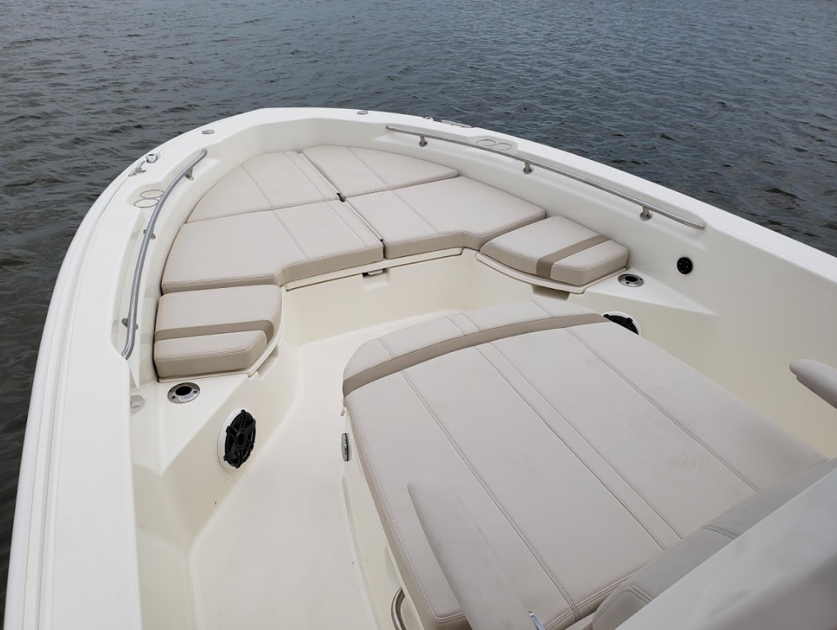
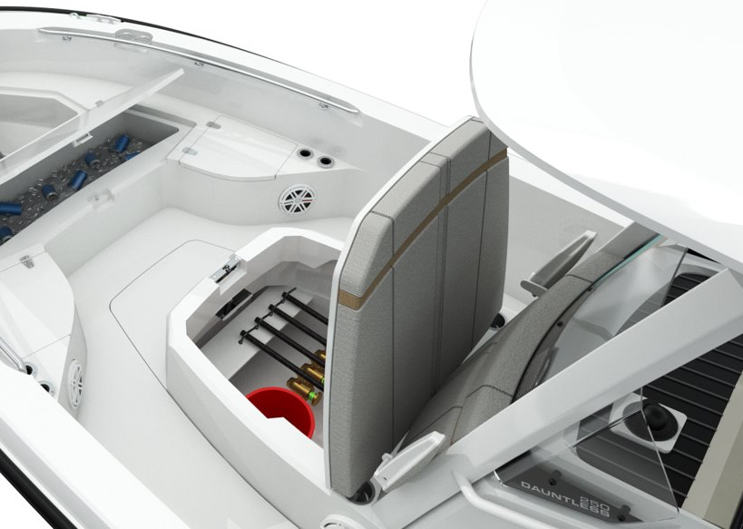
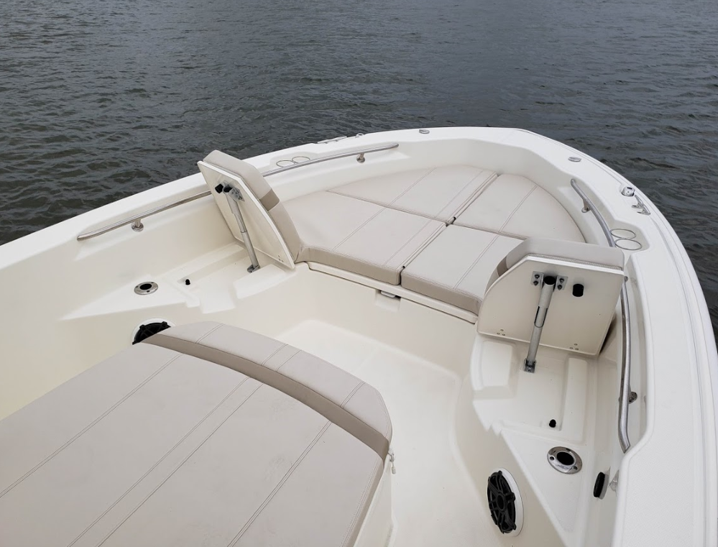
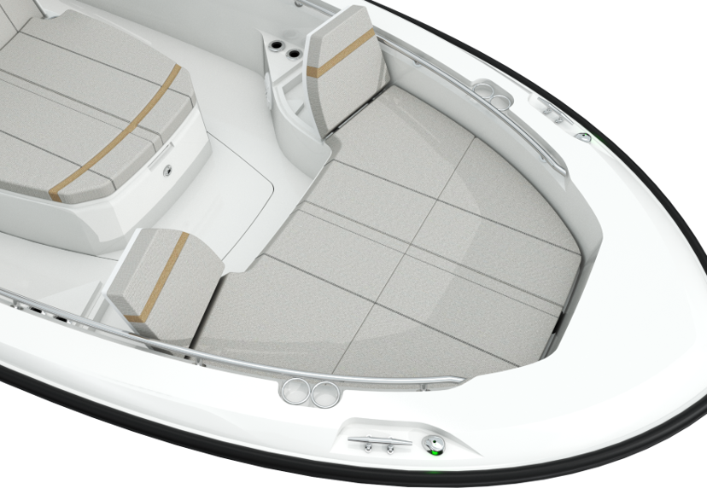
Bow Improvements
All-new forward lounge
  fold down arm rest
  lockable, dry rod storage
Bow cushions with flip-up backrests
Forward rod holders (4)
Welded stainless steel forward grab rails
Fish box / cooler in forward bow deck with easy access paddle latch
Sample Image
SAMPLE IMAGE
Notes:
Although the bow is pointed, we did not loose seating. In fact we gained it with the addition of the double lounge.
Promotes multi-use vs. previous version.
New styling, accent stripes add contrast to the upholstery. Integrated cooler/storage, cupholders

Slide 11
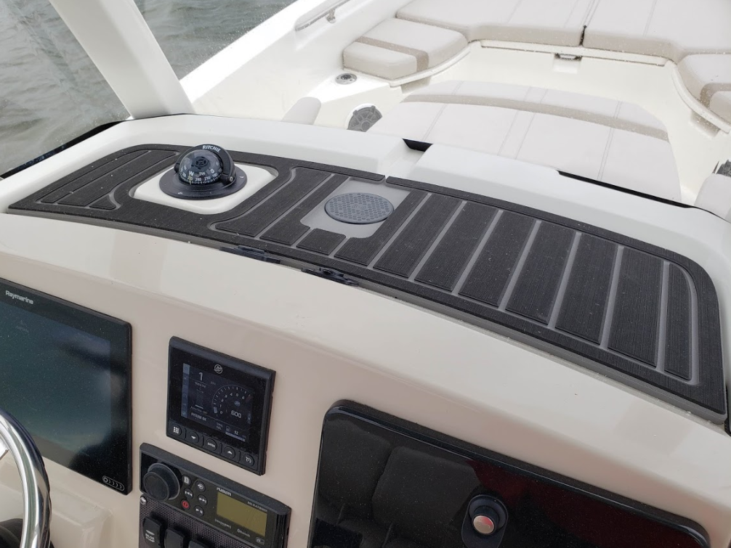
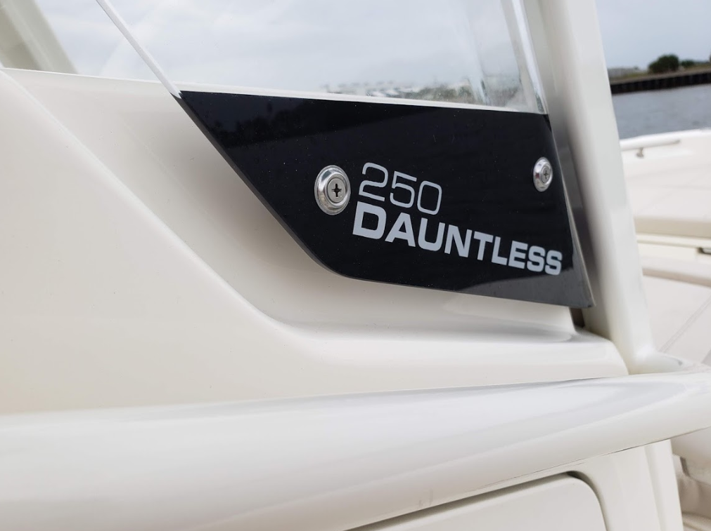
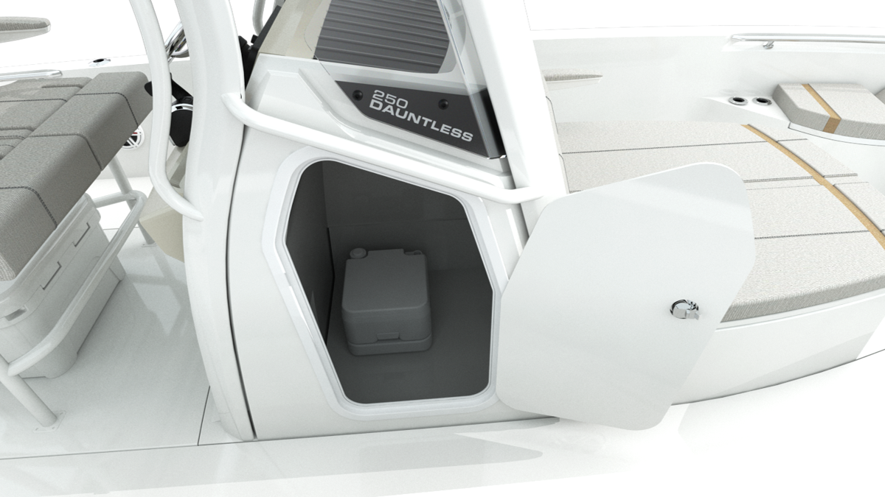
All NEW Helm Console
New SeaDek lined chuck space with wireless phone charging (phones, wallet, keys)
New model designator on windscreen for a very custom look
Improved head access, wider entry door

Slide 12
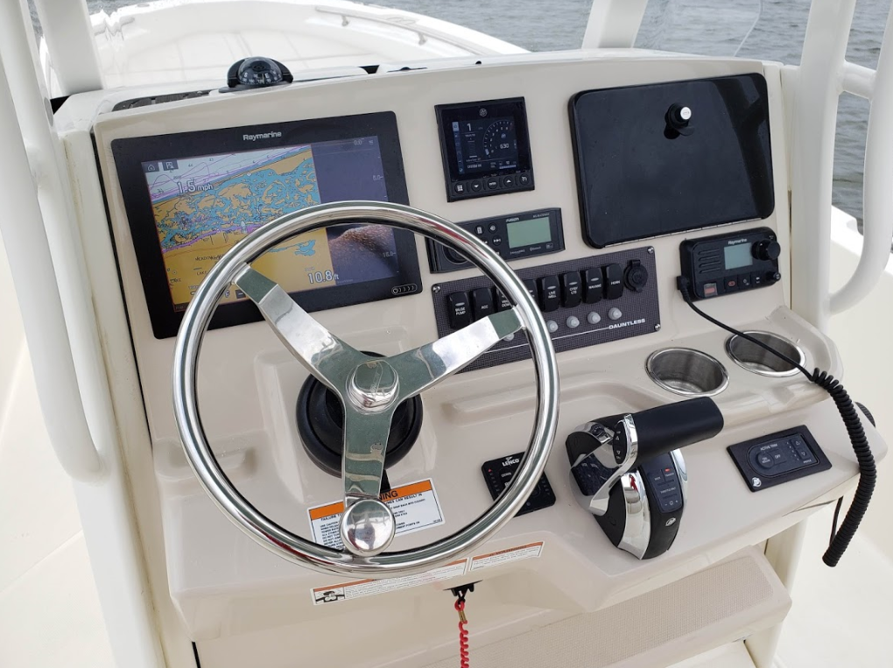
Helm Console Face
Cast stainless steel steering wheel with knob
Compass
12V receptacle
optional glove box
NEW dash visor chuck space with wireless phone charging
NEW stainless-steel drink holders (2)
larger electronics mounting surface fits 12” screen
Electrical switch panel with circuit breaker protection
SAMPLE IMAGE

Slide 13
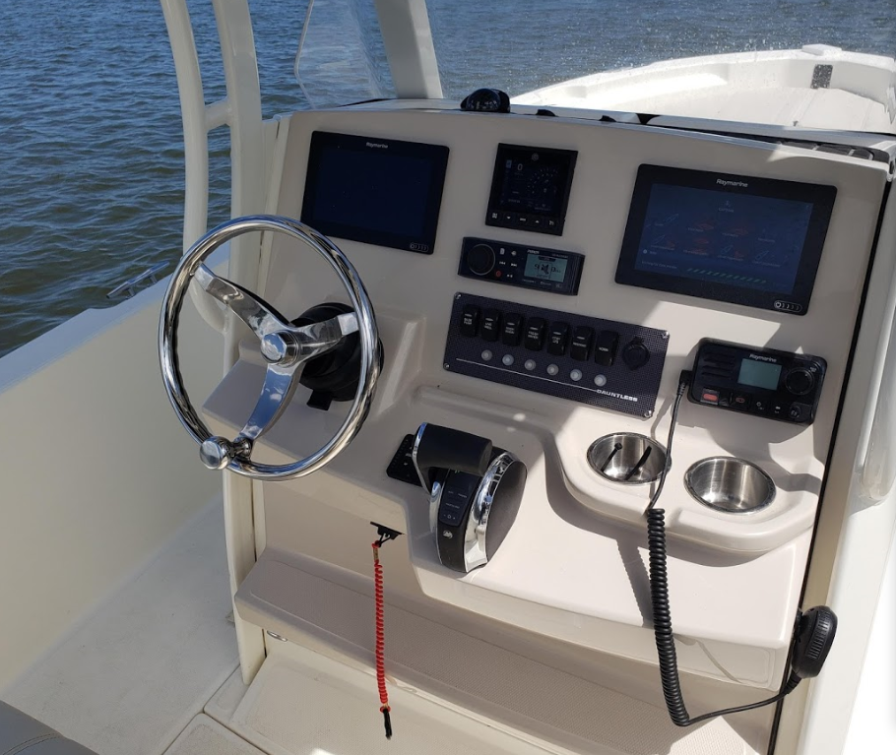
Helm Configuration:
Dual Axiom 9 Inch Screens
Sample Image
SAMPLE IMAGE

Slide 14
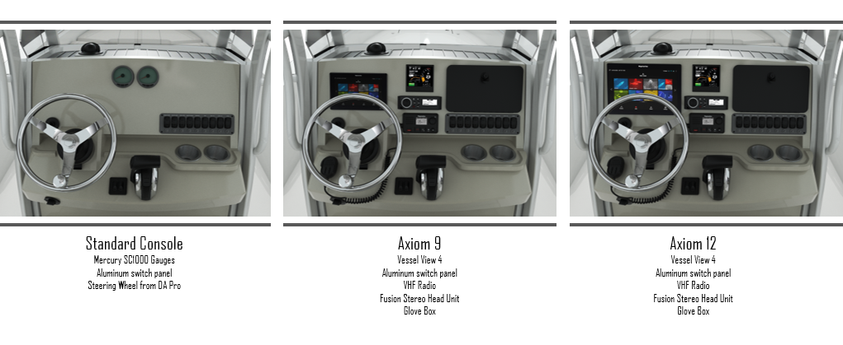
Helm Configurations
Sample Image
SAMPLE IMAGE

Slide 15
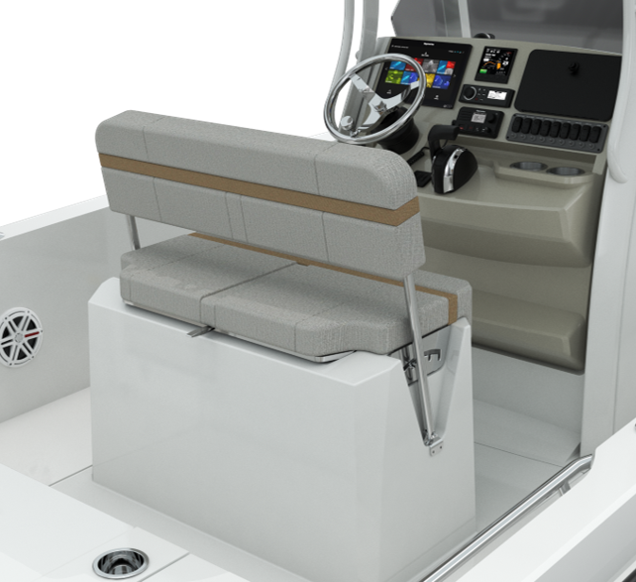
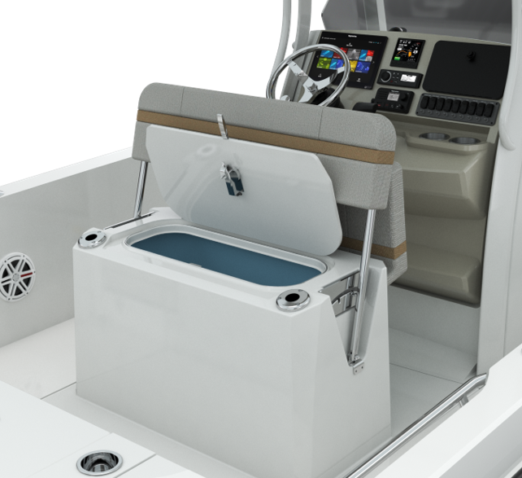
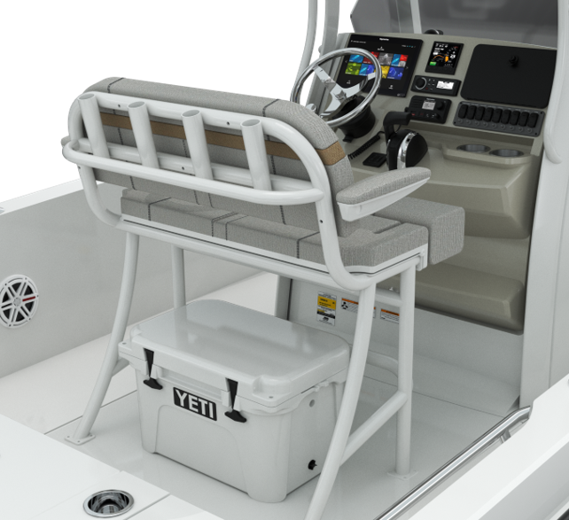
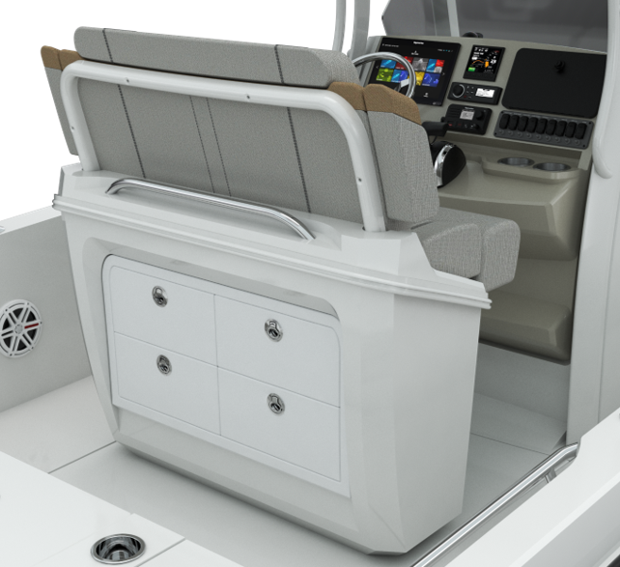
Four Helm Seat Configurations
STANDARD: Reversible seat with storage / Cooler
OPTIONAL: Reversible seat with livewell
OPTIONAL: Leaning Post frame with 75 Quart Yeti cooler
OPTIONAL: Deluxe Leaning Post with aft drawer storage​
1
2
3
4

Slide 16
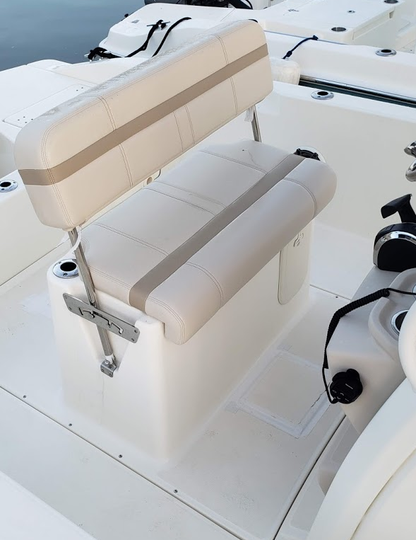
STANDARD: Reversible Leaning Post with Storage
Seat base and fuel tank cover molded as a single fiberglass piece
Insulated fiberglass tub can be used for storage or a cooler
New upholstery
OPTIONAL: RPS with Livewell
Cooler tub becomes livewell

Slide 17

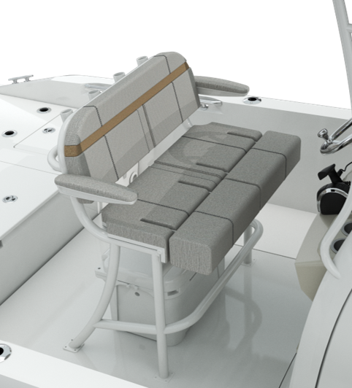
OPTIONAL: Frame Leaning Post with cooler
Powder coated tube seat base with 75 Quart Yeti cooler
New upholstered bench seat with flip-up bolsters and folding arm rest

Slide 18
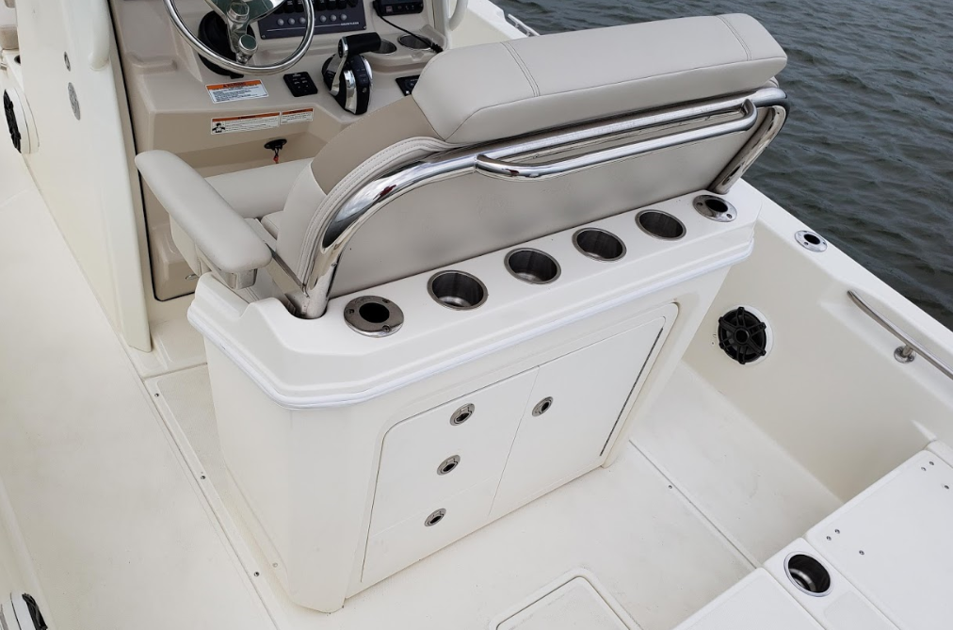
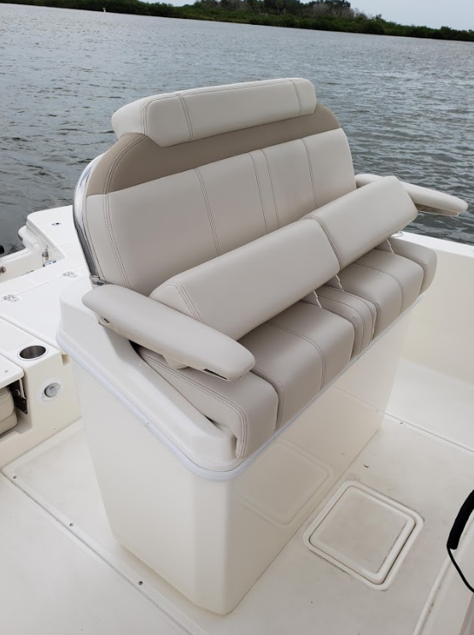
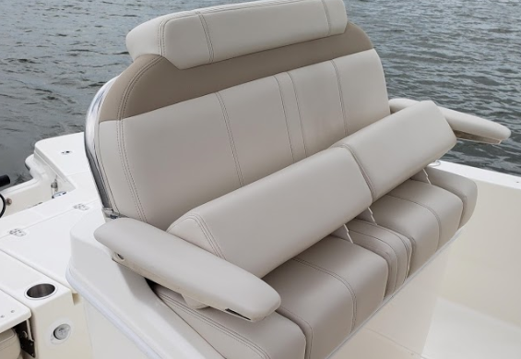
OPTIONAL:
Deluxe Leaning Post with Aft Storage
Fiberglass seat base w/ aft storage drawers
  Storage area includes draws and door which accommodates a 5-gallon bucket inside
  New upholstered bench seat with stand-up bolsters and folding arm rest

Slide 19
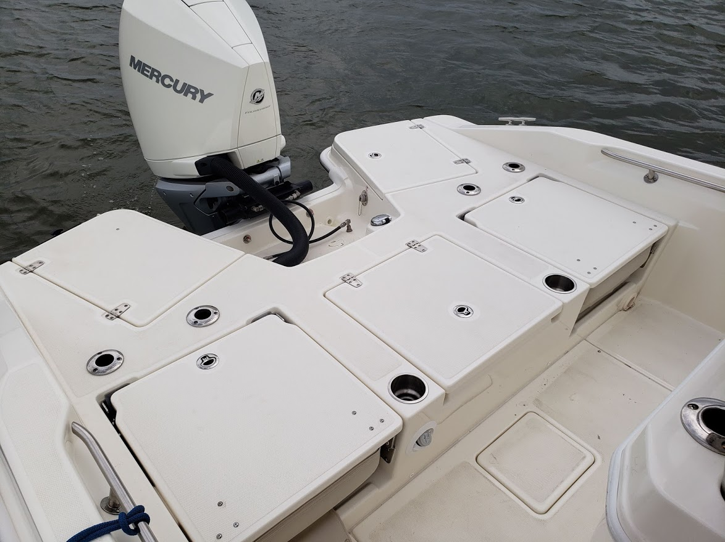
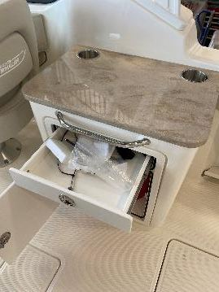
Stern Deck
Flat surface (no more step)
Stainless cup holders
4 standard rod holders
-Usable with seats up
Recessed hardware
No cushion snaps

Slide 20
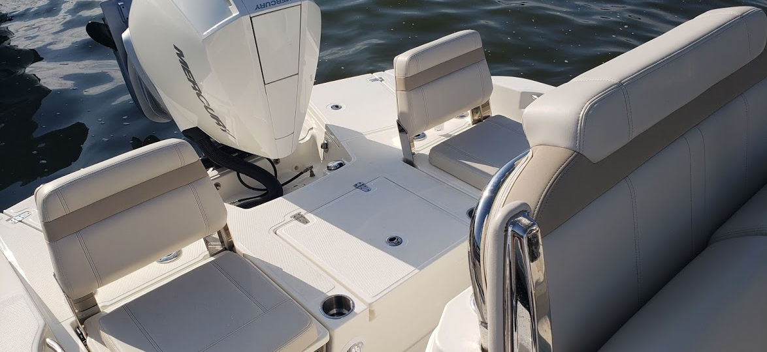
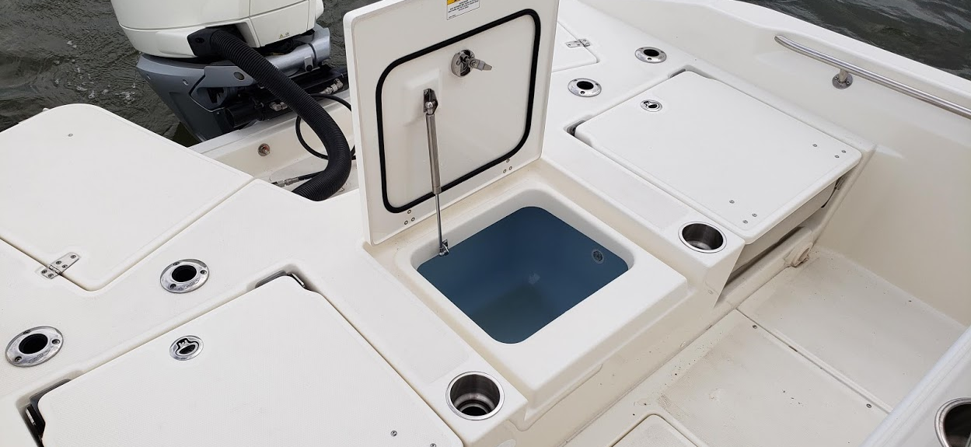
Live Well with Jump Seats
New 35-gallon livewell
  insulated blue interior and flush mounted lid
Dual flip-up jump seats
  innovative design provides ergonomic seated height.

Slide 21
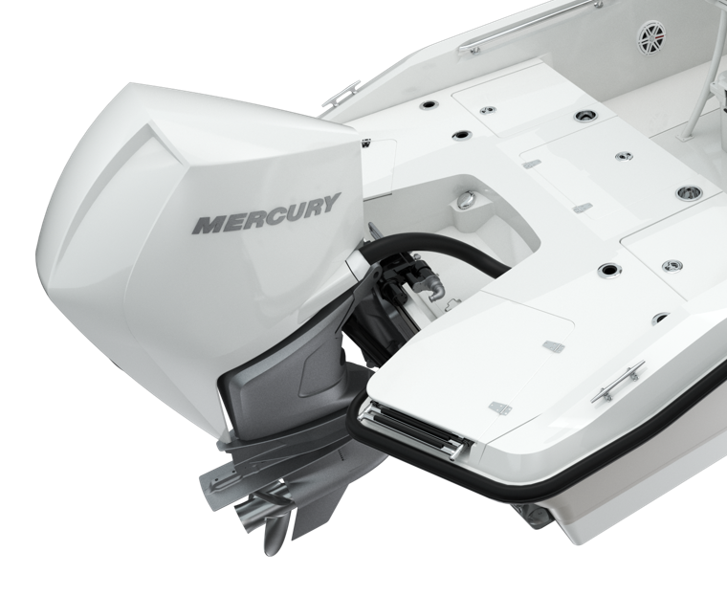
Deployable Swim Ladder
Angled swim ladder for safer boarding
Ladder stows under a fiberglass lid
Notes:
Nice view of the stern deck here; a good opportunity to point out the flat stern deck (no more step).
Standard live well in the center of the stern deck

Slide 22
Rail Choices
Standard: Low profile rails
Optional High Bow and split bow rails are available
  Both options include high aft rails and remove gunwale rod holders

Slide 23
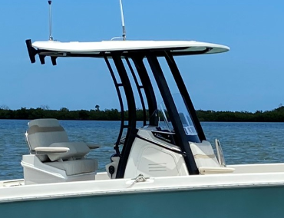
Optional:
Fiberglass Hard-Top
White or Black Frame
Colored gel on the underside of the fiberglass hardtop

Slide 24
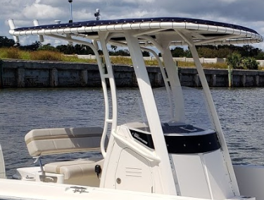
Optional: T-Top
Blue or Black Canvas
White or Black Frame

Slide 25
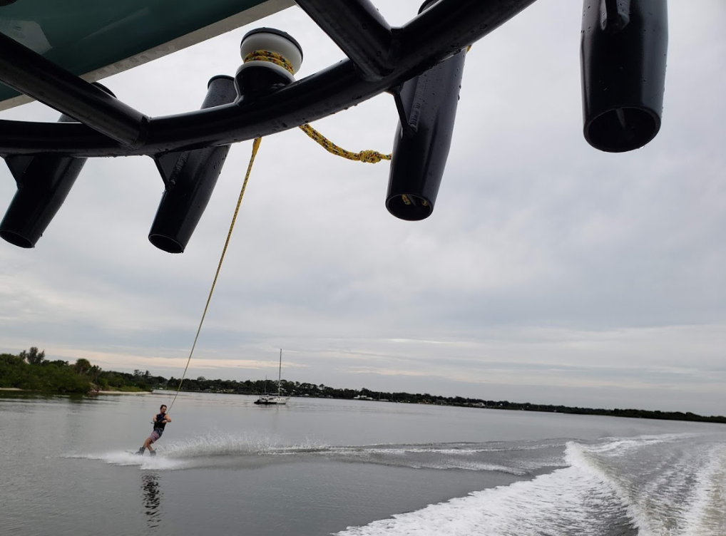
Water Sports
Tow point from both hard top and T-top

Slide 26
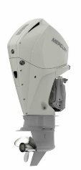
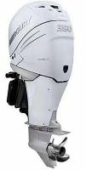

Engines
Standard:
  250 XXL V8 DTS Mercury FourStroke with hydraulic power steering
Optional:
  300 XXL V8 DTS Mercury FourStroke with hydraulic power steering
  350 XXL L6 DTS Mercury Verado FourStroke with hydraulic power steering
  400 XXL L6 DTS Mercury Verado FourStroke with hydraulic power steering
SmartCraft deluxe gauge package
Tilt steering
Stainless steel propeller
Fuel/water separator
Available in black or white

Slide 27
Notable Options:
Active engine trim
Anchor roller (not compatible with trolling motor panel option) (not for use as anchor stowage)
Bow and stern rails, High - (deletes low profile rails) (not compatible with Trolling Motor Panel)
Bow table (with dedicated storage)
Bow tow eye
Electric trim tabs with indicator
Glove Box (Not compatible with 9” additional display)
Porta potti with deck pump-out
Raw-water washdown
Satellite radio (Sirius ® satellite receiver with antenna) (must order stereo option)
SeaDek Cockpit flooring (mocha/black teak, UV protected, non-absorbent foam)
Shower - freshwater with 12-gallon tank
Split bow rail – Includes high aft rails (deletes low profile bow rail) (not compatible with Trolling Motor Panel)
Stereo - FUSION® AM / FM with waterproof speakers (4) and USB input (FUSION® Bluetooth enabled)
Sunshade at bow (must select T-Top or Fiberglass Hardtop)
Vessel View 4” Display (network connections to Raymarine with Navigation Package)
White rub-rail with stainless steel insert

Slide 28
Other Notable Options:
All Activity Tower®
Casting platform
Ski and wakeboard racks
Watersports tow point
TROLLING MOTOR 36V WITH CHARGER (not compatible with anchor roller or Bow rail or split bow rail options)
Battery boxes for trolling motors (3)
Motorguide XI-5 trolling motor with GPS
Trolling motor panel with wiring
Battery charger
trolling motor panel (not compatible with anchor roller or Bow rail or split bow rail options)
Battery boxes for trolling motors (3)
Trolling motor panel with wiring
POWERPOLE
Powerpole bracket (black or white)
Powerpole 8’ or 10’ (black or white)
JACKPLATE
Atlas 10” offset heavy duty jackplane
Control at console

Slide 29
Other Notable Options:
T-TOP (black or blue)
Dome light (red and white)
Storage bag
Watersports tow point
Rod holders (4)
FIBERGLASS HARDTOP
Dome light (red and white)
Lifejacket storage
Watersports tow point
Rod holders (4)
Aluminum Trailer
Disc brakes
Dual torsion axle
Guide on stanchions
LED lights
Radial tires
Spare tire
PREMIUM AUDIO
4 speakers plus 2 Subs
Add Amplifier
Upgrade speakers to M series
Reversible Pilot Seat Livewell
Livewell (32 gallon) with blue interior
Rod holders - stainless steel (2)
Deluxe leaning post
Fiberglass leaning post
Fold down armrests
Flip up bolsters
Integrated storage drawers
Competition leaning post
Aluminum frame leaning post
Fold down armrests
Flip up bolsters
4 integrated rod holders
Carry on cooler (Yeti 65 75 Qt.)
Pedestal fishing seats (2)
VHF Radio
Raymarine Ray 53 VHF /W GPS

Slide 30
Optional: Electronics Package
9” RaYmarine AXIOM 9 RV (RealVision)ELECTRONICS/NAVIGATION PACKAGE
Raymarine Axiom 9 RealVision 3D, 9” touch screen (GPS, chart plotter, fishfinder)
RealVision 3D, DownVision, SideVision and Chirp transom transducer
Navionics Chart Card: North America/Canada
  Navionics Chart Card: Central/South America
  Navionics Chart Card: Europe/Mid East/Asia
  Navionics Chart Card: AU/NZ
9” Raymarine Axiom Additional Display (Must select the 9” Axiom Navigation Package Option or the 12” Axiom Navigation Package Option) (Not compatible with GloveBox)
Raymarine Axiom 9” with single channel chirp sonar
12” RAYMARINE AXIOM RV ELECTRONICS/NAVIGATION PACKAGE
Raymarine Axiom RV, 12.1” screen (GPS / chart plotter / fishfinder)
RV-100 3D Transom Mount Transducer
Navionics Chart Card – North America/Canada
  Navionics Chart Card – Central/South America
  Navionics Chart Card – Europe/Mid East/Asia
  Navionics Chart Card – AU/NZ
Notes:
To provide more versatility, we now a better fishing package with USEFUL rod storage, optional live well in port transom, better fish box center line

Slide 31
Canvas options
Combination helm seat / console cover (black or blue)
Console cover (black or blue)
Console lounge seat with backrest cover (black or blue)
Helm seat cover (black or blue)
Sun top with boot and stainless-steel fittings (black or blue)

Slide 32
Key highlights
Bow to Stern
Bow
Helm
Cockpit
Centerline double lounge with arm rests
Lockable, dry rod, and gear storage in lounge garage
Foreword sun lounge with flip-up backrests
Full beam insulated fish box / cooler in forward bow deck
Integrated dash visor chuck space with wireless charging
Improved head access
New optional helm seat configurations in lieu of standard reversible helm seat
Optional T-top or fiberglass hard-top with tow points
Room for 12” display
Increased cockpit depth
Self-bailing cockpit
Standard livewell
Standard cooler under helm seat
Dual transom seats
gunwale rod holders

Slide 33
New Model Designator Design
The New Dauntless Family Look

Slide 34
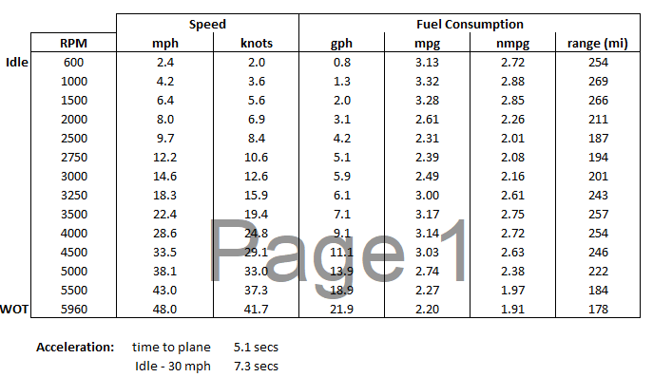
250DNT Engine Performance: 250 V8 AMS

Slide 35
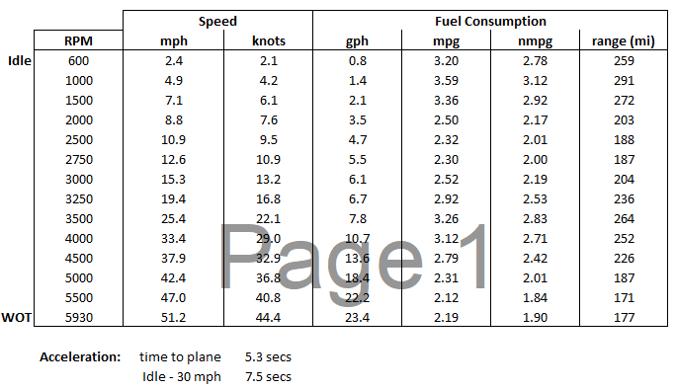
250DNT Engine Performance: 300 V8 AMS

Slide 36
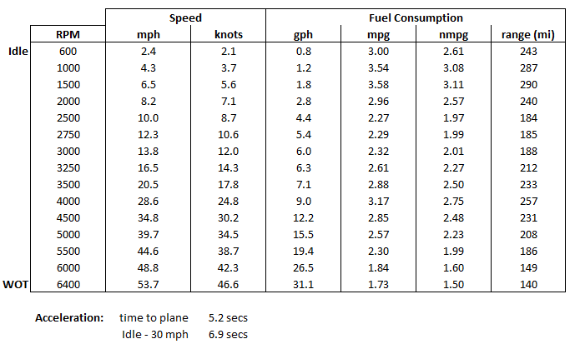
250DNT Engine Performance: 350 Verado

Slide 37
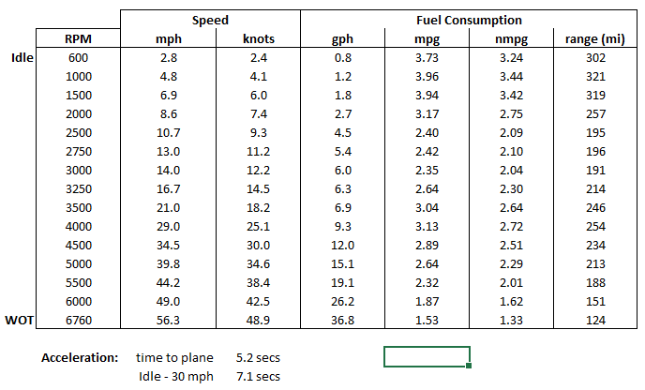
250DNT Engine Performance: 400 Verado

Slide 38
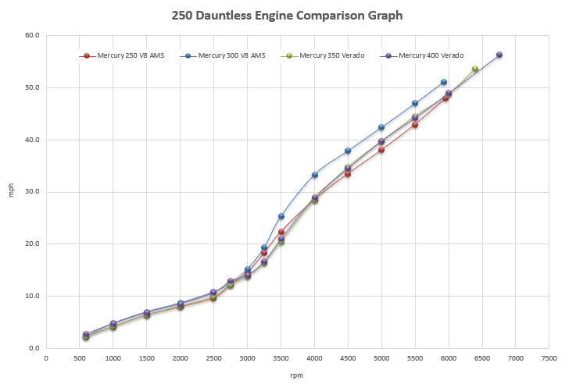
250DNT Engine Performance

Slide 39
Key Takeaways vs. 240 Dauntless
Sample Image
Sample Image
Sample Image
1
All-new, more seaworthy-hull design, 18-degree deadrise at transom, 2-inch deeper cockpit
2
All-new forward double lounge with garage storage provides additional comfort and storage
SAMPLE IMAGE
SAMPLE IMAGE
SAMPLE IMAGE
3
Helm seating options suit any needs from deluxe storage to RPS with live well
4
Added fishability with transom live well, Gunwale rod holders and flush aft stern deck
5
Improved customer experience based on evolution, larger head door, watersport tow point on tops, Wireless phone charger
SAMPLE IMAGE
Sample Image

Slide 40
220 Dauntless
Sales Training

Slide 41
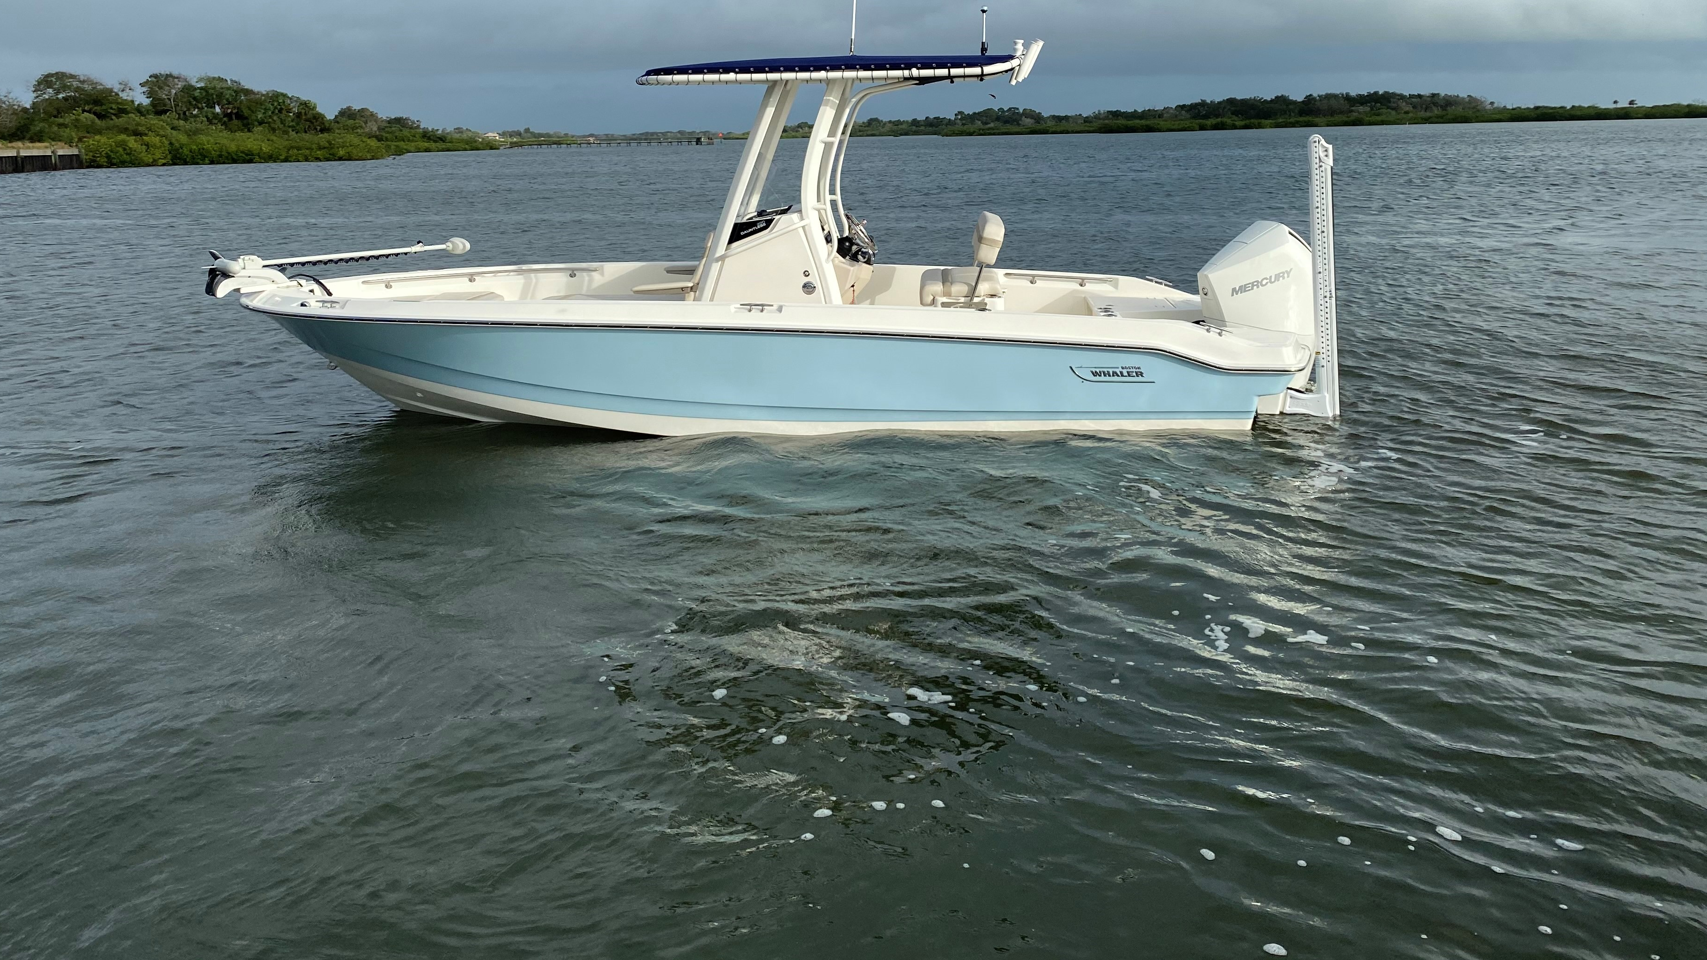
All-New:
220 Dauntless
2021 Model Year
Notes:
The new profile makes a huge statement of being a much more sea capable hull over its predecessor .

Slide 42
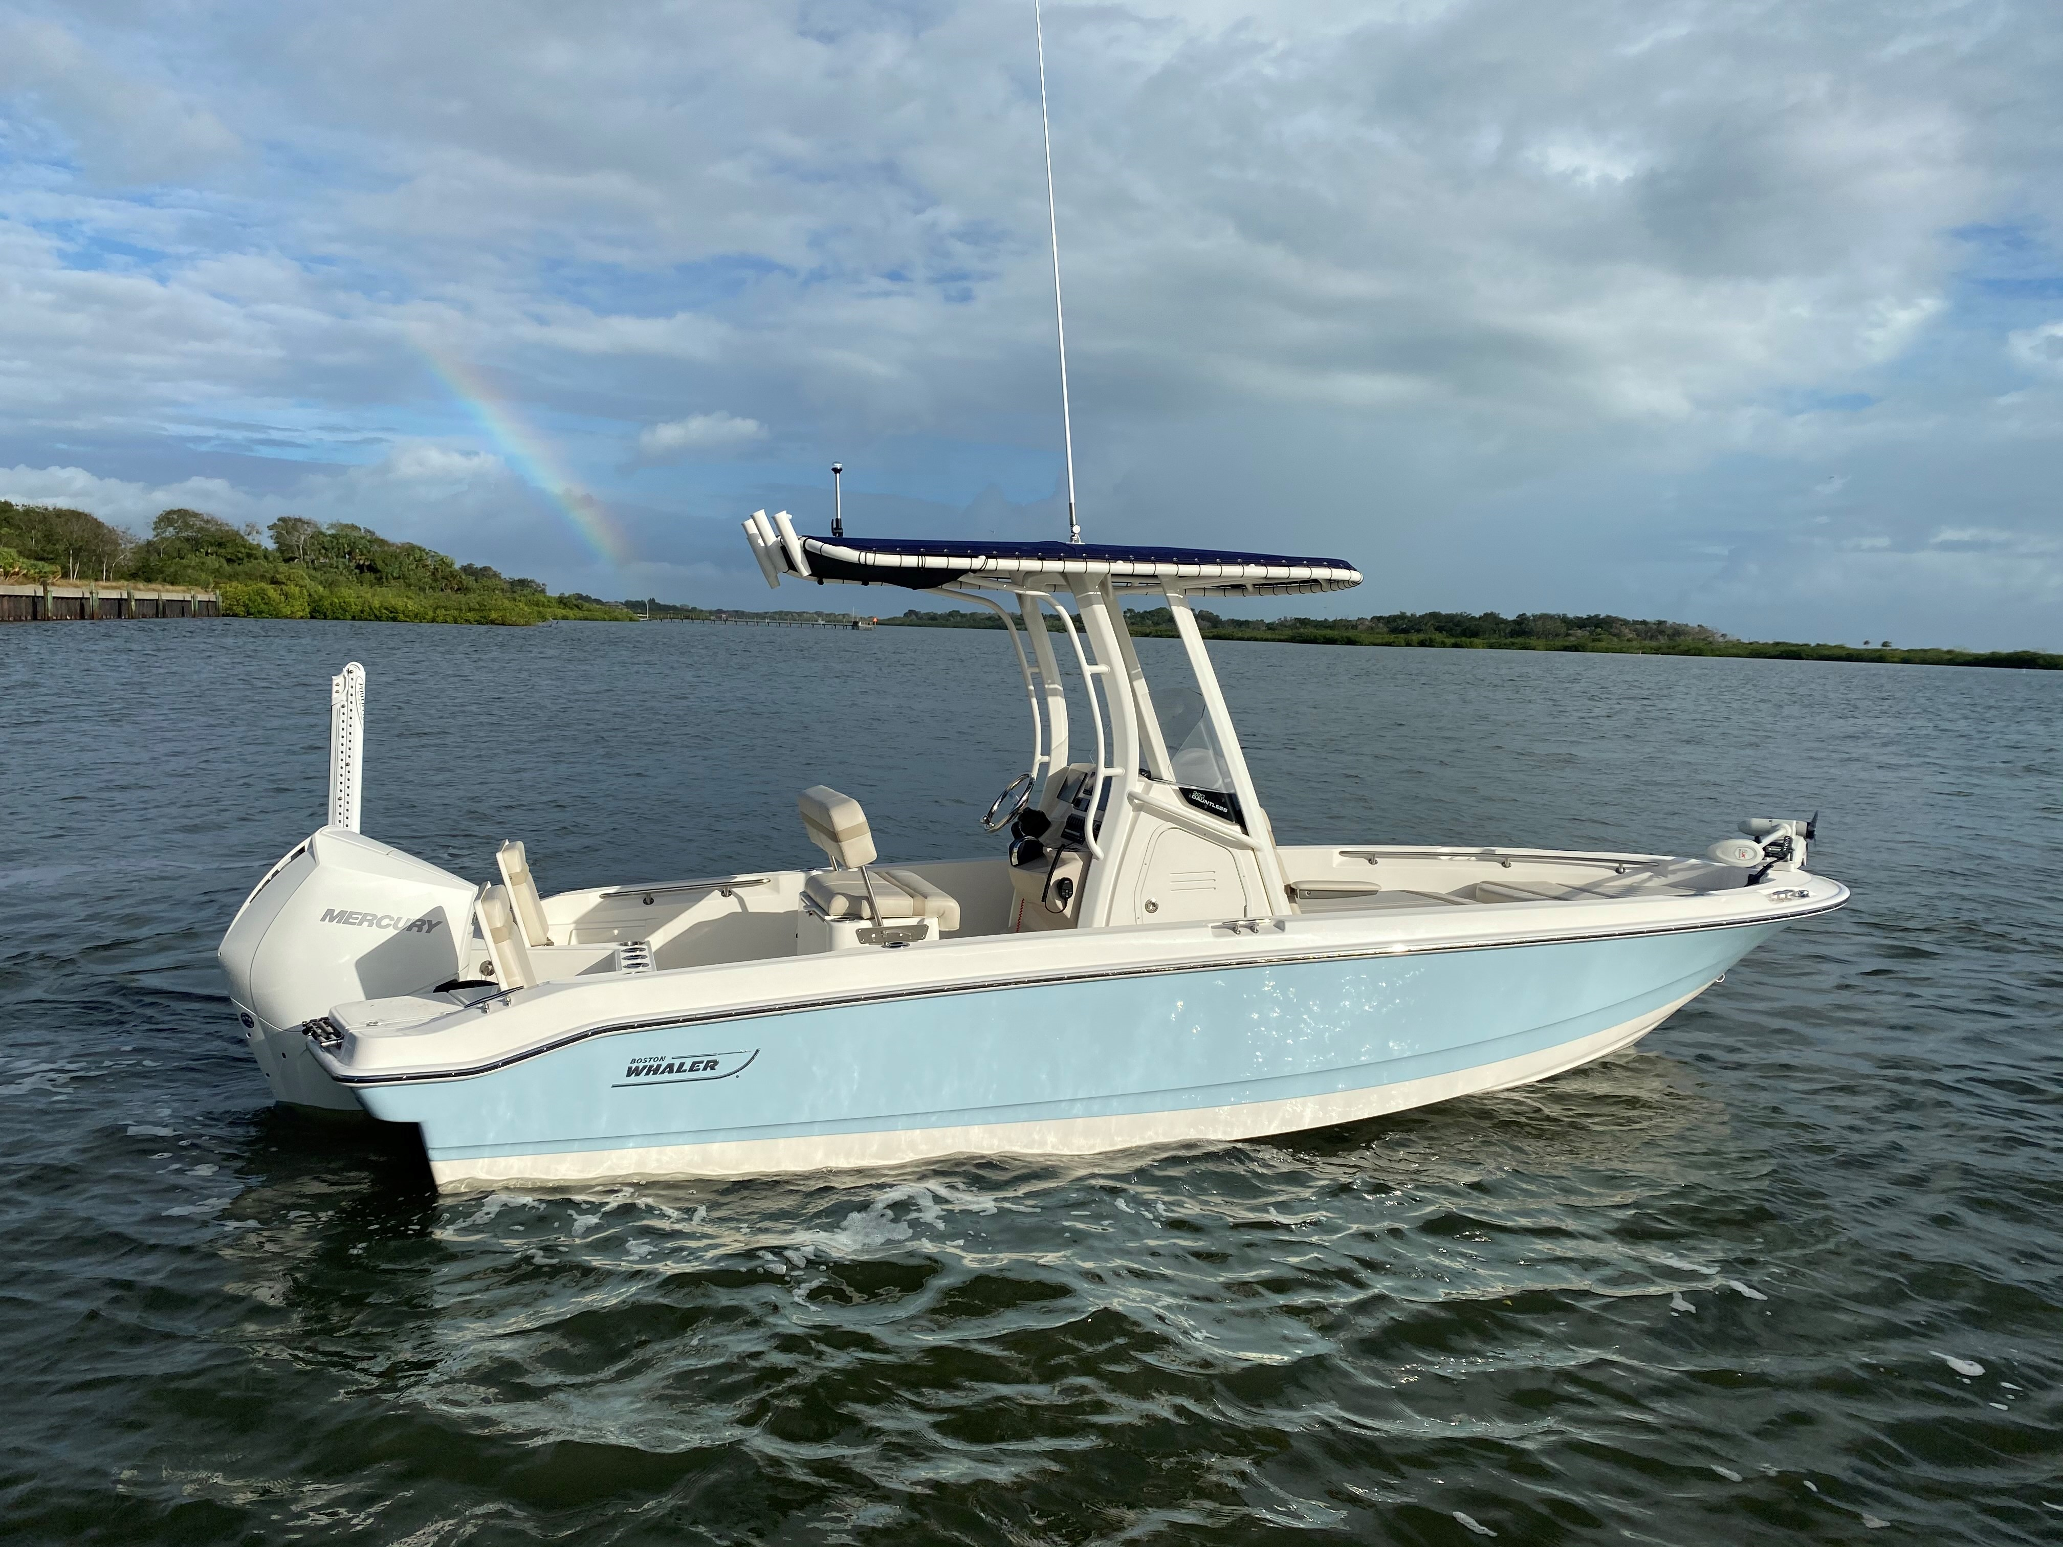
220 Dauntless Sales Training
Spec Sheet
Hull Changes
NEW Bow Layout
Features / Benefits
Notable Options
Performance
Top 5 selling features

Slide 43
SPECIFICATIONS: Comparison between new and old models
210 Dauntless
220 Dauntless
LOA: 20’ 6” (6.24m) (on centerline, from bow to engine mounting location)
LOA: 21’ 3” (6.48m) (with platforms)
Beam: 8’ 6” (2.59m)
Draft: 14” (.36m)
Weight (dry, no engine): 2,600 lbs (1179.3 kg)
Weight (w/engine, fuel & water): 3,616 lbs (1,640 kg)
Maximum Weight Capacity: 2,300 lbs (1043 kg)
Swamped Capacity: 4,300 lbs (1950.4 kg)
Persons Capacity: 8
Maximum HP: 200 hp (149 kW)
Minimum HP: 150 hp (112 kW)
Maximum Engine Weight: 700 lbs (318 kg)
Transom Height: 25" (.64m)
Deadrise at Transom: 16º
Fuel Capacity: 75 gallons (284 L)
Bridge Clearance: 5’ 7” (1.70m)
Bridge Clearance with Top: 7’ 7” (2.31m)
Package boat specs (base boat on trailer, engine up:) 28’3” X 8’ 6” X 8’ 10” (Reduction for swing tongue 2’ 7”)
LOA: 22’ 0” (6.71m) (on centerline, from bow to engine mounting location) 18” Longer
LOA: 23’ 4” (7.11m) (with platforms) 25” Longer
Beam: 8’ 6” (2.59m)
Draft: 15“(0.38m) 1” Deeper
Weight (dry, no engine): 3,040 lbs (1329 kg)
Weight (with engine, fuel, and water): 4,190 lbs (1901 kg)
Maximum Weight Capacity: TBD
Swamped Capacity: TBD
Persons Capacity: 8
Maximum HP: 250 hp (149 kW) + 50HP
Minimum HP: 200 hp (112 kW) + 50HP
Maximum Engine Weight: 550 lbs (249kg)
Transom Height: 25" (.64m)
Deadrise at Transom: 18º 2° Steeper
Fuel Capacity: 80 gallons (303L) +5 Gallons
Bridge Clearance: TBD
Bridge Clearance with Top: TBD
Package boat specs (base boat on trailer, engine up:) TBD
*LOA: (on centerline, from bow to engine mounting location)

Slide 44
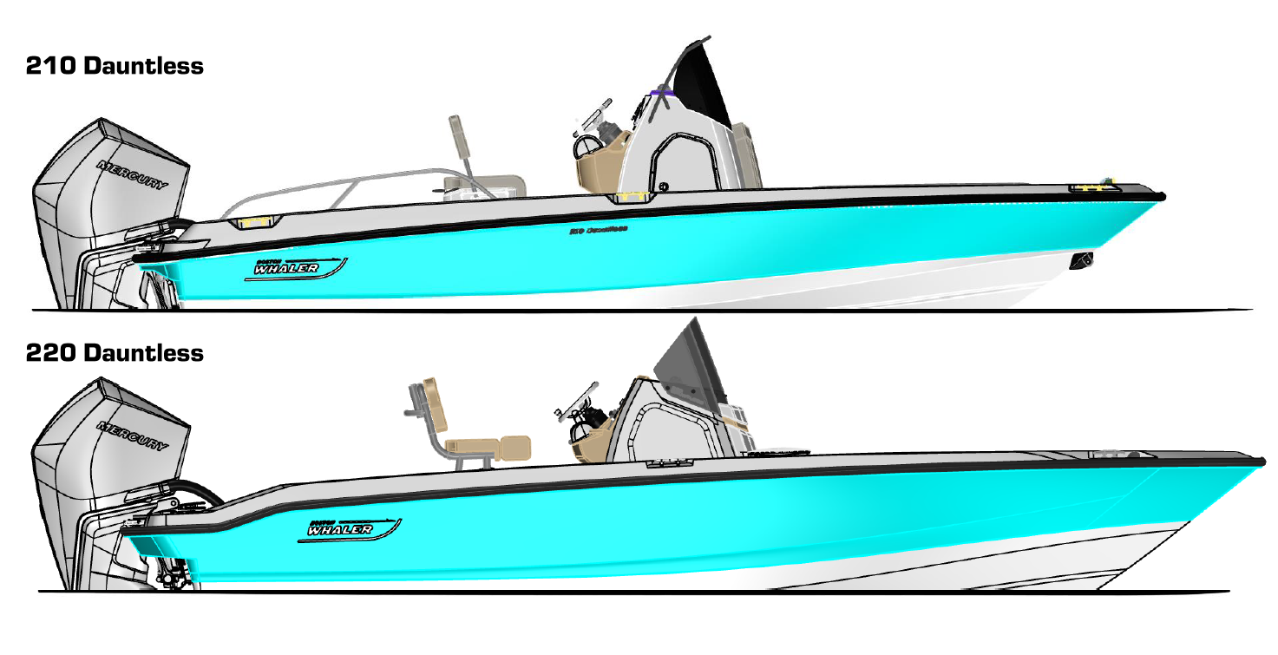
What’s new for the Dauntless Platform
Keel Up Re-design
  More capable and seaworthy- sharper bow entry with Increased flare to create better offshore performance
  Increased freeboard- 2” more cockpit depth at the bow
  Increased LOA to 23’ 4” from 21’ 3” (with platforms)

Slide 45
220 Dauntless
210 Dauntless
Notes:
Increased deadrise and higher gunwales make this a more capable and more seaworthy hull.

Slide 46
Hull Changes
- Pointed bow with increased flare: Provides a softer, drier ride with increased capability
Length over all 1’ longer
18 degrees of deadrise
Gained 2” cockpit depth

Slide 47
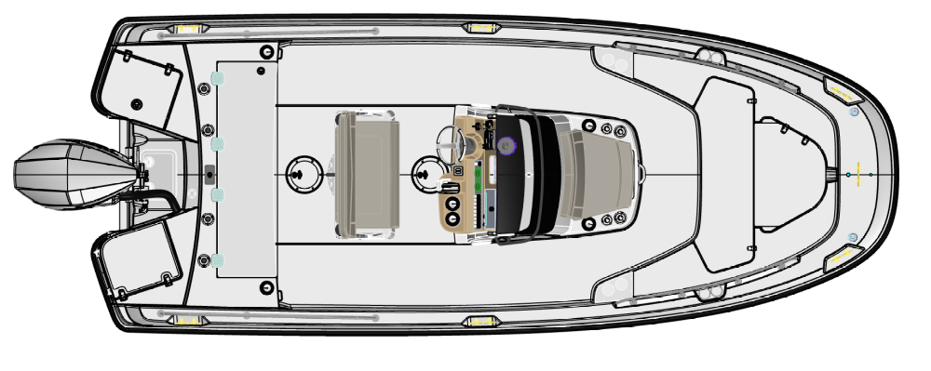
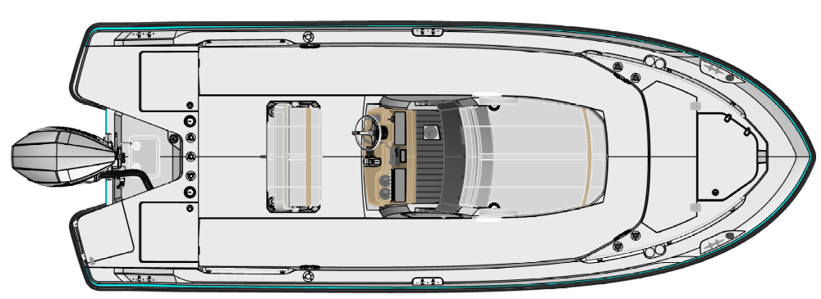
What’s new for the Dauntless Platform
More versatility for the whole family
  More standard fishing options
    Flat, single level stern deck with no obstructions
    Gunwale rod holders
  Improved comfort
    Forward console lounge
    Helm seating options
  Watersports tow point from tops
  No compromises - accommodates everyone's needs:
    Fishing
    Watersports
    Entertaining
210 Dauntless
NEW 220 Dauntless

Slide 48
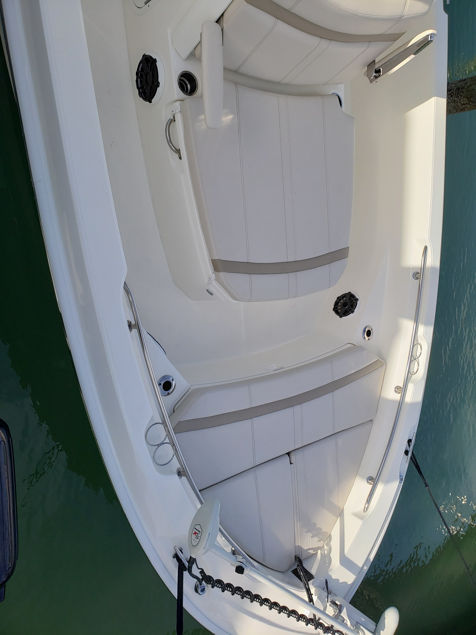
Bow
All-new forward lounge
  fold down arm rest
  lockable, dry rod storage
Large bow flat accommodates trolling motor panel
Two forward 90-degree rod holders
Welded stainless steel forward grab rails
Fish box / cooler in forward bow deck with easy access paddle latch
Notes:
Although the bow is pointed, we did not loose seating. In fact we gained it with the addition of the double lounge.
Promotes multi-use vs. previous version.
New styling, accent stripes add contrast to the upholstery. Integrated cooler/storage, cupholders

Slide 49
All NEW Helm Console (250 images shown)
New SeaDek lined chuck space (no wireless charger on 220)
New model designator on windscreen for a very custom look
Improved head access, wider entry door

Slide 50
Helm Console Face
Cast stainless steel steering wheel with knob
Compass
12V receptacle
optional glove box
NEW dash visor chuck space with wireless phone charging
NEW stainless-steel drink holders (2)
larger electronics mounting surface fits 12” screen
Electrical switch panel with circuit breaker protection
SAMPLE IMAGE

Slide 51
Helm Configuration:
Dual Axiom 9 Inch Screens
Sample Image
SAMPLE IMAGE

Slide 52
Helm Configurations
Sample Image
SAMPLE IMAGE

Slide 53
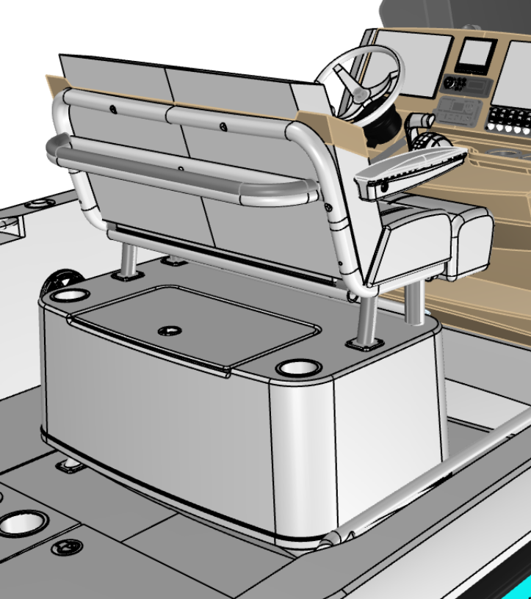
Five Helm Seat Configurations
1
STANDARD: Reversible seat with storage / cooler
OPTIONAL: Reversible seat with livewell
OPTIONAL: Leaning Post frame with 75 Quart Yeti cooler
OPTIONAL: Deluxe Leaning Post with aft drawer storage​
OPTIONAL: Deluxe Leaning Post with livewell
2
3
4
5

Slide 54
STANDARD: Reversible Leaning Post with Storage
Seat base and fuel tank cover molded as a single fiberglass piece
Insulated fiberglass tub can be used for storage or a cooler
New upholstery
OPTIONAL: RPS with Livewell
Cooler tub becomes livewell

Slide 55
OPTIONAL: Frame Leaning Post with cooler
Powder coated tube seat base with 75 Quart Yeti cooler
New upholstered bench seat with flip-up bolsters and folding arm rest

Slide 56
OPTIONAL:
Deluxe Leaning Post with Aft Drawer Storage
Fiberglass seat base w/ aft storage drawers
  Storage area accommodates a 5-gallon bucket inside
  New upholstered bench seat with stand-up bolsters and folding arm rest

Slide 57
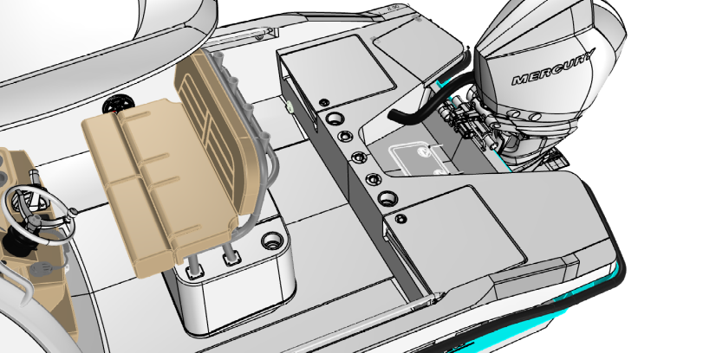
OPTIONAL:
Deluxe Leaning Post with Livewell
Fiberglass seat base w/ livewell
  Insulated blue interior and flush mounted lid
  New upholstered bench seat with stand-up bolsters and folding arm rest
Very similar to 210 Montauk with upgraded seating and armrests

Slide 58
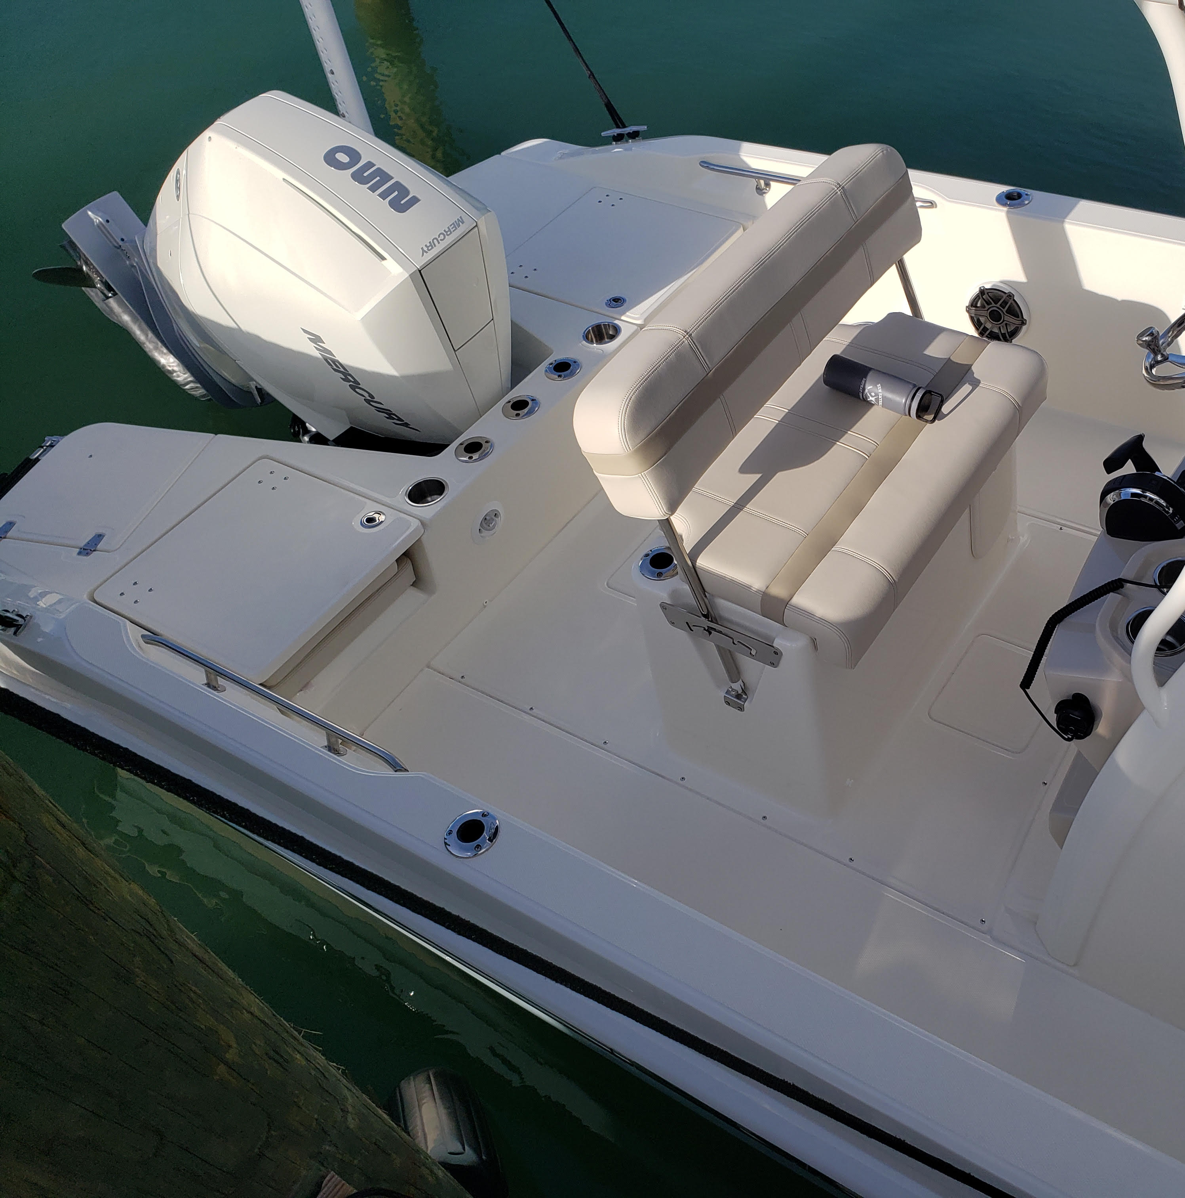
Stern Deck
Flat surface (no more step)
Dual jump seats similar to the 210 Montauk
Stainless cup holders
3 standard rod holders
Recessed hardware

Slide 59

Deployable Swim Ladder
Angled swim ladder for safer boarding
Ladder stows under a fiberglass lid
Notes:
Nice view of the stern deck here; a good opportunity to point out the flat stern deck (no more step).
Standard live well in the center of the stern deck

Slide 60

Rail Choices
Standard: Low profile rails
Optional High Bow and split bow rails are available
  Both options include high aft rails and remove gunwale rod holders

Slide 61
Optional:
Fiberglass Hard-Top
Optional: White or Black Frame
Optional; Colored gel on the underside of the fiberglass hardtop

Slide 62
Optional:
T-Top with canvas
Optional: Blue or Black Canvas
Optional: White or Black Frame

Slide 63
Water Sports
Tow point from both hard top and T-top

Slide 64


220 Dauntless Engines
Standard:
Optional:
Available in black or white

Slide 65

Notable Options:

Slide 66

Other Notable Options:

Slide 67




Other Notable Options:

Slide 68
Optional: Electronics Package
9” RaYmarine AXIOM 9 RV (RealVision)ELECTRONICS/NAVIGATION PACKAGE
Raymarine Axiom 9 RealVision 3D, 9” touch screen (GPS, chart plotter, fishfinder)
RealVision 3D, DownVision, SideVision and Chirp transom transducer
Navionics Chart Card: North America/Canada
  Navionics Chart Card: Central/South America
  Navionics Chart Card: Europe/Mid East/Asia
  Navionics Chart Card: AU/NZ
9” Raymarine Axiom Additional Display (Must select the 9” Axiom Navigation Package Option or the 12” Axiom Navigation Package Option) (Not compatible with GloveBox)
Raymarine Axiom 9” with single channel chirp sonar
12” RAYMARINE AXIOM RV ELECTRONICS/NAVIGATION PACKAGE
Raymarine Axiom RV, 12.1” screen (GPS / chart plotter / fishfinder)
RV-100 3D Transom Mount Transducer
Navionics Chart Card – North America/Canada
  Navionics Chart Card – Central/South America
  Navionics Chart Card – Europe/Mid East/Asia
  Navionics Chart Card – AU/NZ
Notes:
To provide more versatility, we now a better fishing package with USEFUL rod storage, optional live well in port transom, better fish box center line

Slide 69
Canvas options
Combination helm seat / console cover (black or blue)
Console cover (black or blue)
Console lounge seat with backrest cover (black or blue)
Helm seat cover (black or blue)
Sun top with boot and stainless-steel fittings (black or blue)

Slide 70
Key highlights
Bow to Stern
Bow
Helm
Cockpit
Centerline double sun lounge with arm rest and garage storage
Lockable, dry rod storage in sun lounge garage
Full beam insulated cooler in forward bow deck
Increased cockpit depth
Integrated dash visor chuck space
Improved head access
Four optional helm seat configurations in lieu of standard reversible helm seat
Optional T-top or fiberglass hard-top with tow points
Increased cockpit depth
Self-bailing cockpit
Standard cooler under helm seat
Dual transom seats
gunwale rod holders

Slide 71


Key Takeaways vs. 210 Dauntless
Sample Image
Sample Image
Sample Image
1
All-new, more seaworthy-hull design, 18-degree deadrise at transom, 2-inch deeper cockpit
2
All-new forward double lounge with garage storage provides additional comfort and storage
SAMPLE IMAGE
SAMPLE IMAGE
SAMPLE IMAGE
3
Helm seating options suit any needs from deluxe storage to RPS with live well
4
Added fishability with gunwale rod holders and flush aft stern deck
5
Improved customer experience based on evolution, larger head door, watersport tow point on tops, Wireless phone charger
SAMPLE IMAGE
Sample Image

