Slide 1
240 Vantage
Webinar #4 | Product Review with Mark Robinson

Slide 2
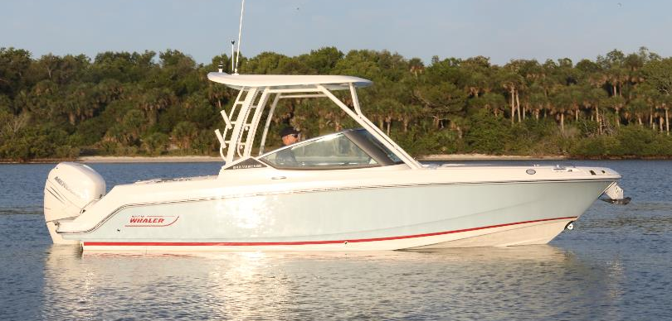
All-New : 240 VANTAGE
2021 Model Year
Add image of 240 Vantage
Shown with optional hard-top
Standard engine: 250 hp V8 DTS Black Mercury Verado engine with hydraulic power steering
Notes:
It’s not specific to fishing or entertaining. Integrated graphics into windshield.

Slide 3
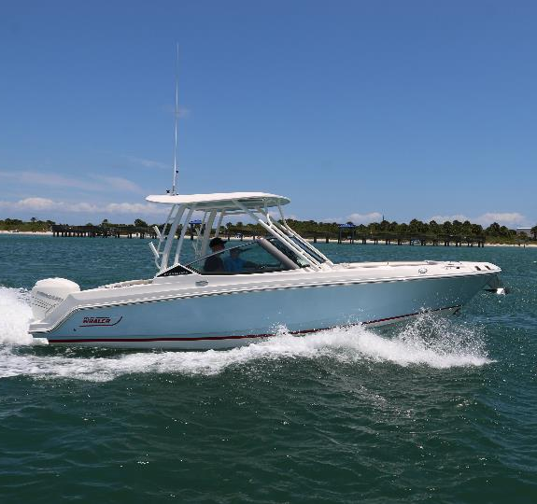
Spec Sheet
Bow to stern callouts
Performance
Top 5 selling features
Sales training

Slide 4
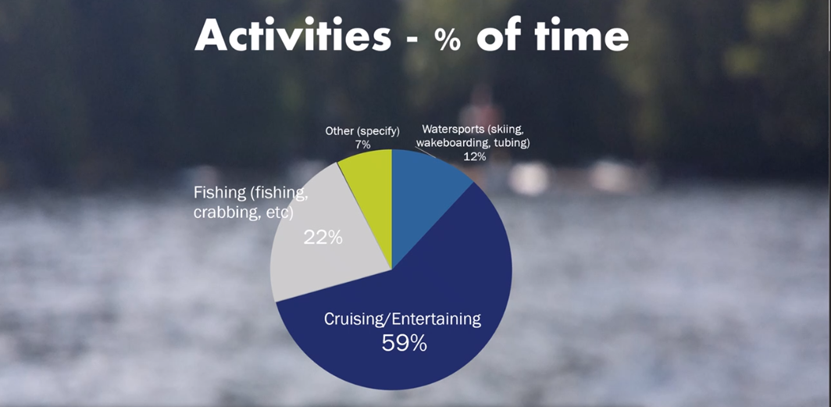
The Everything boat for the family.

Slide 5
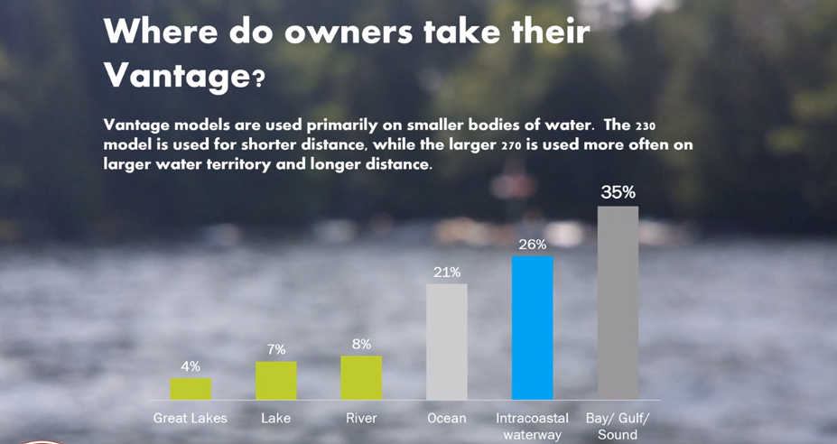
“Fair weather boat”

Slide 6
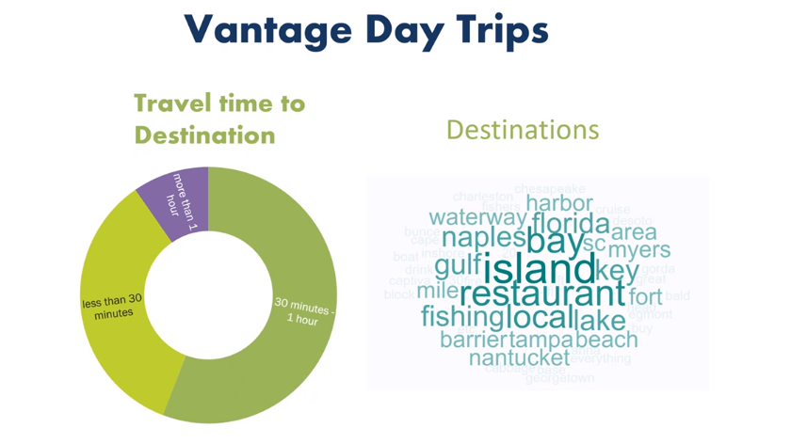
“Fair weather pleasure boat”

Slide 7

Keeping it easy

Slide 8
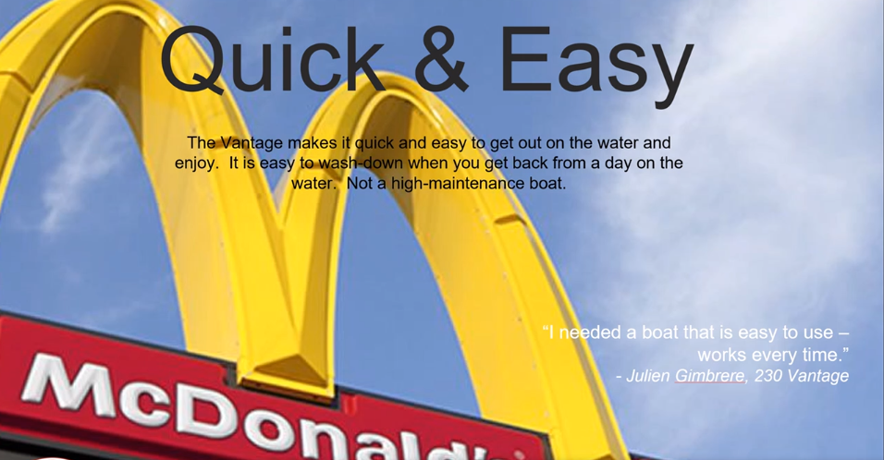
Simplicity

Slide 9
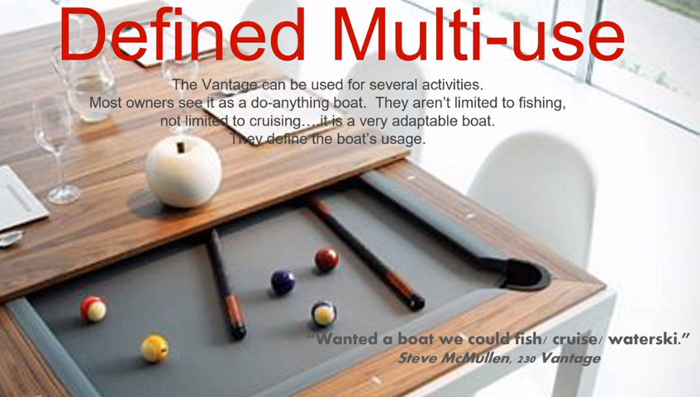
Designed to be fished, but yet we have comfortable seating, sound system, designed to be cruised

Slide 10
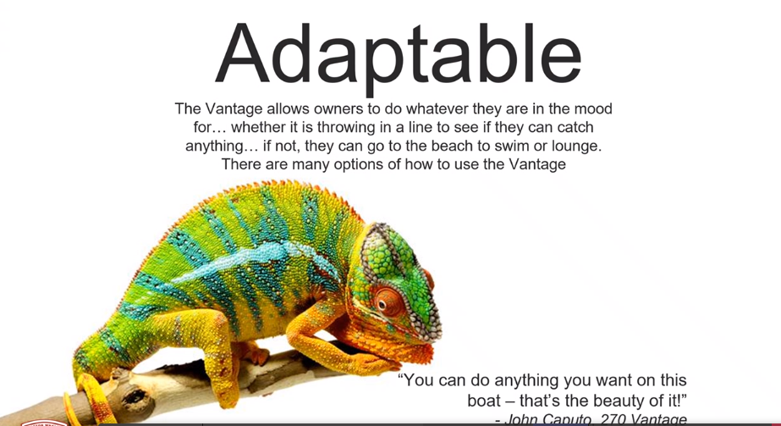
Can be a hard core fishing boat, if the customer needs that

Slide 11
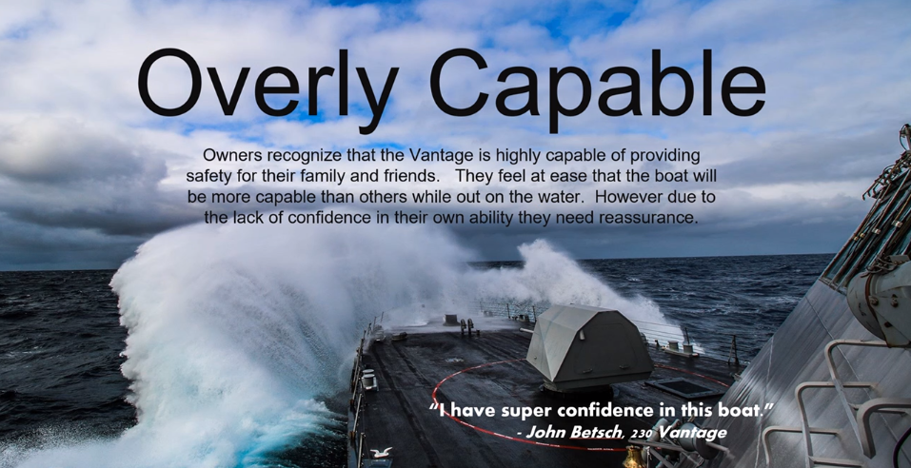
Our customers won’t but it could

Slide 12

Multipurpose

Slide 13
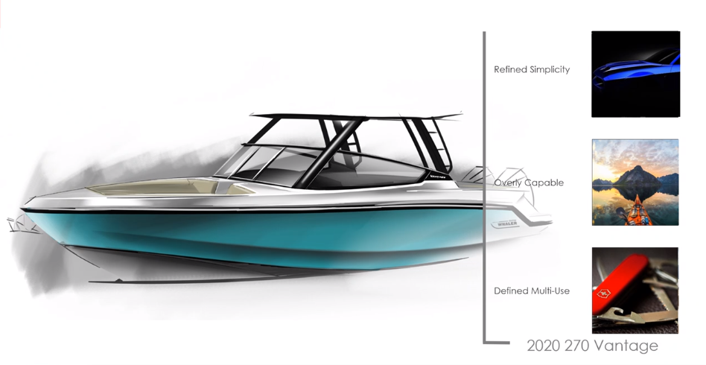
Same themes as 280 Vantage carried over to 240 Vantage

Slide 14
SPECIFICATIONS: Comparison between new and old models
240 Vantage
230 Vantage
LOA*: 24’ 2” (7.36 m) 1’ longer
LOA with platforms: 25’ 6” (7.58 m) 10.5” longer
Beam: 8’ 6" (2.59 m)
Draft: 18” (0.46 m) 1‘ deeper
Weight (dry, no engine): 4,360 lbs (1979 kg) 460 lbs heavier
Weight (w/ engine, fuel, and water): 5,837 lbs (2648 kg)
Maximum Weight Capacity: 2,800 lbs (1270 kg)
Swamped Capacity: 4,000 lbs (1814 kg)
Persons Capacity: 11 1 more person
Maximum HP: 400 hp (298 kW) 50hp more
Minimum HP: 250 hp (186 kW)
Maximum Engine Weight: 700 lbs (318 kg)
Transom Height: 25" (0.64 m)
Deadrise at Transom: 20º
Fuel Capacity: 111 gallons (420.18 L)
Water Capacity: 18 gallons (68.14 L)
Bridge Clearance: 5’ 6” (1.68 m) 2” taller
Bridge Clearance with water sports tower: 8’ 4” (2.54 m)
Bridge Clearance with sun-top: 7’ 6” (2.29m)
Bridge Clearance with hardtop: 8’ 4” (2.54 m)
Package boat specs (base boat on trailer, engine up): TBD (TBD m)
LOA*: 23’ 2” (7.06m)
LOA with platforms: 24’ 7^{1/2}” (7.51 m)
Beam: 8’ 6" (2.59 m)
Draft: 17” (.43 m)
Weight (dry, no engine): 3,900 lbs (1769 kg)
Weight (w/engine, fuel & water): 5,450 lbs (2,472 kg)
Maximum Weight Capacity: 3,000 lbs (1361 kg)
Swamped Capacity: 4,000 lbs (1814 kg)
Persons Capacity: 10
Maximum HP: 350 hp (261 kW)
Minimum HP: 250 hp (186 kW)
Maximum Engine Weight: 700 lbs (318 kg)
Transom Height: 25" (0.64 m)
Deadrise at Transom: 20º
Fuel Capacity: 111 gallons (420.18 L)
Water Capacity: 18 gallons (68.14 L)
Bridge Clearance: 5’ 4” (1.63 m)
Bridge Clearance with tow arch: 8’ 2^{3/4}” (2.51 m)
Bridge Clearance with sun-top: 7’ 4” (2.24 m)
Bridge Clearance with hardtop: 8’ 1½” (2.48 m)
Package boat specs (base boat on trailer, engine up:) 31’ 7” X 8’ 6” X 8’ 6”
*LOA: (on centerline, from bow to engine mounting location)

Slide 15
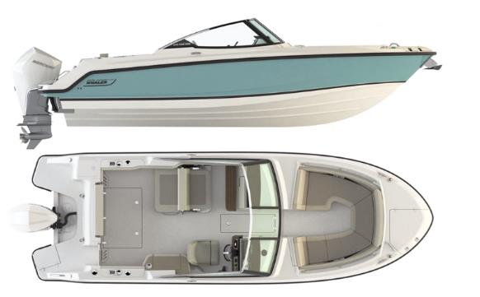
What’s new for the Vantage Platform
Keel Up Re-design
  Increased freeboard- 2” more cockpit depth at the bow
  More capable and seaworthy- sharper bow entry with hull side flare to create better offshore performance
Increased LOA to 25’ 6” from 24’ 7”
More versatility for the whole family
  More fishing options
  Comfort and space for entertaining
  No compromises- accommodates everyone's needs: Fishing, watersports, entertaining
Windlass and Bow ladder are compatible
Optional transom live well
Std. center line storage fish box with overbord drainage and optional pumpout
Add bullet points of key standard features and small image
Notes:
Layout remains similar to 23 Vantage
More broadly capable than the 230 Vantage ever was.
230 was very capable, but this boat doesn’t just give the perception, but it is, with flare, deeper with sheer line gives perception of a larger hull that is capable and safe.
Tells the story of a tougher, but more elegant, for those who want to do it all.

Slide 16
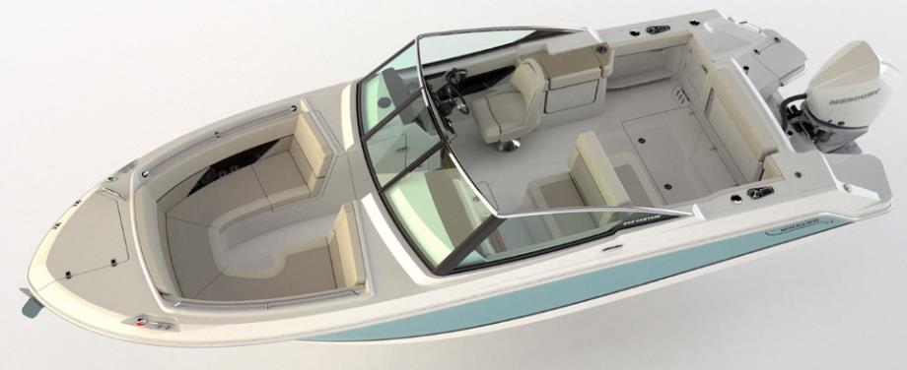
Hull changes
- Pointed bow with increased flare: Provides a softer, drier ride with increased capability
Nearly 1’ longer
Gained 2” cockpit depth in bow
Sample Image
SAMPLE IMAGE

Slide 17
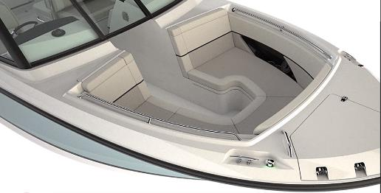
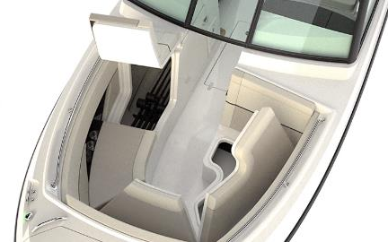
Bow improvements
Windlass is further forward which allows:
  A full seat on the center line
  Center line bow storage
    insulated cooler (50 quarts) under centerline seat
    drains overboard
Lockable, dry rod storage
12-V receptacle
USB receptacle
Bow anchor locker with drainage
Bow bolsters
Bow cushions with backrests
Bow walkthrough block off panel
Drink holders (4)
Fiberglass lids with latches (3)
Port and starboard bow storage lockers
Recessed storage/cup holder compartments
Welded stainless steel forward grab rails
Sample Image
SAMPLE IMAGE
Notes:
Although the bow is pointed, we did not loose seating area space. In fact we gained it by moving the windlass forward, allowing us to have a full seat on center line and insulated storage underneath that see.
Promotes multi-use vs. previous version.
New styling, accent piping, contract in upholstery. Intergrated storage, USB charging, cupholders, etc.

Slide 18
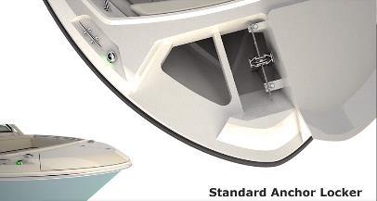
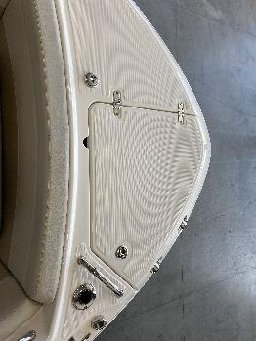
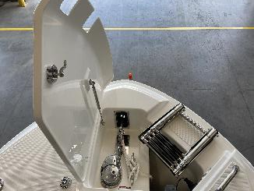
Optional: Beach Boarding ladder and anchor windlass combo
Combination telescoping bow swim ladder and anchor windlass compatibility
Anchor windlass
  Through hull anchor system
  200’ of rode, chain and anchor
  New mounting elevation provides reliable retrieval
With optional ladder
and windlass
Sample Image
SAMPLE IMAGE
Notes:
Having ladder deployed with anchor windlass works now. Moved ladder to the side, that allows the two features to work very well together.

Slide 19
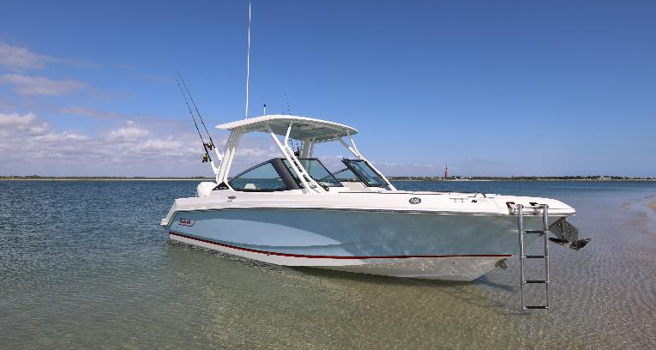
Optional: Beach Boarding ladder and anchor windlass combo
With optional ladder
and windlass
Sample Image
SAMPLE IMAGE

Slide 20
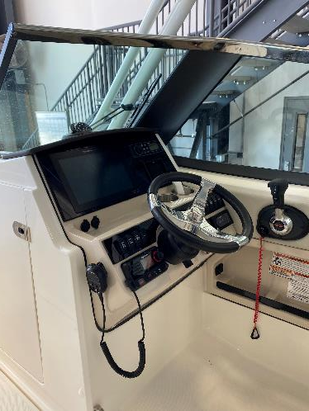
Helm Console
Access panel to electronics
Cast stainless steel steering wheel with urethane grip
Compass
Console storage with stainless steel latch
Dash visor
Drink holders (2)
Electronics mounting surface
12V receptacle
Helm footrests (increased legroom)
Custom helm seat with high/low pedestal and slide
Outboard armrest
Electrical switch panel with circuit breaker protection
Starboard captain’s pocket storage with USB outlet
Storage bucket
Tempered glass windshield
Trash door
Windshield wiper (stbd)
SAMPLE IMAGE
Notes:
Shown with the glass dash and full option
Nice side pockets, with speakers and storage

Slide 21
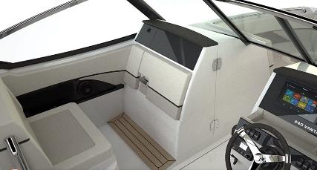
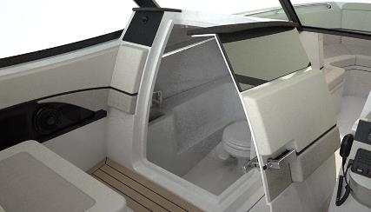
Side console/head
New door latch
  Gasketed
  Lockable
Improved weatherproofing on door
Dash visor
Inside head:
  Easy to clean, no nonsense
  Interior light (red/white)
  Molded sink with drain
  Portable head with pump-out
  Optional Vacu-Flush® toilet, holding tank, overboard discharge, and dockside pump-out
  Stainless Steel storage hooks (2)
Sample Image
SAMPLE IMAGE
Notes:
Sink below, standard

Slide 22
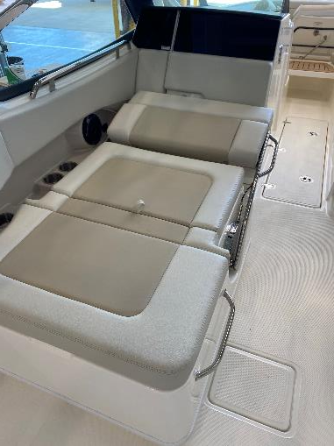
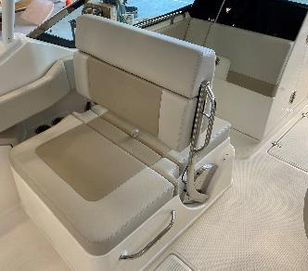
Port side seating
Improved mechanism
Convertible seat with storage
New upholstery
Port storage pocket with 4 cup holders and USB outlet
Sample Image
SAMPLE IMAGE
Notes:
Same configuration as the 230 Vantage
Port side seating, was well loved. Upgrading the upholstery?!

Slide 23
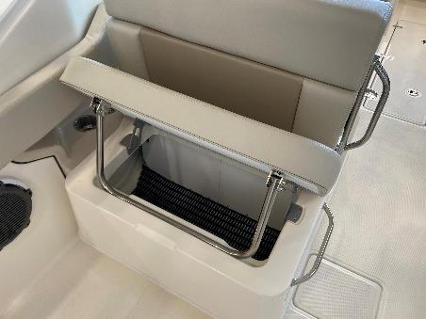
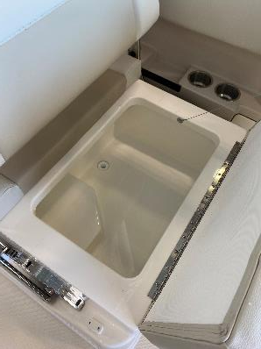
Port side storage
Optional : Insulated built in 65 Quart cooler under port lounge forward seat, Drains overboard
Includes flip up back rest for one of many convertible seating positions
Sample Image
SAMPLE IMAGE
Notes:
Same configuration as the 230 Vantage

Slide 24
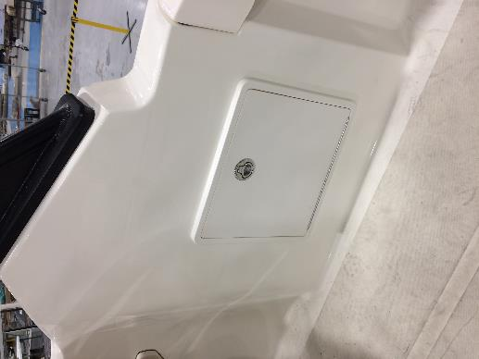
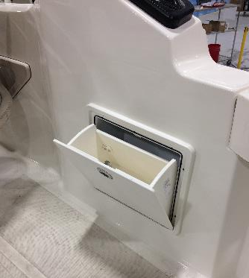
Standard starboard cockpit area, behind helm seat
Open space allows flexible use, place for carry on coolers and room to move about

Slide 25
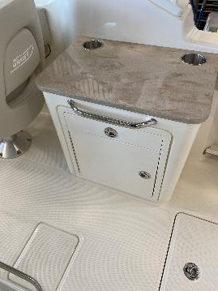
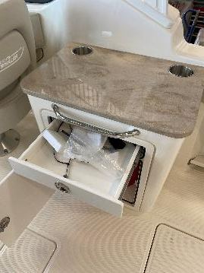
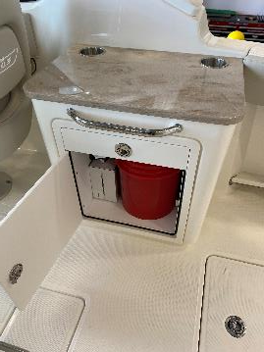
Starboard cockpit: Optional Utility Center
Corian countertop, SS grab rail, 2x drink holders
Dedicated 5-gal bucket storage
Storage drawer

Slide 26
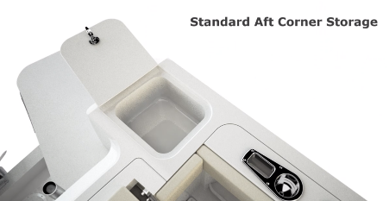
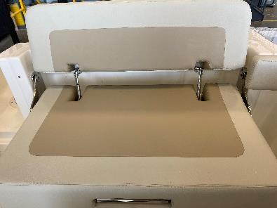
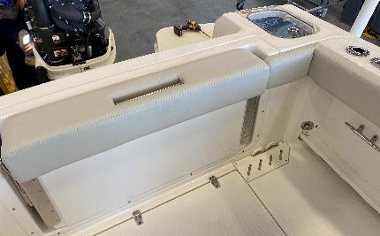
Aft cockpit
Fold-out stern seat with backrest
Sample Image
SAMPLE IMAGE
Shown with optional Livewell

Slide 27
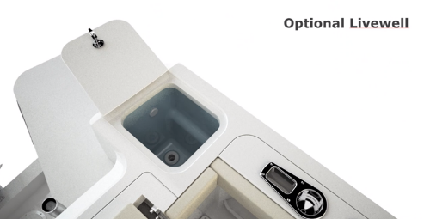

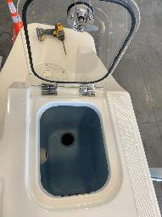
Options: Fishing Package
13 gallon transom livewell with light
Raw-water washdown
Stainless steel transom mounted rod holders (2)
Fishbox pump-out
Stainless steel toe rails with under gunnel storage shelf
Lockable rod storage in starboard side console
Standard: Rod holders - gunnel mounted stainless steel (4)
Notes:
To provide more versatility, we now a better fishing package with USEFUL rod storage, optional live well in port transom, better fish box center line

Slide 28
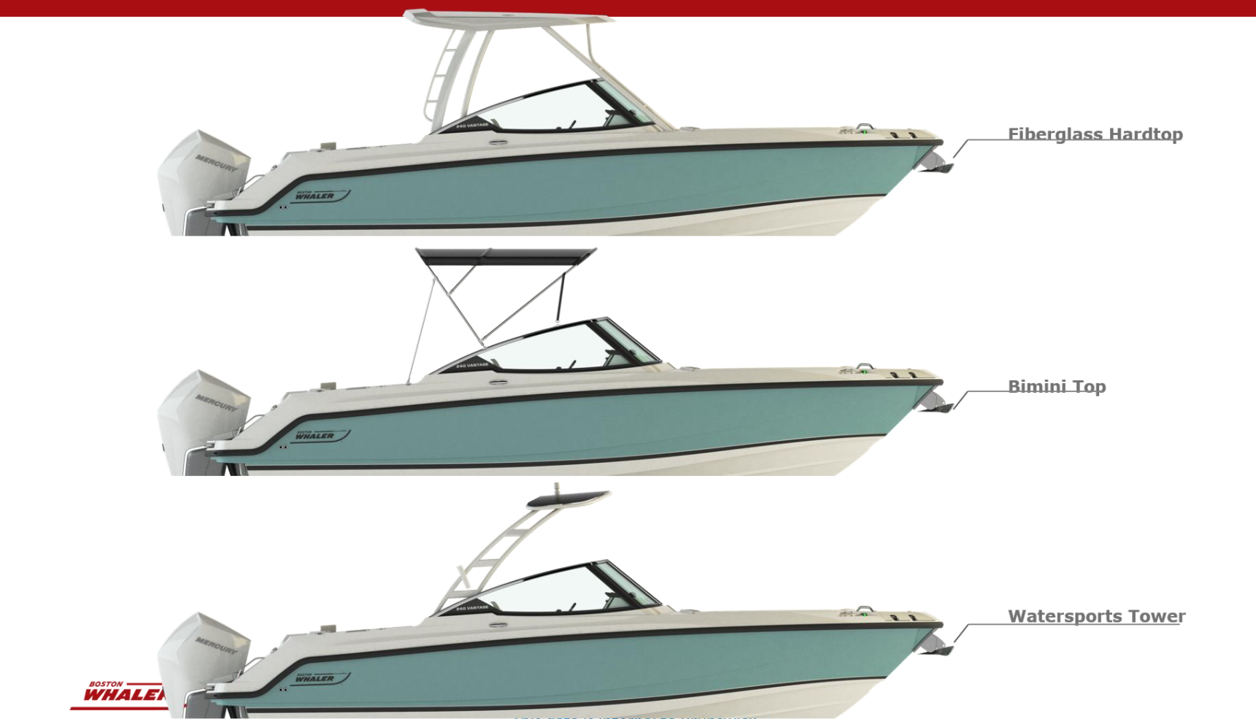

Slide 29
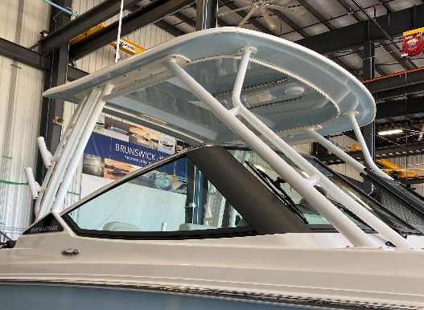
Optional: Fiberglass Hard-Top
  Navigation light (replaces mast light)
  Rod holders (4)
  Grab rails-located on centerline - stainless steel (2)
  Tow bit
  Dome light (red and white)
  Courtesy lights
  Welded aluminum frame tower (white or black frame)
  Colored gelcoat underside of Hard-Top
    Classic Desert Tan
    Glacier Green
    Light Blue (shown)
    Light Grey

Slide 30
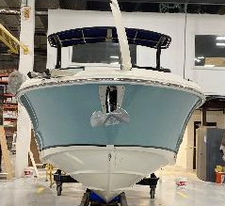
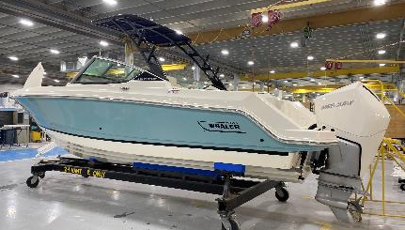
Optional: Waters Sports Tower
Navigation light (replaces standard mast light)
Courtesy lights
Rod holders (4)
Tow bit
Welded aluminum frame tower with canvas shade (frame available in white or black powder coating)
Optional: wakeboard racks available to add to sports tower

Slide 31
Other notable options:
Active engine trim
Air Compressor System
Battery charging System
Bow filler cushion / Bow Table
Bow tow eye
Cockpit Flooring: Seadek EVA Flooring
Cockpit Table (with dedicated storage)
Factory installed GR31 AGM batteries
Freshwater shower – bow and stern sprayers
Grey water system
Satellite radio (Sirius ® satellite receiver w/ antenna)
Split bow rail
Stainless steel anchor (must select anchor windlass)
Stainless steel anchor (must select anchor windlass)
Stainless steel windshield cap
Stereo - FUSION® AM / FM with waterproof speakers (4), and USB inputs (FUSION® Bluetooth enabled)
PREMIUM AUDIO PACKAGE (must select stereo option)
  Amp
  Speakers (6)
  Subwoofer
Tow arch
Vessel View 4” Display
VHF w/GPS Ramarine Ray53
White rub-rail with stainless steel insert

Slide 32
Optional: Electronics Package
9” RAYMARINE AXIOM 9 RV ELECTRONICS/NAVIGATION PACKAGE
Raymarine Axiom 9 RealVision 3D, 9” screen (GPS / chart plotter / fishfinder)
RealVision 3D, DownVision, SideVision and Chirp transom transducer
Navionics Chart Card: North America/Canada
12” RAYMARINE AXIOM PRO RVX ELECTRONICS/NAVIGATION PACKAGE
Axiom Pro-RVX 12.1” MFD
RealVision 3D, DownVision, SideVision and Chirp transom transducer
Navionics Chart Card: North America/Canada
Supplement to electronics packages:
SATELLITE WEATHER:
Raymarine Sirius® marine weather receiver
Notes:
To provide more versatility, we now a better fishing package with USEFUL rod storage, optional live well in port transom, better fish box center line

Slide 33
Optional: Deluxe Helm Electronics Package
Combines premium electronics options with port and starboard acrylic dash and switch panels for integrated, look and functionality.
  12” RAYMARINE AXIOM RV ELECTRONICS/NAVIGATION PACKAGE
    Raymarine Axiom 12 RealVision 3D, 12.1” screen (GPS / chart plotter / fishfinder)
    RealVision 3D, DownVision, SideVision and Chirp transom transducer
    Dash surface – custom black acrylic on port and starboard dash areas
    Navionics Chart Card: North America/Canada
  Stereo system with Premium Audio
  Vessel View 4” Display
  Custom black acrylic on port and starboard dash areas including switch panels
Notes:
To provide more versatility, we now a better fishing package with USEFUL rod storage, optional live well in port transom, better fish box center line

Slide 34
Canvas options
Bimini top for water sports tower
Cockpit cover (includes bow and cockpit)
Pedestal seat cover
Port lounge cover
Stern seat cover
Sun top with boot and stainless steel fittings
Weather curtain set for sun top or fiberglass hard-top: side, fwd, and aft, curtains
Aft Cockpit Sunshade - with fiberglass hard-top
Bow Sunshade - with fiberglass hard-top
All canvas available in black or blue

Slide 35
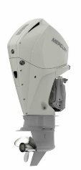
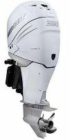

Engines
Standard:
  250 V8 DTS Mercury FourStroke with hydraulic power steering
Optional:
  300 XL V8 DTS Mercury FourStroke with hydraulic power steering
  350 XL L6 DTS Mercury Verado FourStroke with hydraulic power steering
  400 XL L6 DTS Mercury Verado FourStroke with hydraulic power steering
SmartCraft deluxe gauge package
Tilt steering
Stainless steel propeller
Fuel/water separator
Available in black or white

Slide 36
Key highlights
Bow to stern
Bow
Helm
Cockpit
Centerline seating
Centerline insulated cooler
Lockable, dry rod storage
Increased cockpit depth
Beach boarding ladder and windlass compatibility
Helm armrest
Increased legroom
Dash visor
Optional glass dash
Custom helm seat with high/low pedestal and slide
Insulated floor fishbox
26” cockpit depth
Self-bailing cockpit sole
Optional livewell
Optional cooler under port lounge
Optional Starboard prep station
Improved Head door with better sealing

Slide 37
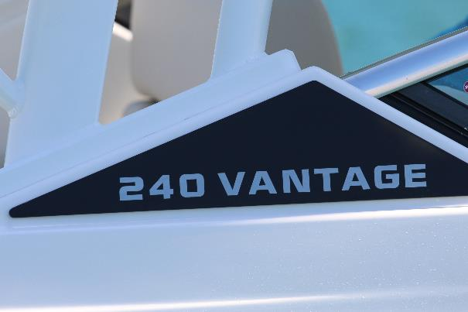
New brand designator design
Continues the new Vantage family look
Body Copy Goes Here

Slide 38
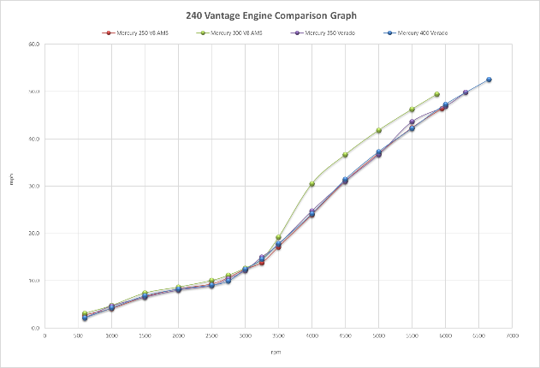
Performance: 240 Vantage
Engine Comparison

Slide 39
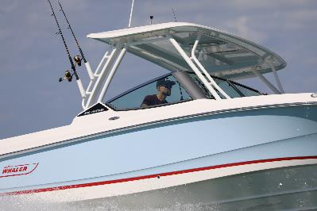
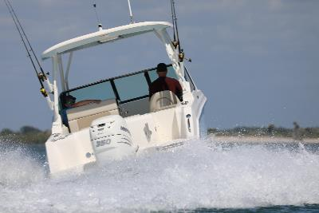
Key Takeaways vs. 230 Vantage
Sample Image
Sample Image
Sample Image
1
All new, more seaworthy-hull design 25’LOA
2
Increased comfort with windlass ladder compatibility and cockpit cooler
SAMPLE IMAGE
SAMPLE IMAGE
SAMPLE IMAGE
3
Customizable use of cockpit space with optional prep station or open floorplan
4
Added fishability with transom livewell and fishbox with pumpout options
5
Improved customer experience based on evolution, more waterproof head door, improved port lounge mechanism, increased headroom at hardtop frame
SAMPLE IMAGE
Sample Image

