Slide 1
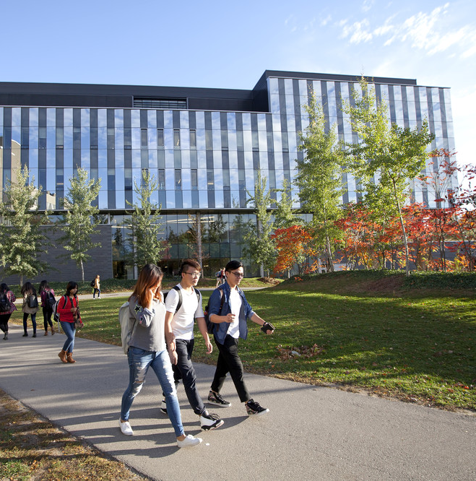
Starting off right: Practical tips for inclusive design
Presented by: Rachael Verbruggen
rachael.verbruggen@uwaterloo.ca
Centre for Extended Learning
Notes:
Rachael Verbruggen – Lead Instructional Digital Media Developer at the Centre for Extended Learning at the University of Waterloo
Unique situation – service department to assist instructors with the development of online course material. We have a team that includes an instructional designer, a developer and a QA person. We have a team of about 20 people to work specifically on STEM courses.

Slide 2
Delivery of digital content
The Centre for Extended Learning (CEL) supports the design, development and delivery of online credit and non-credit courses for the University of Waterloo (and beyond), and advocates for adult, part-time and online learners.
Credit courses
  Over 500 courses total; 150-200 per term
  Mathematics: 20 undergrad; 25 graduate
Open.math.uwaterloo.ca
Courseware.cemc.uwaterloo.ca (Grade 12, grade 7/8 content, and computer science adding 9/10/11)
Open.science.uwaterloo.ca
Open.engineering.uwaterloo.ca
Notes:
CEL tries to focus on the “non-traditional” learner. Our learners have varying backgrounds, knowledge, skill sets etc.
We build this content for multiple purposes and multiple audiences. Lots of the time the same content has multiple purposes or multiple audiences. We might use the same content in an undergraduate course and then again as review in a graduate course. Or we might use the same content we developed for an online credit course on one of our open sites, or in an campus class for a blended or flipped classroom.
Credit courses: over 500 courses total. We run about 150-200 per term (3 terms/year). Mathematics we have about 20 undergrad with more coming for a fully online degree; 25 graduate courses where we run a masters for math teachers. Again – these are just fully online courses.
We have a number open resources (which have stricter accessibility guidelines than content that lives behind a paywall).
Open math = 4 lin alg. Courses, and not our best example of accessibility – technology didn’t allow us to do everything we wanted, but we are working on updating it
Courseware = jr. high/high school resources (mathematics) and open science (consulted)
Open engineering (chem for engineers)

Slide 3
Universal design
“Universal Design is the design and composition of an environment so that it can be accessed, understood and used to the greatest extent possible by all people regardless of their age, size, ability or disability.”
Centre for Excellence in Universal Design, National Disability Authority
Notes:
There are a few things we want to consider when developing content. On such thing is to start with a framework of Universal Design.
Chris just spoke about Universal Design for Learning, and I want to reiterate some things about Universal design in general.
The National Disability Authority in Ireland defines Universal Design as “the design and composition of an environment so that it can be accessed, understood and used to the greatest extent possible by all people regardless of their age, size, ability or disability.”

Slide 4
WHAT IS UNIVERSAL DESIGN?
Not about 'one size fits all’
Flexibility in use
Benefits many
Not accessible design standards
Integrated throughout the design process
Notes:
So what is universal design?
It’s not about one size fits all. The designer is not expected to find one design solution that accommodates the needs of 100% of the population. Rather, designers are urged to explore design solutions that are more inclusive; those designs that push the boundaries as far out as possible without compromising the integrity or quality of the product. It’s about making decisions that reach as many people as possible.
Sometimes to reach more people, flexibility of use comes into play. For example, providing students the option between an auditory version of the content or a text version of the content can be as simple as posting the script that already exists that you used to create the audio piece.
This leads to the third point about UD, which is that it benefits many, not just those with disabilities. In the example of providing a text version of auditory content, it helps a wide range users including those that can’t hear, but also people with slow internet connections, English language learners or even people who forgot their headphones at home.
UD is not an accessible design standard. We live in a place where accessibility standards are legislated: the Accessibility for Ontarians with Disabilities Act or AODA. UD is not a list of specifications to meet accessibility (those do exist); rather it is an approach to design that considers the varied abilities of all users.
And finally, UD is something that is integrated throughout the design and development process. It cannot be effectively or efficiently applied at the end of a project.
I have a lot of ground to cover, so I’m going to be going fast, but I do want to take a minute to dwell on these because I think they are important driving forces to remember. As we look at some of the things in the coming slides, remember that some of the choices you make you won’t be able to satisfy all people with all solutions, but you can make an effort to include as many people as possible. That the choices you make to make something more accessible also benefit other learns, and that it is something that you should do as you build your content and not as an after thought. These ideas are going to surface a lot.
Mohawk has some excellent resources about universal design, and we have what we like to call the honeycomb, which isn’t specifically about universal design, but it is about user experience in online learning and it goes hand in hand with these ideas. These resources and more are listed at the end of my presentation, which will be made available to you

Slide 5
Web accessibility
“Essential for some, useful for all.”
Web Accessibility Initiative
Notes:
The other thing we want to talk about is web accessibility. The Web Accessibility Initiative says that Web accessibility is “essential for some, but useful for all.” (there’s that Universal design idea again).
You might be used to working in programs where it’s about end product and not how you got there. For example, the pdf that gets spits out by our LaTeX code, it doesn’t matter how much weird stuff we had to do to get it to look right, as long as the pdf looks good, that’s all that matters. Or in Word you might put 25 spaces in to try to get something to line up because it’s not going where you want, but it doesn’t matter because you are just going to print it off.
HTML is a different thing. It’s used to make nice looking front-end material, but people have access to the underlying code as well, and in fact, it is often used by tools to make things more accessible – so it needs to be done right. Good HTML code can be the difference between something being accessible or not. (Caveat that I am not an accessibility expert, but I do what I can and learn as I go).

Slide 6
HTML
Benefits
Selectable
Zoomable
Flexible
Customizable
Easy to embed other resources
Etc.
Notes:
When we look at delivering content to students, we are looking at html content. Out of the box, HTML content is more accessible than a PDF - especially a PDF with math in it. That’s not to say there aren’t things you can do to make pdfs accessible or that we don’t use pdfs in our courses (generally to deliver assignments), but we also recognize the fact that we would probably have to provide a alternative version if it was requested.
Some of the benefits of HTML are that it’s selectable, zoomable, searchable, you can customize fonts, colours, and it allows more flexibility to your end-user to make choices about how to interact with the content, etc. etc. etc., And all of this is great, but you need to watch the choices you are making. (As Uncle Ben in Spiderman says “With great power comes great responsibility”)

Slide 7
GOOD HTML
Using the correct elements for the correct purpose
Doesn’t take longer to write if you do it consistently from the start
Benefits beyond accessibility
  Easier to develop with
  Better on mobile
  Good for searchability
Notes:
HTML does not equal accessibility. However, it does allow for more opportunities.
A few things to keep in mind when using HTML.
The first is to use the correct elements for the correct purpose. HTML is based on structure. Made up of elements with various rules for various purposes. We’re going to look at some examples of this coming up.
Again, good HTML is similar to UD ideas – doesn’t take longer if you do it from the start. You’re doing something anyways, you might as well make sure it is as useful as possible.
Accessibility is one reason to pay attention to what you’re doing HTML-wise, but there are also other reasons.
It’s easier to develop with.
It’s better on mobile
Better for searchability
Now, I don’t want you to be worried that you have to learn all the ins and outs of how html works, or even have to know how to code html. I assume most if not all of you have an LMS that you are working in that does provide a WSYWIG HTML editor.
So now we are going to look at five main topics where you can do things that contribute to the universally design your content, or making it accessible. Again, this is stuff that is easy do as you are designing and building your content and really doesn’t add to the development time.

Slide 8
HEADINGS
Notes:
The first is headings.

Slide 9
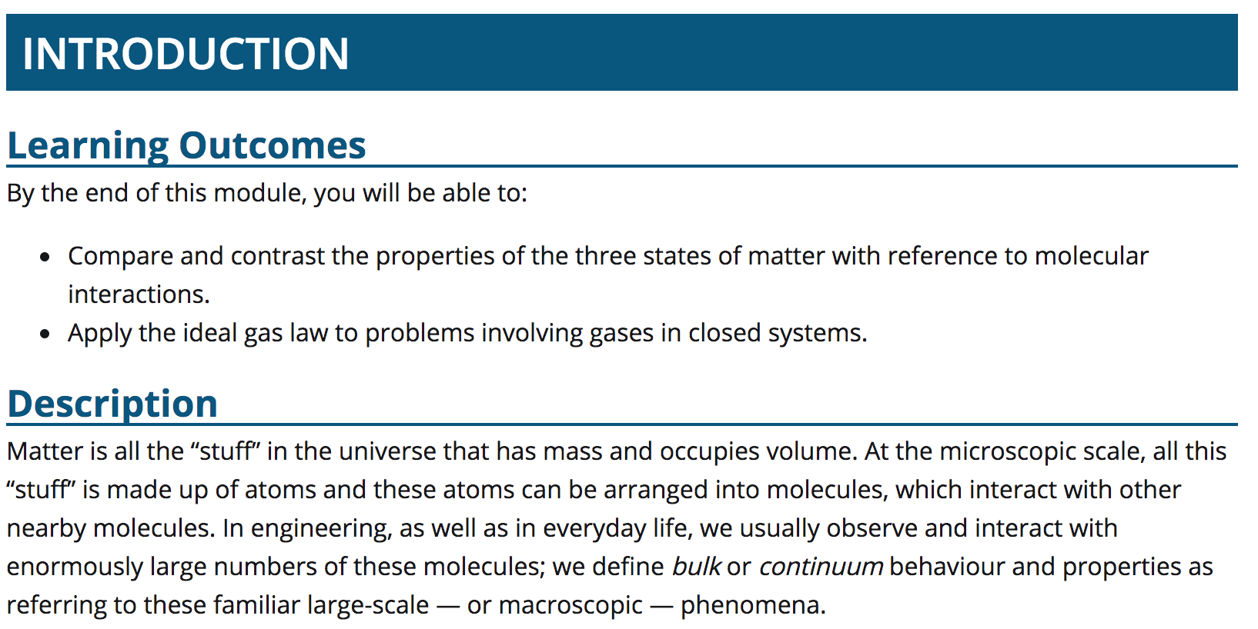
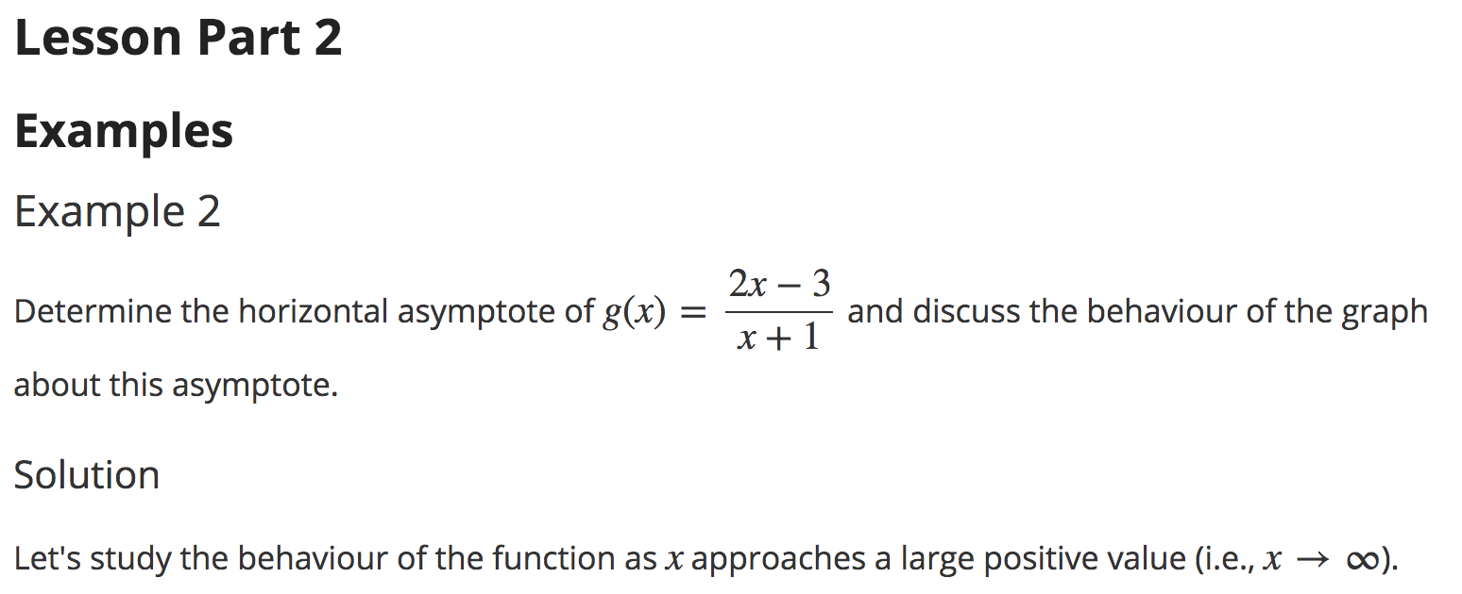
HEADINGS
Notes:
Heading is a way you provide structure. Often times we style them to provide visual structure for students, but this is really about providing back-end structure in the code.

Slide 10
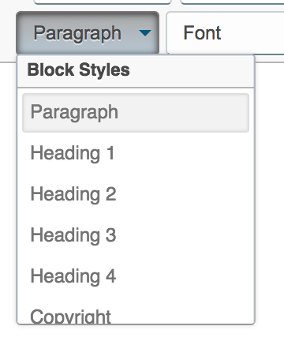
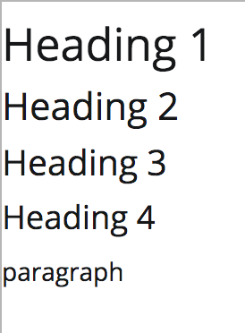
HEADINGS
Communicate the organization of the content on the page
Nested by rank
Heading levels should not be skipped
Should not be made by only styling text
Should not be used to style text only
Notes:
Think of it like chapter, section and subsection titles of a textbook (or as umbrellas). It communicates the organization of the content on the page and helps students to understand the hierarchy of the content.
A few notes about headers:
It is nested by rank (So you want to think about does this topic belong above, under or at the same level as the heading before it before it?).
Heading levels should not be skipped. So you shouldn’t go from a heading 1 to a heading 4. If you have a heading 3, the next thing that comes should be a heading 2 if you want to go up a level, a heading 3 if you want to stay at the same level, or a heading 4 if you want to go down a level (but not a heading 5). Headers should be chosen based on heirarchy and structure, not on how they look.
Headings should not be made by just styling the text. It’s not just about how it looks. Often times header are styled to be larger font, bolded, etc. Taking your text and just making the font bigger and bolder is not the same as making it a heading level (again, it’s about back-end structure not just front end looks)
On the flip side, headings should not be used to only style text. If you want you text to be larger or bolder, but it’s not part of that underlying structure, then a heading is not the right tool – that is when you want to change the font size/boldness yourself.
It really comes down to thinking about how your content fits together

Slide 11
TABLES
Notes:
Secondly, I want to talk about tables – about how to get things to appear on the screen where you want them.

Slide 12
TABLES
Data tables are used to organize data with a logical relationship in grids.
Accessible tables are simple, rather than complex, and have an identified header row.
Notes:
A lot of people are tempted to use tables to layout things on the page because it provides a nice grid structure, but again, as with other html elements, tables have a particular use and shouldn’t be used beyond that.
Tables are about organizing data with logical relationships (it’s not just about whether things need to line up or not).
To make your table more accessible, it should be simple and have identified headers. If your table doesn’t have headers, it is probably a good indication that you should be adding them to help the user know what the information is, or taking the information out of a table because it probably doesn’t belong there.
Okay, We’re going to be getting a bit more interactive as we go now.
I’m going to show you a few examples, and I want you to think about whether the information belongs in a table or not.

Slide 13
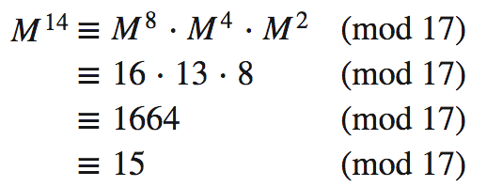
IS THIS A TABLE?
No.
✘
Notes:
So here’s an example of a math equation where we want to line up all of the equivalent signs. Does this call for using a table?
No. There are other ways to make math equations (we’ll talk about this in a bit).

Slide 14
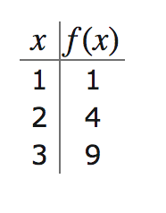
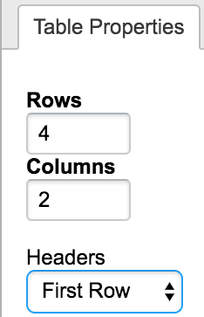
IS THIS A TABLE?
Yes. Be sure to indicate the headers.
✓
Notes:
What about this, is this table of values a good use of a table?
Yes. The name kind of gives it away, but also the fact that it has headers. The important thing to remember is to indicate which parts of the table are the headers. Most editors will have a way to indicate this. You can choose whether it is the first row, first column, or both, that make up the headers for the table. In this case it is the first row.

Slide 15
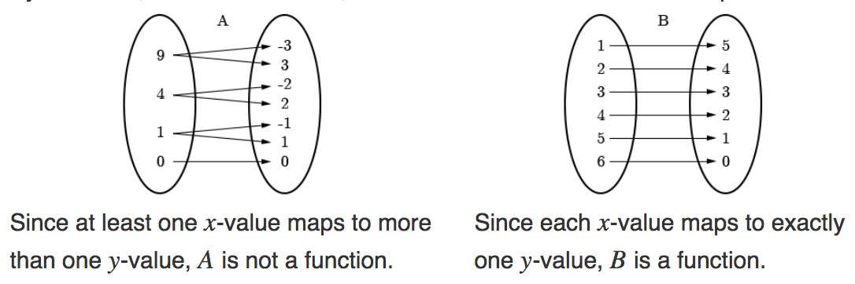
IS THIS A TABLE?
No.
✘
Notes:
What about these two images with text below that I want to line up side by side?
No. Use CSS or a WSIWYG editor, or place them one on top of the other.

Slide 16
COlouR
Notes:
Third, we’re going to talk about colour.
I would like to take a minute for a quick disclaimer. We have two more talks coming up that have to do with vision impairment and I am very excited to hear what they have to say. However, often times when we talk about accessibility we jump straight to ”but i don’t have a blind student”. There are many other reasons why someone might need an accessible version of your content. And for images sometimes it’s because the page didn’t load properly and your image didn’t show up. So I don’t want you to get focused just on visual impairment, but we are going to dwell on visuals for a while.

Slide 17
COLOUR CONTRAST
Does this pass?
Does this pass?
Does this pass?
Does this pass?
Does this pass?
Does this pass?
Does this pass?
Does this pass?
Notes:
There are 2 main things to remember when you are choosing colours. The first is colour contrast or how well one colour shows up against another colour.
Accessibility guidelines have a formula with a ratio to check if two colours are in contrast to one another enough to be visible to as many people as possible. Would anyone like to guess which of these pass the accessibility requirements and which ones don’t?

Slide 18
COLOUR CONTRAST
1.
2.
3.
4.
Does this pass?
Does this pass?
Does this pass?
Does this pass?
5.
6.
7.
8.
Does this pass?
Does this pass?
Does this pass?
Does this pass?
Notes:
This is just my little side plug that labelling/referencing things also really helps for user experience. Now you and I have a common, and easy, way to refer to these things. So, what do you think? Which ones pass and which ones don’t?

Slide 19
COLOUR CONTRAST
Goal: 4.5:1 or higher
✘
✘
1.
2.
3.
4.
Does this pass?
Does this pass?
Does this pass?
Does this pass?
21.0:1
4.0:1
4.54:1
1.07:1
✘
✘
5.
6.
7.
8.
Does this pass?
Does this pass?
Does this pass?
Does this pass?
3.66:1
4.76:1
4.23:1
21.0:1
Notes:
So there are different ratios for different reasons, but generally we try to pass with a level of 4.5:1 or higher. Of these, 4 passed and 4 did not.
Number 2 does not pass, which is important to note, because it is often the default red in many programs we might use to create images.
6 and 7 are really to show you that you can’t always go with your gut (I thought 7 would pass and it did not), but that the number is also not the be all and end all of what you are doing. Although 6 passes, I have a really hard time reading it, so it’s still probably not a good idea.
I have provided a list of online resources at the end for checking colour contrast, switching between colour codes (most colour contrast checkers use hex codes and most programs use RGB) and even lightening or darkening the shade of a colour to help make it more accessible.

Slide 20
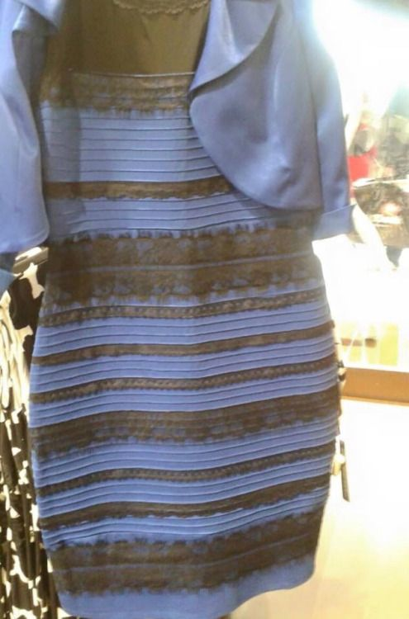
COLOUR ALONE
Notes:
The second thing to remember about colour, is that colour alone should not be used to indicate meaning. A second indicator should be used as well, this can include things like texture, patterns, shapes, labels, etc.
Some of you might recognize this as the dress that broke the internet. There was great controversy over whether it was blue and black or white and gold. What do you see? How many see blue and black? How many see white and gold?
Not everyone experiences colour the same. We need to be conscious of this.

Slide 21
COLOUR ALONE
Definition:
The term anabolism refers to the metabolic processes involved in the biosynthesis (assimilation) of cellular material such as proteins, lipids, polysaccharides, and DNA.
Notes:
Here we have the word we are defining in blue.

Slide 22
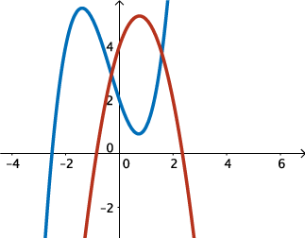
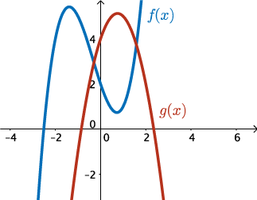
COLOUR ALONE
Definition:
Graphs
The term anabolism refers to the metabolic processes involved in the biosynthesis (assimilation) of cellular material such as proteins, lipids, polysaccharides, and DNA.
Notes:
The better choice would be to also bold it so it stands out more.
In this graph, we cannot just refer to these as the blue graph and the red graph, and we definitely can’t use position to define them (which is the top graph?). What might you do?
It’s as simple as throwing a label on them.

Slide 23
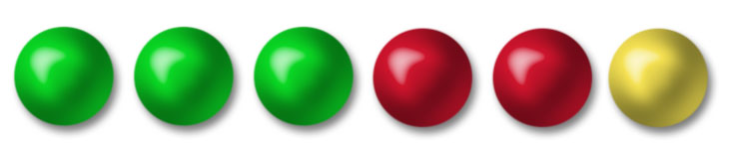
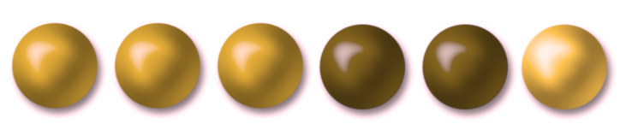
COLOUR ALONE
Example
There are 6 beads in a bag. You reach in and randomly pick one out. What is the probability you picked a green bead?
Notes:
This was an interesting example. We were working on a probability class, and this was one of the questions.
And here’s why it matters, because here’s what the question looks like with the most common form of colour-blindness applied to it.
Now I do have to say that since there were already round items on the screen, my first reaction was to make the different colours also be different shapes. Then I remembered it was a probability question and the probability of drawing a round green bead would be 100% if I could reach in and feel the square and triangular shaped beads as well. So what do you do?

Slide 24
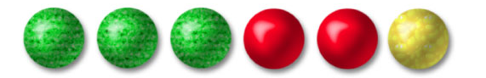
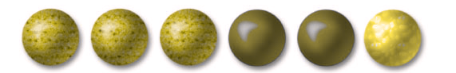
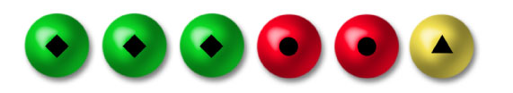
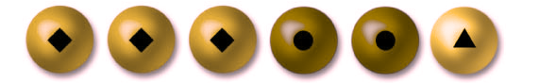
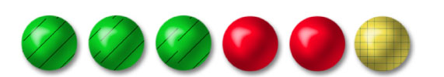
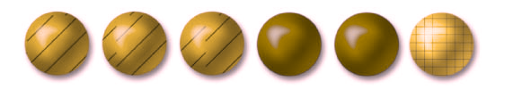
COLOUR ALONE
Example
There are 6 beads in a bag. You reach in and randomly pick one out. What is the probability you picked a green bead?
Notes:
One option, add a pattern. Here are some examples. Now, you need to also make sure what you are adding can be easily referred to as well. The question here still needs to be modified to ask the probability that you pick a green-stripped bead, or include a legend so they colours and the patterns can be lined up.

Slide 25
Images
Notes:
Fourth we’re going to look at images. We’re going to spend a bit of time here.

Slide 26
IMAGES
Make them as accessible as possible
  Colour contrast
  Colour alone
  Image size
  Font size
Notes:
When you are drawing your images, you want to make them as accessible as possible. Remember, that some of the accessibility choices that we make will benefit others as well. Also remember, that if you do some of these things as you go, it’s not really any extra work. We’ve already talked about colour contrast and colour alone. Start a list of accessible colours you like to use, so when you go to draw an image you just automatically choose one of those colours and don’t even have to think about it. Another easy thing to remember is font size. Pick a font size that is easily legible.
However, even after doing all those things, there are still some people who might not be able to fully interact with your images.

Slide 27
IMAGES – ALTERNATIVE TEXT
What is the purpose of the image?
What information is missing if someone can’t see the image?
3 forms of text alternatives
  Surrounding text
  Alt tag
  Link to separate information
! 125 characters
Notes:
This leads to a discussion about alternative text.
The first thing to ask yourself is what is the purpose of your image? Is it functional (then it needs to be described)? is it decorative (then it doesn’t need to be described)?
The second thing to ask yourself is “What info is missing if someone can’t see this image?” This is where alternative text comes in. How do we get that information across to someone who can’t see the image (for whatever reason).
There are 3 forms of text alternatives.
Surrounding text – This means providing information in the text around the image. Sometimes that is all or just some of the information. Sometimes the image is already supporting the text, or is the alternative to the text. Then it does not need to be described again. Sometimes it doesn’t always make sense to include the information in the surrounding text – redundant, too “easy”, etc. That leads to
Alt tag – This is an attribute of the image tag. Used to describe the image. Read by a screen reader or displayed if image cannot load (in some browsers). It gives a way of providing additional information that maybe doesn’t make sense to be in the surrounding text, but needs to be covered. However…125 character limit. Have you ever tried describing a math image in 125 characters or less. (This is where putting information in the surrounding text is useful). But again, it doesn’t always belong there. So there is a third option.
Long description…provide information elsewhere and then link to it (e.g., separate page). It is important to provide clarity over brevity. However, you want to remember that this might not be the clearest way to interact with content (constantly leaving for more information and then coming back), so you might want to limit your use of the long description.
Okay, we’re going to get to some examples of some things to consider.

Slide 28

IMAGES - EXAMPLES
Consider surrounding information
“In this illustration, there is a solid dot at the number 3. A solid dot means that the endpoint is included in the interval.
On the other end, there is an open dot at −2. An open dot means that the endpoint is excluded from the interval.
This interval, denoted by a solid line between the points at -2 and 3, represents all the numbers from −2 to 3, not including −2, but including 3.”
Notes:
One thing we want to consider is the surrounding information.
Don’t consider your image in isolation. The surrounding text matters, the context matters, etc. The first thing I do if someone asks for help writing an alt text for their image is ask to see it in context.
As mentioned, the surrounding text is one place where information can go for everyone.
For example, this number line is described in the text that follows. Great. Our work is done.

Slide 29
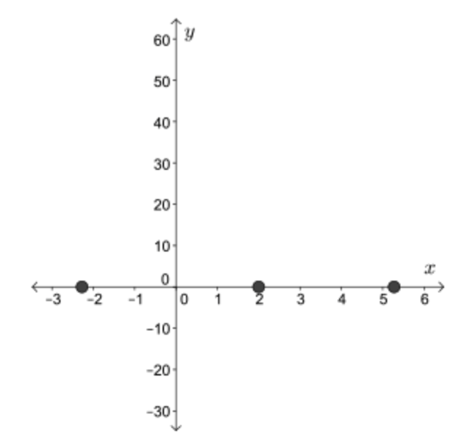
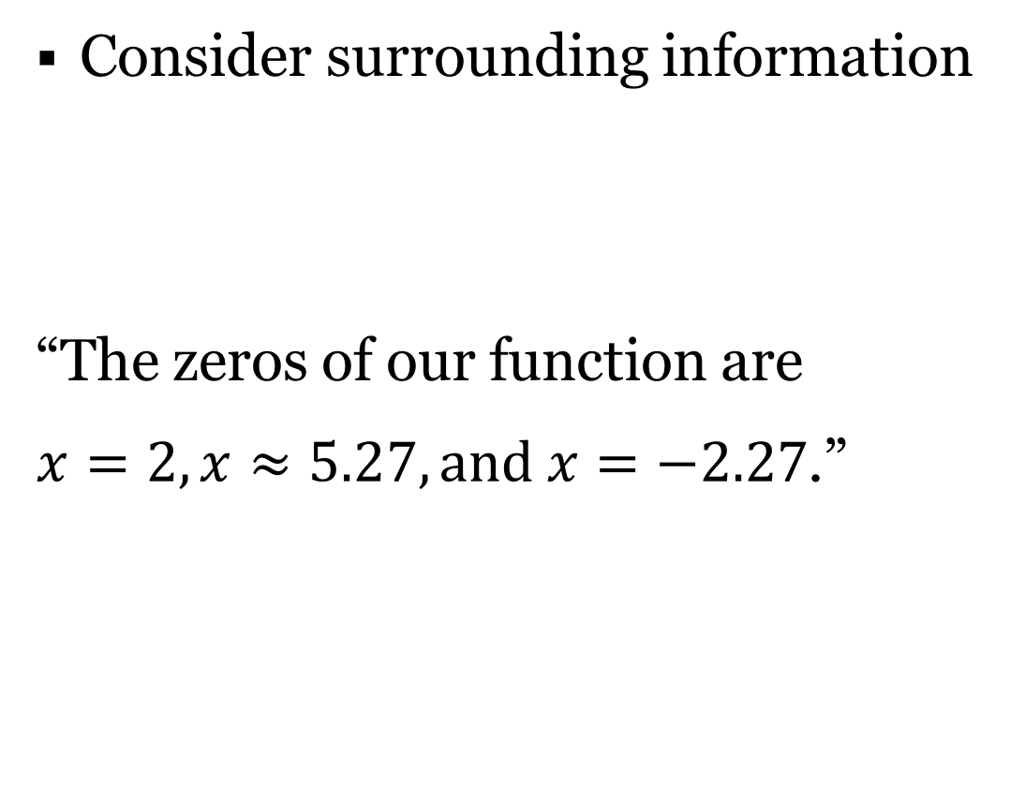
IMAGES - EXAMPLES
Consider surrounding information
“The zeros of our function are
$x=2, x≈5.27, and x=−2.27$.”
Notes:
Don’t consider your image in isolation. The surrounding text matters, the context matters, etc. The first thing I do if someone asks for help writing an alt text for their image is ask to see it in context.

Slide 30
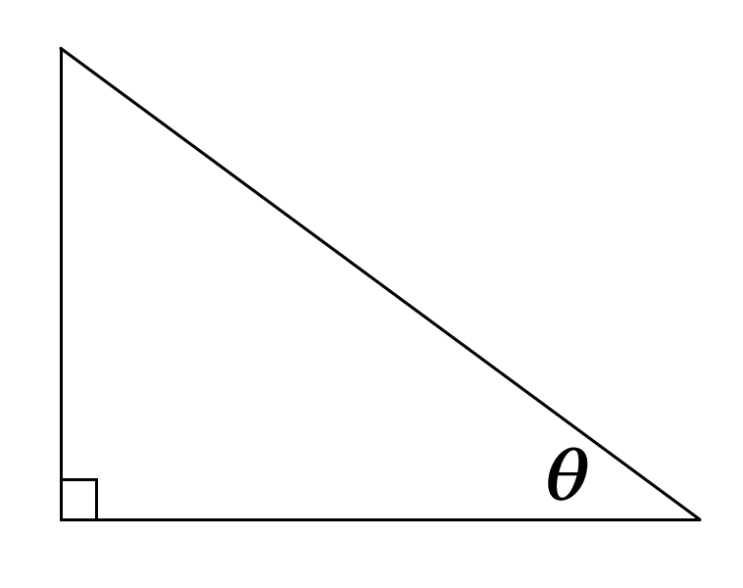
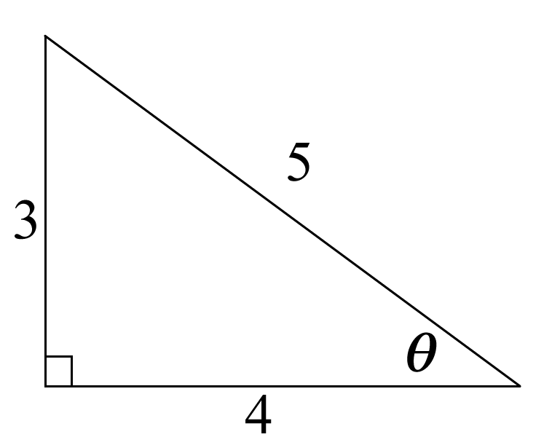
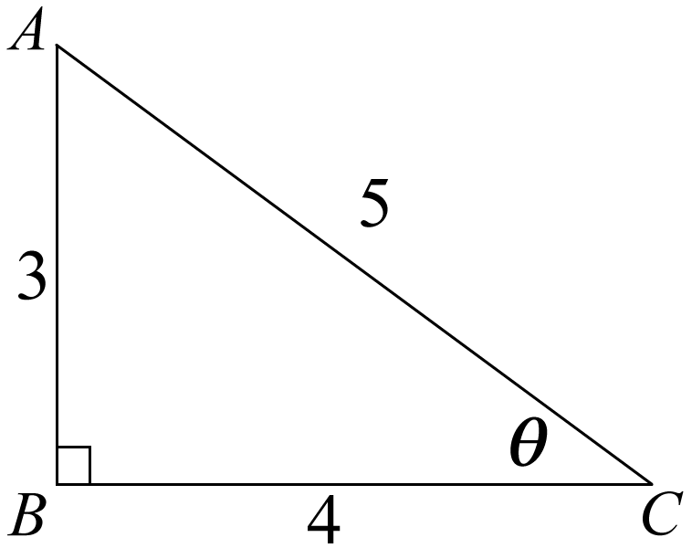
IMAGES - EXAMPLES
Consider labels (and use them!)
Which is easier to describe?
Notes:
Consider labels (and use them!). We’ve already talked about how having a point of reference makes things easier.
Turn to your neighbour and describe where theta is.
Does this help?
Does this help?

Slide 31
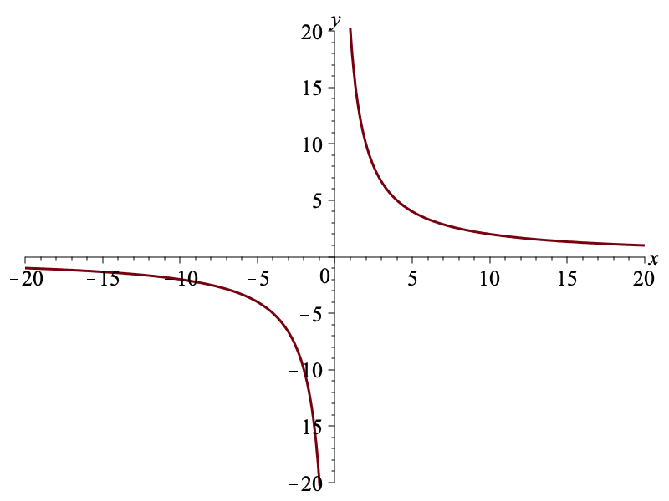
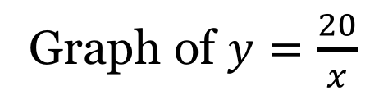
IMAGES - EXAMPLES
Consider labels
Graph of $y=\frac{20}{x}$
Notes:
Keep as much text out of the image as possible. The more text you put in the image, the more you have to describe elsewhere. Here’s a great example of where that label can just be in the text underneath the image instead of part of the image itself.

Slide 32
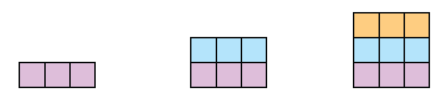

IMAGES - EXAMPLES
Consider important information
“Is the following pattern linear?”
Notes:
Often times colours, directions, layouts, etc. are not important pieces of information.
When asking if the pattern is linear or not, students who can’t see the image only need to know how many tiles are in each figure. We don’t have to spend our time describing that the next 3 tiles stack on top of the first 3 tiles, just that the are 3 tiles and then 6 tiles and then 9 tiles, or that 3 tiles are added each time.

Slide 33
IMAGES - EXAMPLES
Consider important information
“What is the length of the hypotenuse?”
Notes:
It’s also worth considering that if there are things in the image that you deem unnecessary to explain to students who can’t seem the image then maybe students who can see the image don’t need that information either. This is most common with labels. The theta here is unnecessary. It is not being used to help solve the problem, nor can it be, so why include it.

Slide 34
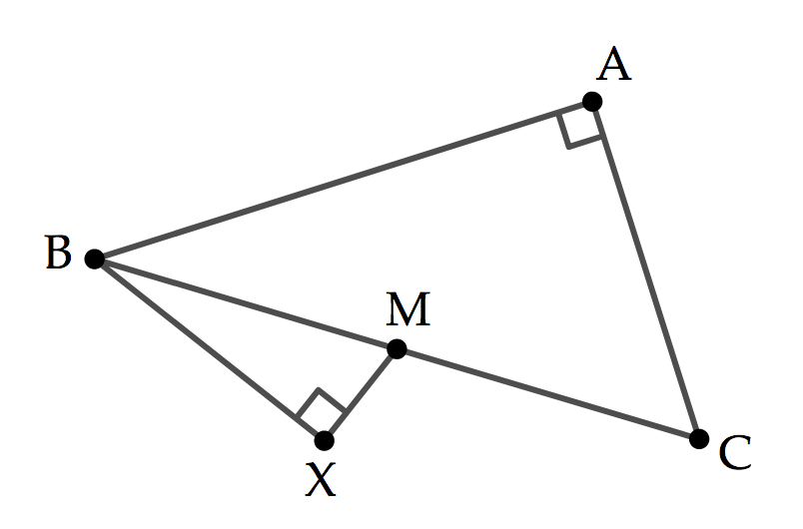
IMAGES - EXAMPLES
Consider important information
Alt: Two right-angled triangles, CAB and MXB, are drawn with shared edge BMC and triangle MXB lying outside triangle CAB.
In the diagram, AC has length 30, M is the midpoint of BC, MX has length 7, and MC has length 25.
∠CAB and ∠MXB are right angles. Determine the distance from A to X”
Notes:
Sometimes it is important to consider ambiguity. Could this be interpreted a different way? It took me a couple attempts at writing this alt text to recognized that I needed to specify that one triangle laid outside of the other one, because that affects the length of AX, which is what we are being asked to find.

Slide 35
IMAGES - EXAMPLES
Consider prior knowledge
Grade 7 & 8
Representational
Alt text:
  “A line with arrows on both ends and equally spaced numbers with negative numbers on the left and positive numbers on the right.”
Grade 12
Specific
Alt text:
  “A number line with a open dot at negative 2, a solid dot at 3, and a line segment from negative 2 to 3.”
Notes:
Consider prior knowledge. What do my students already know.
Here is an example of a number line, which we used in both grades 7/8 content and grade 12 content.
In 7/8 it was representational. We were looking at the idea of what a number line is, so the alt text here was describing what a number line is and how it works.
In gr. 12 we are just using it as one example of how to represent interval notation. We assume students know what a number line looks like, and just address what is on this particular numberline.

Slide 36
IMAGES - EXAMPLES
Consider prior knowledge
1st time
Alt text:
    “An open number line: a line with two arrows at the end with no numbers or tick marks noted.”
Subsequent times
Alt text:
    “An open number line.”
Notes:
Even within a particular project, the first time (or few times) that you introduce something, it might need more explanation than subsequent times

Slide 37
IMAGES - EXAMPLES
Consider what’s missing (and where it belongs)
“What is the value of θ?”
Alt: Triangle ABC is right-angled at B, with AB equal to 3, BC equal to 4, and AC equal to 5. Angle ACB is equal to theta.
Notes:
Can you answer this question?
So now that you see the picture, what information do we need to give students?
Then you can figure out where it belongs.
If it is worth putting information in the picture, it is worth giving out that information elsewhere.

Slide 38
IMAGES - EXAMPLES
Consider what’s missing (and where it belongs)
“In the 3-4-5 triangle, what is the value of θ?”
Alt: Triangle ABC is right-angled at B, with AB equal to 3, BC equal to 4, and AC equal to 5. Angle ACB is equal to theta.
Notes:
Here I’ve pulled out some information, but I still need everything that is in the alt text.

Slide 39
IMAGES - EXAMPLES
Consider what’s missing (and where it belongs)
“In the 3-4-5 triangle, what is the value of θ?”
Alt: Theta lies between the side of length 4 and the hypotenuse of length 5.
Notes:
Or I can word it differently

Slide 40
IMAGES - EXAMPLES
Consider what’s missing (and where it belongs)
“In triangle ABC, what is the value of θ?”
Alt: Triangle ABC is right-angled at B, with AB equal to 3, BC equal to 4, and AC equal to 5. Angle ACB is equal to theta.
Notes:
Still need all the information in the alt.

Slide 41
IMAGES - EXAMPLES
Consider what’s missing (and where it belongs)
“In right-angled triangle ABC, with AB=3, BC=4, AC=5, what is the value of θ?”
Alt: Angle ACB is equal to theta.
Notes:
There is more information in the question now…
But we’re still missing where theta is

Slide 42
IMAGES - EXAMPLES
Consider what’s missing (and where it belongs)
“In right-angled triangle ABC, with AB=3, BC=4, AC=5, what is the value of angle ABC?”
Alt:
Notes:
We changed one small thing, and now we have all of the information in the question…
and don’t need anything in the alt.
All of these are viable options. It depends on the context and personal preference.

Slide 43
IMAGES - EXAMPLES
Consider what’s missing (and where it belongs)
Example
There are 6 beads in a bag. You reach in and randomly pick one out. What is the probability you picked a green bead?
Notes:
We’re going to come back to the beads. We looked before at modifying the picture. How could we modify the question instead?

Slide 44
IMAGES - EXAMPLES
Consider what’s missing (and where it belongs)
Example
There are 6 beads in a bag (three green, two red, and one yellow). You reach in and randomly pick one out. What is the probability you picked a green bead?)
Notes:
Doesn’t take away from the question. Order doesn’t matter, etc.
For all of these things, ask a friend. Provide the question without the image, or the alt text, or surrounding text, and see what they come up with.

Slide 45
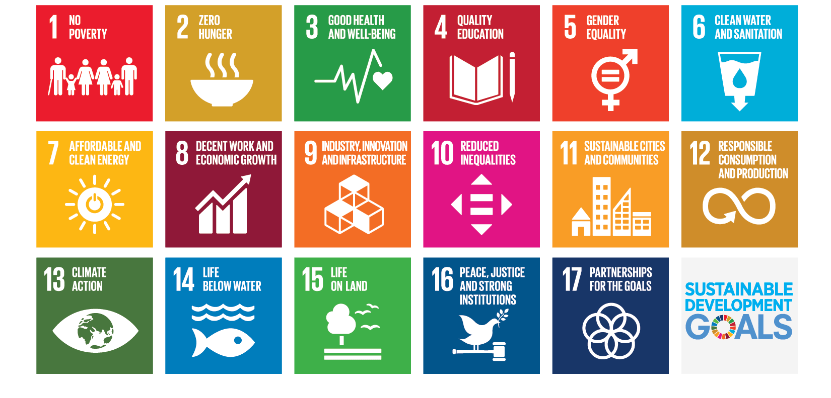
IMAGES - EXAMPLES
Consider what’s missing (and where it belongs)

Slide 46
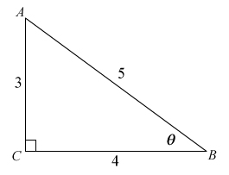
IMAGES - EXAMPLES
Consider order
What is the value of θ?
Triangle ABC is right-angled at C, with AC equal to 3, BC equal to 4, and AC equal to 5. Angle CBA is equal to theta.

Slide 47
IMAGES - EXAMPLES
Consider order
Triangle ABC is right-angled at C, with AC equal to 3, BC equal to 4, and AC equal to 5. Angle CBA is equal to theta.
What is the value of θ?

Slide 48
MATH
Notes:
Finally, we’re going to talk about math.

Slide 49
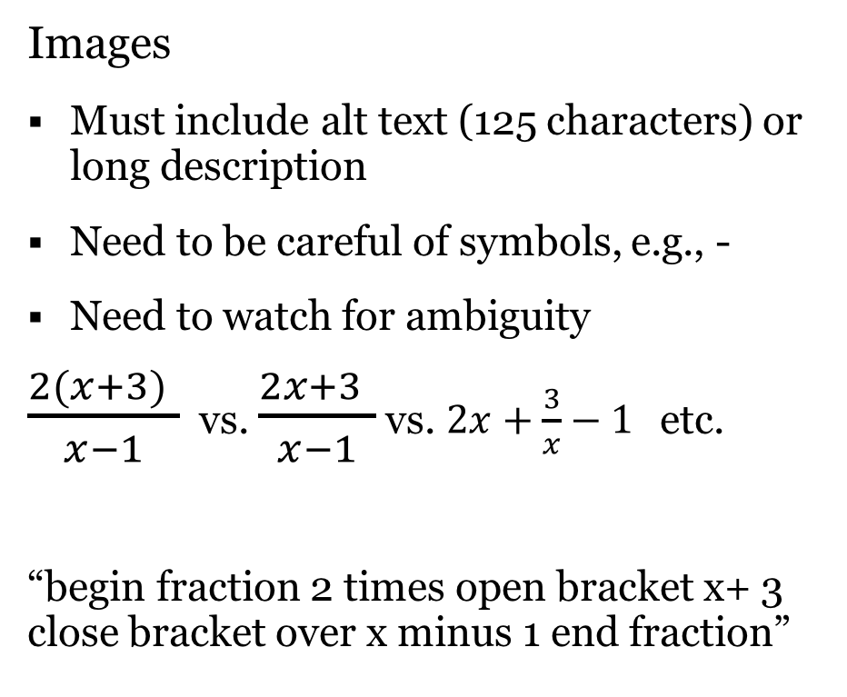
MATH
Images
Must include alt text (125 characters) or long description
Need to be careful of symbols, e.g., -
Need to watch for ambiguity
$\frac{2(x+3) }{x−1}$ vs. $\frac{2x+3 }{x−1}$ vs. $2x+\frac{3}{x}−1$ etc.
“begin fraction 2 times open bracket x+ 3 close bracket over x minus 1 end fraction”
Text (MathJax)
Available for use in your LMS or on your own
Considers accessibility for you
Provides math in a format that assistive technologies can interact with
Notes:
One option for putting math on your page is to use images. However, if you are going to do that, you have to remember the things we just talk about about text alternatives for images, puls a few more things.
Remember that you only have 125 characters to use
You need to be careful of symbols, for example, a hyphen vs. a negative sign, there is nothing to tell a screen reader which is which and it’s especially a problem because some screen readers don’t read a hyphen. This means you need to write out the word negative. And that cuts into your 125 characters
You also need to watch for ambiguity. If I say to you 2 times x plus 3 over x minus 1.
Your other option is to use MathJax to display the mathematics as text.
Math can be inputed as LaTeX code, MathML code, or in some instance using a WSIWYG interface. Most LMSs work with MathJax, or you can add your own call to your page. I have included some resources at the end that discuss how to use mathjax with various LMSs.
The benefit of this is that it considers accessibilty for you. It provides many accessible option in the right-click menu including the ability to zoom the math to help make it more legible. It also provides the math in a format that assistive technologies can interact with it.

Slide 50
SUMMARY
Headings
Tables
Colour
  Contrast
  Colour alone
Images
  Surrounding information
  Labels
  Important information
  Prior knowledge
  What’s missing?
Math
  Images vs. text

Slide 51
ACT NOW
Do what you can
Pick one thing and do it! Then add one more.

Slide 52
References
Centre for Excellence in Universal Design, National Disability Authority
http://universaldesign.ie
HTML: A good basis for accessibility (Mozilla)
https://developer.mozilla.org/en-US/docs/Learn/Accessibility/HTML

Slide 53
COLOUR CONTRAST: Online Tools
Colour contrast checker
  https://webaim.org/resources/contrastchecker/
  https://snook.ca/technical/colour_contrast/colour.html
RGB to Hex converter
  http://www.rgbtohex.net
  http://www.rapidtables.com/convert/color/rgb-to-hex.htm
Hex colour manipulation
  http://www.colorhexa.com/ (includes colour blind checker)
  https://www.cssfontstack.com/oldsites/hexcolortool/

Slide 54
Resources - MathJax
Blackboard
https://www.mathjax.org/video-tutorial-using-mathjax-in-blackboard-released/
Brightspace (older)
http://www.math.uwaterloo.ca/~pkates/MathJax/d2l.html
https://bgrasley.wordpress.com/2015/02/09/latex-math-for-e-learning-in-d2l/
MathJax call should be
<script type="text/javascript" src="https://cdnjs.cloudflare.com/ajax/libs/mathjax/2.7.5/MathJax.js?config=TeX-AMS-MML_CHTML"> </script>
Moodle
https://docs.moodle.org/36/en/Using_TeX_Notation
https://docs.moodle.org/36/en/MathJax_filter

Slide 55
Resources
Alt text generator for math equations
https://mathmlcloud.org
Accessibility of Word documents
https://support.office.com/en-us/article/make-your-word-documents-accessible-to-people-with-disabilities-d9bf3683-87ac-47ea-b91a-78dcacb3c66d
https://oae.stanford.edu/scribe/accessible-ms-word-docs
https://store.wiris.com/en

Slide 56
Resources
Centre for Extended Learning UXDL Honeycomb
http://cel.uwaterloo.ca/honeycomb
Accessibility for Online Course Design:
http://accessibilitystandards.cel.uwaterloo.ca
BCcampus Open Education Accessibility Toolkit 2nd Edition https://opentextbc.ca/accessibilitytoolkit/
Government of Ontario: How to Make Websites Accessible
https://www.ontario.ca/page/how-make-websites-accessible
Mohawk Universal Design for Learning
https://www.mohawkcollege.ca/employees/centre-for-teaching-learning/universal-design-for-learning

Slide 57
Rachael Verbruggen
rachael.verbruggen@uwaterloo.ca

