Slide 1
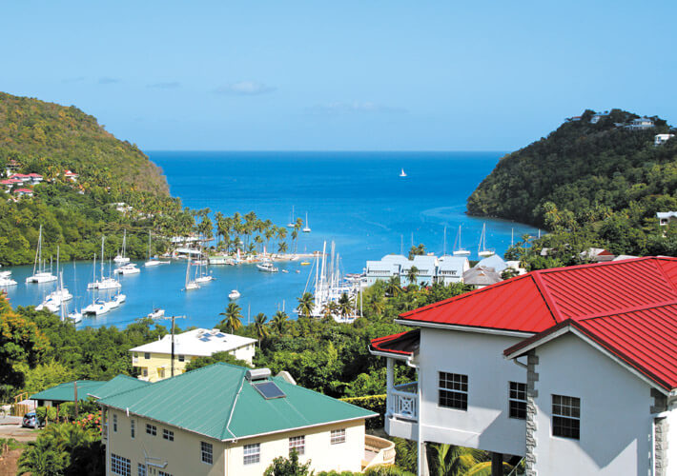
Vacation Property Management St Lucia
St Lucia Apartment Rentals

Slide 2
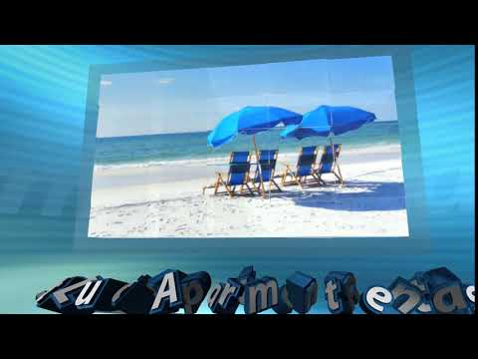
Vacation Property Management St Lucia

Slide 3

Contact us below to market your vacation and holidays properties today.
https://vacationrentalstlucia.com

