Slide 1
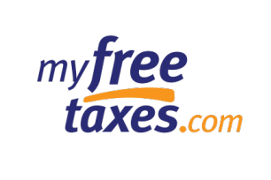
MyFreeTaxes 2024 Pre-Season Webinar
January 11, 2024 2pm ET

Slide 2
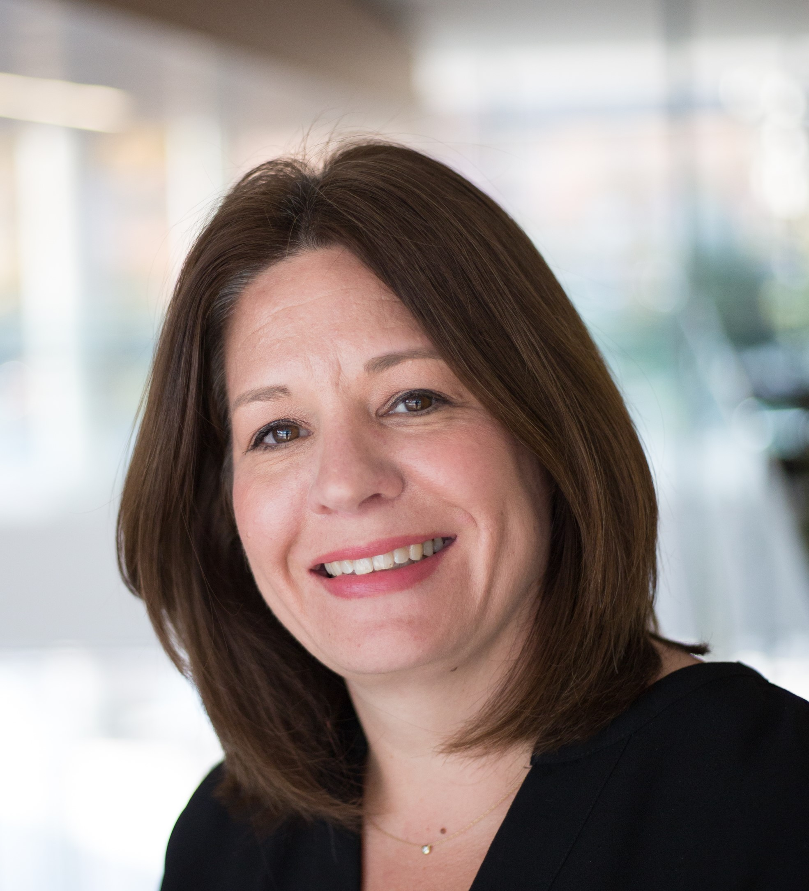

Today’s Speakers
Laura Scherler
Senior Director
Economic Mobility and Corporate Solutions
United Way Worldwide
Ynaira Burgos
Manager, Economic Mobility Programs
United Way Worldwide

Slide 3
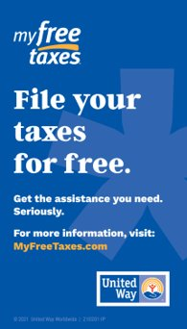
Agenda
Welcome
Intro to MyFreeTaxes: Program & Key Features
2023 Results Summary
2024 Improvements
MyFreeTaxes VITA Volunteers
Partner Resources
Q&A

Slide 4
Intro to MyFreeTaxes: Program & Key Features

Slide 5
What is MyFreeTaxes?
MyFreeTaxes is an online tax filing program that helps people file their federal and state taxes for free while getting the assistance they need.
United Way provides MyFreeTaxes in partnership with the IRS’s Volunteer Income Tax Assistance (VITA) program to help filers prepare their tax returns on their own or have their return prepared for them for free.
For millions of Americans, tax refunds and credits are essential to their financial stability and success. These credits maximize filers’ refunds and provide important opportunities for individuals and families to build financial stability. For many households, their tax refund may be the biggest check they receive all year.
That is why United Way provides MyFreeTaxes. Since 2009, MyFreeTaxes has helped more than 1.3 million people file their taxes for free while claiming over $1 billion in refunds and saving over $260 million in filing fees.

Slide 6
MyFreeTaxes User Benefits
Convenient
  Free federal and state returns
  No geographic or age limits
  “No wrong door” program design ensures everyone accesses the free filing option they need and are eligible to receive
Accessible
  Mobile friendly
  Available in English and Spanish
  Includes Schedule C for Small Business Owners, Contractors, Childcare + Gig Economy
  Operates all year (IRS e-filing January – October)
Supportive
  MyFreeTaxes Helpline and email support systems are staffed by VITA-certified support specialists

Slide 7
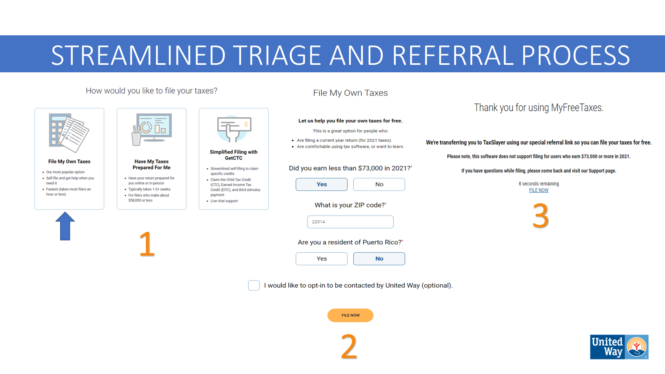
How MyFreeTaxes Works

Slide 8
2024 Tax Season Timeline
January 12th: IRS Free File opens
January 26th: Earned Income Tax Credit Awareness Day
January 29th: IRS begins accepting and processing electronic returns
February 27th: EITC/CTC refunds issued
April 15th: Federal tax return deadline
October 15th: Due date for extension filers

Slide 9
MyFreeTaxes 2023 Results
Notes:
ynaira

Slide 10
2023 Filer Support Results
MyFreeTaxes Helpline: 4,000 calls
Email support: 4k+ email inquiries
Over 42,000 accepted federal returns
$9 million+ CTC refunded to filers
$14 million+ in EITC refunded to filers
$59 million+ refunded to filers nationwide
Notes:
ynaira

Slide 11
MyFreeTaxes 2024 Improvements
Notes:
ynaira

Slide 12
2024 Improvements
MyFreeTaxes Website
Filer Support
Maintain Helpline
Expand FAQs and written filer guides
Expand MyFreeTaxes VITA Volunteers to support filers via :
  Email
  Live Chat
Create site-wide search function
Reorganize FAQs into categories to make information easier to find
  Transform existing business guides into embedded HTML content
  Create an "Articles" section to highlight relevant tax season content
  Update "Tax Time Financial Checklist" page to include additional financial resources to support filers
  New data dashboard on Partner Portal to improve access to local filer data
Notes:
ynaira

Slide 13
2024 Improvements: Updated Outreach Materials
MyFreeTaxes outreach and promotional materials are located on the MyFreeTaxes Partner Portal unitedway.org/myfreetaxes/partners/materials/partner-promotion
Currently updating the customizable materials, including:
MyFreeTaxes Posters
    White Poster in English and Spanish // Blue Poster in English and Spanish
MyFreeTaxes Info Cards
    White Info Card in English and Spanish // Blue Info Card in English and Spanish

Slide 14
2024 Improvements: Expansion of Filer Guides
In 2023, we released the following guides:
FSA VITA Software Filing Guide: using MyFreeTaxes to access FSA software + using FSA software to complete your return
MyFreeTaxes Guides to Filing Self-Employment Taxes: an in-depth guide to preparing and filing self-employment taxes using MyFreeTaxes and FSA VITA
Guide to be Released in February 2024:
Disaster Resiliency: Leveraging Tax Time To Recover After a Natural Disaster, an in-depth guide to assist filers on how to file taxes after a federally declared disaster
Notes:
yna
All guides and materials will be available in English and Spanish. All will be in written format, and some will include video companions.

Slide 15
2024 Improvements: New Financial Resources for Filers
UWW is partnering with Change Machine to connect filers to financial coaching and other resources to help them make the best use of their refund.
UWW is expanding its partnership with Savi, a fintech company that helps student loan borrowers navigate the repayment process better understand their debt, optimize their repayment options, and enroll in the best repayment plan for their financial needs. MFT filers can get access to the Savi repayment portal at no cost via unitedway.bysavi.com.
Notes:
yna

Slide 16
MyFreeTaxes VITA Volunteers
Notes:
yna

Slide 17
MyFreeTaxes VITA Volunteers
Now Recruiting MyFreeTaxes VITA Volunteers for the 2024 Season!
Please help promote this remote volunteering opportunity!
  Volunteer 2+ hours a week and set your own schedule
  Deliver huge financial impacts by helping filers as they self-file their return
  Accepting English and Spanish speaking volunteers
  Activities include email assistance and live chat
  Timeline: training starts in December. Additional training may be available in January and February
Notes:
yna

Slide 18
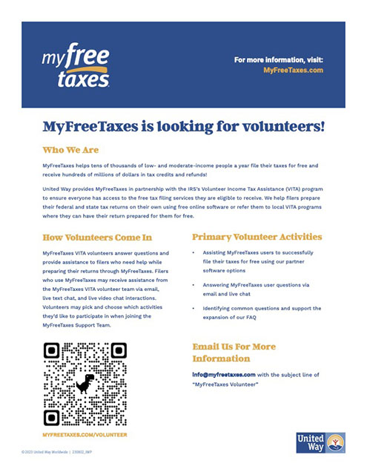

MyFreeTaxes VITA Volunteers
Learn more and download our flyer at:
MyFreeTaxes.com/Volunteer MyFreeTaxes.com/Voluntario

Slide 19
MyFreeTaxes Disaster Resilience Guide

Slide 20
MyFreeTaxes: Leveraging Tax Time to Recover After a Natural Disaster
Natural disasters like a hurricane or tornado, can be unpredictable and frightening. Oftentimes, it can be challenging to anticipate all the ways a disaster could affect filers, their business, and their property. This guide will highlight how filers can equip themselves to handle disasters in two ways:
First, by ensuring filers are informed and better prepared to make financial decisions immediately following a disaster. To do that, this guide will provide an understanding of how the government defines a disaster area, the tax implications associated with being located within a disaster area, how the use of different financial resources impact their taxes, and how to protect important documentation ahead of time.
Second, by giving filers the tools you will need to properly and confidently file their taxes after receiving disaster assistance. To do that, this guide will give provide step-by-step filing instructions using TaxSlayer software for personal and business needs.
Notes:
yna

Slide 21
MyFreeTaxes Partner Resources

Slide 22
MFT Partner Resources
MyFreeTaxes Partner Portal: access partner materials, including outreach content and data reports, at unitedway.org/myfreetaxes/partners
UWW VITA Community of Practice: bi-weekly call to engage with peers, discuss challenge, and share ideas. Register here.
UW VITA Workplace by Facebook Group: connect with United Ways operating VITA programs
Questions or comments about MyFreeTaxes? Contact us! partners@myfreetaxes.org
Notes:
yna

Slide 23
Upcoming Calls and Webinars
United Way Direct File Discussion
Tuesday, January 16th at 2:00pm ET
To Register: https://us02web.zoom.us/webinar/register/WN_5UI_P4RJS5qY548tqC_kuw
MyFreeTaxes Disaster Resilience Guide Webinar
Thursday, February 8th at 2:00pm ET
To Register: https://us02web.zoom.us/webinar/register/WN_wnaEApqwSbyn-n3Xk9gs_Q

Slide 24
Q&A
Email any remaining questions to Partners@MyFreeTaxes.com

Slide 25

Thank you

