Slide 1
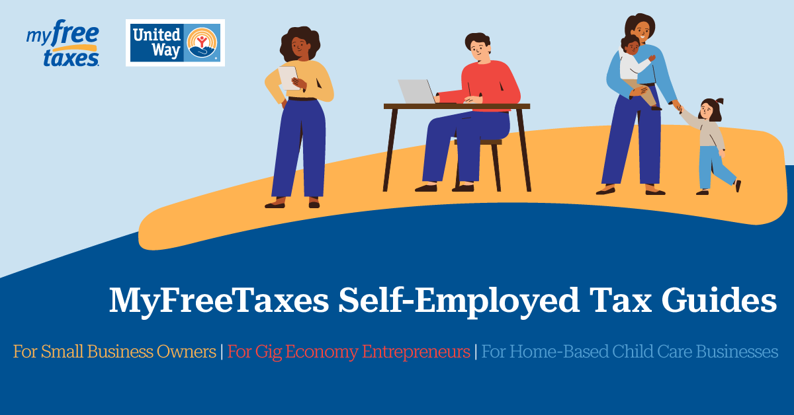
MyFreeTaxes Self-Employed Tax Guides Release Webinar
United Way Worldwide and Civitas Strategies, LLC
March 2, 2023, 2 pm ET

Slide 2
Agenda
Welcome
About MyFreeTaxes
About Civitas Strategies, LLC
Overview of the MyFreeTaxes Self-Employed Tax Guides
MyFreeTaxes Support Offerings
Outreach and Promotion
Q&A

Slide 3



Today’s Speakers
Bryndan Stueve
Manager
Community Impact and Economic Mobility
United Way Worldwide
Ynaira Burgos
Manager, Economic Mobility Programs
United Way Worldwide
Laura Scherler
Senior Director
Economic Mobility and Corporate Solutions
United Way Worldwide

Slide 4
What is MyFreeTaxes?
MyFreeTaxes is an online tax filing program that helps people file their federal and state taxes for free while getting the assistance they need.
United Way provides MyFreeTaxes in partnership with the IRS’s Volunteer Income Tax Assistance (VITA) program to help filers prepare their tax returns on their own or have their return prepared for them for free.
For millions of Americans, tax refunds and credits are essential to their financial stability and success. These credits maximize filers’ refunds and provide important opportunities for individuals and families to build financial stability. For many households, their tax refund may be the biggest check they receive all year.
That is why United Way provides MyFreeTaxes. Since 2009, MyFreeTaxes has helped more than 1.3 million people file their taxes for free while claiming over $1 billion in refunds and saving over $260 million in filing fees.
Get started at www.myfreetaxes.com.

Slide 5
Why United Way Created These Guides
Better support for MyFreeTaxes users
  10% of MyFreeTaxes users have self-employment income and could benefit from these additional resources
Scale access to safe, easy, and free tax filing for LMI entrepreneurs
  17% - 28% of households (26 million – 44 million) have self-employment income
  Half of all microbusinesses (13 million households) have incomes below $50k annually
  Only about 6% of VITA and TCE returns include Schedule C for self-employment income

Slide 6
Overview of the MyFreeTaxes Self-Employed Tax Guides

Slide 7
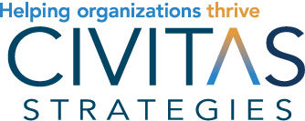
Who We Are
Founded 14 years ago to help nonprofits and small businesses excel.
Our team of 15 has a varied and deep background, working with small businesses nationwide.
Tax education has been a critical part of our work since inception.
Notes:
Thank you Bryndan – and thanks for the opportunity to introduce you to our work and our history in this space.
We wanted to take this opportunity to share a little bit about HOW we do our work, so you better understand this important resource available to you and those you serve. CSES was formalized out of the pandemic, as a way for us to organize our work that supported child care businesses and community leaders in meeting the serious and ever-evolving challenges the they were facing. As a result, from the moment we put CSES together and started building it, we knew we needed to be constantly innovating and iterating, and responsive to the external environment and to what we are hearing every day on the ground.

Slide 8
A New Approach to Tax Support
Taxes are a key opportunity and risk for small businesses
The ability to offer quality returns at scale is a key challenge
We have turned to digital software which is already in distribution and effective
Notes:
We’ve built up knowledge on taxes that over the years has grown both wide and deep. In the last few years, our work providing assistance and resources on taxes has accelerated.
Thinking about how we improve outcomes at scale, led us to capitalize on software that is already on the market, that can be utilized for more business people to get quality tax preparation and better understand their taxes.

Slide 9
MyFreeTaxes Self-Employed Tax Guides
Actionable, easy-to-use guides for business owners and entrepreneurs that need to file a Schedule C. They include information on:
How business taxes work and the important components of tax documents
Step-by-step guidance on how to use the software
Helpful worksheets and resources to build understanding and make implementation a breeze
As a result, business owners can have confidence in their tax filings and are more empowered in their new business operation skills
Notes:
These tax guides are the result of all our hands-on work in the tax space over the years. Here’s what they include…

Slide 10



How These Guides Differ
Small Business Owners:
Focuses on a range of micro businesses such as Etsy sellers to those with side hustles, freelancers, or other independent contractors
Covers a range of scenarios including the use of a home office
Gig Economy Entrepreneurs:
Focuses on those who are working with apps and other tools that allow them to work on demand, particularly using their own vehicle
Covers operations with a particular emphasis on transportation costs
Home-Based Child Care Providers:
Focuses on business owners who operate a child care out of their home
Addresses several tax rules exclusive to these business owners

Slide 11
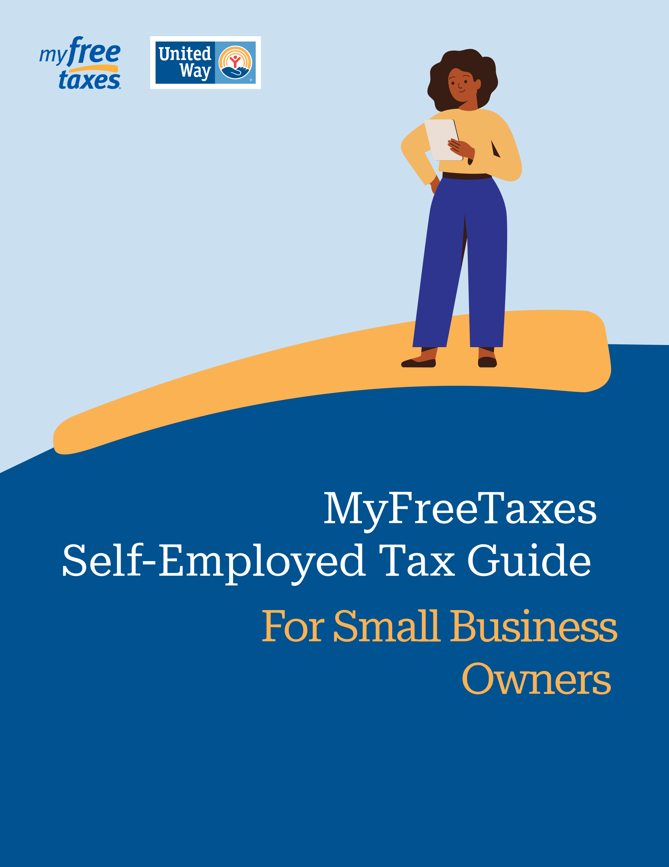
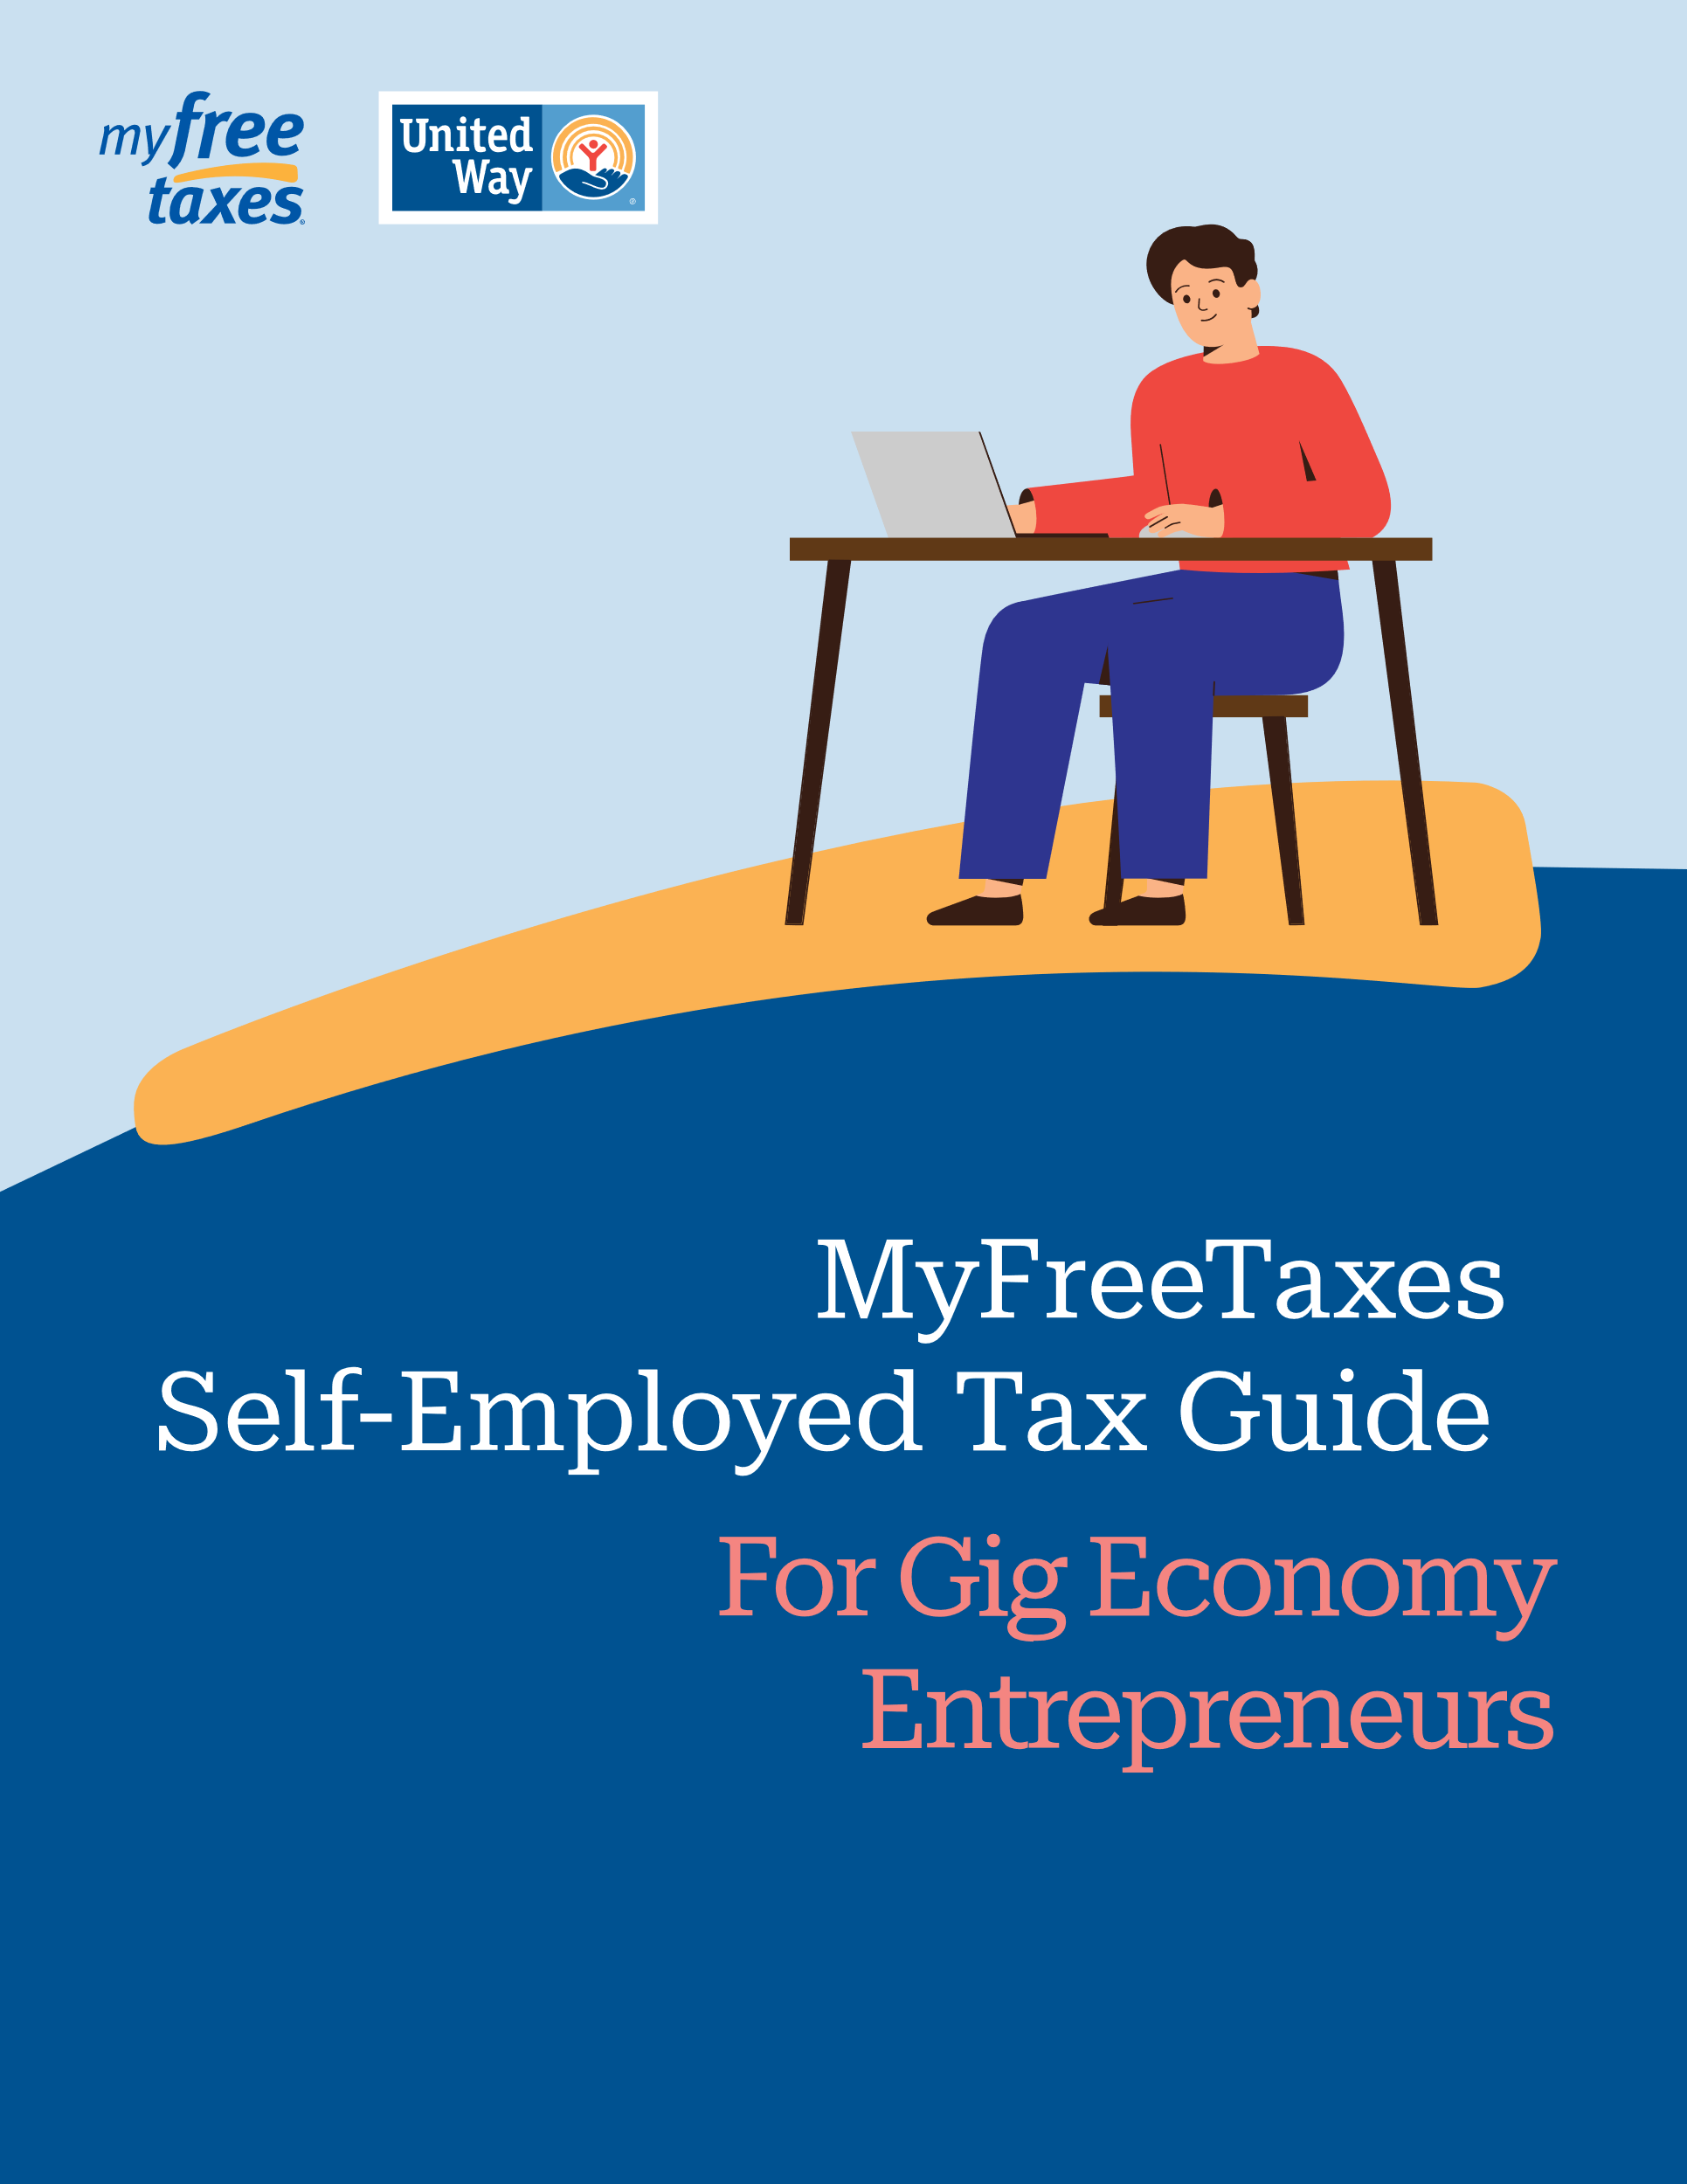
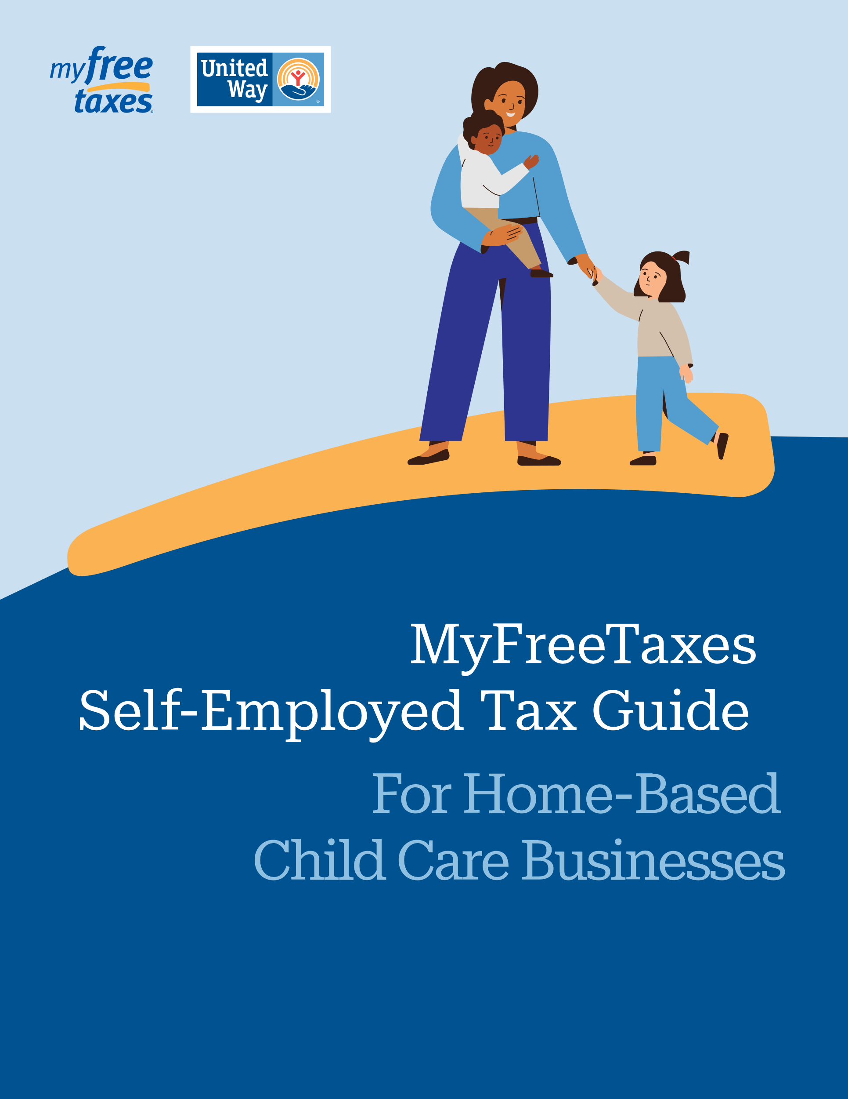
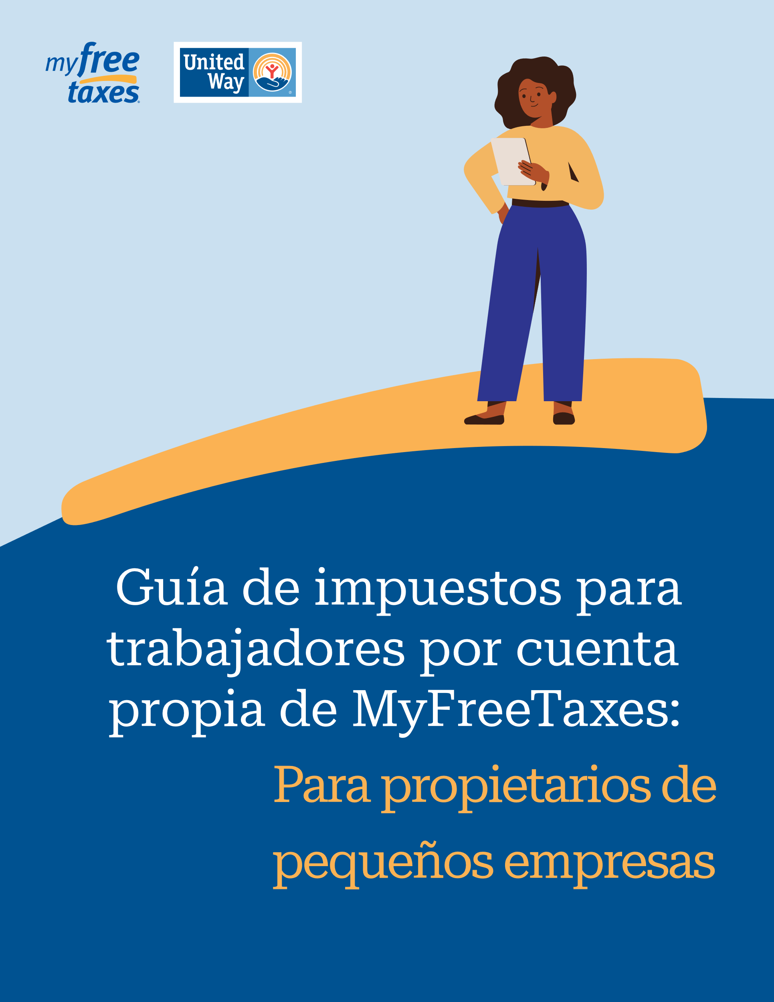
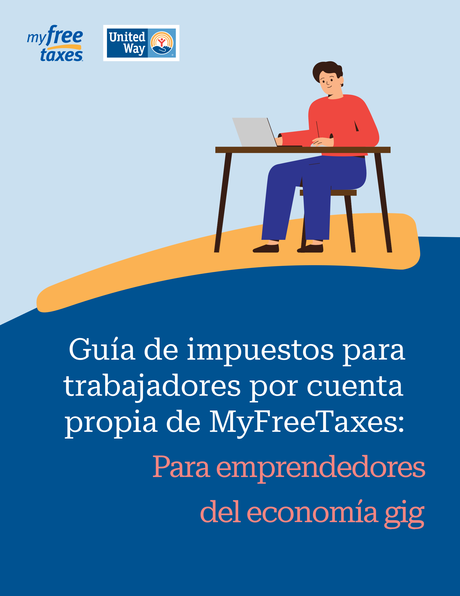
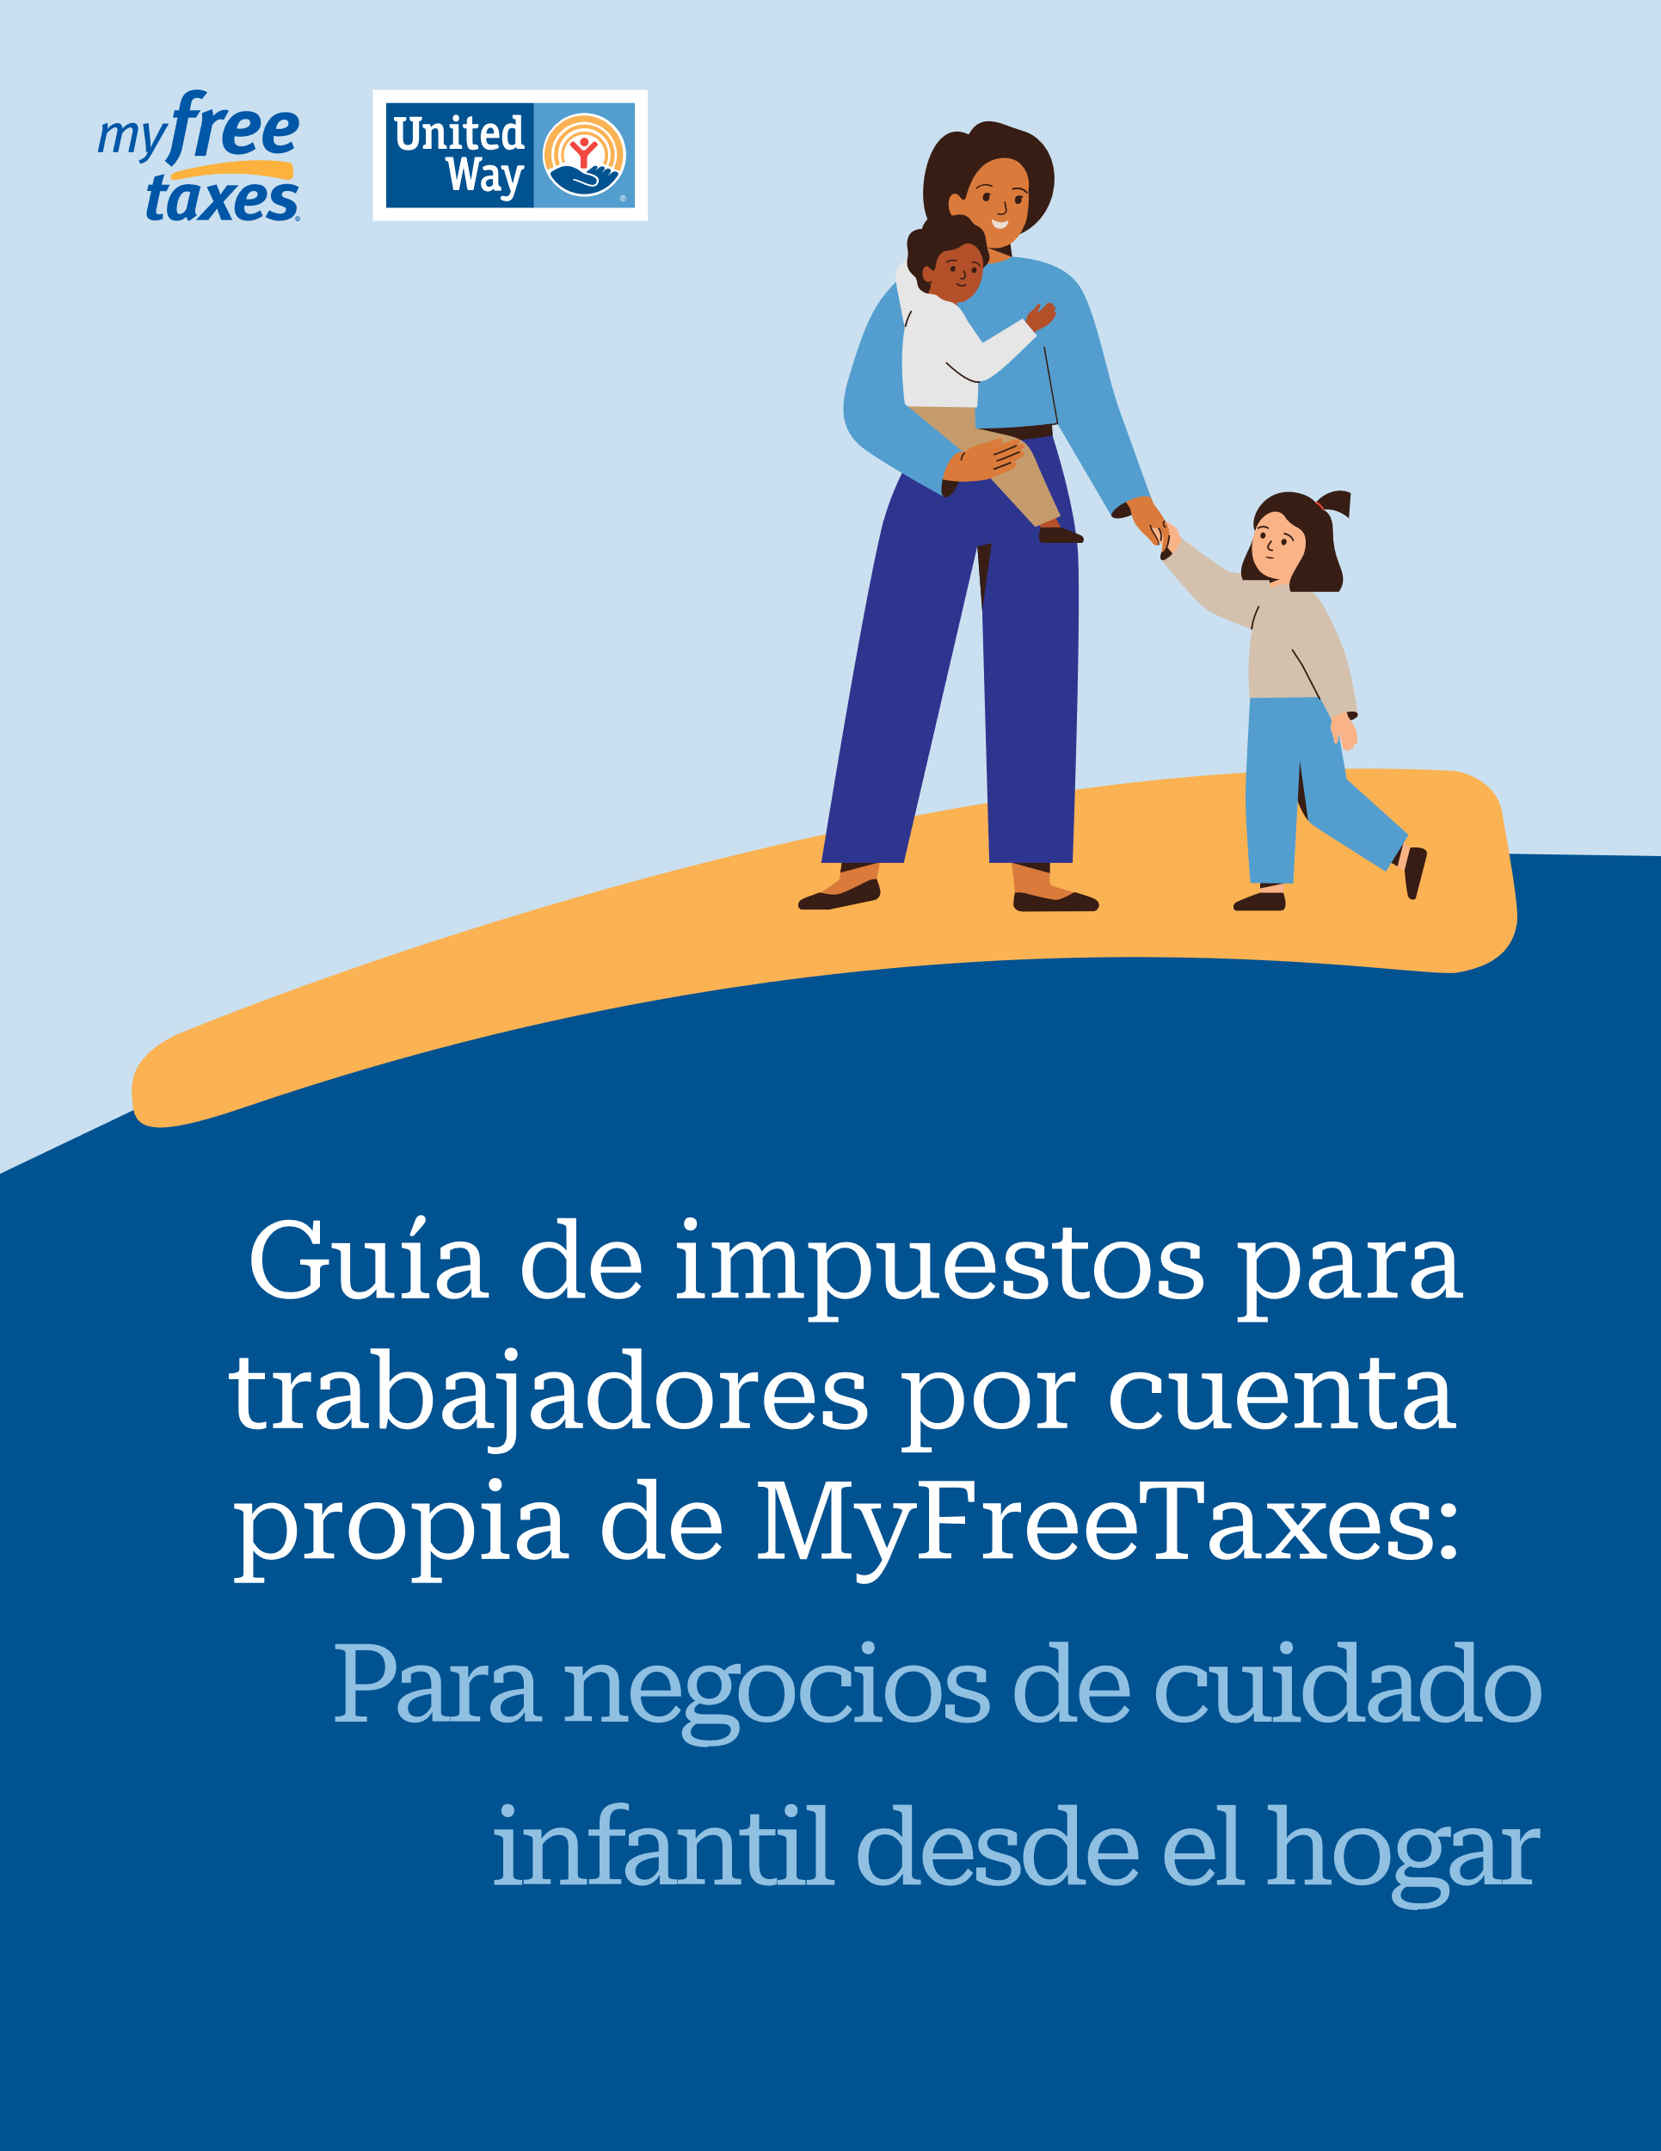
Multiple Versions Curated to Meet the Needs of Specific Audiences
Three Versions, in English and Spanish
MyFreeTaxes Self-Employed Tax Guides:
For Small Business Owners
For Gig Economy Entrepreneurs
For Home-Based Child Care Businesses
Available as embedded content and downloadable PDFs at myfreetaxes.com/selfemployed and
myfreetaxes.com/es/cuentapropia

Slide 12
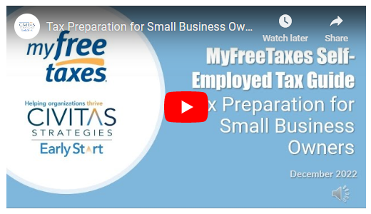
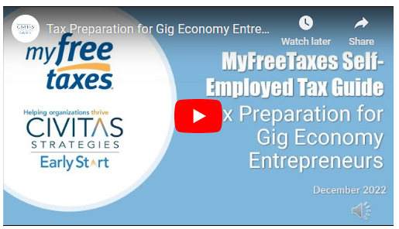
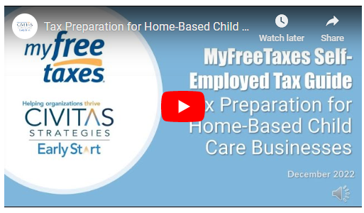
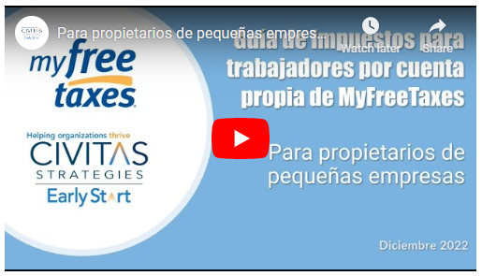
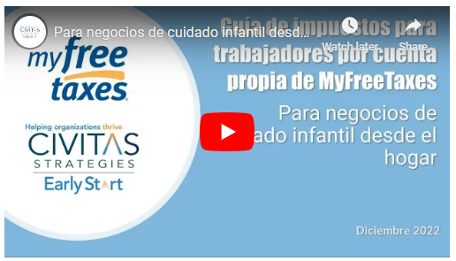
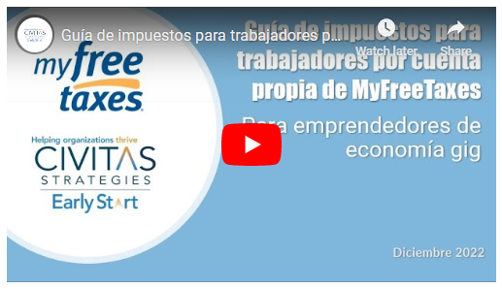
Each Guide is Available in Video Format

Slide 13
Support for MyFreeTaxes Filers with Self-Employment Income
Our IRS-certified support specialists are available to assist MyFreeTaxes users at myfreetaxes.com/support.
Phone Helpline
  10a – 6p Daily thru April 18; 5 days a week April 19 – Oct 31
Email and Message Support
  Receive a reply within one business day
Searchable FAQs
Filer Guides and Videos
  Currently: MyFreeTaxes Self-Employed Tax Guides
  More on the way!

Slide 14
Demo:
MyFreeTaxes Self-Employed Tax Guides

Slide 15
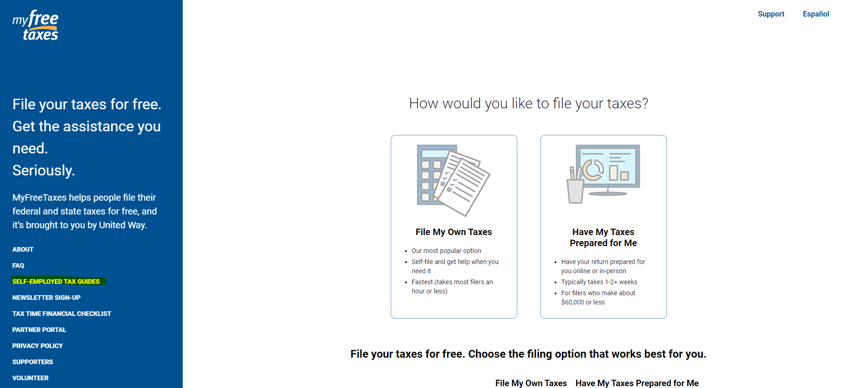

Slide 16
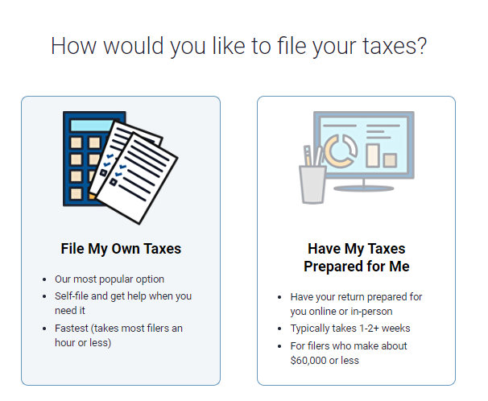
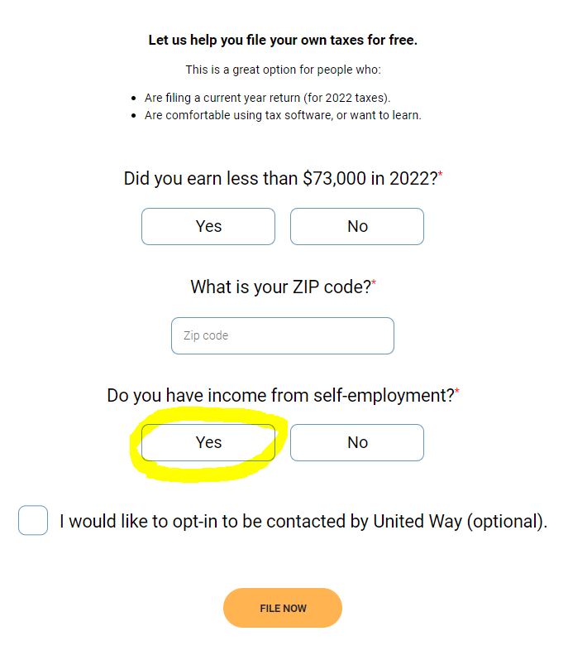
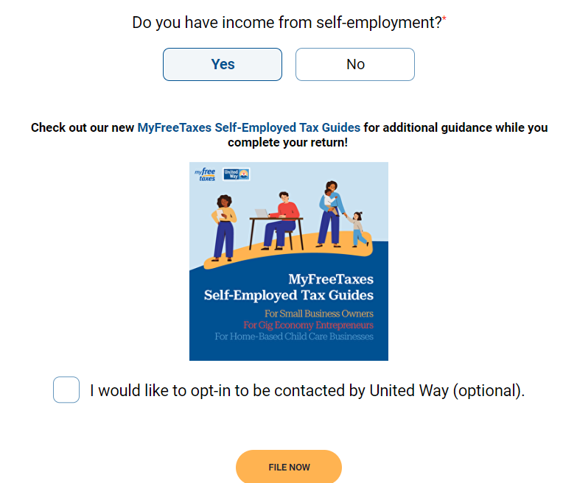

Slide 17
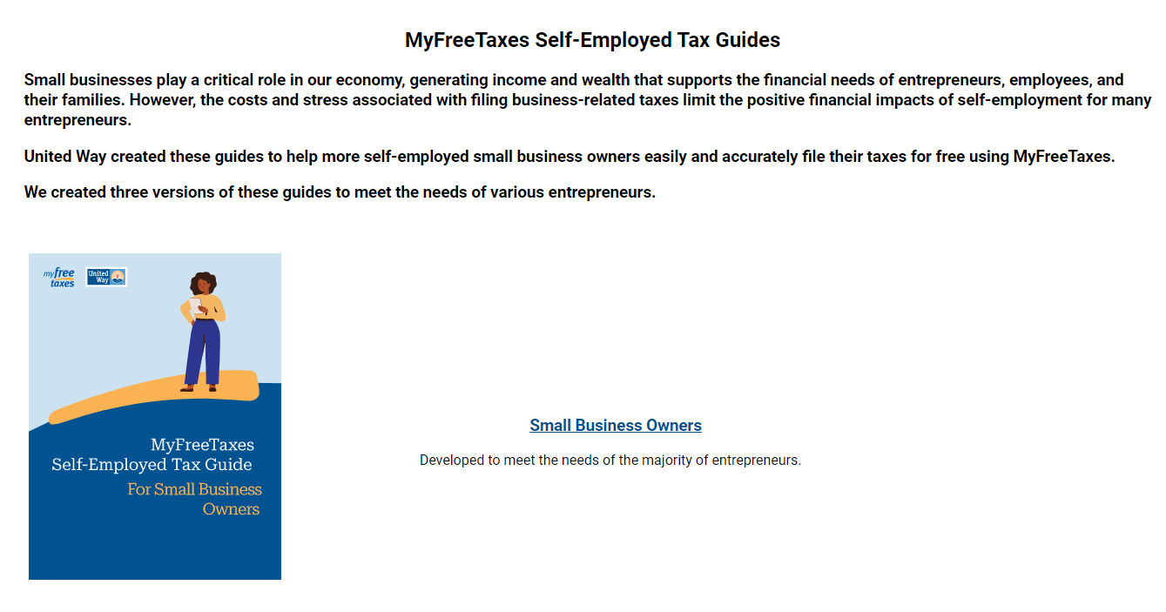

Slide 18
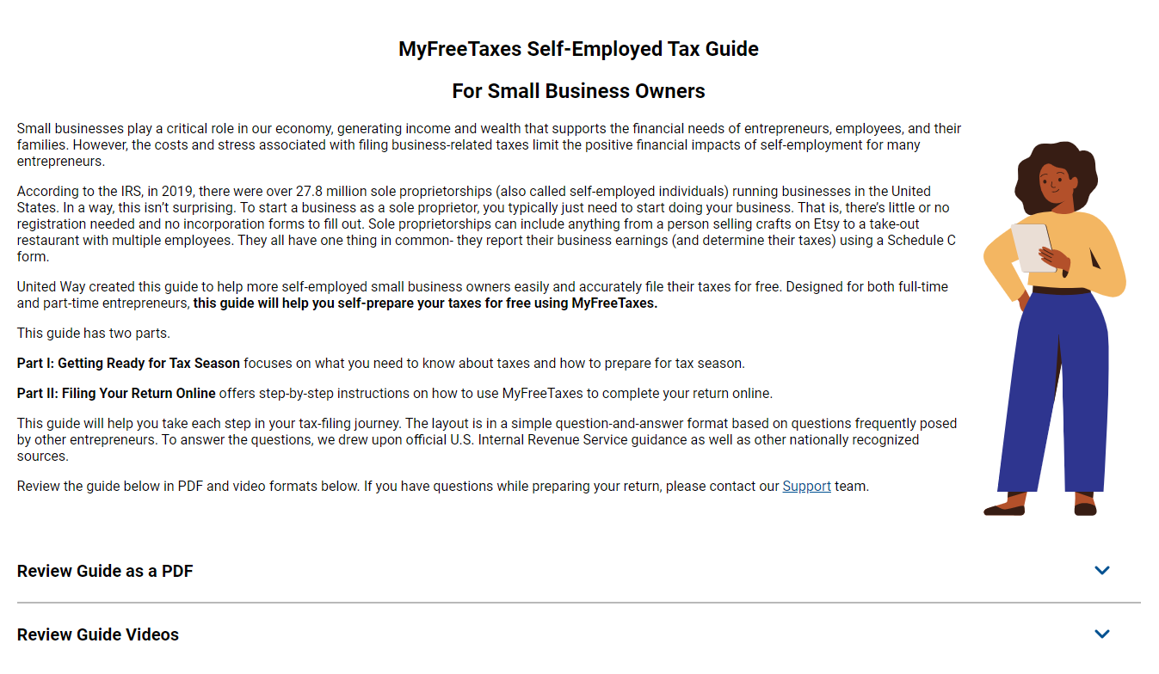

Slide 19
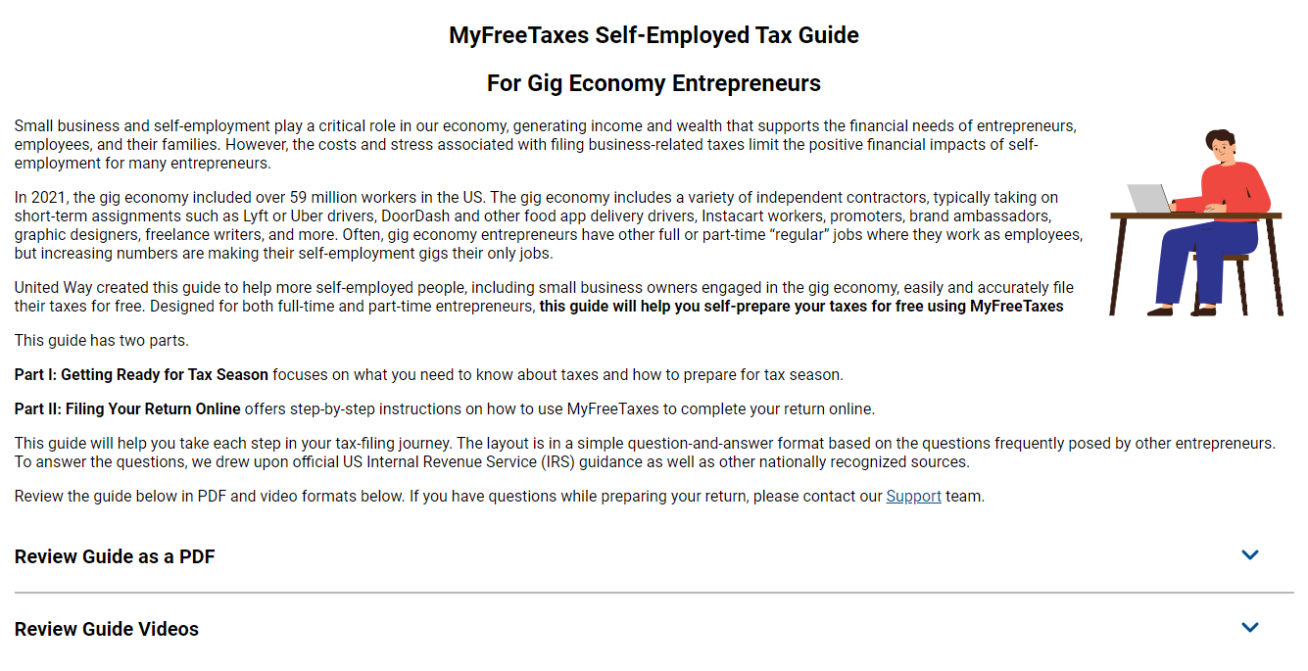

Slide 20
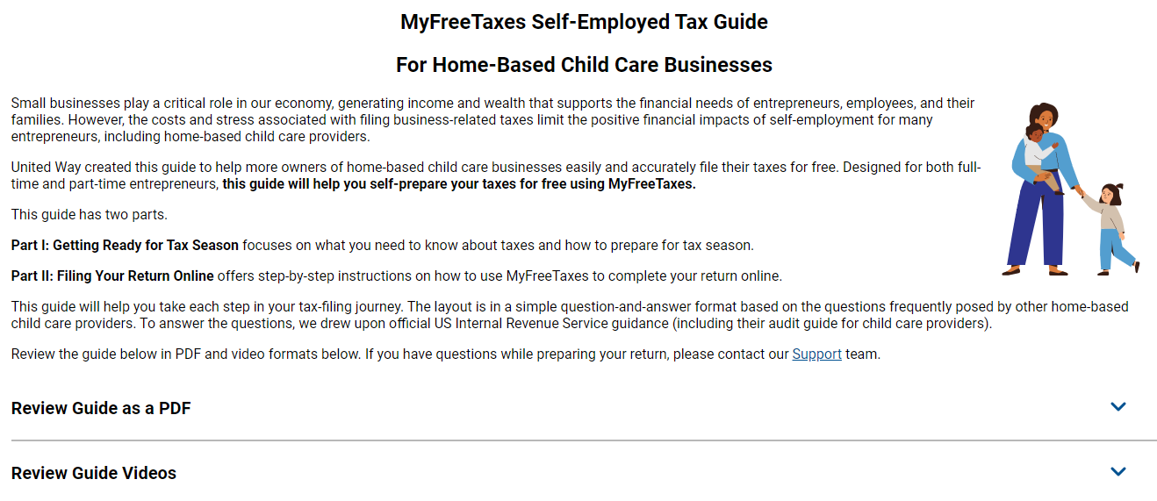

Slide 21
MyFreeTaxes Self-Employed Tax Guides
Outreach and Promotion

Slide 22

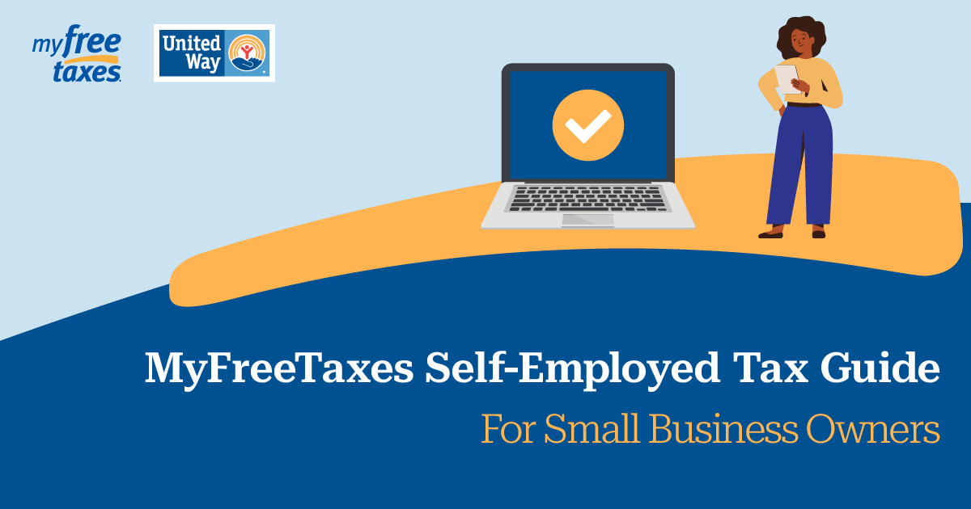
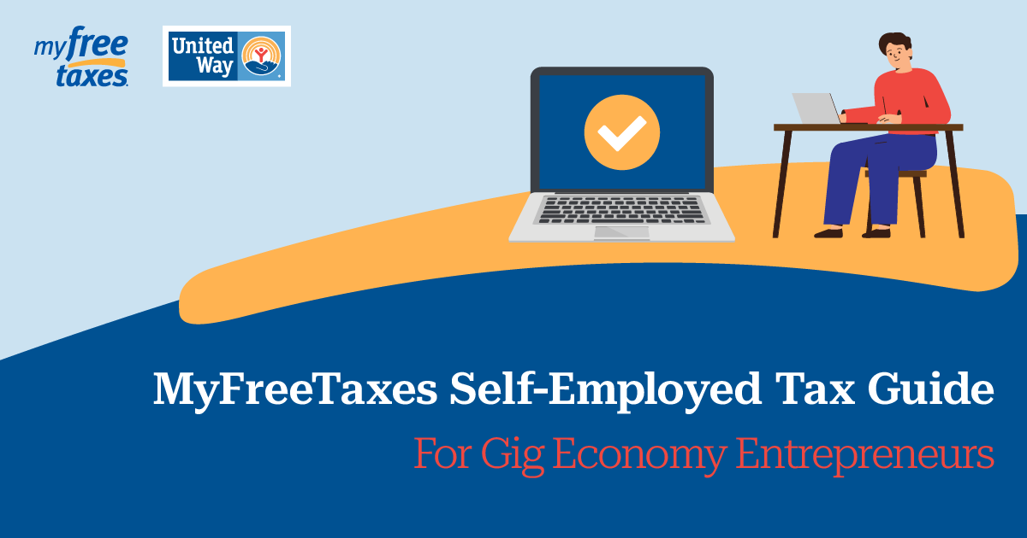
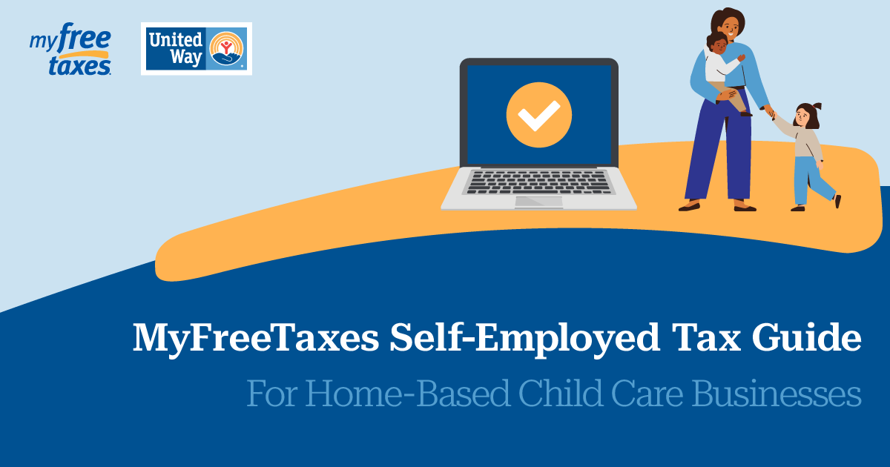
Outreach and Promotion
We rely on our partners to reach filers in your community!
Promote the MyFreeTaxes Self-Employed Tax Guides at your VITA sites
Promote on your social channels and via your newsletter
  Social cards for the tax guides are available on the partner portal – combined or guide version-specific

Slide 23
Resources
MyFreeTaxes: www.myfreetaxes.com
MyFreeTaxes Self-Employed Tax Guides: www.myfreetaxes.com/selfemployed
MyFreeTaxes Support: www.myfreetaxes.com/support
MyFreeTaxes Partner Portal: access our partner materials, including outreach content at www.unitedway.org/myfreetaxes/partners
Outreach materials: www.unitedway.org/myfreetaxes/partners/materials/partner-promotion
Partner data: www.unitedway.org/myfreetaxes/partners/data
Partner webinar: www.unitedway.org/myfreetaxes/partners/quick-tools/webinars

Slide 24
Q&A
Email any remaining questions to Partners@MyFreeTaxes.com

Slide 25
Thank you

