Slide 1


Creating sustainable quality intergenerational community programs
Jill Juris, PhD
October 2025
Salvation Army Kroc Centers

Slide 2
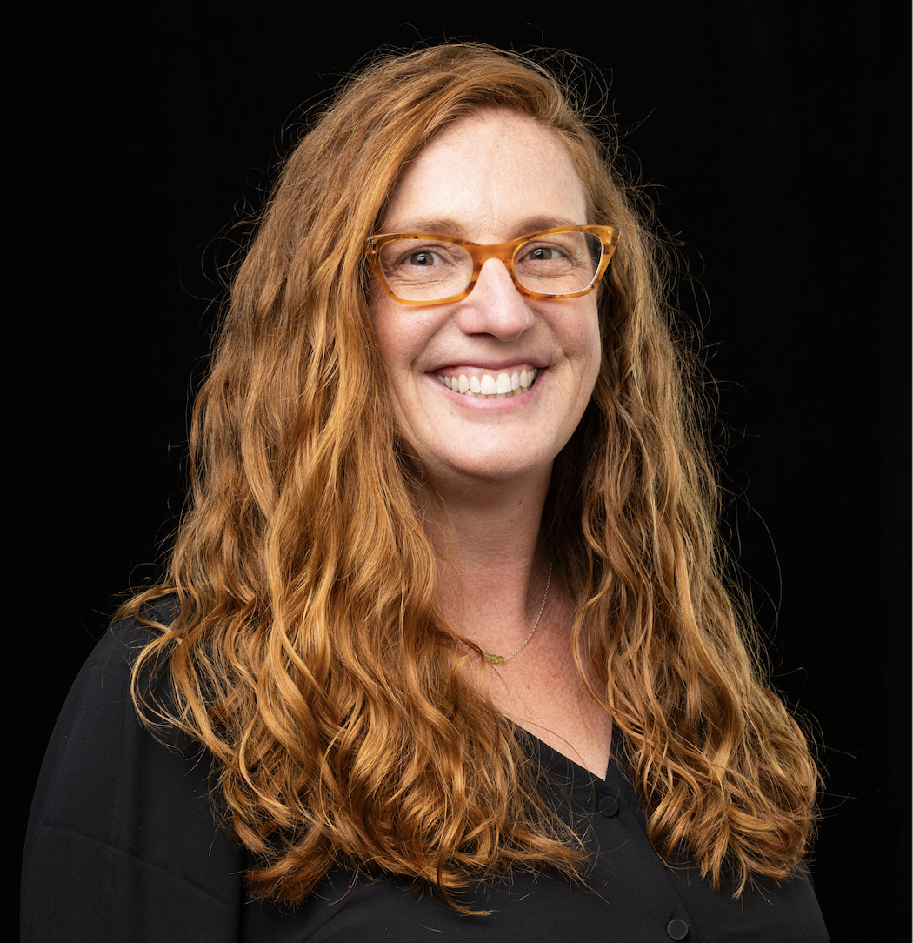
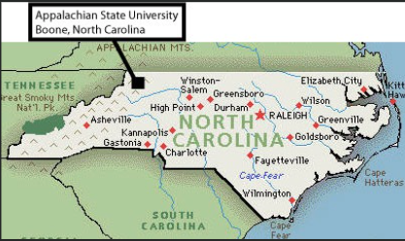
Presenter: Jill Juris
Applicable Experience
Activities Director-Retirement Community
Camp Staff-YMCA Camp Greenville
Faculty in Recreation Management
Leadership Team Center for Intergenerational Research and Practice
Education
M.S. Recreation and Park Administration
Ph.D. Human Development and Family Science
Power of Intergenerational Relationships
Programmer at heart
Dance of implementation and research

Slide 3
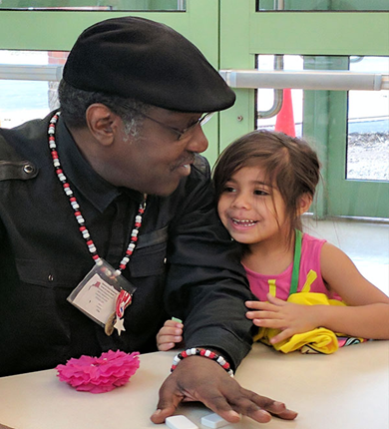
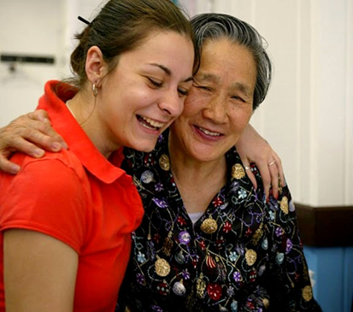
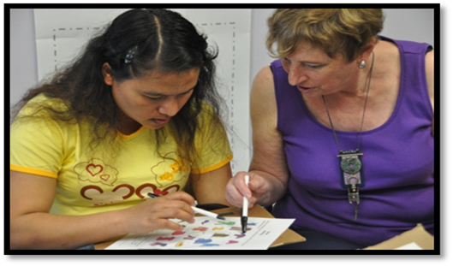
Workshop Overview
What is intergenerational practice?
How can you create sustainable intergenerational programs?
What assistance/resources do you need to take the next step?
Notes:
Introduce you to resources along the way

Slide 4
Intergenerational
Practice

Slide 5
What is Intergenerational Practice?
Intentionally unites generations
Strives to enrich participants’ lives
  Mutually beneficial and meaningful
Helps address vital social and community issues
Builds upon the positive resources that young and old have to offer each other and their communities

Slide 6
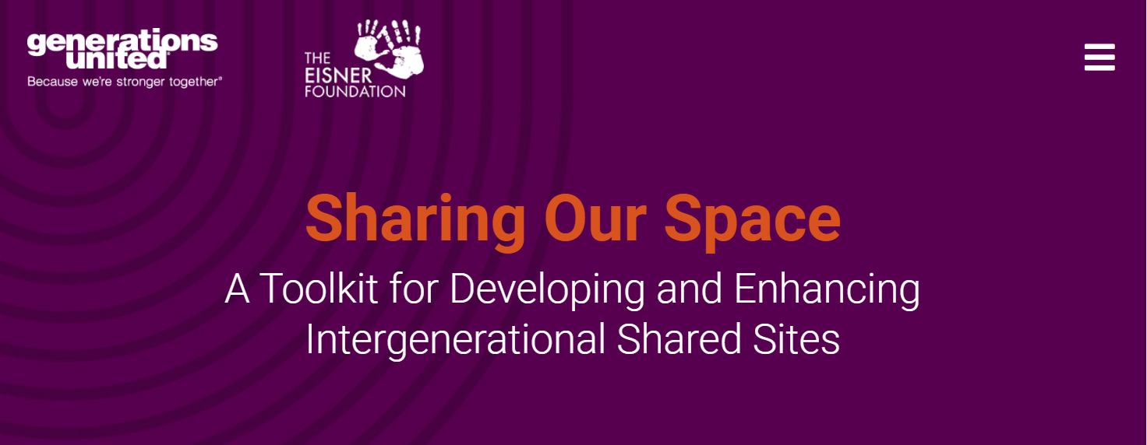
Intergenerational Shared Sites
Intentionally designed places
Provide services/programs to multiple generations concurrently
Foster meaningful cross-age relationships.
Participants interact in planned intergenerational activities as well as through informal encounters.
Shared sites have built-in opportunities for cost-efficiencies in terms of sharing space, personnel, rent, and other costs.

Slide 7
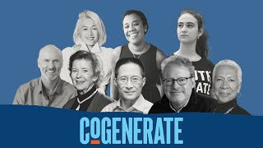

Slide 8
In the Chat…
Please share your:
Name
Location
Age
Best thing about your age

Slide 9
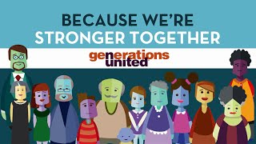

Slide 10
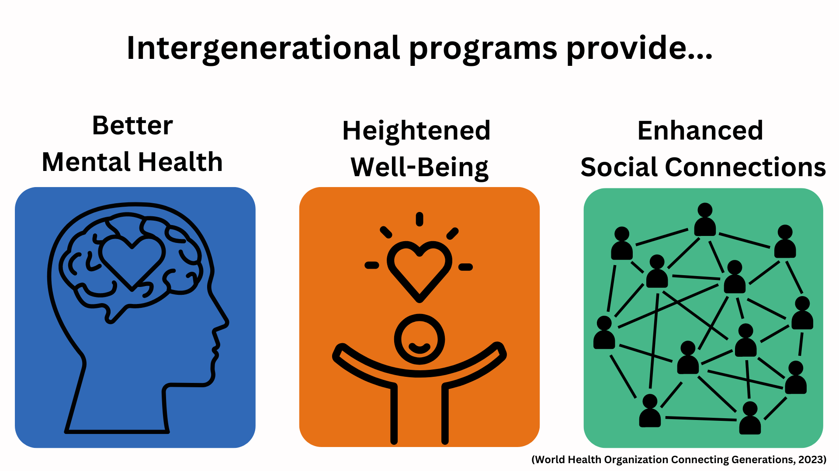
Notes:
Reducing social isolation and loneliness
Combating ageism
Fostering intergenerational empathy
Finding it is more than just ‘nice’ but ‘wise’

Slide 11
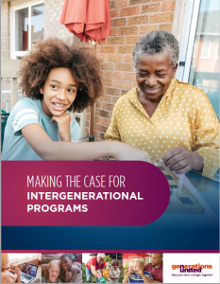
Benefits for everyone
  Babies, pre-school, elementary, middle, high school, young adults, college students
  Parents, adult children
  Older adults
  Staff, caregivers, older adults
Varied outcomes
  Improved empathy
  Improved peer relationships, decreased bullying
  Increased physical activity
  Reduced ageism
  Greater sense of belonging

Slide 12
Creating high quality sustainable intergenerational programs

Slide 13
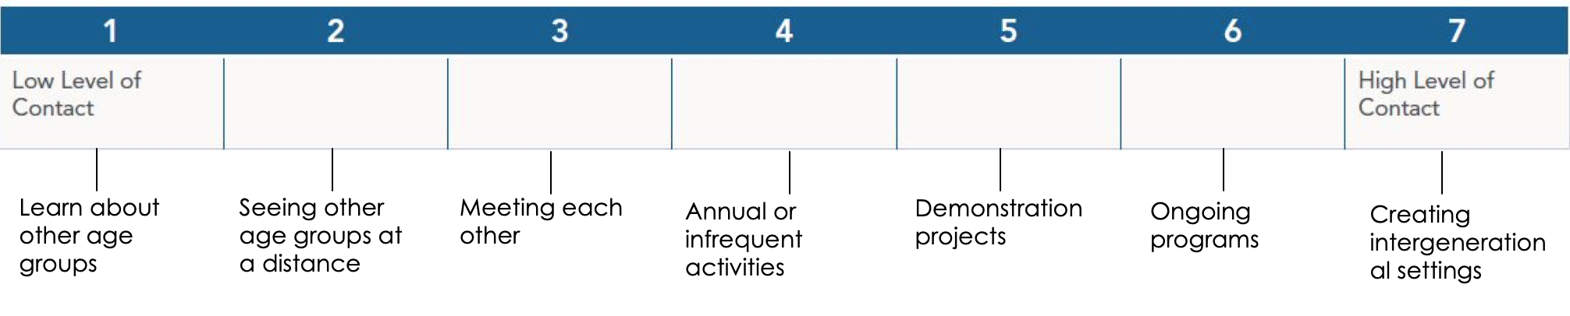
Levels of Engagement (Kaplan, 2004)

Slide 14
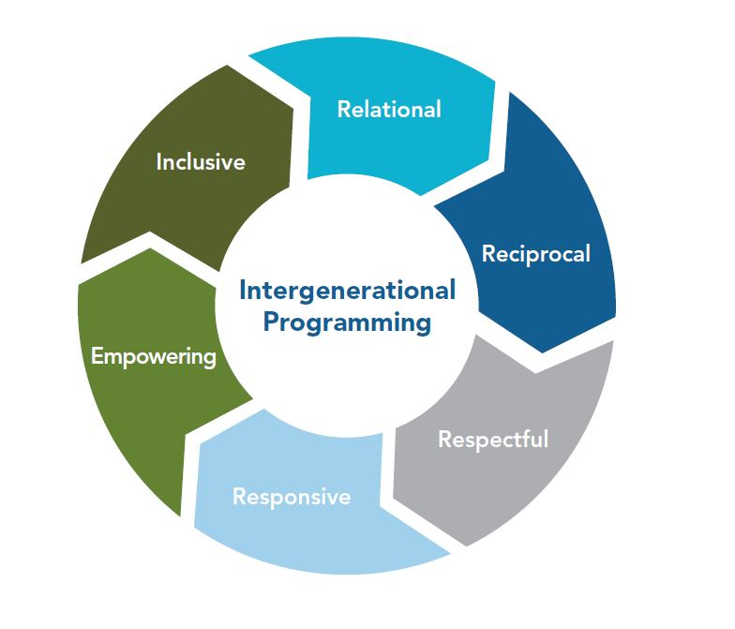
Best Practices for Successful
Intergenerational
Programs

Slide 15
Approaches to creating programs
Participants
Activities
Settings
Notes:
Participants
Preschool, Middle School, High School
Active Older Adults, Homebound Older Adults
Related (grandparents/grandchildren)
Nonfamilial
Activities
New intergenerational program
Expand a program already in existence
Intentionally group participants
Age/ability/culturally appropriate
Related to the mission of partners
Sufficient staff and financial resources
When and where to offer the activity
Transportation
Cultural norms and values
Nature of programming

Slide 16
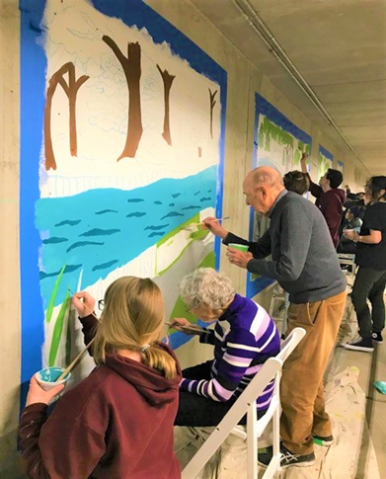
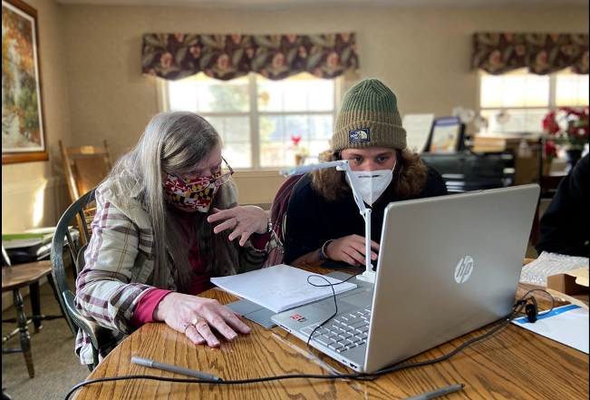
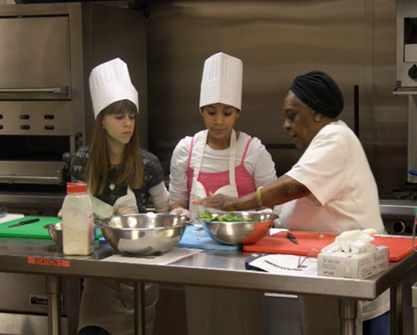
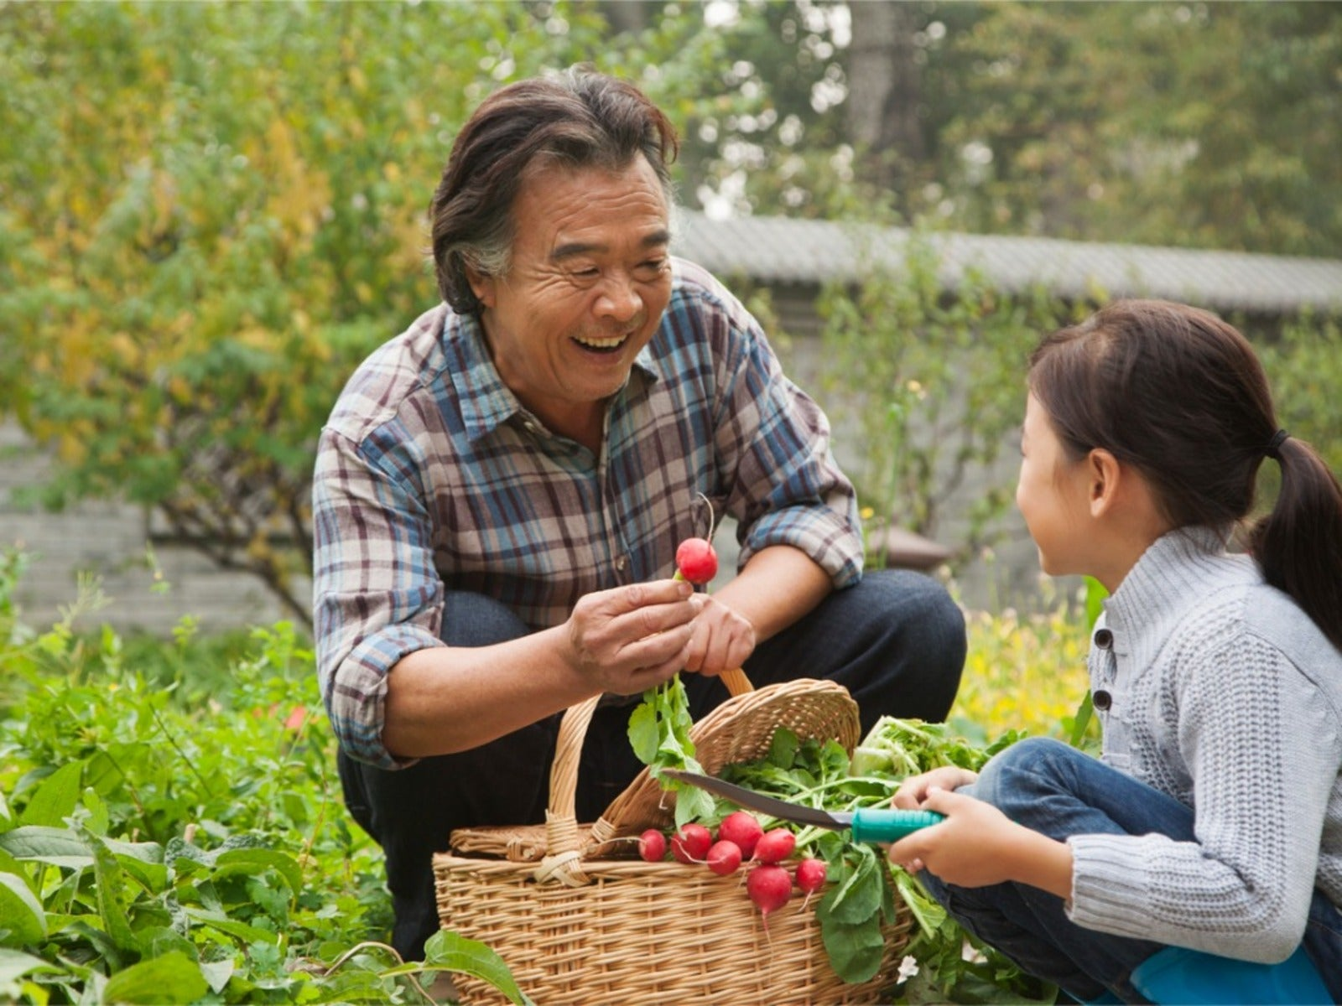
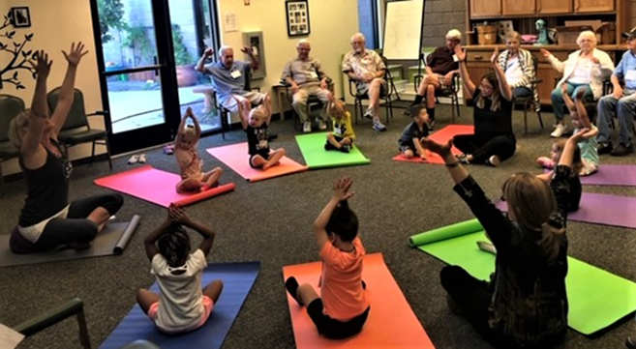
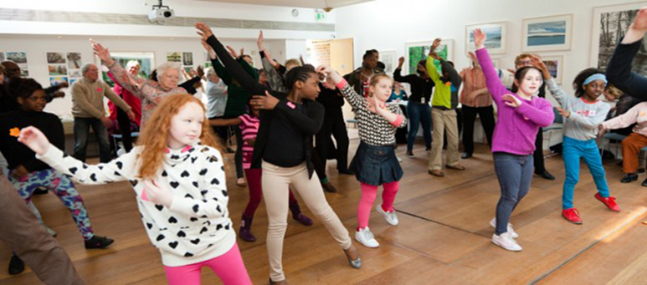

Slide 17
In the Chat…
What approach would you consider for your center?
Please provide an idea for your:
Target participant age groups
Activity
Setting

Slide 18
Path to Intergenerational Programs
Development
Implementation
Step 1
Step 3
Step 2
Step 4
Development
Planing
Planning
Sustainability
Notes:
Strengths-based approach
Handling differences in values
Effective communication/importance of listening

Slide 19
Activity as a means to relationships
It is the relationship –what is happening between generations- that really matters. Intergenerational activities and programs are a means to building a culture of caring relationships.
(Saez, Ponanzo & Sanchez, 2007)

Slide 20
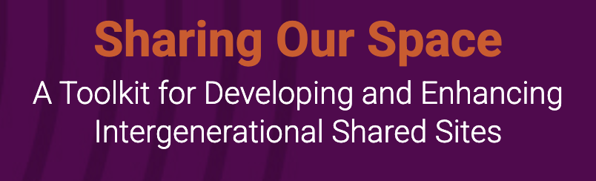
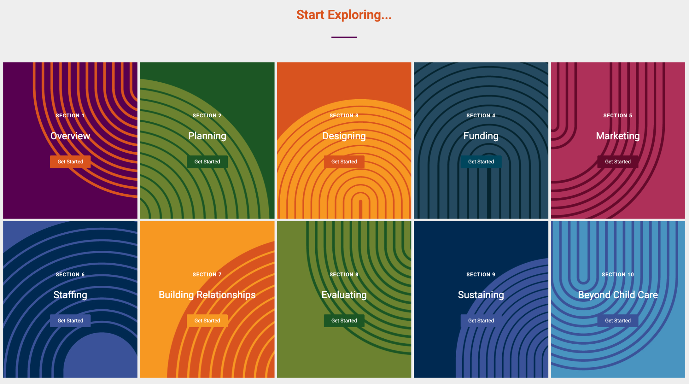
http://www.sharingourspace.org/

Slide 21
Best Practices: Co-Designing and Preparing
Participants:
Youth and
Older Adults
Partnerships
Staff
Notes:
Who are your internal or external partners?
How will you get their buy-in?
What challenges do you anticipate in building partnerships?
What makes a successful partnership?
How will you co-create your program?
Preparing staff
Benefits of intergenerational work
Generational awareness
Concerns about working with different age groups
Creating activities that are age and ability appropriate
Facilitating intergenerational activities
Preparing Participants
Hopes and concerns
Realistic expectations/defining success
Strengths-based approach
Handling differences in values
Effective communication/importance of listening

Slide 22
Best Practices
Intentional
Pairing/
Small Groups
Repeated Programming
Recruitment
Notes:
Design Considerations
Where will most of the intergenerational programming take place?
How can the space be flexible enough to allow for both structured activities and informal cross-age interaction?
How can the building be designed to foster different levels of active and passive interaction?
How can the design of the mono-generational spaces be welcoming to multiple age groups?
How can you use design features to transform mono-generational spaces into intergenerational spaces?

Slide 23
Core Practice rather than an ‘add-on’
How can an intergenerational lens be built into your center’s core practice rather than as an ‘add-on’?
Shifting from it’s nice, to it’s wise
(and central)

Slide 24
In the Chat…
What is something you learned from today’s workshop?
What assistance/resources would you need to take the next step in creating an intergenerational initiative at your center?
Questions?
Jill Juris, PhD
Appalachian State University
jurisjj@appstate.edu

Slide 25




Resources and Community

Slide 26
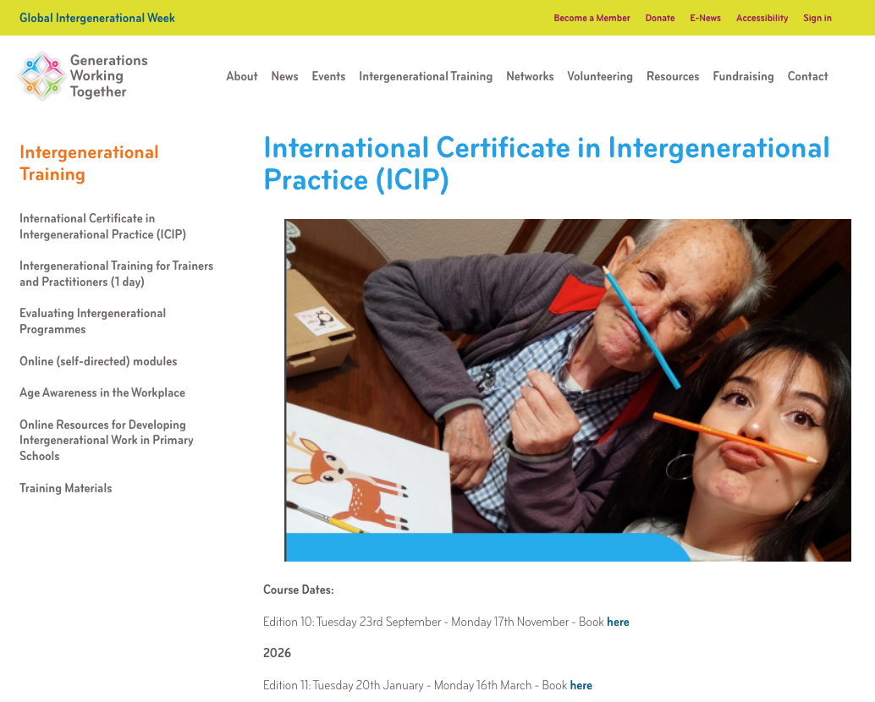
Resources and Community-Certificate

Slide 27
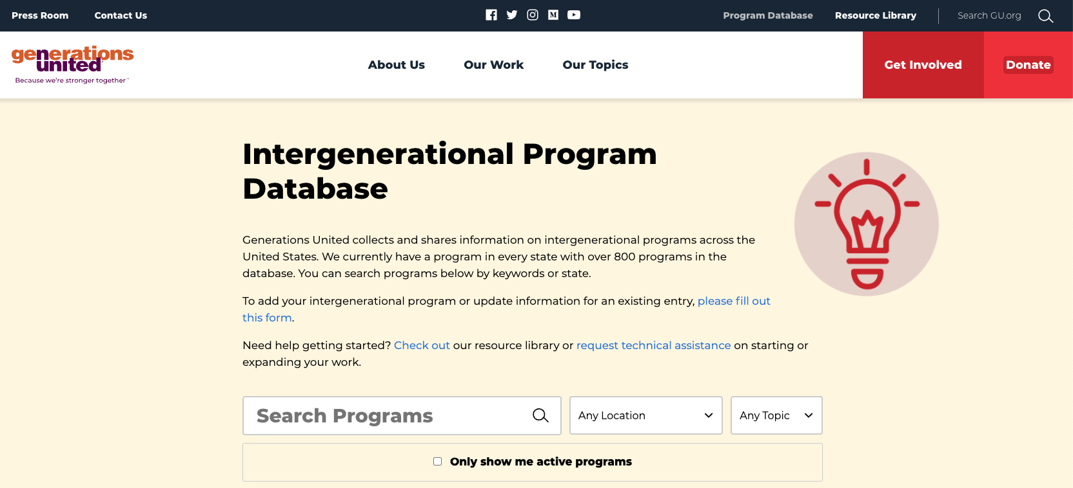
Resources and Community-Certificate

Slide 28
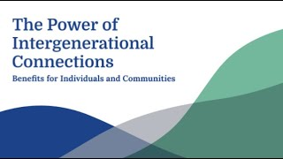

Resources and Community-Video

Slide 29
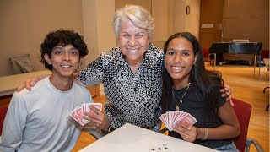

Resources and Community-Video

Slide 30
