Slide 1
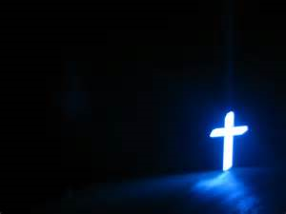
CHRISTOLOGY
The Doctrine of Christ

Slide 2
The Person & Work of Jesus Christ
We believe the Lord Jesus Christ, the eternal Son of God, second Person of the Trinity, of one substance, equal with the Father; became man, without ceasing to be God, having been conceived by the Holy Spirit and born of virgin Mary, and lived a sinless life. He came that He might reveal God and redeem sinful people (Luke 1:35; John 1:1,2,14).

Slide 3
We believe the Lord Jesus Christ accomplished our redemption through His death on the cross as a vicarious, substitutionary sacrifice and that our justification is verified by His literal, physical resurrection from the dead (Romans 3:24,25; Ephesians 1:7; Hebrews 2:9; 1 Peter 1:3-5 and 2:24; 1 John 2:2).

Slide 4
We believe the Lord Jesus Christ ascended to heaven and is now exalted at the right hand of the Father where, as our High Priest, He fulfills the ministry of Intercessor, and Advocate (Acts 1:9,10; Romans 8:34; Hebrews 7:25 and 9:24; 1 John 2:1,2).

Slide 5
CHRIST’S PERSON
HIS ETERNITY
  Was in the beginning (John 1:1, 2)
  Was from everlasting (Micah 5:2)
  Was before Abraham (John 8:58)
  The works of creation are ascribed to Christ (John 1:3)
  The angel of the Lord

Slide 6
HIS DIETY
  John 1:1-2
  Hebrews 1:8-10

Slide 7
  Titles of Christ
    Logos (word)
    Basic concept: The expression or communication of God
    Summary: Christ is the visible, tangible expression of God (John 1:14, 17, 18; 14:1)

Slide 8
  Son of God
    Did not imply subordination, but rather equality and identity of nature.
    Eternal generation – Psalm 2:7

