Slide 1
OLD TESTAMENT
PART 5
Hosea thru Malachi

Slide 2

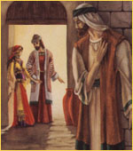
THE BOOK OF HOSEA

Slide 3

HOSEA
Author: Hosea means salvation.
Recipients: Primarily to Israel, sometimes called Ephriam.
Date: Between 785-725 BC—reign of Jeroboan II. Written before Assyria captured the Northern Kingdom.
Purpose: Show unfaithfulness, punishment and restoration of Israel.
Theme: The faithfulness of God's love.

Slide 4

Pictures of Israel that can be applied to our Christian commitment:
Morning Dew (6:4-6) Not lasting
A fire not stirred (7:4) Hot for a time
A cake not turned (7:8) Not deep
Grey hairs (7:9) Not strong
Silly dove (7:11) Not serious
Deceitful bow (7:16) Not dependable
A luxuriant vine (10:1) Misused prosperity
Like a heifer (10:11) Rebellious
Chaff (13:3) Useless
Smoke (13:3) Vanishes away

Slide 5
Israel’s blessings if they turn back to God
They will blossom like the lily.
They will take root like a tree.
Their shoots will spread out.
Their beauty will be like the olive.
Their fragrance will be like Lebanon.
They will dwell beneath the Lord’s shadow.
They will flourish like grain.
They shall blossom like the vine.
Their fame will be like the wine of Lebanon.

Slide 6
THE MINOR PROPHETS
Minor Prophets are minor only in the sense that they were shorter.
Hebrew Bible regards these writing as one book, and calls them simply “The Twelve.”
Hosea was the only writing prophet of Israel to Israel. He is the last prophet to Israel before their fall. Amos prophecies to Israel but he is from Judah
Three of the Minor Prophets ministered in the Northern Kingdom of Israel. They were in Chronological order: Jonah, Amos, Hosea.

Slide 7
MINOR PROPHETS
Hosea, Joel, Amos, Micah, Jonah – 8th century BC before Israel fell in 722 BC.
Nahum, Habakkuk, Zephaniah – 7th century contemporary with Jeremiah, before Jerusalem fell.
Obadiah – 6th century, shortly after fall of Jerusalem 586 BC.
Haggai, Zechariah, Malachi – 5th century after Israel’s return from exile.

Slide 8
MINOR PROPHETS (by recipients):
Prophets to Israel
  Hosea
Prophets to Judah
  Joel
  Habakkuk
  Zephaniah
Prophets to both:
  Amos
  Micah
Prophets to the Gentiles
  Obadiah – Edom
  Jonah – Nineveh
  Nahum – Assyria
Prophets after the Exile
  Haggai
  Zechariah
  Malachi
  Malachi

Slide 9
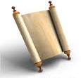
MINOR PROPHETS (chronological)
Obadiah 845
Joel 835-825
Jonah 784-722
Amos 780-740
Hosea 750-722
Micah 749-697
Nahum 650-620
Habakkuk 600
Zephaniah 630
Haggai 520
Zechariah 520-518
Malachi 436-416

Slide 10
JOEL
JEHOVAH IS GOD

Slide 11
JOEL
AUTHOR: Joel—name means Jehovah is God.
RECIPIENTS: All the inhabitants of the land of Judah.
DATE: Around 838-756 BC.
PURPOSE: God was bringing judgment on the people in order to bring them back to Him.
THEME: The Day of the Lord. Tribulation—Return of Christ—Millennial Reign.

Slide 12
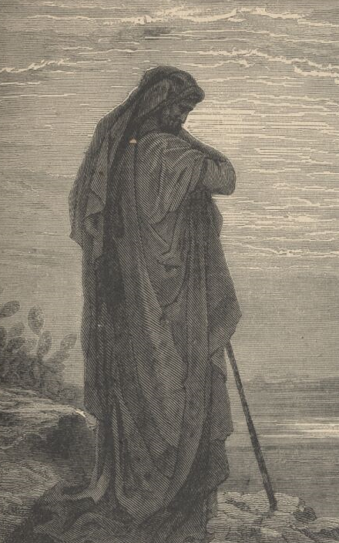
AMOS

Slide 13
AMOS
AUTHOR: Amos (burden)—a sheepherder until called by the Lord to prophesy.
RECIPIENTS: Israel—zenith of power.
DATE: Between 810-785 BC, during reign of Uzziah in Judah and Jeroboam II in Israel. Ministry lasted about 10 years.
PURPOSE: To pronounce the inevitable judgment of God on sin.

Slide 14
JUDGMENT AGAINST THE
GENTILE NATIONS
Damascus (1:3-6)
Gaza (Philista) (1:6-8)
Tyre (1:9-10)
Edom (1:11-12)
Ammon (1:13-15)
Moab (2:1-3)

Slide 15
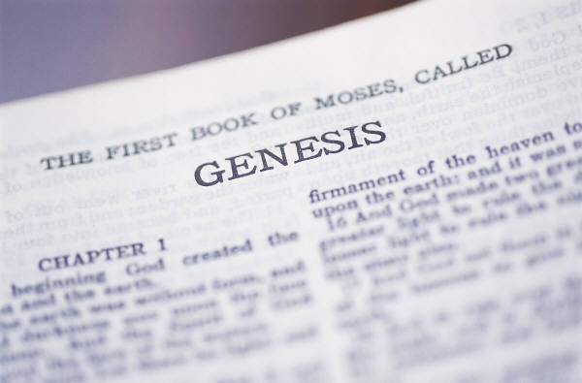
OLD TESTAMENT TEACHING OF KINGDOM AGE
The Millennial Kingdom will be a period of the full manifestation of the glory of the Lord Jesus Christ on earth

Slide 16
SOME CHARACTERISTICS ARE:
Righteousness will flourish (Isa 11:3-5 cp. Ps 2:9; Rev 2:27; 12:5; 19:15).
Peace universal (Isa 2:4; 9:6; Jere 23:5-8).
Productivity (Isa 35:1,2; Amos 9:13).
Longevity (Isa 65:20).
Limitation of curse (Isa 11:6-9; 65:25).
Healing (Isa 29:18; 35:5-6).

Slide 17
Reproduction (Isa 65:23).
Fruitful labor (Isa 62:8-9; 65:21-23; Jere 31:5; Ezek 48:18-19; Isa 30:23-24).
Joy (Isa 35:9-10; Zech 8:19).
Christ will reign personally (Ezek 37:27-28; Zech 2:10-13; Isa 9:6-7).
The kingdom had not yet come when Jesus ascended (Acts 1:6-8).
It will last 1000 years (Rev 20:1-7).

Slide 18
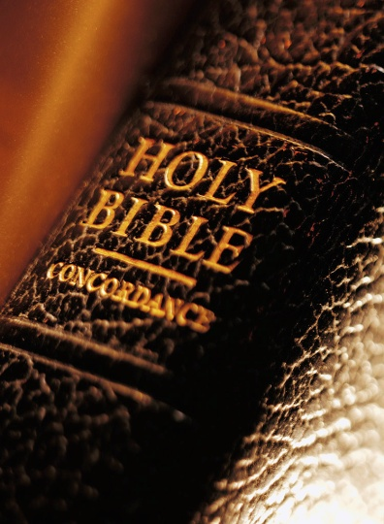

A Dispensational Understanding of the Kingdom
Acts 1:3
“Lord, is it at this time You are restoring the kingdom to Israel (Acts 1:6)?”
The kingdom was still coming.
John MacArthur states, “If they are mistaken about this, Jesus’ failure to correct them is mystifying and deceptive.”

Slide 19
The kingdom would take form as promised.
The kingdom therefore was postponed until Christ would return, but it was never withdrawn altogether,
The promised kingdom was still on the agenda-but when?

Slide 20
“Kingdom of God”
Three essential elements of any kingdom:
  There must be a ruler.
  There must be a realm to rule.
  There must be the exercising of authority.

Slide 21
In Scripture: Six unique kingdoms as related to God:
Universal kingdom of God.
Spiritual kingdom of God.
Theocratic kingdom.
Mystery form of the kingdom.
Messianic kingdom.
Eternal kingdom.

Slide 22
The kingdom is prominent in the Gospels but begins to fade in the Acts and the epistles.
“Kingdom” is found only five more times in Acts (8:12; 19:8; 20:25; 28:23, 31).

Slide 23

18 references to a kingdom in the epistles, most are referring to a future kingdom.
However, a few passages (only 4 clearly) such as Romans 14:17 and Colossians 1:13 show that God’s kingdom is a mediatorial kingdom. A kingdom already chartered but which will have its manifestation in the Millennium.

Slide 24


People’s good deeds toward one another and the planet are welcomed, but they do not form the kingdom, advance the kingdom or hasten the kingdom. The church’s mandate is not to clean up the planet, wipe out illness, eradicate poverty and injustice and call for peace treaties.

Slide 25


Our mandate is to make disciples of all nations (Matthew 28:19-20). We are not to set up Christ’s kingdom on earth, that is His job. We are instead to call sinners to Christ that they might join us in proclaiming “the excellencies of Him who has called you out of darkness into His marvelous light” (1 Peter 2:9).

Slide 26
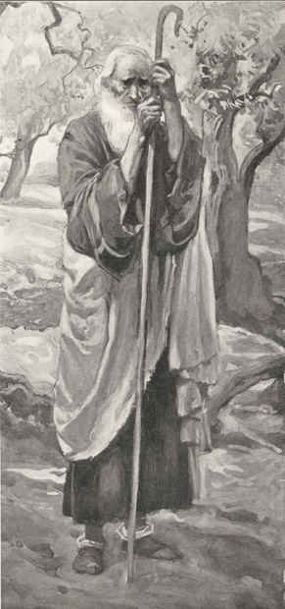
OBADIAH
THE
PROPHET

Slide 27
OBADIAH
AUTHOR: The prophet Obadiah.
RECIPIENTS: Edom—a nation descended from Esau, south of the Dead Sea.
DATE: Either 840 or 586 BC.
PURPOSE: To warn Edom of judgment soon to come upon them, because of their pride and malicious treatment of Judah.

Slide 28
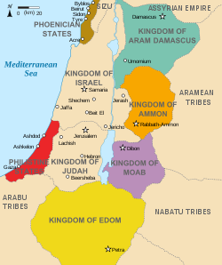
E
D
O
M

Slide 29

MODERN
DAY MAP
OF AREA
INCLUDING
EDOM

Slide 30
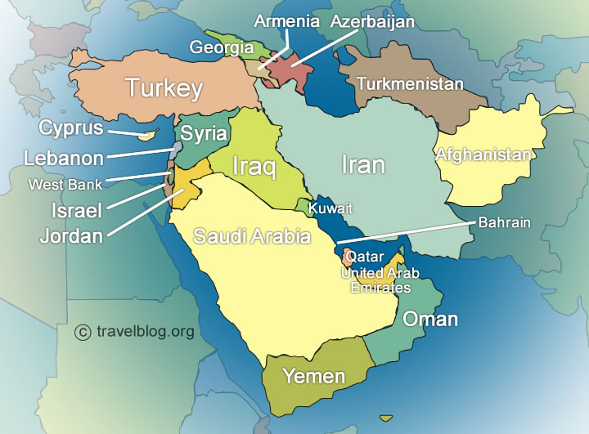
MODERN DAY MIDDLE EAST

Slide 31
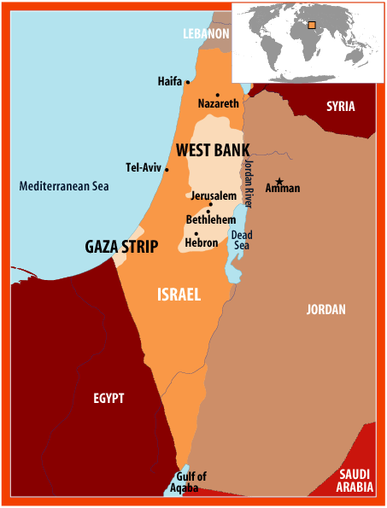
MODERN DAY
MIDDLE EAST

Slide 32
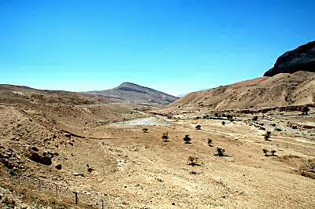
EDOM

Slide 33
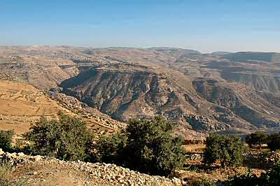
EDOM

Slide 34
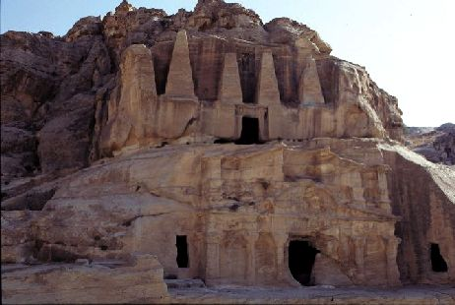
PETRA

Slide 35
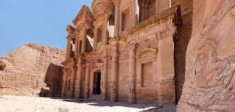
PETRA

Slide 36
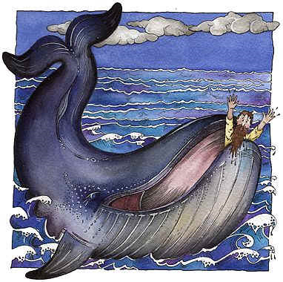
THE BOOK OF JONAH

Slide 37
JONAH
AUTHOR: The prophet Jonah. Mentioned in 2 Kings 14, Matthew 12, 16; Luke 11.
RECIPIENTS: Not stated. Describes ministry to Nineveh.
DATE: About 760 BC.
PURPOSE:
  1) Show God’s love for Gentiles—as for Israel.
  2) Show the compassion of God.
  3) Show God’s method of dealing with his own disobedient servant.

Slide 38
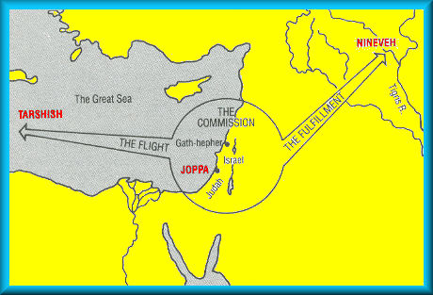
Jonah’s travels

Slide 39
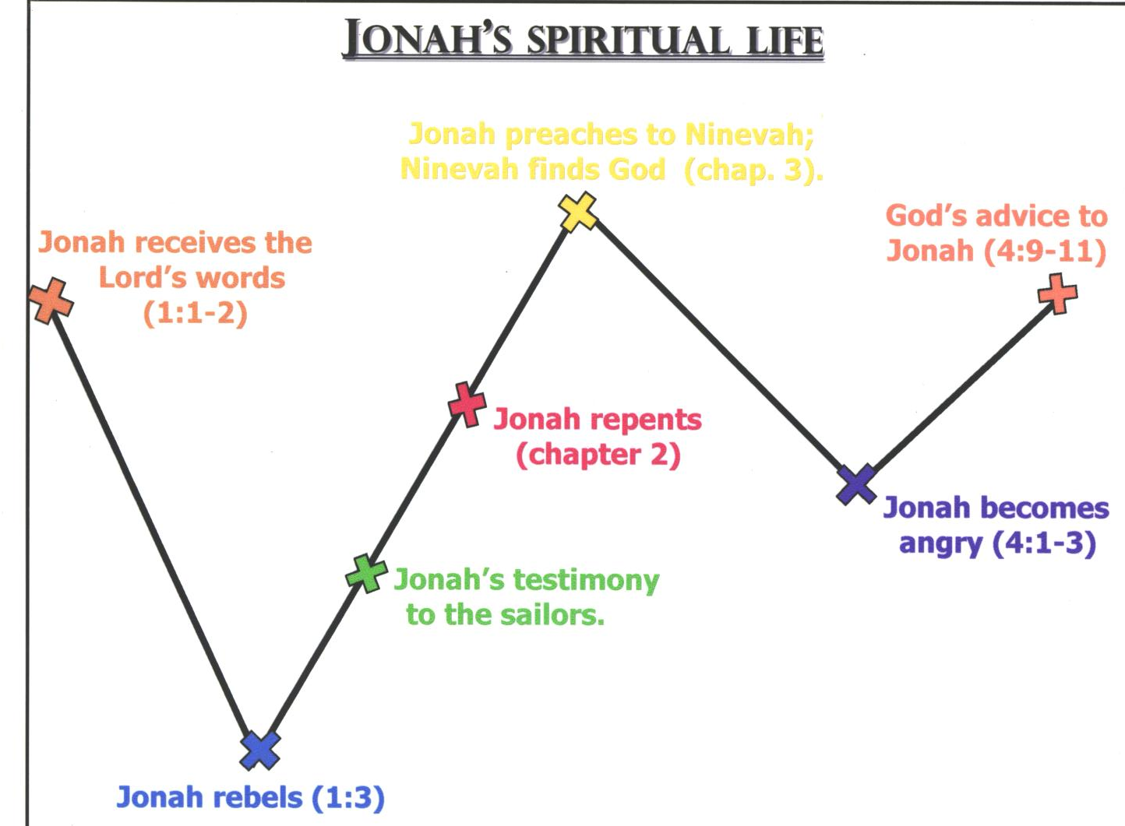
Jonah preaches to Nineveh; Nineveh finds God (chapter 3 )

Slide 40
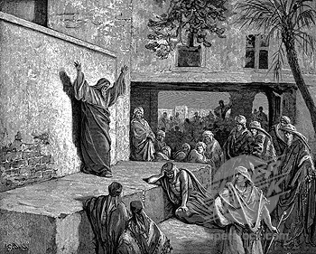
MICAH

Slide 41
MICAH
AUTHOR: The prophet Micah—a contemporary of Hosea in Israel and Isaiah in Jerusalem. Prophesied during reigns of Jotham, Ahaz and Hezekiah. Preached primarily to Judah, but also to Israel.
RECIPIENTS: Israel and Judah.
DATE: between 749-697 BC.
PURPOSE: Show sins of Israelites, inevitable coming of judgment and eventual restoration.

Slide 42
Future in the Kingdom Age
Jerusalem will become the center of the earth (v. 1).
Nations will gather there to be taught the ways of the Lord (v. 2).
War will cease and peace will be universal (vv. 3-4, cp Isa 2:4).
The Lord will gather the outcasts and make them into a strong nation (vv. 6-8).
The Lord will reign over them (v. 7b).

Slide 43
MICAH’S TRUST IN IN THE LORD
Who will hear him (v. 7)
Raise him up (v. 8a)
Will be his light (v. 8b
Plead his cause (v. 9a)
Will vindicate him (vv. 9b-10)

Slide 44
A NEW DAY FOR ISRAEL
Build walls (v. 11a)
Extend their boundary (v. 11b)
Have the nations come before them (vv. 12-13)
Be shepherd in the land of their inheritance (vv. 14-15)
Will see the nations turn to the Lord and fear Israel (7:16-17)

Slide 45
THE GREATNESS OF GOD
Pardons sins (v. 18a)
Does not stay angry forever (v. 18b)
Delights in lovingkindness (v. 18c)
Will again have compassion on Israel (v. 19a)
Do away completely with all their sins (v. 19b; cp Psalm 103:12)
Will keep His promises to Israel in faithfulness and lovingkindness (v. 20)

Slide 46
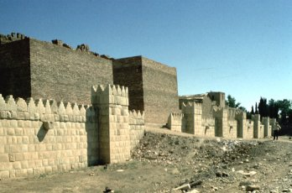
NAHUM
NINEVEH

Slide 47
NAHUM
AUTHOR: Nahum—this is the only mention of him in Scripture.
RECIPIENTS: Nineveh—the capitol of Assyria.
DATE: Between 663-612 BC – about 100 years after the revival under Jonah. Nineveh was destroyed in 612 BC.
PURPOSE: To announce judgment on Nineveh and show a reason for it.

Slide 48
The Wrath &
Goodness of God
The Lord is jealous and avenging (v. 2).
The Lord is slow to anger and great in power (v. 3a).
The Lord will never clear the guilty. He will ultimately avenge sin (vv. 3b-5).
No one can stand before His wrath (v. 6).
The Lord is good and a refuge to those who know Him (v. 7).
The Lord will destroy those who oppose Him (vv. 8-10).

Slide 49
Devastation of Nineveh
Because of their evil (vv. 1, 4) they will be overrun by superior forces (vv. 2-3).
But their destruction ultimately comes from the hand of God since He is against them (vv. 5-7).
Thinking they have the means to escape, God informs them that no escape is possible (vv. 8-13).
No matter what efforts they make to protect themselves they will inevitably fall and be scattered (vv. 14-17).
Assyria’s situation is hopeless and those who hear the news will rejoice because of all their evil (vv. 18-19).

Slide 50


Slide 51
HABAKKUK
AUTHOR: The prophet, Habakkuk. Nothing is known of his life.
RECIPIENTS: Not stated—probably Judah.
DATE: Written between the reign of Josiah and the time of the final overthrow of Jerusalem. Possibly during the reign of Jehoiakim (610-599 BC).
PURPOSE: To defend God’s goodness and power in view of the existence of evil.
THEME: “The just shall live by faith.”

Slide 52
HABAKKUK COMPLAINS TO GOD
Lack of action (v. 2) Why is the Lord waiting so long to act in the face of injustice?
Having to personally face iniquity and its consequences (v. 3).
Injustice (v. 4).

Slide 53
HABAKKUK—Lessons in Prayer
Habakkuk’s Questions
God’s Answers
Impatience with God
“Lord, how can You allow
Judah to remain in sin
without punishing her?”
(1:1-4)
“Lord, how can You punish
Judah with someone more
wicked than herself?” (1:12-2:1)
“Lord, I don’t understand,
But I will trust You.” (3:1-19)
“I am raising up the Chaldeans to punish Judah.” (1:5-11)
“The righteous will live by Faith.” (2:2-20)
You won’t believe what I am going to
do.
Justify Your actions
TRUST GOD

Slide 54
JUDGMENT ON BABYLONIANS
For plundering the nations (vv. 6b-8).
For getting gain through evil to provide false security (vv. 9-11).
For building cities through the murder of people (vv. 12-14).
For drunkenness and lewdness (vv. 15-17).
For idolatry (vv. 18-20).

Slide 55
THOSE WHO HAVE:
Plundered others will be plundered (vv. 7-8a).
Received evil gain will forfeit their lives (vv. 10-11).
Built cities through murder will find that their efforts were in vain (vv. 13-14).
Live for drunkenness and lewdness will be shamed (v. 16) and be violently overwhelmed (v. 17).
Worshiped idols will forfeit the true God (v. 20).

Slide 56
FAITH WILL PRODUCE FAITHFULNESS
In Romans—the emphasis is on the “RIGHTEOUS” (1:17).
In Galatians—the emphasis is on “SHALL LIVE” (3:11).
In Hebrews—the emphasis is on “BY FAITH” (10:38).

Slide 57
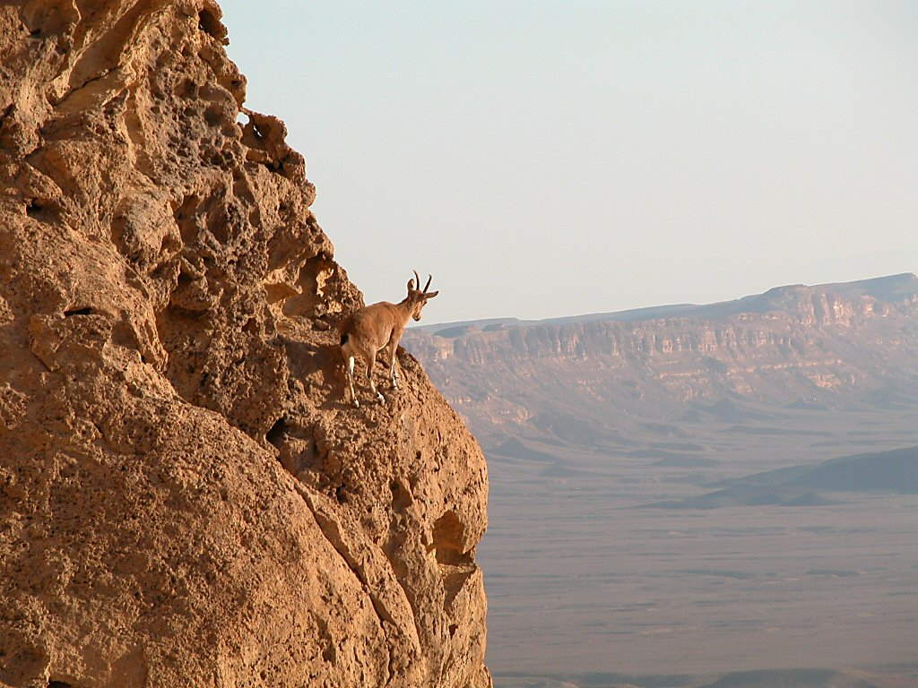
Ibex on cliff in Machtesh Ramon
“The LORD God is my strength, and He has made my feet like hinds' feet, and makes me to walk on my high places.”
Habakkuk 3:19
Ibex on cliff in Machtesh Ramon
Notes:
57
Habakkuk 3:19 (KJV) “The LORD God is my strength, and he will make my feet like hinds' feet, and he will make me to walk upon mine high places.

Slide 58
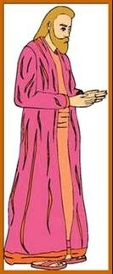
zephaniah

Slide 59
ZEPHANIAH
AUTHOR: The prophet, Zephaniah, who was the great-great grandson of Hezekiah.
RECIPIENTS: Judah and Jerusalem.
DATE: Probably written around 630-625 BC before the great reformation which was in the 18th year of Josiah’s reign (2 Chron 34:8); that is about 621 BC.
PURPOSE: To warn Judah of the coming judgment and to comfort the faithful remnant.
THEME: The Day of the Lord as prefigured by the Babylonian invasion.

Slide 60

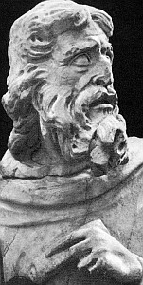
HAGGAI

Slide 61
HAGGAI
AUTHOR: Haggai. Jewish tradition says he was a Levite who returned with Zerubbabel to Jerusalem.
RECIPIENTS: All returned exiles—especially Zerubbabel and Joshua.
DATE: 520 BC—covers 4 months during second year of Darius’ reign. Haggai was contemporary with Zechariah.
PURPOSE: To encourage the people to rebuild the Temple.

Slide 62
HAGGAI can be divided into 4 messages
A word of REPROOF (1:2-11).
A word of SUPPORT (2:1-9).
A word of BLESSING (2:10-19).
A word of PROMISE (2:20-23).

Slide 63
THE PROPHECY
Be strong and complete the work (v. 4a).
The Lord is with them as promised in His covenant with them so they have no need to fear (vv. 4b-5).
The Lord will yet bring the world’s treasures into this house (vv. 6-7a).
The Lord will fill the temple with glory, so that it will outshine the glory of the first temple (vv. 7b-9a).
The Lord will give peace (v. 9b).

Slide 64
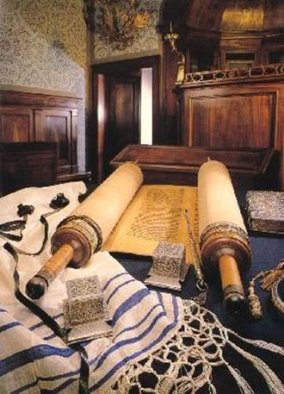
ZECHARIAH

Slide 65
ZECHARIAH
AUTHOR: Zechariah, the grandson of Iddo.
RECIPIENTS: All the people who had returned from captivity.
DATE: Second to fourth year of King Darius 520-518 BC.
PURPOSE: To encourage the people to complete the unfinished Temple.
THEME: The two advents of the Messiah, Israel’s great Deliverer.

Slide 66
THE VISIONS OF ZECHARIAH
VISION
INTERPRETATION
Horses and riders (1:7-17)
Four horns & four workmen (1:18-21)
Surveyor (2:1-13)
Joshua—the High Priest (3:1-10)
Golden Lampstand (4:1-14)
God will restore Israel
God will destroy Israel’s oppressors.
The assured restoration & blessing of Israel & Jerusalem.
Satan is our accuser, but Joshua given God’s righteousness.
Through power of the Holy Spirit, Zerubbabel will be able to build Temple.

Slide 67
THE VISIONS OF ZECHARIAH
VISION
INTERPRETATION
Flying Scroll (5:1-4)
Woman in the Ephah (5:5-11)
Four Chariots (6:1-8)
A curse will fall on the people if they continue to sin.
Wickedness among the people will to be removed.
The 4 spirits of the heavens which go out to execute God’s judgment on the great world powers.

Slide 68
REVELATIONS CONCERNING THE KING
ZECH 9 ― the coming of the King.
ZECH 10 ― the call of the King.
ZECH 11 ― the crucifixion of the King.
ZECH 12 ― the curse of the King.
ZECH 13 ― the compassion of the King.
ZECH 14 ― the coronation of the King.

Slide 69
PROPHECIES IN ZECHARIAH
PROPHECY OF CHRIST
FULFILLMENT IN N. T.
SERVANT (3:8)
BRANCH (3:8; 6:12)
KING-PRIEST (6:13)
LOWLY KING (9:9-10)
BETRAYED (11:12-13)
HANDS PIERCED (12:10)
CLEANSING FOUNTAIN (13:1)
HUMANITY & DEITY (13:7; 6:12)
SMITTEN SHEPHERD (13:7-9)
SECOND COMING & CORONATION (14:5, 9)
Mark 10:45
Luke 1:78, (margin KJV)
Hebrews 6:30-7:1
Matthew 21:4-5; John 12:14-16
Matthew 27:9
John 19:37
Revelation 1:5
John 8:40; 1:1
Matthew 26:31; Mark 14:27
John 10:16; Revelation 11:15; 21:27

Slide 70
Descriptions of the coming of the Lord
Jerusalem falling to their enemies and half the city going into exile (vv. 1-2).
The Lord then battles the invaders (v. 3).
As He returns He will stand on the Mount of Olives and it will split in two (v. 4).
The Jews will flee (v. 5a).

Slide 71
Coming of the Lord (cont’d)
The Lord returns with His holy ones (v. 5b).
This will be unlike any other day (vv. 6-7).
Living waters will flow from Jerusalem (v. 8).
The Lord will be King over all the earth (v. 9).
The topography of the land will change (v. 10).

Slide 72
Coming of the Lord (cont’d)
Jerusalem will dwell in security (v. 11).
The opposing armies will be destroyed (vv. 12-15).
All survivors will worship the Lord and keep the Feast of Booths (v. 16).
Any who do not keep the feast will not receive rain (vv. 17-19).
Life will now be holy to the Lord (vv. 20-21).

Slide 73
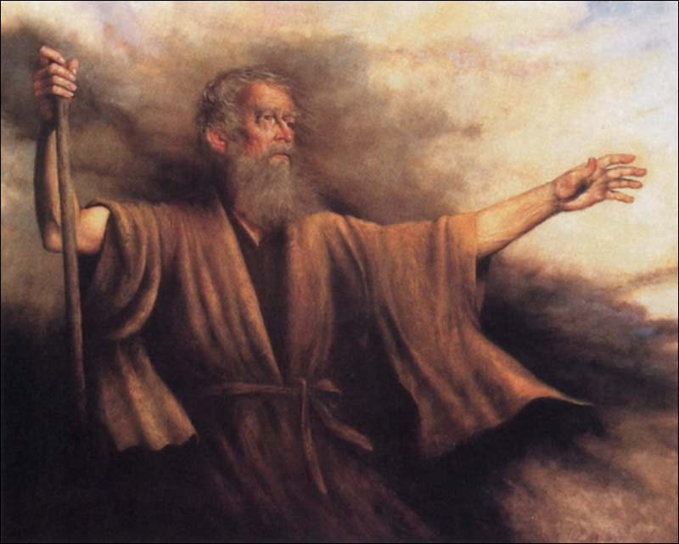
MALACHI

Slide 74
MALACHI
AUTHOR: Malachi. Nothing else known.
RECIPIENTS: People of Israel who had returned to the land after their captivity.
DATE: Between 450-400 BC.
PURPOSE: People were mechanically keeping the Law but in a backslidden condition. Malachi rebukes them and calls them to repentance.
SPECIAL NOTE: Question & answer method—23 questions in this book. People use 7 of them for their defense.

Slide 75
The sins of the people described by what they lost.
Lost their separation—married Gentiles (2:11).
Lost their homes—through divorce (2:13-16).
Lost their understanding of God—thought God favors the evil-doer. God should have acted by now, etc (2:17).
Lost the sensitivity to God’s spirit—didn’t know how to return to God (3:7).
Lost the blessing of giving (3:8-12).
Lost the joy of service (3:13-15)

Slide 76
Questions and Statements from the Israelites to God
“How have You loved us” (1:2)?
“How have we despised Your name” (1:6)?
“How have we defiled You” (1:7)?
“The table of the Lord is defiled” (1:12).
“What weariness this is” (1:13).
“Why does He not” (2:14)?

Slide 77
Questions of the Israelites to God
“How have we wearied Him” (2:17a)?
“Where is the God of justice” (2:17b)?
“How shall we return” (3:7)?
“How have we robbed You” (3:8)?
“How have we spoken against You” (3:8)?
“It is vain to serve God” (3:14).

Slide 78
This power point has been produced by
Southern View Chapel
Springfield, IL
All rights are reserved. May not be reproduced without permission of the publisher.
Please contact us for further information at email: svchapel@svchapel.org

