Slide 1
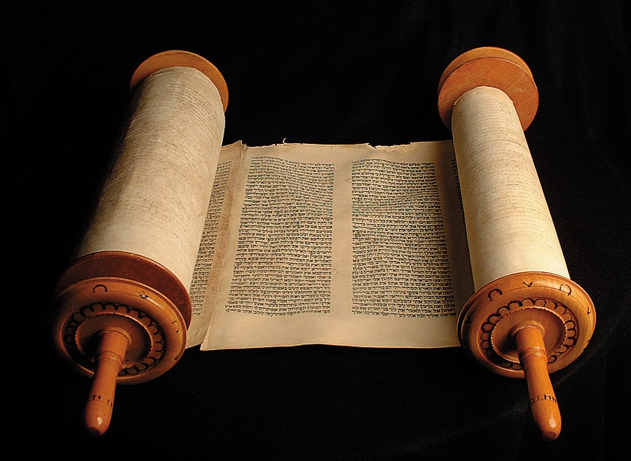
OLD TESTAMENT
SURVEY

Slide 2
ATTITUDES TOWARD BIBLE STUDY
FAULTY ATTITUDES
  The Negative
  The Closed Heart
  The Lazy
HELPFUL ATTITUDES
  The Positive
  The Receptive
  The Expectant
  The Faithful

Slide 3
WHAT IS THE BIBLE?
A Miracle Book
      Its Birth
      Its Unity
      Its Transmission
      Its Survival
A Manual for Living
      Our Maker
      Our Destiny
      Our Present Life
It is Manna for Strength

Slide 4
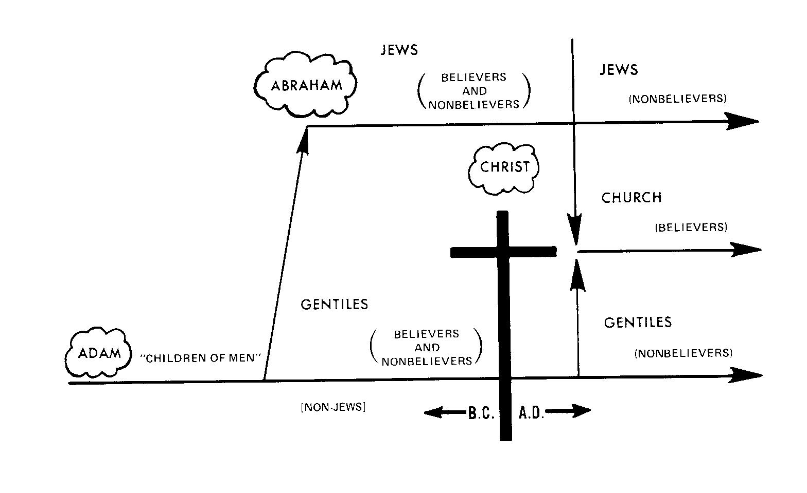
THE STREAM OF THE HUMAN RACE

Slide 5
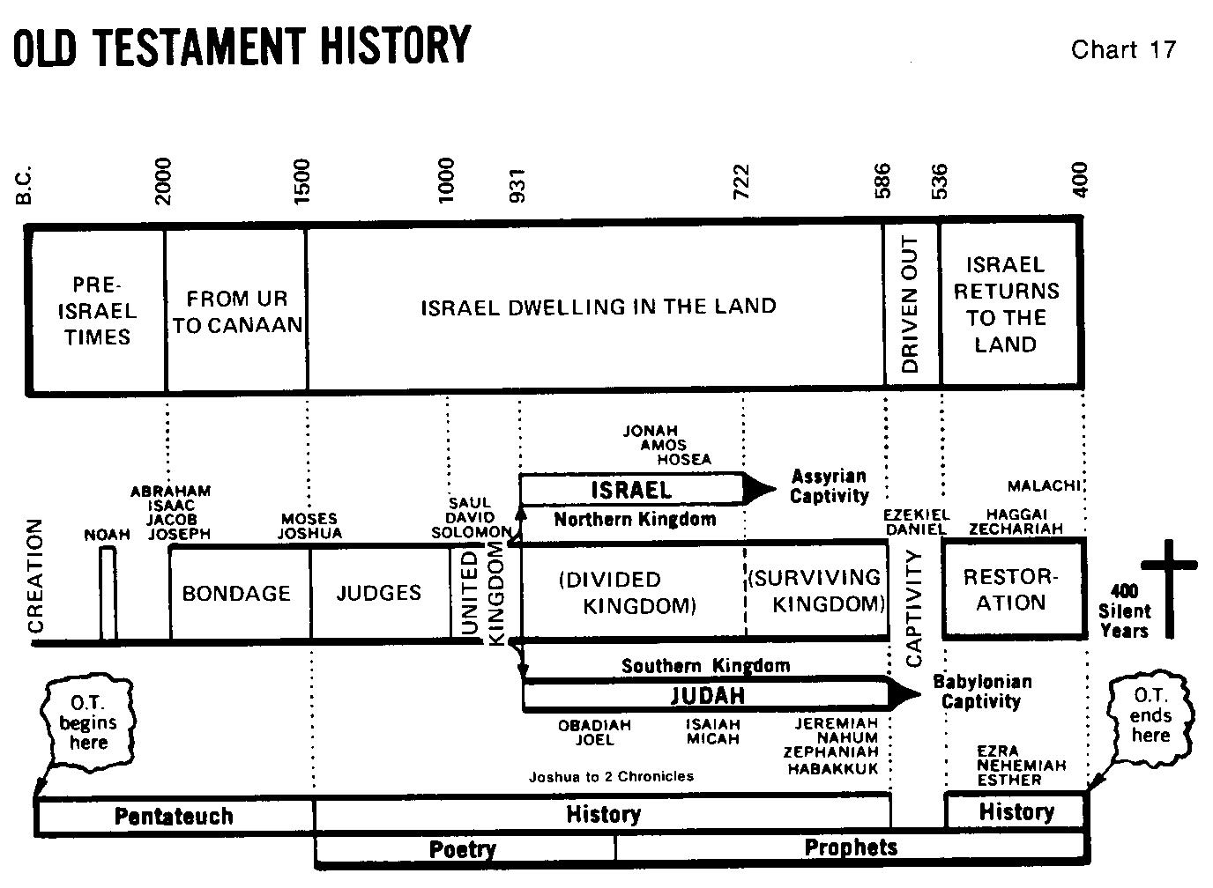

Slide 6
OLD TESTAMENT BOOKS
5 | 12 | 5 | 5 | 12
Pentateuch | History | Poetry | Major Prophets | Minor Prophets
Genesis to Deuteronomy | Joshua to Esther | Job to Song of Solomon | Isaiah to Daniel | Hosea to Malachi
Mainly Narrative | Mainly Narrative | Mainly Reflection | Mainly Oracles | Mainly Oracles

Slide 7
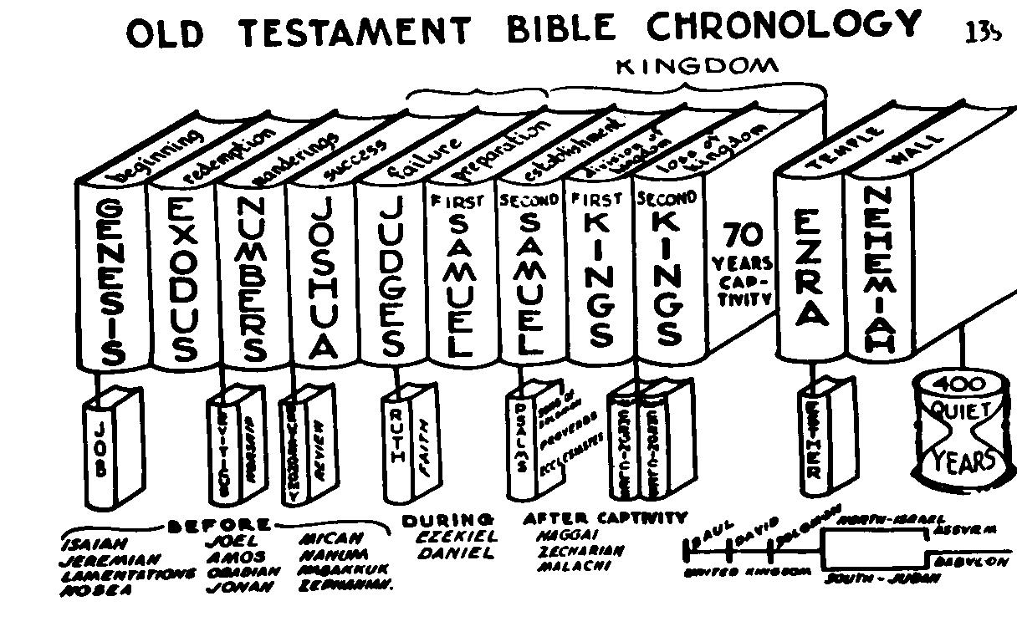

Slide 8
PURPOSE OF GENESIS 1-12
Show Beginnings of:
Universe (1:1)
Man (1:26,27)
Sabbath (2:2,3)
Marriage (2:21-24)
Sin (3:1-7)
Sacrifice (3:21; 4:1-7)
Governments (9:6)
Nations (10:32)
Nation of Israel (12:1)

Slide 9
OUTLINE OF GENESIS
1 Creation
2-5 Adam
6-11 Noah
12-23 Abraham
24-27 Isaac
28-36 Jacob
37-50 Joseph

Slide 10
OT NAMES FOR GOD
LORD = JEHOVAH = “I AM” (All Sufficient) YAHWEH
Lord = ADONAI = MASTER
GOD = ELOHIM = THE STRONG ONE
THEOS = GOD = EL
KURIOS = LORD = JEHOVAH

Slide 11
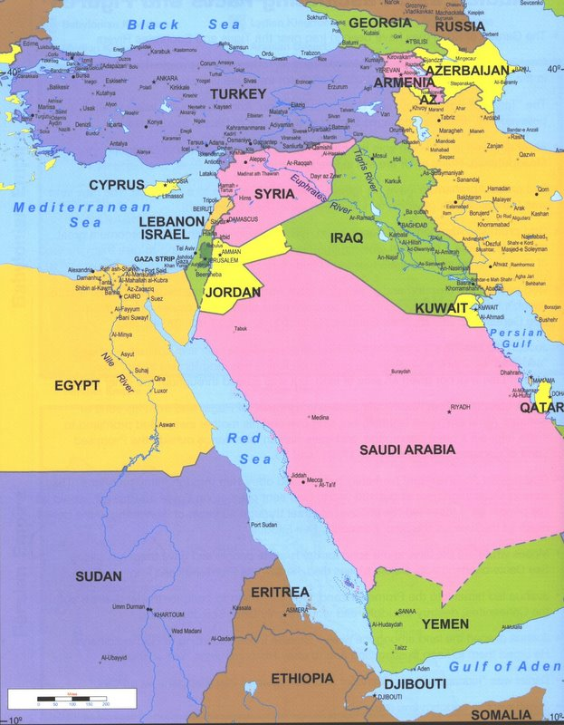
Map of Asia
MAP
OF
ASIA

Slide 12
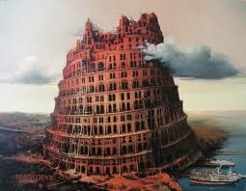
TWO PURPOSES
To assure that they would have the strength that comes with unity.
To make a name for themselves.
Tower of Babel

Slide 13
Map of Asia
MAP
OF
ASIA

Slide 14
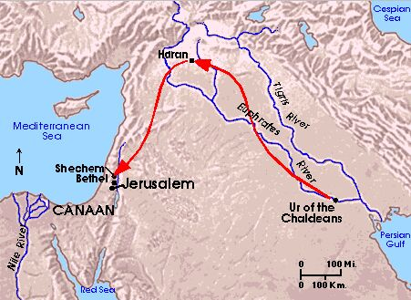
Journey of Abraham from UR to Haran

Slide 15
The Call of Abram
“A world having turned from God, He left it and chose a man, through whom He would ultimately, by Christ, reach the lost world.” Scroggie
Only man who was ever called “The friend of God” (2 Chron 20:7).
Acts 7:2-4 – God called Abram out of Ur; then later out of Haren (Gen 12:1-5).
Hebrews 11:8 – Abram went out not knowing where he was going.

Slide 16
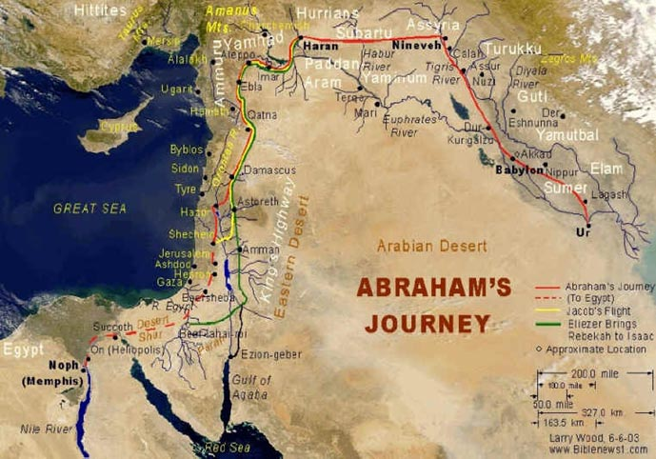
Journey from Haran to Egypt

Slide 17
GOD TESTED ABRAHAM’S CHARACTER
12:1 – Test of obedience
13:5-18 – Test of values
14:1-24 – Test of love and loyalty
15:1-21:34 – Tests of faith
22:1-19 – Test of dedication
22:20-25:18 – Final years

Slide 18
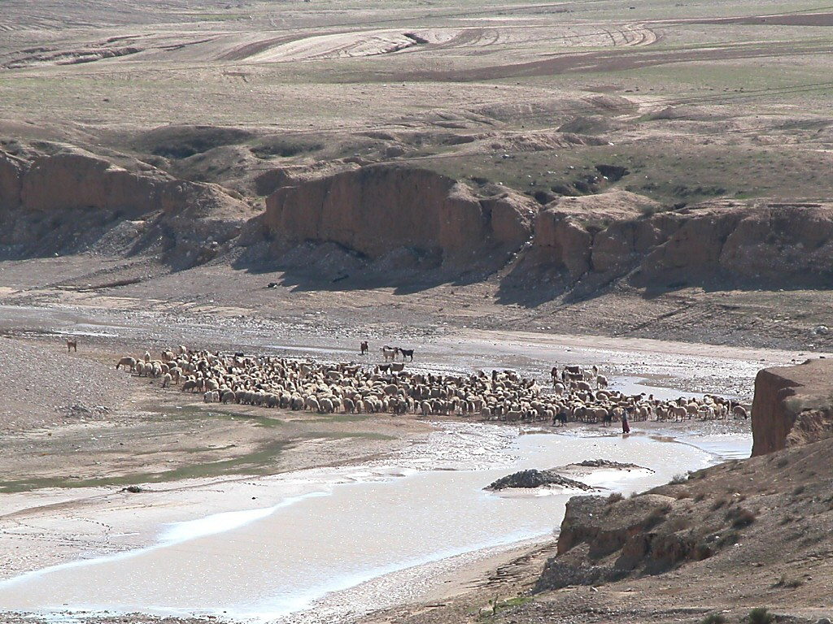
Nahal Beersheba with sheep at water
Nahal Beersheba with sheep at water
Notes:
Psalm 126:4 (NIV) “Restore our fortunes, O LORD, like streams in the Negev.”

Slide 19
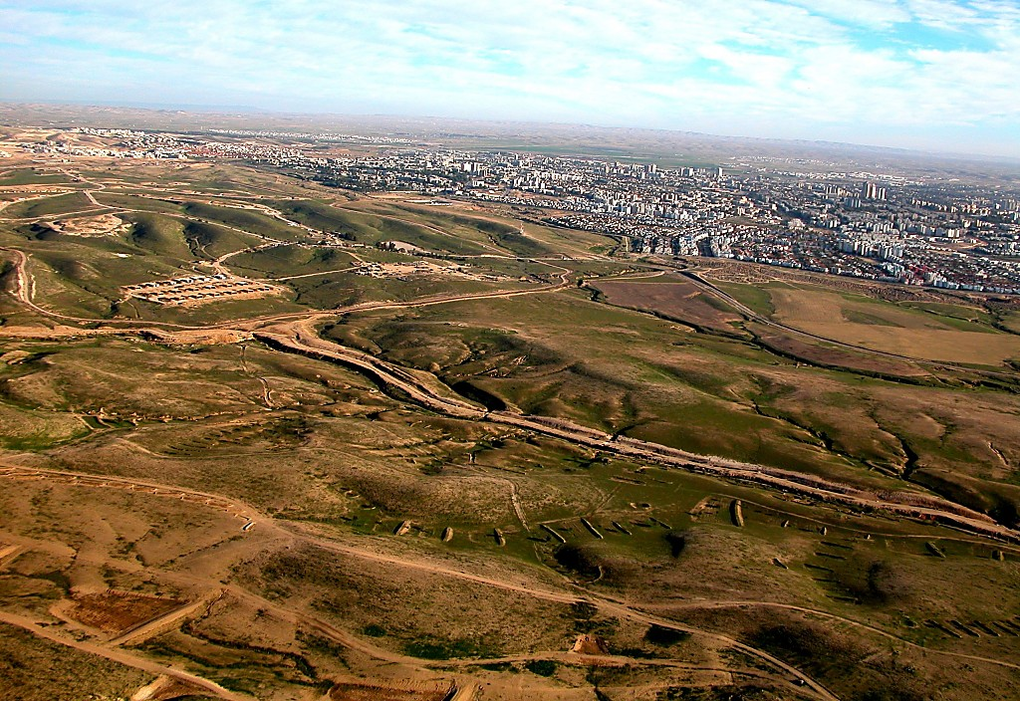
Beersheba modern city aerial from northwest
Beersheba modern city aerial from northwest

Slide 20
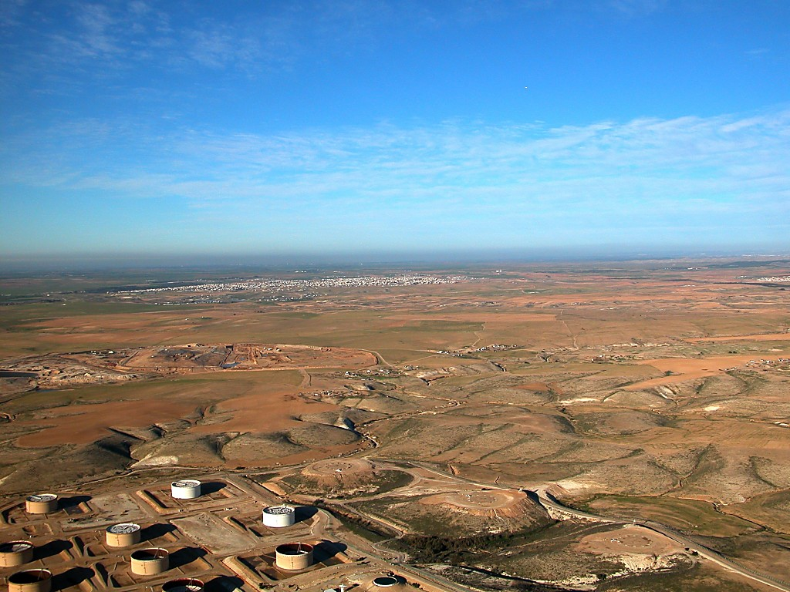
Negev north of Beersheba aerial
Negev north of Beersheba aerial

Slide 21
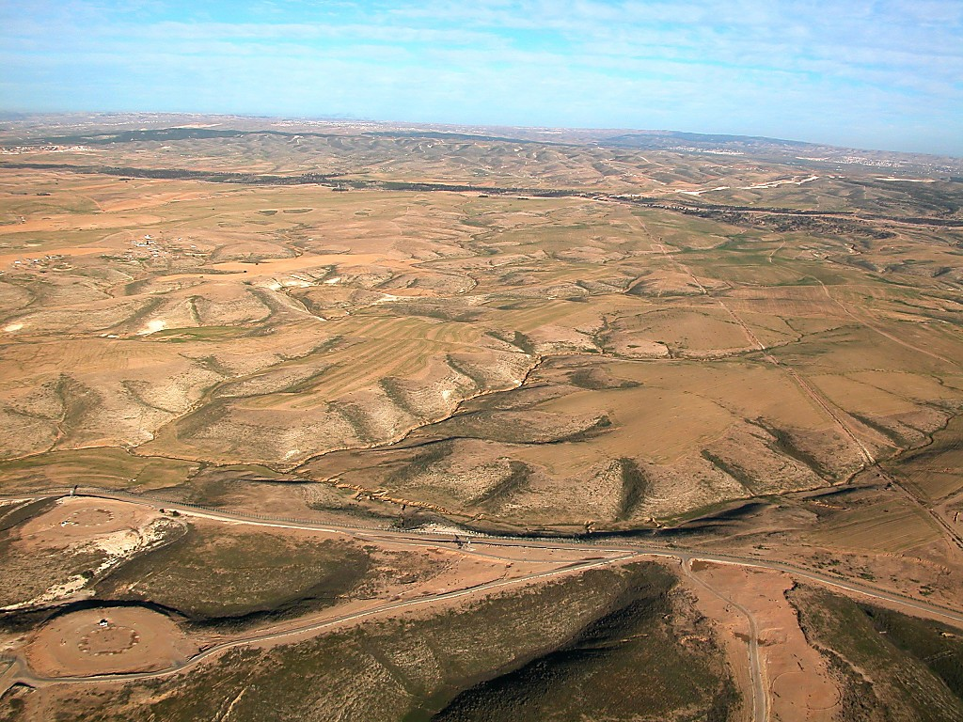
Negev north of Beersheba aerial
Negev north of Beersheba aerial

Slide 22
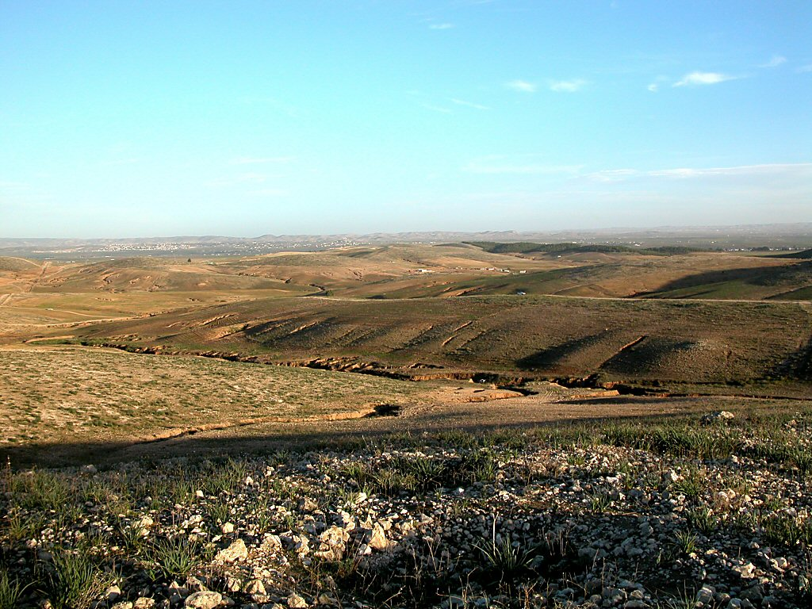
Negev hills north of Beersheba
Negev hills north of Beersheba

Slide 23
Journey of Abraham from Ur to Haran

Slide 24
Journey from Haran to Egypt

Slide 25
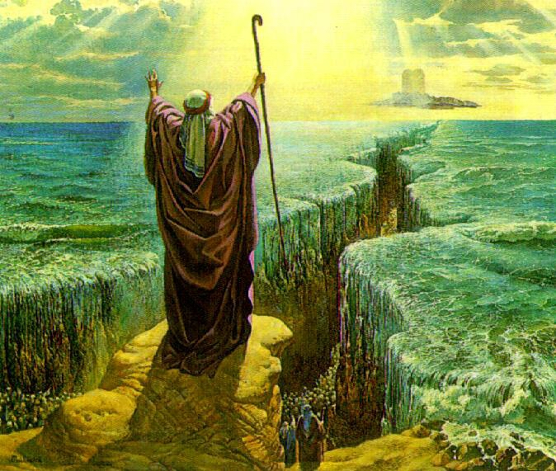
E
X
O
D
U
S

Slide 26
EXODUS
THEME: Redemption by blood & power
AUTHOR: Moses
TIME: 1520s – 1444 (The Exodus was 1446)
EXTENT: Approx. 126 years
KEY VERSE: 20:2

Slide 27
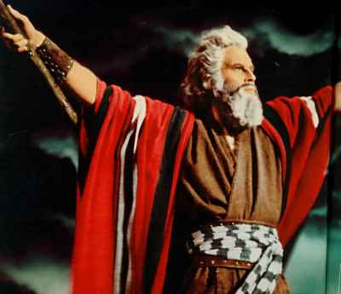
MOSES FIVE EXCUSES
MOSES EXCUSES | GOD’S ANSWER
1. No confidence | 1. His presence (3:11,12)
2. No message | 2. His name (3:13,14)
3. No authority | 3. His power (4:1-9)
4. No ability | 4. Will give ability (4:10-12)
5. No desire to go | 5. His instruction (4:13-17)

Slide 28
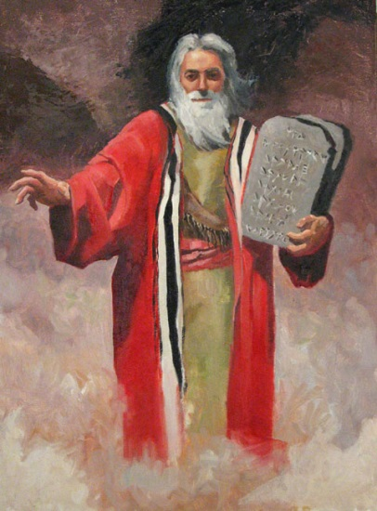
3 Periods of Moses’ Life
First 40 years: A Prince: he saw his
own importance.
Second 40 years: A shepherd: he saw himself as unimportant.
Third 40 years: A leader: he saw the importance and power of God.

Slide 29

CONFLICT BETWEEN GOD & PHARAOH
THREE PURPOSES
To Reveal the power of God over the gods.
To Show that Israel belonged to God, not Pharaoh.
To Establish the faith of Israel in God.

Slide 30
The Plagues of Egypt
# | PLAGUE | REF. | ATTACK | EFFECT
1 | BLOOD | 7:14-25 | The Idol River | Hardened
2 | FROGS | 8:1-15 | Goddess Hekt (w/ frog head) | Hardened
3 | LICE | 8:16-19 | Seb, the Earth God | Hardened
4 | BEETLES | 8:20-32 | The Sacred Scarabaeus | Compromise
5 | LIVESTOCK | 9:1-7 | Apis, the Sacred Bull | Hardened

Slide 31
The Plagues of Egypt
# | PLAGUE | REF. | ATTACK | EFFECT
6 | BOILS | 9:8-12 | Typhon, the Evil Genius | Hardened
7 | HAIL & FIRE | 9:13-35 | Shu, the Atmosphere | Hardened
8 | LOCUSTS | 10:1-20 | Serapia, Protector from Locusts | Compromise
9 | DARKNESS | 10:21-29 | Ra, the Sun God | Compromise
10 | DEATH OF FIRST BORN | 11:1-12:36 | All Gods | Capitulation

Slide 32
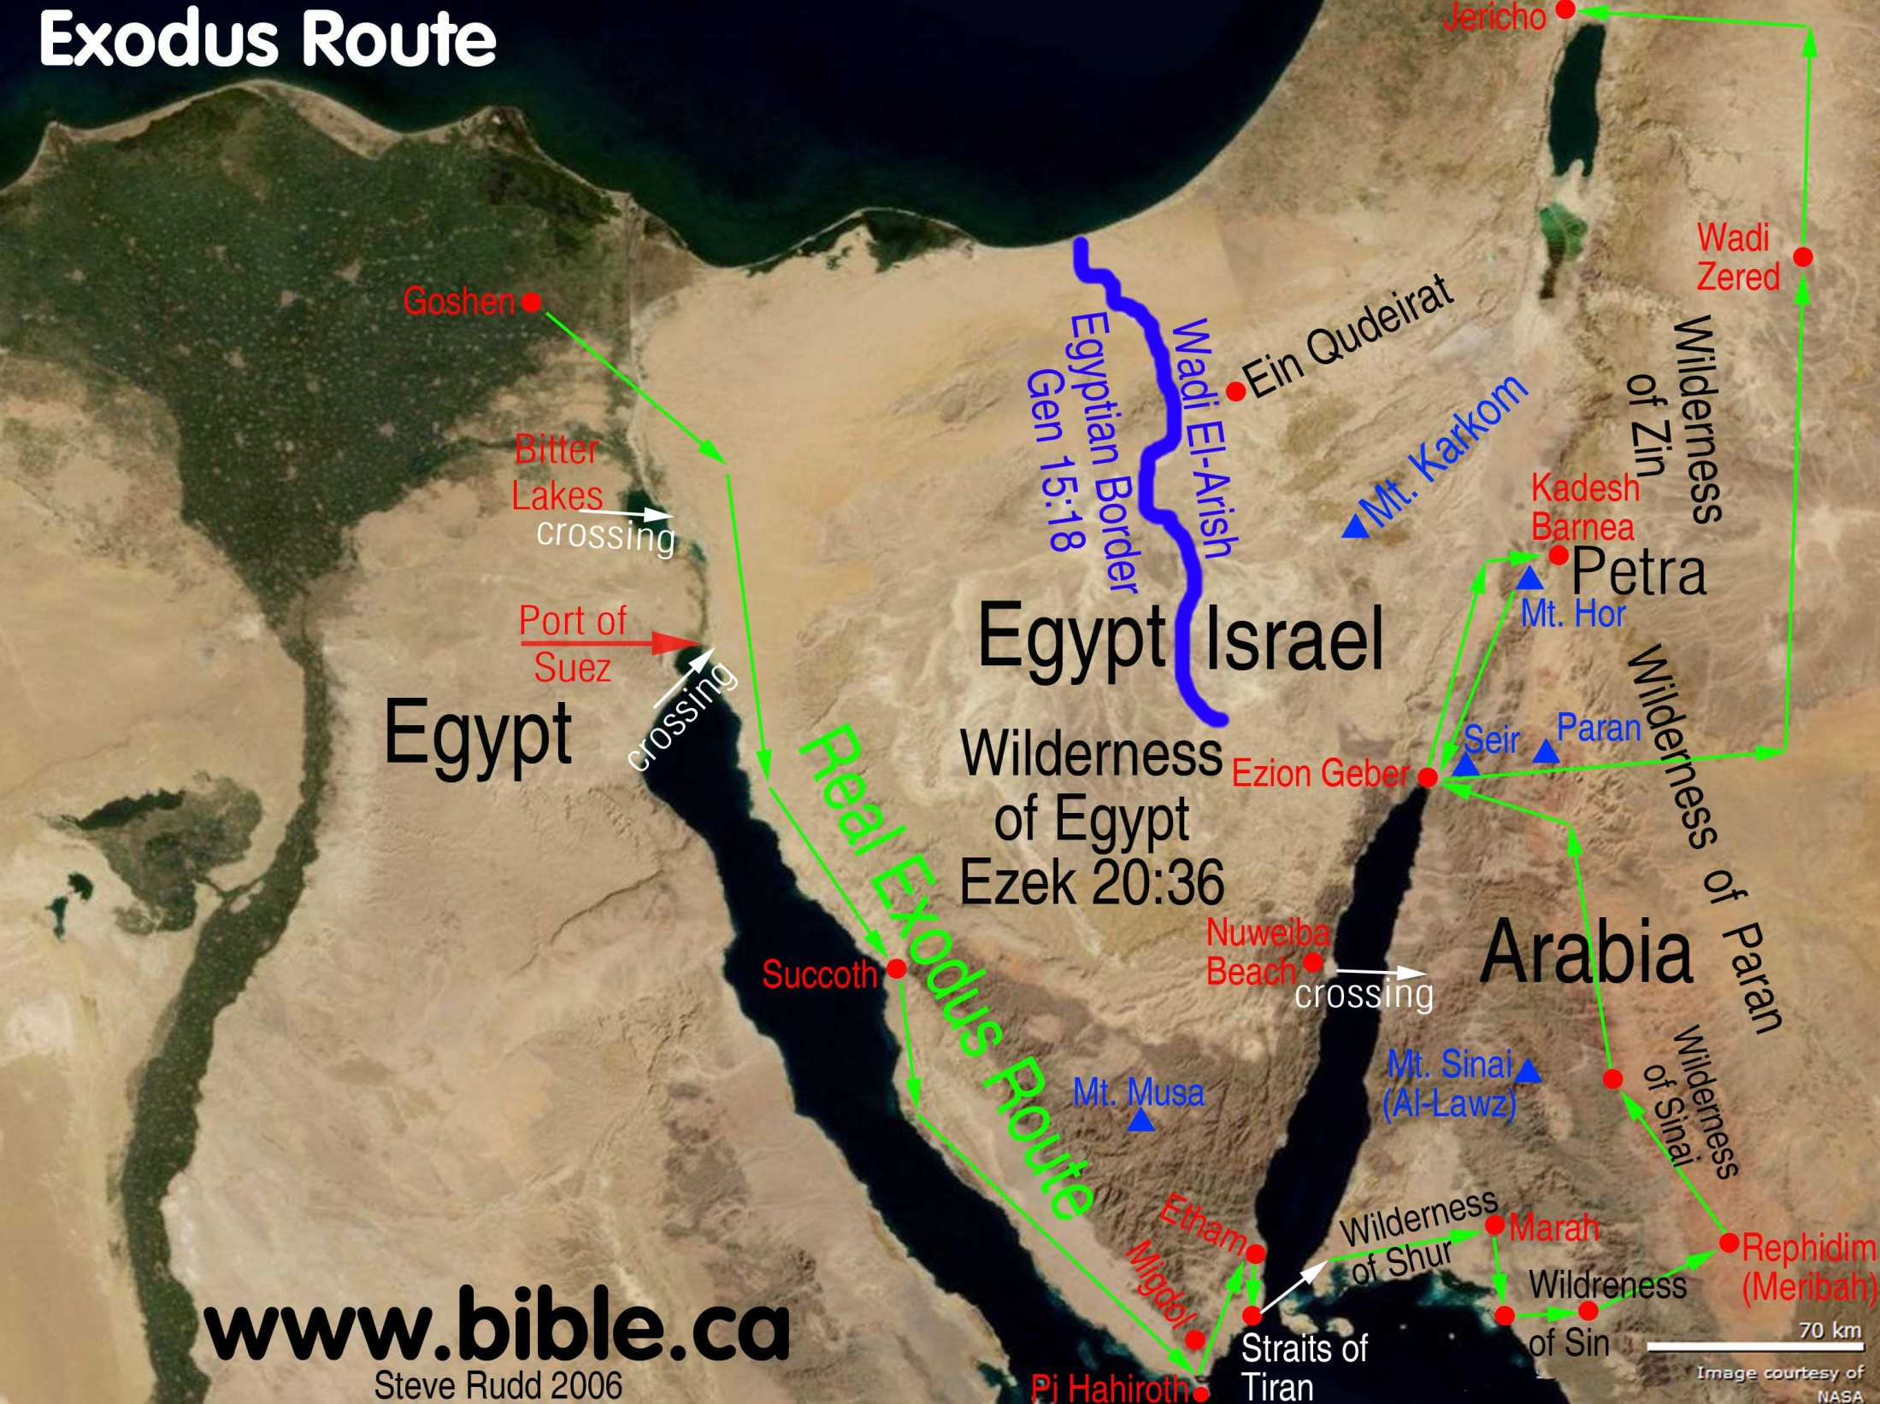

Slide 33
DISPENSATIONS
Rapture
Human Government
Conscience
Innocence
Promise
Law
Grace
Kingdom
Responsibility:
Failure:
Judgment:
Tribulation
Law (Grace) Tribulation

Slide 34
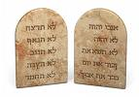
TEN COMMANDMENTS
Have no other gods.
Have NO idols.
DO NOT take the Lord’s Name in vain.
Keep the Sabbath Day.
Honor father and mother.
DO NOT murder.
DO NOT commit adultery
DO NOT steal.
DO NOT lie.
DO NOT covet.

Slide 35
Tabernacle Model
The Pictorial Library of Bible Lands provides PowerPoint files in addition to individual jpg images. This may make it easier for those using PowerPoint to quickly copy and paste slides into their own presentations. The PowerPoints also have some measure of organization (usually in a logical tour sequence), whereas the jpg images are listed alphabetically. Note though that the PowerPoint files do not include the highest-resolution images (1600x1200 or higher) for reasons of space and performance. The images in the PowerPoints are approximately 1024x768 (XGA), the maximum that most projectors and many monitors are capable of. Users will particularly benefit from accessing the individual higher-res jpg images if 1) they have a projection system higher than XGA; 2) they want to zoom in on a particular portion of an image; 3) they want to crop, edit, adapt, or print an image. See also the “Readme” file for more information and tips.

Slide 36
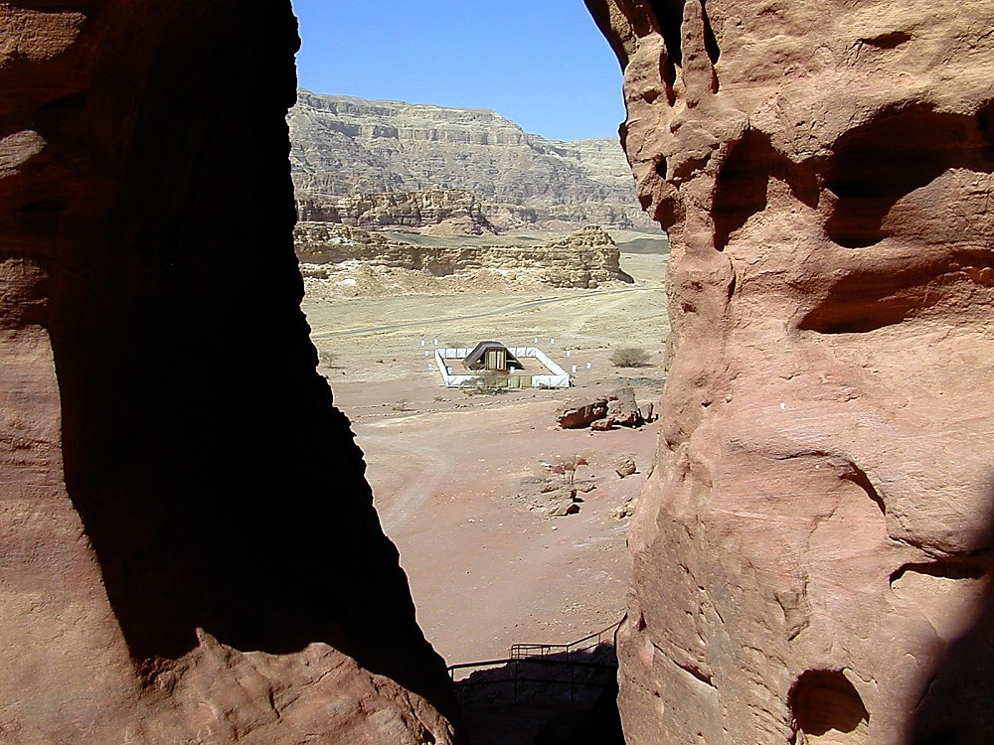
Tabernacle from above
Tabernacle from above
Notes:
The Model
At Timna Park, 20 miles north of Eilat in the Aravah, a life-size replica of the biblical tabernacle (Hebrew miskan, meaning “dwelling-place”) has been erected.
The model was created in 1986 by the Bible Center Theological Vocational School in Breckerfeld, Germany. It was displayed at exhibitions in seven European cities, mainly in Germany and Switzerland, before being purchased by the Southern Baptist Convention and erected at Timna.
While no original materials (e.g., gold, silver, bronze) have been used, the model is accurate in every other way based upon the biblical description.
The Bible names the components used to construct the tabernacle and gives measurements and locations, but it does not indicate how the components were put together. Thus, a model can only be formed using the given information (Ex 25-31; 33:7-11; 35-40; Lev 17; Num 11-12; Dt 31:14ff; 1 Chr 16:39; 21:29; 2 Chr 1:3; 5:5), with some details left open to interpretation.

Slide 37
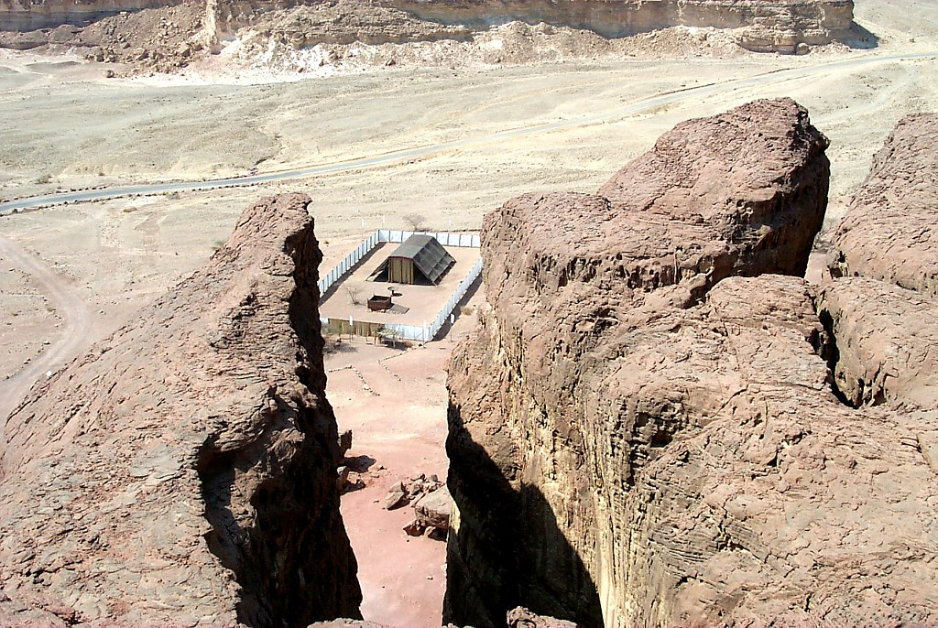
Tabernacle from above
Tabernacle from above
Notes:
The Tabernacle
Moses received the command and the directions to build the tabernacle while on Mt Sinai (Exodus 25), but when he returned to the camp, the people had built for themselves a golden calf, forsaking the Lord. It was only after Moses entreated the Lord to keep His presence among them that He did so (Ex 33:14).
The Israelites constructed the tabernacle about nine months after arriving at Mount Sinai. “Bezaleel the son of Uri, the son of Hur, of the tribe of Judah” (Ex 31:2, KJV) was in charge of the construction with the help of “Aholiab, the son of Ahisamach, of the tribe of Dan” (Ex 31:6, KJV). Every Israelite male who was able helped with the construction work, while women spun the necessary yarn. It took about seven months to construct.
The Israelites donated the materials need for construction: “gold, and silver, and brass, and blue, and purple, and scarlet, and fine linen, and goats' hair, and rams' skins dyed red, and badgers' skins, and shittim wood, and oil for the light, and spices for anointing oil, and for the sweet incense, and onyx stones, and stones to be set for the ephod, and for the breastplate” (Ex 35:5c-9, KJV). “[The] stuff they had was sufficient for all the work to make it, and too much” (Ex 36:7, KJV).
Once the tabernacle was constructed, it was anointed with oil (Ex 40:9-11; Lev 8:10ff) and the glory of the Lord came down upon it (Ex 29:43), a cloud covering the tabernacle. As the shekinah glory cloud moved, the Levites would pack up the tabernacle, carry it with them in a very exact manner, and reconstruct it just outside their new camp (Numbers 3-4). From Mount Sinai (Ex 40:18-19; Num 10:11-12), they carried it to Gilgal (Josh 5:10-11), and then to Shiloh (Josh 18:1; 19:51). When the Philistines defeated the Israelite army, they took the Ark of the Covenant (1 Sam 7:1), which eventually was returned to Kiriath Jearim. Meanwhile, the tabernacle was taken to Nob (1 Samuel 21) and then to Gibeon (1 Chr 16:39; 21:29). It was probably taken to King Solomon’s newly-erected temple in Jerusalem in 966 B.C., where it was reunited with the ark (1 Chr 6:16-17).

Slide 38
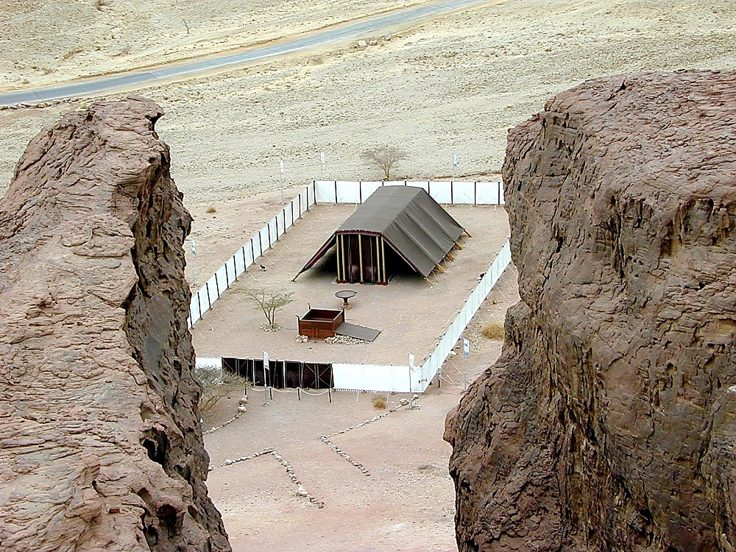
Tabernacle from above
Tabernacle from above
Notes:
Names for the Tabernacle
Tabernacle of the Lord (Josh 22:19; 1 Ki 2:28; 1 Chr 16:39)
Tabernacle of testimony or witness (Ex 38:21; Num 1:50; 17:7, 8; 2 Chr 24:6; Acts 7:44)
Tabernacle of the congregation (Ex 27:21; 33:7; 40:26)
Tabernacle of Shiloh (Ps 78:60)
Tabernacle of Joseph (Ps 78:67)
Temple of the Lord (1 Sam 1:9; 3:3)
House of the Lord (Josh 6:24; 1 Sam 1:7, 24)
Source: The MacArthur Study Bible.

Slide 39
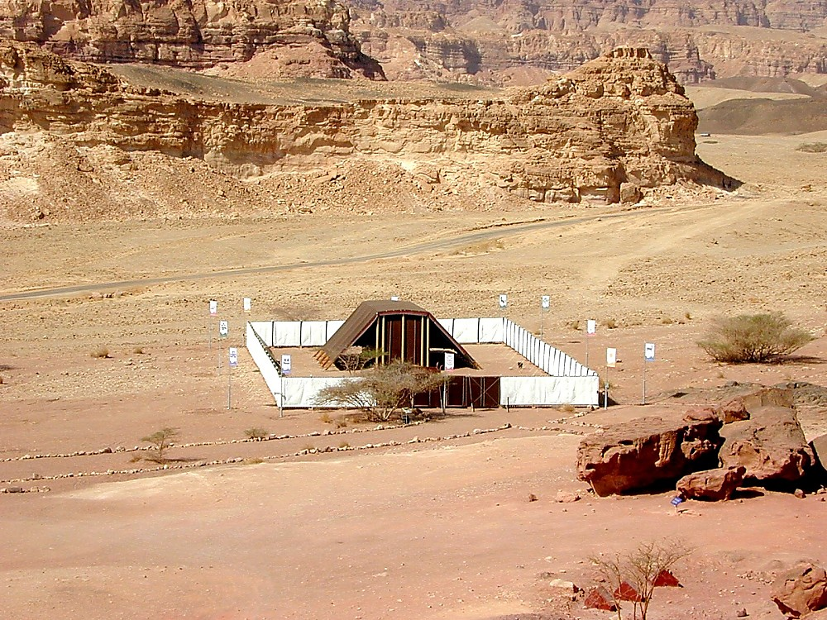
Tabernacle from above
Tabernacle from above
Notes:
New Testament Significance
John 1:14 (KJV) “And the Word was made flesh, and dwelt (literally “tabernacled”) among us, and we beheld his glory, the glory as of the only begotten of the Father, full of grace and truth.” The epistle to the Hebrews most clearly links the tabernacle to Jesus Christ. The tabernacle was divinely ordained but imperfect in that it was only a shadow of what was to come (Heb 8:5). While the workings of the tabernacle were temporary and its sacrifices insufficient, Jesus, on the other hand, was the ultimate sacrifice. He entered through the inner veil to the mercy seat to bring propitiation and to allow a way for those who believe in Him to enter the presence of the Lord. The tabernacle illustrates Christ (Isa 4:6; John 1:14; Heb 9:8, 9, 11), the Church (Ps 15:1; Isa 16:5; 54:2; Heb 8:2; Rev 21:2, 3), and the body (2 Cor 5:1; 2 Pet 1:13).

Slide 40
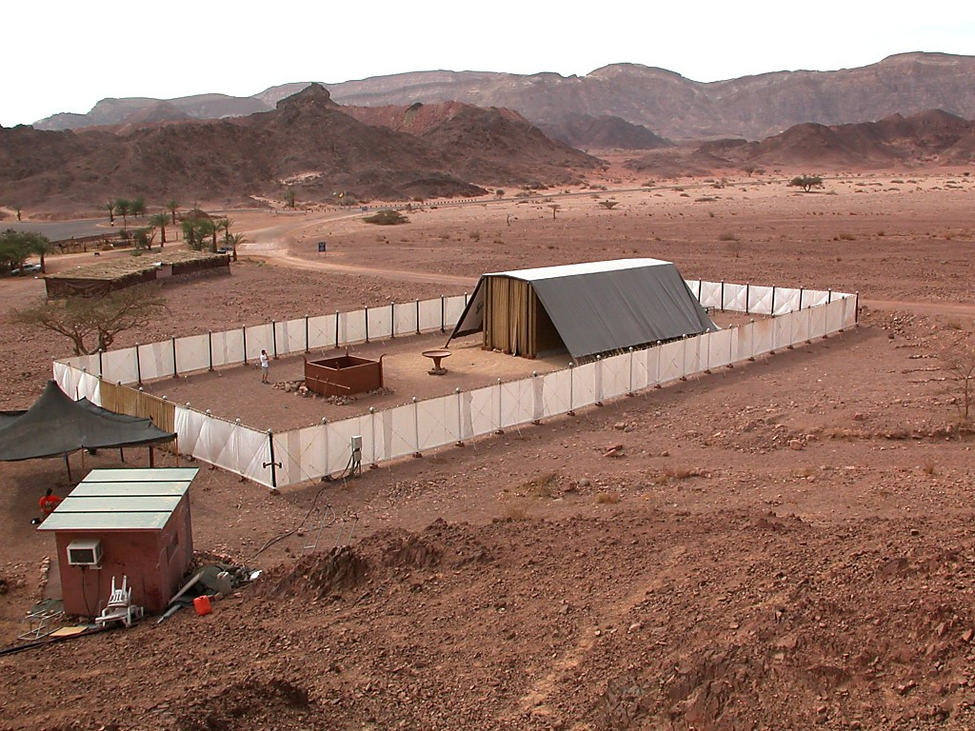
Tabernacle from above
Tabernacle from above

Slide 41
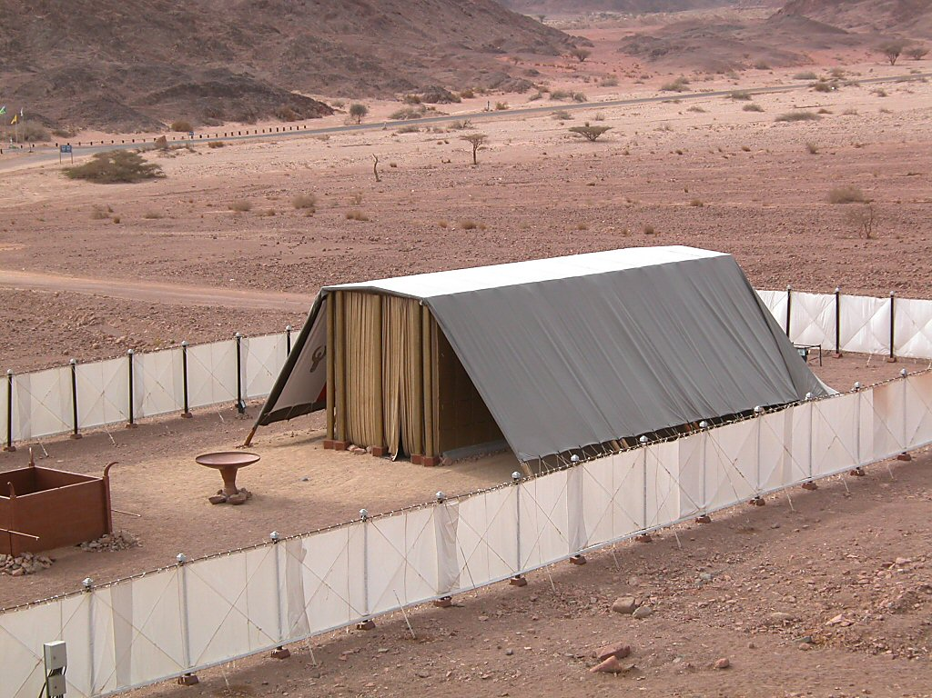
Tabernacle from above
Tabernacle from above

Slide 42
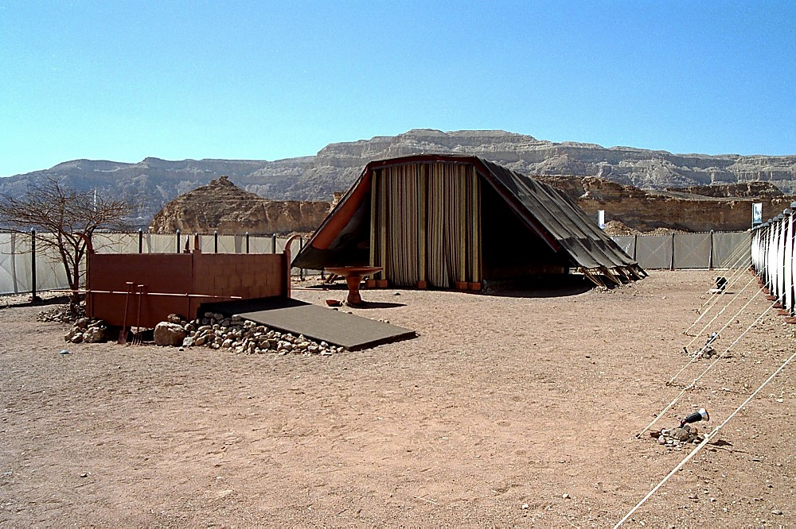
Tabernacle with altar
Tabernacle with altar

Slide 43
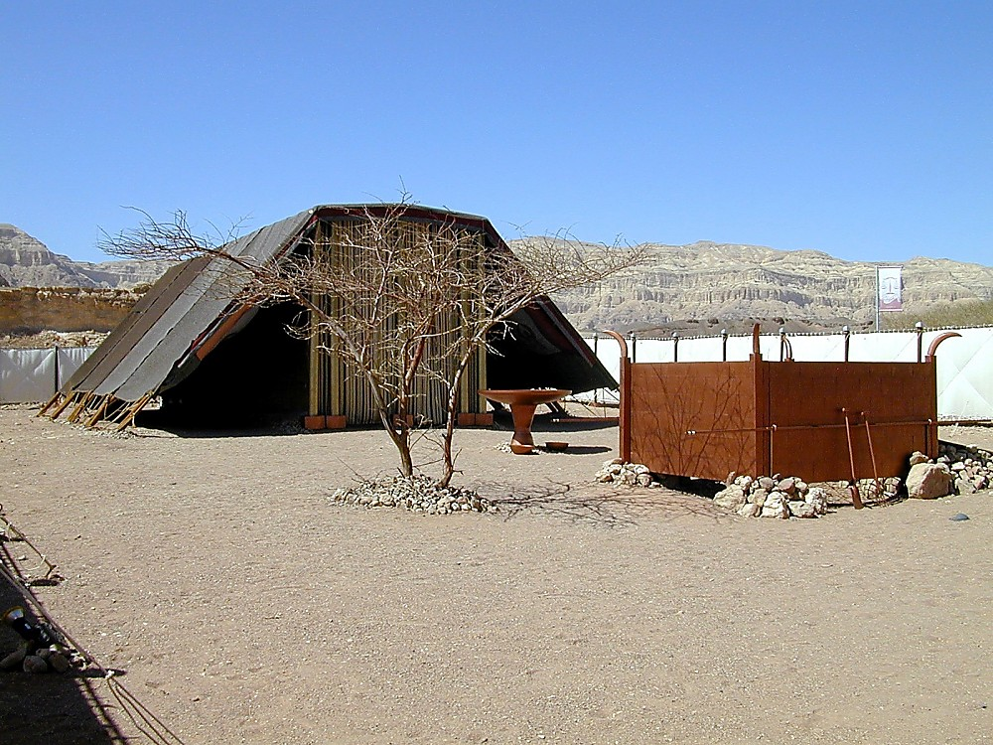
Tabernacle with altar and bronze laver
Tabernacle with altar and bronze laver

Slide 44
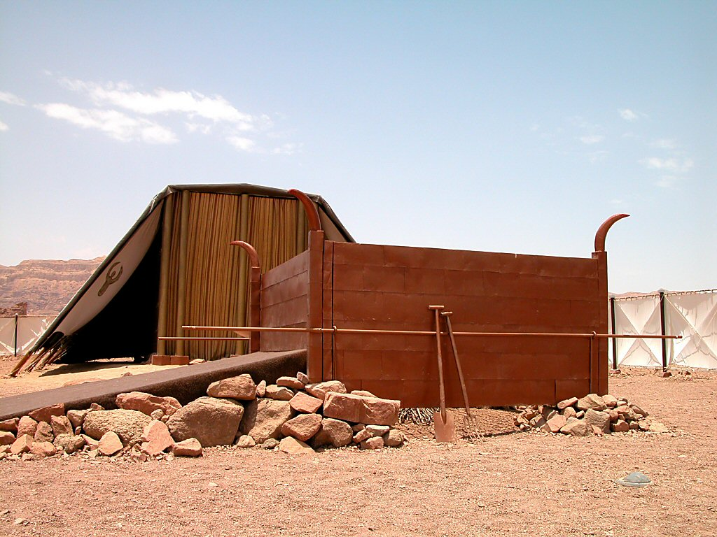
Tabernacle sacrificial altar
Tabernacle sacrificial altar
Notes:
The Sacrificial Altar (Ex 27:1-8)
The sacrificial altar at the tabernacle was to be the only place of sacrifice for the Israelites, as commanded by the Lord (Lev 17:8). It was 7.5 feet square and 4.5 feet high, was made of acacia wood overlaid with bronze, and had a horn on each corner. The fire on the altar was to be kept burning at all times (Lev 6:8-13); daily sacrifices were offered in the morning and afternoon (Ex 29:38-42; Num 28:3-8). Animals were slain north of the altar and the priest probably stood on a ledge projecting from the base of the altar to arrange the parts of the animals and to pour the ashes to the east of the altar (Lev 1:16).

Slide 45
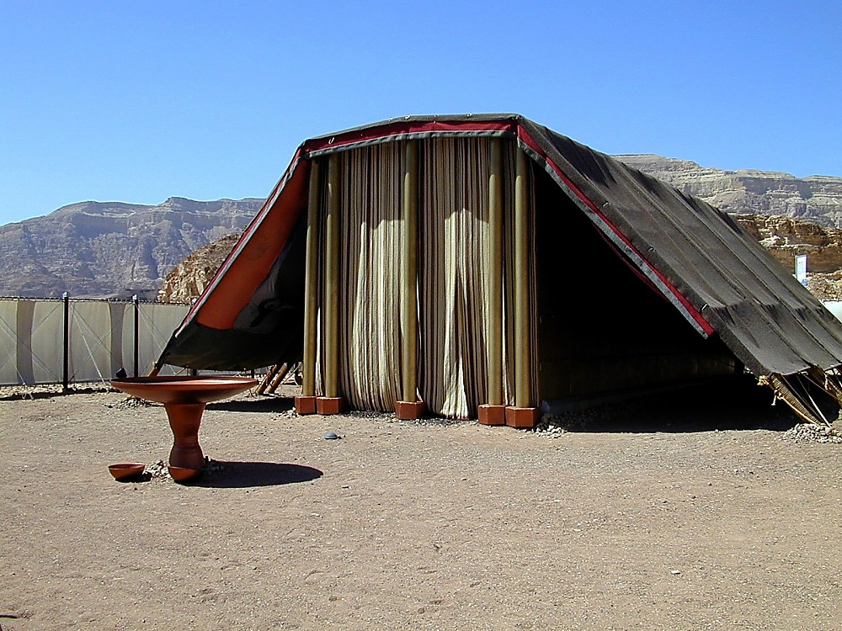
Tabernacle with bronze laver
Tabernacle with bronze laver
Notes:
The Screen
Exodus 26:36 (KJV) “And thou shalt make an hanging for the door of the tent, of blue, and purple, and scarlet, and fine twined linen, wrought with needlework.” This outer screen was made of the same materials as the inner veil, but it required less-skilled workmanship. Only the priests, all of whom were Levites, could pass through this screen and into the tabernacle (Num 18:3, 5), where they performed their services (Num 3:10; 18:1, 2; Heb 8:2; 9:6).

Slide 46
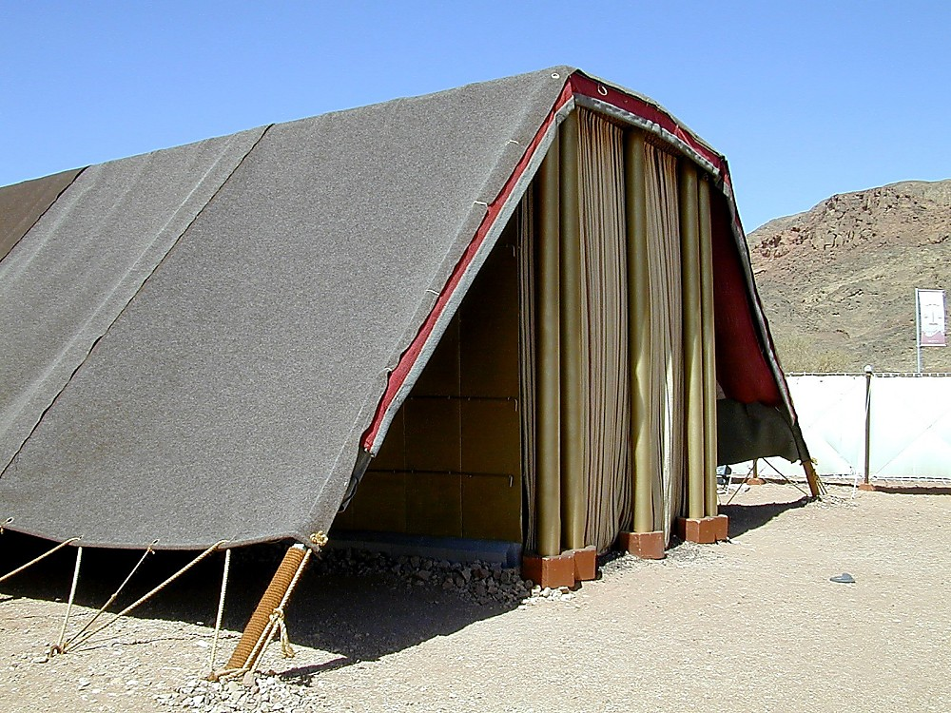
Tabernacle structure
Tabernacle structure
Notes:
The Frame (Ex 26:15-30)
The upright frames of the tabernacle itself were made of acacia (“shittim”) wood overlaid with gold. They rested on silver bases, and there were 20 on each side and six in back (with two extra on the back corners).

Slide 47
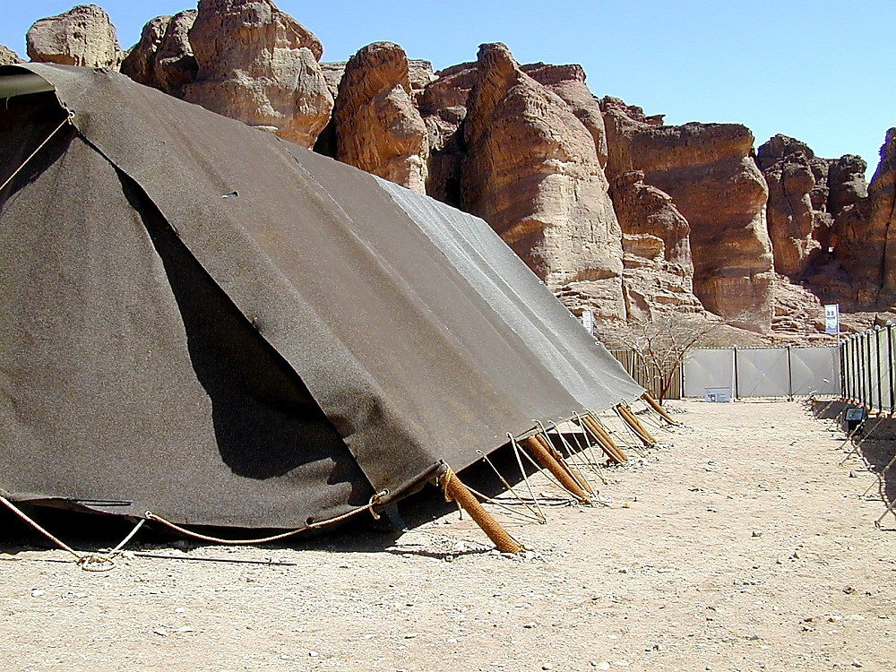
Tabernacle structure with Solomon's Pillars
Tabernacle structure with Solomon's Pillars

Slide 48
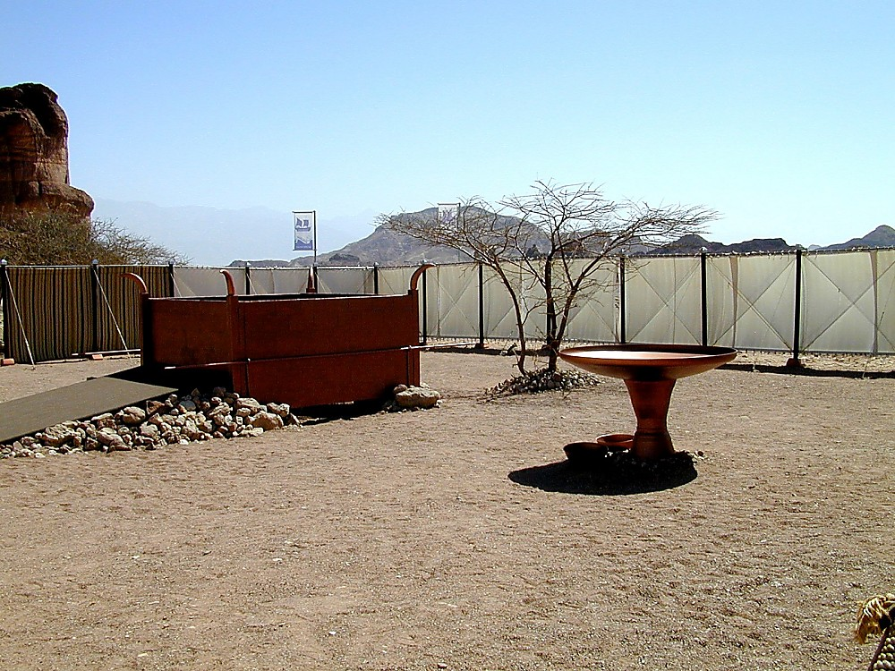
Tabernacle court with altar and bronze laver
Tabernacle court with altar and bronze laver
Notes:
The Outer Court (Ex 27:9-19)
The bronze laver and bronze altar were located in the outer court, which was surrounded by fine linen hung from silver hooks. The only entrance was on the eastern side, where linens were not hung for a span of 20 cubits. The tabernacle sat at the western end of the court with its opening to the east.

Slide 49
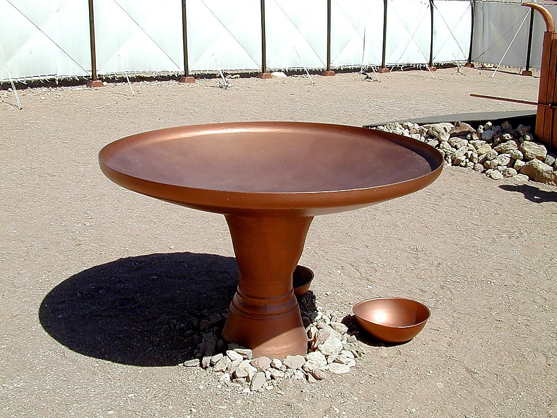
Tabernacle bronze laver
Tabernacle bronze laver
Notes:
The Bronze Laver (Ex 30:17-21)
Exodus 30:18-20 (KJV) “Thou shalt also make a laver of brass, and his foot also of brass, to wash withal: and thou shalt put it between the tabernacle of the congregation and the altar, and thou shalt put water therein. For Aaron and his sons shall wash their hands and their feet thereat: When they go into the tabernacle of the congregation, they shall wash with water, that they die not; or when they come near to the altar to minister, to burn offering made by fire unto the LORD.” The bronze laver was a wash basin situated between the sacrificial altar and the tabernacle entrance. Exodus 38:8 explains that it was made from bronze mirrors collected from the “ministering women” after they had come up out of Egypt. Its size, shape, ornamentation, and mode of transport are not given in the text, but the above is one example of how it may have looked.

Slide 50
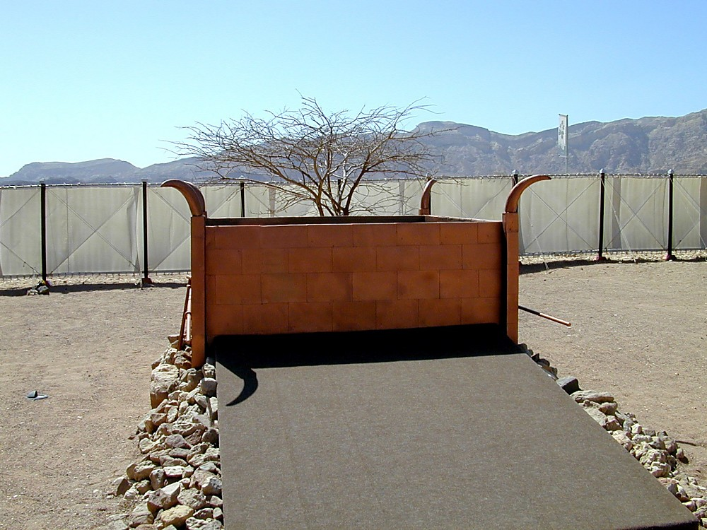
Tabernacle sacrificial altar with ramp
Tabernacle sacrificial altar with ramp

Slide 51
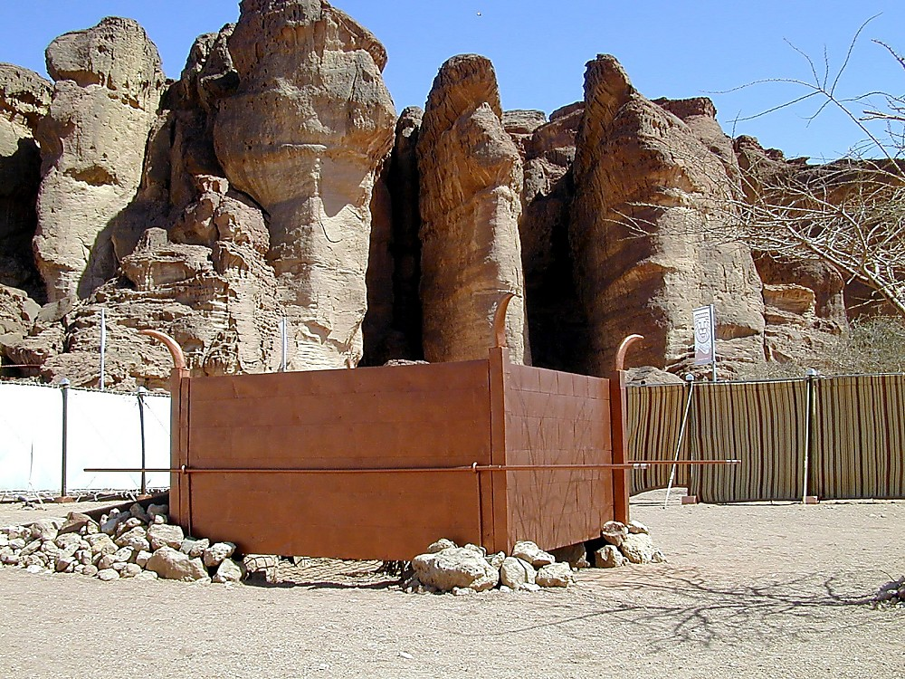
Tabernacle sacrificial altar with Solomon's Pillars
Tabernacle sacrificial altar with Solomon's Pillars

Slide 52
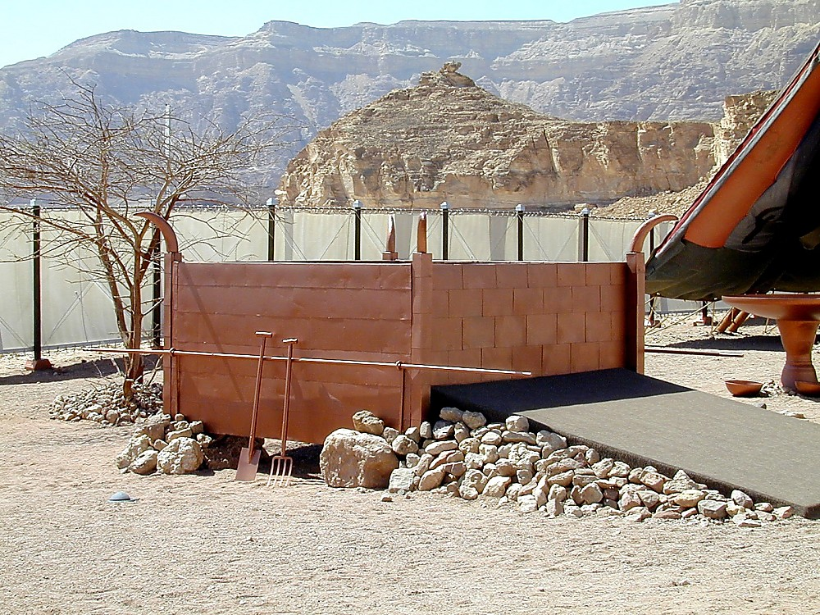
Tabernacle sacrificial altar
Tabernacle sacrificial altar

Slide 53
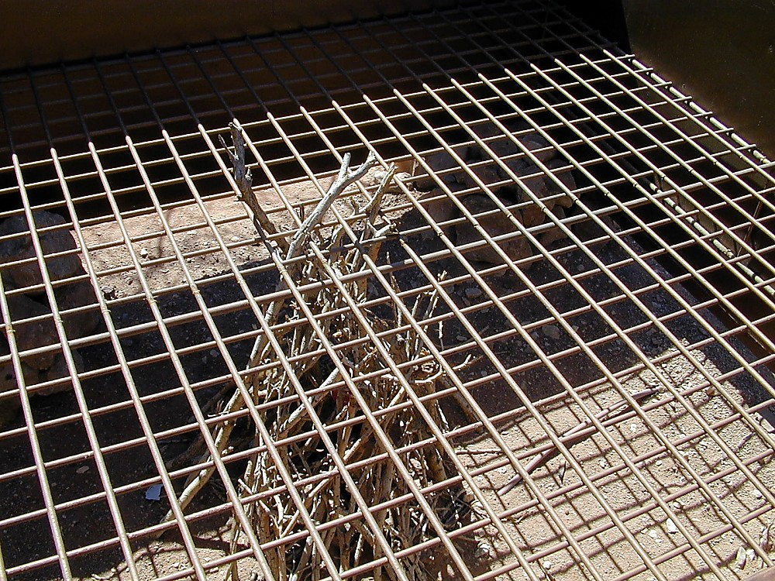
Tabernacle sacrificial altar grate
Tabernacle sacrificial altar grate
Notes:
Exodus 27:4-5 (KJV) “And thou shalt make for it a grate of network of brass; and upon the net shalt thou make four brasen rings in the four corners thereof. And thou shalt put it under the compass of the altar beneath, that the net may be even to the midst of the altar.”

Slide 54
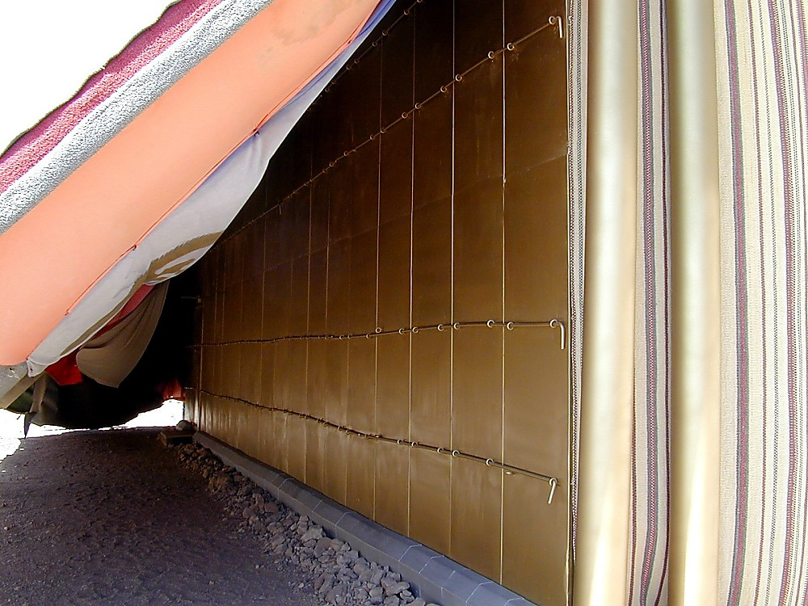
Tabernacle structure with golden poles
Tabernacle structure with golden poles

Slide 55
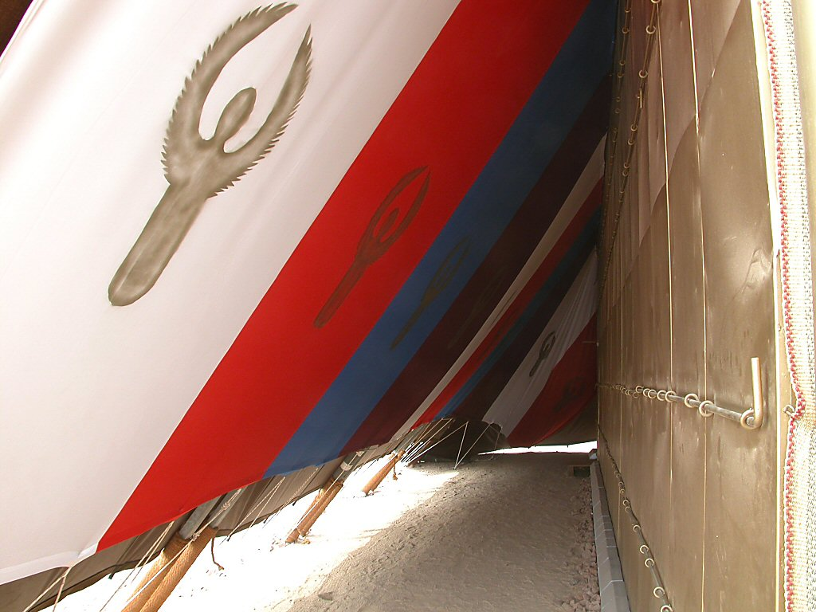
Tabernacle tent fabric
Tabernacle tent fabric
Notes:
The Coverings (Ex 26:1-14)
The first layer of fabric over the tabernacle was made of 10 sections joined with loops and golden clasps. The fabric had colors of blue, purple, scarlet, and linen, with gold cherubim woven into the material. The second layer was eleven curtains of goat hair, the third was tanned ram’s skin dyed red, and finally there was a layer of dugong, which is usually translated as “badger,” “dolphin,” or “sea cow” skin. The tent fabric was held in place by bronze pegs driven into the ground.

Slide 56
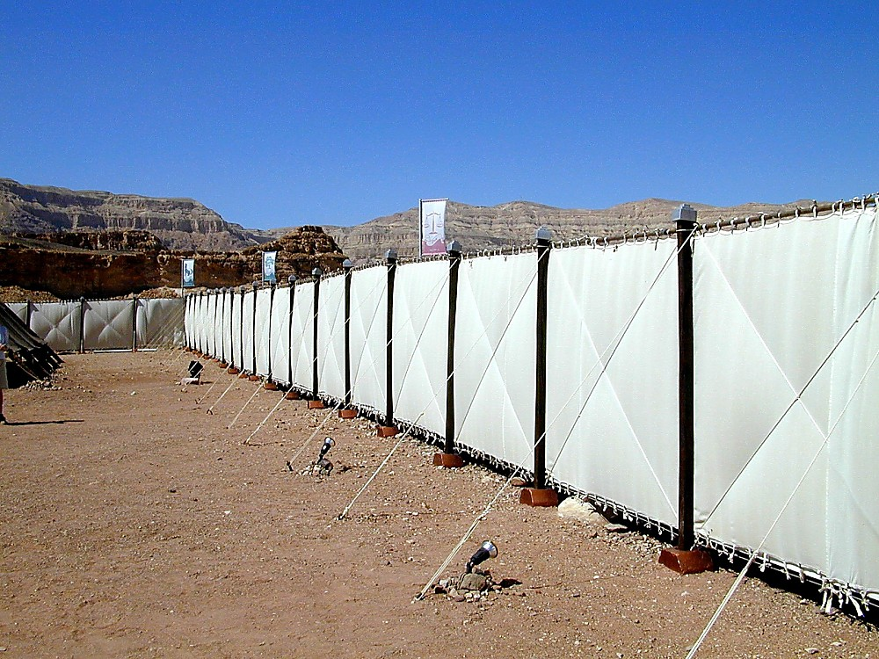
Tabernacle outer court
Tabernacle outer court

Slide 57
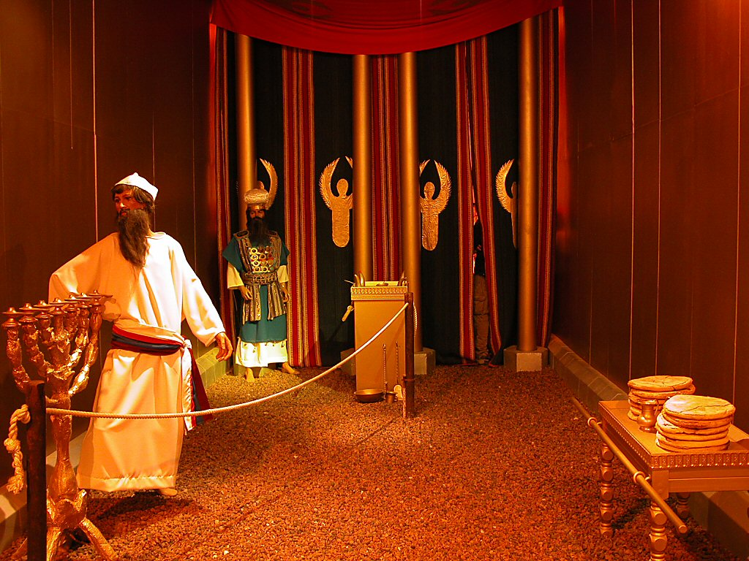
Tabernacle holy place
Tabernacle holy place
Notes:
The Holy Place
This sacred area (Ex 26:33; Heb 9:2-6) was the larger of the two inner compartments of the tabernacle. It was occupied by the golden lampstand, the incense altar, and the table of showbread.

Slide 58
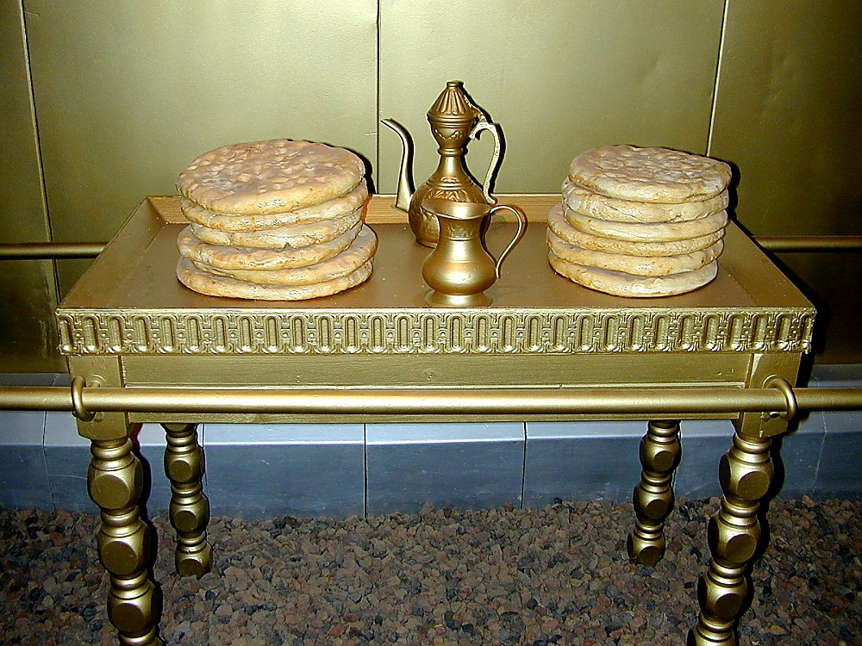
Table of showbread
Table of showbread
Notes:
The Table of Showbread (Ex 25:23-30)
Exodus 26:35 (KJV) “And thou shalt set the table without the vail . . . and thou shalt put the table on the north side.” Sitting at the north side of the Holy Place, opposite the menorah, was the table of showbread (“Bread of the Presence”). Built of acacia wood and overlaid with solid gold, the table had a surface of 3 x 1.5 feet. Twelve loaves of bread were placed on the table on Shabbat and were replaced by fresh bread the following Shabbat. The high priestly line would eat the replaced bread.

Slide 59
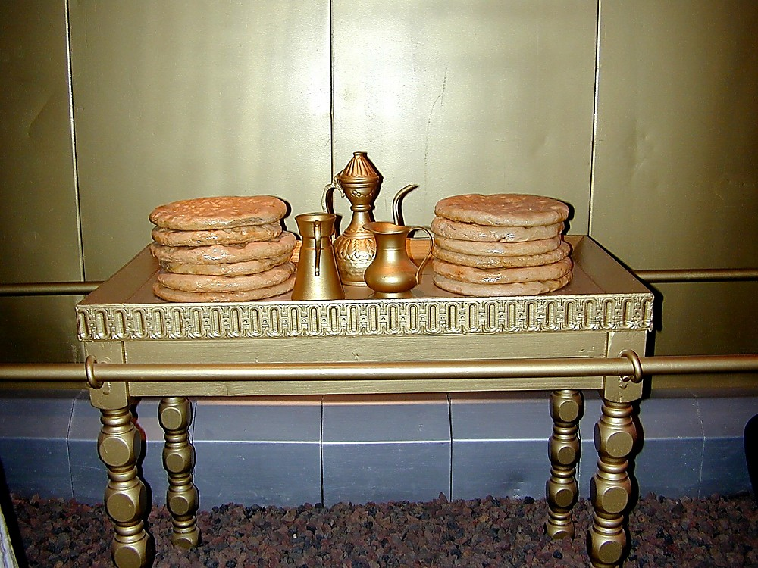
Table of showbread
Table of showbread

Slide 60
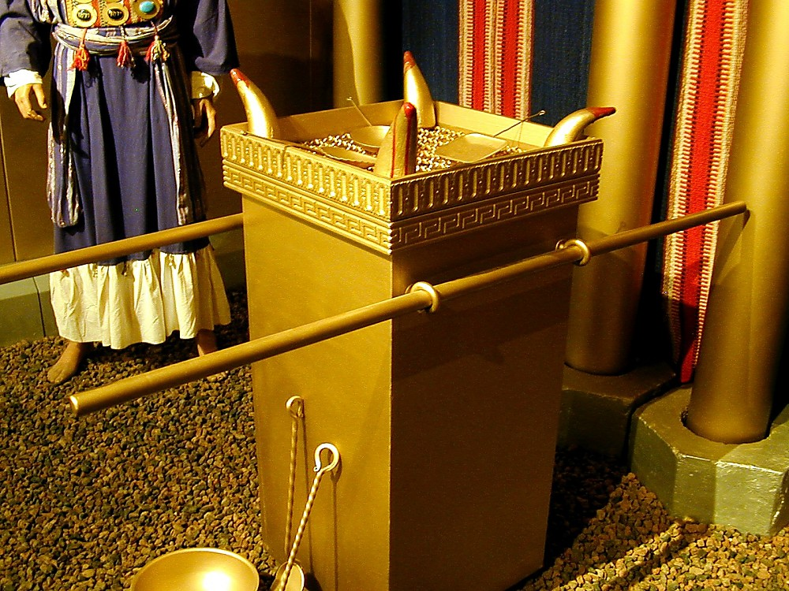
Tabernacle altar of incense
Tabernacle altar of incense
Notes:
The Altar of Incense (Ex 30:1-10)
Exodus 30:1, 3, 7-8 (KJV) “And thou shalt make an altar to burn incense upon: of shittim wood shalt thou make it . . . And thou shalt overlay it with pure gold, the top thereof, and the sides thereof round about, and the horns thereof; and thou shalt make unto it a crown of gold round about . . . And Aaron shall burn thereon sweet incense every morning: when he dresseth the lamps . . . a perpetual incense before the LORD throughout your generations.” Also known as the “golden altar” or the “inner altar,” this three-foot-high altar was the location of regular incense offerings. Every morning and evening when tending the light of the menorah, the priests would offer a mixture of frankincense and other aromatic gums. On the Day of Atonement, the high priest would sprinkle blood on the horns of this altar (Ex 30:10), but nothing besides incense was ever to burn here.

Slide 61
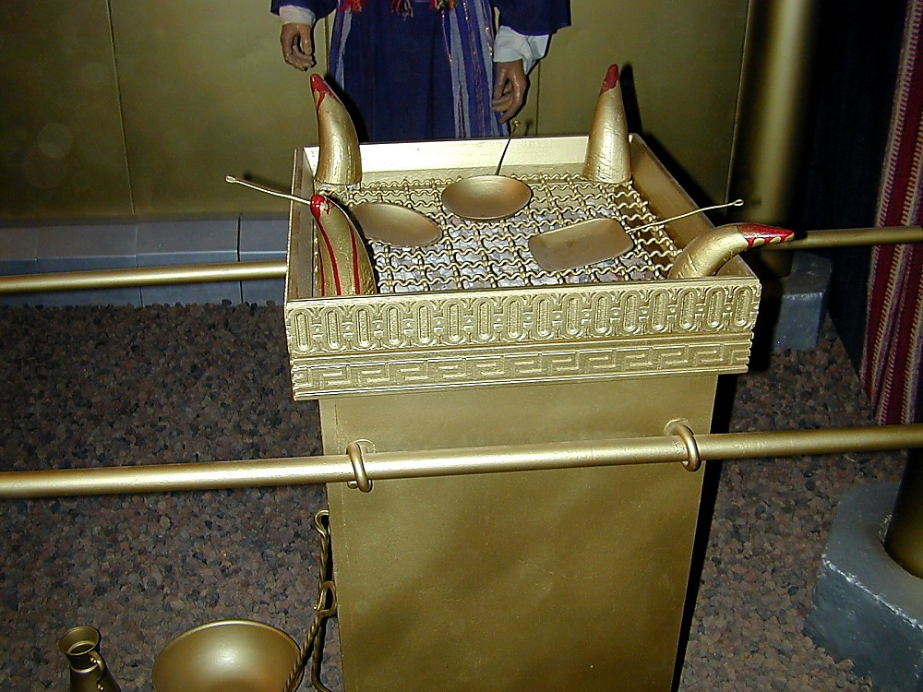
Tabernacle altar of incense
Tabernacle altar of incense

Slide 62
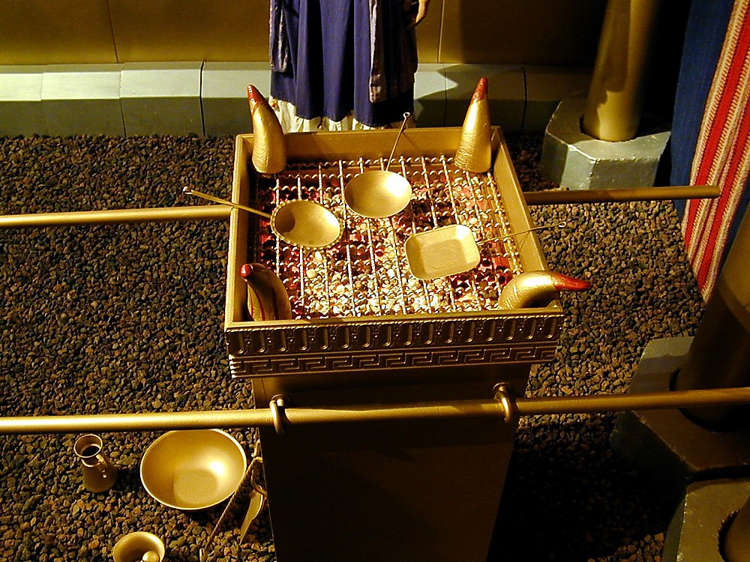
Tabernacle altar of incense
Tabernacle altar of incense

Slide 63
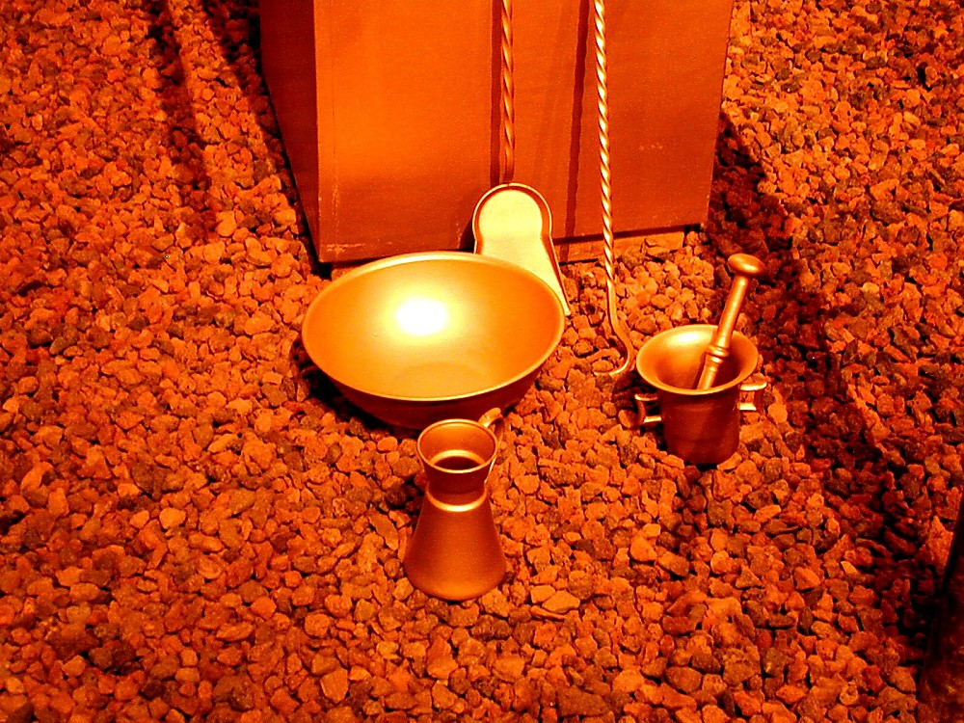
Tabernacle altar of incense utensils
Tabernacle altar of incense utensils
Notes:
All vessels used in the tabernacle were made of bronze (Ex 27:19).

Slide 64
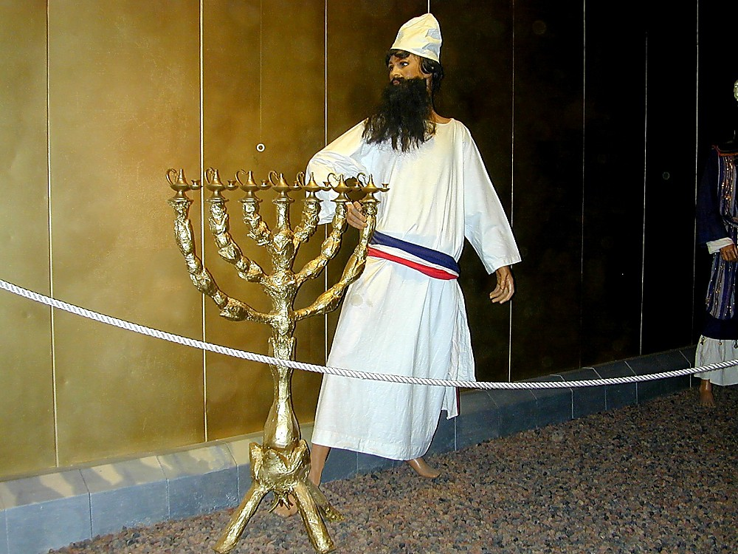
Tabernacle priest with golden menorah
Tabernacle priest with golden menorah
Notes:
The Menorah (Ex 25:31-40; Lev 24:1-4; Num 8:1-4)
Exodus 26:35 (KJV) “. . . and the candlestick over against the table on the side of the tabernacle toward the south . . .” A lampstand, or menorah, was placed on the south side of the Holy Place. It was beaten and fashioned out of a single block of gold and had three branches coming out of each side of the central shaft. It rested on some sort of base, although the Bible does not specify what this looked like.

Slide 65
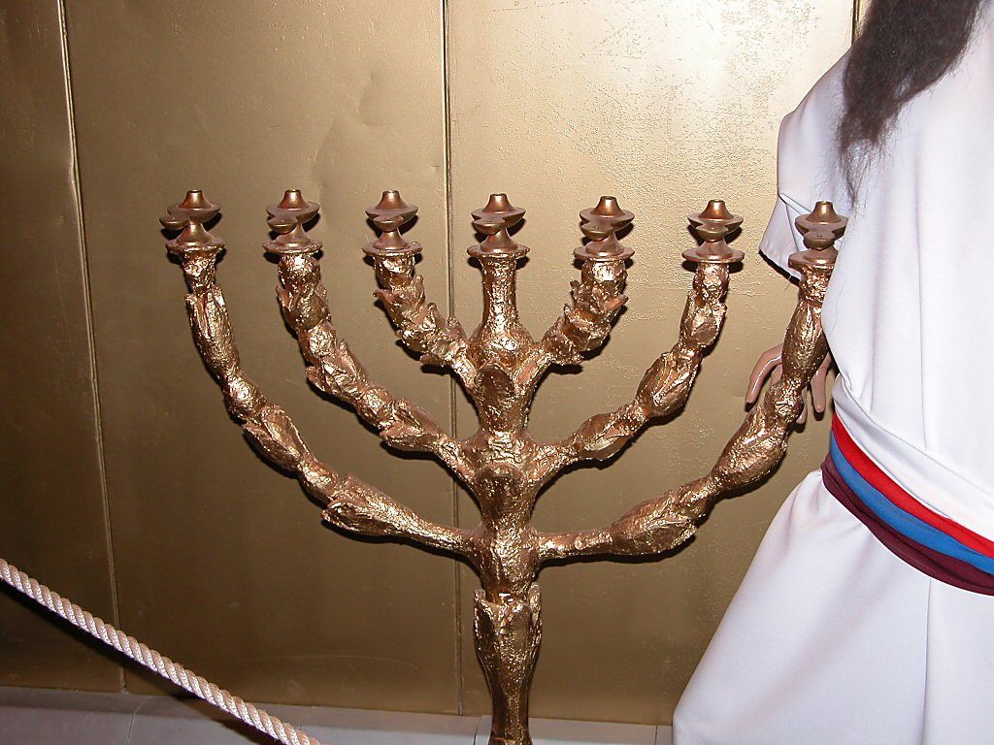
Tabernacle golden menorah
Tabernacle golden menorah
Notes:
The branches of the menorah had ornamentation of “bowls made like unto almonds” (Ex 25:33, KJV). The seven lamps on top of the branches were likely round saucers with pinched rims which held a wick and olive oil.

Slide 66
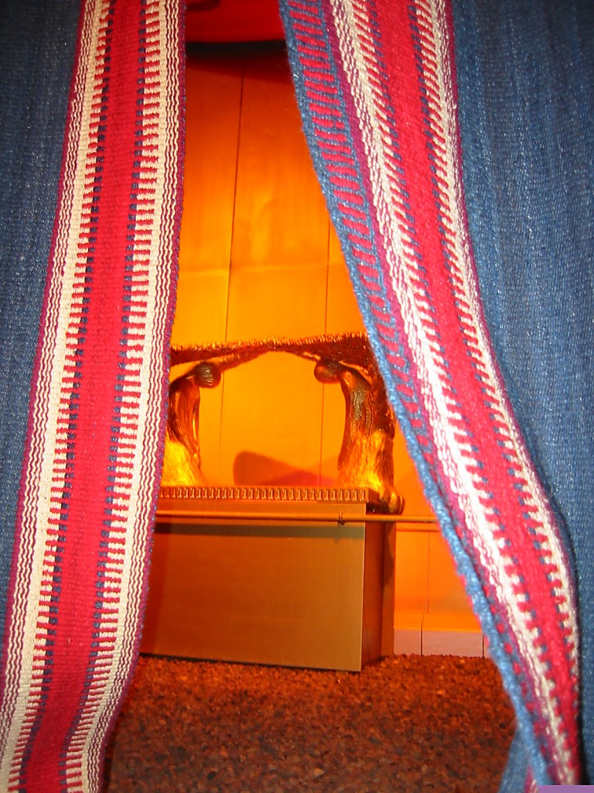
Tabernacle Holy of Holies behind the veil
Tabernacle Holy of Holies behind the veil
Notes:
The Veil
Exodus 26:31-33 (KJV) “And thou shalt make a vail of blue, and purple, and scarlet, and fine twined linen of cunning work: with cherubims shall it be made . . . And thou shalt hang up the vail under the taches, that thou mayest bring in thither within the vail the ark of the testimony: and the vail shall divide unto you between the holy place and the most holy.” A double-layered veil divided the two compartments of the tabernacle. The inner chamber was the Holy of Holies, or Most Holy Place (Ex 26:34; Heb 9:3-7). It was only entered once a year (the Day of Atonement) and only by the high priest. In the New Testament the veil represents Christ’s body (Heb 10:20) and the Holy of Holies illustrates heaven (Heb 6:19, 20; 9:12, 24; 10:19).

Slide 67
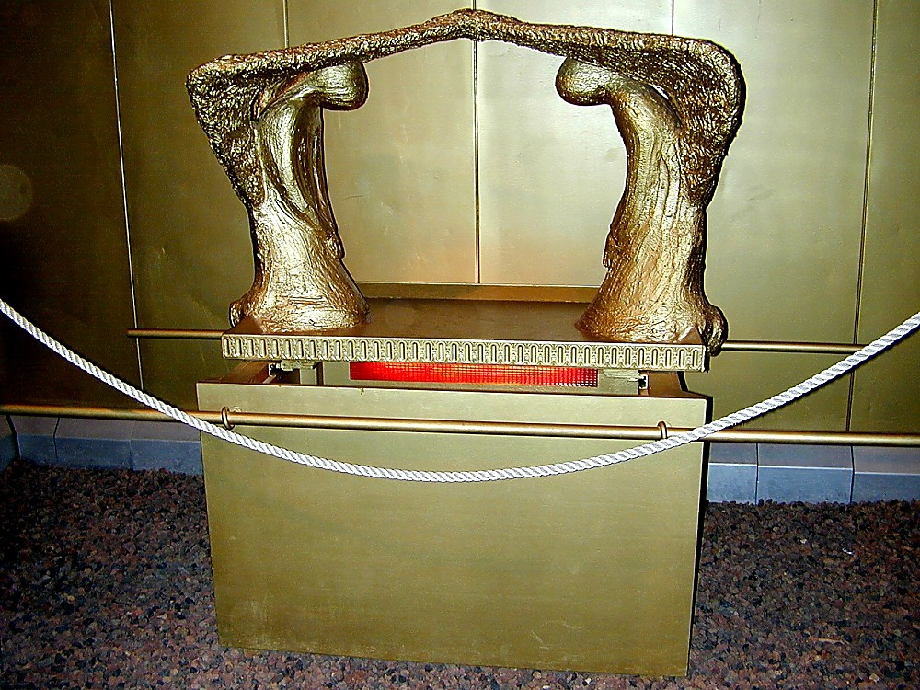
Ark of the Covenant
Ark of the Covenant
Notes:
The Ark of the Covenant (Ex 25:10-22)
Exodus 26:34 (KJV) “And thou shalt put the mercy seat upon the ark of the testimony in the most holy place.” The ark was covered by the “mercy seat,” which was made of pure gold, and on which the high priest sprinkled the blood of the goat seven times on the Day of Atonement (Lev 16:14ff). From here God spoke to Moses in Numbers 7:89. The ark was made of acacia wood and overlaid with pure gold; it represented the footstool of God's throne. The ark was the first object the Lord described when he gave directions to Moses concerning the construction of the tabernacle. It was the most sacred part of the structure.

Slide 68

Tabernacle Ark of the Covenant with cherubim
Tabernacle Ark of the Covenant with cherubim
Notes:
Cherubim
Exodus 25:20 (KJV) “And the cherubims shall stretch forth their wings on high, covering the mercy seat with their wings, and their faces shall look one to another; toward the mercy seat shall the faces of the cherubims be.” The cherubim sat atop the ark leaning downward, with their faces turned toward each other, and their wings stretched outward.

Slide 69

Tabernacle Ark of Covenant
Tabernacle Ark of Covenant

Slide 70

View inside the Ark of the Covenant
View inside the Ark of the Covenant
Notes:
The only object in the Holy of Holies, the sacred ark (Ex 25:10-22) contained the two tablets with the Ten Commandments, the rod of Aaron that blossomed (Num 17:10, 23-26), and the pot of manna (Ex 16:33-34).

Slide 71

Tabernacle high priest
Tabernacle high priest
Notes:
The High Priest
Exodus 28:2, 4-5 (KJV) “And thou shalt make holy garments for Aaron thy brother for glory and for beauty . . . And these are the garments which they shall make; a breastplate, and an ephod, and a robe, and a broidered coat, a mitre, and a girdle: and they shall make holy garments for Aaron thy brother, and his sons, that he may minister unto me in the priest's office. And they shall take gold, and blue, and purple, and scarlet, and fine linen.” The remainder of the chapter describes the garments of the high priest in detail. On his head he wore a turban with a gold seal reading “Holy to the Lord” and a blue cord resting upon his forehead. His tunic was of linen and his robe was blue. At his shoulders were two onyx stones with the names of the 12 tribes written upon them. Even the fringe was specified; its pomegranates and gold bells would alert the other priests if the high priest were to die upon entering the Holy Place (vv. 34-35). Exodus 29 goes on to discuss the anointing and duties of the priest.

Slide 72

Tabernacle high priest
Tabernacle high priest

Slide 73

Tabernacle high priest breastplate
Tabernacle high priest breastplate
Notes:
The Breastplate
The breastplate of the high priest was connected to the ephod and bore 12 different stones: ruby, topaz, beryl, turquoise, sapphire, emerald, jacinth, agate, amethyst, chrysolite, onyx, and jasper. The names of the tribes written upon them and they were mounted in gold filigree; thus the tribes were on the high priest’s heart as a memorial before the Lord. The Urim and the Thummim were also in the breastpiece to be used in making decisions; it is not certain what exactly these items were (Ex 28:6-30).

Slide 74

Priest blowing shofar
Priest blowing shofar
Notes:
Numbers 10:5-7 (NIV) “When a trumpet blast is sounded, the tribes camping on the east are to set out. At the sounding of a second blast, the camps on the south are to set out. The blast will be the signal for setting out. To gather the assembly, blow the trumpets, but not with the same signal.”

Slide 75

L
E
V
I
T
I
C
U
S

Slide 76
LEVITICUS
AUTHOR: Moses
DATE: 1439 BC
THEME: A holy people worshipping a Holy God.
LEVITICUS MEANS: “Levitical Book”
KEY COMMANDS: “You Shall Be Holy.”
KEY PHRASE: “I Am the LORD.”

Slide 77
THE OFFERINGS
OFFERING | REF. | PURPOSE RELATED TO CHRIST | PURPOSE RELATED TO MAN
BURNT | Lev 1 | Fullness of Christ’s Devotion | Dedication to God
MEAL | Lev 2 | Flawlessness of Christ’s Devotion | Gift of Man to God
PEACE | Lev 3 | Fruitfulness of Christ’s Devotion | Communion with God
SIN | Lev 4:1- 5:13 | Covering the Principle of Sin | Covering of Sin
TRESPASS | Lev 5:14- 6:7 | Covering the Practice of Sin | Covering of Sin

Slide 78
Laws were to maintain ceremonial cleanliness
“They served:
  To reflect the holiness of God;
  To keep Israel distinct from the idolatrous practices of the nations around them;
  To help maintain physical health.” –Ryrie

Slide 79

JEWISH FEASTS
Passover (23:4-5)
Unleavened Bread (23:6-8)
First Fruits (23:9-14)
Feast of Weeks (Pentecost) (23:15:22)
Feast of Trumpets (23:23-25)
Day of Atonement (23:26-32)
Feast of Tabernacles (or Booths) (23:34-44)
Every male in Israel was required to attend the Passover, Pentecost and Tabernacle feasts.

Slide 80


Slide 81
YEAR OF JUBILEE
All Jewish slaves were set free (25:10).
All family property that had been sold was returned to the family (25:13).
The land was given rest for a year (25:11).

Slide 82

NUMBERS

Slide 83
Comparison of the Books of Moses
BOOK | NATION OF ISRAEL | MAN | GOD
Genesis | Birth; infancy | His creation, Fall, hope | Sovereignty
Exodus | Delivered from Egypt | Deliverance | Mercy
Leviticus | Given Law of Worship & living | Access to God and fellowship w/Him | Holiness
Numbers | Traveling to Canaan | Conditions for inheritance | Patience & Judgment
Deuteronomy | Final preparations for entering Canaan | Consecration | Lordship

Slide 84
NUMBERS
DATE: Covers 38 years & 9 months. Written by 1401 BC.
PURPOSE: Record wilderness wanderings. Record 2 numberings of Israel.
THEME: Discipline because of disobedience.
TITLE: Has had various titles (e.g. Hebrew title was “In the Wilderness,” Book of Journeys, Book of Murmurings).

Slide 85



Slide 86
THREE DIVISION OF LEVITES
KOHATH: included the priests who were from Aaron. Other Kohath Levites cared for the sacred furniture and carried them when necessary (3:23-25).
GERSHON: cared for the actual Tabernacle itself (3:23-25).
MERARI: were in charge of the woodwork or the Tabernacle (3:33-37).
  The Levites were to serve from age 25-50 (8:24-25); the priest from 30-50 (4:3).

Slide 87

WILDERNESS WANDERINGS
Zeredr
Mt Hor
Pthahiroth
MarahElim
Elath
Hazaroth

Slide 88

The Bronze Serpent

Slide 89

Nations of Canaan
www.Studylight.org
Other Nations
Hittite Empire
Phoenicia
Canaanites
Hittites
Philistines
Phoenicians
Moabites
Ammonites
Edomites
Midianites
Mediterranean
Galilee
River
Canaan
Jordan
Ammon
Jerusalem
Moab
Dead Sea
Edom
Philistia
Midian
© EBibleTeacher.com
NASA PHOTO

Slide 90
WILDERNESS WANDERINGS
Zeredr
Mt Hor
Pthahiroth
MarahElim
Elath
Hazaroth

Slide 91

DIVISION
OF THE
LAND
MAP

Slide 92

CITIES OF REFUGE
Hebron
Bezer
Shechem
Ramoth-gilead
Golan
Kedesh

Slide 93


Deuteronomy

Slide 94
DEUTERONOMY
AUTHOR: Moses
RECIPIENTS: The generation of Israelites that were to enter the Promised Land.
DATE: About 1400 BC
PURPOSE:
  Moses about to die (2:14-16)
  Encouragement to remain faithful.
  Preparation for entrance into the Land
THEME: Repetition and explanation of the Law.

Slide 95
BOOK OF SPEECHES
Five speeches or sermons:
  A review of where they had been (1:5-4:43)
  A reminder of what they had learned (4:44-26:19)
  A revelation of future options (27-28)
  A reiteration of the covenant (29-30)
  Moses’s final words (31-33)

Slide 96

Hittites
Other Nations
Phoenicia
Canaanites
Hittites
Philistines
Phoenicians
Moabites
Ammonites
Edomites
Midianites
Canaan
JORDAN
Ammon
Jerusalem
Moab
Philistia
Edom
Midian

Slide 97

JEWISH FEASTS
PASSOVER—Deliverance from Egypt
UNLEAVENED BREAD—Connected with Passover
PENTECOST—Anniversary of Law & completion of harvest
TRUMPETS—Like our New Year
ATONEMENT—Atonement for sin
TABERNACLES—The wanderings in the wilderness
LIGHTS—Cleansing of the Temple
PURIM—failure of Haman’s plot

Slide 98


Slide 99
Comparison of the Books of Moses
BOOK | NATION OF ISRAEL | MAN | GOD
Genesis | Birth; infancy | His creation, Fall, hope | Sovereignty
Exodus | Delivered from Egypt | Deliverance | Mercy
Leviticus | Given Law of Worship & living | Access to God and fellowship w/Him | Holiness
Numbers | Traveling to Canaan | Conditions for inheritance | Patience
Deuteronomy | Final preparations for entering Canaan | Consecration | Lordship

Slide 100
This power point has been produced by
Southern View Chapel
Springfield, IL
All rights are reserved. May be reproduced with permission of the publisher.
Please contact us for further information at email: svchapel@svchapel.org

