Slide 1

MASTERING YOUR MONEY

Slide 2
GATHERING INFORMATION

Slide 3
THE NEED TO MASTER YOUR MONEY
In 2019 the average personal savings rate is 6.0% of annual income which included retirement, compared to an average of 8.82% from 1959-2018.
The more disturbing statistic is 57% of Americans have less than $1000 in their savings accounts and 39% have zero retirement or personal savings.

Slide 4
According to a 2016 national survey, the average American household contributes 2.1% of its annual income to charity.

Slide 5
Adjusted Gross Income (AGI) | Average charitable deduction | % of AGI
Under $25,000 | $1,847 | 12.3%
$25,000-$50,000 | $2,594 | 6.8%
$50,000-$75,000 | $2,970 | 4.8%
$75,000-$100,000 | $3,356 | 3.8%
$100,000-$200,000 | $4,130 | 3%
$200,000-$500,000 | $7,424 | 2.6%
$500,000-$1,000,000 | $18,615 | 2.8%
$1,000,000-$2,000,000 | $43,944 | 3.2%
$2,000,000 or more | $382,953 | 5.6%
*SOURCE: IRS STATISTICS OF INCOME 2014

Slide 6
According to the National Council on aging, 75% of Social Security recipients 65+ in 2013 depended on Social Security for most of their monthly income; 14% of seniors 65+ retire with negative net worth contributing to a rise in bankruptcies that has grown at the fastest pace ever, due to high credit card debt and debts against their home.
According to a Kansas State University researcher, money problems in a marriage is the #1 predictor of divorce.

Slide 7
The median savings of all working age families is just $5,000.
Median retirement savings by age group:
    *American Equity 2/2/18
Age Group | Median retirement savings
Age 32-37 | $480
Age 38-43 | $4,200
Age 44-49 | $6,200
Age 50-55 | $8,000
Age 56-61 | $17,000

Slide 8
HOW MUCH SHOULD YOU HAVE SAVED
In your 20’s: Aim to save 25% of your overall gross pay. That includes any retirement account contributions, matching funds from your company, cash savings or money you have invested elsewhere.
By age 30: Have the equivalent of your annual salary saved. So, if you earn $50,000 a year, aim to have $50,000 in savings at age 30.

Slide 9
By age 35: Have twice your annual salary saved.
By age 40: Have three times your annual salary saved.
By age 45: Four times your annual salary saved.
By age 50: Five times your annual salary saved.
By age 55: Six times your annual salary saved.
By age 60: Seven times your annual salary saved.
By age 65: Eight times your annual salary saved.
*These numbers should exclude your home

Slide 10
FOR ENCOURAGMENT NOTE WHAT SAVING $100 A MONTH AT 7% WOULD ACCUMULATE TO:
SAVING $100 A MONTH AT AGE: | WHAT YOU WILL HAVE BY AGE 70 (ASSUMES A 7% AVERAGE ANNUAL RETURN)
25 | $343,000
30 | $240,000
35 | $166,000
40 | $113,000
45 | $76,000

Slide 11
“Most of us are responders rather than planners; we respond to friends, advertising, and our emotions rather than plan our spending.” Ron Blue

Slide 12
The purpose of this course will be threefold:
Teach biblical and practical principles of handling finances.
Give an opportunity to apply these principles.
Encourage you to take control of your finances right now.

Slide 13
Biblical Principles
All money belongs to God (Haggai 2:8; Deut 8:18; 1 Cor 4:7; Gen 28:22).
God does not give us the privilege of having money, or owning possessions, in order for us to live selfishly (1 John 3:17).
We are neither to love or worship money ( 1 John 2:15-17).

Slide 14
Biblical Principles
We will never possess enough money to be satisfied (Eccl 5:10,11).
If we cannot be responsible with money, God is not likely to trust us with more important responsibilities (Luke 16:10, 11).

Slide 15
Biblical Principles
“In a sense, money is a good barometer of your spirituality, because the way you handle your money is an indication of your performance as a Christian steward.”
John MacArthur

Slide 16
Biblical Principles
God expects you to take control of your finances by working (2 Thess 3:10-12), saving (Prov 12:11; 13:11; 21:20) and planning (Prov 24:3,4; 30:25).
Scripture teaches a balance when it comes to money.

Slide 17
Getting Started
Any number of things may keep us from getting started:
  Laziness
  Stubbornness
  Lack of knowledge
  Procrastination
It is much easier to accumulate money by starting early in life.

Slide 18
INVESTING $1000 ANNUALLY
Interest Earned | 5 YEARS | 10 YEARS | 15 YEARS | 20 YEARS
5 | $5, 525 | $12, 578 | $21, 578 | $33,065
6 | 5, 637 | 13,181 | 23, 276 | 36,786
7 | 5,751 | 13,816 | 25,276 | 40,995
8 | 5,867 | 14,487 | 27,152 | 45,762
9 | 5,985 | 15,193 | 29,361 | 51,160
10 | 6,105 | 15,937 | 31,772 | 57,275
11 | 6,228 | 16,722 | 34,405 | 64,203
12 | 6,353 | 17,548 | 37,279 | 75,052

Slide 19

HOW TO RETIRE AT AGE 55 WITH
$1 MILLION BEFORE TAXES
Required amount of money per month at 10% interest
$2,412.72
$753.67
$263.39
AGE
20
30
40

Slide 20
SAVING WEEKLY AT 5% INTEREST
Amount Saved Per Week
Value After 10 Years
$ 7.00
14.00
21.00
28.00
35.00
$ 4,720
9,440
14,160
18,888
23,600

Slide 21
THE SIX STEPS OF THE FINANCIAL PLANNING PROCESS
Step 6: MONITOR THE PLAN
Step 5: IMPLEMENT THE PLAN
Step 4: DEVELOP A COMPREHENSIVE FINANCIAL PLAN
Step 3: PROCESS & ANALYZE INFORMATION
Step 2: ESTABLISH FINANCIAL GOALS & OBJECTIVES
Step 1: GATHER PERSONAL & FINANCIAL DATA
College for Financial Planning Chart

Slide 22
NET WORTH
What we own:
Money in bank or money market
Cash value in life insurance (call agent)
Savings
Stocks and Bonds (present market value) Mutual Funds
Real Estate (Price in today’s market)

Slide 23
NET WORTH
What we own:
6. Other investments
7. Personal Possessions
8. Automobiles
9. Other property (boats, trailers, etc.)
10. Special property (cameras, guns, camping equip, etc.)
11. Interest in retirement or pension plan

Slide 24
What we own TOTALS:
(1-4) Cash and other savings: ___________
(5) Real Estate: ___________
(6-10) Other Property: ___________
(11) Retirement: ___________
GRAND TOTAL ___________

Slide 25
WHAT WE OWE:
Home Mortgage (amount due, monthly payment, estimated annual interest)
To Others
  Bank
  Loan Co.
  Credit union
  Insurance Co.

Slide 26
WHAT WE OWE:
Credit Card Co.
Other businesses
Other family loans, etc.
Medical/Dental/Hospital
Grand Total __________

Slide 27
RECAP:
What we own grand total:
Less what we owe grand total:
What we have accumulated (NET WORTH)
Number of years of accumulation:
Average annual accumulation of resources (C divided by D)

Slide 28
Personal Record of _____________
Week of _____________
INCOME | SPENDING
SUNDAY
MONDAY
TUESDAY
WEDNESDAY
THURSDAY
FRIDAY
SATURDAY

Slide 29
SETTING GOALS

Slide 30
4 TRUTHS
All of us have limited resources.
There are more alternatives than money available.
Today’s decision determine destiny.
The longer the perspective the better.

Slide 31
Therefore financial planning is allocating limited resources among various unlimited alternatives.

Slide 32
Definition of Goals
A goal is a broad, general statement specifying what an individual wants to accomplish either personally or financially. Under the broad, general statement more specific goals, known as objectives should be set.

Slide 33
“People do not plan to fail, they fail to plan.”

Slide 34
The goal-setting process involves determining one’s wants and needs based on values and outside influences.

Slide 35
Goal Ranges
Short-term goals are defined as by a
1-4 week time frame.

Slide 36
5 Short-term Goal Setting Alternatives
Given away.
Spent to support lifestyle.
Used for repayment of debt.
Used to meet tax obligations.
5. Accumulated or saved.

Slide 37
Goal Ranges
Short-term goals are defined as by a 1-4 week time frame.
Medium-term goals are defined as by a 2-12 month range.
Long-term goals are defined as more than a year away.

Slide 38
INCOME:
Salary (Husband): ___________
Salary (Wife): ___________
Other: ___________
TOTAL ____________

Slide 39
EXPENSES
Giving
Housing
Food
Insurance
Automobiles
Debts

Slide 40
EXPENSES
7. Medical
8. Miscellaneous
9. Clothing
10. Entertainment
11. Vacation
12. Savings & Investments

Slide 41
INCOME VS. EXPENSE
NET INCOME: ___________
EXPENSES: ___________
DIFFERENCES: ___________

Slide 42
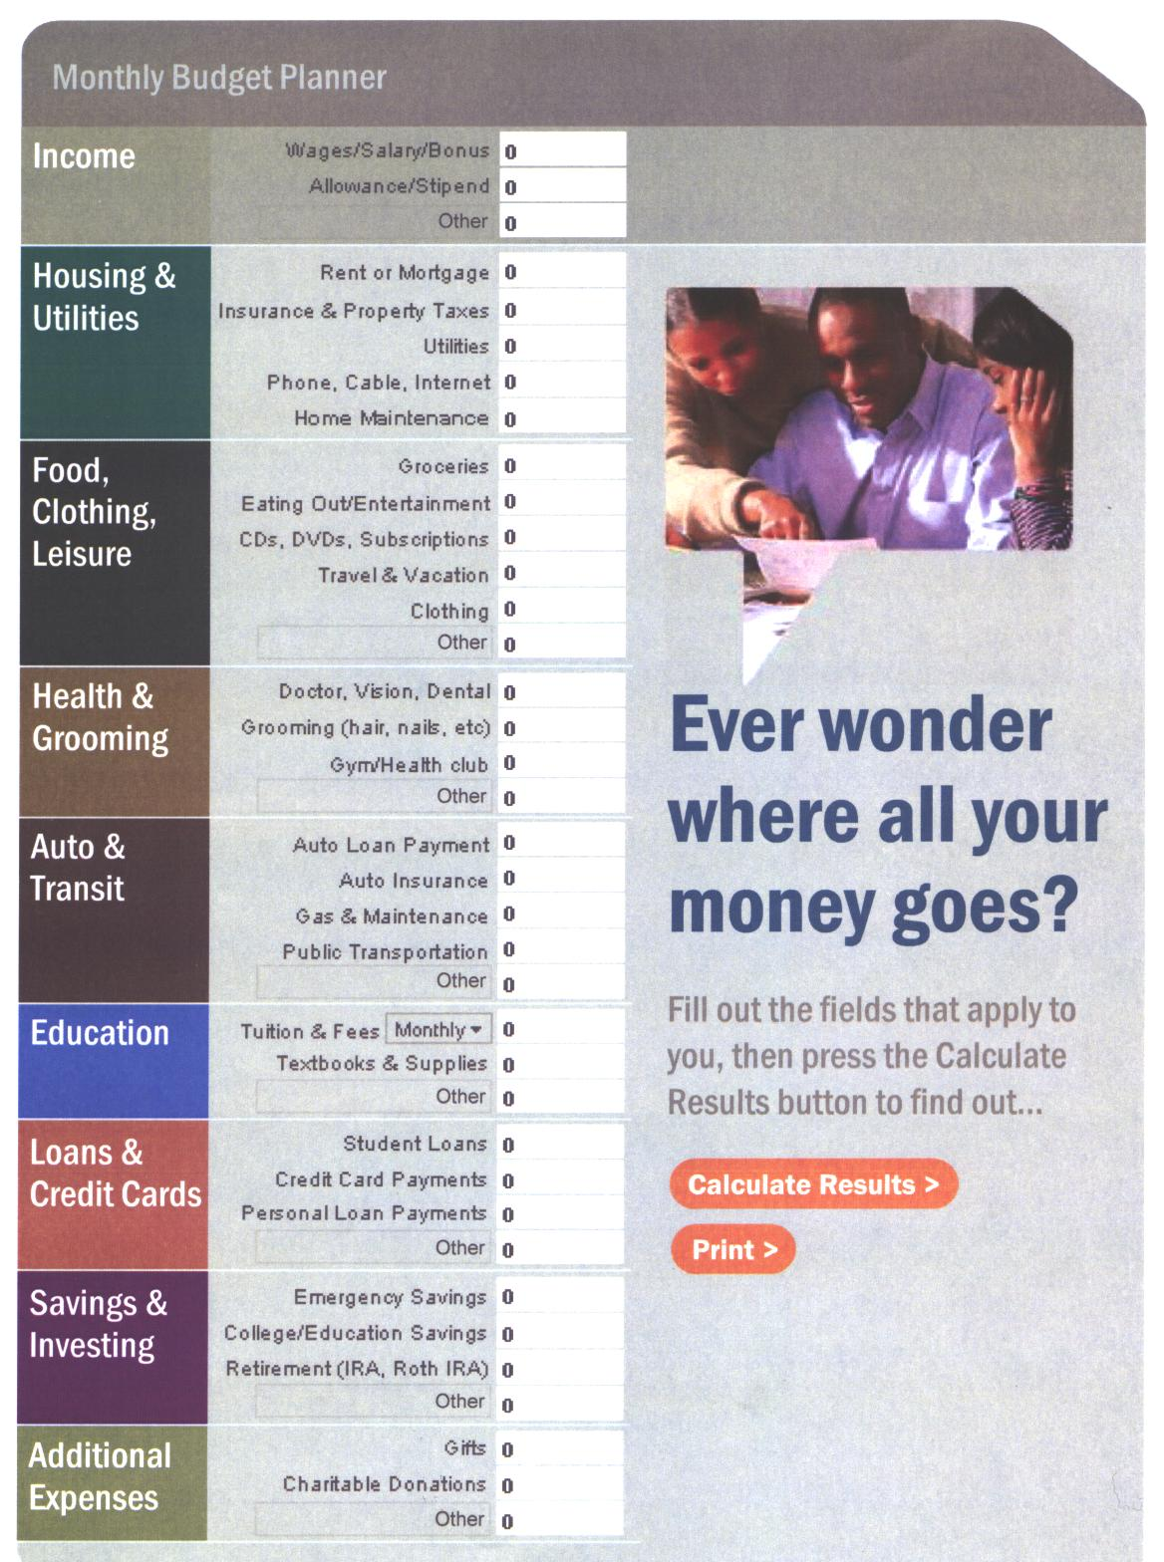

Slide 43
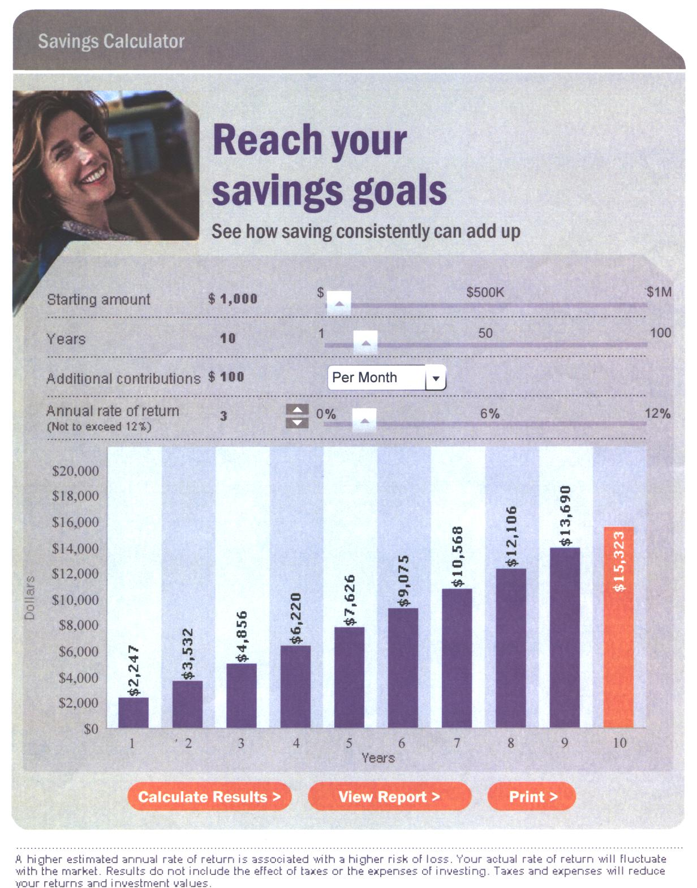

Slide 44
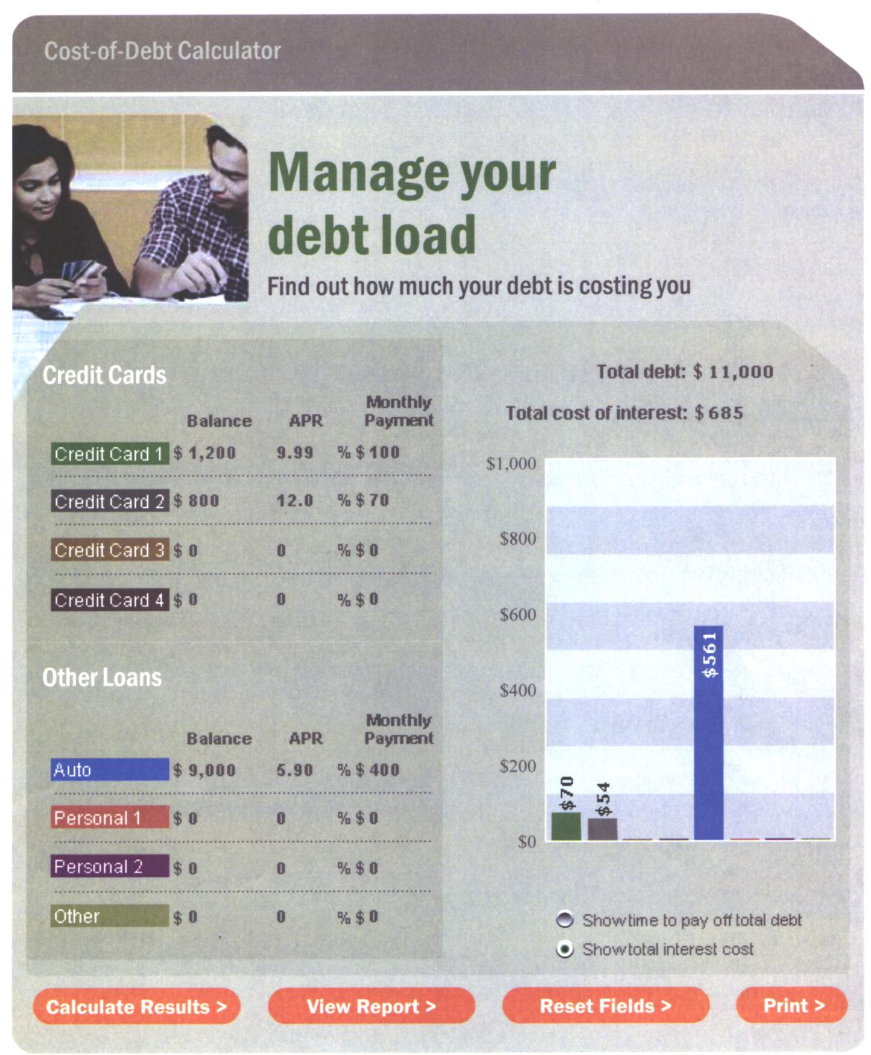

Slide 45
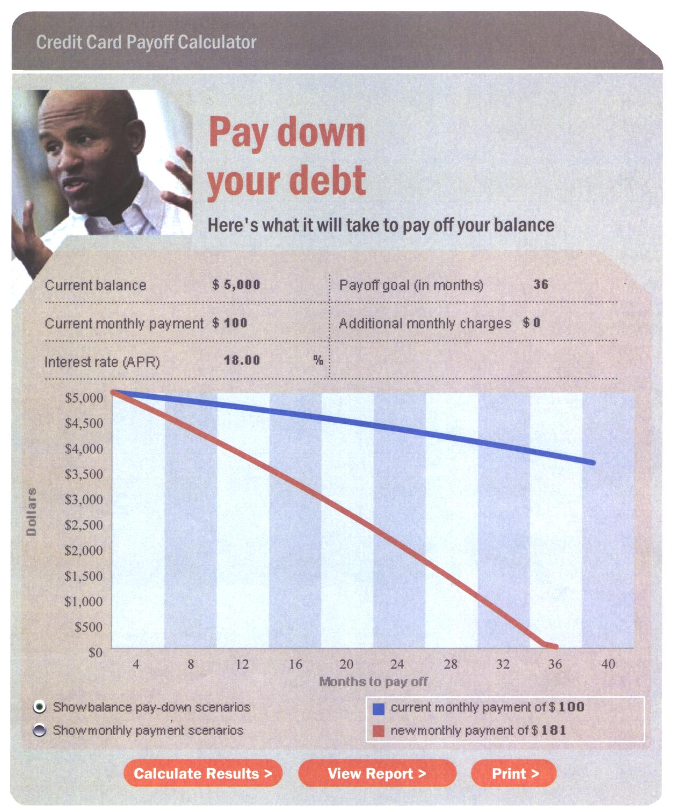

Slide 46
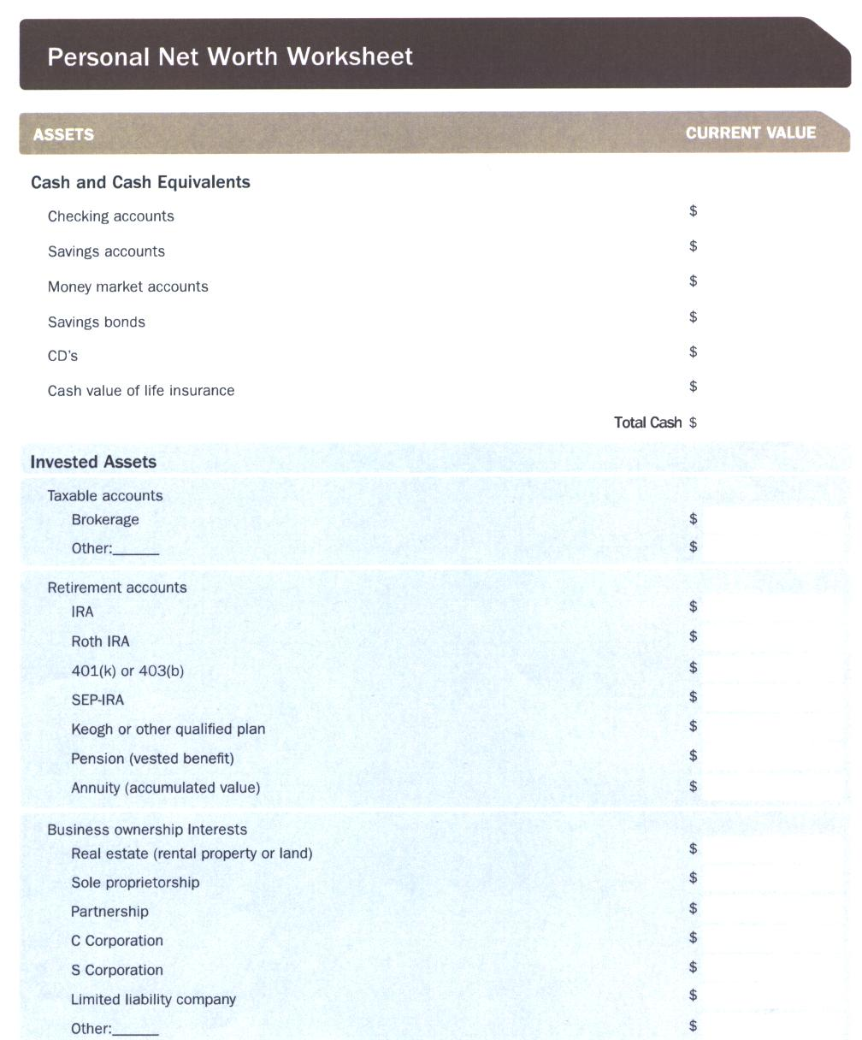

Slide 47
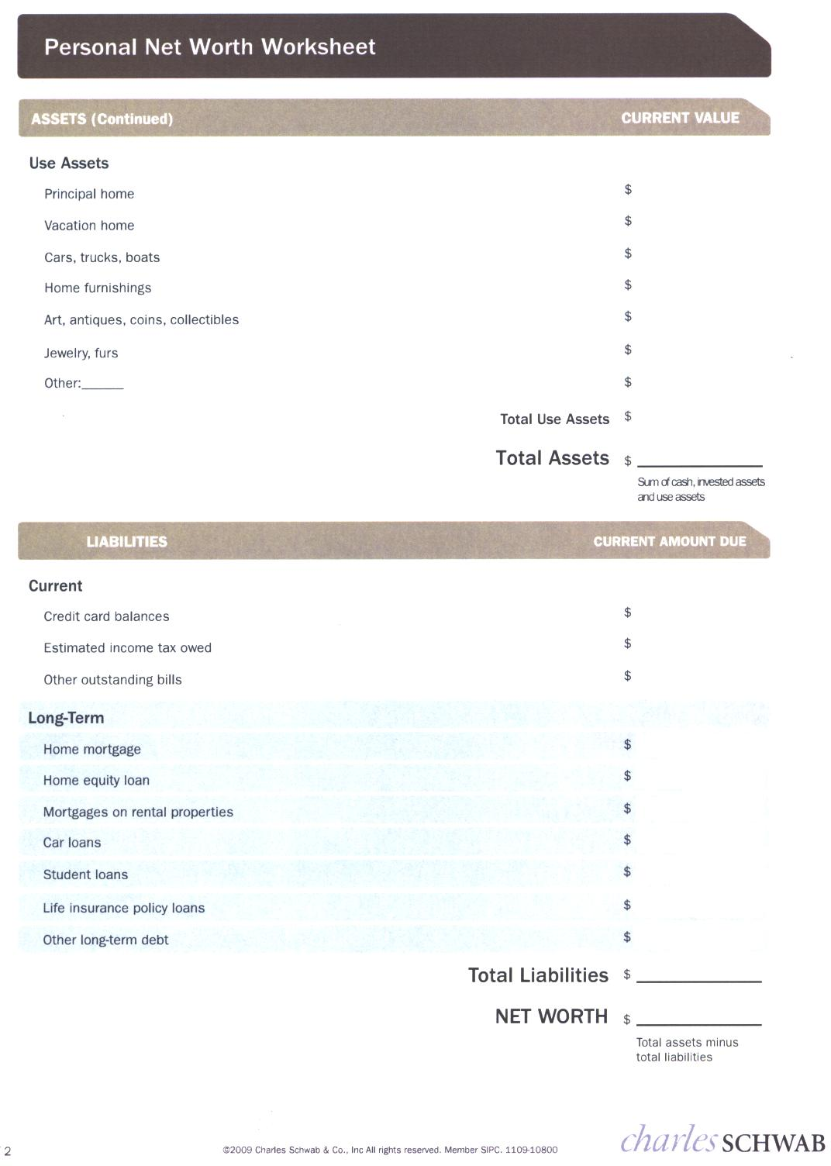

Slide 48
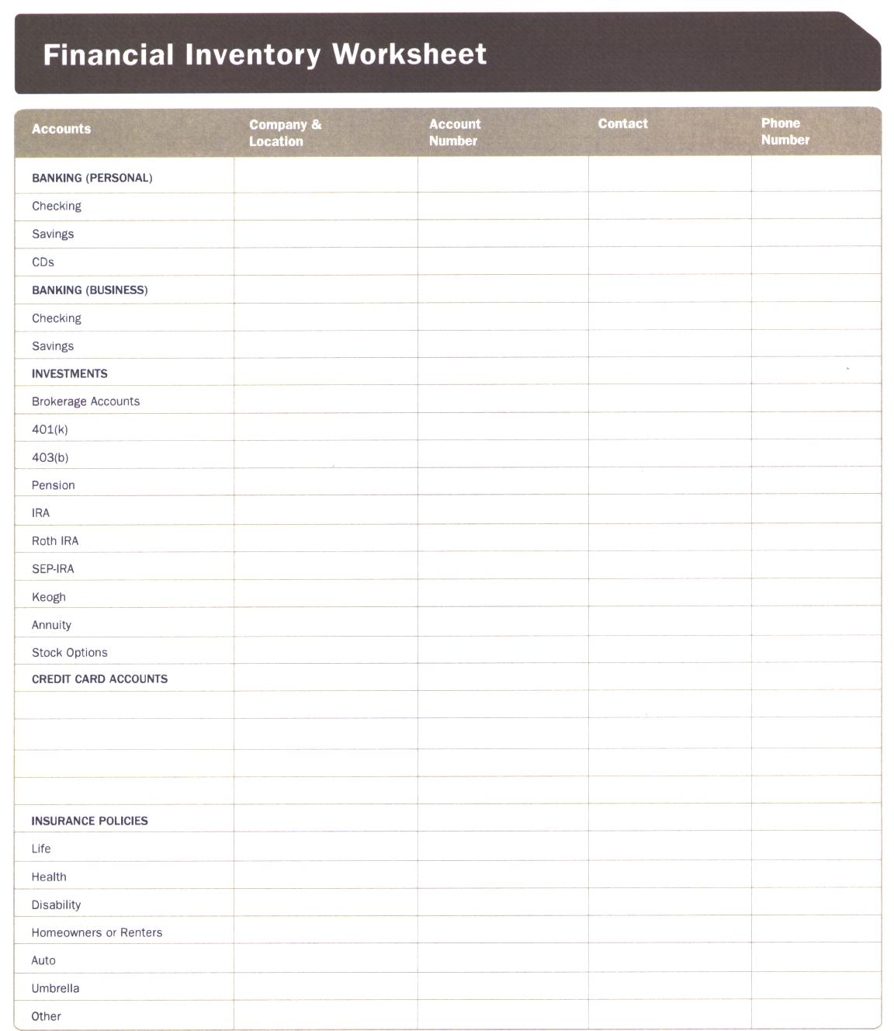

Slide 49
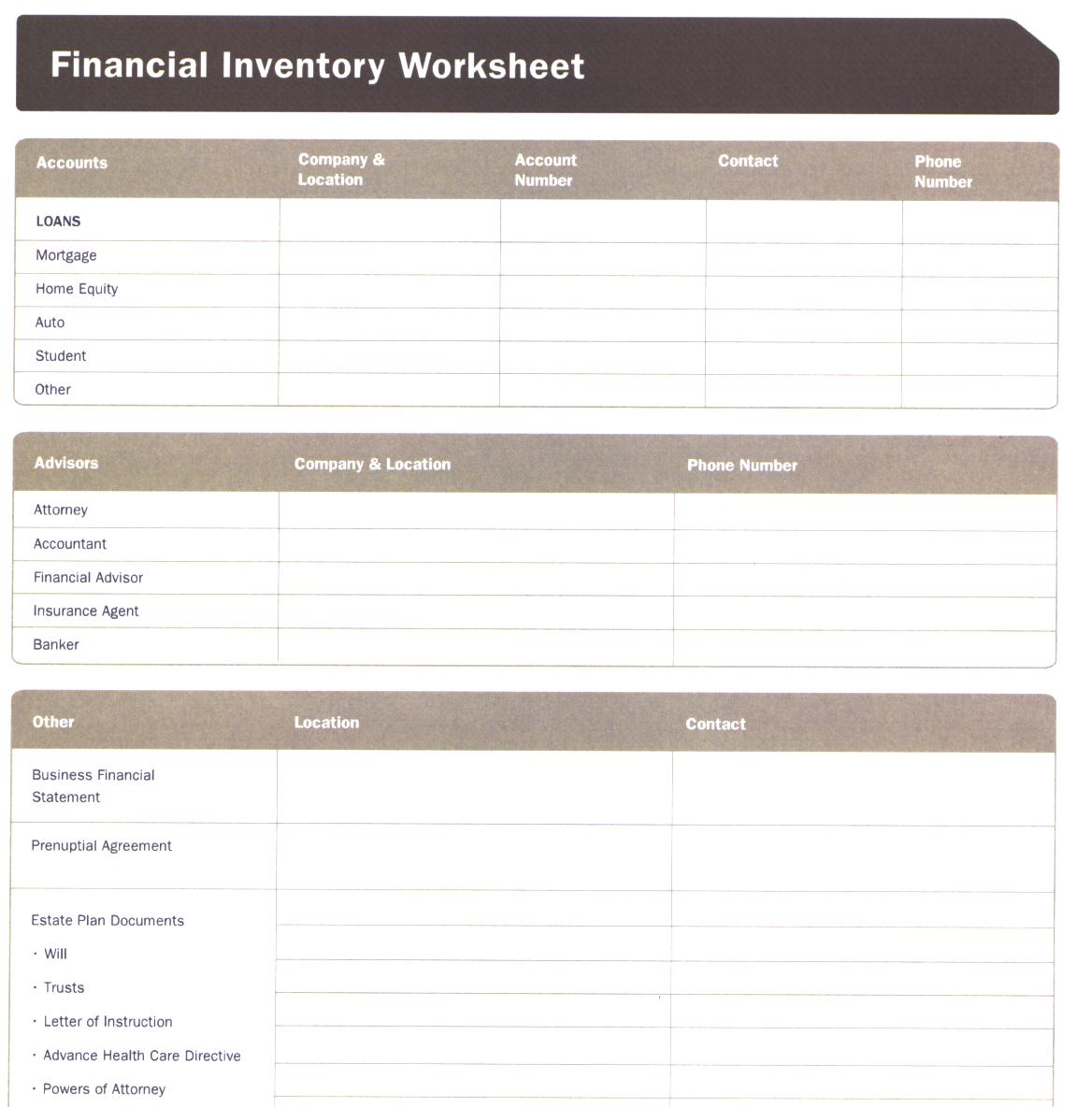

Slide 50
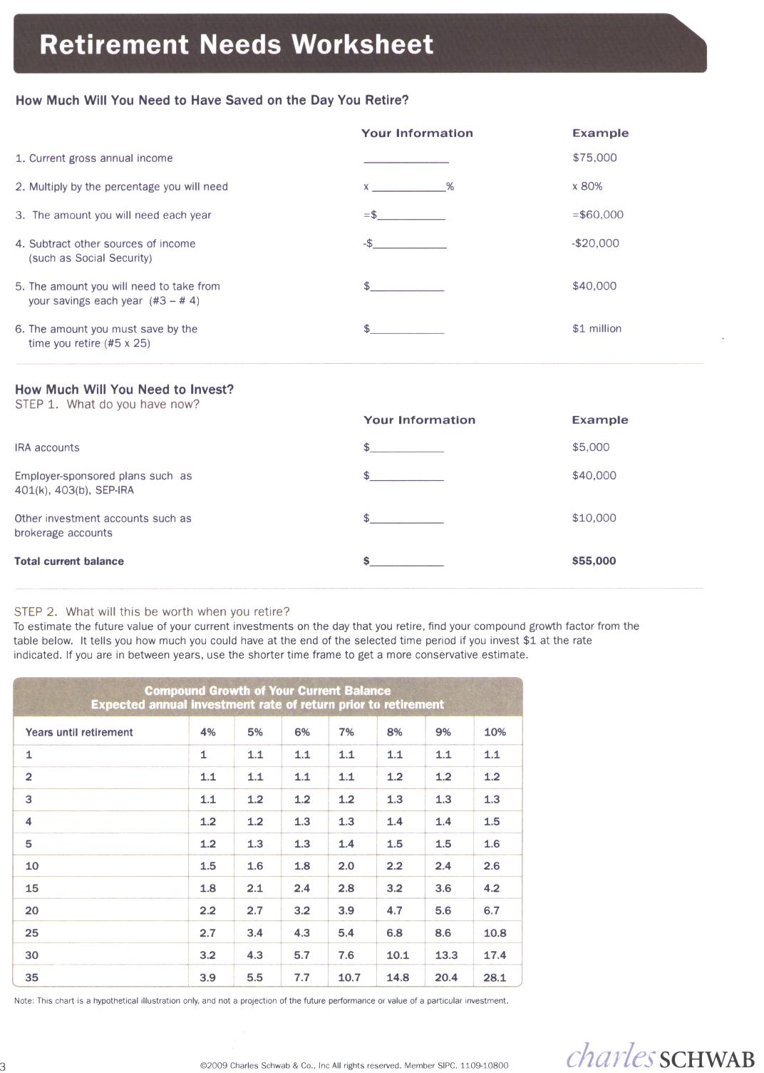

Slide 51
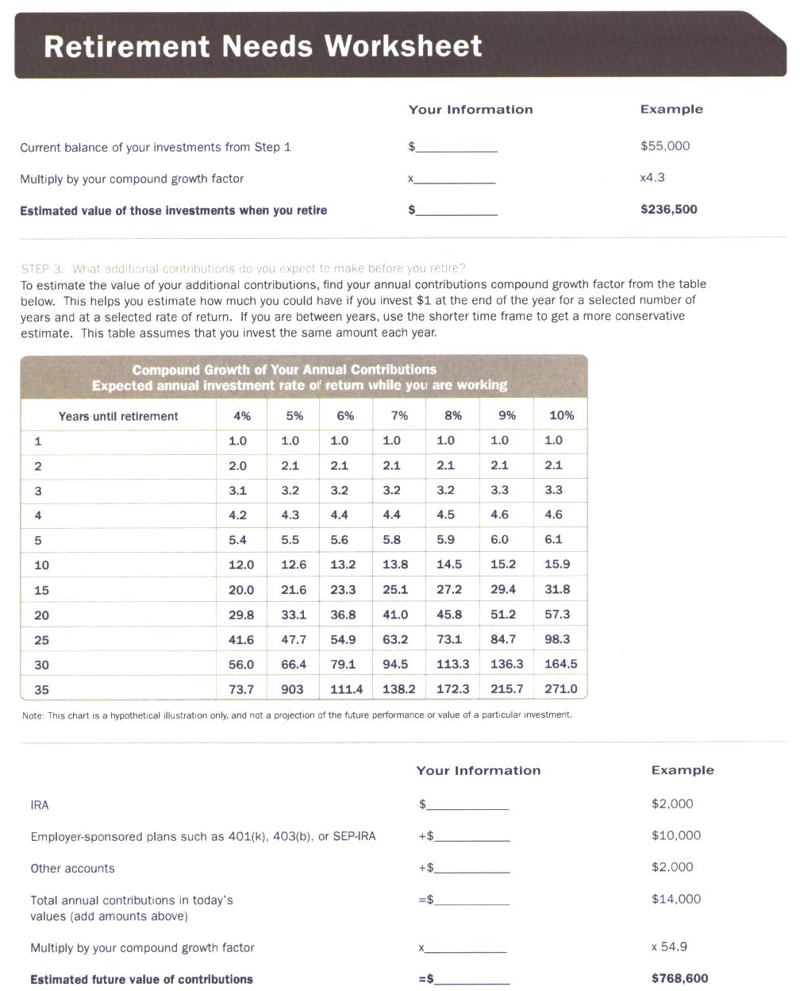

Slide 52
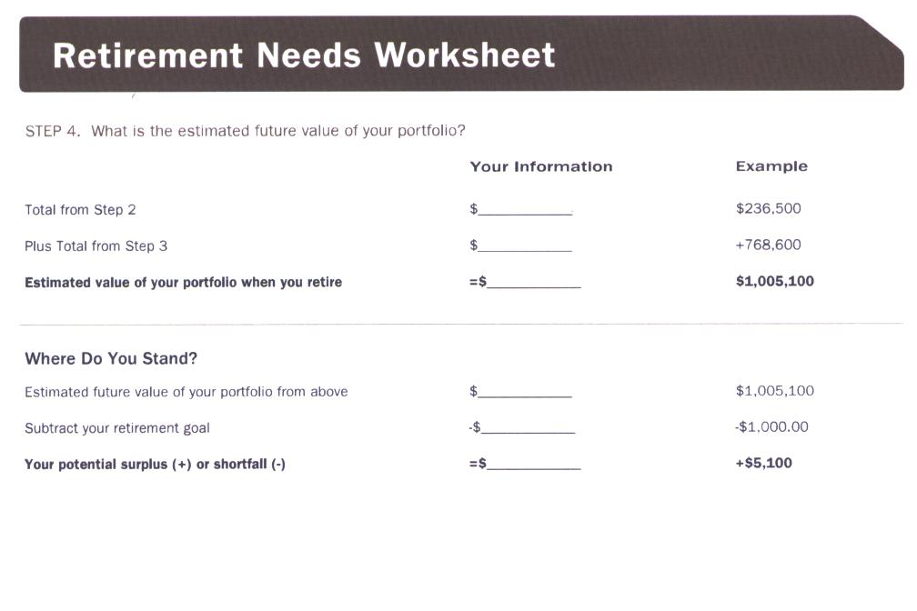

Slide 53
BUDGETING

Slide 54
WHY DEVELOP A BUDGET?
To determine where money currently is being spent.
To decide where to spend money in the future.
To learn to live on less than available income.
To take control of your financial future beginning now.

Slide 55
Definition
A budget is a systematic plan for managing your money during a given time period. The more realistic it is, the easier it will be for you to follow. A budget will help you take control of your finances to ensure enjoyment of the things you value most.

Slide 56
How to Develop a Budget
Three basic principles:
Money has to be pre-allocated.
Spending stops when the money is gone.
Current awareness of financial situation is necessary.

Slide 57
In order to begin to put a budget in place you must take three steps:
Estimate your living expenses
Record what actually is being spent
Establish a reasonable budget

Slide 58
CHRISTIAN FINANCIAL BUDGET
Income Per Month:
Salaries _________
Rents _________
Notes _________
Interest _________
Dividends _________
Other _________
Income tax return _________
TOTAL $________

Slide 59
PAYMENTS PER MONTH
1. Church & Charity Contributions:
    Church _______
    Other ___________
    Tithe _______
  2. Taxes _______

Slide 60
PAYMENTS PER MONTH
  3. Housing _________
    Payments _______
    Lawn _______
    Maintenance _______
    Taxes __________

Slide 61
PAYMENTS PER MONTH
4. Food
  Groceries ________
  Milk/bread ________
  Sundry items ________
5. Auto
  Payments ________
  Gasoline ________
  Maintenance ________
  License & tag ________

Slide 62
PAYMENTS PER MONTH
6. Utilities
  Electricity ________
  Gas ________
  Water ________
  Garbage ________
  Telephone ________
  Other ________

Slide 63
PAYMENTS PER MONTH
7. Insurance
  Auto ________
  Health ________
  Life ________
  Other ________
8. Loans
  Major ________
  Credit Card ________
  Installation ________
  Other ________

Slide 64
PAYMENTS PER MONTH
9. Entertainment-Recreation________
10. Clothing ________
11. Savings
  Regular ________
  Emergency ________
  Retirement ________

Slide 65
PAYMENTS PER MONTH
12. Medical
  Dentist ________
  Doctor ________
  Other ________
13. Miscellaneous
  Subscriptions ________
  Gifts, birthdays, Christmas ________
  Vacation ________

Slide 66
PAYMENTS PER MONTH
TOTAL PAYMENTS ________
INCOME VS. EXPENSES
Net Monthly Income ________
Less Expense ________
Overage ________

Slide 67
BUDGET PERCENTAGE GUIDELINES
Salaries for Guideline = ______/year
Gross Income Per Month $________
  Tithe (10% of Gross) _____ = $_____
  Tax (12% of Gross) _____ = $_____
Net Spendable Income $________
  Housing (33% of Net) _____ = $_____
  Food (15% of Net) _____ = $_____
  Auto (15% of Net) _____ = $_____
  Insurance (5% of Net) _____ = $_____
  Debts (5% of Net) _____ = $_____
  Entertainment/Rec. (7% of Net) _____ = $_____
  Clothing (5% of Net) _____ = $_____
  Savings (5% of Net) _____ = $_____
  Medical/Dental (5% of Net) _____ = $_____
  Miscellaneous (6% of Net) _____ = $_____
TOTAL (cannot exceed net spendable) $________

Slide 68
CASH CONTROL OVERVIEW
Checking Account
DEPOSITS & EXPENSES LEDGER
Regular Monthly
Expenses
Account
Periodic Large Expenses Account
Debt Reduction Account
Savings/ Investment Account

Slide 69
INDIVIDUAL ACCOUNT PAGE Account_________ Allocation_______
DATE | TRANSACTION | DEPOSIT | W/DRAW | BALANCE

Slide 70
VARIABLE EXPENSE PLANNING
      Est. cost per month
Vacation $______ ÷12= $______
Dentist $______ ÷12= $______
Doctor $______ ÷12= $______
Automobile $______ ÷12= $______
Annual Insurance $______ ÷12= $______
  Life $______ ÷12= $______
  Health $______ ÷12= $______
  Auto $______ ÷12= $______
  Home $______ ÷12= $______
Clothing $______ ÷12= $______
Investments $______ ÷12= $______
Other $______ ÷12= $______

Slide 71
HOW TO SAVE

Slide 72
The Most Important Financial Principle
Spend less than you earn and do it for a long time and you will be financially successful

Slide 73
$ HOW TO SAVE $
Pay yourself first
  And make your savings untouchable.
Make use of the magic of compounding.
  The amount saved
  Time

Slide 74
INDIVIDUAL RETIREMENT ACCOUNT AT 9% INTEREST
AGE | CONTRIBUTIONS EARLY | CONTRIBUTIONS LATER
22 | $2000 | 0
23 | $2000 | 0
24 | $2000 | 0
25 | $2000 | 0
26 | $2000 | 0
27 | $2000 | 0
28 | $2000 | 0
29 | $2000 | 0
30 | $2000 | 0
31….. | 0 $18,000 over | $2000 $70,000 over
64 | 0 9 years | $2000 35 years
65 | 0 | $2000
Amt. available @ 65 | $579,471 | $470,249

Slide 75
$ HOW TO SAVE $
Pay yourself first.
  And make your savings untouchable.
Make use of the magic of compounding.
  The amount saved
  Time
  Rate of return

Slide 76
RULE OF 72
______72______ YEARS TO DOUBLE
Interest Rate INVESTMENT
OR
______72______ INTEREST RATE
YEARS TO DOUBLE REQUIRED
INVESTMENT
Copyright College of Financial Planning

Slide 77
RULE OF 72: $10,000 INVESTED
INTEREST EARNED | 6 YEARS | 12 YEARS | 18 YEARS | 24 YEARS
3 | $------ | $----- | $----- | $20,000
6 | ----- | $20,000 | ------ | $40,000
12 | $20,000 | $40,000 | $80,000 | $160,000
Copyright College of Financial Planning

Slide 78
$ HOW TO SAVE $
Pay yourself first
  And make your savings untouchable.
Make use of the magic of compounding.
  The amount saved
  Time
  Rate of return
  Adjust your lifestyle

Slide 79
$1000/yr car payments for 40 years = $40,000
Bank lends your $40,000 at 12.5%. Over the 40 years the bank will have accumulated $1 million
The bank has made $960,000 on your $40,000 = avg $24,000/yr in interest = 2400% annual return

Slide 80
EXPENSES | Before Planning | After Planning | Actions Taken
Housing
Food
Clothing
Transportation
Entertainment
Medical
Insurance
Children
Gifts
Miscellaneous
TOTAL
Difference from balance Total

Slide 81
$ HOW TO SAVE $
Pay yourself first
  And make your savings untouchable.
Make use of the magic of compounding.
  The amount saved
  Time
  Rate of return
  Adjust your lifestyle
  Re-align your assets

Slide 82
Assets | Before Planning | After Planning | Actions Taken
Savings = $5000 @ 1% | $50/yr | $150/yr (=$100/yr) | 3% T-Bills
No IRA | 0 | $300/yr at 15% Tax | $2000 in IRA
Refi Mortgage | 100,000 at 6% | Save 2000/yr | 100,000 @ 4%
Life Insurance | $200/mo whole | $50/mo term | Switch to term ins.
Total Assets
LIABILITIES
Credit card | $2000 @ 15%= $300/yr | $2000 @ 6 % = $120/yr = $180 savings | Switch to teaser rate
Car payment | $10,000 @ 10% = $1000/yr | 0 car payment, saving $1000/yr | Pay cash for car you can afford
Total Liabilities
NET WORTH

Slide 83
$ HOW TO SAVE $
Pay yourself first
  And make your savings untouchable.
Make use of the magic of compounding.
  The amount saved
  Time
  Rate of return
  Adjust your lifestyle
  Re-align your assets
  Avoid Debt

Slide 84

SPENDING

Slide 85
If you spend less than you earn and do it for a long time, you will be financially successful.

Slide 86
INFLATION
$10,000 @ 5 ¼ % = $10,525.00
Taxes @ 15% = $78.75
Inflation @ 5% = Money worth $9,946.25
Inflation @ 12% = Money worth $9,246.25
Money is lost in purchasing power.

Slide 87
4 Myths of Inflation
Buy now because it will cost more later.
Always borrow to buy.
You can never accumulate enough.
The rate of inflation is standard for everyone

Slide 88
Basic Principles
1. Begin living on a cash basis
2. Consider how each purchase will increase, or decrease your Christ-like character.
3. Make your spending money difficult to get to:

Slide 89
Basic Principles
  Don’t carry a lot of cash
  If necessary, leave your credit cards home except on a trip.
  Know what you want before you shop.
  Reject bargain items you weren’t looking for.
4. Associate cost of purchase with the sacrifice it took to earn.

Slide 90
Basic Principles
5. Become a friend to the seller who passes the test of character.
6. Build sales resistance.
  Do I need it?
  Am I buying more than I need?
  Does it do what it claims?
  Will it soon be outdated?
  Does my use justify purchase?
  Am I paying unnecessary overhead and middle men?

Slide 91
Basic Principles
7) We must always love God more than money.
8) Riches cannot be trusted.
9) Wait before making purchases: “use it up, wear it out, make it do, or do without.”
10) Learn to just say, “No”.

Slide 92
Loaning to Others
Four principles:
  1) Don’t become a loan company. (Prov 22:7).
  2) If the purchase is not necessary, don’t loan (1 John 3:7)
  3) If it is a need, don’t loan, give expecting nothing in return. (Luke 6:34,35).
  4) Do not co-sign (Prov 17:18).

Slide 93
CREDIT AND DEBT

Slide 94
We are going to play a short game today to see how well advertisers are doing in invading your mind
I will show you an advertisement and then you try to figure out the company the advertisement represents……

Slide 95

You DESERVE a Break Today
So Get Up and Get Away TO

Slide 96
Because I’m WORTH It
L'Oréal

Slide 97

You DESERVE Better

Slide 98

Have it YOUR way

Slide 99

We want MORE,
MORE is better

Slide 100

When you CARE enough
to send the VERY BEST

Slide 101

Tastes GREAT
LESS Filling
You are watching too much football!

Slide 102

There are some things money can’t buy
For EVERYTHING ELSE there’s

Slide 103


WINNING TAKES CARE
OF EVERYTHING

Slide 104

So then it appears that we are not really responsible. If it weren’t for Satan we would not have a problem with being discontent.

Slide 105
CREDIT AND DEBT

Slide 106



Definition
Debt is any money owed to anyone for anything

Slide 107
The danger of debt
Compounding works against us.
$15,000 car loan x 6 yrs @12%
= $21,114 total payment for a car now worth $5,000.
Debt becomes a trap.

Slide 108

The danger of debt
Debt always mortgages the future.
$5,000 credit card debt @ $250/mo payments would take 2 years @18% interest.

Slide 109
Principles concerning debt
The wicked borrow and do not repay
(Psalm 37:21).
You are in bondage to the lender
(Proverbs 22:7).
You are responsible to provide for your own family (1 Timothy 5:8).
Debt makes it easier to fund our greed (Luke 12:15).

Slide 110
When is debt acceptable?
When it makes economic sense.
When there is a guaranteed way of repayment.
When we are not in violation of personal and biblical values and goals.

Slide 111
Kinds of debt
Credit card debt
Consumer debt
Mortgage debt
Investment business debt

Slide 112
Common Mistakes
Mistake #1
  CONSUMPTIVE LIFESTYLE
  Solution:
  Don’t allow others to control your spending

Slide 113
Common Mistakes
Mistake #2
  LACK OF BUDGET
  Solution:
  Develop a budget according to the first 4 lessons in this series.

Slide 114
Common Mistakes
Mistake #3
  BUYING AND SELLING AUTOMOBILES
  Solution:
  Drive your present car until it is at least 10 yrs old. When car is paid off, continue to make payments to yourself until you have cash for the next vehicle.

Slide 115

Common Mistakes
The cheapest car in America to own is the car you presently own.

Slide 116
3 ways out of debt
Sell assets to reduce debt
Set up a repayment schedule
Apply any unexpected money that may come your way to debt reduction.
Creditkarma.com – free annual credit report with credit score

Slide 117
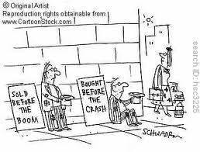
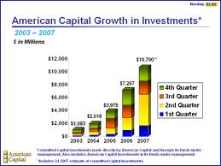
INVESTMENTS

Slide 118
ACCUMULATION STRATEGY
4 STEP PLAN
Eliminate all credit card and consumer debt.
Set up an emergency fund.
Set up separate accounts for major purchases.
Invest for long range goals.

Slide 119
RISK
Types of risk
    Business
    Financial
    Market
    Interest rate
    Purchasing power
Risk tolerance
    Is the stock market riskier than an interest savings account

Slide 120
DIVERSIFICATION
Diversify across many types of investments:
  Liquid
  Growth
  Non-liquid
  Real Estate

Slide 121
REASONS FOR FAILURE
“In my thirty years of experience in the financial field, I have learned that 90% of all investors, investing in anything, make no money over a ten-year period.”
He gives the following reasons for failure:
  Investors have no financial goals.
  Investors do not understand the laws of compound growth.

Slide 122
REASONS FOR FAILURE (CONT’D)
3. Investors follow complex investment
strategies.
4. Investors are greedy.
5. Investors are influenced by, and act
upon, what they read in the financial
press.
6. Investors rely on gurus, brokers, etc.
for investment advice.
7. Investors chase investments, acting
emotionally rather than rationally.

Slide 123
BIBLICAL PRINCIPLES OF INVESTING
Do not presume upon the future (James 4:13-15).
Avoid speculation and hasty investment (Prov 28:20; 13:11).
Never cosign (Prov 22:26-27; 11:15; 17:18)
Evaluate the risk (Luke 14:28).
Avoid investments that cause anxiety (Matt 6:31).
Never trust in riches (1 Tim 6:17).
Diversify (Eccl 11:1, 2)

Slide 124
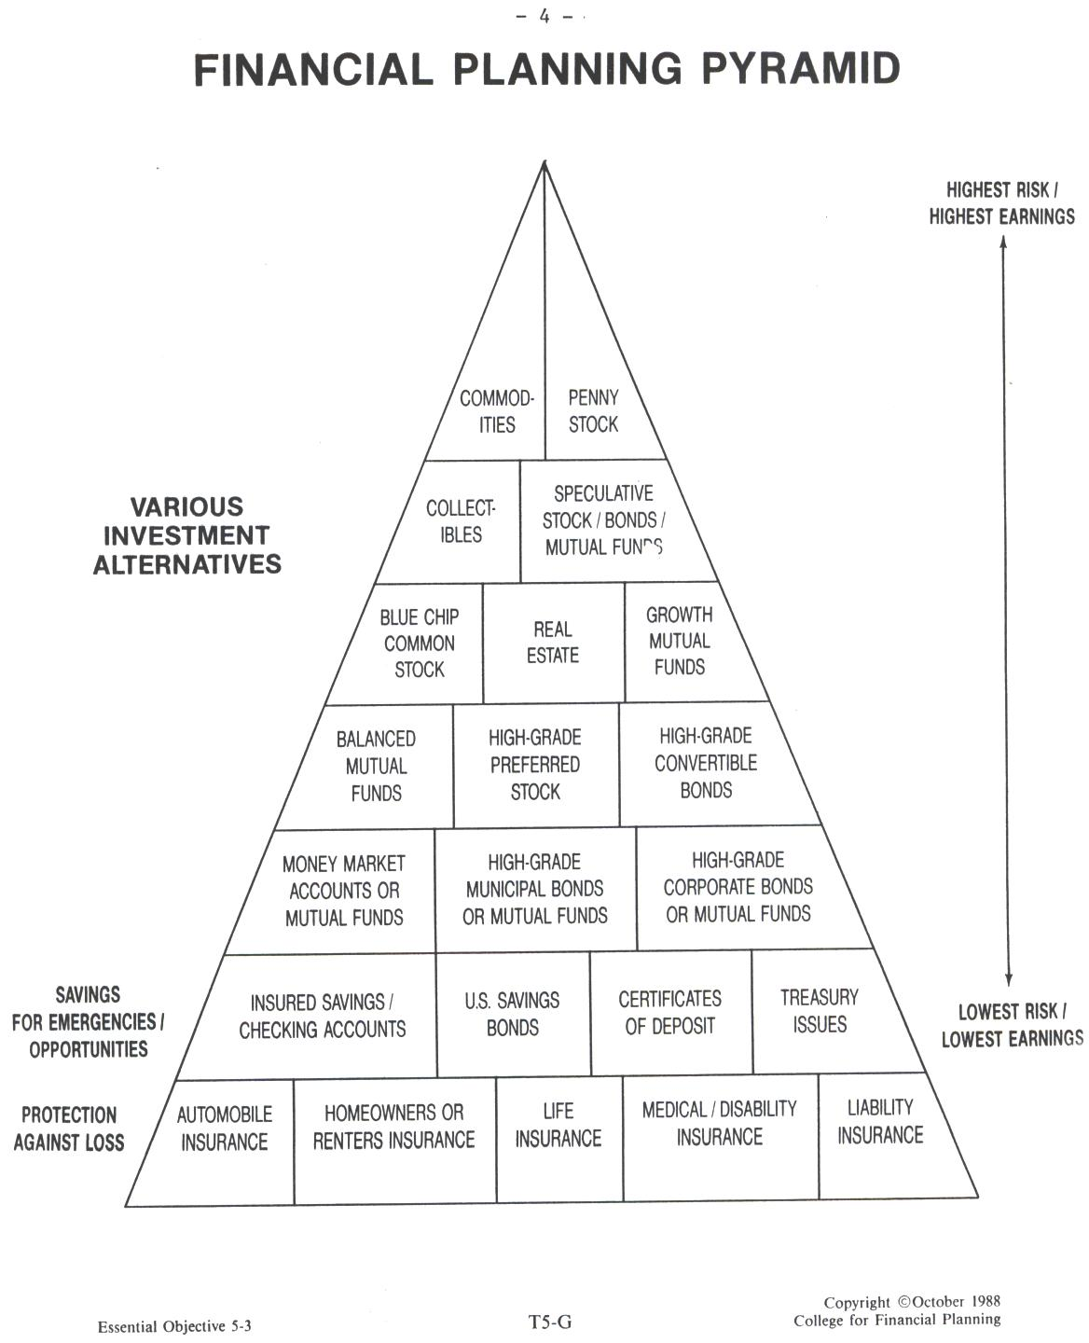

Slide 125
INTEREST BEARING INVESTMENTS
Insured savings accounts
U. S. Savings Bonds
Certificates of Deposit
Money market
College savings bond
Annuities

Slide 126

BONDS
Treasury securities (notes, bills, bonds)
Corporate bonds.
Municipal bonds.

Slide 127
READING FINANCIAL DATA
Bond Financials
BONDS | Cur Ytd | Vol | High | Low | Close | Net Chg
PrCl 9s11 | 14.1 | 26 | 65.25 | 63.75 | 63.75 | —1.10
DXY 8s91 | 8.4 | 25 | 95.25 | 95.85 | 95.25 | +.75
DOGS zr97 | — | 8 | 22.50 | 22 | 22.50 | —.25

Slide 128


STOCKS
Income
Growth
Blue-chips

Slide 129
READING FINANCIAL DATA
Stock Financials
52 week High Low | Stocks | Div. | Ytd. % | P-E Ratio | Sales in 100s | High | Low | Close | Net Chg.
50.75 32.50 | AMR |  | . . . | 7 | 8618 | 42.25 | 41 | 41 | -1.40
24.50 18.60 | AMR pf | 2.18 | 8.9 | . . . | 6 | 24.50 | 24.40 | 24.40 | . . .
55.75 32.75 | ASA | 2.00 | 5.7 | . . . | 436 | 35.50 | 34.60 | 35.25 | -.25

Slide 130

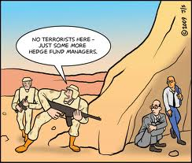
MUTUAL FUNDS
Income funds
Growth funds.
Total-return funds.
Sector funds.
International funds.

Slide 131
READING FINANCIAL DATA
Mutual Fund Financials
Fund | NAV | Offer Price | NAV Chg.
AARP Invest Program
Cap Grw | 24.09 | N.L. | +.23
Gen Bnd | 14.90 | N.L. | +.08
Ginnie M | 15.18 | N.L. | +.07
Franklin Temp bal | 20.00 (5.75% Ld) | 21.15 one yr w Ld = 13. 1%; with ld = 6.56% | +.29
Vanguard Group
Bd Mkt | 9.25 | N.L. | +.06
Explor | 29.48 | N.L. | -.01
HiY Bnd | 8.48 | N.L. | —

Slide 132
REASONS TO USE MUTUAL FUNDS
Professional management (a good place to get started)
Diversification
Record keeping
Automatic reinvestment of dividends
A ready market for buying and selling shares
Variety of objectives

Slide 133


REAL ESTATE

Slide 134
TYPES OF REAL ESTATE INVESTMENTS
Most Important—your own house
Rental Property
Real Estate Investment Trust
Real Estate Limited Partnerships

Slide 135


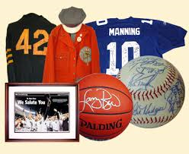
OTHER INVESTMENTS
Commodities
                Gold and Silver
Collectibles

Slide 136

INSURANCE

Slide 137
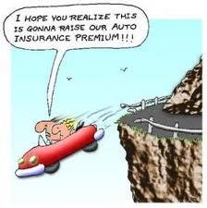
MAIN TYPES OF INSURANCE
Automobile
Homeowners/renters
Life
Medical and disability
Long term care
Liability

Slide 138

LIFE INSURANCE
Three questions:
  Why do we need life insurance?
  How much insurance do you need?

Slide 139
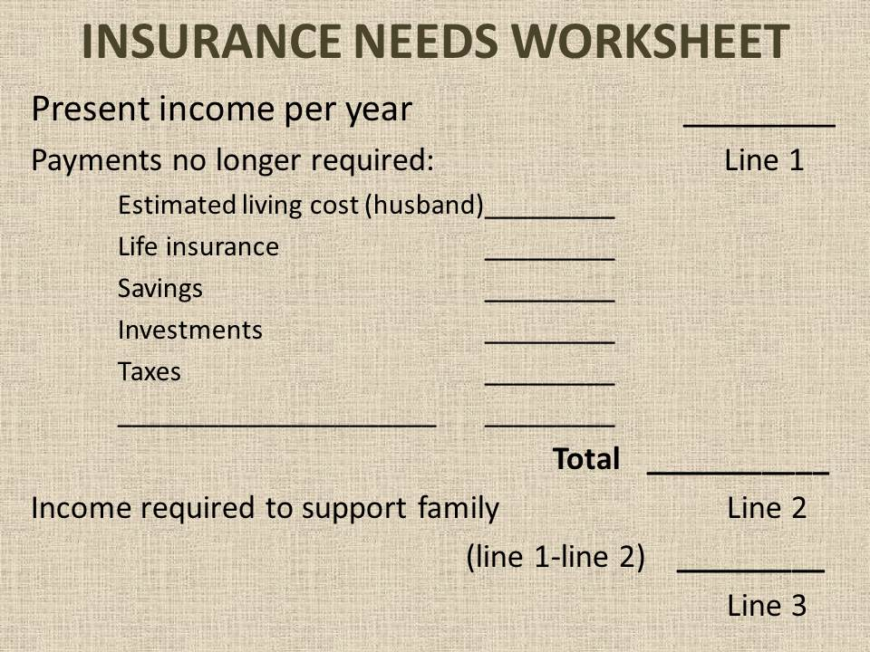

Slide 140
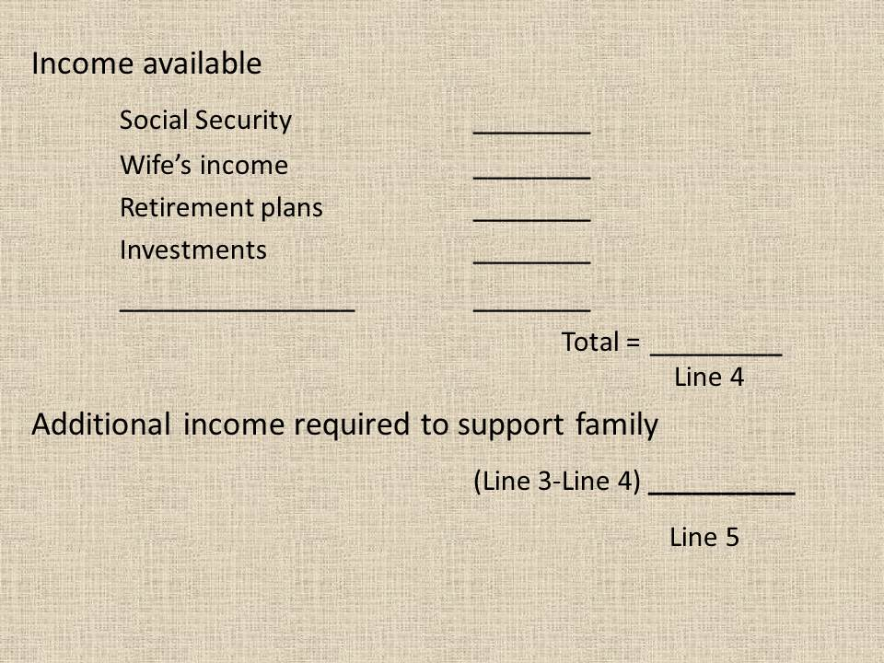

Slide 141
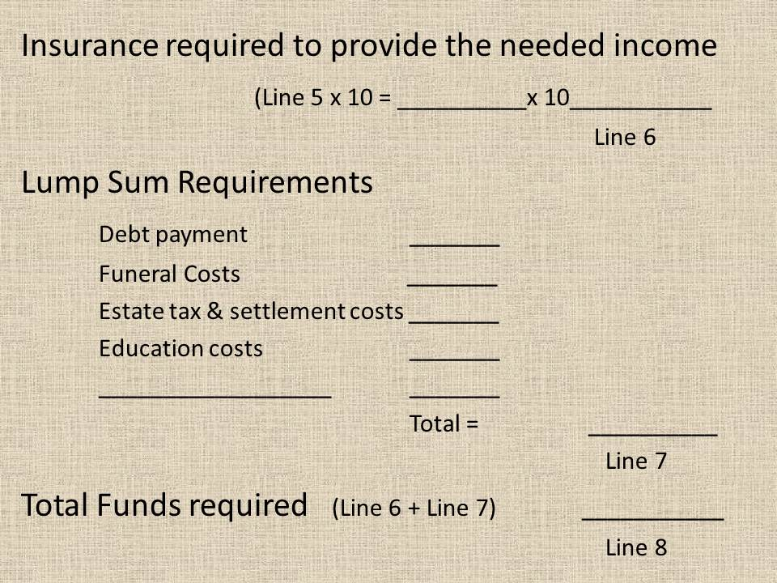

Slide 142
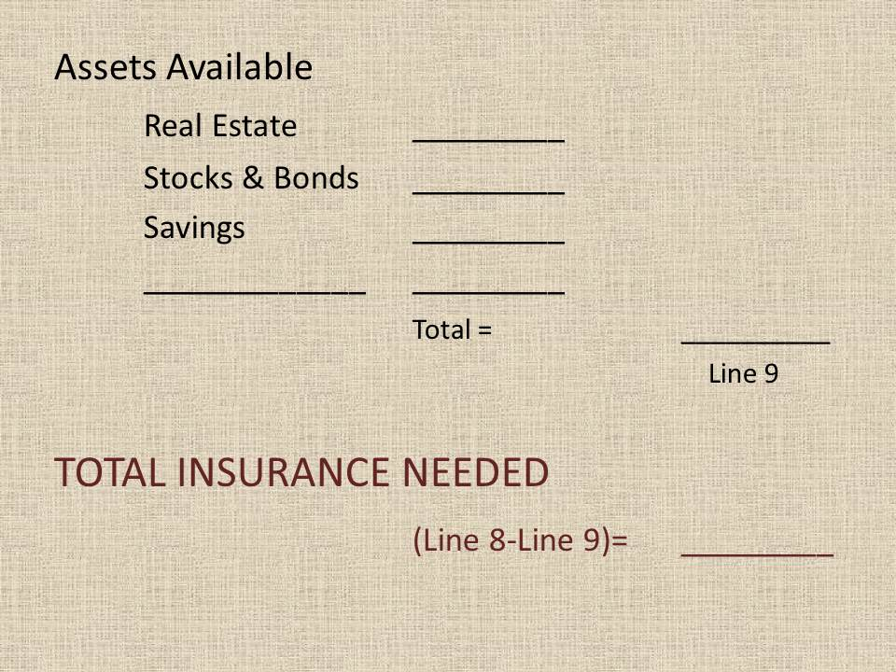

Slide 143
What kind of insurance should you purchase?
    Term: (Annual, 5-15 year renewal, Decreasing): see Zander Insurance Group for rates.
    Cash value (Whole, Universal, Variable)

Slide 144
POLICY – 15 YEAR
POLICY | ANNUAL PREMIUM | 15 YEAR TOTAL
15 YR. LEVEL TERM | $398 | $5,973
5 YR. RENEWABLE TERM | $473 | $7, 108
ANNUAL RENEWABLE TERM | $508 | $7,617
UNIVERSAL LIFE | $866 | $13,302
WHOLE LIFE | $2183 | $32,751

Slide 145
THINGS TO CONSIDER
Life insurance is not a permanent need
Cash-value life insurance is seldom wise
Insurance dividends are a refund
Add a rider for spouse and children
Mortgage insurance is a form of decreasing term insurance

Slide 146



TAXES, ESTATE PLANNING, & GIVING

Slide 147
Objective in Tax Planning is to Reduce the Effective Tax
Four Ways:
  Timing strategies
  Shifting strategies
  Investments
  Tax-deferred investments

Slide 148
INDIVIDUAL RETIREMENT ACCOUNTS
Can be established in almost any kind of investment
Anyone who has earned income
You may have as many IRAs as you wish
Intended to be funds set aside for retirement
Contributions to IRA can be made for current year until April 15 of following year or until you file tax forms.
Roth IRA

Slide 149
TRUSTS

Slide 150
ESTATE PLANNING
If you do not plan the distribution of your estate the government will.
The state will determine guardians for your children if you do not.

Slide 151
ESTATE PLANNING (CONT’D)
Plans for our estate should include:
  Will
  Life Insurance
  Property deeded appropriately
  Instructions as to wishes/desires
  Proper and easily located records
  Advisors properly selected and instructed
  Both spouses should know how to handle the finances
  Leaving money to adult children

Slide 152
ESTATE TAXES
Unified credit
Ways to minimize your estate/gift taxes
  Annual gift exclusions
  Marital deduction
  Marital gift exclusion
  Charitable gifts

