Slide 1


THE SAFETRACE TEAM
APRIL, ASHLEY, NEA, XINYI, YIXIN

Slide 2

PRODUCT
SHOW
https://app.safetrace.ca/

Slide 3





KEY FEATURES
AI Detection
Google Gemini 3.1 Pro
Intuitive Interface
Security first architecture

Slide 4

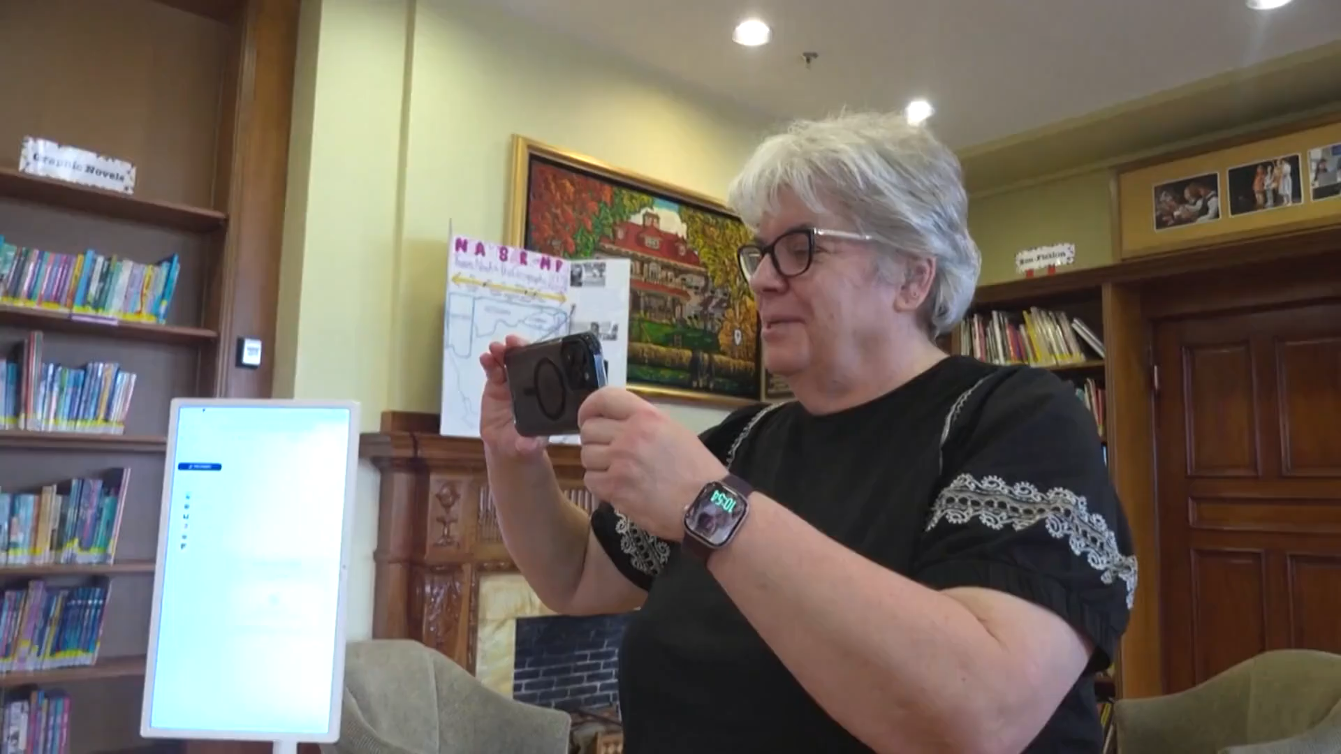
CTV
NEWS

Slide 5

FINANCIAL
MODEL
Basic
Completely free
Pro
$9/month
100 analysis
Monthly profile Audit + Personal Exposure Report
Pro+
$19/month
Continuous monitoring
Video scanning
Five-year operating costs: $5000

Slide 6
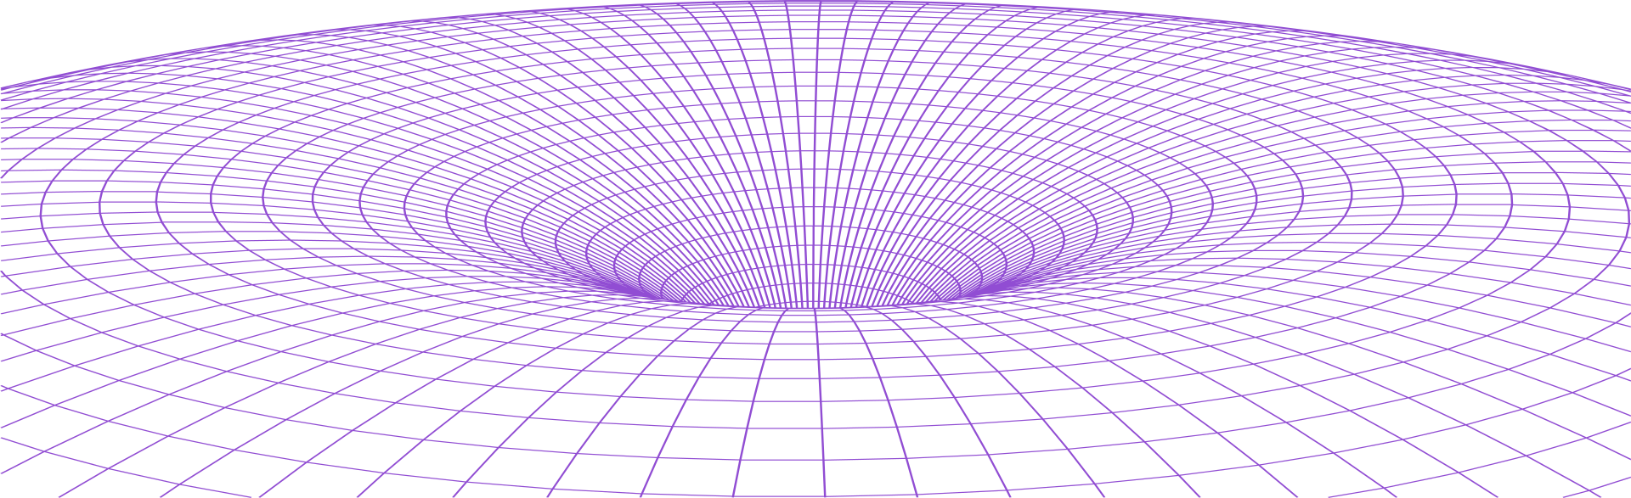
THANK YOU!

