Slide 1

ClimateSafe
“Your shield against climate change”
ClimateSafe : Emily Fetco and Zixin (Alina) Liu

Slide 2
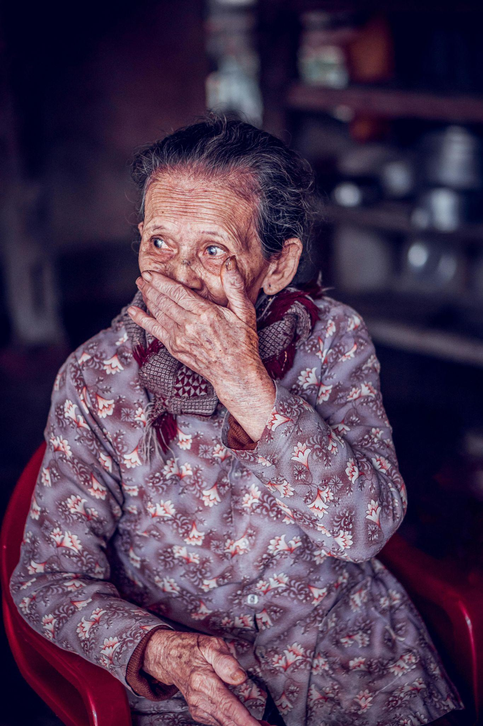
“What would you do if someone you love was in danger…and you couldn’t help?”

Slide 3
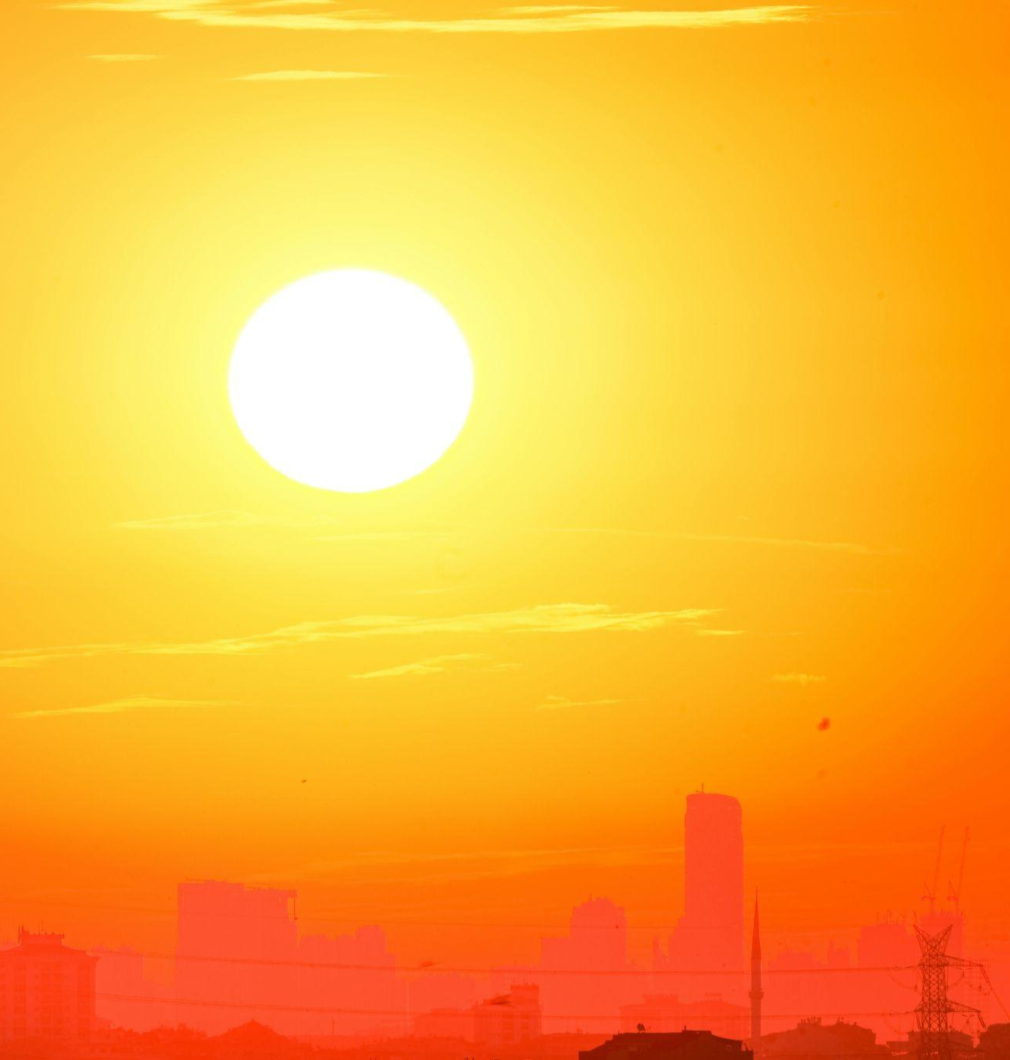
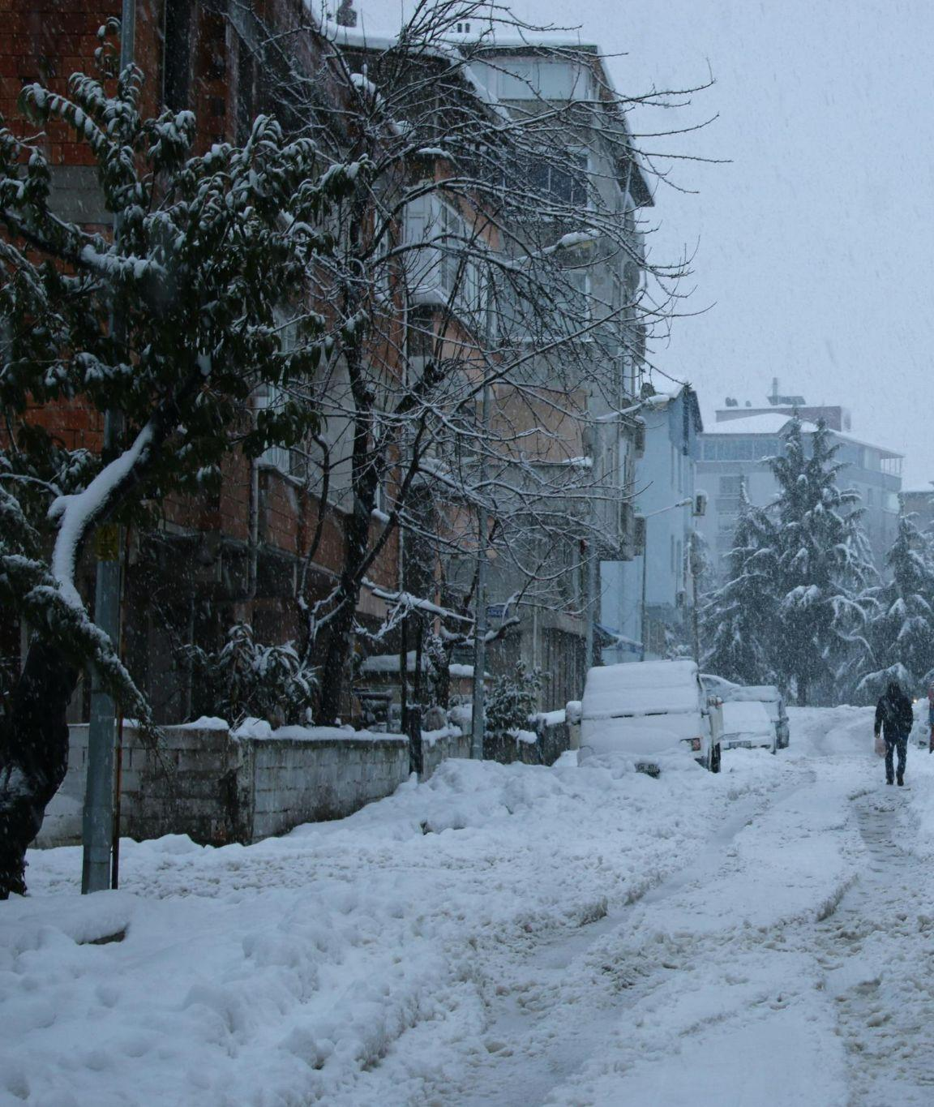
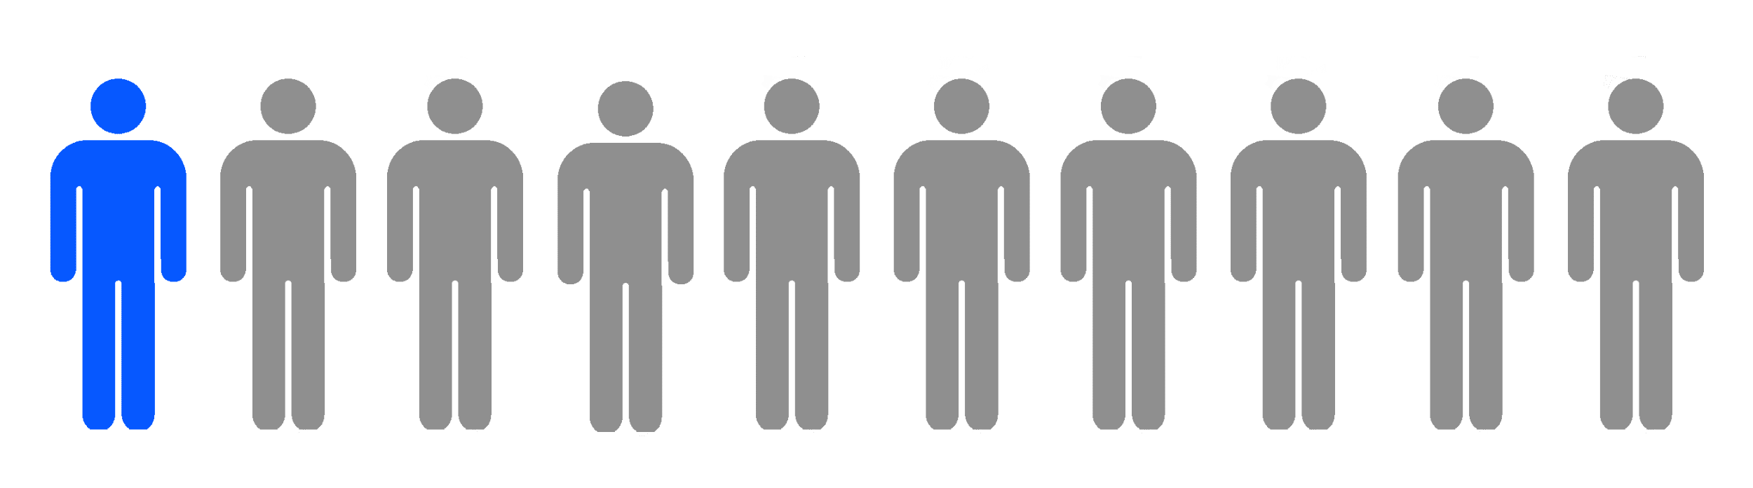
THE PROBLEM

Slide 4

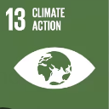
SOLUTION
01
02
03
Personalized alerts. Real actions. Real protection.
User
ClimateSafe
Protection

Slide 5
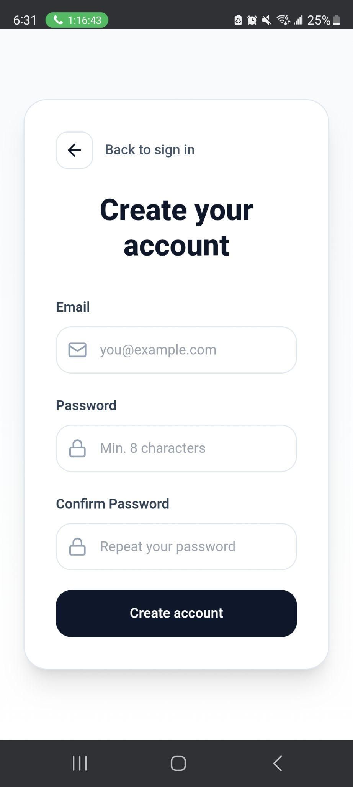
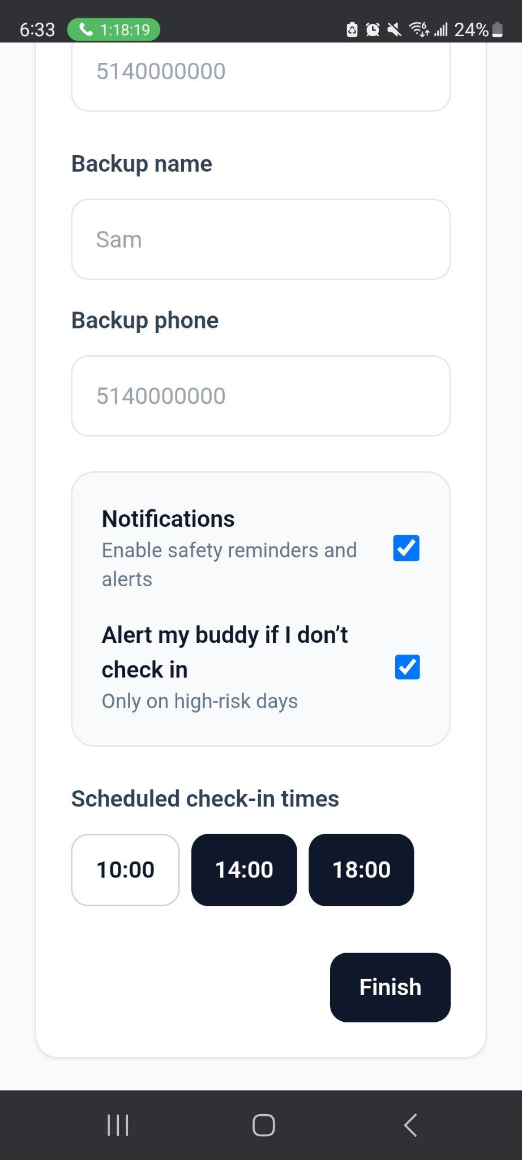
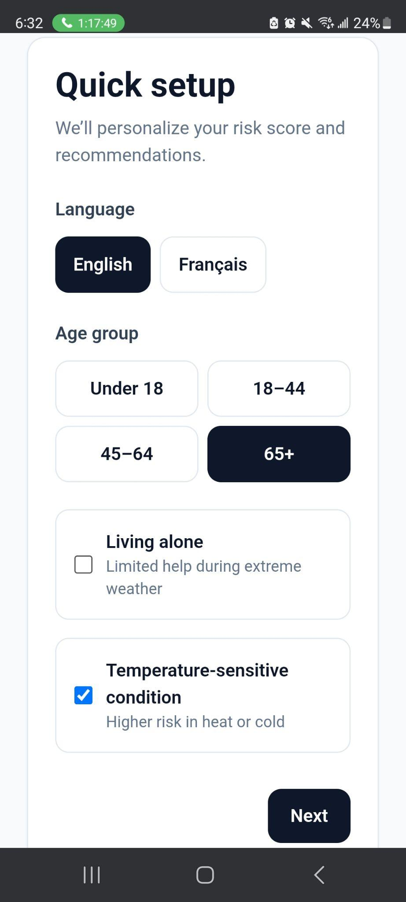
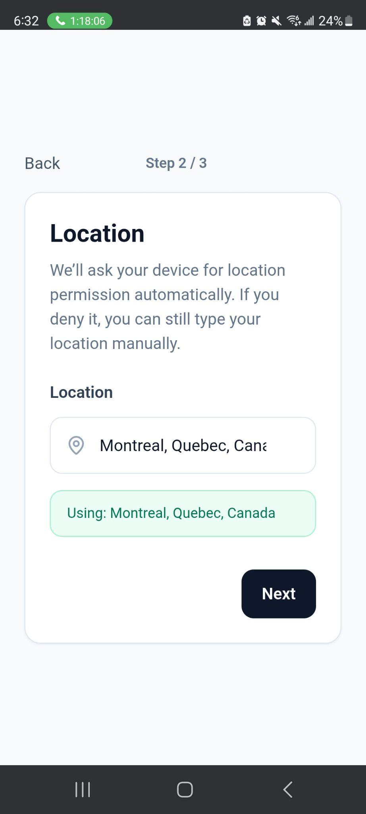
DEMO

Slide 6
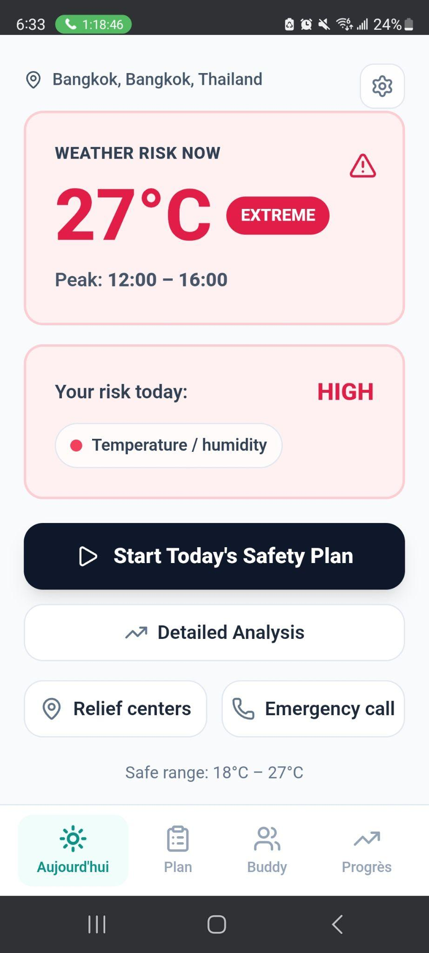
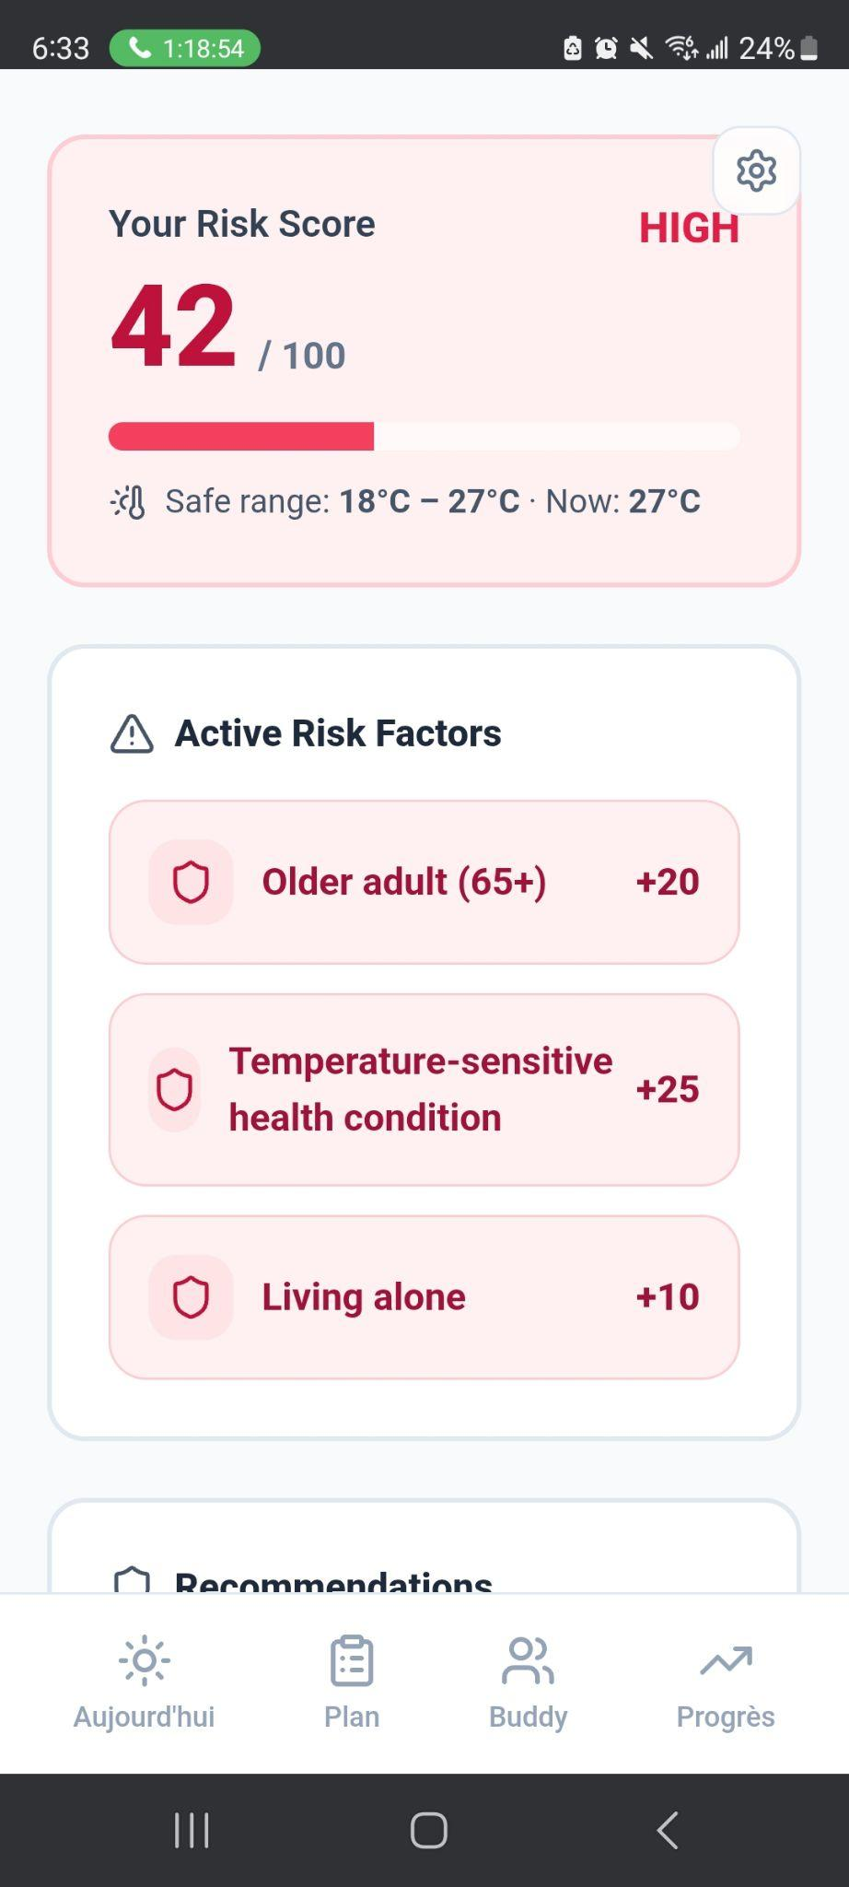
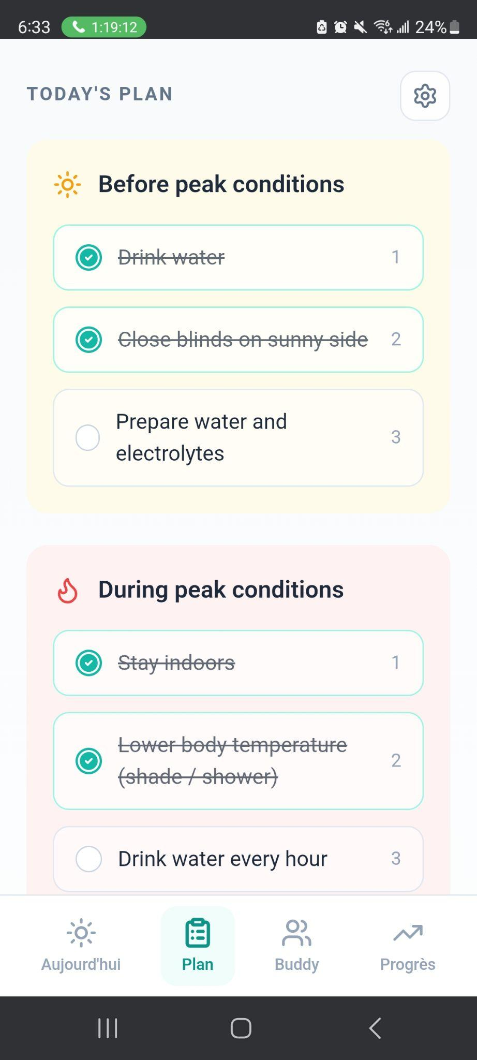
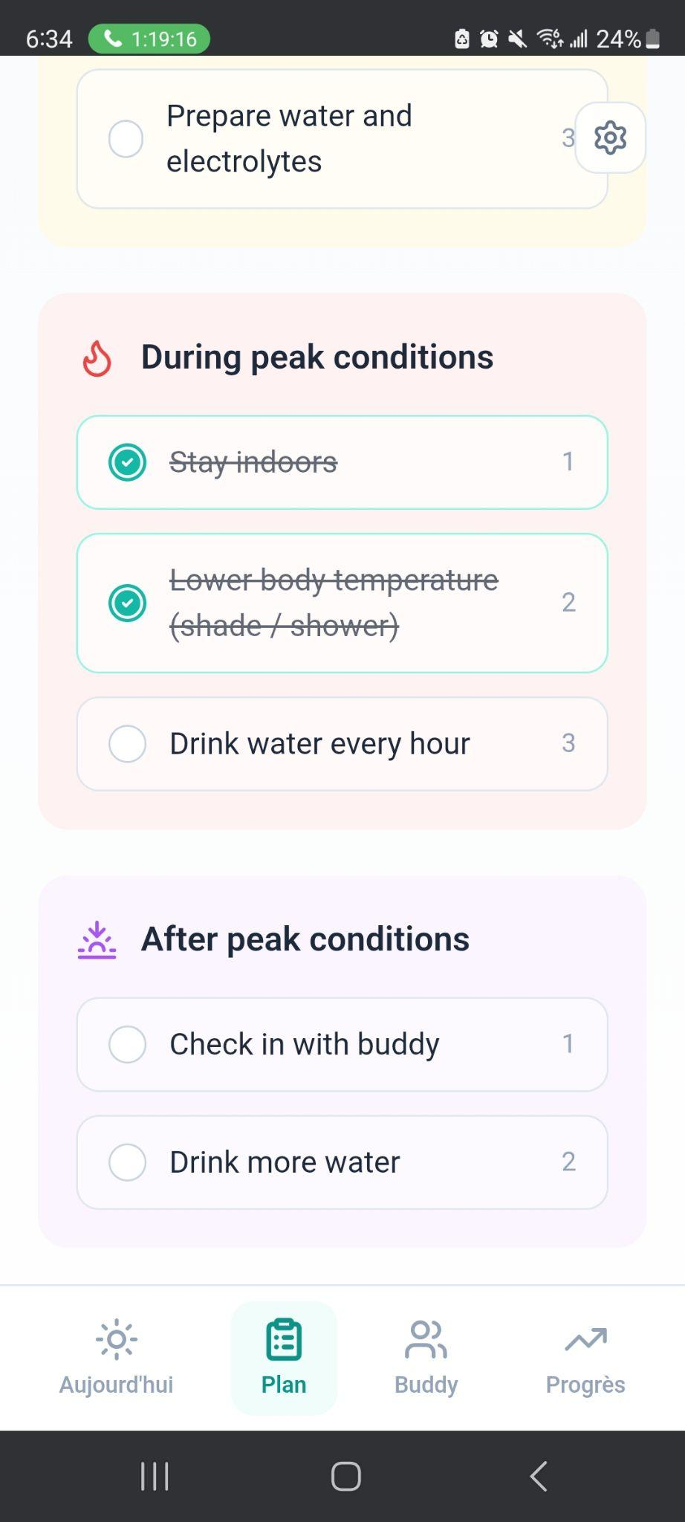
DEMO

Slide 7
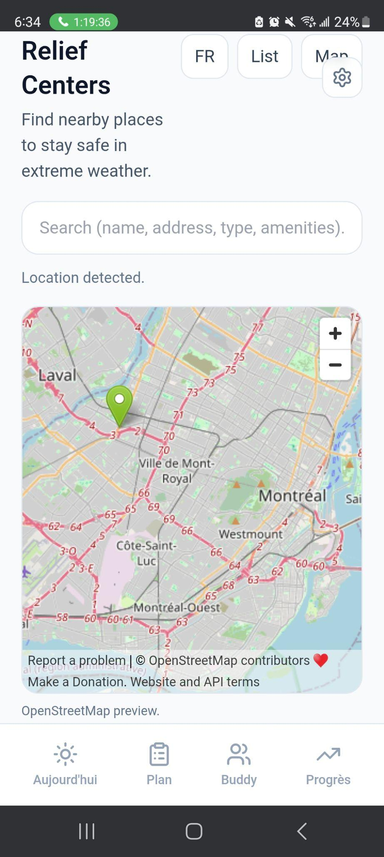
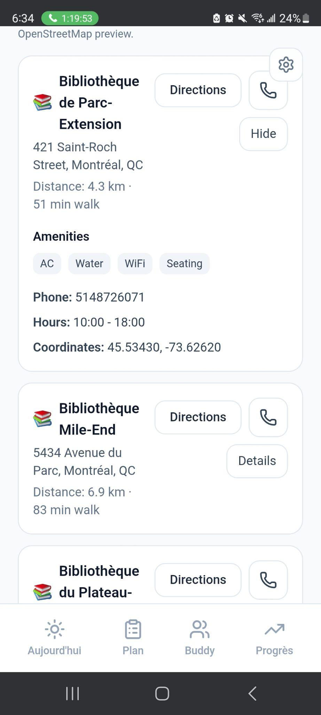
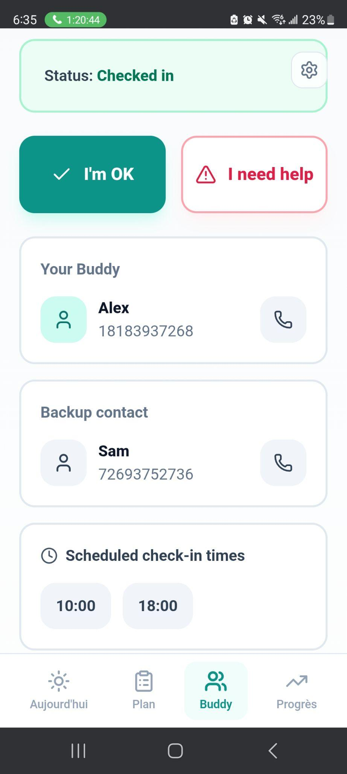
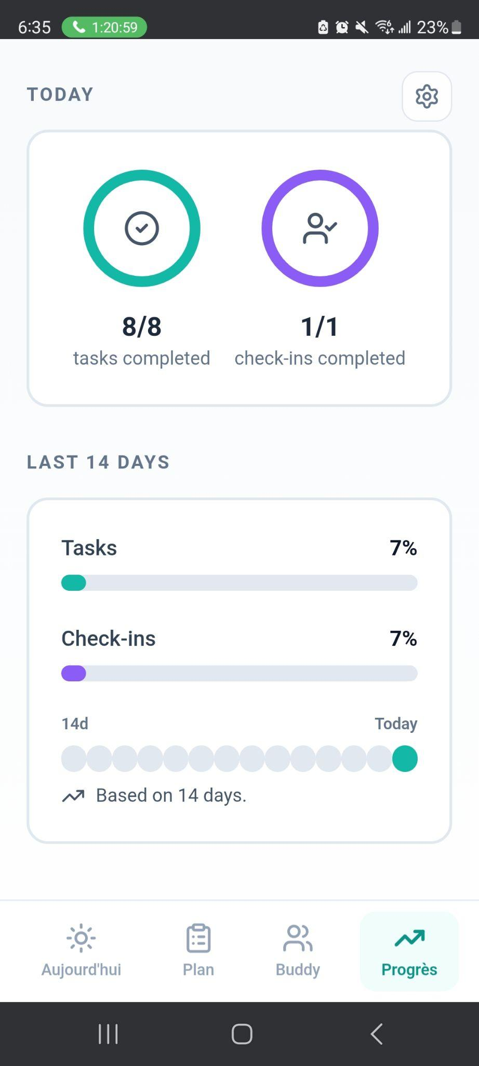
DEMO

Slide 8
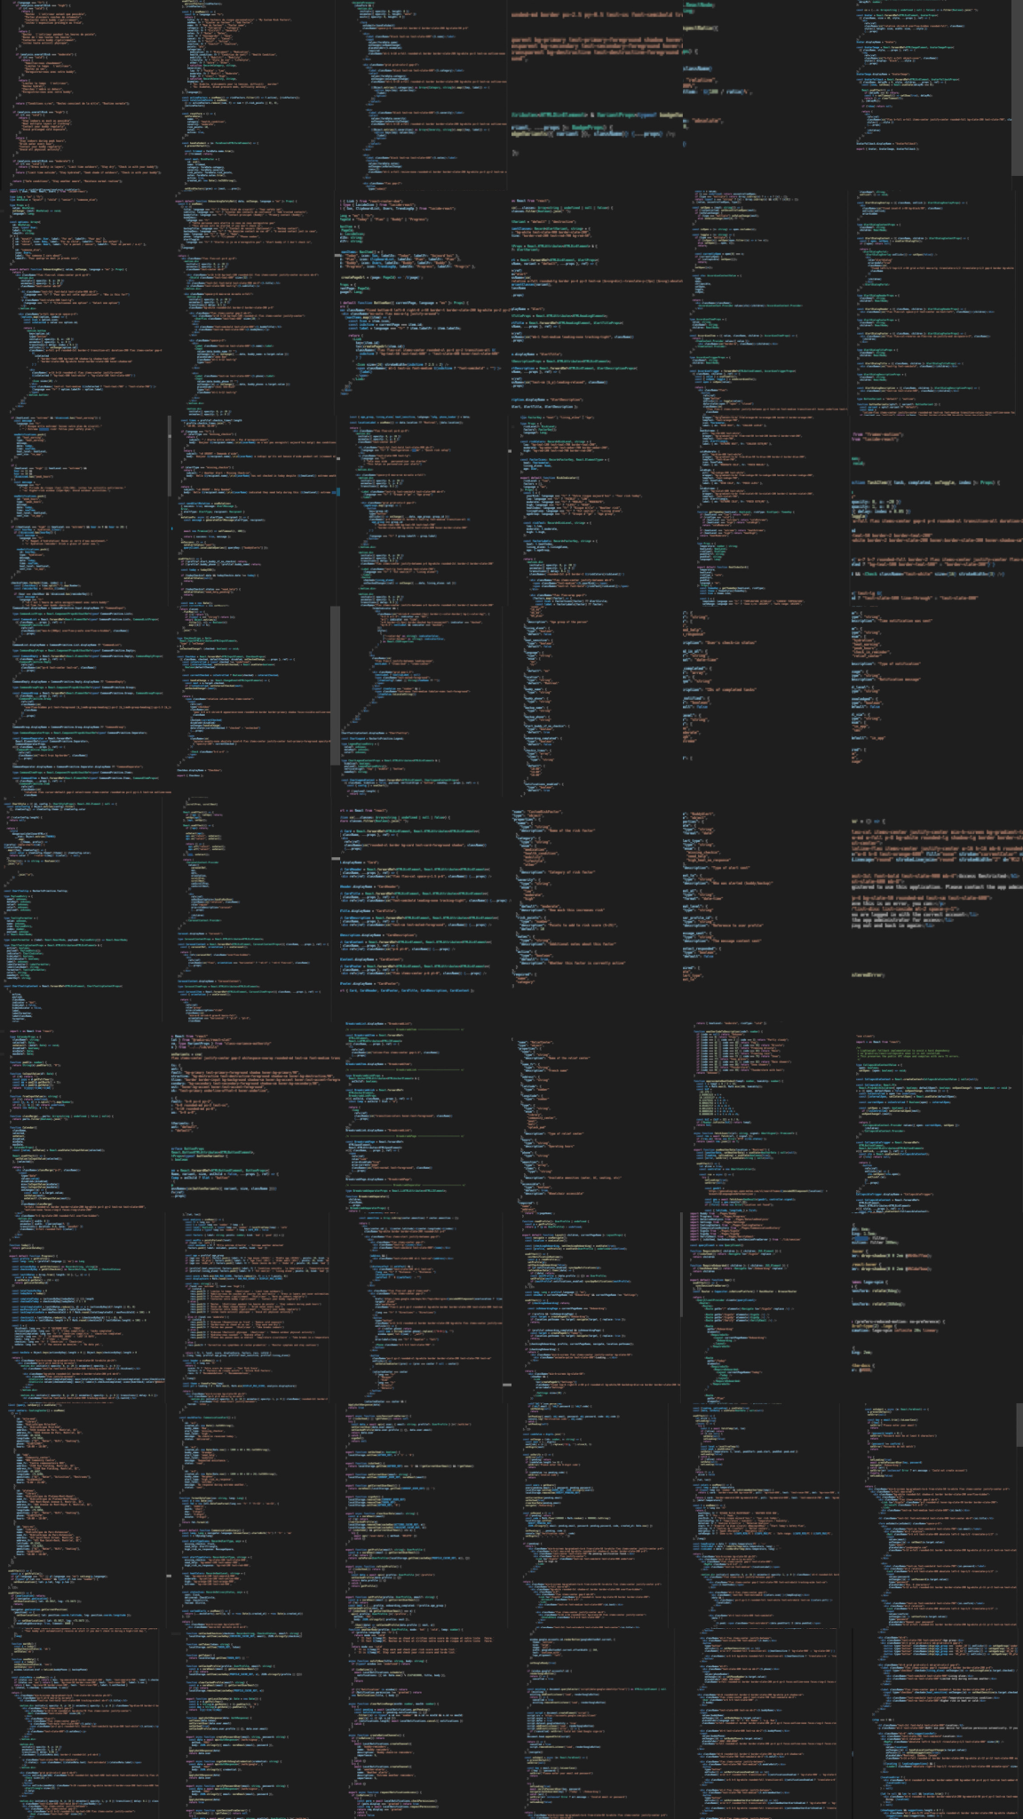
Hundreds of lines of code…

Slide 9
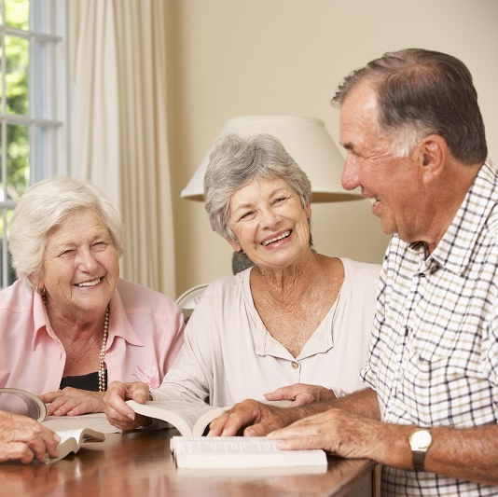
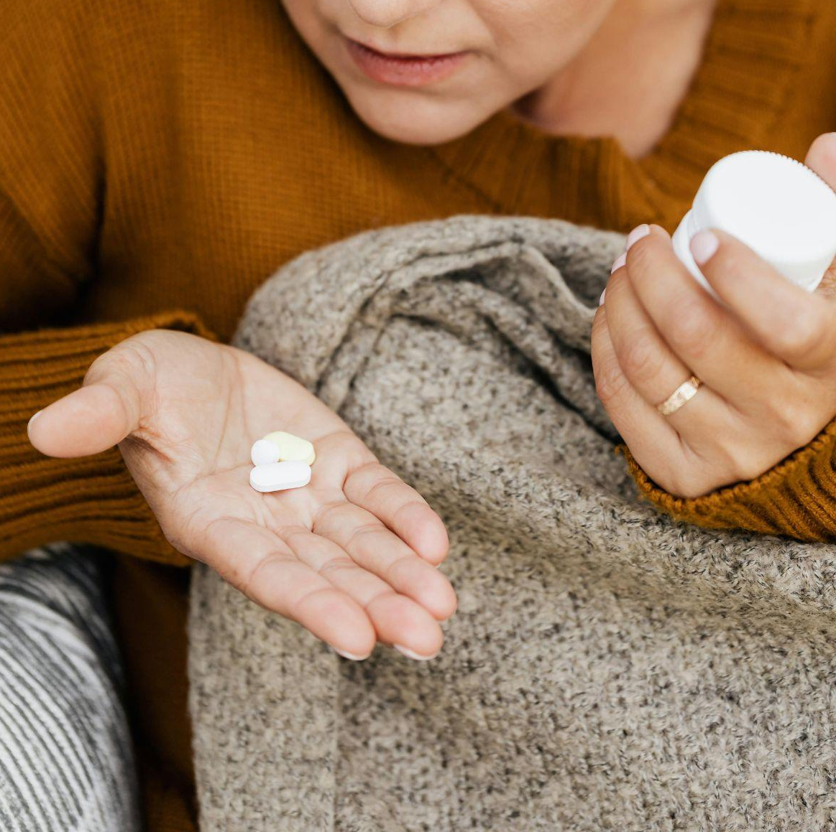
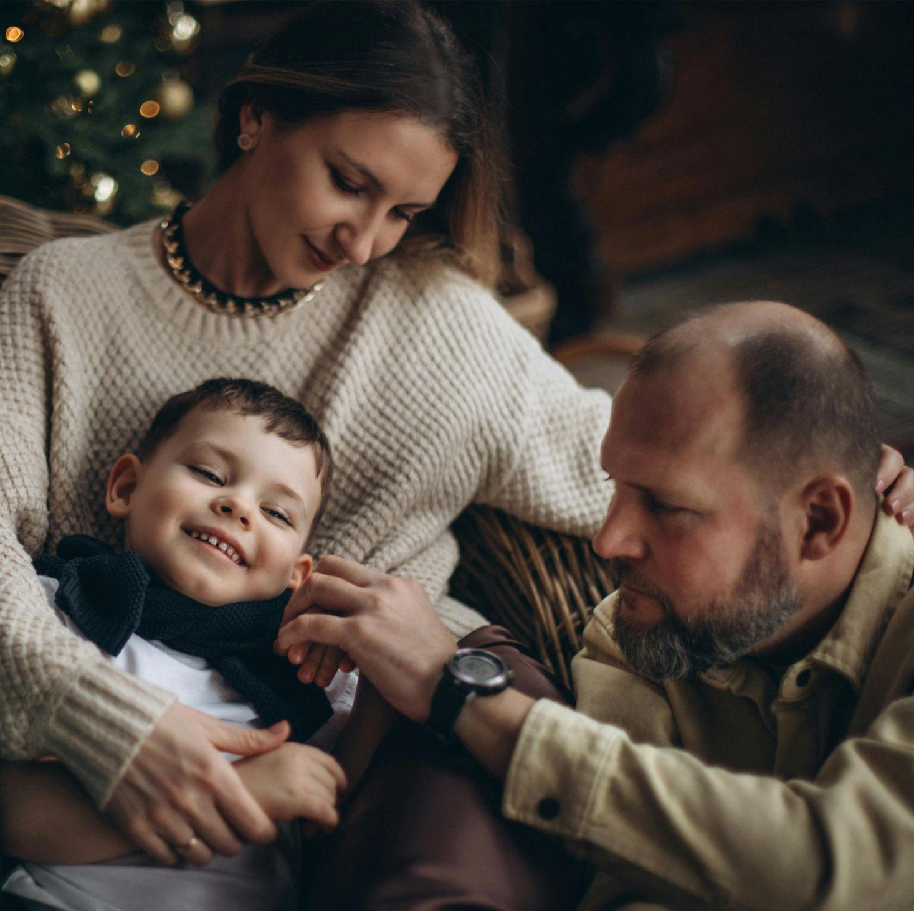
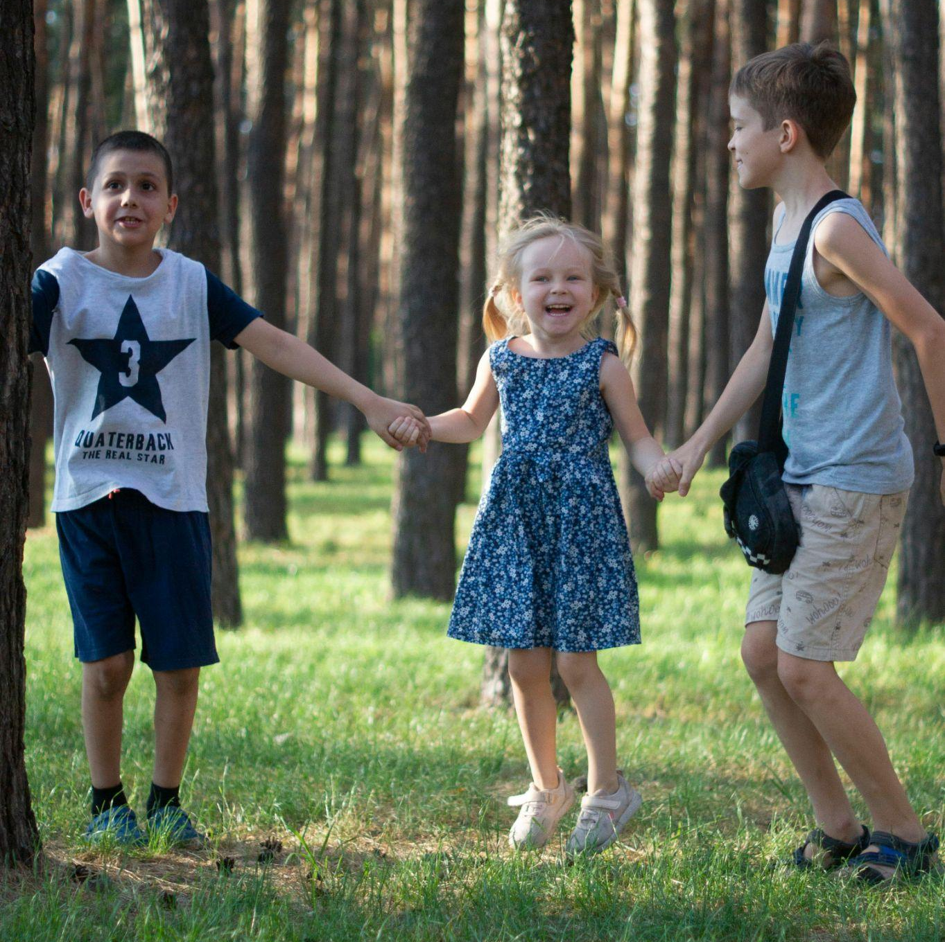
MAIN USERS
Elderly people
Children
Caregivers or families
People with health conditions

Slide 10
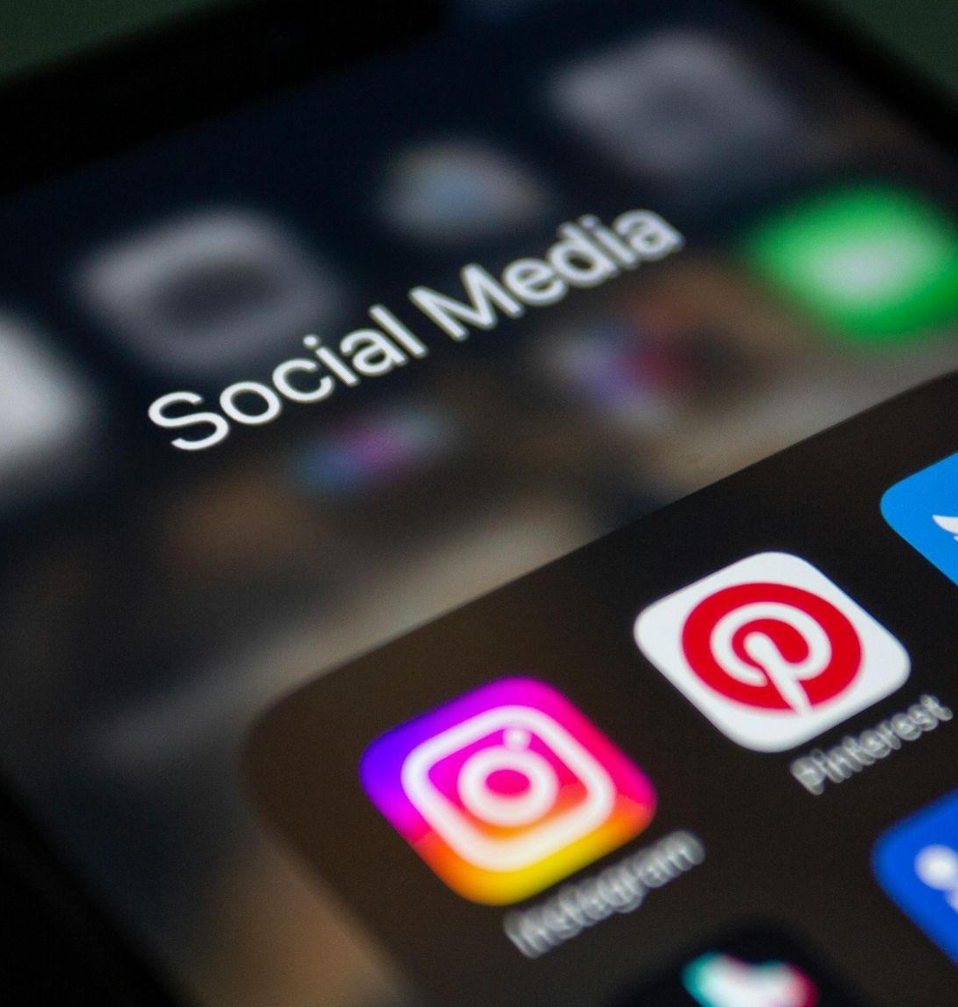
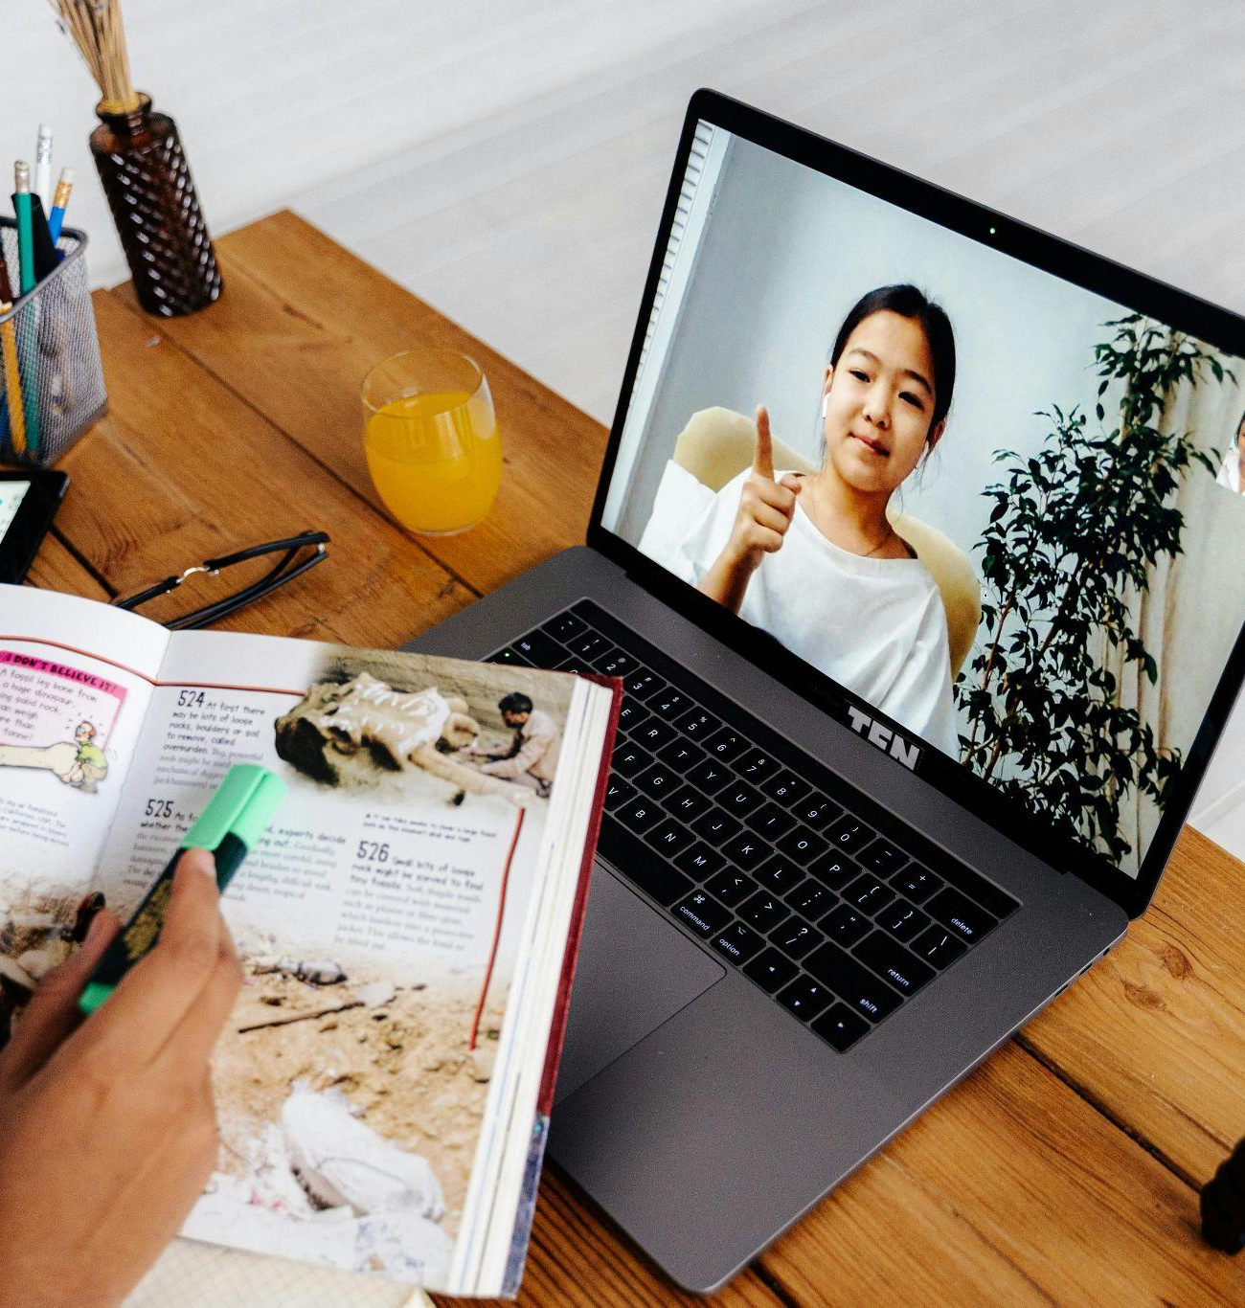
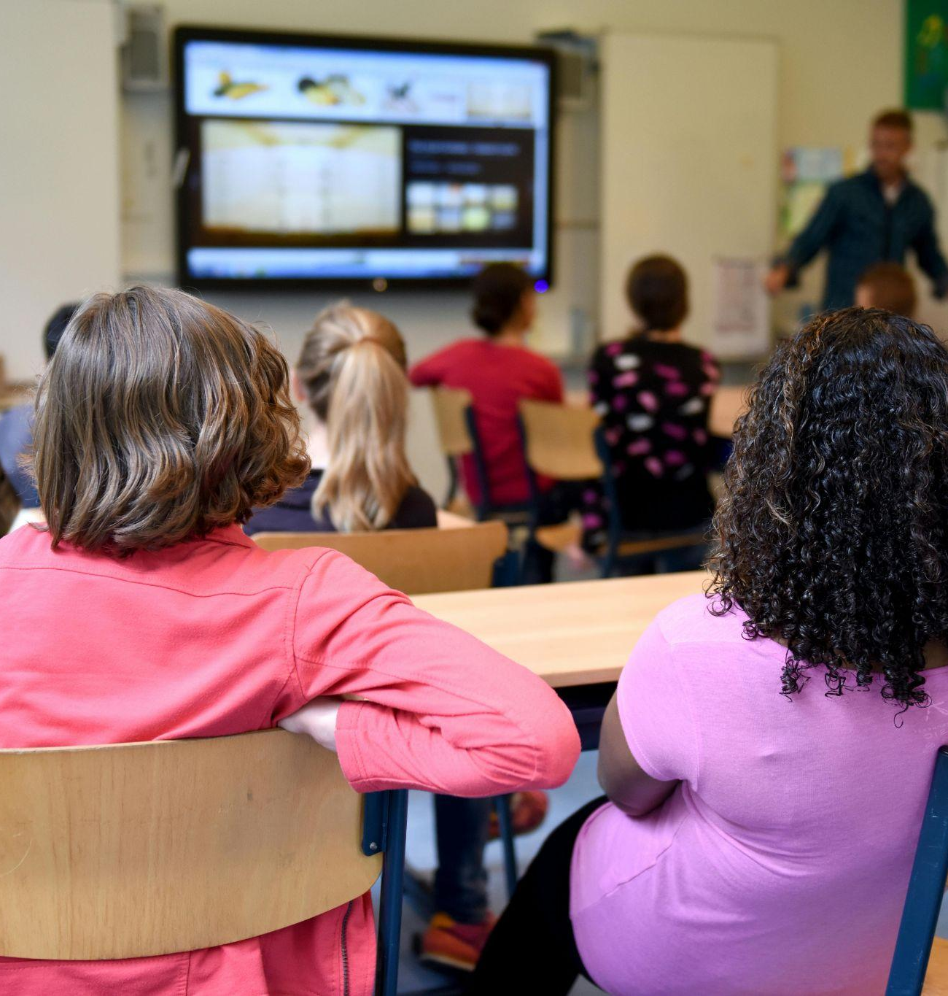

Users - Outreach

Slide 11
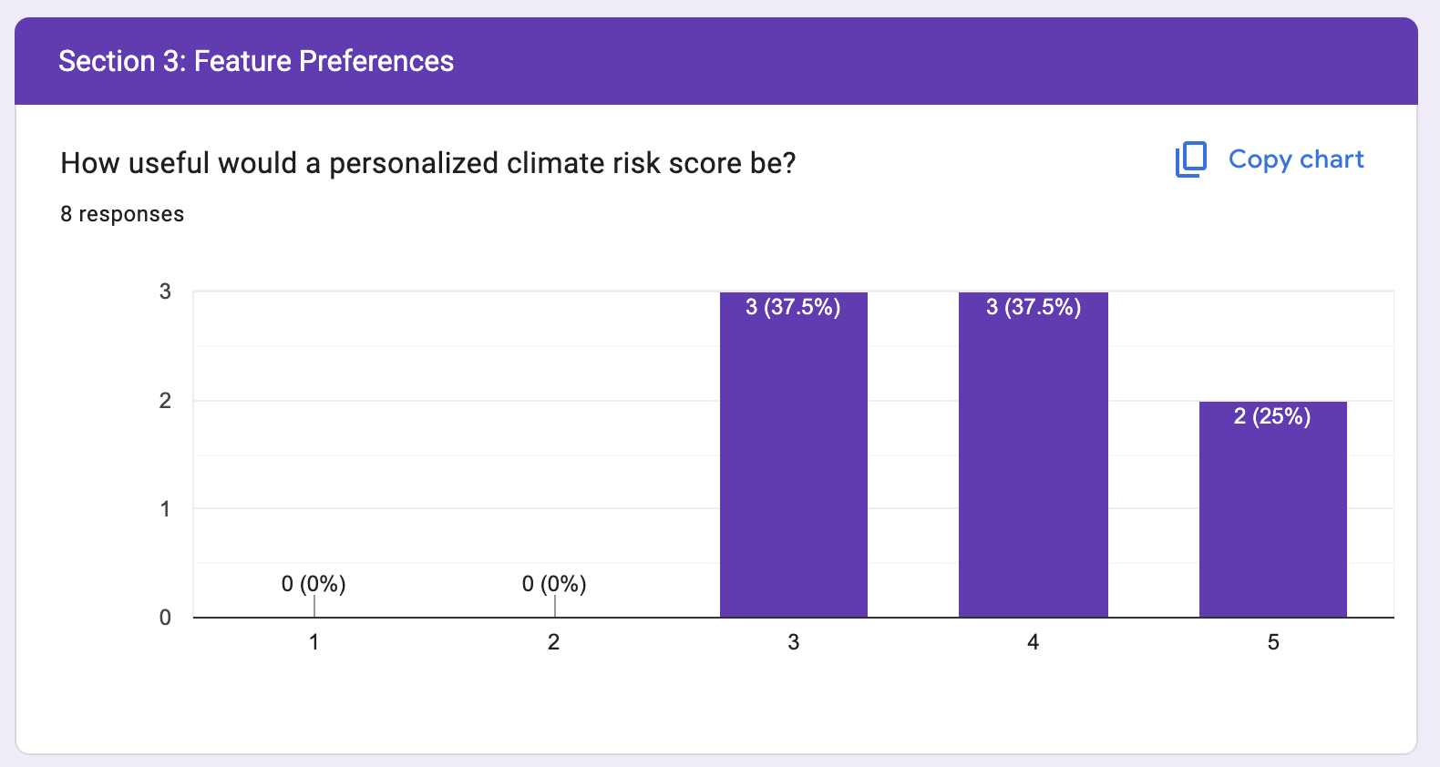
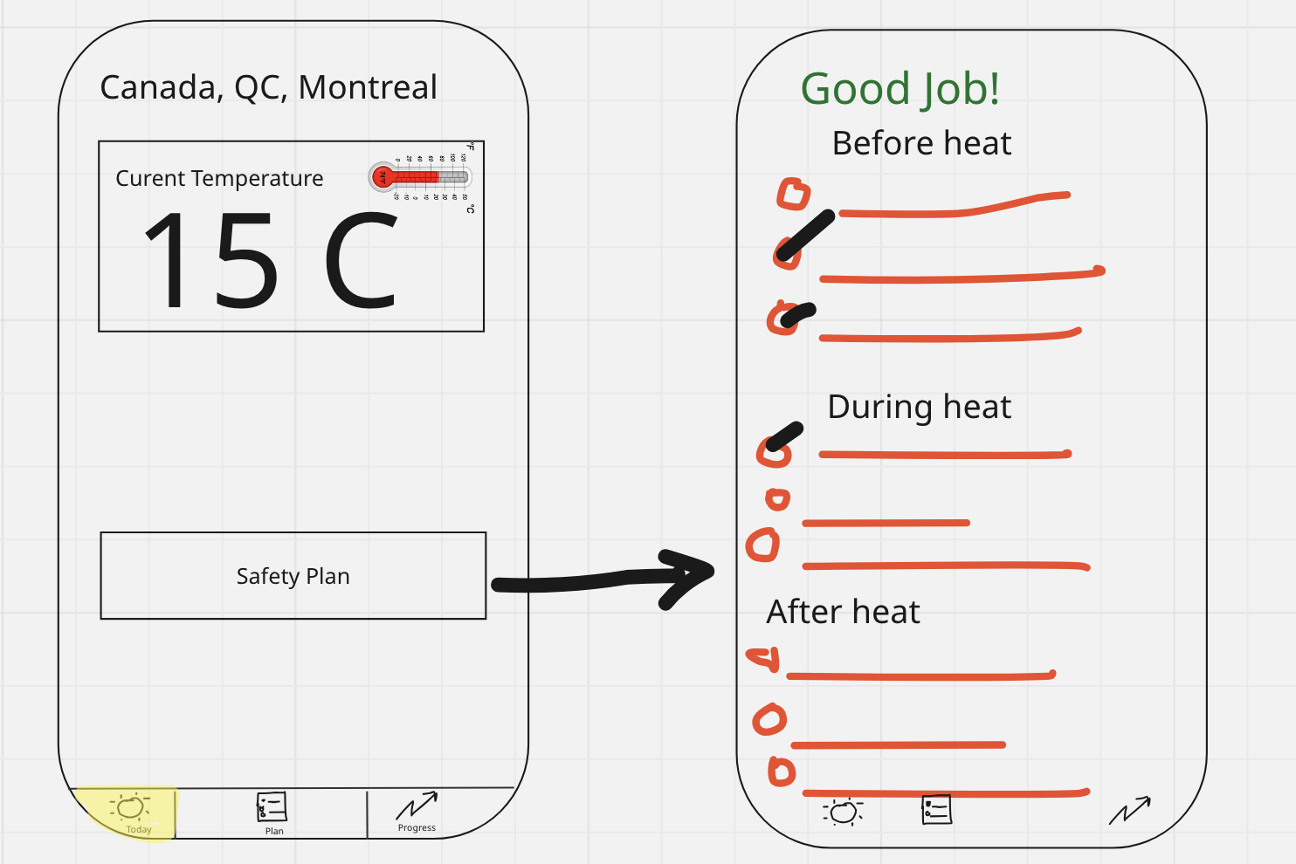
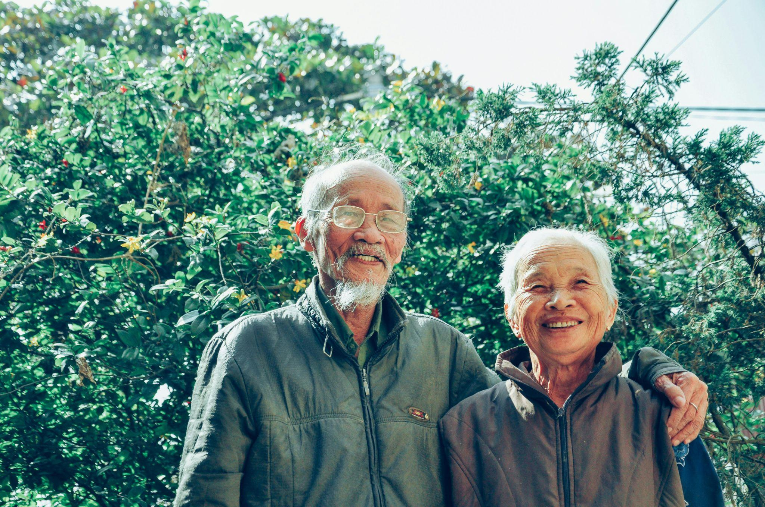
Users - Feedback
Before Feedback
After Feedback

Slide 12
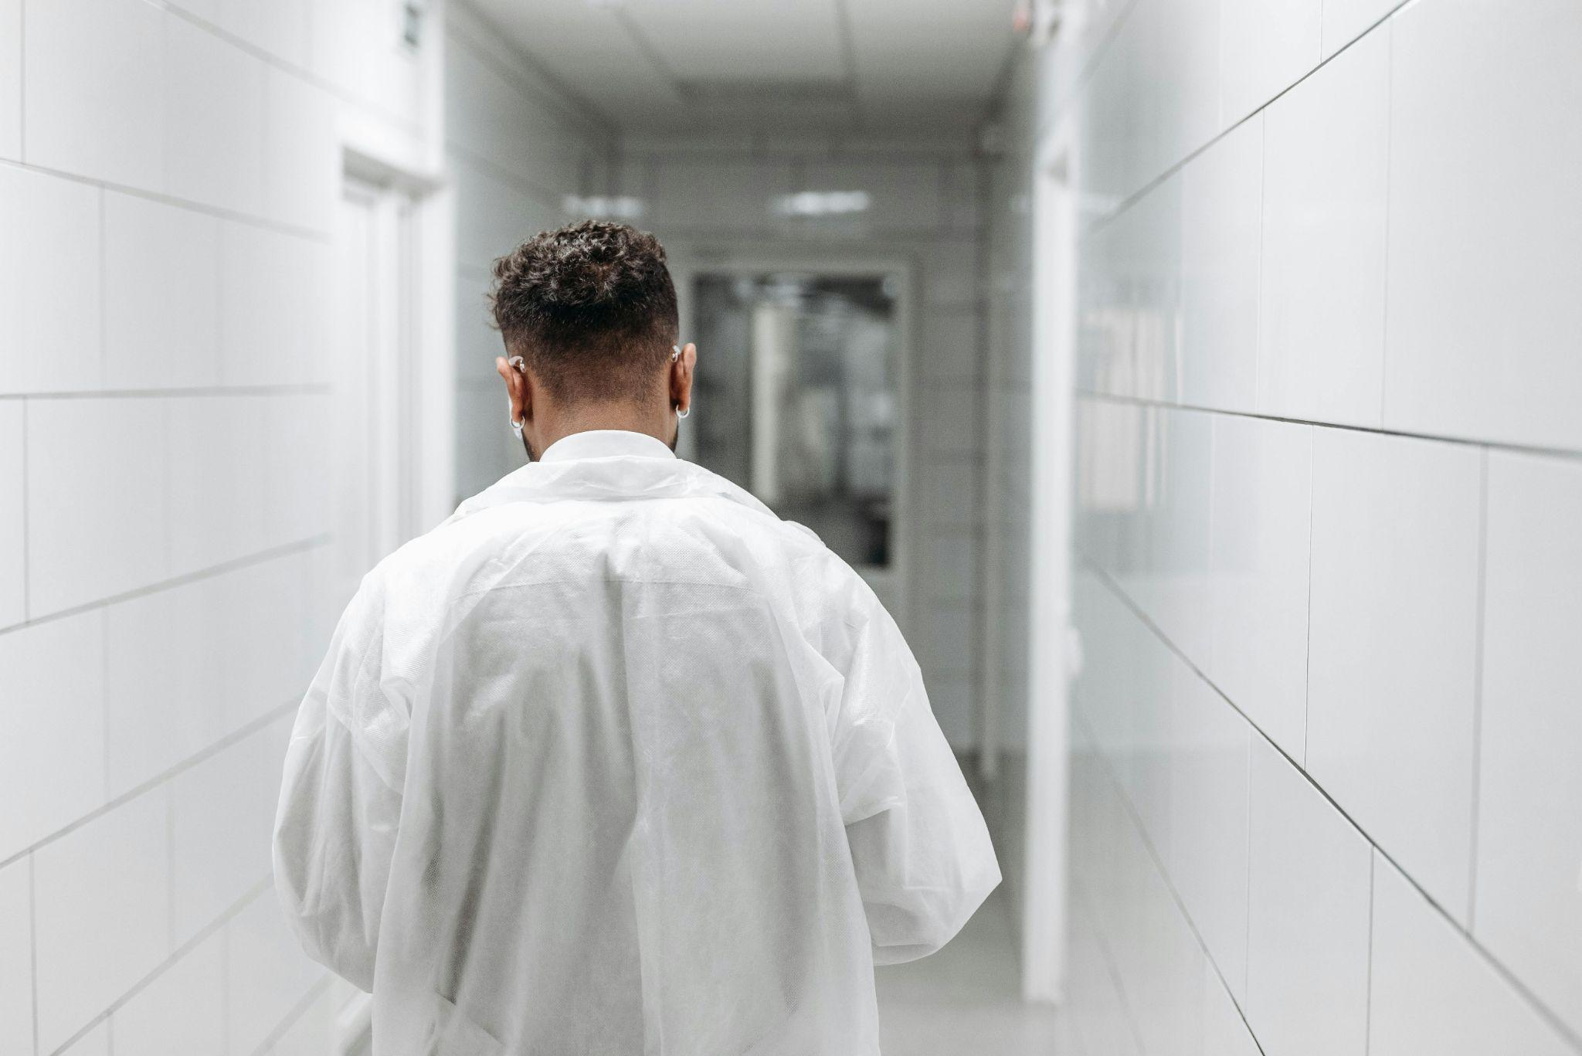
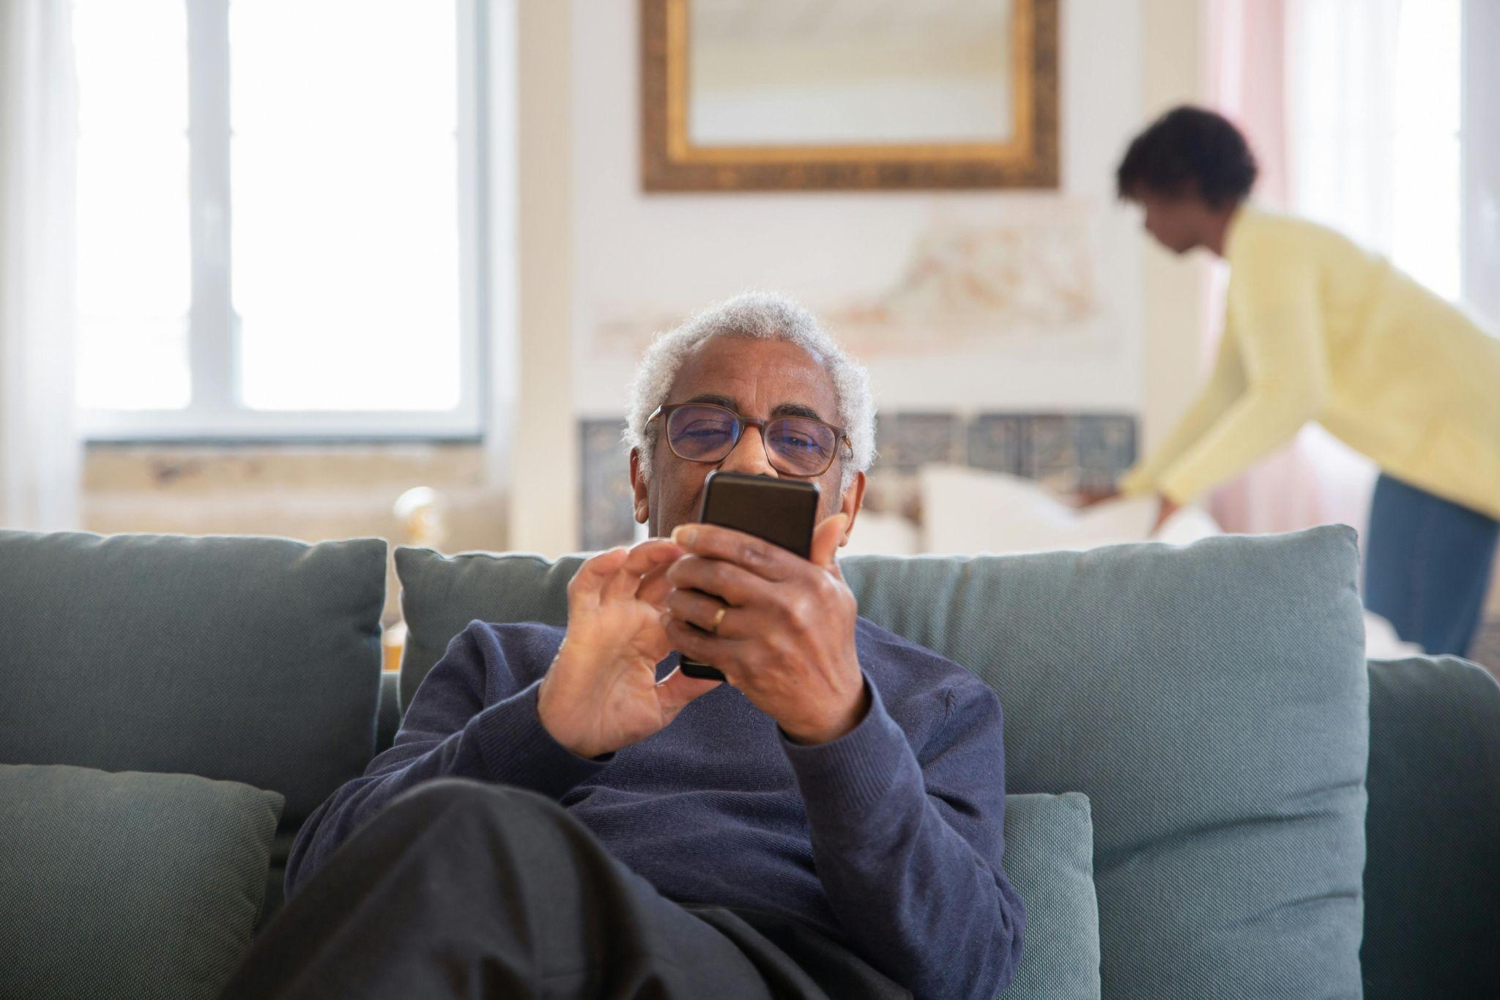

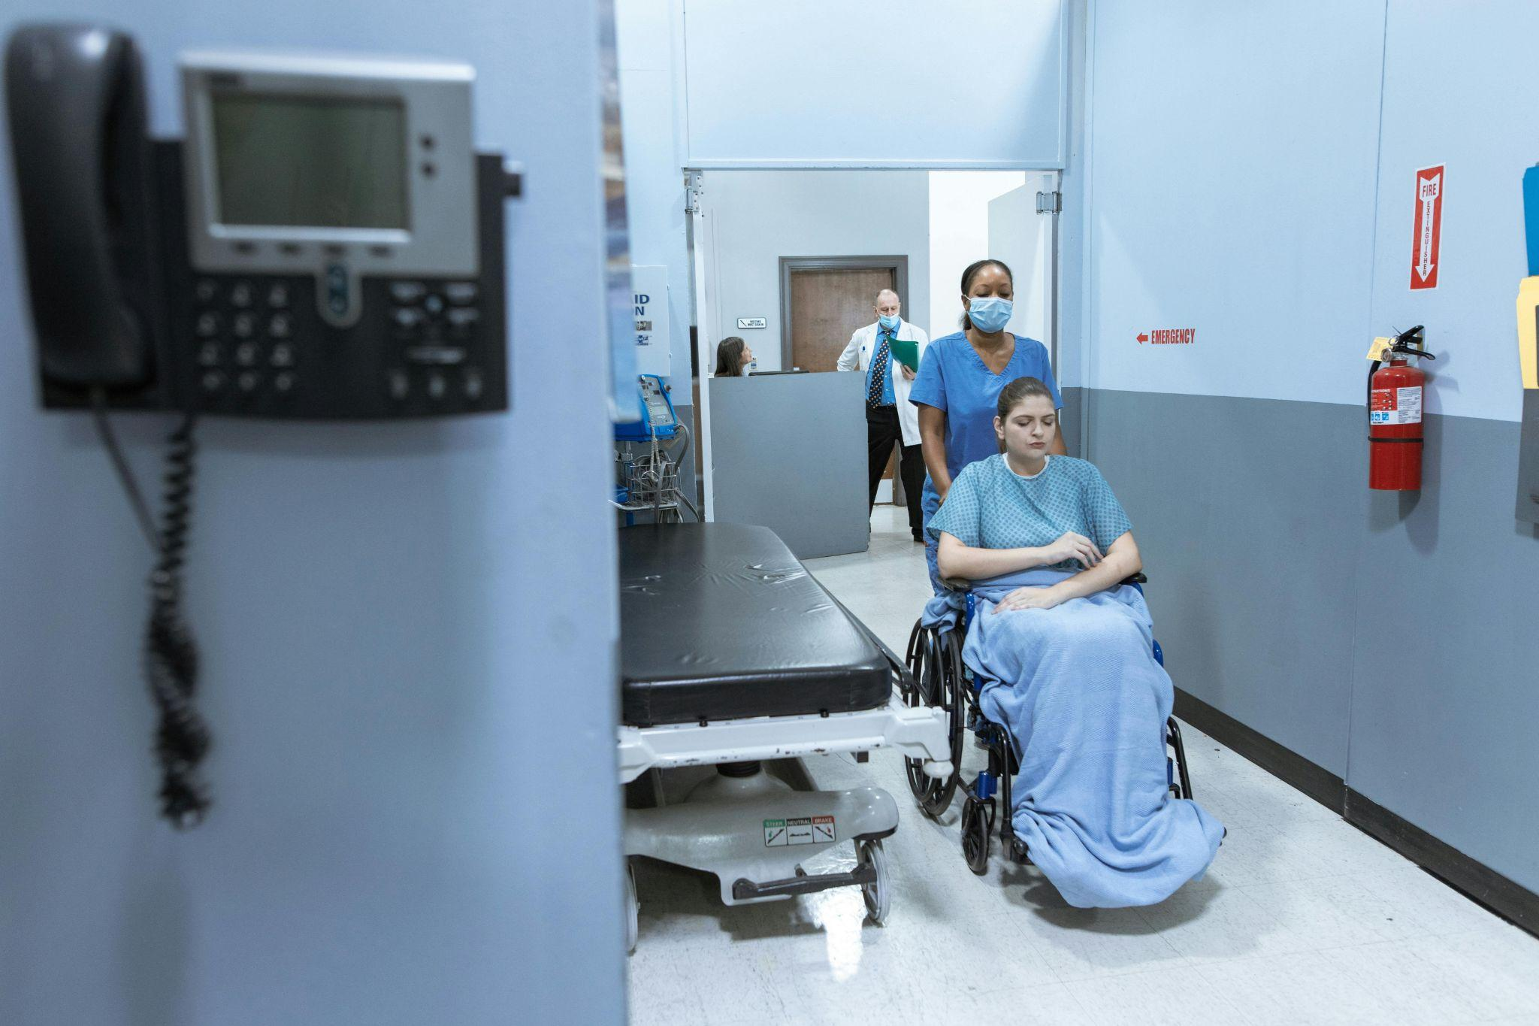
Impact: What We Have Done So Far

Slide 13
BUSINESS MODEL
01
02
03
Freemium model
Memberships
Partnerships

Slide 14



OUR COMPETITORS
APP NAMES/ CRITERIAS | CLIMATESAFE (Our app) | APPLE WEATHER | WEATHERCAN | LIFE360
Real time weather data | ✔ | ✔ | ✔
Personalised risk score | ✔
Safety Recommendations | ✔
Personalized alerts and notifications | ✔
Family check-ins | ✔ |  |  | ✔

Slide 15
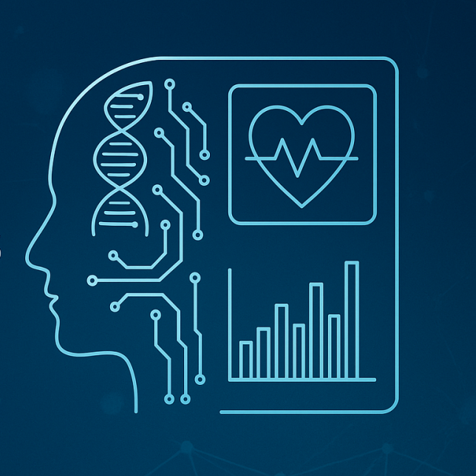


OUR NEXT STEPS…
Build additional features
Expand partnerships
Launch the application
on Play Store

Slide 16
CONCLUSION
Current alerts = too general, don’t tell people what to do
Risk level → clear/immediate actions
Makes vulnerable individuals to act at the right time

Slide 17
Thank you!
Any questions?

