Slide 1

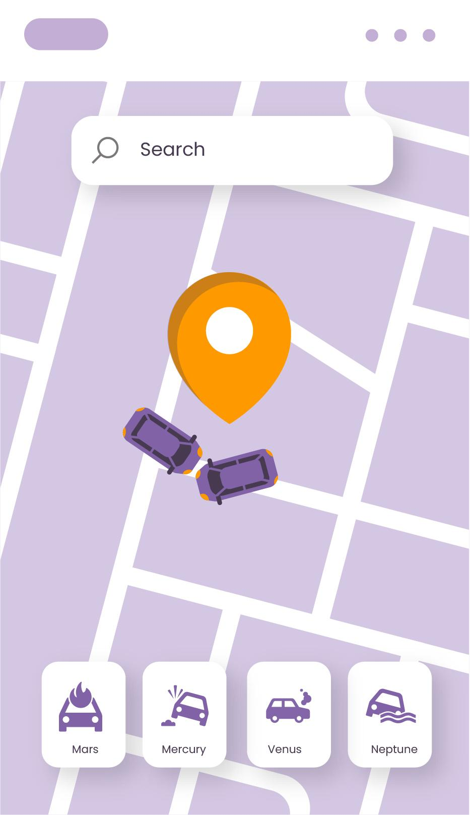
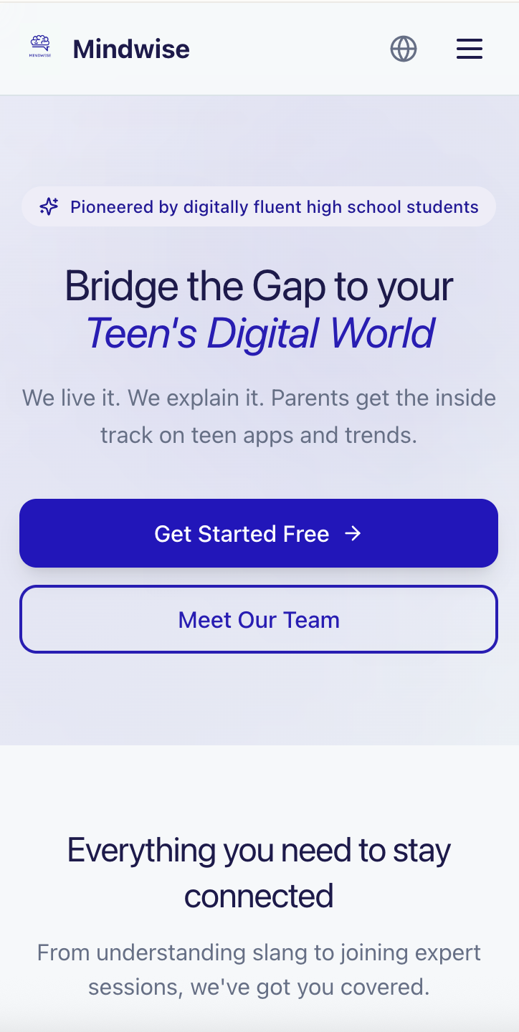
Mindwise App
by Lumina Collective
Awareness Starts with Us
Made by Nara Aiyaranaparak & Juliette Pacheco-Mathers for Technovation 2026

Slide 2
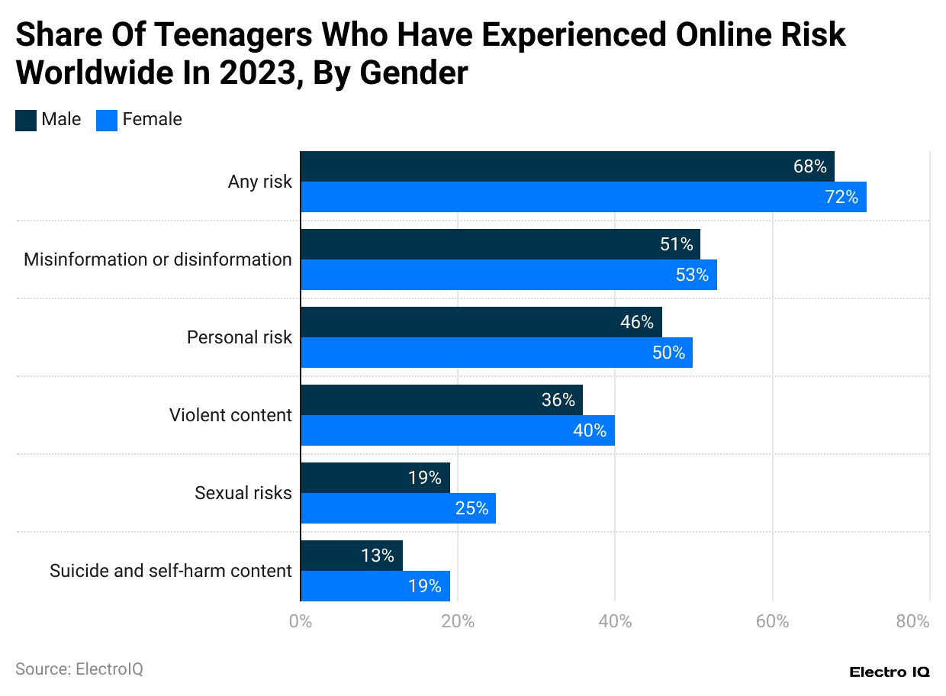
The problem
Our solution
Lack of communication about the internet between parents and teens.
Helping educate parents on the internet and how to communicate with a teenager.

Slide 3



SDGs
SDG 3
SDG 4
SDG 16
Good Health and Well-Being
Quality Education
Peace, Justice, and Strong Institutions

Slide 4
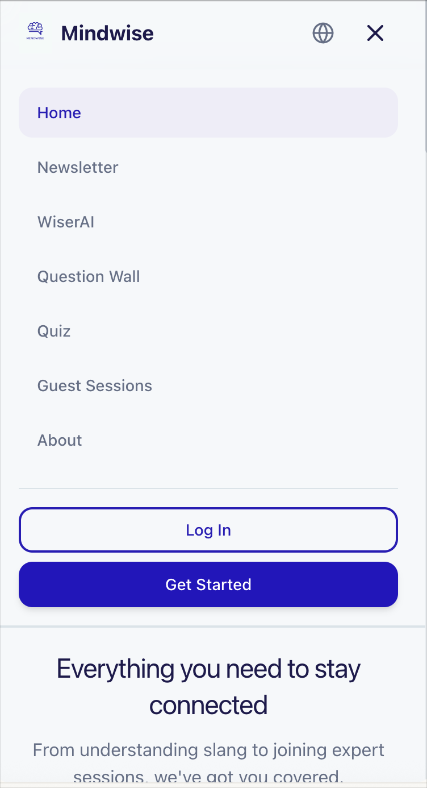
Main Features
Personalized Quiz
Question Wall
WiserAI
Weekly Newsletter
Guest sessions

Slide 5
Timeline
Step 1
Step 3
Step 5
Brainstorming
Prototype
Final Product
Step 2
Step 4
Step 6
Research
Testing & Refining our ideas
Soft Launch

Slide 6
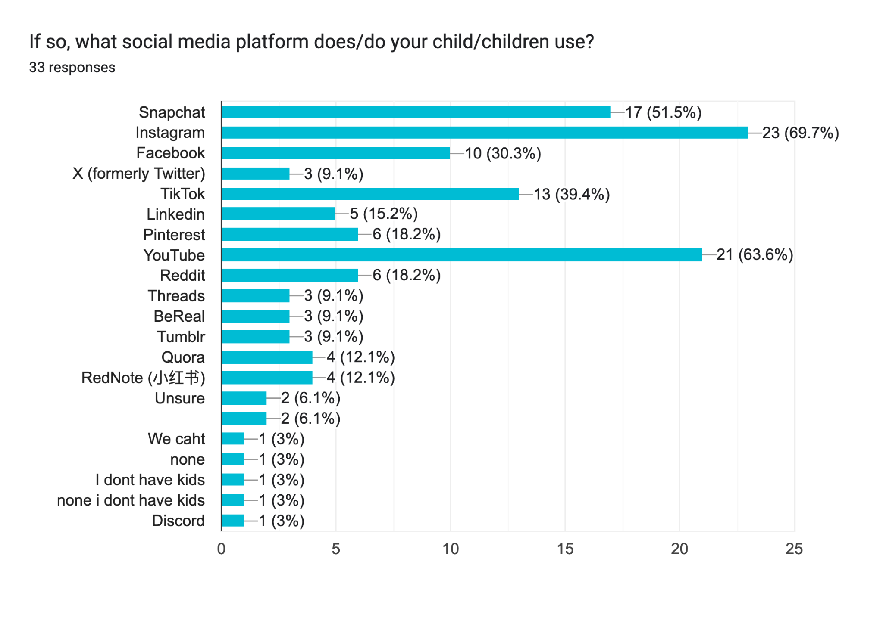
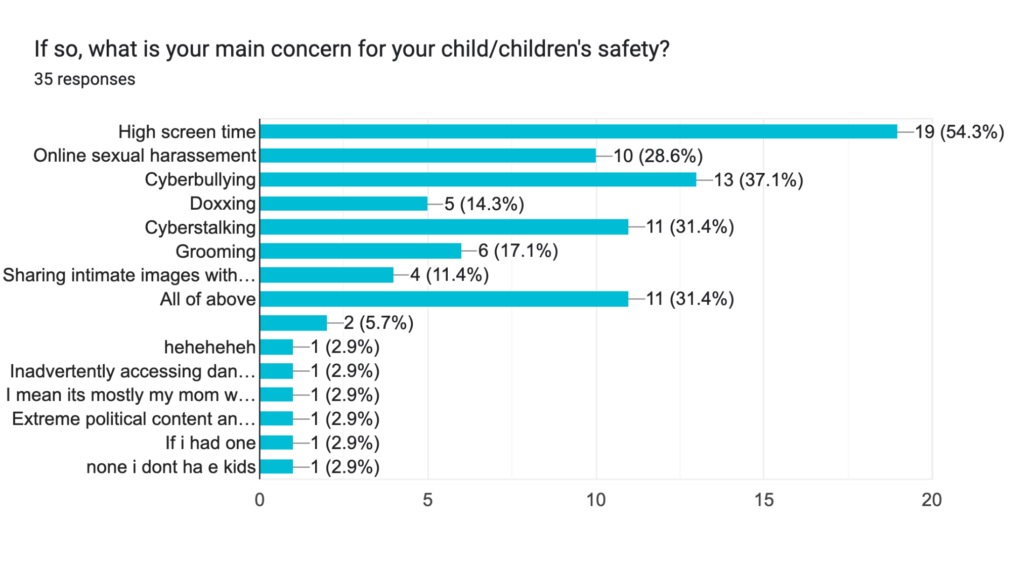
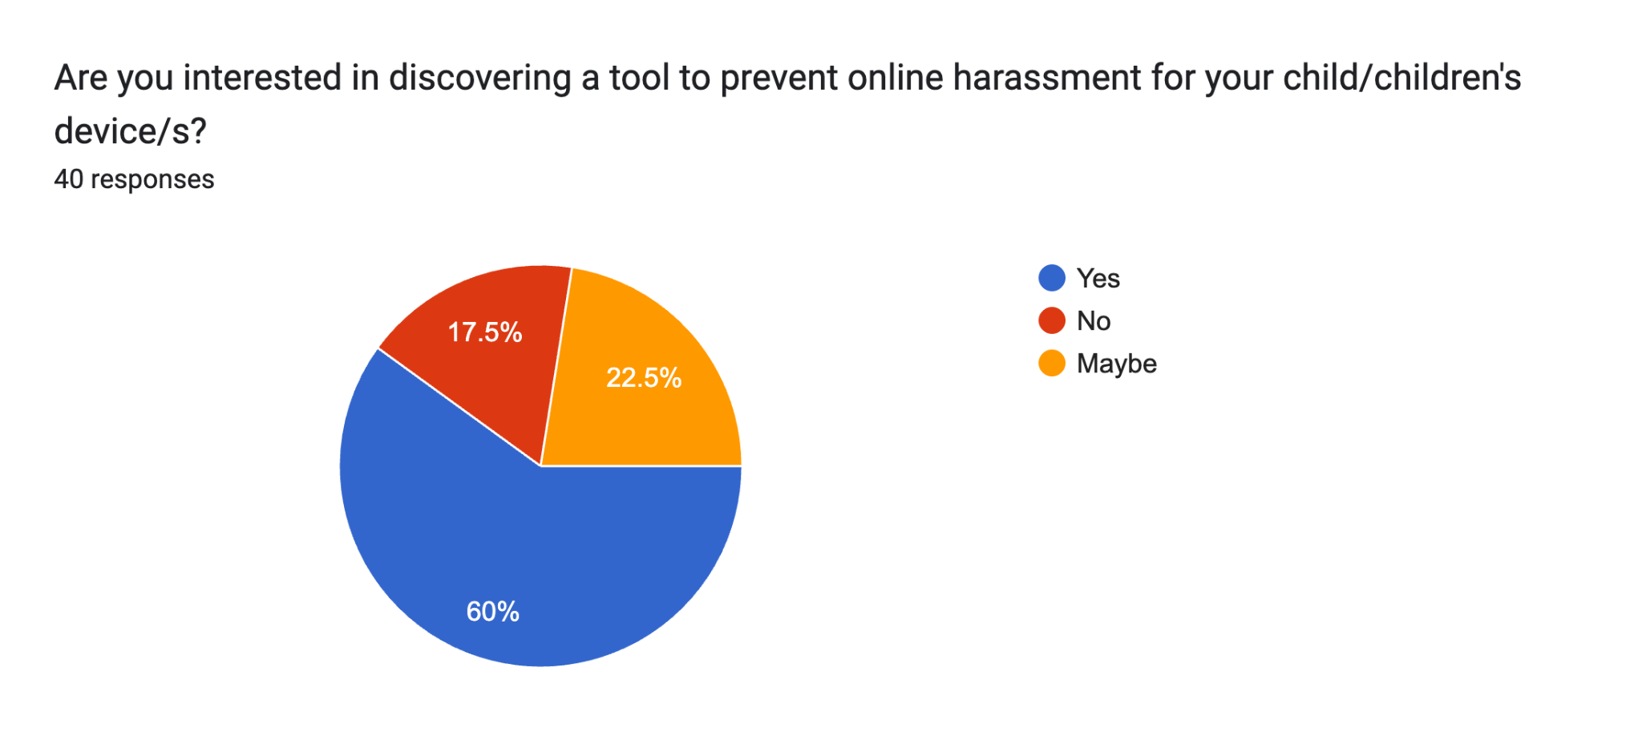
App development
User interest in a tool like this prior to its development
Top Internet Safety Concerns
Most-Used Apps by Teenagers

Slide 7
Mindwise App
by Lumina Collective
Awareness Starts with Us
Technovation 2026

