Slide 1
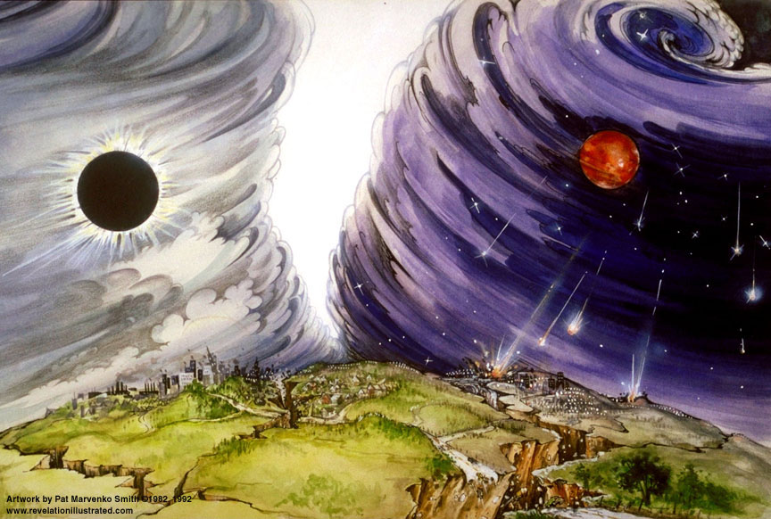
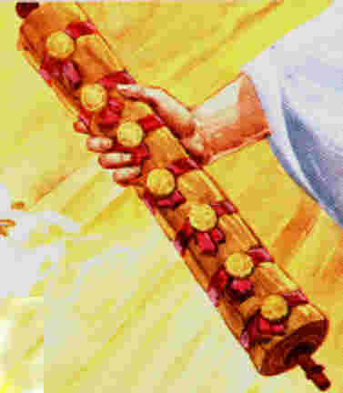
The Revelation of Jesus Christ
Finish Rev 6
Rev. 22:10 And he said to me, "Do not seal up the words of the prophecy of this book, for the time is near.”
Rev. 1:3 Blessed is he who reads and those who hear the words of the prophecy, and heed the things which are written in it; for the time is near.

Slide 2

Insight on Dan 11
Daniel 11:41 "He will also enter the Beautiful Land, and many countries will fall; but these will be rescued out of his hand: Edom, Moab and the foremost of the sons of Ammon. [present Jordan]
The question is, “why Jordan is spared?”

Slide 3
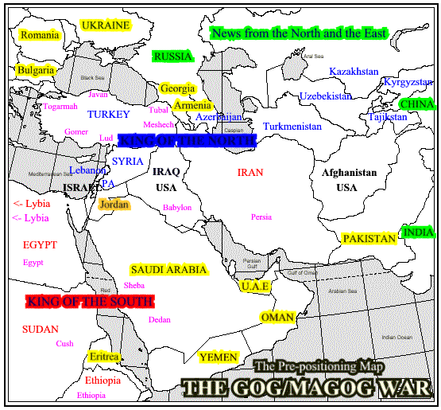
http://www.11th-hour.info/Articles/Gog_Maps.html

Slide 4
During the Great Tribulation…
Revelation 12:5-6 And she gave birth to a son, a male child, who is to rule all the nations with a rod of iron; and her child was caught up to God and to His throne. ⁶ Then the woman fled into the wilderness where she *had a place prepared by God, so that there she would be nourished for one thousand two hundred and sixty days [3 ½ years].

Slide 5
The Lord returns from Jordan after defeating His enemies there…
Isaiah 63:1-4 Who is this who comes from Edom, With garments of glowing colors from Bozrah, This One who is majestic in His apparel, Marching in the greatness of His strength? "It is I who speak in righteousness, mighty to save." ² Why is Your apparel red, And Your garments like the one who treads in the wine press? ³ "I have trodden the wine trough alone, And from the peoples there was no man with Me. I also trod them in My anger And trampled them in My wrath; And their lifeblood is sprinkled on My garments, And I stained all My raiment. ⁴ "For the day of vengeance was in My heart, And My year of redemption has come."

Slide 6
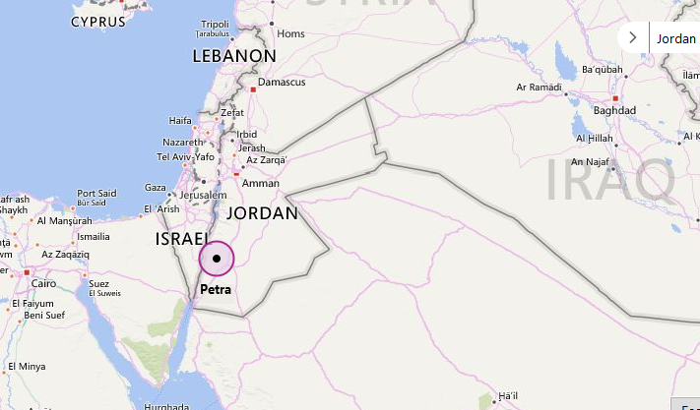
Where is Petra?

Slide 7
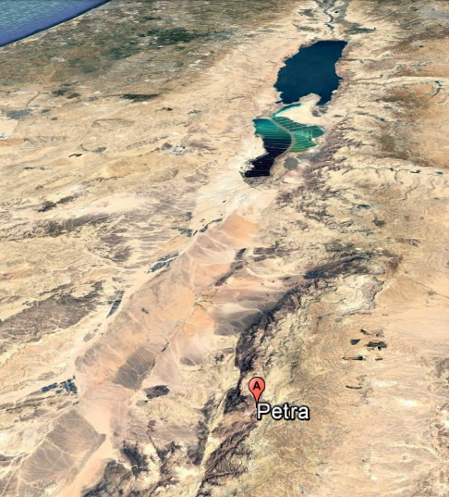

Slide 8
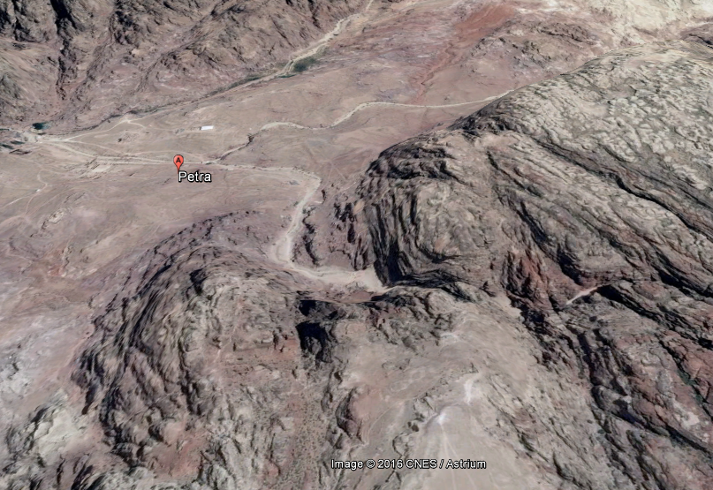

Slide 9
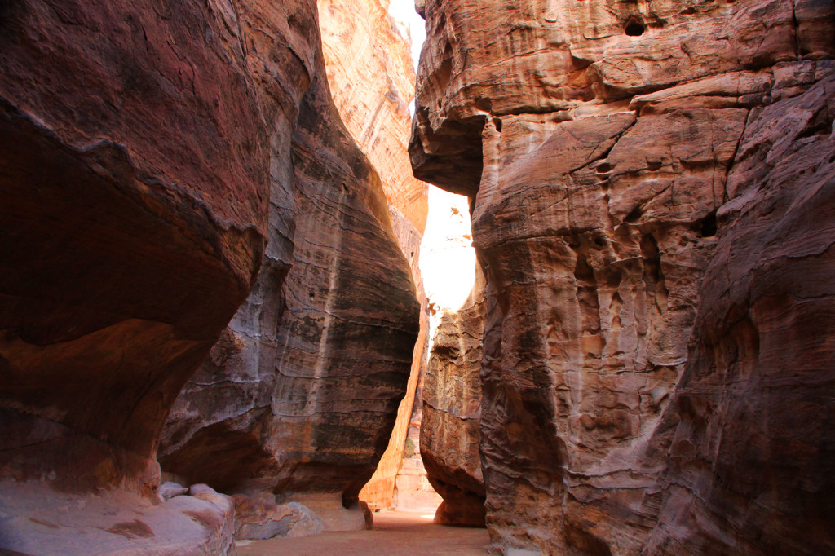

Slide 10
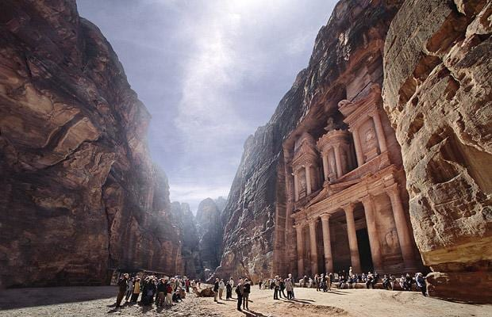

Slide 11
We stopped after the first 5 seals of Rev 6…

Slide 12
5th
⁹And when He broke the fifth seal, I saw underneath the altar the souls of those who had been slain because of the word of God, and because of the testimony which they had maintained; ¹⁰and they cried out with a loud voice, saying, "How long, O Lord, holy and true, wilt Thou refrain from judging and avenging our blood on those who dwell on the earth?" ¹¹And there was given to each of them a white robe; and they were told that they should rest for a little while longer, until the number of their fellow servants and their brethren who were to be killed even as they had been, should be completed also. | ⁹"Then they will deliver you to tribulation, and will kill you, and you will be hated by all nations on account of My name. ¹⁰"And at that time many will fall away and will deliver up one another and hate one another. ¹¹"And many false prophets will arise, and will mislead many. ¹²"And because lawlessness is increased, most people's love will grow cold. ¹³"But the one who endures to the end, he shall be saved. ¹⁴"And this gospel of the kingdom shall be preached in the whole world for a witness to all the nations, and then the end shall come. Rom 11:25

Slide 13
¹²And I looked when He broke the sixth seal, and there was a great earthquake; and the sun became black as sackcloth made of hair, and the whole moon became like blood; ¹³and the stars of the sky fell to the earth, as a fig tree casts its unripe figs when shaken by a great wind. ¹⁴And the sky was split apart like a scroll when it is rolled up; and every mountain and island were moved out of their places. | ¹⁵"Therefore when you see the abomination of desolation which was spoken of through Daniel the prophet, standing in the holy place (let the reader understand), ¹⁶then let those who are in Judea flee to the mountains; ¹⁷let him who is on the housetop not go down to get the things out that are in his house; ¹⁸and let him who is in the field not turn back to get his cloak. ¹⁹"But woe to those who are with child and to those who nurse babes in those days! ²⁰"But pray that your flight may not be in the winter, or on a Sabbath; ²¹for then there will be a great tribulation, such as has not occurred since the beginning of the world until now, nor ever shall. ²⁹"But immediately after the tribulation of those days the sun will be darkened, and the moon will not give its light, and THE STARS WILL FALL from the sky, and the powers of the heavens will be shaken,
6th

Slide 14
J.V. McGee states:
The Great Tribulation begins and ends with these signs:
Joel 2:31 "The sun will be turned into darkness, And the moon into blood, Before the great and awesome day of the Lord comes.
Joel 3 – Armageddon

Slide 15
Stars of Revelation
Isaiah 14:12-15 "How you have fallen from heaven, O star of the morning, son of the dawn! You have been cut down to the earth, You who have weakened the nations! ¹³ "But you said in your heart, 'I will ascend to heaven; …' ¹⁵ "Nevertheless you will be thrust down to Sheol, To the recesses of the pit.
Revelation 12:9 And the great dragon was thrown down, the serpent of old who is called the devil and Satan, who deceives the whole world; he was thrown down to the earth, and his angels were thrown down with him.

Slide 16
6th
¹⁵And the kings of the earth and the great men and the commanders and the rich and the strong and every slave and free man, hid themselves in the caves and among the rocks of the mountains; ¹⁶and they said to the mountains and to the rocks, "Fall on us and hide us from the presence of Him who sits on the throne, and from the wrath of the Lamb; ¹⁷for the great day of their wrath has come; and who is able to stand?" | ³²"Now learn the parable from the fig tree: when its branch has already become tender, and puts forth its leaves, you know that summer is near; ³³even so you too, when you see all these things, recognize that He is near, right at the door. ³⁴"Truly I say to you, this generation will not pass away until all these things take place.

Slide 17
The Judgments
The Lamb
opens the
seals.
1/3 Earth
God sends the
bowls out, full
of the wrath of God.
Sores
1/3 Sea
Sea to blood
1
White
2
Red
3
Black
4
Ashen
5
Martyrs
6
Signs
7
Wrath
1/3 Rivers
Rivers to blood
1/3 Heavens
Sun scorches
1st Woe, Locusts
Earth in darkness
compressed
2nd Woe, 1/3 Men Die
Euphrates dried
Angels sound
the trumpets.
3rd Woe, 7 Bowls
Earthquake, hail
Tribulation
Great Tribulation

Slide 18
End of Rev 6

Slide 19
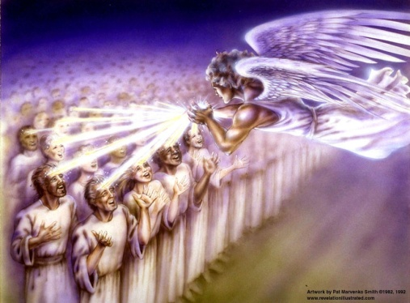
The Revelation of Jesus Christ
Chapter 7 of 22
Deut. 32:43 "Rejoice, O nations, with His people; For He will avenge the blood of His servants, And will render vengeance on His adversaries, And will atone for His land and His people."
[Song of Moses]
Rev. 1:3 Blessed is he who reads and those who hear the words of the prophecy, and heed the things which are written in it; for the time is near.

Slide 20
Outline of Revelation
Chapters | Topic
1 | Things which you have seen ─ Glorified Christ in heaven
2-3 | Things which are ─ 7 letters to the 7 churches
4-5 | Things which shall take place ─ Introduction / background to the future — 7 sealed scroll
6 | 6 seals
7 | 1st parenthetic ─ 2 groups (144,000, multitude from all nations in white robes
8 | 7th seal and first 4 trumpets
9 | 5th & 6th trumpets, 1st & 2nd Woes
10-11:14 | 2nd parenthetic ─ the little book, the two witnesses, end of 2nd Woe
11:15-19 | 7th trumpet, 3rd Woe
12 | 3rd parenthetic ─ important characters
13 | 3rd parenthetic ─ wicked rulers
14 | 3rd parenthetic ─ visions of Christ triumphant
15-16 | 7 bowls leading to the 2nd coming of Christ
17 | 4th parenthetic ─ Destruction of ecclesiastic Babylon
18 | 4th parenthetic ─ Destruction of political Babylon
19 | 2nd Coming of Christ, the great supper of God
20 | Millennial reign of Christ ─ Satan bound, 1000 year reign, Satan released, great white throne judgment
21 | New Jerusalem, new heaven and new earth
22 | Concluding revelations

Slide 21
The Judgments
The Lamb opens the seals.
1/3 Earth
God sends the
bowls out, full
of the wrath of God.
Sores
1/3 Sea
Sea to blood
1
White
2
Red
3
Black
4
Ashen
5
Martyrs
6
Signs
7
Wrath
1/3 Rivers
Rivers to blood
1/3 Heavens
Sun scorches
1st Woe, Locusts
Earth in darkness
Angels sound
the trumpets.
2nd Woe, 1/3 Men Die
Euphrates dried
3rd Woe, 7 Bowls
Earthquake, hail
Tribulation
Great Tribulation

Slide 22
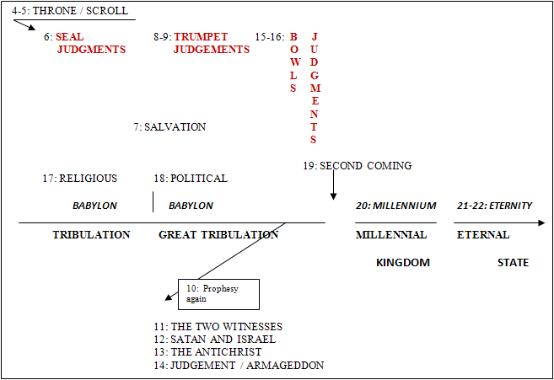
Third Major Section of Revelation: Ch 4-22
(Benware, “Understanding End Times Prophecy”)
Rev. 1:19 "Write therefore the things which you have seen, and the things which are, and the things which shall take place after these things.

Slide 23
Rev 7 – Those who can stand: 144,000 and the multitude of saints
¹ After this I saw four angels standing at the four corners of the earth, holding back the four winds of the earth, so that no wind should blow on the earth or on the sea or on any tree. ²And I saw another angel ascending from the rising of the sun, having the seal of the living God; and he cried out with a loud voice to the four angels to whom it was granted to harm the earth and the sea, | Ezekiel 7:2 "And you, son of man, thus says the Lord God to the land of Israel, 'An end! The end is coming on the four corners of the land.” Jeremiah 49:36 'And I shall bring upon Elam the four winds From the four ends of heaven, And shall scatter them to all these winds; And there will be no nation To which the outcasts of Elam will not go. | For our benefit, explanatory interludes occur between the 6th and 7th seals and the 6th and 7th trumpets Rev 7 is a parenthetic insertion to answer the question asked in Rev 6:17. Wind is a symbol of judgment. Loud voice – GK: phone megale, or megaphone! Something important coming!! 2 Peter 3:9 The Lord is not slow about His promise, as some count slowness, but is patient toward you, not wishing for any to perish but for all to come to repentance.

Slide 24


Slide 25
Rev 7 – Those who can stand: 144,000 and the multitude of saints
³saying, "Do not harm the earth or the sea or the trees, until we have sealed the bond-servants of our God on their foreheads." ⁴And I heard the number of those who were sealed, one hundred and forty-four thousand sealed from every tribe of the sons of Israel: | Ezekiel 9:4-5 …And the Lord said to him, "Go through the midst of the city, even through the midst of Jerusalem, and put a mark on the foreheads of the men who sigh and groan over all the abominations which are being committed in its midst. Rev. 9:4 And they were told that they should not hurt the grass of the earth, nor any green thing, nor any tree, but only the men who do not have the seal of God on their foreheads. Rev 14:1-5 Then I looked, and behold, the Lamb was standing on Mount Zion, and with Him one hundred and forty-four thousand, having His name and the name of His Father written on their foreheads… ³ And they *sang a new song …; and no one could learn the song except the one hundred and forty-four thousand who had been purchased from the earth. ⁴ These are the ones who have not been defiled with women, for they have kept themselves chaste… | Here is the reason for the pause. “until” indicates judgment restrained but imminent. “bond-servants” - This begins the conclusion of the prophesy McGee notes that in dealing with Israel scripture uses numbers and dates but never with the Church or other saints. Rom 11:25-27 For I do not want you, brethren, to be uninformed of this mystery—so that you will not be wise in your own estimation—that a partial hardening has happened to Israel until the fullness of the Gentiles has come in; .... ²⁷ "THIS IS MY COVENANT WITH THEM, WHEN I TAKE AWAY THEIR SINS."
Notes:
I want to repeat this: the 144,000 witnesses in the Great Tribulation period are going to do in seven years what the church up to the present has not done in over nineteen hundred years. Do not boast about your missionary program. None of us are reaching very many. But, during the Great Tribulation, there will be a great company of people who will be saved.Thru The Bible with J. Vernon McGee.

Slide 26
Rev 7 – Those who can stand: 144,000 and the multitude of saints
⁵from the tribe of Judah, twelve thousand were sealed, from the tribe of Reuben twelve thousand, from the tribe of Gad twelve thousand, ⁶from the tribe of Asher twelve thousand, from the tribe of Naphtali twelve thousand, from the tribe of Manasseh twelve thousand, ⁷from the tribe of Simeon twelve thousand, from the tribe of Levi twelve thousand, from the tribe of Issachar twelve thousand, ⁸from the tribe of Zebulun twelve thousand, from the tribe of Joseph twelve thousand, from the tribe of Benjamin, twelve thousand were sealed. | Romans 9:27 And Isaiah cries out concerning Israel, "Though the number of the sons of Israel be AS THE SAND OF THE SEA, IT IS THE REMNANT THAT WILL BE SAVED; Romans 11:5-6 In the same way then, there has also come to be at the present time a remnant according to God's gracious choice. ⁶But if it is by grace, it is no longer on the basis of works; otherwise grace is no longer grace. Romans 11:11 I say then, they did not stumble so as to fall, did they? May it never be! But by their transgression salvation has come to the Gentiles, to make them jealous. | Note: there are still 12 tribes of Israel! God knows who they are. Dan is omitted – first into idolatry? (Judges 18:30). In Scripture there are 29 listings of 12 tribes of Israel with many variations of the names. Zechariah 13:8-9 "It will come about in all the land," Declares the Lord, "That two parts in it will be cut off and perish; But the third will be left in it. ⁹ "And I will bring the third part through the fire, Refine them as silver is refined, And test them as gold is tested. They will call on My name, And I will answer them; I will say, 'They are My people,' And they will say, 'The Lord is my God.'" 2010 population of Israel = 5.75M Jewish, 1.8M gentile → 1.9M Jewish saved, 3.8M lost

Slide 27
Rev 7 – Those who can stand: 144,000 and the multitude of saints
⁹After these things I looked, and behold, a great multitude, which no one could count, from every nation and all tribes and peoples and tongues, standing before the throne and before the Lamb, clothed in white robes, and palm branches were in their hands; ¹⁰and they cry out with a loud voice, saying, "Salvation to our God who sits on the throne, and to the Lamb." ¹¹And all the angels were standing around the throne and around the elders and the four living creatures; and they fell on their faces before the throne and worshiped God, | Romans 15:8-10 For I say that Christ has become a servant to the circumcision on behalf of the truth of God to confirm the promises given to the fathers, ⁹and for the Gentiles to glorify God for His mercy; as it is written, "Therefore I will give PRAISE TO YOU AMONG THE GENTILES, And I will sing to Your name." ¹⁰Again he says, "Rejoice , O Gentiles , with His people." Doxology [7:10] | Palm branches are a symbol of celebration, joy, and/or victory. Rev. 20:4-5 And I saw thrones, and they sat upon them, and judgment was given to them. And I saw the souls of those who had been beheaded because of the testimony of Jesus and because of the word of God, and those who had not worshiped the beast or his image, and had not received the mark upon their forehead and upon their hand; and they came to life and reigned with Christ for a thousand years. ⁵The rest of the dead did not come to life until the thousand years were completed. This is the first [best, or chief] resurrection.
Psalm 116:15 Precious in the sight of the LORD Is the death of His godly ones.

Slide 28
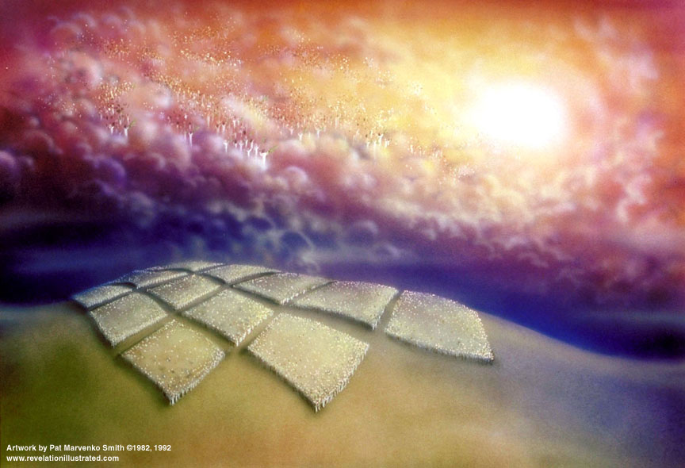

Slide 29
Rev 7 – Those who can stand: 144,000 and the multitude of saints
¹²saying, "Amen, blessing and glory and wisdom and thanksgiving and honor and power and might, be to our God forever and ever. Amen." ¹³And one of the elders answered, saying to me, "These who are clothed in the white robes, who are they, and from where have they come?" ¹⁴And I said to him, "My lord, you know." And he said to me, "These are the ones who come out of the great tribulation, and they have washed their robes and made them white in the blood of the Lamb. | Doxology [7:12] – seven fold Rev. 6:11 And there was given to each of them a white robe; and they were told that they should rest for a little while longer, until the number of their fellow servants and their brethren who were to be killed even as they had been, should be completed also. Rev. 13:15 And there was given to him to give breath to the image of the beast, that the image of the beast might even speak and cause as many as do not worship the image of the beast to be killed. But what about: 2 Thessalonians 2:7-8 For the mystery of lawlessness is already at work; only he who now restrains will do so until he is taken out of the way. ⁸ Then that lawless one will be revealed whom the Lord will slay with the breath of His mouth and bring to an end by the appearance of His coming; | Living tribulation saints are not included here. Holy Spirit still at work (omnipresent), just not restraining now. These are likely the ones referred to in Rev 6:11 as “brethren” to the martyrs under the altar. The 144k bond-servants are at least partially responsible for this harvest. Robes washed white in the blood of the Lamb → this is substitutionary atonement Great Tribulation: see Dan 12:1

Slide 30
Rev 7 – Those who can stand: 144,000 and the multitude of saints
¹⁵"For this reason, they are before the throne of God; and they serve Him day and night in His temple; and He who sits on the throne shall spread His tabernacle over them. ¹⁶"They shall hunger no more, neither thirst anymore; neither shall the sun beat down on them, nor any heat; ¹⁷for the Lamb in the center of the throne shall be their shepherd, and shall guide them to springs of the water of life; and God shall wipe every tear from their eyes." | Revelation 13:17 and he provides that no one will be able to buy or to sell, except the one who has the mark, either the name of the beast or the number of his name. Isaiah 25:8 He will swallow up death for all time, And the Lord God will wipe tears away from all faces, And He will remove the reproach of His people from all the earth; For the Lord has spoken. | These two groups, the 144,000 and the great multitude of gentiles, are distinguished from the 24 elders. Therefore they cannot be the Church. Conversely, this means that the Church is not the “true Israel” which Covenant Theology teaches. Note the tense here is future; meaning John’s view is of events future to his current vision. In distinguishing between the 144K Jews and the great multitude that no one could count God is clearly stating the latter are special. Being protected, they are largely responsible for the salvation of the latter – which is in keeping with God’s general purposes for the Jewish nation throughout history.

Slide 31
Timeline Review:
Apostasy of the church
The rise of a 10 nation confederacy (countries of Christendom?)
Rapture of the Church (true believers)
Judgment seat of Christ (Bema seat) ⎯ of the Church saints
Three of the 10 nations taken over by a strong ruler
Strong ruler ascends to lead the 7 nation confederacy
Treaty between the strong leader and Israel
The Tribulation begins
Scroll with 7 seals, Lion of Judah/Root of David/Lamb is the only one worthy to open it
6 seal judgments begin
Northern and Southern confederacies attack Israel, defeated by God
Abomination of Desolation
The Great Tribulation beginsat 7th seal (Chap 8)
144,000 sons of Israel sealed as servants of the Lord
Great multitude of Gentiles standing before the Lamb
7th seal opened giving 7 trumpet judgments

Slide 32
The Judgments
The Lamb
opens the
seals.
1/3 Earth
God sends the
bowls out, full
of the wrath of
God.
Sores
1/3 Sea
Sea to blood
1
White
2
Red
3
Black
4
Ashen
5
Martyrs
6
Signs
7
Wrath
1/3 Rivers
Rivers to blood
1/3 Heavens
Sun scorches
1st Woe, Locusts
Earth in darkness
2nd Woe, 1/3 Men Die
Euphrates dried
Angels sound
the trumpets.
3rd Woe, 7 Bowls
Earthquake, hail
Tribulation
Great Tribulation

Slide 33
Colossians 1:15-20 He is the image of the invisible God, the firstborn of all creation. ¹⁶ For by Him all things were created, both in the heavens and on earth, visible and invisible, whether thrones or dominions or rulers or authorities—all things have been created through Him and for Him. ¹⁷ He is before all things, and in Him all things hold together. ¹⁸ He is also head of the body, the church; and He is the beginning, the firstborn from the dead, so that He Himself will come to have first place in everything. ¹⁹ For it was the Father's good pleasure for all the fullness to dwell in Him, ²⁰ and through Him to reconcile all things to Himself, having made peace through the blood of His cross; through Him, I say, whether things on earth or things in heaven.

Slide 34
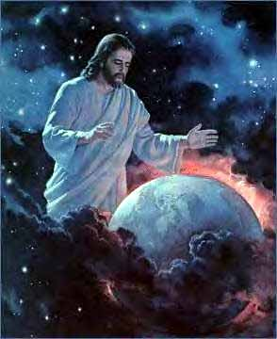

Slide 35
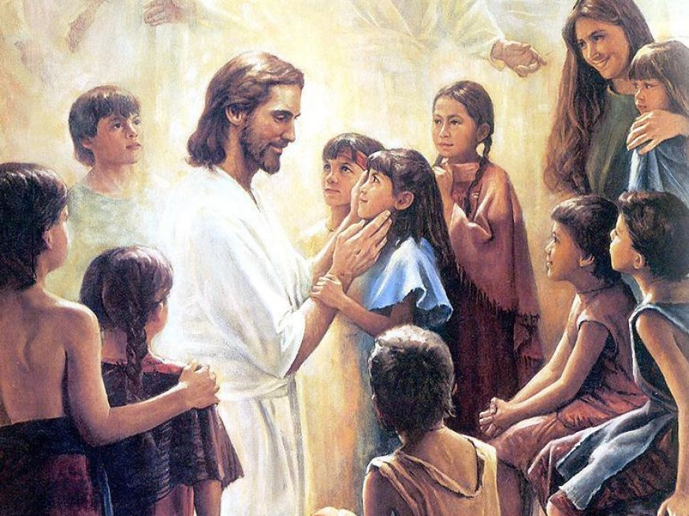

Slide 36
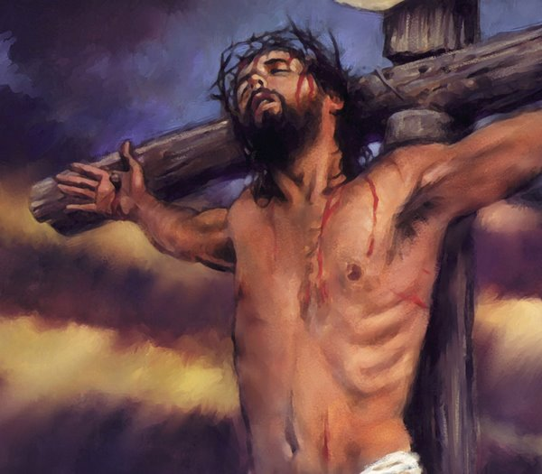

Slide 37
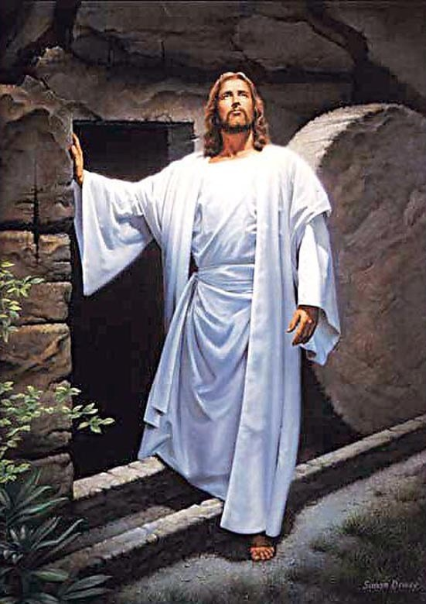

Slide 39
Questions?

