Slide 1
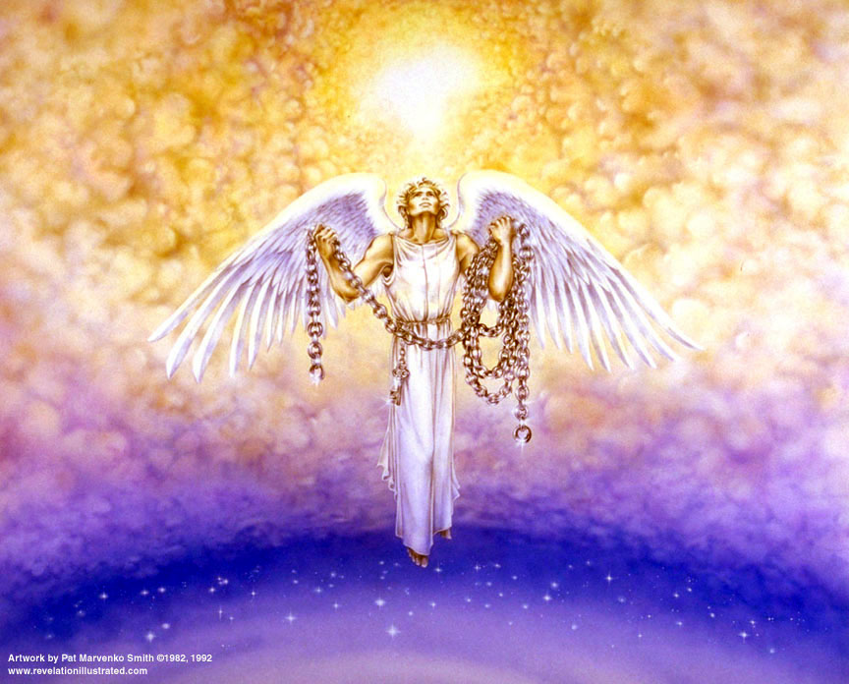

Slide 2
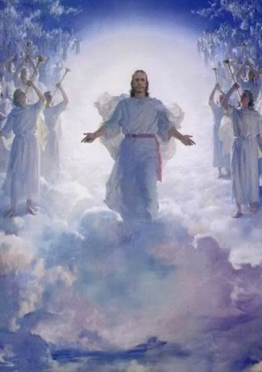
The Revelation of Jesus Christ
The Millennium
Rev. 22:10 And he said to me, "Do not seal up the words of the prophecy of this book, for the time is near.
Rev 20b of 22
Rev. 1:3 Blessed is he who reads and those who hear the words of the prophecy, and heed the things which are written in it; for the time is near.

Slide 3

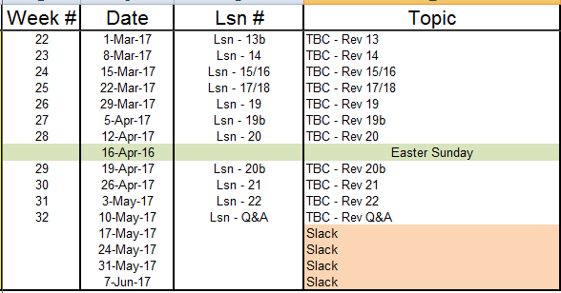
Outline of Revelation

Slide 4
Outline of Revelation
Chapters | Topic
1 | Things which you have seen ─ Glorified Christ in heaven
2-3 | Things which are ─ 7 letters to the 7 churches
4-5 | Things which shall take place ─ Introduction / background to the future — 7 sealed scroll
6 | 6 seals
7 | 1st parenthetic ─ 2 groups (144,000, multitude of gentiles in white robes
8 | 7th seal and first 4 trumpets
9 | 5th & 6th trumpets, 1st & 2nd Woes
10-11:14 | 2nd parenthetic ─ the little book, the two witnesses, end of 2nd Woe
11:15-19 | 7th trumpet, 3rd Woe
12 | 3rd parenthetic ─ important characters
13 | 3rd parenthetic ─ wicked rulers
14 | 3rd parenthetic ─ visions of Christ triumphant
15-16 | 7 bowls leading to the 2nd coming of Christ
17/18 | 4th parenthetic ─ Destruction of ecclesiastic Babylon
19 | 2nd Coming of Christ, the great supper of God
20 | Millennial reign of Christ ─ Satan bound, 1000 year reign, Satan released, great white throne judgment
21 | New Jerusalem, new heaven and new earth
22 | Concluding revelations

Slide 5
Events in Rev 19-20
[19] Christ returns
[19] Beast and false prophet into the Lake of Fire
[19] Armies destroyed at Armageddon
[20] Satan is bound
[20] Thrones are setup for judgment (rule)
[20] Satan is released after 1000 years
[20] Rebellion destroyed by fire from heaven
[20] Satan cast into the Lake of Fire
[20] Great White Throne is revealed

Slide 6
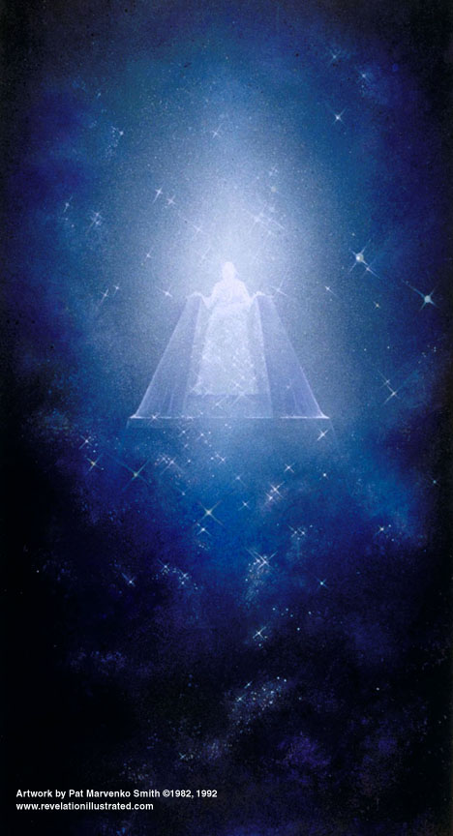

Slide 7
Rev. 20: 4
⁴And I saw thrones, and they sat upon them, and judgment was given to them. And I saw the souls of those who had been beheaded because of the testimony of Jesus and because of the word of God, and those who had not worshiped the beast or his image, and had not received the mark upon their forehead and upon their hand; and they came to life [“lived”] and reigned with Christ for a thousand years.

Slide 8
Rev. 20: 5-6
⁵The rest of the dead did not come to life [“live”] until the thousand years were completed. This is the first resurrection. ⁶Blessed and holy is the one who has a part in the first resurrection; over these the second death has no power, but they will be priests of God and of Christ and will reign with Him for a thousand years.

Slide 9
Rev. 20: 11
¹¹And I saw a great white throne and Him who sat upon it, from whose presence earth and heaven fled away, and no place was found for them.

Slide 10
Rev. 20: 12-13
¹²And I saw the dead, the great and the small, standing before the throne, and books were opened; and another book was opened, which is the book of life; and the dead were judged from the things which were written in the books, according to their deeds. ¹³And the sea gave up the dead which were in it, and death and Hades gave up the dead which were in them; and they were judged, every one of them according to their deeds.

Slide 12
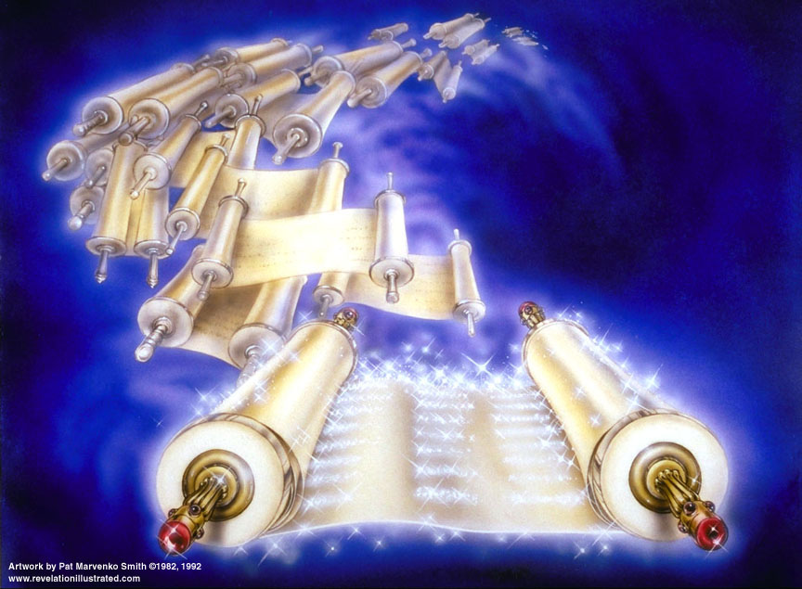

Slide 13
Rev 20 – Satan, Saints, and Sinners
¹²And I saw the dead, the great and the small, standing before the throne, and books were opened; and another book was opened, which is the book of life; and the dead were judged from the things which were written in the books, according to their deeds. ¹³And the sea gave up the dead which were in it, and death and Hades gave up the dead which were in them; and they were judged, every one of them according to their deeds. | Matthew 16:27 "For the Son of Man is going to come in the glory of His Father with His angels; and will then recompense every man according to his DEEDS. Hebrews 9:27 And inasmuch as it is appointed for men to die once and after this comes judgment, Daniel 7:9-10 "I kept looking Until thrones were set up, And the Ancient of Days took His seat; His vesture was like white snow And the hair of His head like pure wool. His throne was ablaze with flames, Its wheels were a burning fire. ¹⁰ "A river of fire was flowing And coming out from before Him; Thousands upon thousands were attending Him, And myriads upon myriads were standing before Him; The court sat, And the books were opened. This is NOT the below judgment… 2 Corinthians 5:10 For we must all appear before the judgment seat of Christ, so that each one may be recompensed for his deeds in the body, according to what he has done, whether good or bad. | Event 10 – Books opened & Book of Life The dead before the throne – the “wicked dead” Event 11 – 2nd resurrection & judgment: “death and Hades gave up the dead” means that bodies of the unsaved will be joined with their spirits which have been in Hades [Walvoord] “sea gave up the dead” – gave up bodies, confirmation that all dead are raised Sheol or Hades – intermediate state Hell – eternal state of punishment [lake of fire]

Slide 14
Rev. 20: 14-15
¹⁴And death and Hades were thrown into the lake of fire. This is the second death, the lake of fire. ¹⁵And if anyone's name was not found written in the book of life, he was thrown into the lake of fire.

Slide 15
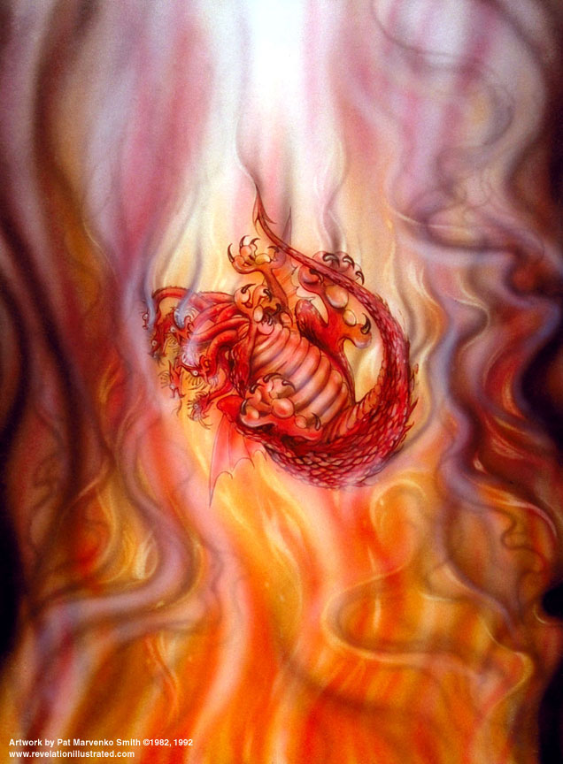

Slide 16
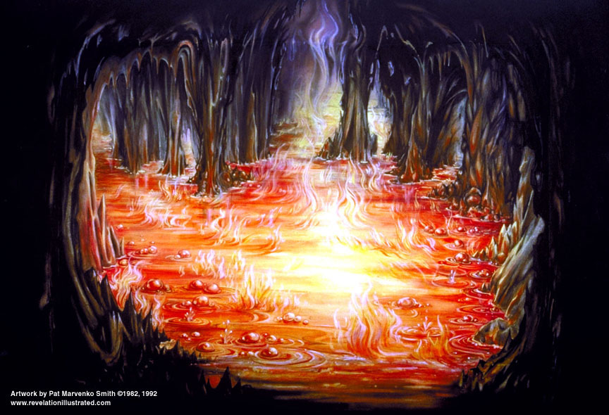

Slide 17

Rev 20 – Satan, Saints, and Sinners
¹⁴And death and Hades were thrown into the lake of fire. This is the second death, the lake of fire. ¹⁵And if anyone's name was not found written in the book of life, he was thrown into the lake of fire. | 1 Corinthians 15:25-26 For He must reign until He has put all His enemies under His feet. ²⁶ The last enemy that will be abolished is death. Rev. 3:5 'He who overcomes shall thus be clothed in white garments; and I will not erase his name from the book of life, and I will confess his name before My Father, and before His angels. Matthew 25:41 "Then He will also say to those on His left, 'Depart from Me, accursed ones, into the eternal fire which has been prepared for the devil and his angels; | Event 12 –death & Hades sent to 2nd death, the Lake of Fire Event 13 – unbelievers to 2nd death, the Lake of Fire

Slide 18
The Millennium
[Walvoord, Major Bible Prophesies, pp. 389-406]
Final and permanent re-gathering of Israel:
Ezekiel 39:25-27 Therefore thus says the Lord God, "Now I shall restore the fortunes of Jacob, and have mercy on the whole house of Israel; and I shall be jealous for My holy name. ²⁶"And they shall forget their disgrace and all their treachery which they perpetrated against Me, when they live securely on their own land with no one to make them afraid. ²⁷"When I bring them back from the peoples and gather them from the lands of their enemies, then I shall be sanctified through them in the sight of the many nations.
Amos 9:15 "I will also plant them on their land, And they will not again be rooted out from their land Which I have given them," Says the Lord your God.
Jeremiah 23:5-8 "Behold, the days are coming," declares the Lord, "When I shall raise up for David a righteous Branch; And He will reign as king and act wisely And do justice and righteousness in the land. ⁶"In His days Judah will be saved, And Israel will dwell securely; And this is His name by which He will be called, 'The Lord our righteousness.' ⁷"Therefore behold, the days are coming," declares the Lord, "when they will no longer say, 'As the Lord lives, who brought up the sons of Israel from the land of Egypt,' ⁸but, 'As the Lord lives, who brought up and led back the descendants of the household of Israel from the north land and from all the countries where I had driven them.' Then they will live on their own soil."
Ezekiel 37:21-22 "And say to them, 'Thus says the Lord God, "Behold, I will take the sons of Israel from among the nations where they have gone, and I will gather them from every side and bring them into their own land; ²²and I will make them one nation in the land, on the mountains of Israel; and one king will be king for all of them; and they will no longer be two nations, and they will no longer be divided into two kingdoms.

Slide 19
2. Christ’s Reign:
Daniel 7:13-14 "… And He came up to the Ancient of Days And was presented before Him. ¹⁴ "And to Him was given dominion, Glory and a kingdom, That all the peoples, nations and men of every language Might serve Him. His dominion is an everlasting dominion...
Isaiah 2:2-3 … In the last days The mountain of the house of the LORD Will be established as the chief of the mountains... ³And many peoples will come and say, "Come, let us go up to the mountain of the LORD, To the house of the God of Jacob; That He may teach us concerning His ways And that we may walk in His paths." For the law will go forth from Zion And the word of the LORD from Jerusalem.
Acts 2:29-30 "Brethren, I may confidently say to you regarding the patriarch David that he both died and was buried, and his tomb is with us to this day. ³⁰ "And so, because he was a prophet and knew that GOD HAD SWORN TO HIM WITH AN OATH TO SEAT one OF HIS DESCENDANTS ON HIS THRONE,

Slide 20
3. David’s Reign:
Ezekiel 37:24-25 "And My servant David will be king over them, and they will all have one shepherd; and they will walk in My ordinances, and keep My statutes, and observe them. ²⁵"And they shall live on the land that I gave to Jacob My servant, in which your fathers lived; and they will live on it, they, and their sons, and their sons' sons, forever; and David My servant shall be their prince forever.
Jeremiah 30:9 'But they shall serve the Lord their God, and David their king, whom I will raise up for them.
Ezekiel 34:24 "And I, the Lord, will be their God, and My servant David will be prince among them; I, the Lord, have spoken.
Hosea 3:5 Afterward the sons of Israel will return and seek the Lord their God and David their king; and they will come trembling to the Lord and to His goodness in the last days.

Slide 21
4. Israel Exalted over the Gentiles:
Isaiah 14:1-2 When the Lord will have compassion on Jacob, and again choose Israel, and settle them in their own land, then strangers will join them and attach themselves to the house of Jacob. ²And the peoples will take them along and bring them to their place, and the house of Israel will possess them as an inheritance in the land of the Lord as male servants and female servants; and they will take their captors captive, and will rule over their oppressors.
Isaiah 49:22-23 Thus says the Lord God, "Behold, I will lift up My hand to the nations, And set up My standard to the peoples; And they will bring your sons in their bosom, And your daughters will be carried on their shoulders. ²³"And kings will be your guardians, And their princesses your nurses. They will bow down to you with their faces to the earth, And lick the dust of your feet; And you will know that I am the Lord; Those who hopefully wait for Me will not be put to shame.
Isaiah 60:14-17 "And the sons of those who afflicted you will come bowing to you, And all those who despised you will bow themselves at the soles of your feet; And they will call you the city of the Lord, The Zion of the Holy One of Israel. ¹⁵"Whereas you have been forsaken and hated With no one passing through, I will make you an everlasting pride, A joy from generation to generation. ¹⁶"You will also suck the milk of nations, And will suck the breast of kings; Then you will know that I, the Lord, am your Savior, And your Redeemer, the Mighty One of Jacob. ¹⁷"Instead of bronze I will bring gold, And instead of iron I will bring silver, And instead of wood, bronze, And instead of stones, iron. And I will make peace your administrators, And righteousness your overseers.

Slide 22
Spiritual Life in the Millennium:
Isaiah 11:9 They will not hurt or destroy in all My holy mountain, For the earth will be full of the knowledge of the Lord As the waters cover the sea.
Jeremiah 31:33 "But this is the covenant which I will make with the house of Israel after those days," declares the Lord, "I will put My law within them, and on their heart I will write it; and I will be their God, and they shall be My people.
Ezekiel 36:26-27 "Moreover, I will give you a new heart and put a new spirit within you; and I will remove the heart of stone from your flesh and give you a heart of flesh. ²⁷ "I will put My Spirit within you and cause you to walk in My statutes, and you will be careful to observe My ordinances.

Slide 23
Millennial Temple [Ezek. 40-46]:
Ezekiel 40:48 Then he brought me to the porch of the temple and measured each side pillar of the porch, five cubits on each side; and the width of the gate was three cubits on each side.
Ezekiel 44:4 Then He brought me by way of the north gate to the front of the house; and I looked, and behold, the glory of the Lord filled the house of the Lord, and I fell on my face.

Slide 24
Things Missing in the Millennial Temple
The wall of partition (held gentiles back)
The court of the women (held women back)
The bronze laver (ceremonial cleansing)
The golden lampstand (provided light)
The table of showbread (God’s provisions)
The altar of incense (ceremonial prayers)
The veil (prevented entrance to the Holy of Holies)
The Ark of the Covenant (where God met High Priest)
Jeremiah 3:16-17 "It shall be in those days when you are multiplied and increased in the land," declares the LORD, "they will no longer say, 'The ark of the covenant of the LORD.' And it will not come to mind, nor will they remember it, nor will they miss it, nor will it be made again. ¹⁷ "At that time they will call Jerusalem 'The Throne of the LORD,' and all the nations will be gathered to it, to Jerusalem, for the name of the LORD; nor will they walk anymore after the stubbornness of their evil heart.

Slide 25
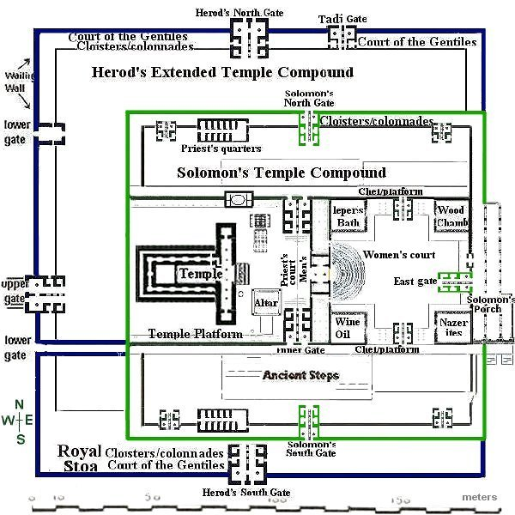

Slide 26
Sacrifices in the Millennium:
Isaiah 56:7 Even those I will bring to My holy mountain, And make them joyful in My house of prayer. Their burnt offerings and their sacrifices will be acceptable on My altar; For My house will be called a house of prayer for all the peoples."
Jeremiah 33:18 and the Levitical priests shall never lack a man before Me to offer burnt offerings, to burn grain offerings, and to prepare sacrifices continually.' "
Zech. 14:16-21 Then it will come about that any who are left of all the nations that went against Jerusalem will go up from year to year to worship the King, the Lord of hosts, and to celebrate the Feast of Booths … . ²⁰In that day there will be inscribed on the bells of the horses, "HOLY TO THE LORD." And the cooking pots in the Lord 's house will be like the bowls before the altar. ²¹And every cooking pot in Jerusalem and in Judah will be holy to the Lord of hosts; and all who sacrifice will come and take of them and boil in them …
Malachi 3:3-4 "And He will sit as a smelter and purifier of silver, and He will purify the sons of Levi and refine them like gold and silver, so that they may present to the Lord offerings in righteousness. ⁴"Then the offering of Judah and Jerusalem will be pleasing to the Lord, as in the days of old and as in former years.

Slide 27
Social and Economic Life in the Millennium:
  a. Most will be saved:
Jeremiah 31:34 "And they shall not teach again, each man his neighbor and each man his brother, saying, 'Know the Lord,' for they shall all know Me, from the least of them to the greatest of them," declares the Lord, "for I will forgive their iniquity, and their sin I will remember no more."
Isaiah 11:3-4 And He will delight in the fear of the Lord, And He will not judge by what His eyes see, Nor make a decision by what His ears hear; 4But with righteousness He will judge the poor, And decide with fairness for the afflicted of the earth; And He will strike the earth with the rod of His mouth, And with the breath of His lips He will slay the wicked.

Slide 28
  b. Prosperity:
Ezekiel 34:25-27 "And I will make a covenant of peace with them and eliminate harmful beasts from the land, so that they may live securely in the wilderness and sleep in the woods. 26"And I will make them and the places around My hill a blessing. And I will cause showers to come down in their season; they will be showers of blessing. 27"Also the tree of the field will yield its fruit, and the earth will yield its increase, and they will be secure on their land. …

Slide 29
  c. Health and long life:
Isaiah 35:5-7 Then the eyes of the blind will be opened, And the ears of the deaf will be unstopped. ⁶Then the lame will leap like a deer, And the tongue of the dumb will shout for joy. For waters will break forth in the wilderness And streams in the Arabah. ⁷And the scorched land will become a pool, And the thirsty ground springs of water; In the haunt of jackals, its resting place, Grass becomes reeds and rushes.
Isaiah 65:18-20 "But be glad and rejoice forever in what I create; For behold, I create Jerusalem for rejoicing, And her people for gladness. ¹⁹"I will also rejoice in Jerusalem, and be glad in My people; And there will no longer be heard in her The voice of weeping and the sound of crying. ²⁰"No longer will there be in it an infant who lives but a few days, Or an old man who does not live out his days; For the youth will die at the age of one hundred And the one who does not reach the age of one hundred Shall be thought accursed.
Jeremiah 30:19 'And from them shall proceed thanksgiving And the voice of those who make merry; And I will multiply them, and they shall not be diminished; I will also honor them, and they shall not be insignificant.

Slide 30
9. Changes in the physical earth:
Zech. 14:4 And in that day His feet will stand on the Mount of Olives, which is in front of Jerusalem on the east; and the Mount of Olives will be split in its middle from east to west by a very large valley, so that half of the mountain will move toward the north and the other half toward the south.
Zech. 14:10 All the land will be changed into a plain from Geba to Rimmon south of Jerusalem; but Jerusalem will rise and remain on its site from Benjamin's Gate as far as the place of the First Gate to the Corner Gate, and from the Tower of Hananel to the king's wine presses.
Ezekiel 47:1-12 Then he brought me back to the door of the house; and behold, water was flowing from under the threshold of the house toward the east, for the house faced east. And the water was flowing down from under, from the right side of the house, from south of the altar. ²And he brought me out by way of the north gate and led me around on the outside to the outer gate by way of the gate that faces east. And behold, water was trickling from the south side… ⁵… and it was a river that I could not ford, for the water had risen, enough water to swim in, a river that could not be forded…. ⁸Then he said to me, "These waters go out toward the eastern region and go down into the Arabah; then they go toward the sea, being made to flow into the sea, and the waters of the sea become fresh ... ¹²"And by the river on its bank, on one side and on the other, will grow all kinds of trees for food. Their leaves will not wither, and their fruit will not fail. They will bear every month because their water flows from the sanctuary, and their fruit will be for food and their leaves for healing."

Slide 31
  Two Reasons Why Jesus May Be Coming Soon:
  1. Leviticus 26:14,17-18,33 'But if you do not obey Me and do not carry out all these commandments, … ¹⁷'… I will set My face against you so that you shall be struck down before your enemies [606 B.C.]; and those who hate you shall rule over you, and you shall flee when no one is pursuing you. ¹⁸'If also after these things, you do not obey Me [536 B.C.] , then I will punish you seven times more for your sins….³³'You, however, I will scatter among the nations and will draw out a sword after you, as your land becomes desolate and your cities become waste. [Written ~1450 B.C.]
    Ezekiel 4:5-6 "For I have assigned you a number of days corresponding to the years of their iniquity, three hundred and ninety days…⁶"When you have completed these, you shall lie down a second time, but on your right side, and bear the iniquity of the house of Judah; I have assigned it to you for forty days, a day for each year. [Written ~580 B.C.]
    [See Jeremiah 25:11]
  430 years of punishment Israel continued to sin 536 B.C.
  +2483.8 years
  606 B.C. Babylonian captivity 360 x 7 = 2520 years more, 1948 A.D.
  -536 B.C. partial return 2520 x 360 = 907,200 days,
  70 years, therefore 360 years remain 907,200 / 365.25 = 2483.8 years
  Israel became a nation again on May 14, 1948
    Matthew 24:32-34 "Now learn the parable from the fig tree: when its branch has already become tender, and puts forth its leaves, you know that summer is near; ³³even so you too, when you see all these things, recognize that He is near, right at the door. ³⁴"Truly I say to you, this generation will not pass away until all these things take place.
    [“Armageddon, Appointment with Destiny”, Grant Jeffrey, Bantam Books, Aug 88, pp38-42.]

Slide 32
  Two Reasons Why Jesus May Be Coming Soon:
  2. Psalm 90:4 For a thousand years in Thy sight Are like
  yesterday when it passes by, Or as a watch in the night.
  Exodus 31:16-17 'So the sons of Israel shall observe the Sabbath...' ¹⁷"It is a sign between Me and the sons of Israel forever; for in six days the Lord made heaven and earth, but on the seventh day He ceased from labor, and was refreshed."
    Exodus 24:16 And the glory of the Lord rested on Mount Sinai, and the cloud covered it for six days; and on the seventh day He called to Moses from the midst of the cloud.
    Joshua 6:4 "Also seven priests shall carry seven trumpets of rams' horns before the ark; then on the seventh day you shall march around the city seven times, and the priests shall blow the trumpets.
    2 Peter 3:7-8 But the present heavens and earth by His word are being reserved for fire, kept for the day of judgment and destruction of ungodly men. ⁸But do not let this one fact escape your notice, beloved, that with the Lord one day is as a thousand years, and a thousand years as one day.
    Hosea 6:1-2 "Come, let us return to the Lord. For He has torn us [70 A.D.], but He will heal us; He has wounded us, but He will bandage us. ²"He will revive us after two days [May 14, 1948]; He will raise us up on the third day [Dan 12:1-2] that we may live before Him. [Is 65:18-23, Millennium]
Biblical genealogy places Adam ~ 4000 B.C.
www.answersingenesis.org/bible-characters/adam-and-eve/when-was-adam-created/

Slide 33
Outline of Revelation
Chapters | Topic
1 | Things which you have seen ─ Glorified Christ in heaven
2-3 | Things which are ─ 7 letters to the 7 churches
4-5 | Things which shall take place ─ Introduction / background to the future — 7 sealed scroll
6 | 6 seals
7 | 1st parenthetic ─ 2 groups (144,000, multitude of gentiles in white robes
8 | 7th seal and first 4 trumpets
9 | 5th & 6th trumpets, 1st & 2nd Woes
10-11:14 | 2nd parenthetic ─ the little book, the two witnesses, end of 2nd Woe
11:15-19 | 7th trumpet, 3rd Woe
12 | 3rd parenthetic ─ important characters
13 | 3rd parenthetic ─ wicked rulers
14 | 3rd parenthetic ─ visions of Christ triumphant
15-16 | 7 bowls leading to the 2nd coming of Christ
17 | 4th parenthetic ─ Destruction of ecclesiastic Babylon
18 | 4th parenthetic ─ Destruction of political Babylon
19 | 2nd Coming of Christ, the great supper of God
20 | Millennial reign of Christ ─ Satan bound, 1000 year reign, Satan released, great white throne judgment
21 | New Jerusalem, new heaven and new earth
22 | Concluding revelations

Slide 34
End

