Slide 1
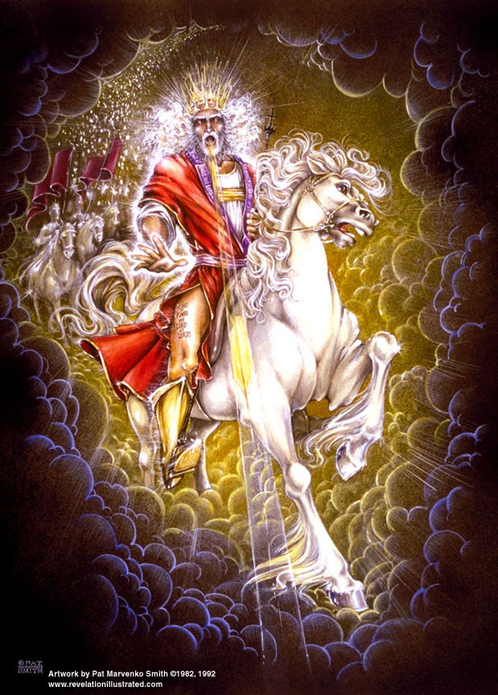

Slide 2
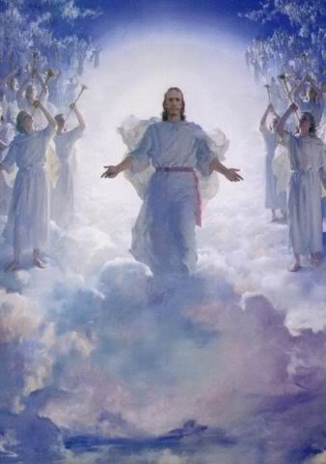
The Revelation of Jesus Christ
Rev. 22:10 And he said to me, "Do not seal up the words of the prophecy of this book, for the time is near.
The Return of the King of Kings
Rev 19b of 22
Rev. 1:3 Blessed is he who reads and those who hear the words of the prophecy, and heed the things which are written in it; for the time is near.

Slide 3

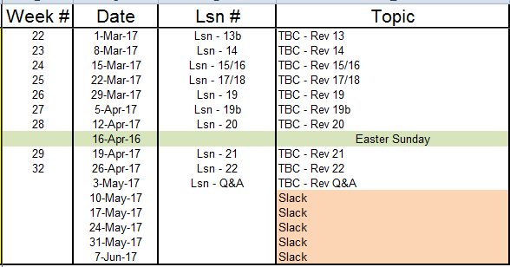
Outline of Revelation

Slide 4
Outline of Revelation
Chapters | Topic
1 | Things which you have seen ─ Glorified Christ in heaven
2-3 | Things which are ─ 7 letters to the 7 churches
4-5 | Things which shall take place ─ Introduction / background to the future — 7 sealed scroll
6 | 6 seals
7 | 1st parenthetic ─ 2 groups (144,000, multitude of gentiles in white robes
8 | 7th seal and first 4 trumpets
9 | 5th & 6th trumpets, 1st & 2nd Woes
10-11:14 | 2nd parenthetic ─ the little book, the two witnesses, end of 2nd Woe
11:15-19 | 7th trumpet, 3rd Woe
12 | 3rd parenthetic ─ important characters
13 | 3rd parenthetic ─ wicked rulers
14 | 3rd parenthetic ─ visions of Christ triumphant
15-16 | 7 bowls leading to the 2nd coming of Christ
17/18 | 4th parenthetic ─ Destruction of ecclesiastic Babylon
19 | 2nd Coming of Christ, the great supper of God
20 | Millennial reign of Christ ─ Satan bound, 1000 year reign, Satan released, great white throne judgment
21 | New Jerusalem, new heaven and new earth
22 | Concluding revelations

Slide 5
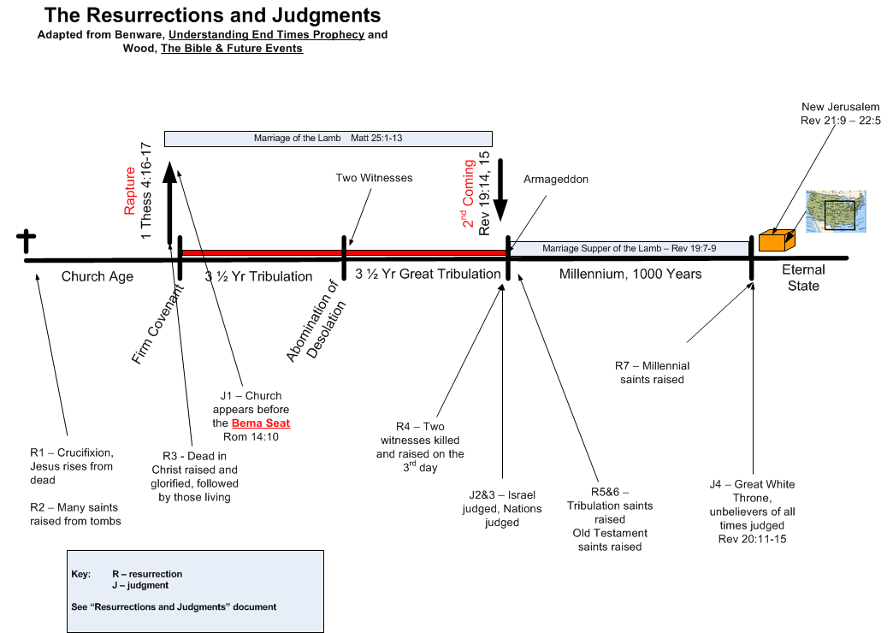

Slide 6
Rev. 19: 1-6
4 Hallelujahs

Slide 7
Hallelujah Chorus Hymn
Hallelujah! Hallelujah! Hallelujah!
Hallelujah! Hallelujah!
For the Lord God Omnipotent reigneth.
Hallelujah! Hallelujah! Hallelujah! Hallelujah!
For the Lord God omnipotent reigneth.
Hallelujah! Hallelujah! Hallelujah! Hallelujah!
Hallelujah! Hallelujah! Hallelujah!
The kingdom of this world
Is become the kingdom of our Lord,
And of His Christ, and of His Christ;
And He shall reign for ever and ever,
For ever and ever, forever and ever,
King of kings, and Lord of lords,
King of kings, and Lord of lords,
And Lord of lords,
And He shall reign,
And He shall reign forever and ever,
King of kings, forever and ever,
And Lord of lords,
Hallelujah! Hallelujah!
And He shall reign forever and ever,
King of kings! and Lord of lords!
And He shall reign forever and ever,
King of kings! and Lord of lords!
Hallelujah! Hallelujah! Hallelujah! Hallelujah!
Hallelujah!

Slide 8
Handel’s Messiah
Part I Scene 1: Isaiah's prophecy of salvation Scene 2: The coming judgment Scene 3: The prophecy of Christ's birth Scene 4: The annunciation to the shepherds Scene 5: Christ's healing and redemption | Part II Scene 1: Christ's Passion Scene 2: Christ's Death and Resurrection Scene 3: Christ's Ascension Scene 4: Christ's reception in Heaven Scene 5: The beginnings of Gospel preaching Scene 6: The world's rejection of the Gospel Scene 7: God's ultimate victory | Part III Scene 1: The promise of eternal life Scene 2: The Day of Judgment Scene 3: The final conquest of sin Scene 4: The acclamation of the Messiah

Slide 9
The 2nd Coming of the Lord

Slide 10
OT & NT passages on 2nd Advent
This is the culmination of God’s plan. There are 1527 Old Testament passages referring to the Second Coming of the Lord Jesus Christ. 330 NT passages. Some are… Genesis 49:10 "The scepter shall not depart from Judah, Nor the ruler's staff from between his feet, Until Shiloh comes, And to him shall be the obedience of the peoples." 2 Samuel 7:12-13 "When your days are complete and you lie down with your fathers, I will raise up your descendant after you, who will come forth from you, and I will establish his kingdom. ¹³ "He shall build a house for My name, and I will establish the throne of his kingdom forever. Isaiah 11:4-6 But with righteousness He will judge the poor, And decide with fairness for the afflicted of the earth; And He will strike the earth with the rod of His mouth, And with the breath of His lips He will slay the wicked. ⁵Also righteousness will be the belt about His loins, And faithfulness the belt about His waist. ⁶ And the wolf will dwell with the lamb, And the leopard will lie down with the young goat, And the calf and the young lion and the fatling together; And a little boy will lead them.

Slide 11
Ezekiel 39:25-29 Therefore thus says the Lord GOD, "Now I will restore the fortunes of Jacob and have mercy on the whole house of Israel; and I will be jealous for My holy name. ²⁶ "They will forget their disgrace and all their treachery which they perpetrated against Me, when they live securely on their own land with no one to make them afraid. ²⁷ "When I bring them back from the peoples and gather them from the lands of their enemies, then I shall be sanctified through them in the sight of the many nations. ²⁸ "Then they will know that I am the LORD their God because I made them go into exile among the nations, and then gathered them again to their own land; and I will leave none of them there any longer. ²⁹ "I will not hide My face from them any longer, for I will have poured out My Spirit on the house of Israel," declares the Lord GOD. Joel 3:1-2 "For behold, in those days and at that time, When I restore the fortunes of Judah and Jerusalem, ² I will gather all the nations And bring them down to the valley of Jehoshaphat. Then I will enter into judgment with them there On behalf of My people and My inheritance, Israel, Whom they have scattered among the nations; And they have divided up My land.

Slide 12
Zechariah 14:1-4 Behold, a day is coming for the LORD when the spoil taken from you will be divided among you. ² For I will gather all the nations against Jerusalem to battle, and the city will be captured, the houses plundered, the women ravished and half of the city exiled, but the rest of the people will not be cut off from the city. ³ Then the LORD will go forth and fight against those nations, as when He fights on a day of battle. ⁴ In that day His feet will stand on the Mount of Olives, which is in front of Jerusalem on the east; and the Mount of Olives will be split in its middle from east to west by a very large valley, so that half of the mountain will move toward the north and the other half toward the south. Matthew 13:47-50 "Again, the kingdom of heaven is like a dragnet cast into the sea, and gathering fish of every kind ⁴⁸ and when it was filled, they drew it up on the beach; and they sat down and gathered the good fish into containers, but the bad they threw away. ⁴⁹ "So it will be at the end of the age; the angels will come forth and take out the wicked from among the righteous, ⁵⁰ and will throw them into the furnace of fire; in that place there will be weeping and gnashing of teeth.

Slide 13
Last Week…
Rev 19:7-10 "Let us rejoice and be glad and give the glory to Him, for the marriage of the Lamb has come and His bride has made herself ready." ⁸ It was given to her to clothe herself in fine linen, bright and clean; for the fine linen is the righteous acts of the saints. ⁹ Then he *said to me, "Write, 'Blessed are those who are invited to the marriage supper of the Lamb.'" And he *said to me, "These are true words of God." ¹⁰ Then I fell at his feet to worship him. But he *said to me, "Do not do that; I am a fellow servant of yours and your brethren who hold the testimony of Jesus; worship God. For the testimony of Jesus is the spirit of prophecy."

Slide 14
Rev. 19: 11-14
¹¹And I saw heaven opened; and behold, a white horse, and He who sat upon it is called Faithful and True; and in righteousness He judges and wages war. ¹²And His eyes are a flame of fire, and upon His head are many diadems; and He has a name written upon Him which no one knows except Himself. ¹³And He is clothed with a robe dipped in blood; and His name is called The Word of God. ¹⁴And the armies which are in heaven, clothed in fine linen, white and clean, were following Him on white horses.

Slide 15
Rev 19 – The 2nd Advent
¹¹And I saw heaven opened; and behold, a white horse, and He who sat upon it is called Faithful and True; and in righteousness He judges and wages war. ¹²And His eyes are a flame of fire, and upon His head are many diadems; and He has a name written upon Him which no one knows except Himself. ¹³And He is clothed with a robe dipped in blood; and His name is called The Word of God. ¹⁴And the armies which are in heaven, clothed in fine linen, white and clean, were following Him on white horses. | Isaiah 63:3 "I have trodden the wine trough alone, And from the peoples there was no man with Me. I also trod them in My anger, And trampled them in My wrath; And their lifeblood is sprinkled on My garments, … 1 Thessalonians 3:13 so that He may establish your hearts without blame in holiness before our God and Father at the coming of our Lord Jesus with all His saints. Revelation 7:9 After these things I looked, and behold, a great multitude which no one could count, from every nation and all tribes and peoples and tongues, standing before the throne and before the Lamb, clothed in white robes, and palm branches were in their hands; Matthew 25:31 "But when the Son of Man comes in His glory, and all the angels with Him, then He will sit on His glorious throne. | White horse – victory Many diadems – king of all nations Note: no mention of rapture here Where is the marriage supper held? The Rider’s names are... Faithful and True Unknown name The Word of God King of Kings Lord of Lords

Slide 16
Acts 17:22-23 So Paul stood in the midst of the Areopagus and said, "Men of Athens, I observe that you are very religious in all respects. ²³"For while I was passing through and examining the objects of your worship, I also found an altar with this inscription, 'TO AN UNKNOWN GOD.' Therefore what you worship in ignorance, this I proclaim to you.

Slide 17
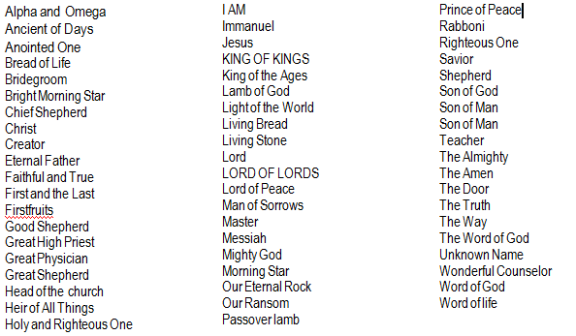
THE NAMES OF JESUS

Slide 18
Luke 10:22 "All things have been handed over to Me by My Father, and no one knows who the Son is except the Father, and who the Father is except the Son, and anyone to whom the Son wills to reveal Him."
Philippians 3:10 that I may know Him and the power of His resurrection and the fellowship of His sufferings, being conformed to His death;

Slide 19
Rev. 19: 15-16
¹⁵And from His mouth comes a sharp sword, so that with it He may smite the nations; and He will rule them with a rod of iron; and He treads the wine press of the fierce wrath of God, the Almighty. ¹⁶And on His robe and on His thigh He has a name written, "KING OF KINGS, AND LORD OF LORDS."

Slide 20
Rev 19 – The 2nd Advent
¹⁵And from His mouth comes a sharp sword, so that with it He may smite the nations; and He will rule them with a rod of iron; and He treads the wine press of the fierce wrath of God, the Almighty. ¹⁶And on His robe and on His thigh He has a name written, "KING OF KINGS, AND LORD OF LORDS." | Rev. 1:16 And in His right hand He held seven stars; and out of His mouth came a sharp two-edged sword;… Isaiah 11:4 But with righteousness He will judge the poor, And decide with fairness for the afflicted of the earth; And He will strike the earth with the rod of His mouth,…

Slide 21
Rev. 19: 17-18
¹⁷And I saw an angel standing in the sun; and he cried out with a loud voice, saying to all the birds which fly in midheaven, "Come, assemble for the great supper of God; ¹⁸ in order that you may eat the flesh of kings and the flesh of commanders and the flesh of mighty men and the flesh of horses and of those who sit on them and the flesh of all men, both free men and slaves, and small and great."

Slide 22
Rev 19 – The 2nd Advent
¹⁷And I saw an angel standing in the sun; and he cried out with a loud voice, saying to all the birds which fly in midheaven, "Come, assemble for the great supper of God; ¹⁸in order that you may eat the flesh of kings and the flesh of commanders and the flesh of mighty men and the flesh of horses and of those who sit on them and the flesh of all men, both free men and slaves, and small and great." | Zech. 14:3-4 Then the Lord will go forth and fight against those nations, as when He fights on a day of battle. ⁴And in that day His feet will stand on the Mount of Olives, … Ezekiel 39:17 "… says the Lord God, 'Speak to every kind of bird and to every beast of the field, "Assemble and come, gather from every side to My sacrifice which I am going to sacrifice … Matt 24:26-28 "So if they say to you, 'Behold, He is in the wilderness,' do not go out, or, 'Behold, He is in the inner rooms,' do not believe them. ²⁷ "For just as the lightning comes from the east and flashes even to the west, so will the coming of the Son of Man be. ²⁸ "Wherever the corpse is, there the vultures will gather. | loud voice – something important about to happen Ezekiel 38 & 39 foretell the invasion of Israel in the Tribulation

Slide 23
Rev. 19: 19-21
¹⁹And I saw the beast and the kings of the earth and their armies, assembled to make war against Him who sat upon the horse, and against His army. ²⁰And the beast was seized, and with him the false prophet who performed the signs in his presence, by which he deceived those who had received the mark of the beast and those who worshiped his image; these two were thrown alive into the lake of fire which burns with brimstone. ²¹And the rest were killed with the sword which came from the mouth of Him who sat upon the horse, and all the birds were filled with their flesh.

Slide 24
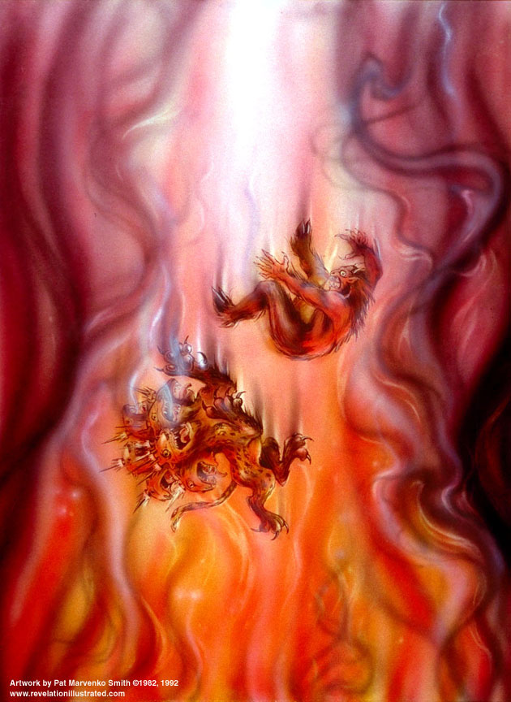

Slide 25
Rev 19 – The 2nd Advent
¹⁹And I saw the beast and the kings of the earth and their armies, assembled to make war against Him who sat upon the horse, and against His army. ²⁰And the beast was seized, and with him the false prophet who performed the signs in his presence, by which he deceived those who had received the mark of the beast and those who worshiped his image; these two were thrown alive into the lake of fire which burns with brimstone. ²¹And the rest were killed with the sword which came from the mouth of Him who sat upon the horse, and all the birds were filled with their flesh. | Rev. 16:14 for they (3 unclean spirits) are spirits of demons, performing signs, which go out to the kings of the whole world, to gather them together for the war of the great day of God, the Almighty. Daniel 7:11 "Then I kept looking because of the sound of the boastful words which the horn was speaking; I kept looking until the beast was slain, and its body was destroyed and given to the burning fire. | lake of fire – second death, not the same as Hades Rev. 20:10 And the devil who deceived them was thrown into the lake of fire … Rev. 20:14 And death and Hades were thrown into the lake of fire. This is the second death, the lake of fire.

Slide 27
End

Slide 28
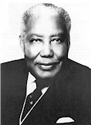
“That’s My King”
S. M. Lockridge
http://www.ignitermedia.com/products/iv/singles/4/Thats-My-King
Dr. Lockridge was the Pastor of Calvary Baptist Church, San Diego CA from 1953 - 1993. He entered heaven in 2000.

Slide 29
Biblical Jewish Marriage Customs
Dr. Renald Showers, Friends of Israel
Betrothal – groom goes to home of the prospective bride to establishment a marriage covenant and payment of the price to purchase the bride.
Preparation – After paying the price the groom returned to his father’s house for 12 months and prepared a place for the bride to live.
Taking the bride – the groom and best man return for the bride at night and unannounced. He takes her back to his father’s house. They enter the bridal chamber and consummate the marriage.
Celebration – the groom celebrates with guests for 7 days; the bride remains in the bridal chamber.
Presentation – At the end of 7 days the bride is presented to the guests for the marriage supper.

Slide 30
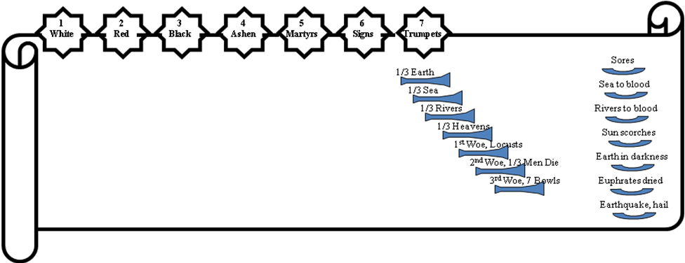
The Judgments
God sends the
bowls out, full
of the wrath
of God.
The Lamb opens
the seals.
Angels sound
the trumpets.

