Slide 1
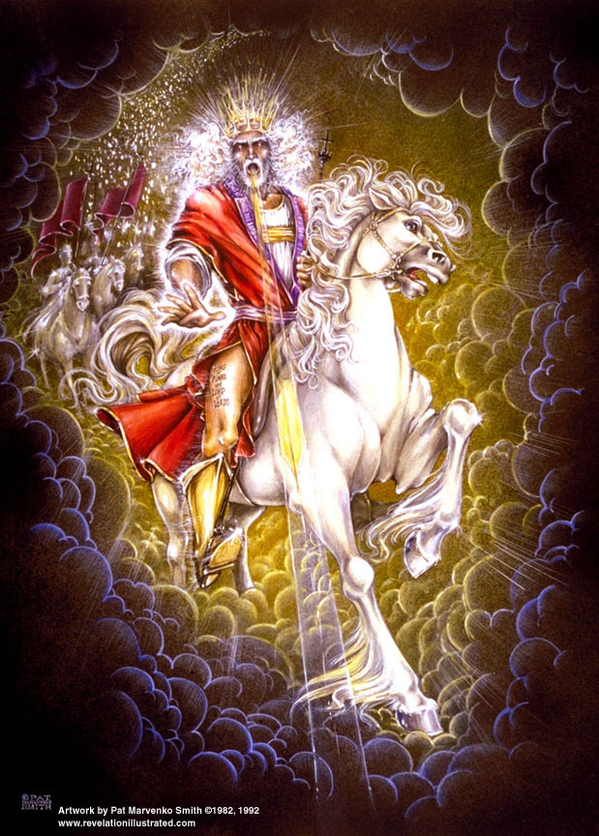

Slide 2
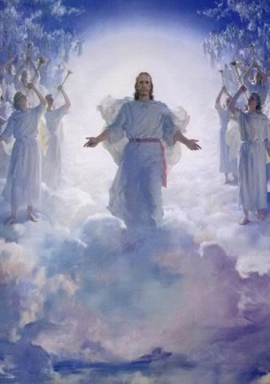
The Revelation of Jesus Christ
Rev. 22:10 And he said to me, "Do not seal up the words of the prophecy of this book, for the time is near.
The Return of the King of Kings
Rev 19 of 22
Rev. 1:3 Blessed is he who reads and those who hear the words of the prophecy, and heed the things which are written in it; for the time is near.

Slide 3

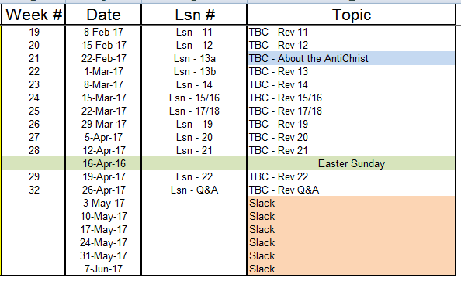
Outline of Revelation

Slide 4
Outline of Revelation
Chapters | Topic
1 | Things which you have seen ─ Glorified Christ in heaven
2-3 | Things which are ─ 7 letters to the 7 churches
4-5 | Things which shall take place ─ Introduction / background to the future — 7 sealed scroll
6 | 6 seals
7 | 1st parenthetic ─ 2 groups (144,000, multitude of gentiles in white robes
8 | 7th seal and first 4 trumpets
9 | 5th & 6th trumpets, 1st & 2nd Woes
10-11:14 | 2nd parenthetic ─ the little book, the two witnesses, end of 2nd Woe
11:15-19 | 7th trumpet, 3rd Woe
12 | 3rd parenthetic ─ important characters
13 | 3rd parenthetic ─ wicked rulers
14 | 3rd parenthetic ─ visions of Christ triumphant
15-16 | 7 bowls leading to the 2nd coming of Christ
17/18 | 4th parenthetic ─ Destruction of ecclesiastic Babylon
19 | 2nd Coming of Christ, the great supper of God
20 | Millennial reign of Christ ─ Satan bound, 1000 year reign, Satan released, great white throne judgment
21 | New Jerusalem, new heaven and new earth
22 | Concluding revelations

Slide 5
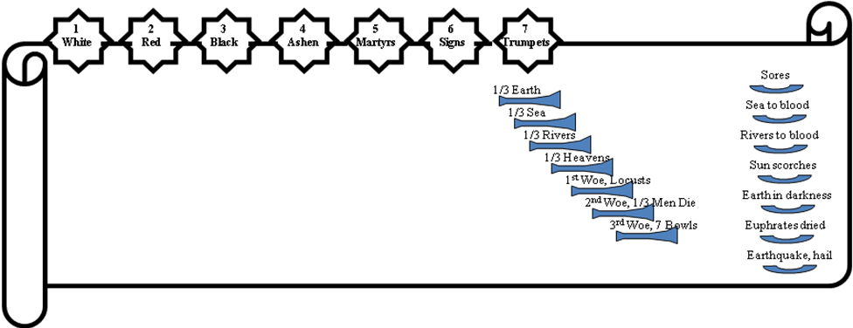
The Judgments
God sends the
bowls out, full
of the wrath
of God.
The Lamb opens
the seals.
Angels sound
the trumpets.

Slide 6
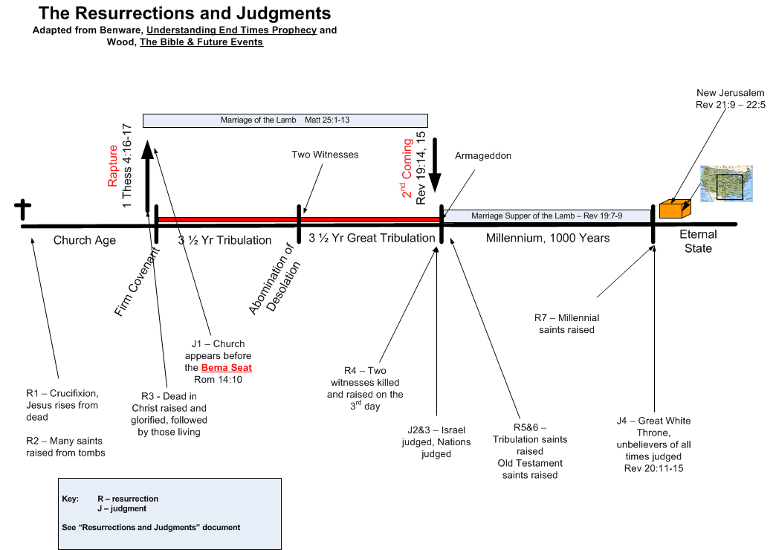

Slide 8
5th & 6th Resurrections [order is indeterminate]
Old Testament Saints: Daniel 12:1-3 "Now at that time Michael, the great prince who stands guard over the sons of your people, will arise. And there will be a time of distress such as never occurred since there was a nation until that time; and at that time your people, everyone who is found written in the book, will be rescued. ²"And many of those who sleep in the dust of the ground will awake, these to everlasting life, but the others to disgrace and everlasting contempt…
Daniel 12:11-13 "And from the time that the regular sacrifice is abolished, and the abomination of desolation is set up, there will be 1,290 days. ¹²"How blessed is he who keeps waiting and attains to the 1,335 days! ¹³"But as for you, go your way to the end; then you will enter into rest and rise again for your allotted portion at the end of the age."
Tribulation Saints: Rev. 20:4-6 And I saw thrones, and they sat upon them, and judgment was given to them. And I saw the souls of those who had been beheaded because of the testimony of Jesus and because of the word of God, and those who had not worshiped the beast or his image, and had not received the mark upon their forehead and upon their hand; and they came to life and reigned with Christ for a thousand years. ⁵The rest of the dead did not come to life until the thousand years were completed. This is the first resurrection… [includes the Church, OT saints, & tribulation saints]

Slide 10
2nd & 3rd Judgments [order is indeterminate]
Nations of the Tribulation: Matthew 25:13-46 …³¹"But when the Son of Man comes in His glory, and all the angels with Him, then He will sit on His glorious throne. ³²"And all the nations will be gathered before Him; and He will separate them from one another, as the shepherd separates the sheep from the goats; ³³and He will put the sheep on His right, and the goats on the left. ³⁴"Then the King will say to those on His right, 'Come, you who are blessed of My Father, inherit the kingdom prepared for you from the foundation of the world. ³⁵'For I was hungry, and you gave Me something to eat…
Israel judged: Ezekiel 20:33-44 "As I live," declares the Lord God, "surely with a mighty hand and with an outstretched arm and with wrath poured out, I shall be king over you. ³⁴"And I shall bring you out from the peoples and gather you from the lands where you are scattered, with a mighty hand and with an outstretched arm and with wrath poured out; ³⁵and I shall bring you into the wilderness of the peoples, and there I shall enter into judgment with you face to face… ³⁸and I shall purge from you the rebels and those who transgress against Me; I shall bring them out of the land where they sojourn, but they will not enter the land of Israel. Thus you will know that I am the Lord… ⁴⁰"For on My holy mountain, on the high mountain of Israel," declares the Lord God, "there the whole house of Israel, all of them, will serve Me in the land…

Slide 11
  Luke 4:17-20 And the book of the prophet Isaiah was handed to Him. And He opened the book, and found the place where it was written … And He closed the book, and gave it back to the attendant, and sat down…, ²¹…”Today this Scripture has been fulfilled in your hearing."
  Isaiah 61:1-9 The Spirit of the Lord God is upon me, Because the Lord has anointed me To bring good news to the afflicted; He has sent me to bind up the brokenhearted, To proclaim liberty to captives, And freedom to prisoners; ²To proclaim the favorable year of the Lord, …[Jesus stopped here] …And the day of vengeance of our God; To comfort all who mourn, ³To grant those who mourn in Zion, Giving them a garland instead of ashes, The oil of gladness instead of mourning, The mantle of praise instead of a spirit of fainting. So they will be called oaks of righteousness, The planting of the Lord, that He may be glorified. ⁴Then they will rebuild the ancient ruins, They will raise up the former devastations, And they will repair the ruined cities, The desolations of many generations…⁹Then their offspring will be known among the nations, And their descendants in the midst of the peoples. All who see them will recognize them Because they are the offspring whom the Lord has blessed. (meaning… His special people!)

Slide 12
Rev. 19: 1-4
After these things I heard, as it were, a loud voice of a great multitude in heaven, saying, "Hallelujah! Salvation and glory and power belong to our God; ²because His JUDGMENTS ARE TRUE AND RIGHTEOUS; for He has judged the great harlot who was corrupting the earth with her immorality, and He has AVENGED THE BLOOD OF His bond-servants ON HER." ³And a second time they said, "Hallelujah! Her smoke rises up forever and ever." ⁴And the twenty-four elders and the four living creatures fell down and worshiped God who sits on the throne saying, "Amen. Hallelujah!"

Slide 13
Doxa – glory “Words of glory” which include: 1) praise, 2) eternal attributes
Logos – words
14 Doxologies in the Book of Revelation
References | The One(s) Giving the Praise | The One(s) Receiving the Praise
4:8 | 4 living creatures | God the Father
4:11 | 24 elders | God the Father
5:9-10 | 24 elders and 4 living creatures | The Lamb (Christ)
5:12 | Many angels | The Lamb
5:13 | Every creature | God the Father and the Lamb
7:10 | Tribulation martyrs | God the Father and the Lamb
7:12 | Angels, 24 elders, and 4 living creatures | God the Father
11:16-18 | 24 elders | God the Father
15:3-4 | Tribulation saints | God the Father and the Lamb
16:5-6 | Angel | God the Father
16:7 | “The altar” | God the Father
19:1-3 | A great multitude | God the Father
19:4 | 24 elders and 4 living creatures | God the Father
19:6-7 | A greater multitude | God the Father

Slide 14
Rev 19 – The 2nd Advent (Hallelujah Chorus is appropriate)
After these things I heard, as it were, a loud voice of a great multitude in heaven, saying, "Hallelujah! Salvation and glory and power belong to our God; ²because His JUDGMENTS ARE TRUE AND RIGHTEOUS; for He has judged the great harlot who was corrupting the earth with her immorality and He has AVENGED THE BLOOD OF His bond-servants ON HER." ³And a second time they said, "Hallelujah! Her smoke rises up forever and ever." ⁴And the twenty-four elders and the four living creatures fell down and worshiped God who sits on the throne saying, "Amen. Hallelujah!" | Rev. 7:9-14 After these things I looked, and behold, a great multitude, which no one could count, from every nation and all tribes and peoples and tongues, … ¹⁴And I said to him, "My lord, you know." And he said to me, "These are the ones who come out of the great tribulation, and they have washed their robes and made them white in the blood of the Lamb. Psalm 19:9 The fear of the Lord is clean, enduring forever; The judgments of the Lord are true; they are righteous altogether. First use of “halal yah” in the OT… Psalm 104:35 Let sinners be consumed from the earth And let the wicked be no more. Bless the LORD, O my soul. Praise the LORD [“halal Yah”]! | Read all of Isaiah 61 Note the three doxologies in vs. 1 thru 7. After these things – events in Rev 17 & 18 great multitude = ______________ Hallelujah – “Praise” + “to God”, is transliteration of phrase in OT. Hallel sections: Ps 104-109, 113-118. Reserved for God’s deliverance of His people and destruction of the ungodly. How long is the great harlot’s judgment? 24 elders = church age saints

Slide 15
Rev. 19: 5-6
⁵And a voice came from the throne, saying, "Give praise to our God, all you His bond-servants, you who fear Him, the small and the great."
⁶And I heard, as it were, the voice of a great multitude and as the sound of many waters and as the sound of mighty peals of thunder, saying, "Hallelujah! For the Lord our God, the Almighty, reigns.

Slide 16
Rev 19 – The 2nd Advent
⁵And a voice came from the throne, saying, "Give praise to our God, all you His bond-servants, you who fear Him, the small and the great." ⁶And I heard, as it were, the voice of a great multitude and as the sound of many waters and as the sound of mighty peals of thunder, saying, "Hallelujah! For the Lord our God, the Almighty, reigns." | Acts 2:19-22 'AND I WILL GRANT WONDERS IN THE SKY ABOVE AND SIGNS ON THE EARTH BELOW, BLOOD, AND FIRE, AND VAPOR OF SMOKE. ²⁰ 'THE SUN WILL BE TURNED INTO DARKNESS AND THE MOON INTO BLOOD, BEFORE THE GREAT AND GLORIOUS DAY OF THE LORD SHALL COME. ²¹ 'AND IT SHALL BE THAT EVERYONE WHO CALLS ON THE NAME OF THE LORD WILL BE SAVED.' ²² "Men of Israel, listen to these words…[Peter quoting Joel] | Prophetic hallelujah for what’s coming 2nd great multitude likely greater than above & = _____________

Slide 17
Rev. 19: 7-8
⁷"Let us rejoice and be glad and give the glory to Him, for the marriage of the Lamb has come and His bride has made herself ready." ⁸And it was given to her to clothe herself in fine linen, bright and clean; for the fine linen is the righteous acts of the saints.

Slide 18
Biblical Jewish Marriage Customs
Dr. Renald Showers, Friends of Israel
Betrothal – groom goes to home of the prospective bride to establishment a marriage covenant and payment of the price to purchase the bride.
Preparation – After paying the price the groom returned to his father’s house for 12 months and prepared a place for the bride to live.
Taking the bride – the groom and best man return for the bride at night and unannounced. He takes her back to his father’s house. They enter the bridal chamber and consummate the marriage.
Celebration – the groom celebrates with guests for 7 days; the bride remains in the bridal chamber.
Presentation – At the end of 7 days the bride is presented to the guests for the marriage supper.

Slide 19
Rev 19 – The 2nd Advent
⁷"Let us rejoice and be glad and give the glory to Him, for the marriage of the Lamb has come and His bride has made herself ready." ⁸And it was given to her to clothe herself in fine linen, bright and clean; for the fine linen is the righteous acts of the saints. 2 Corinthians 11:2 For I am jealous for you with a godly jealousy; for I betrothed you to one husband, so that to Christ I might present you as a pure virgin. John 3:29 "He who has the bride is the bridegroom; but the friend of the bridegroom, who stands and hears him, rejoices greatly because of the bridegroom's voice. So this joy of mine has been made full. Hebrews 13:20 Now the God of peace, who brought up from the dead the great Shepherd of the sheep through the blood of the eternal covenant, even Jesus our Lord, | Philip. 1:11 having been filled with the fruit of righteousness which comes through Jesus Christ, to the glory and praise of God. Matt 22:2,12,13 "The kingdom of heaven may be compared to a king, who gave a wedding feast for his son…¹²and he said to him, 'Friend, how did you come in here without wedding clothes?' And he was speechless. ¹³"Then the king said to the servants, 'Bind him hand and foot, and cast him into the outer darkness; … Matt 8:8-12 But the centurion said, "Lord, I am not worthy for You to come under my roof, but just say the word, and my servant will be healed… . ¹⁰ Now when Jesus heard this, He marveled and said to those who were following, "Truly I say to you, I have not found such great faith with anyone in Israel. ¹¹ "I say to you that many will come from east and west, and recline at the table with Abraham, Isaac and Jacob in the kingdom of heaven; ¹² but the sons of the kingdom will be cast out into the outer darkness; in that place there will be weeping and gnashing of teeth. | Jewish marriage had 5 steps: Betrothal Preparation Groom goes for the bride Consummation and feasting Wedding feast (marriage supper) “bride” – gk “gune”, wife → step 4 complete; only the feast remains. Normally the word for bride is “numphe” for young woman. Who prepares the “bride”? “The unfounded notion that God treats all saints of all ages exactly alike is hard to displace in the theology of the Church.” – Walvoord “Such distinctions are secondary to the great primary truth that all will be there by virtue of the saving work of Christ and their personal trust in the true creator God and in His provision of salvation” - MacArthur
Isaiah 54:6 "For the LORD has called you, Like a wife forsaken and grieved in spirit, Even like a wife of one's youth when she is rejected," Says your God.

Slide 20
Rev. 19: 9
⁹And he said to me, "Write, 'Blessed are those who are invited to the marriage supper of the Lamb.' " And he said to me, "These are true words of God."

Slide 21
Rev 19 – The 2nd Advent
⁹And he said to me, "Write, 'Blessed are those who are invited to the marriage supper of the Lamb.' "And he said to me, "These are true words of God." | Matthew 24:30-31 "And then the sign of the Son of Man will appear in the sky, and then all the tribes of the earth will mourn, and they will see the SON OF MAN COMING ON THE CLOUDS OF THE SKY with power and great glory. ³¹ "And He will send forth His angels with A GREAT TRUMPET and THEY WILL GATHER TOGETHER His elect from the four winds, from one end of the sky to the other. | Who is invited to the marriage supper? _____________ _____________ Gathering is probably all tribulation saints and Old Testament saints – for marriage supper

Slide 22
Rev. 19: 10
¹⁰And I fell at his feet to worship him. And he said to me, "Do not do that; I am a fellow servant of yours and your brethren who hold the testimony of Jesus; worship God. For the testimony of Jesus is the spirit of prophecy."

Slide 23
Rev 19 – The 2nd Advent
¹⁰And I fell at his feet to worship him. And he said to me, "Do not do that; I am a fellow servant of yours and your brethren who hold the testimony of Jesus; worship God. For the testimony of Jesus is the spirit of prophecy." | Revelation 21:2 And I saw the holy city, new Jerusalem, coming down out of heaven from God, made ready as a bride adorned for her husband. | “Spirit of prophecy” – The very nature or purpose of prophecy is to testify of Jesus Christ and to bring glory to Him

Slide 24
Click for Handle’s Alleluia Chorus

Slide 25
End

