Slide 1
Public Service Announcement
You can find all Revelation teaching material at
http://www.tbc.me/revelation-study
See top of your handouts.

Slide 2


Slide 3
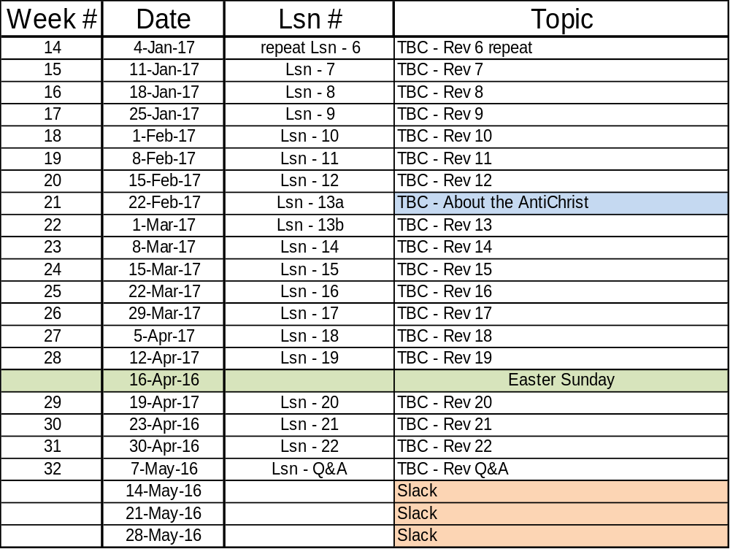

Slide 4
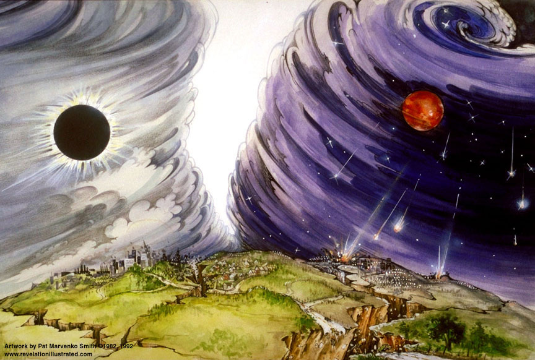
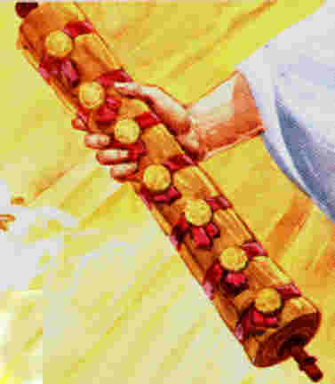
The Revelation of Jesus Christ
Chapter 6 of 22
Rev. 22:10 And he said to me, "Do not seal up the words of the prophecy of this book, for the time is near.”
Rev. 1:3 Blessed is he who reads and those who hear the words of the prophecy, and heed the things which are written in it; for the time is near.

Slide 5
Outline of Revelation
Chapters | Topic
1 | Things which you have seen ─ Glorified Christ in heaven
2-3 | Things which are ─ 7 letters to the 7 churches
4-5 | Things which shall take place ─ Introduction / background to the future — 7 sealed scroll
6 | 6 seals
7 | 1st parenthetic ─ 2 groups (144,000, multitude from all nations in white robes)
8 | 7th seal and first 4 trumpets
9 | 5th & 6th trumpets, 1st & 2nd Woes
10-11:14 | 2nd parenthetic ─ the little book, the two witnesses, end of 2nd Woe
11:15-19 | 7th trumpet, 3rd Woe
12 | 3rd parenthetic ─ important characters
13 | 3rd parenthetic ─ wicked rulers
14 | 3rd parenthetic ─ visions of Christ triumphant
15-16 | 7 bowls leading to the 2nd coming of Christ
17 | 4th parenthetic ─ Destruction of ecclesiastic Babylon
18 | 4th parenthetic ─ Destruction of political Babylon
19 | 2nd Coming of Christ, the great supper of God
20 | Millennial reign of Christ ─ Satan bound, 1000 year reign, Satan released, great white throne judgment
21 | New Jerusalem, new heaven and new earth
22 | Concluding revelations

Slide 6

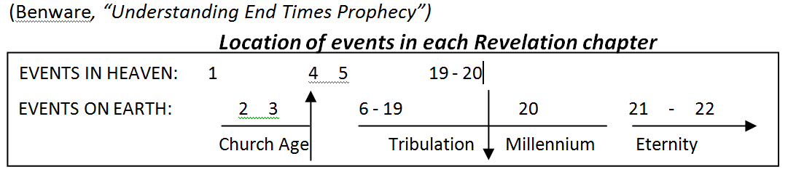
Overview of Revelation

Slide 8
Rev 4 & 5 Doxologies
4 Living Creatures: Rev 4:8 …"HOLY, HOLY, HOLY is THE LORD GOD, THE ALMIGHTY, WHO WAS AND WHO IS AND WHO IS TO COME."
24 Elders: Rev 4:11 "Worthy are You, our Lord and our God, to receive glory and honor and power; for You created all things, and because of Your will they existed, and were created."
4 & 24: Rev 5:9-10 …new song, saying, "Worthy are You to take the book and to break its seals; for You were slain, and purchased for God with Your blood men from every tribe and tongue and people and nation. ¹⁰ "You have made them to be a kingdom and priests to our God; and they will reign upon the earth."
Rev 5:5 and one of the elders *said to me, "Stop weeping; behold, the Lion that is from the tribe of Judah, the Root of David, has overcome so as to open the book and its seven seals.“
4&24& myriads: Rev 5:12 …"Worthy is the Lamb that was slain to receive power and riches and wisdom and might and honor and glory and blessing."
All creation: Rev 5:13 …"To Him who sits on the throne, and to the Lamb, be blessing and honor and glory and dominion forever and ever."

Slide 10
The Revealing of Jesus Christ
Rev 6 is the “Continental Divide” - McGee
We see the Lion of the Tribe of Judah, the Lamb who was slain for the sins of the world
Only He is “Worthy”… to redeem the world & redeem Israel (not because of who He is, but because of what He has done.)
Scroll does not “contain” the judgments…but the terms of redemption.
The Kinsman/Redeemer executes the terms
  He is also acting as Blood Avenger
2 Peter 1:20 But know this first of all, that no prophecy of Scripture is a matter of one's own interpretation, …
Scene shifts back down to earth

Slide 11
The Judgments
The Lamb
opens the
seals.
1/3 Earth
God sends the
bowls out, full
of the wrath of God.
Sores
1/3 Sea
Sea to blood
1
White
2
Red
3
Black
4
Ashen
5
Martyrs
6
Signs
7
Wrath
1/3 Rivers
Rivers to blood
1/3 Heavens
Sun scorches
1st Woe, Locusts
Earth in darkness
compressed
2nd Woe, 1/3 Men Die
Euphrates dried
Angels sound
the trumpets.
3rd Woe, 7 Bowls
Earthquake, hail
Tribulation
Great Tribulation

Slide 12
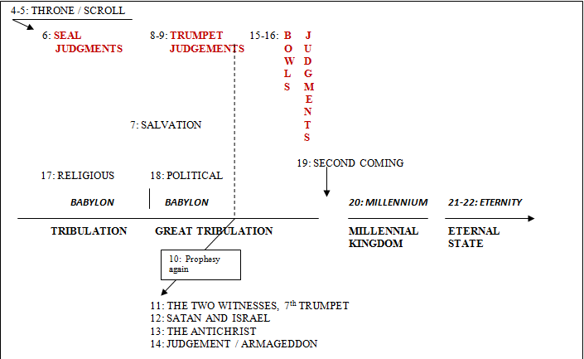
Third Major Section of Revelation: Ch 4-22
(Benware, “Understanding End Times Prophecy”)
Rev. 1:19 "Write therefore the things which you have seen, and the things which are, and the things which shall take place after these things.

Slide 13
The Judgments
The Lamb
opens the
seals.
1/3 Earth
God sends the
bowls out, full
of the wrath of God.
Sores
1/3 Sea
Sea to blood
1
White
2
Red
3
Black
4
Ashen
5
Martyrs
6
Signs
7
Wrath
1/3 Rivers
Rivers to blood
1/3 Heavens
Sun scorches
1st Woe, Locusts
Earth in darkness
compressed
2nd Woe, 1/3 Men Die
Euphrates dried
Angels sound
the trumpets.
3rd Woe, 7 Bowls
Earthquake, hail
Tribulation
Great Tribulation
Luke 21:20-22 "But when you see Jerusalem surrounded by armies, then recognize that her desolation is near. ²¹ "Then those who are in Judea must flee to the mountains, and those who are in the midst of the city must leave, and those who are in the country must not enter the city; ²² because these are days of vengeance, so that all things which are written will be fulfilled.

Slide 14
UN vote against Israel
Dec 23rd, 2016
China
France
Russia
United Kingdom
United States
Angola
Egypt
Japan
Malaysia
New Zealand
Senegal
Spain
Ukraine
Uruguay
Venezuela

Slide 15
UN 2014-2015 Resolutions
Against Israel = 20
Against all other nations = 3
http://blog.unwatch.org/index.php/2015/01/22/2014-at-the-un-20-resolutions-against-israel-3-on-rest-of-the-world/

Slide 16
Why Israel?
Population of Israel – 8.38 M
Population of World – 7.35 B
Israel % of World pop. = .114%

Slide 17
Psalm 2
(A Royal Psalm)
Why are the nations in an uproar And the peoples devising a vain thing? ² The kings of the earth take their stand And the rulers take counsel together Against the LORD and against His Anointed, saying, ³ "Let us tear their fetters apart And cast away their cords from us!"
⁴ He who sits in the heavens laughs, The Lord scoffs at them. ⁵ Then He will speak to them in His anger And terrify them in His fury, saying, ⁶ "But as for Me, I have installed My King Upon Zion, My holy mountain."⁷ "I will surely tell of the decree of the LORD:
He said to Me, 'You are My Son, Today I have begotten You. ⁸ 'Ask of Me, and I will surely give the nations as Your inheritance, And the very ends of the earth as Your possession. ⁹ 'You shall break them with a rod of iron, You shall shatter them like earthenware.'" ¹⁰ Now therefore, O kings, show discernment; Take warning, O judges of the earth. ¹¹ Worship the LORD with reverence And rejoice with trembling. ¹² Do homage to the Son, that He not become angry, and you perish in the way, For His wrath may soon be kindled. How blessed are all who take refuge in Him!

Slide 18
Our approach…
Look at the handout:
  1st column is Rev 6
  2nd column is Matt 24
  3rd column is OT verses expanding the narrative
We will first cover seals 1 thru 4
Then OT verses in column 3
Then the rest of Rev 6 and Matt 24

Slide 19
Other Verses & Notes
Daniel 9:26-27 "Then after the sixty-two weeks the Messiah will be cut off and have nothing, and the people of the prince who is to come will destroy the city and the sanctuary. And its end will come with a flood; even to the end there will be war; desolations are determined. ²⁷ "And he will make a firm covenant with the many for one week, but in the middle of the week he will put a stop to sacrifice and grain offering; and on the wing of abominations will come one who makes desolate, even until a complete destruction, one that is decreed, is poured out on the one who makes desolate."

Slide 20
Revelation 6 | Matthew 24
¹And I saw when the Lamb broke one of the seven seals, and I heard one of the four living creatures saying as with a voice of thunder, "Come.“[Go!] ²And I looked, and behold, a white horse, and he who sat on it had a bow; and a crown was given to him; and he went out conquering, and to conquer. | ³And as He was sitting on the Mount of Olives, the disciples came to Him privately, saying, "Tell us, when will these things be, and what will be the sign of Your coming, and of the end of the age?" ⁴And Jesus answered and said to them, "See to it that no one misleads you. ⁵"For many will come in My name, saying, 'I am the Christ,' and will mislead many. 4 horsemen of the Apocalypse Bow with no arrows – victory by covenants and agreement. Crown – ‘stephanos’, a victor’s crown as in winning; not ‘diadem’, a sovereign’s crown.
1st

Slide 21
2nd
³And when He broke the second seal, I heard the second living creature saying, "Come."[Go!] ⁴And another, a red horse, went out; and to him who sat on it, it was granted to take peace from the earth, and that men should slay one another; and a great sword was given to him. | ⁶"And you will be hearing of wars and rumors of wars; see that you are not frightened, for those things must take place, but that is not yet the end. ⁷"For nation will rise against nation, and kingdom against kingdom, … Note: The Armageddon Campaign begins when Israel is at peace, thus during the first 3 ½ years.

Slide 22
3rd
⁵And when He broke the third seal, I heard the third living creature saying, "Come."[Go!] And I looked, and behold, a black horse; and he who sat on it had a pair of scales in his hand. ⁶And I heard as it were a voice in the center of the four living creatures saying, "A quart of wheat for a denarius, and three quarts of barley for a denarius; and do not harm the oil and the wine." | ⁷…and in various places there will be famines and earthquakes. ⁸"But all these things are merely the beginning of birth pangs.

Slide 23
⁷And when He broke the fourth seal, I heard the voice of the fourth living creature saying, "Come."[Go!] ⁸And I looked, and behold, an ashen horse; and he who sat on it had the name Death; and Hades was following with him. And authority was given to them over a fourth of the earth, to kill with sword and with famine and with pestilence and by the wild beasts of the earth. | “them” = 4 horsemen
4th

Slide 25
Midpoint of the 7 Year Tribulation
Look at “Other Verses & Notes” in column 3 of the handout

Slide 26
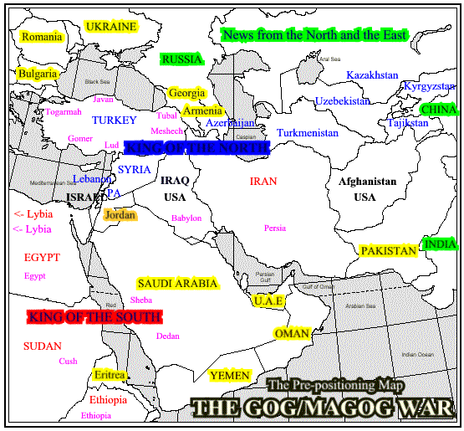
http://www.11th-hour.info/Articles/Gog_Maps.html

Slide 27
End Time Confederacies
Pentecost, “Things to Come” Chapter XIX
Last form of the Roman Empire led by the Antichrist [Dan 7:7-8]
  All countries in which there is any claim to apostate Christianity, P326.
Northern Confederacy [Ezek 38:2-6]
  Magog (Russia)
  Persia (Iran)
  Ethiopia (part of Arabia)
  Put (Libya - adjacent to Iran)
  Gomer (modern Germany)
  Togarmah (Turkey or Armenia)
Eastern Confederacy [Rev 16:12]
All countries east of the Euphrates – nations in Asia, P331.
Southern Confederacy [Dan 11:40]
Egypt, p332.
The Armies of Heaven led by Christ [Rev 19:11,14]

Slide 28
Beginning of the Armageddon Campaign
The person on the White Horse is the Antichrist who builds military power. He is not yet the world leader. He makes a “firm covenant” with Israel for 7 years.
As a result of his ambitions [and God’s plan], the Southern and Northern confederacies move against him by attacking Israel.
  In Ezekiel 38-39 Gog, prince of Magog, [Northern Confed.] will attack Israel and be defeated by God, resulting in recognition that God alone is sovereign.
  In Daniel 11:36-45 the same battle is described, including the Southern Confed.
God defeats the Northern confederacy
The Antichrist takes advantage of destruction of the Northern Confederacy by moving thru Israel and into Egypt [the Southern Confederacy].
Rumors of armies in the far north and east cause him to withdrawn back to Israel.
Libya and Ethiopia nip at his heels as he withdraws.
He occupies the Beautiful Land (Israel) and sets up headquarters in Jerusalem – then desecrates the temple & declares himself god. This is the mid-point of the 7 year tribulation period.

Slide 29
http://www.11th-hour.info/Articles/Gog_Maps.html

Slide 30
Other Verses & Notes
Ezekiel 38:10-12 'Thus says the Lord God, "It will come about on that day, that thoughts will come into your [Gog – Northern confederacy] mind, and you will devise an evil plan, ¹¹and you will say, 'I will go up against the land of unwalled villages. I will go against those who are at rest, that live securely, all of them living without walls, and having no bars or gates, ¹²to capture spoil and to seize plunder, to turn your hand against the waste places which are now inhabited, and against the people who are gathered from the nations, who have acquired cattle and goods, who live at the center of the world.'

Slide 31
http://www.11th-hour.info/Articles/Gog_Maps.html

Slide 32
Other Verses & Notes
Ezekiel 38:16 and you will come up against My people Israel like a cloud to cover the land. It shall come about in the last days that I will bring you against My land, so that the nations may know Me when I am sanctified through you before their eyes, O Gog."

Slide 33
Other Verses & Notes
Ezekiel 38:18-22 "And it will come about on that day, when Gog comes against the land of Israel," declares the Lord God, "that My fury will mount up in My anger. ¹⁹"And in My zeal and in My blazing wrath I declare that on that day there will surely be a great earthquake in the land of Israel. ²⁰"And the fish of the sea, the birds of the heavens, the beasts of the field, all the creeping things that creep on the earth, and all the men who are on the face of the earth will shake at My presence; the mountains also will be thrown down, the steep pathways will collapse, and every wall will fall to the ground. ²¹"And I shall call for a sword against him on all My mountains," declares the Lord God. "Every man's sword will be against his brother. ²²"And with pestilence and with blood I shall enter into judgment with him; and I shall rain on him, and on his troops, and on the many peoples who are with him, a torrential rain, with hailstones, fire, and brimstone.

Slide 34
http://www.11th-hour.info/Articles/Gog_Maps.html

Slide 35
Daniel 11:40-45 "And at the end time the king of the South will collide with him [the antichrist], and the king of the North will storm against him with chariots, with horsemen, and with many ships; and he will enter countries, overflow them, and pass through. ⁴¹"He will also enter the Beautiful Land, and many countries will fall; but these will be rescued out of his hand: Edom, Moab and the foremost of the sons of Ammon. [present Jordan] ⁴²"Then he will stretch out his hand against other countries, and the land of Egypt will not escape. ⁴³"But he will gain control over the hidden treasures of gold and silver, and over all the precious things of Egypt; and Libyans and Ethiopians will follow at his heels " ⁴⁴"But rumors from the East and from the North will disturb him, and he will go forth with great wrath to destroy and annihilate many. ⁴⁵And he will pitch the tents of his royal pavilion between the seas and the beautiful Holy Mountain; yet he will come to his end, and no one will help him.

Slide 36
http://www.11th-hour.info/Articles/Gog_Maps.html

Slide 37
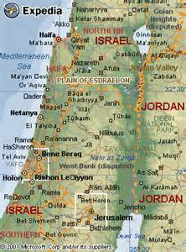

Slide 38
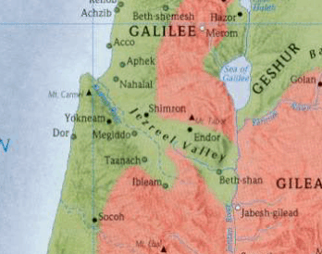

Slide 39
Other Verses & Notes
Daniel 12:1-2 "Now at that time Michael, the great prince who stands guard over the sons of your people, will arise. And there will be a time of distress such as never occurred since there was a nation until that time; and at that time your people, everyone who is found written in the book, will be rescued. ² "Many of those who sleep in the dust of the ground will awake, these to everlasting life, but the others to disgrace and everlasting contempt.

Slide 40
The Judgments
Beginning of birth pangs
The Lamb
opens the
seals.
1/3 Earth
God sends the
bowls out, full
of the wrath of God.
Sores
1/3 Sea
Sea to blood
1
White
2
Red
3
Black
4
Ashen
5
Martyrs
6
Signs
7
Wrath
1/3 Rivers
Rivers to blood
1/3 Heavens
Sun scorches
1st Woe, Locusts
Earth in darkness
compressed
2nd Woe, 1/3 Men Die
Euphrates dried
Angels sound
the trumpets.
3rd Woe, 7 Bowls
Earthquake, hail
Tribulation
Great Tribulation

Slide 41
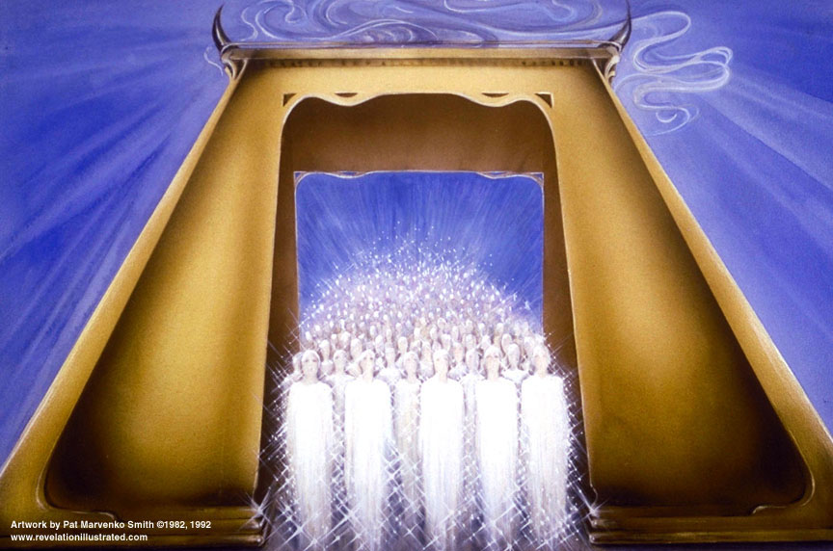

Slide 42
First - Ske-no’-o; from Greek 4633 (skene); to have one’s tent, dwell [used only in 5 verses in the New Testament as below]
Biblical principle of “dwelling”:
Leviticus 25:23 'The land, moreover, shall not be sold permanently, for the land is Mine; for you are but aliens and sojourners with Me.
There are two types of “dwelling” …that which is approved by God and that which is condemned. Likewise, there are two different Greek words to represent each; however they are both normally translated into some form of “to dwell”.
John 1:14 And the Word became flesh, and dwelt among us, and we beheld His glory, glory as of the only begotten from the Father, full of grace and truth.
Rev. 7:15 "For this reason, they are before the throne of God; and they serve Him day and night in His temple; and He who sits on the throne shall spread His tabernacle over them.
Rev. 12:12 "For this reason, rejoice, O heavens and you who dwell in them. Woe to the earth and the sea, because the devil has come down to you, having great wrath, knowing that he has only a short time."
Rev. 13:6 And he opened his mouth in blasphemies against God, to blaspheme His name and His tabernacle, that is, those who dwell in heaven.
Rev. 21:3 And I heard a loud voice from the throne, saying, "Behold, the tabernacle of God is among men, and He shall dwell among them, and they shall be His people, and God Himself shall be among them,

Slide 43
First - Ske-no’-o; from Greek 4633 (skene); to have one’s tent, dwell [used only in 5 verses in the New Testament as below]
Biblical principle of “dwelling”:
Leviticus 25:23 'The land, moreover, shall not be sold permanently, for the land is Mine; for you are but aliens and sojourners with Me.
There are two types of “dwelling” …that which is approved by God and that which is condemned. Likewise, there are two different Greek words to represent each; however they are both normally translated into some form of “to dwell”.
Ruth 1:16 But Ruth said, "Do not urge me to leave you or turn back from following you; for where you go, I will go, and where you lodge, I will lodge. Your people shall be my people, and your God, my God.
John 1:14 And the Word became flesh, and dwelt among us, and we beheld His glory, glory as of the only begotten from the Father, full of grace and truth.
Rev. 7:15 "For this reason, they are before the throne of God; and they serve Him day and night in His temple; and He who sits on the throne shall spread His tabernacle over them.
Rev. 12:12 "For this reason, rejoice, O heavens and you who dwell in them. Woe to the earth and the sea, because the devil has come down to you, having great wrath, knowing that he has only a short time."
Rev. 13:6 And he opened his mouth in blasphemies against God, to blaspheme His name and His tabernacle, that is, those who dwell in heaven.
Rev. 21:3 And I heard a loud voice from the throne, saying, "Behold, the tabernacle of God is among men, and He shall dwell among them, and they shall be His people, and God Himself shall be among them,

Slide 44
Second - Ka-toi-ke’-o; Greek 2596 (kata) and Greek 3611 (oikeo); to inhabit, to settle [used 40 times in the New Testament; see Rev instances below]
Rev. 3:10 'Because you have kept the word of My perseverance, I also will keep you from the hour of testing, that hour which is about to come upon the whole world, to test those who dwell upon the earth.
Rev. 6:10 and they cried out with a loud voice, saying, "How long, O Lord, holy and true, wilt Thou refrain from judging and avenging our blood on those who dwell on the earth?"
Rev. 8:13 And I looked, and I heard an eagle flying in midheaven, saying with a loud voice, "Woe, woe, woe, to those who dwell on the earth [KJV: inhabiters of], because of the remaining blasts of the trumpet of the three angels who are about to sound!"
Rev. 11:10 And those who dwell on the earth will rejoice over them and make merry; and they will send gifts to one another, because these two prophets tormented those who dwell on the earth.
Rev. 13:8 And all who dwell on the earth will worship him, everyone whose name has not been written from the foundation of the world in the book of life of the Lamb who has been slain.
Rev. 13:12 And he exercises all the authority of the first beast in his presence. And he makes the earth and those who dwell in it to worship the first beast, whose fatal wound was healed.
Rev. 13:14 And he deceives those who dwell on the earth because of the signs which it was given him to perform in the presence of the beast, telling those who dwell on the earth to make an image to the beast who had the wound of the sword and has come to life.
Rev. 17:2 with whom the kings of the earth committed acts of immorality, and those who dwell on the earth [KJV: inhabitants of] were made drunk with the wine of her immorality."
Rev. 17:8 "The beast that you saw was and is not, and is about to come up out of the abyss and to go to destruction. And those who dwell on the earth will wonder, whose name has not been written in the book of life from the foundation of the world, when they see the beast, that he was and is not and will come.

Slide 45
Second - Ka-toi-ke’-o; Greek 2596 (kata) and Greek 3611 (oikeo); to inhabit, to settle [used 40 times in the New Testament; see Rev instances below]
Rev. 3:10 'Because you have kept the word of My perseverance, I also will keep you from the hour of testing, that hour which is about to come upon the whole world, to test those who dwell upon the earth.
Rev. 6:10 and they cried out with a loud voice, saying, "How long, O Lord, holy and true, wilt Thou refrain from judging and avenging our blood on those who dwell on the earth?"
Rev. 8:13 And I looked, and I heard an eagle flying in midheaven, saying with a loud voice, "Woe, woe, woe, to those who dwell on the earth [KJV: inhabiters of], because of the remaining blasts of the trumpet of the three angels who are about to sound!"
Rev. 11:10 And those who dwell on the earth will rejoice over them and make merry; and they will send gifts to one another, because these two prophets tormented those who dwell on the earth.
Rev. 13:8 And all who dwell on the earth will worship him, everyone whose name has not been written from the foundation of the world in the book of life of the Lamb who has been slain.
Rev. 13:12 And he exercises all the authority of the first beast in his presence. And he makes the earth and those who dwell in it to worship the first beast, whose fatal wound was healed.
Rev. 13:14 And he deceives those who dwell on the earth because of the signs which it was given him to perform in the presence of the beast, telling those who dwell on the earth to make an image to the beast who had the wound of the sword and has come to life.
Rev. 17:2 with whom the kings of the earth committed acts of immorality, and those who dwell on the earth [KJV: inhabitants of] were made drunk with the wine of her immorality."
Rev. 17:8 "The beast that you saw was and is not, and is about to come up out of the abyss and to go to destruction. And those who dwell on the earth will wonder, whose name has not been written in the book of life from the foundation of the world, when they see the beast, that he was and is not and will come.
Genesis 19:26 But his [Lot’s] wife, from behind him, looked back, and she became a pillar of salt.

Slide 46
5th
⁹And when He broke the fifth seal, I saw underneath the altar the souls of those who had been slain because of the word of God, and because of the testimony which they had maintained; ¹⁰and they cried out with a loud voice, saying, "How long, O Lord, holy and true, wilt Thou refrain from judging and avenging our blood on those who dwell on the earth?" ¹¹And there was given to each of them a white robe; and they were told that they should rest for a little while longer, until the number of their fellow servants and their brethren who were to be killed even as they had been, should be completed also. | ⁹"Then they will deliver you to tribulation, and will kill you, and you will be hated by all nations on account of My name. ¹⁰"And at that time many will fall away and will deliver up one another and hate one another. ¹¹"And many false prophets will arise, and will mislead many. ¹²"And because lawlessness is increased, most people's love will grow cold. ¹³"But the one who endures to the end, he shall be saved. ¹⁴"And this gospel of the kingdom shall be preached in the whole world for a witness to all the nations, and then the end shall come.

Slide 47
¹²And I looked when He broke the sixth seal, and there was a great earthquake; and the sun became black as sackcloth made of hair, and the whole moon became like blood; ¹³and the stars of the sky fell to the earth, as a fig tree casts its unripe figs when shaken by a great wind. ¹⁴And the sky was split apart like a scroll when it is rolled up; and every mountain and island were moved out of their places. | ¹⁵"Therefore when you see the abomination of desolation which was spoken of through Daniel the prophet, standing in the holy place (let the reader understand), ¹⁶then let those who are in Judea flee to the mountains; ¹⁷let him who is on the housetop not go down to get the things out that are in his house; ¹⁸and let him who is in the field not turn back to get his cloak. ¹⁹"But woe to those who are with child and to those who nurse babes in those days! ²⁰"But pray that your flight may not be in the winter, or on a Sabbath; ²¹for then there will be a great tribulation, such as has not occurred since the beginning of the world until now, nor ever shall. ²⁹"But immediately after the tribulation of those days the sun will be darkened, and the moon will not give its light, and THE STARS WILL FALL from the sky, and the powers of the heavens will be shaken,
6th

Slide 48
J.V. McGee states:
The Great Tribulation begins and ends with these signs:
Joel 2:31 "The sun will be turned into darkness, And the moon into blood, Before the great and awesome day of the Lord comes.
Joel 3 – Armageddon

Slide 49
Stars of Revelation
Isaiah 14:12-15 "How you have fallen from heaven, O star of the morning, son of the dawn! You have been cut down to the earth, You who have weakened the nations! ¹³ "But you said in your heart, 'I will ascend to heaven; …' ¹⁵ "Nevertheless you will be thrust down to Sheol, To the recesses of the pit.
Revelation 12:9 And the great dragon was thrown down, the serpent of old who is called the devil and Satan, who deceives the whole world; he was thrown down to the earth, and his angels were thrown down with him.

Slide 50
6th
¹⁵And the kings of the earth and the great men and the commanders and the rich and the strong and every slave and free man, hid themselves in the caves and among the rocks of the mountains; ¹⁶and they said to the mountains and to the rocks, "Fall on us and hide us from the presence of Him who sits on the throne, and from the wrath of the Lamb; ¹⁷for the great day of their wrath has come; and who is able to stand?" | ³²"Now learn the parable from the fig tree: when its branch has already become tender, and puts forth its leaves, you know that summer is near; ³³even so you too, when you see all these things, recognize that He is near, right at the door. ³⁴"Truly I say to you, this generation will not pass away until all these things take place.

Slide 51
The Judgments
The Lamb
opens the
seals.
1/3 Earth
God sends the
bowls out, full
of the wrath of God.
Sores
1/3 Sea
Sea to blood
1
White
2
Red
3
Black
4
Ashen
5
Martyrs
6
Signs
7
Wrath
1/3 Rivers
Rivers to blood
1/3 Heavens
Sun scorches
1st Woe, Locusts
Earth in darkness
compressed
2nd Woe, 1/3 Men Die
Euphrates dried
Angels sound
the trumpets.
3rd Woe, 7 Bowls
Earthquake, hail
Tribulation
Great Tribulation

Slide 52
Timeline Review:
Apostasy of the church
The rise of a 10 nation confederacy (countries of Christendom?)
Rapture of the Church (true believers)
Judgment seat of Christ (Bema seat) ⎯ of the Church saints
Three of the 10 nations taken over by a strong ruler
Strong ruler ascends to lead the 7 nation confederacy
Treaty between the strong leader and Israel
The Tribulation begins
Scroll with 7 seals, Lion of Judah/Root of David/Lamb is the only one worthy to open it
6 seal judgments begin
Northern and Southern confederacies attack Israel, defeated by God
The Great Tribulation begins at 5th seal (Rev 6:12-17)
Abomination of Desolation
144,000 sons of Israel sealed as servants of the Lord
Great multitude of Gentiles standing before the Lamb

Slide 53
Chapter 7: 144,000 Sons of Israel sealed with a mark on their foreheads; multitude from all tribes and nations before the throne dressed in white.
Chapters 8 & 9:
7
Trumpets

Slide 55
End

Slide 56
The Revelation of Jesus Christ ⎯ Future Events
The Rapture of the Church
Apostasy of the church
Rapture of the Church
Judgment seat of Christ (Bema seat) ⎯ of the Church saints
Three of the 10 nations taken over by a strong ruler
Strong ruler ascends to lead the 7 nation confederacy
Treaty between the strong leader and Israel
The Tribulation begins
Scroll with 7 seals, Lion of Judah/Root of David/Lamb is the only one worthy to open it
6 seal judgments begin
Northern and Southern confederacies attack Israel, defeated by God. Antichrist establishes HQ at Jerusalem.
The Great Tribulation begins at 5th seal (Rev 6:12-17)
Abomination of Desolation
Wrath of the Lamb – Rev 6:16-17 (Day of the Lord)
Parenthetic 1 - 144,000 sons of Israel sealed as servants of the Lord
Parenthetic 1 - Great multitude of Gentiles standing before the Lamb
7th seal opened giving 7 trumpet judgments
Silence in heaven for ½ hour

Slide 57
Since this book is the last book of the Bible, the only requirement is to have a working knowledge of the sixty-five books which go before. Then you will find that this book makes a great deal of sense and is quite logical.
J. Vernon McGee.

