Slide 1
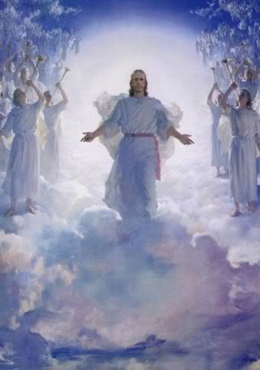
The Revelation of Jesus Christ
Lsn 3c of 22
Chapter 2 & 3 – Letter to the Church In Laodicea
Rev. 1:3 Blessed is he who reads and those who hear the words of the prophecy, and heed the things which are written in it; for the time is near.

Slide 2
Age: | Middle Ages (500-1500) | Reformation (1517- 1648) | Renaissance (1648-1789) |  | Revival (1789-1914) | Ideologies (1914-1996)
Church Letter to: | Thyatira “Continuing Sacrifice” | Sardis “Remnant” |  |  | Philadelphia “Brotherly Love” | Laodicea “Judgment of the people”
The Lord’s description/promise [Note: to Pergamum He said, 'Repent therefore; or else I am coming to you quickly, and I will make war against them with the sword of My mouth. | The Son of God, who has eyes like a flame of fire, and His feet are like burnished bronze 'Nevertheless what you have, hold fast until I come. | He who has the seven Spirits of God, and the seven stars, If therefore you will not wake up, I will come like a thief, and you will not know at what hour I will come upon you. |  |  | He who is holy, who is true, who has the key of David, who opens and no one will shut, and who shuts and no one opens Because you have kept the word of My perseverance, I also will keep you from the hour of testing, that hour which is about to come upon the whole world, … 'I am coming quickly; | The Amen, the faithful and true Witness, the Beginning of the creation of God I advise you to buy from Me gold and white garments, … 'Behold, I stand at the door and knock; if anyone hears My voice and opens the door, I will come in to him…
Question: | All of the below church and “world” views continue today.
1. How saved? | Gregory: grace + good works | Luther: grace alone, faith alone, Rom 1:17 “…the just shall live by faith…” Calvin: grace/faith, chosen | Positive view of man, not a sinner; common sense needed more than grace. “Membership” by formal assent to doctrinal views set forth by scholars |  | Evangelical view: 1. by grace, thru faith 2. New birth, “born again” 3. God’s love revealed in Jesus | - Salvation is not required
2. Source of authority? | Innocent III: Pope is Vicar of Christ | Luther: church, as justified by scripture Calvin: God is sovereign Tyndale: scripture to the masses | Reason: truth found thru senses, not revelation Modernism (liberalism), scriptures rejected in favor of learning thru experience |  | 4. devotion to Bible as only authority (Higher criticism challenges the Bible) | - Rational thought, science, experience
3. What is the Church? | An Institution: Sectarian Pope Leo III & Charles the Great (Charlemagne): Universal Catholic Church, Holy Roman Empire | Luther: universal church, hierarchy with Pope at head. Zwingli (Anabaptists): community of saints separate from government. | REASON The goal is a religiously neutral civilization Denominations emerge | AWAKENING Edmonds, Whitefield, Wesley: Evangelical awakening led to “volunteer” missions New World Puritans | - Body of Christ - Mission to world, from “nurturing to spreading” - July 1800 Gasper River camp meeting | - Universal ecumenical federation - Meet personal needs - Marketing to people’s needs [wants]
4. What is the Christian life? | Sacraments, baptism, confession, celebration of Mass …, indulgences, Crusades | Zwingli (Anabaptists): Confession, baptism, discipleship – daily walk with Christ Personal preparation for the return of Christ, and life in Heaven with Him | Moral conduct. Happiness and fulfillment in this life | Pietism emphasizes importance of regeneration. Moved back to personal faith and fellowship with Jesus Led to Puritans who lived it | - faith in deeds - millennialism returns, live expectantly - Public vs. Private Protestants - Fundamentals of the Faith: Inerrancy of Bible Deity of Jesus Virgin Birth Jesus’ physical resurrection Jesus’ physical return, 1000 yr reign | - Sacred and secular life separated - Being [experience] and doing are more important that belief - Social/political activism

Slide 3

Summary to date
Church | Letter | Parable | Age
Ephesus | Not tolerate evil men Test claim of being an apostle Left first love | Sower | 30-100 AD Apostolic church
Smyrna | Devil will test Be faithful unto death | Wheat & tares | 100-313 AD Persecuted church
Pergamum | Hold fast to name of Christ Tolerate unbelievers “you also have some” in error | Mustard seed | 313-500 AD Compromising church
Thyatira | Many works Tolerate false teachers “the rest ” faithful | Leaven | 500-1517 AD Corrupt church
Sardis | Name of alive, deeds incomplete You are dead “a few people” faithful | Hidden Treasure | 1517 – 1789 AD Alive/dead
Philadelphia | Little power, open door, will be kept from the hour of testing | Pearl of Great Price | 1789 – 1914 AD Faithful/Revival
Laodicea

Slide 4
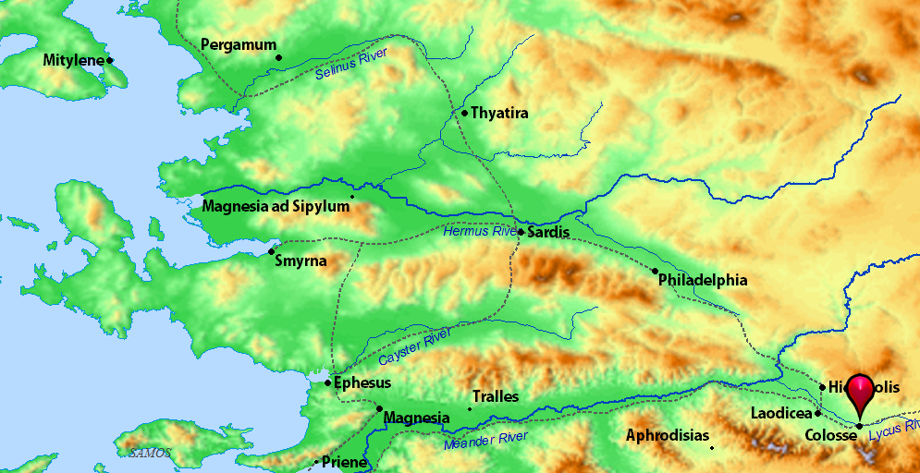

Slide 5
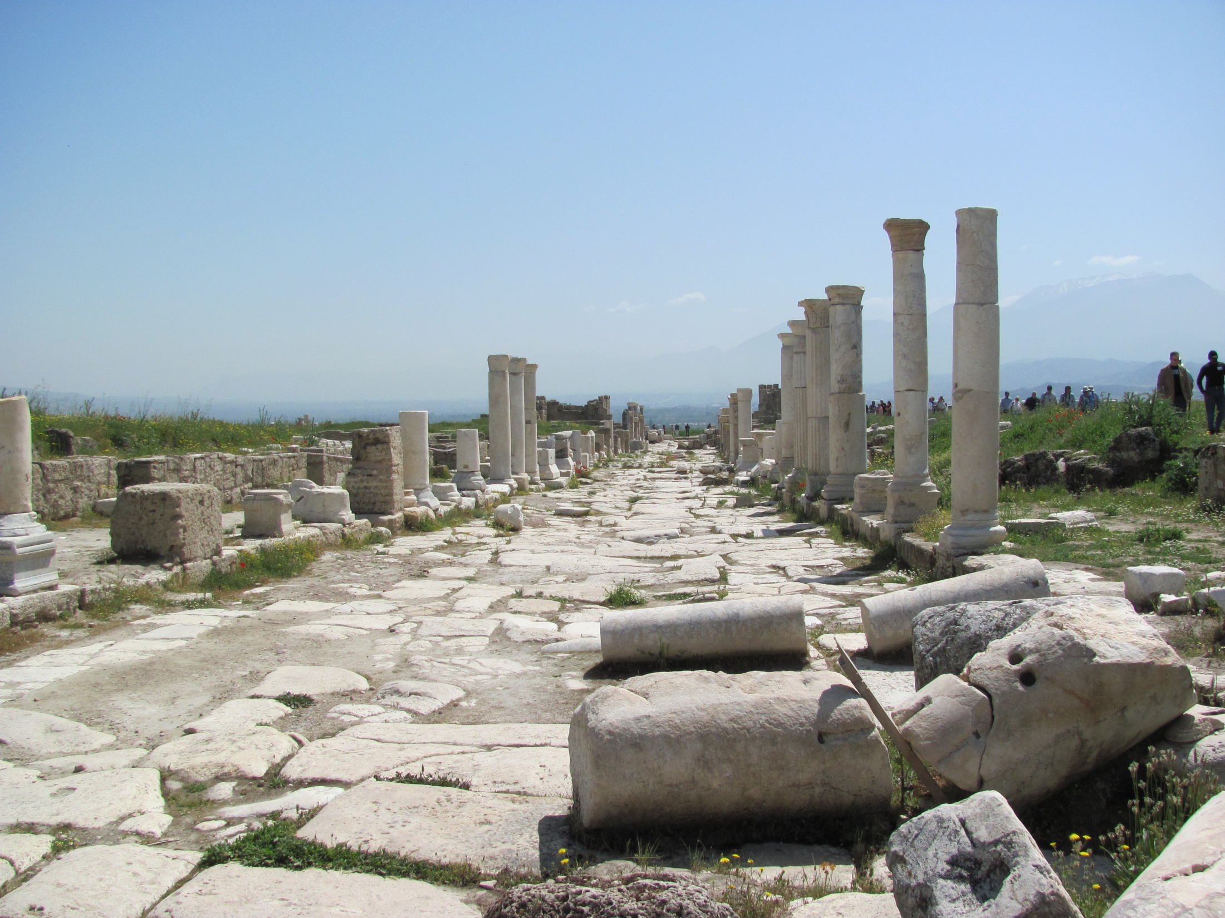
Laodicea
The Old Roman Road

Slide 6
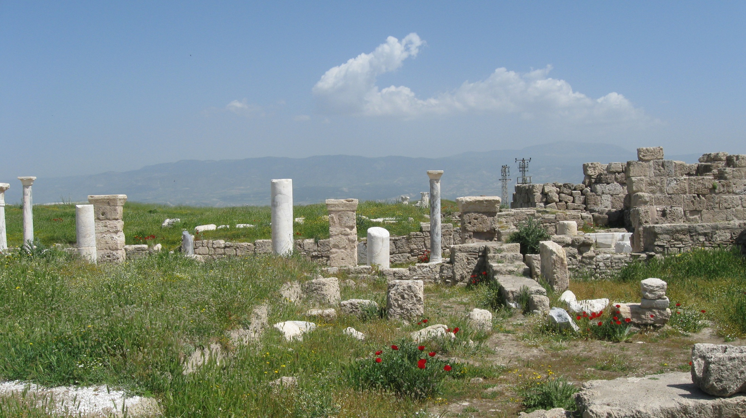
Laodicea

Slide 7
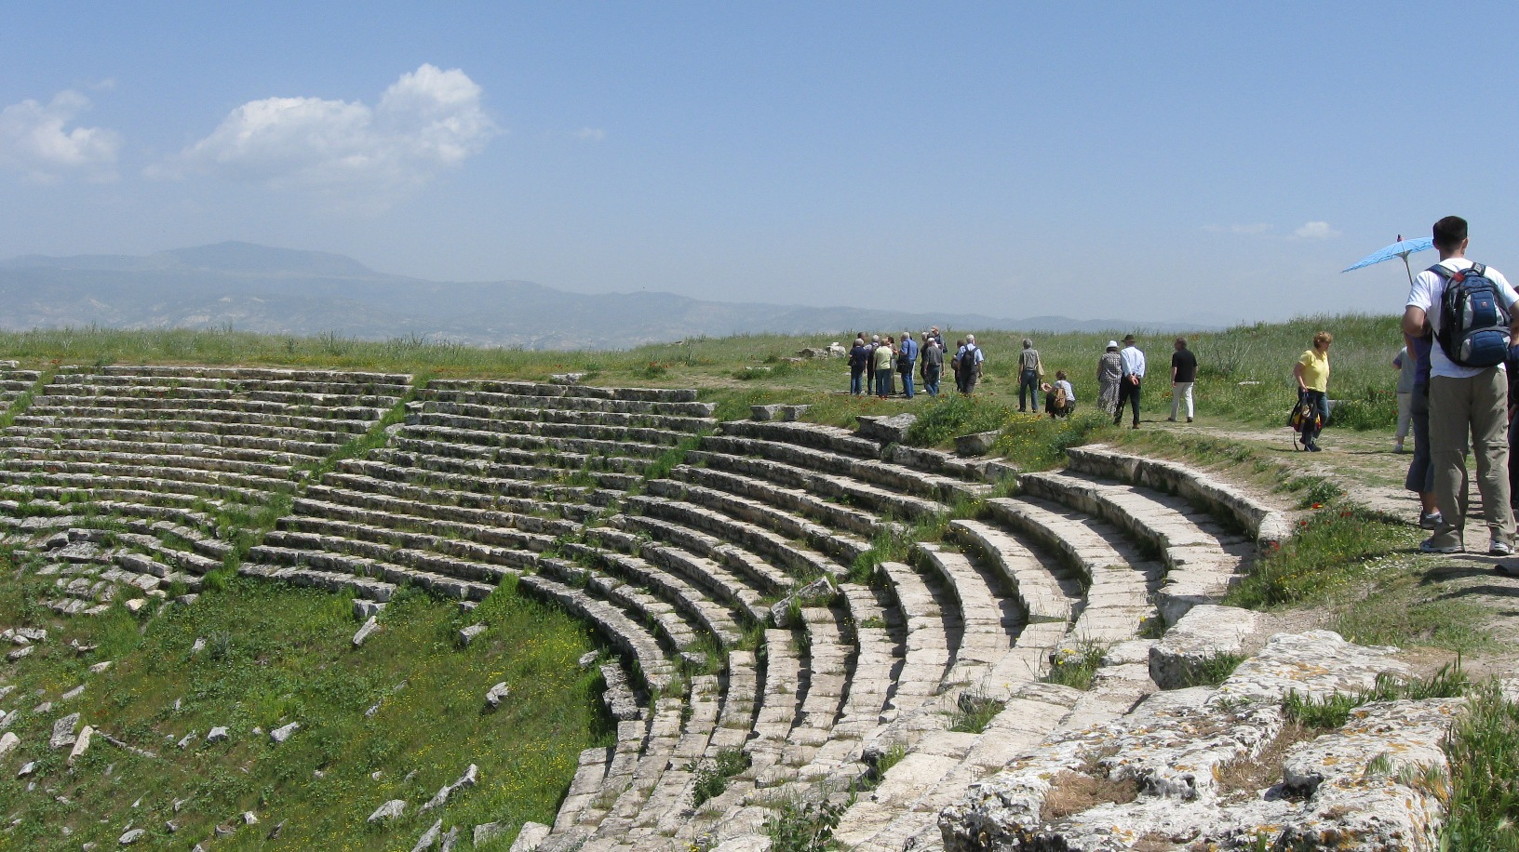
Laodicea – The Roman Theater

Slide 8
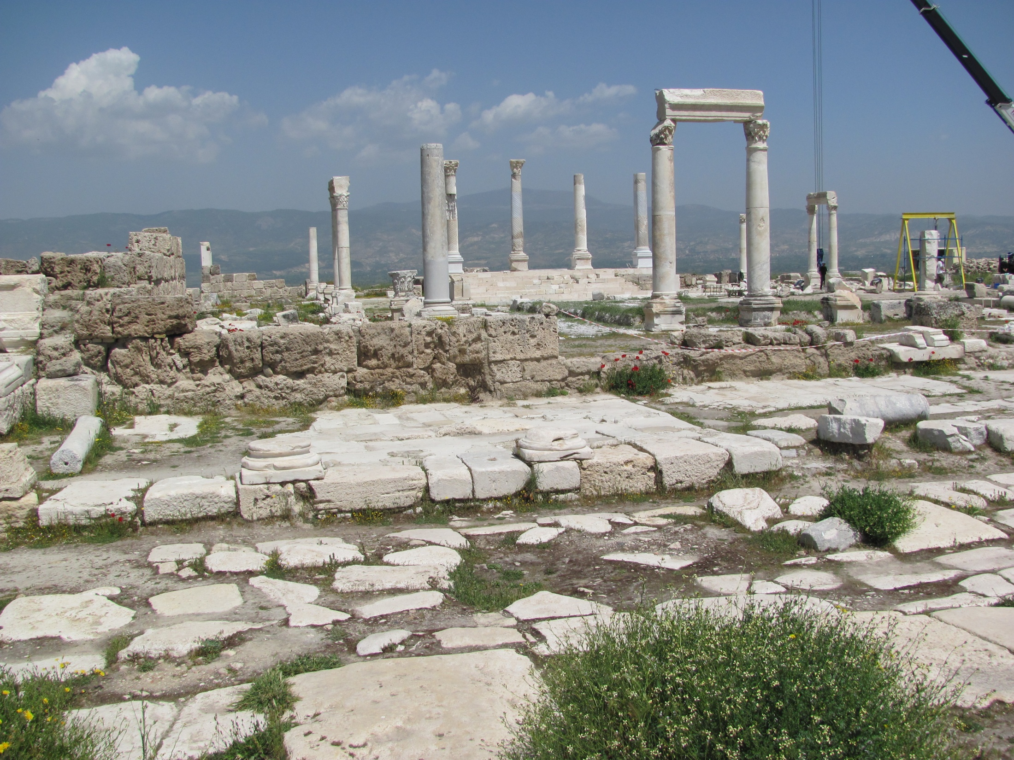
Laodicea

Slide 9
Laodicea
laos + dikê = “the people” + “expected behavior”
“Judgment of the people”; better -“people’s choice”
Most Wealthy: banks, black wool, medicine [eye salve]
Place of science and great literature
Tepid water from Denizli’s calcium rich warm springs
Toleration and allowance: heresy similar to that of Colossae (10 miles away) – “Christ a created being”
No good works and no good doctrine indicated
Temporal sufficiency had led to false comfort

Slide 10
Rev. 3:14-22 "And to the angel of the church in Laodicea write:
The Amen, the faithful and true Witness, the Beginning of the creation of God, says this: ¹⁵'I know your deeds, that you are neither cold nor hot; I would that you were cold or hot. ¹⁶'So because you are lukewarm, and neither hot nor cold, I will spit you out of My mouth. ¹⁷'Because you say, "I am rich, and have become wealthy, and have need of nothing," and you do not know that you are wretched and miserable and poor and blind and naked, ¹⁸I advise you to buy from Me gold refined by fire, that you may become rich, and white garments, that you may clothe yourself, and that the shame of your nakedness may not be revealed; and eye salve to anoint your eyes, that you may see. ¹⁹'Those whom I love, I reprove and discipline; be zealous therefore, and repent. ²⁰'Behold, I stand at the door and knock; if anyone hears My voice and opens the door, I will come in to him, and will dine with him, and he with Me. ²¹'He who overcomes, I will grant to him to sit down with Me on My throne, as I also overcame and sat down with My Father on His throne. ²²'He who has an ear, let him hear what the Spirit says to the churches.' "

Slide 11
Rev. 3:14-22 "And to the angel of the church in Laodicea write:
Colossians 4:16-17 When this letter is read among you, have it also read in the church of the Laodiceans; and you, for your part read my letter that is coming from Laodicea. ¹⁷ Say to Archippus, "Take heed to the ministry which you have received in the Lord, that you may fulfill it."
2 Corinthians 1:20 For as many as are the promises of God, in Him they are yes; therefore also through Him is our Amen to the glory of God through us.
The Amen, the faithful and true Witness, the Beginning of the creation of God, says this:
John 5:24 "Truly, truly, I say to you, he who hears My word, and believes Him who sent Me, has eternal life, and does not come into judgment, but has passed out of death into life.
John 18:37 Therefore Pilate said to Him, "So You are a king?" Jesus answered, "You say correctly that I am a king. For this I have been born, and for this I have come into the world, to testify to the truth. Everyone who is of the truth hears My voice."

Slide 12
Rev. 3:14-22 "And to the angel of the church in Laodicea write:
Lukewarm:
satisfied
complacent
neutral
self-centered
distracted
half-committed
half-hearted
lethargic
Indifferent
¹⁵'I know your deeds, that you are neither cold nor hot; I would that you were cold or hot. ¹⁶'So because you are lukewarm, and neither hot nor cold, I will spit you out of My mouth
self-sufficient
independent
self-centered
prideful
conceited
boastful
…

Slide 13
Rev. 3:14-22 "And to the angel of the church in Laodicea write:
¹⁷'Because you say, "I am rich, and have become wealthy, and have need of nothing," and you do not know that you are wretched and miserable and poor and blind and naked

Slide 14
Rev. 3:14-22 "And to the angel of the church in Laodicea write:
¹⁸I advise you to buy from Me gold refined by fire, that you may become rich, and white garments, that you may clothe yourself, and that the shame of your nakedness may not be revealed; and eye salve to anoint your eyes, that you may see.
Isaiah 55:1 "Ho! Every one who thirsts, come to the waters; And you who have no money come, buy and eat. Come, buy wine and milk Without money and without cost.

Slide 15
Rev. 3:14-22 "And to the angel of the church in Laodicea write:
¹⁹'Those whom I love, I reprove and discipline; be zealous therefore, and repent. ²⁰'Behold, I stand at the door and knock; if anyone hears My voice and opens the door, I will come in to him, and will dine with him, and he with Me

Slide 16
Rev. 3:14-22 "And to the angel of the church in Laodicea write:
²¹'He who overcomes, I will grant to him to sit down with Me on My throne, as I also overcame and sat down with My Father on His throne. ²²'He who has an ear, let him hear what the Spirit says to the churches.' "

Slide 17
Laodicea
Name Meaning
Images of Christ
Christ’s Title
Approval
Accusation
Admonition
Alternative
Praise to Overcomer
Church Period
Matt 13 Parable
“Judgment of the people”, wealthy; toleration and
allowance; no special works and no departure from correct
doctrine; temporal sufficiency led to false comfort
Amen, Faithful & true witness, Source of creation of God
Divine Lord
X
neither hot nor cold, lukewarm, ignorant of condition
buy from Me: gold, white garment, eye salve;
be zealous, repent, hear, open the door
spit out of mouth, reject
Jesus stands at door and knocks; if you hear & open, He will
come to you, dine with you, grant to sit on His throne
Universal, End-times, 1914 – Present, rich, complacent,
twentieth century western world
Dragnet at end of age

Slide 18
MacArthur on the Laodicean church…
This is the apostate church where Satan dwells. It isn't a church; it's a counterfeit. Revelation 3:15-16 says, "I know thy works, that thou art neither cold nor hot; I would thou wert cold or hot. So, then, because thou art lukewarm, and neither cold nor hot, I will spew thee out of My mouth." This is the church that sickens God. It is on its way to hell. It is a liberal church run by a cult that denies the true gospel. It is accursed and damned, but will thrive during the Tribulation.
With the exception of Smyrna and Philadelphia, the churches progressed from bad to worse. Ephesus was cold, but the last two were dead and apostate.

Slide 19
MacArthur on Laodicean members…
God forbid, but I imagine that there are Laodiceans in the church. They don't even know Jesus Christ; yet they come to church. They go through spiritual motions. But they are false believers. In the end they will say, "Lord, Lord. It's us." But He is going to say, "... I never knew you; depart from Me ..." (Mt. 7:23).

Slide 20
Ironside’s summary…
And so we have come down to the closing days of the present dispensation of grace. The Ephesus period passed away long ago, and the same is true of the Smyrna and Pergamos periods. Thyatira, which, as we have seen, speaks of Romanism, and began properly when the Pope was recognized as universal Bishop, is with us still, and will go on to the end. Sardis, which began centuries later, remains to the present time, and will remain till the Lord shall come. Philadelphia, thank God, is also here, and, though it has but a little strength, will also abide to the end. But Laodicea is more and more in evidence, and seems to be almost swamping everything that is of God.

Slide 21
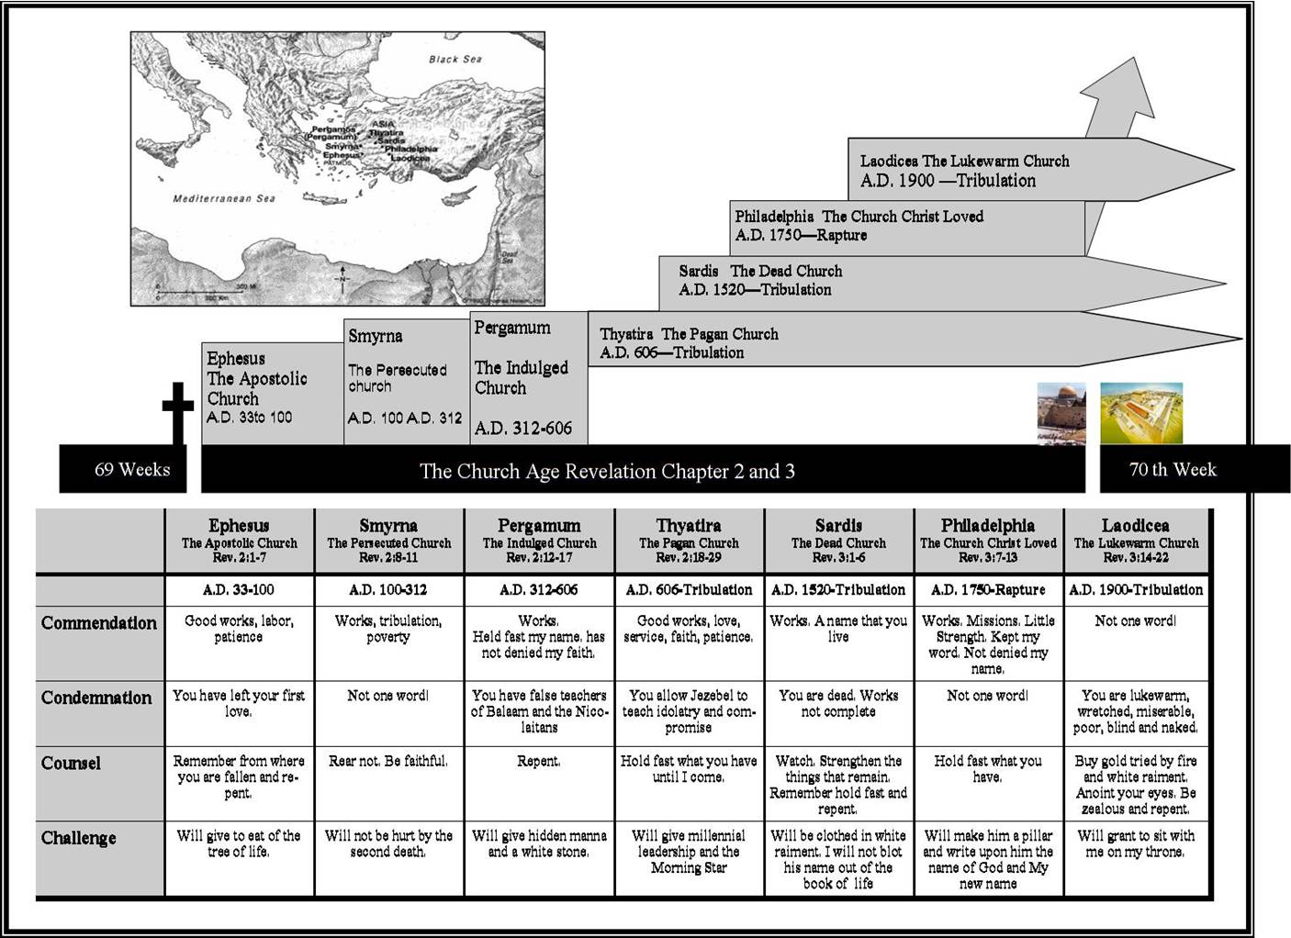
TruthNet.org
Rev. 4:1 After these things I looked, and behold, a door standing open in heaven, and the first voice which I had heard, like the sound of a trumpet speaking with me, said, "Come up here, and I will show you what must take place after these things.“

Slide 22
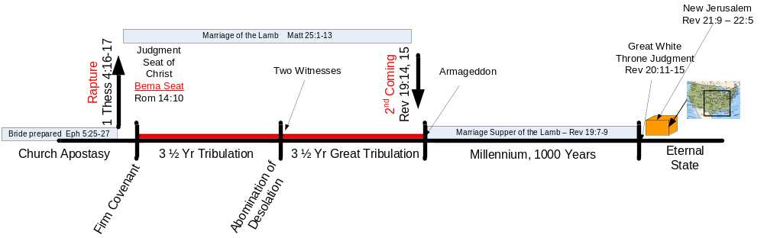
Revelation – Chap 4 to 22

Slide 23
Matt 13:47-50 “The Dragnet”
"Again, the kingdom of heaven is like a dragnet cast into the sea, and gathering fish of every kind; ⁴⁸and when it was filled, they drew it up on the beach; and they sat down, and gathered the good fish into containers, but the bad they threw away. ⁴⁹"So it will be at the end of the age; the angels shall come forth, and take out the wicked from among the righteous, ⁵⁰and will cast them into the furnace of fire; there shall be weeping and gnashing of teeth.”

Slide 24
Revelation – Chap 4 to 22

Slide 25
Matt 13:47-50 “The Dragnet” expanded
Matthew 24:37-41 “For the coming of the Son of Man will be just like the days of Noah…³⁹and they did not understand until the flood came and took them all away; so shall the coming of the Son of Man be. ⁴⁰"Then there shall be two men in the field; one will be taken, and one will be left. ⁴¹"Two women will be grinding at the mill; one will be taken, and one will be left.

Slide 26
Matt 13:47-50 “The Dragnet” expanded
Matthew 25:31-40 "But when the Son of Man comes in His glory, and all the angels with Him, then He will sit on His glorious throne. ³² "All the nations will be gathered before Him; and He will separate them from one another, as the shepherd separates the sheep from the goats; ³³ and He will put the sheep on His right, and the goats on the left. ³⁴ "Then the King will say to those on His right, 'Come, you who are blessed of My Father, inherit the kingdom prepared for you from the foundation of the world. ³⁵ 'For I was hungry, and you gave Me something to eat; I was thirsty, and you gave Me something to drink; I was a stranger, and you invited Me in; ³⁶ naked, and you clothed Me; I was sick, and you visited Me; I was in prison, and you came to Me.' ³⁷ "Then the righteous will answer Him, 'Lord, when did we see You hungry, and feed You, or thirsty, and give You something to drink? ³⁸ 'And when did we see You a stranger, and invite You in, or naked, and clothe You? ³⁹ 'When did we see You sick, or in prison, and come to You?' ⁴⁰ "The King will answer and say to them, 'Truly I say to you, to the extent that you did it to one of these brothers of Mine, even the least of them, you did it to Me.'

Slide 27
Summary to date
Church | Letter | Parable | Age
Ephesus | Not tolerate evil men Test claim of being an apostle Left first love | Sower | 30-100 AD Apostolic church
Smyrna | Devil will test Be faithful unto death | Wheat & tares | 100-313 AD Persecuted church
Pergamum | Hold fast to name of Christ Tolerate unbelievers “you also have some” in error | Mustard seed | 313-500 AD Compromising church
Thyatira | Many works Tolerate false teachers “the rest ” faithful | Leaven | 500-1517 AD Corrupt church
Sardis | Name of alive, deeds incomplete You are dead “a few people” faithful | Hidden Treasure | 1517 – 1789 AD Alive/dead
Philadelphia | Little power, open door, will be kept from the hour of testing | Pearl of Great Price | 1789 – 1914 AD Faithful/Revival
Laodicea | Lukewarm, wretched, miserable, poor, blind, naked – buy gold & white garments. Open the door. | Drag net | 1914 – end times Universal church

Slide 28
1914 – Present Universal Church
Fundamentals of the Faith published 1910 – 1915; 12 volumes by 64 authors (response to liberal theology)
  The inspiration and inerrancy of Scripture
  The deity of Jesus Christ
  The virgin birth of Christ
  The substitutionary, atoning work of Christ on the cross
  The physical resurrection and the personal bodily return of Christ to the earth
  And much more…
Post WW I Christendom turns secular; “post-Christian era”
Modernist movement blossomed in 1924
  Religion is evolving
  Man is improving thru science

Slide 29
1914 – Present Universal Church
Church goers seek not God but satisfaction of personal needs.
1948 - World Council of Churches (WCC) begins ecumenical movement to unite
  In late 1970s the WCC turned to social concerns → “social gospel”
Evangelism split between saving the lost or tackling problems in human affairs
Oil rich Middle East enables revival of Islam; world moves toward religious pluralism
1990s see increasing designation of “no religious preference” in the U.S.
Postmodernism: departure from modernist approaches that had previously been dominant, rejection of objective truth
Pluralistic society demands cooperation, not conversion; market driven growth; religious activities focus on popular tastes
Churches must decide to either accommodate to the world or stand fast. Most choose “in between” → LUKEWARM

Slide 30
  The Letter to Laodicea http://www.biblebb.com/files/mac/sg1444.htm
Application — Letter to the church universal
Application — Instruction to “professsing” believers
^{Remind those who only profess…}
¹⁸I advise you to buy from Me gold refined by fire, that you may become rich, and white garments, that you may clothe yourself, and that the shame of your nakedness may not be revealed; and eye salve to anoint your eyes, that you may see.
There is lots of work, much fleshly energy and human effort being put forth to reclaim the world, and make it a comfortable place for men to live in, apart from Christ; but the great things of God's truth are largely neglected, and myriads of so-called church-workers are utter strangers to the new birth, without which no one can see the Kingdom of God. (Ironside)
²⁰'Behold, I stand at the door and knock; if anyone hears My voice and opens the door, I will come in to him, and will dine with him, and he with Me.

Slide 31
George Barna’s research…
shows that "about four out of every ten adults strongly concurred that when Christians, Jews, Buddhists, and others pray to their god, all of those individuals are actually praying to the same god, but simply use different names for that deity. Only one out of every six adults strongly disagreed with this view.

Slide 32
The Progressive Church-1 http://groups.yahoo.com/group/progressive_theology/
The inscription on the cathedral in
L’beck, Germany, is still true:
Thus speaketh Christ our Lord to us:
Ye call Me Master and obey Me not.
Ye call Me Light and see Me not.
Ye call Me Way and walk Me not.
Ye call Me Life and choose Me not.
Ye call Me Wise and follow Me not.
Ye call Me Fair and love Me not.
Ye call Me Rich and ask Me not.
Ye call Me Eternal and seek Me not.
Ye call Me Noble and serve Me not.
Ye call Me Gracious and trust Me not.
Ye call Me Might and honor Me not.
Ye call Me Just and fear Me not.
If I condemn you, blame Me not.
This is the church in Laodicea
Thru The Bible with J. Vernon McGee
This is the church that Stanley High spoke of when he said:
The church has failed to tell me that I am a sinner. The church has failed to deal with me as a lost individual. The church has failed to offer me salvation in Jesus Christ alone. The church has failed to tell me of the horrible consequences of sin, the certainty of hell, and the fact that Jesus Christ alone can save. We need more of the last judgment and less of the Golden Rule, more of the living God and the living devil as well, more of a heaven to gain and a hell to shun. The church must bring me not a message of cultivation but of rebirth. I might fail that kind of church, but that kind of church will not fail me.
Thru The Bible with J. Vernon McGee
If you've been frustrated with literal fundamentalism or find yourself in the "church alumni association" and want to reconnect to the Christian path of a God of love and grace, this group is for you.
A progressive Christian will agree with many of the following ideas:
Inevitability of human progress
Universal salvation
Equality of religions (religious pluralism)
Primacy of personal experience
Rejection of literal biblical interpretations
Emphasis on the humanity of Christ
Rights of individuals
Emphasis on peace and justice
Indifference to strict doctrine
God is immanent (present in and around all things) [pantheism]
Traditional forms of theism are optional

Slide 33

You may be “emergent” if…
DeYoung & Kluck, p. 21
DeYoung & Kluck present the emergent position, while preferring orthodox beliefs.
You love the Bible as a beautiful, inspiring collection of works that leads us into the mystery of God but is not inerrant
You search for truth but aren’t sure it can be found
You believe following Jesus is not believing the right things but living the right way
You believe doctrine gets in the way of an interactive relationship with Jesus
You believe who goes to hell is no one’s business and may be empty anyway
You believe salvation has little to do with atoning for guilt and a lot to do with bringing creation back into shalom with its Maker
It bugs you when people talk about going to heaven instead of bringing heaven to earth
You talk about the myth of “redemptive violence” and the myth of certainty

Slide 34
TruthNet.org

Slide 35
Review Handout Charts 1&2
Chart 1: Revelation 2 & 3 — Letters to the Seven Churches
Chart 2: “Churches” That Continue Since Their Original Church Age

Slide 36
Church | Ephesus 2:1-7 | Smyrna 2:8-11 | Pergamum 2:12-17 | Thyatira 2:18-29 |  | Sardis 3:1-6 | Philadelphia 3:7-13 | Laodicea 3:14-22
Name – Heathens Vs. Christendom Vs. Christians | “Desirable” Paul ministered; Acts 19 silversmiths; Timothy; John; Nicolaitans hated Ephes. 1: 2 Tim. 4: | “Myrrh – bitter” Beautiful, wicked city; gospel opposed by pagans, Jews, Satan; abject poverty; Roman guilds; Caesar worship; Polycarp martyred 155 AD | “Additional marriage” wealthy; many temples; Satan’s throne; civic & religious life entwined; heathen feasts; Nicolaitans accepted, doctrine of Balaam accepted, Christianity popular | “Continuing sacrifice” small and obscure, Acts 16 Lydia converted; Baal worship (Jezebel); pagan doctrines accepted; local church likely led by woman Gone by 200 AD |  | “Remnant” wealthy; on trade routes; many different pagan cults; gross depravity in worship of mother goddess Cybele; letter starts with condemnation; | “Brotherly love” agricultural; in center of heathen world | “The People Choose” wealthy; toleration and allowance; no special works; temporal sufficiency led to false comfort
Images of Christ | - 7 stars, sovereign - 7 Lampstands | - First & Last -dead, now alive | - 2 edged sword | - Son of God - eyes like flame of fire - feet like bronze - searches mind and heart |  | - 7 Spirits - 7 stars | - Holy - True - Key of David - authority to open and shut | - Amen - Faithful & true witness - Source of creation of God
Christ’s Title | Sovereign Lord | Risen Lord | Warring Lord | Judging Lord |  | Omniscient Lord | Authoritative Lord | Divine Lord
Approval | - deeds, toil, perseverance - test - endurance for His name - hate diluters (Nicolaitans) | - tribulation -abject poverty - blasphemy | - Satan’s throne - hold fast My Name - not deny My faith - martyr days | - knows love, faith, service, perseverance - growing deeds |  | X | - deeds - little power - kept word - not denied His name - persevered | X
Accusation | - left 1st love reason for deeds is important defect of heart clergy vs. laity | X | - teaching of Balaam idol worship immorality teaching of Nicolaitans guilds compromise | - tolerate Jezebel immoral idol worship 1 Kings 21:25-26 Jer 44:17,18,25 |  | - dead - incomplete deeds | X | - neither hot nor cold - lukewarm - ignorant of condition
Admonition | - remember - repent - restore 1st deeds | - not fear suffering - be faithful until death | - repent | Christendom - repent | Christians - hold fast until I come | - wake up - strengthen remaining - remember - keep - repent | - I am coming quickly, hold fast [continue your current deeds!!] | - buy from Me: gold, white garment, eye salve - be zealous, repent, hear, open the door
Alternative | - removal of light lose effectiveness | X | - or I am coming quickly - war with sword | - sickness & tribulation - pestilence - judgment | - no other burden | - come like a thief | X | - spit out of mouth, reject
Praise to Overcomer | - eat of tree of life all true believers | - crown of life, Jas 1:12 and 1 Cor 9:25 - not hurt by 2nd death | - hidden manna - white stone - new name | - authority over nations - He will give him the morning star, Rev 22:16 |  | - a few righteous - will walk with Me in white - not erase name from Book of Life - confess name before Father and angels | - unbelievers will bow - kept from hour of testing coming on entire world! - pillar in temple - receive name of God, new Jerusalem, & new name | - Jesus stands at door & knocks - If you hear & open, He will come & dine with you - grant to sit on His throne
Church Period? | Apostolic 30-100 AD increasing doctrine, cooling love | Persecuted 100-313 AD suffering, seeds of evil enter | Compromising 313-500 AD Constantine, state church, pagan practices, spiritual compromise | Corrupted 500-1500 AD Dark Ages, inquisition, Mary elevated, works |  | Dead ⎯ Reformed 1500-1789 AD “protesters”; Guttenberg press, enlightenment, denominations, doctrines | Faithful ⎯ Revival 1789-Rapture missionary growth | Universal End-times rich, complacent, twentieth century western world
Matt 13 Parable | Sower and soils Seed = The Gospel Good Soil = Believer | Tares sowed, left ‘til harvest Sower is Son of Man Good seed = Sons of God Tares = Sons of Satan | Mustard seed, birds of air nest in tree Tree = church Birds = false doctrines | Leaven, all becomes leavened Meal = church Leaven = false doctrine |  | Hidden treasure, buy the field Field = world Treasure = Israel | Pearl of great value Merchant = Christ Pearl = Church | Dragnet at end of age Dragnet = angels Sea = world Good fish = believers

Slide 37
Age: | Middle Ages (500-1500) | Reformation (1517- 1648) | Renaissance (1648-1789) |  | Revival (1789-1914) | Ideologies (1914-1996)
Church Letter to: | Thyatira “Continuing Sacrifice” | Sardis “Remnant” |  |  | Philadelphia “Brotherly Love” | Laodicea “Choice of the people”
The Lord’s description/promise [Note: to Pergamum He said, 'Repent therefore; or else I am coming to you quickly, and I will make war against them with the sword of My mouth. | The Son of God, who has eyes like a flame of fire, and His feet are like burnished bronze 'Nevertheless what you have, hold fast until I come. | He who has the seven Spirits of God, and the seven stars, If therefore you will not wake up, I will come like a thief, and you will not know at what hour I will come upon you. |  |  | He who is holy, who is true, who has the key of David, who opens and no one will shut, and who shuts and no one opens Because you have kept the word of My perseverance, I also will keep you from the hour of testing, that hour which is about to come upon the whole world, … 'I am coming quickly; | The Amen, the faithful and true Witness, the Beginning of the creation of God I advise you to buy from Me gold and white garments, … 'Behold, I stand at the door and knock; if anyone hears My voice and opens the door, I will come in to him…
Question: | All of the below church and “world” views continue today.
1. How saved? | Gregory: grace + good works | Luther: grace alone, faith alone, Rom 1:17 “…the just shall live by faith…” Calvin: grace/faith, chosen | Positive view of man, not a sinner; common sense needed more than grace. “Membership” by formal assent to doctrinal views set forth by scholars |  | Evangelical view: 1. faith 2. new birth, “born again” 3. God’s love revealed in Jesus | - Salvation is not required
2. Source of authority? | Innocent III: Pope is Vicar of Christ | Luther: church, as justified by scripture Calvin: God is sovereign Tyndale: scripture to the masses | Reason: truth found thru senses, not revelation Modernism (liberalism), scriptures rejected in favor of learning thru experience |  | 4. devotion to Bible as only authority (Higher criticism challenges the Bible) | - Rational thought, science, experience
3. What is the Church? | An Institution: Sectarian Pope Leo III & Charles the Great (Charlemagne): Universal Catholic Church, Holy Roman Empire | Luther: universal church, hierarchy with Pope at head. Zwingli (Anabaptists): community of saints separate from government. | REASON The goal is a religiously neutral civilization Denominations emerge | AWAKENING Edmonds, Whitefield, Wesley: Evangelical awakening led to “volunteer” missions New World Puritans | - Body of Christ - Mission to world, from “nurturing to spreading” - July 1800 Gasper River camp meeting | - Universal ecumenical federation - Meet personal needs - Marketing to people’s needs [wants]
4. What is the Christian life? | Sacraments, baptism, confession, celebration of Mass …, indulgences, Crusades | Zwingli (Anabaptists): Confession, baptism, discipleship – daily walk with Christ Personal preparation for the return of Christ, and life in Heaven with Him | Moral conduct. Happiness and fulfillment in this life | Pietism emphasizes importance of regeneration. Moved back to personal faith and fellowship with Jesus Led to Puritans who lived it | - faith in deeds - millennialism returns, live expectantly - Public vs. Private Protestants - Fundamentals of the Faith: Inerrancy of Bible Deity of Jesus Virgin Birth Jesus’ physical resurrection Jesus’ physical return, 1000 yr reign | - Sacred and secular life separated - Being [experience] and doing are more important that belief - Social/political activism

Slide 38
The Seven Churches
Well in our day, all seven of these churches are represented. And each of them poses its own challenge. There are pure churches like Smyrna and Philadelphia. There are churches that have left their first love and need the fire of devotion back. There are churches like Pergamos that have tolerated sin and won't deal with it. They are beginning to escalate and to grow in our day...they don't want to deal with sin. They don't want to confront iniquity. There are churches like Thyatira that are in full-blown compromise with the world. There are churches like Sardis that are mostly dead and only a few believers left. And there are the apostate churches. But in every case, the Lord says to these churches with all their defects, "Please repent, please take the steps necessary to make it right.“
John MacArthur

Slide 39
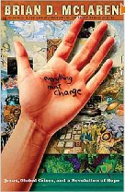
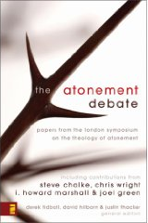
The Progressive Church-2
Brian McLaren , emergent leader…
  Interviewer: Could you elaborate on your personal theory of atonement, “If God wanted to forgive us, why didn’t he just forgive us? Why did torturing Jesus make things better?”
  McLaren, “This is such an important and difficult question. I’d recommend, for starters, you read ‘Recovering the Scandal of the Cross’ (by Baker and Green). There will be a sequel to this book in the next year or so, and I’ve contributed a chapter to it.” http://www.brianmclaren.net/archives/2004/05/theory_of_atonement_41.html

Slide 40
End

