Slide 1

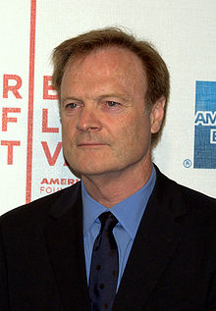
Sign of the Times
Psalm 14:1 The fool has said in his heart, "There is no God." They are corrupt, they have committed abominable deeds; There is no one who does good.
MSNBC host Lawrence O'Donnell said that "The Book of Revelation is a work of fiction describing how a truly vicious God would bring about the end of the world. No half-smart religious person actually believes the Book of Revelation.“ Mar 18, 2011

Slide 2
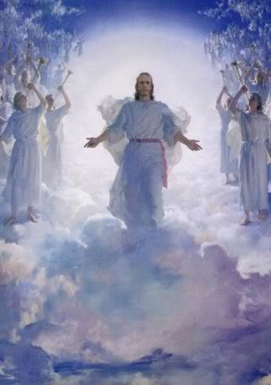
The Revelation of Jesus Christ
Lsn 2&3 of 22
Chapter 2 & 3 – Letter to the Church In Philadelphia
Rev. 1:3 Blessed is he who reads and those who hear the words of the prophecy, and heed the things which are written in it; for the time is near.

Slide 3
Age: | Middle Ages (500-1500) | Reformation (1517- 1648) | Renaissance (1648-1789) |  | Revival (1789-1914) | Ideologies (1914-1996)
Church Letter to: | Thyatira “Continuing Sacrifice” | Sardis “Remnant” |  |  | Philadelphia “Brotherly Love” | Laodicea “Judgment of the people”
The Lord’s description/promise [Note: to Pergamum He said, 'Repent therefore; or else I am coming to you quickly, and I will make war against them with the sword of My mouth. | The Son of God, who has eyes like a flame of fire, and His feet are like burnished bronze 'Nevertheless what you have, hold fast until I come. | He who has the seven Spirits of God, and the seven stars, If therefore you will not wake up, I will come like a thief, and you will not know at what hour I will come upon you. |  |  | He who is holy, who is true, who has the key of David, who opens and no one will shut, and who shuts and no one opens Because you have kept the word of My perseverance, I also will keep you from the hour of testing, that hour which is about to come upon the whole world, … 'I am coming quickly; | The Amen, the faithful and true Witness, the Beginning of the creation of God I advise you to buy from Me gold and white garments, … 'Behold, I stand at the door and knock; if anyone hears My voice and opens the door, I will come in to him…
Question: | All of the below church and “world” views continue today.
1. How saved? | Gregory: grace + good works | Luther: faith alone, Rom 1:17 “…the just shall live by faith…” Calvin: grace/faith, chosen | Positive view of man, not a sinner; common sense needed more than grace. “Membership” by formal assent to doctrinal views set forth by scholars |  | Evangelical view: 1. faith 2. new birth, “born again” 3. God’s love revealed in Jesus | - Salvation is not required
2. Source of authority? | Innocent III: Pope is Vicar of Christ | Luther: church, as justified by scripture Calvin: God is sovereign Tyndale: scripture to the masses | Reason: truth found thru senses, not revelation Modernism (liberalism), scriptures rejected in favor of learning thru experience |  | 4. devotion to Bible as only authority (Higher criticism challenges the Bible) | - Rational thought, science, experience
3. What is the Church? | An Institution: Sectarian Pope Leo III & Charles the Great (Charlemagne): Universal Catholic Church, Holy Roman Empire | Luther: universal church, hierarchy with Pope at head. Zwingli (Anabaptists): community of saints separate from government. | REASON The goal is a religiously neutral civilization Denominations emerge | AWAKENING Edmonds, Whitefield, Wesley: Evangelical awakening led to “volunteer” missions New World Puritans | - Body of Christ - Mission to world, from “nurturing to spreading” - July 1800 Gasper River camp meeting | - Universal ecumenical federation - Meet personal needs - Marketing to people’s needs [wants]
4. What is the Christian life? | Sacraments, baptism, confession, celebration of Mass …, indulgences, Crusades | Zwingli (Anabaptists): Confession, baptism, discipleship – daily walk with Christ Personal preparation for the return of Christ, and life in Heaven with Him | Moral conduct. Happiness and fulfillment in this life | Pietism emphasizes importance of regeneration. Moved back to personal faith and fellowship with Jesus Led to Puritans who lived it | - faith in deeds - millennialism returns, live expectantly - Public vs. Private Protestants - Fundamentals of the Faith: Inerrancy of Bible Deity of Jesus Virgin Birth Jesus’ physical resurrection Jesus’ physical return, 1000 yr reign | - Sacred and secular life separated - Being [experience] and doing are more important that belief - Social/political activism

Slide 4
Summary to date
Church | Letter | Parable | Age
Ephesus desirable | Not tolerate evil men Test claim of being an apostle Left first love | Sower | 30-100 AD Apostolic church
Smyrna bitter, fragrant | Devil will test Be faithful unto death | Wheat & tares | 100-313 AD Persecuted church
Pergamum additional marriage | Hold fast to name of Christ Tolerate unbelievers “you also have some” in error | Mustard seed | 313-500 AD Compromising church
Thyatira unwearied sacrifice | Many works Tolerate false teachers “the rest ” faithful | Leaven | 500-1517 AD Corrupt church
Sardis remnant | Name of alive, deeds incomplete You are dead “a few people” faithful | Hidden Treasure | 1517 – 1789 Name alive, but dead
Philadelphia
Laodicea

Slide 5
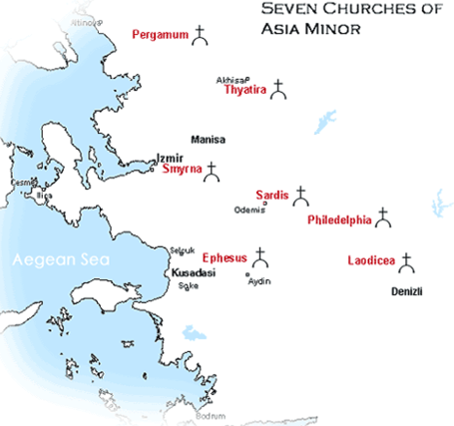

Slide 6
Philadelphia
Established in 189 BC by Attalus II, Greek King of Pergamon. He loved his brother Eumenes so much he was called Attalus Philadelphus (brotherly love). The city received his nick name.
In the center of barbarian world leading to the Orient.
Intention was that it might be a missionary city of Greek culture and language to Lydia and Phrygia
Earthquake in 17 AD destroyed Sardis, almost weekly tremors in Philadelphia for years – people would flee the city.
Byzantine church ruins, ~1200 AD

Slide 7
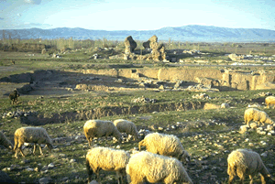
Philadelphia

Slide 8
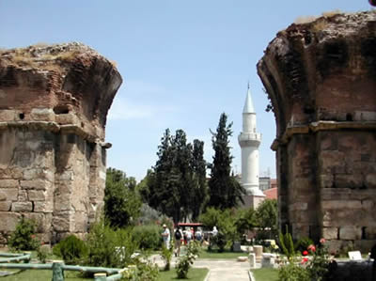

Slide 9
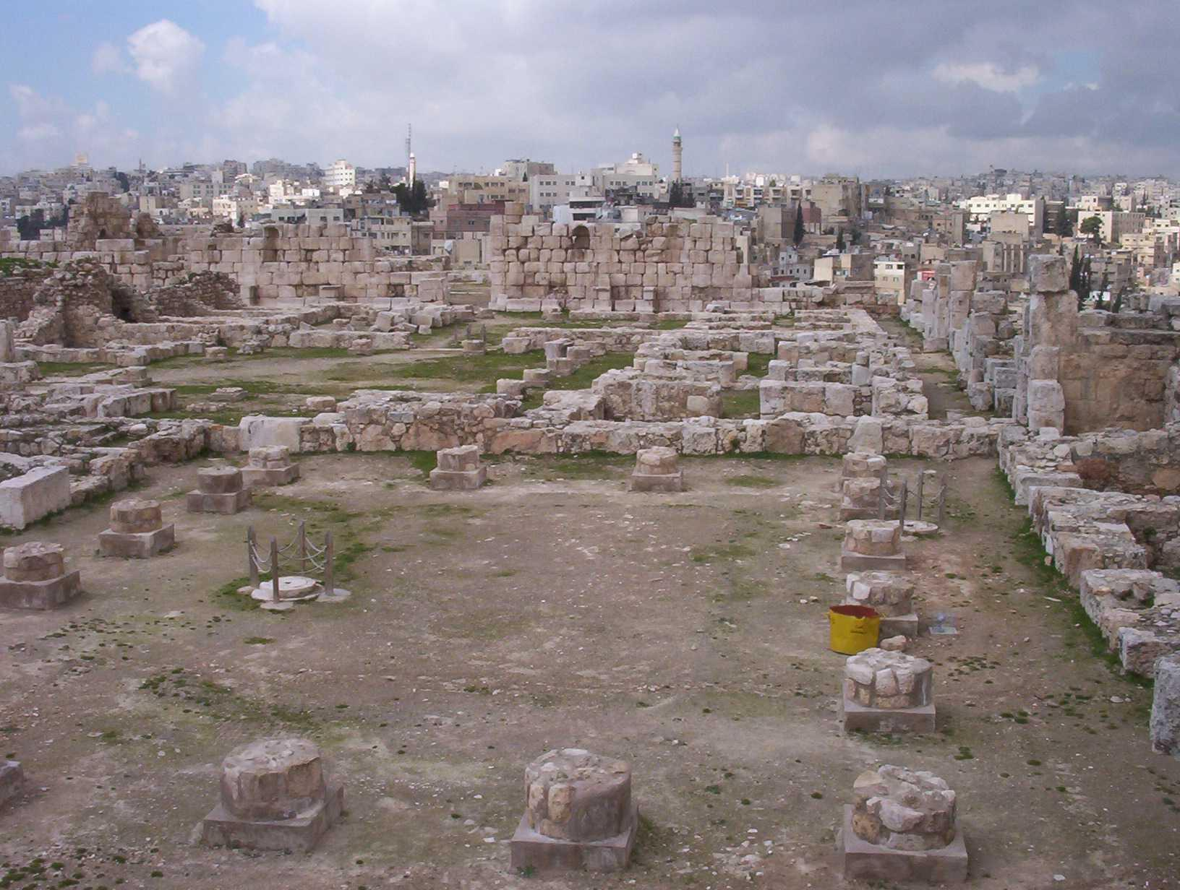

Slide 10
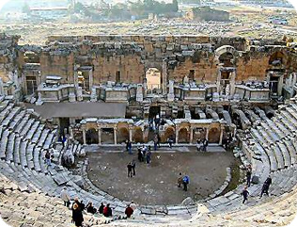

Slide 11
Rev. 3:7-13 "And to the angel of the church in Philadelphia write:
He who is holy, who is true, who has the key of David, who opens and no one will shut, and who shuts and no one opens, says this: ⁸'I know your deeds. Behold, I have put before you an open door which no one can shut, because you have a little power, and have kept My word, and have not denied My name. ⁹'Behold, I will cause those of the synagogue of Satan, who say that they are Jews, and are not, but lie-- behold, I will make them to come and bow down at your feet, and to know that I have loved you. ¹⁰'Because you have kept the word of My perseverance, I also will keep you
from the hour of testing, that hour which is about to come upon the whole world, to test those who dwell upon the earth. ¹¹'I am coming quickly; hold fast what you have, in order that no one take your crown. ¹²'He who overcomes, I will make him a pillar in the temple of My God, and he will not go out from it anymore; and I will write upon him the name of My God, and the name of the city of My God, the new Jerusalem, which comes down out of heaven from My God, and My new name. ¹³'He who has an ear, let him hear what the Spirit says to the churches.'

Slide 12
Rev. 3:7-13 "And to the angel of the church in Philadelphia write:
He who is holy, who is true, who has the key of David, who opens and no one will shut, and who shuts and no one opens, says this:
churches.'
Isaiah 6:3 And one called out to another and said, "Holy, Holy, Holy, is the LORD of hosts, The whole earth is full of His glory.“
John 1:9 There was the true Light which, coming into the world, enlightens every man.
Isaiah 22:22 "Then I will set the key of the house of David on his shoulder, When he opens no one will shut, When he shuts no one will open

Slide 13
Rev. 3:7-13 "And to the angel of the church in Philadelphia write:
⁸'I know your deeds. Behold, I have put before you an open door which no one can shut, because you have a little power, and have kept My word, and have not denied My name.
Acts 14:27 When they had arrived and gathered the church together, they began to report all things that God had done with them and how He had opened a door of faith to the Gentiles.
John 6:68 Simon Peter answered Him, "Lord, to whom shall we go? You have words of eternal life.
Revelation 2:13 'I know where you dwell, where Satan's throne is; and you hold fast My name, and did not deny My faith …

Slide 14
Rev. 3:7-13 "And to the angel of the church in Philadelphia write:
⁹'Behold, I will cause those of the synagogue of Satan, who say that they are Jews, and are not, but lie-- behold, I will make them to come and bow down at your feet, and to know that I have loved you.
Isaiah 49:23 "Kings will be your guardians, And their princesses your nurses. They will bow down to you with their faces to the earth And lick the dust of your feet; And you will know that I am the LORD; Those who hopefully wait for Me will not be put to shame.
John 17:23 I in them and You in Me, that they may be perfected in unity, so that the world may know that You sent Me, and loved them, even as You have loved Me.

Slide 15
Rev. 3:7-13 "And to the angel of the church in Philadelphia write:
¹⁰'Because you have kept the word of My perseverance, I also will keep you from the hour of testing, that hour which is about to come upon the whole world, to test those who dwell upon the earth.
Daniel 12:1 "Now at that time Michael, the great prince who stands guard over the sons of your people, will arise. And there will be a time of distress such as never occurred since there was a nation until that time; and at that time your people, everyone who is found written in the book, will be rescued.

Slide 16
Rev. 3:7-13 "And to the angel of the church in Philadelphia write:
¹¹'I am coming quickly; hold fast what you have, in order that no one take your crown.
Luke 22:32 but I have prayed for you, that your faith may not fail; and you, when once you have turned again, strengthen your brothers.“
2 Tim. 4:8 in the future there is laid up for me the crown of righteousness, which the Lord, the righteous Judge, will award to me on that day; and not only to me, but also to all who have loved His appearing.

Slide 17
Rev. 3:7-13 "And to the angel of the church in Philadelphia write:
¹²'He who overcomes, I will make him a pillar in the temple of My God, and he will not go out from it anymore; and I will write upon him the name of My God, and the name of the city of My God, the new Jerusalem, which comes down out of heaven from My God,
Galatians 2:9 and recognizing the grace that had been given to me, James and Cephas and John, who were reputed to be pillars, gave to me and Barnabas the right hand of fellowship, so that we might go to the Gentiles and they to the circumcised.
Jeremiah 33:15-16 'In those days and at that time I will cause a righteous Branch of David to spring forth; and He shall execute justice and righteousness on the earth. ¹⁶ 'In those days Judah will be saved and Jerusalem will dwell in safety; and this is the name by which she will be called: the LORD is our righteousness.'

Slide 18
Rev. 3:7-13 "And to the angel of the church in Philadelphia write:
¹²‘…, and My new name. ¹³'He who has an ear, let him hear what the Spirit says to the churches.'
Numbers 6:26-27 The LORD lift up his countenance upon thee, and give thee peace. ²⁷ And they shall put my name upon the children of Israel; and I will bless them.
Hebrews 11:9-10 By faith he lived as an alien in the land of promise, as in a foreign land, dwelling in tents with Isaac and Jacob, fellow heirs of the same promise; ¹⁰ for he was looking for the city which has foundations, whose architect and builder is God.

Slide 19
What About Israel?
Romans 11:25-27 For I do not want you, brethren, to be uninformed of this mystery — so that you will not be wise in your own estimation — that a partial hardening has happened to Israel until the fullness of the Gentiles has come in; ²⁶ and so all Israel will be saved; just as it is written, "THE DELIVERER WILL COME FROM ZION, HE WILL REMOVE UNGODLINESS FROM JACOB." ²⁷ "THIS IS MY COVENANT WITH THEM, WHEN I TAKE AWAY THEIR SINS.“

Slide 20
Philadelphia
Name Meaning
Images of Christ
Christ’s Title
Approval
Accusation
Admonition
Alternative
Praise to Overcomer
Church Period
Matt 13 Parable
“Brotherly love”, in center of heathen world, cultural outreach
Holy, True, Key of David, opens and shuts
Authoritative Lord
deeds, little power, kept word, not denied His name,
Christ loved them, persevered
X
hold fast
X
unbelievers will bow, kept from hour of testing,
pillar in temple, receive name of God, name of new Jerusalem,
& Jesus’ new name
Faithful, Revival, 1789-1914 , missionary growth
Pearl of great value

Slide 21
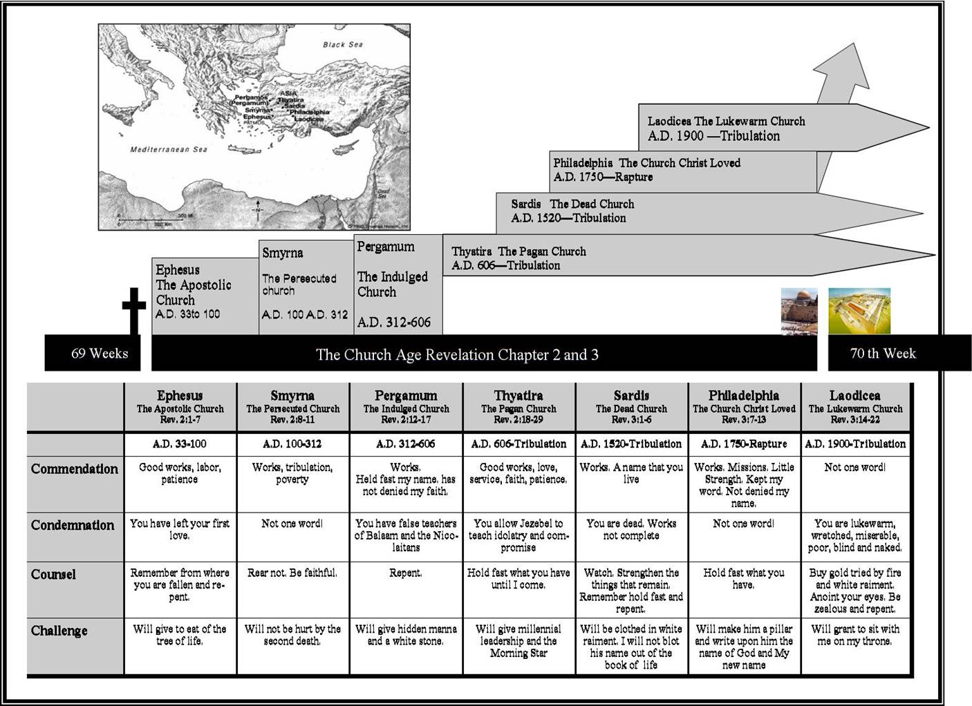
TruthNet.org
Philadelphia
Rev 3:11 ’I am coming quickly…’
Sardis
Rev 3:3 'So remember what you have received and heard; and keep it, and repent. Therefore if you do not wake up, I will come like a thief, and you will not know at what hour I will come to you.
Thyatira
Rev2:25 'Nevertheless what you have, hold fast until I come.

Slide 22
Philadelphia 1: 1789 AD to 1914
Thyatira continues to the end times
Age of Progress:
Thyatira: Corrupted Church continues
1789 Bastille, French revolution → “democratic gospel”, glorification of man, belief that humans are getting better
French revolution motto: Liberty (liberalism), Equality (socialism), Fraternity (nationalism) → civil liberties included worship as you want. Pope did not approve.
1833 Oxford Movement – “High Church”: John Newman, ascribed power to sacraments. Anglican church Catholic in all but supremacy of the pope.
1870 Papal States of Rome defeated by Italian nationalists; 1st Vatican Council emphasizes Papal primacy (spiritual sovereignty) and pronounces infallibility; all to fight liberalism, socialism, and nationalism
1929 Mussolini resolved the papal states issue by establishing the Vatican State

Slide 23
Philadelphia 1: 1789 AD to 1914
Sardis continues to the end times
Age of Progress:
Sardis: Dead Church continues
1859 Darwin’s OOS; industrialization, immigration, higher criticism →
  Public Protestant: social Christianity, social gospel, social service
  Private Protestant: individual salvation (Moody)
Schleiermacher, father of “modern liberal theology”; Jesus a great pioneer.
After 1880, liberal thought challenges:
  Sovereignty of God
  Depravity of man
  The atoning work of Christ
  Holy Spirit essential to conversion
  Eternal separation of the lost in hell
Social Gospel: God’s saving work includes civil structures; the primary sin in society is capitalism [i.e., man is sinful because of the environment…]
H. Richard Niebuhr (1894-1962) – God is sovereign and transcendent
  criticized the social gospel: “a God without wrath brought men without sin into a kingdom without judgment through the ministrations of a Christ without a Cross.”
  influential in post-liberal theology - referred to as "the Yale school" or "narrative theology“
  Major influence on the Emergent Church (see Letter to Laodicea)
Bad system causes sin rather than
sin causes bad system

Slide 24
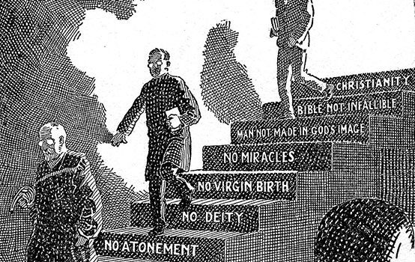
Great Chain of Contempt
(The American Conservative)

Slide 25
Philadelphia 2: 1789 AD to 1914 – Revival Church
Age of Progress:
Philadelphia: Church of Brotherly Love
Christianity in the past focused on local evangelism and then spiritual growth; centered in U.S. and Europe.
19th century Christian world missions was without parallel in history.
  1792 English cobbler William Carey was Father of Modern Missions. Rebuked obstacles of: a) distance, b) barbarism, c) dangers, d) cost of support, e) languages.
  Carey said if merchants can do it so can the church: “evangelize whole countries”, develop local ministry rooted in the culture. Est. Baptist Missionary Society in 1792.
  Carey went to India. British East India Company refused to allow Carey to live in Calcutta, so he settled in Bengal. Studied Hindu way of thinking, produced 6 different translations of the bible.
  “We just need as much love for the souls of men as they have for the profit in an otter’s skin!”
  New Protestant world vision: a) evangelism – Carey, b) prophecy, millennialism (improving world) – Jonathan Edwards
1799 preaching more important than sacraments - Evangelical Movement: Clapham Sect, William Wilberforce, Church Missionary Society + many others. Movement is later called “Low Church” vs. “High Church”
Voluntarism reached across denominations to tap the wealth and talent of the “lay” believers - Gospel restored to the central place in Christianity. Evangelism learns to send out the Gospel of God rather than Presbyterianism, Baptist or Episcopalism.
Great Awakening 1730’s in England, 2nd Great Awakening Rev James McGready’s July 1800 camp meeting inflamed the 1800’s revival: Charles Finney (anti-slavery), D. L. Moody, Billy Graham…

Slide 26
Thus, Christ taught about the “kingdom of heaven” in Matt 13 parables …
… to show the progression of the kingdom in the world until the King returns:
Matt 13:3-9 – The sower
Matt 13:24-30 – The wheat and tares
Matt 13:31-32 – The mustard seed
Matt 13:33 – The leaven
Matt 13:44 – The hidden treasure
Matt 13:45-46 – The pearl of great value
Matt 13:47-50 – The drag net

Slide 27
The Pearl of Great Value

Slide 28
Matt 13:45-46 “The Pearl of Great Value”
"Again, the kingdom of heaven is like a merchant seeking fine pearls, ⁴⁶and upon finding one pearl of great value, he went and sold all that he had, and bought it.”

Slide 29
Matt 13:45-46 “The Pearl of Great Value”
From A.W. Pink:
The Merchant is Jesus, who desires this Pearl, and sold all that He had
Ephes. 5:25 Husbands, love your wives, just as Christ also loved the church and gave Himself up for her;
1 Cor. 6:20 For you have been bought with a price: therefore glorify God in your body.
The Pearl is the Church, built up by accumulation.
A pearl is the product of a living creature, and it is the only gem that is. Not only so, but it is the result of suffering

Slide 30
Take Away
Church (all who have kept His Word, thru all ages)
  Keep His Word, do not deny His name
  There is an “open door” that cannot be shut
  Persevere, hold fast
  He is coming quickly (rapture)
  He will keep us from the hour of testing
  We have a permanent abode in the temple of God
Israel
  Will worship Christ with the Church

Slide 31
Age: | Middle Ages (500-1500) | Reformation (1517- 1648) | Renaissance (1648-1789) |  | Revival (1789-1914) | Ideologies (1914-1996)
Church Letter to: | Thyatira “Continuing Sacrifice” | Sardis “Remnant” |  |  | Philadelphia “Brotherly Love” | Laodicea “Judgment of the people”
The Lord’s description/promise [Note: to Pergamum He said, 'Repent therefore; or else I am coming to you quickly, and I will make war against them with the sword of My mouth. | The Son of God, who has eyes like a flame of fire, and His feet are like burnished bronze 'Nevertheless what you have, hold fast until I come. | He who has the seven Spirits of God, and the seven stars, If therefore you will not wake up, I will come like a thief, and you will not know at what hour I will come upon you. |  |  | He who is holy, who is true, who has the key of David, who opens and no one will shut, and who shuts and no one opens Because you have kept the word of My perseverance, I also will keep you from the hour of testing, that hour which is about to come upon the whole world, … 'I am coming quickly; | The Amen, the faithful and true Witness, the Beginning of the creation of God I advise you to buy from Me gold and white garments, … 'Behold, I stand at the door and knock; if anyone hears My voice and opens the door, I will come in to him…
Question: | All of the below church and “world” views continue today.
1. How saved? | Gregory: grace + good works | Luther: grace alone, faith alone, Rom 1:17 “…the just shall live by faith…” Calvin: grace/faith, chosen | Positive view of man, not a sinner; common sense needed more than grace. “Membership” by formal assent to doctrinal views set forth by scholars |  | Evangelical view: 1. faith 2. new birth, “born again” 3. God’s love revealed in Jesus | - Salvation is not required
2. Source of authority? | Innocent III: Pope is Vicar of Christ | Luther: church, as justified by scripture Calvin: God is sovereign Tyndale: scripture to the masses | Reason: truth found thru senses, not revelation Modernism (liberalism), scriptures rejected in favor of learning thru experience |  | 4. devotion to Bible as only authority (Higher criticism challenges the Bible) | - Rational thought, science, experience
3. What is the Church? | An Institution: Sectarian Pope Leo III & Charles the Great (Charlemagne): Universal Catholic Church, Holy Roman Empire | Luther: universal church, hierarchy with Pope at head. Zwingli (Anabaptists): community of saints separate from government. | REASON The goal is a religiously neutral civilization Denominations emerge | AWAKENING Edmonds, Whitefield, Wesley: Evangelical awakening led to “volunteer” missions New World Puritans | - Body of Christ - Mission to world, from “nurturing to spreading” - July 1800 Gasper River camp meeting | - Universal ecumenical federation - Meet personal needs - Marketing to people’s needs [wants]
4. What is the Christian life? | Sacraments, baptism, confession, celebration of Mass …, indulgences, Crusades | Zwingli (Anabaptists): Confession, baptism, discipleship – daily walk with Christ Personal preparation for the return of Christ, and life in Heaven with Him | Moral conduct. Happiness and fulfillment in this life | Pietism emphasizes importance of regeneration. Moved back to personal faith and fellowship with Jesus Led to Puritans who lived it | - faith in deeds - millennialism returns, live expectantly - Public vs. Private Protestants - Fundamentals of the Faith: Inerrancy of Bible Deity of Jesus Virgin Birth Jesus’ physical resurrection Jesus’ physical return, 1000 yr reign | - Sacred and secular life separated - Being [experience] and doing are more important that belief - Social/political activism

Slide 32
Summary to date
Church | Letter | Parable | Age
Ephesus | Not tolerate evil men Test claim of being an apostle Left first love | Sower | 30-100 AD Apostolic church
Smyrna | Devil will test Be faithful unto death | Wheat & tares | 100-313 AD Persecuted church
Pergamum | Hold fast to name of Christ Tolerate unbelievers “you also have some” in error | Mustard seed | 313-500 AD Compromising church
Thyatira | Many works Tolerate false teachers “the rest ” faithful | Leaven | 500-1517 AD Corrupt church
Sardis | Name of alive, deeds incomplete You are dead “a few people” faithful | Hidden Treasure | 1517 – 1789 Name alive, but dead
Philadelphia | Little power, open door, will be kept from the hour of testing | Pearl of Great Price | 1789 – 1914 AD Faithful/Revival
Laodicea

Slide 33
End

