Slide 1
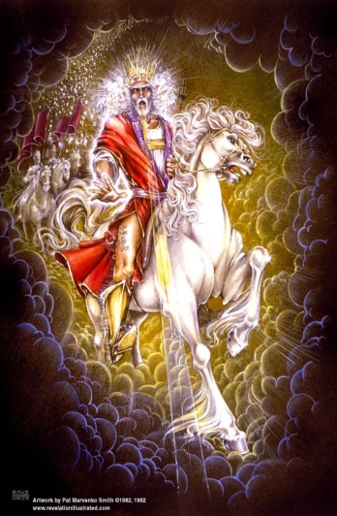

Slide 2
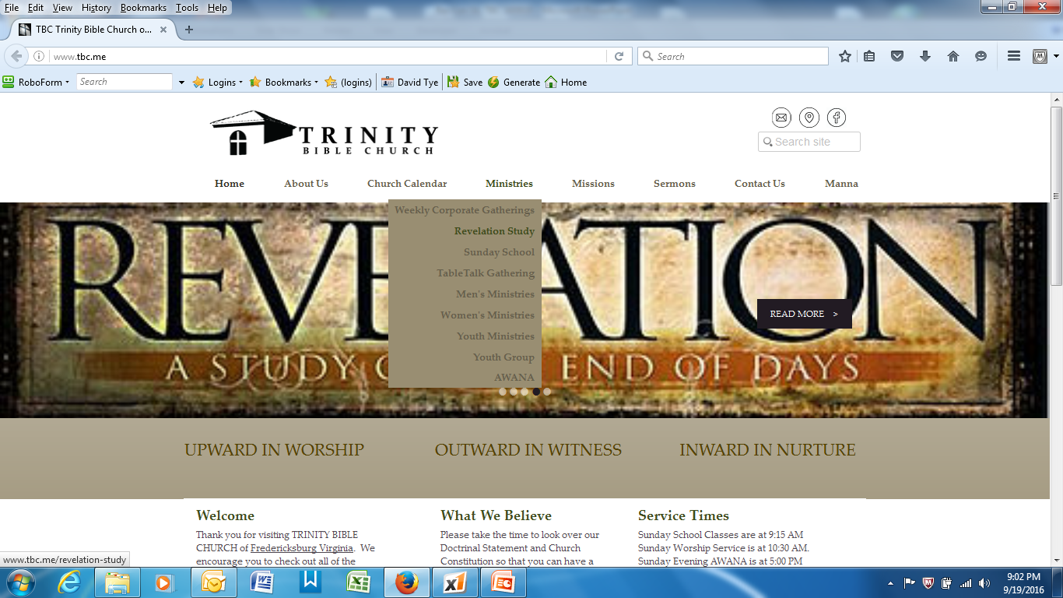

Slide 3
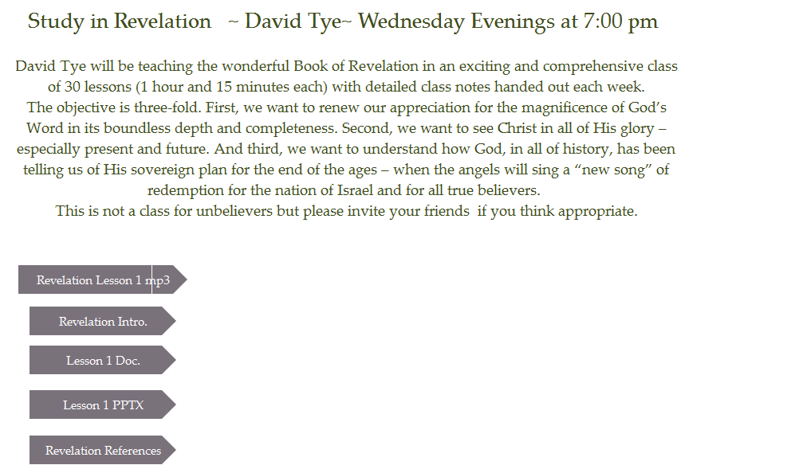

Slide 4
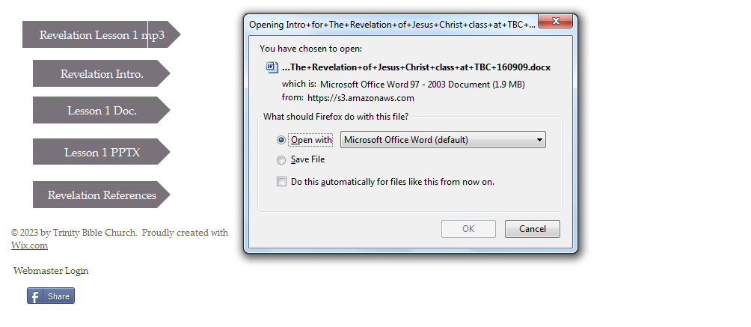

Slide 5
The Revelation of Jesus Christ
Lsn 1b of 22
Trinity Bible Church
Fredericksburg, VA
Finish Chapter 1 & Intro to Letters
Rev. 1:3 Blessed is he who reads and those who hear the words of the prophecy, and heed the things which are written in it; for the time is near.

Slide 6
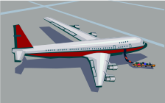
5. What Airplane Are You On?
Biblical Interpretation
  allegorical
  literal, grammatical-historical
Millennial View (when does the 2nd Coming occur)
  amillennial
  post-millennial
  pre-millennial
Eschatological View of Revelation
  historical
  Preterist
  historical-spiritual (symbolic/idealist)
  futurist
Rapture View (when does the Rapture occur)
  mid-tribulation
  post-tribulation
  pre-wrath
  pre-tribulation
Theological View
  Covenant theology
  Dispensational theology

Slide 7
4. Simple timeline of God’s unfolding events
Rapture of the Church
2nd Coming of Christ
Pre-tribulation
Rapture View
Pre-Millennium
2nd Coming View

Slide 8
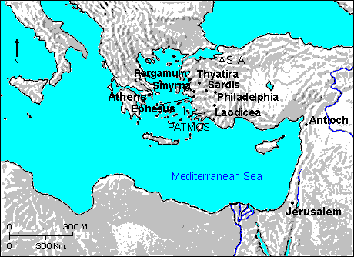
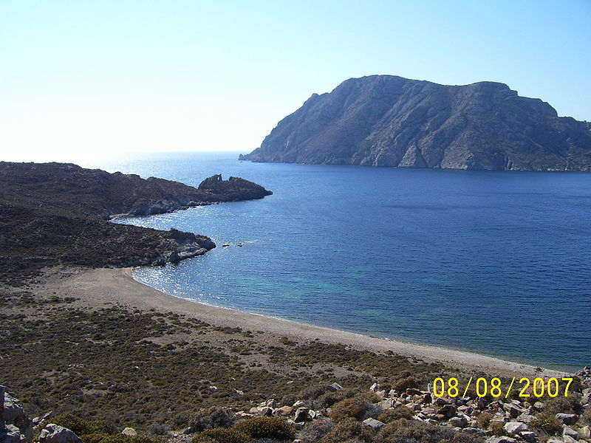
Patmos
Patmos was the island to which John the Apostle was banished.
⇒ Sits out at sea forty miles from the great city of Ephesus.
⇒ It sat in the midst of a group of islands called the Sporades.
⇒ It was only about ten miles long and six miles wide.

Slide 9
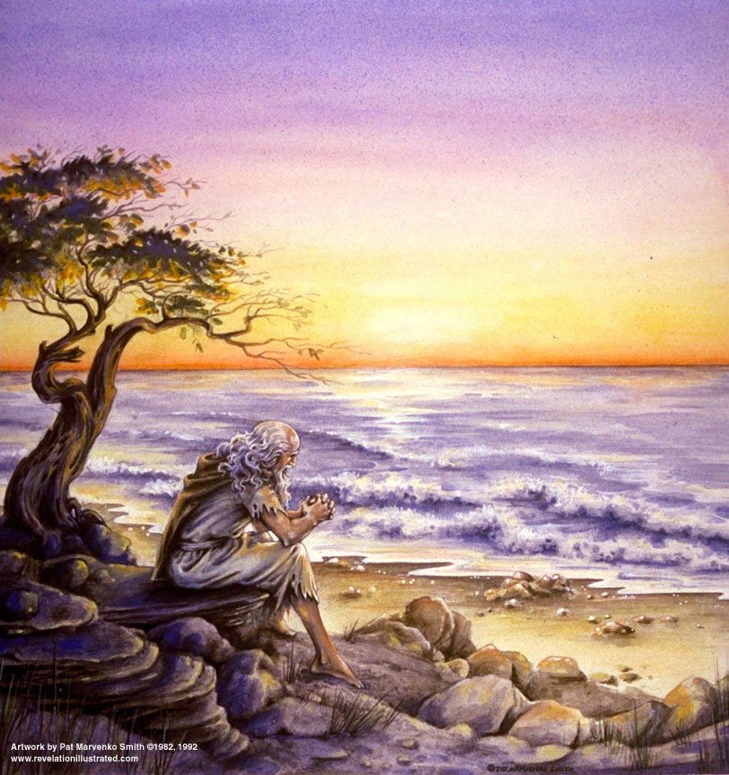

Slide 10
Revelation 1 ⎯ “…things which you have seen…” (vs. 19)
Revelation 1 | Reverence Verses | Other Verses & Notes
Prolog: Rev. 1:1-3 The Revelation of Jesus Christ, which God gave Him to show to His bond-servants, the things which must shortly take place; and He sent and communicated it by His angel to His bond-servant John, ²who bore witness to the word of God and to the testimony of Jesus Christ, even to all that he saw. ³Blessed is he who reads and those who hear the words of the prophecy, and heed the things which are written in it; for the time is near. | Galatians 1:11-12 For I would have you know, brethren, that the gospel which was preached by me is not according to man. ¹² For I neither received it from man, nor was I taught it, but I received it through a revelation of Jesus Christ. Mark 13:32 "But of that day or hour no one knows, not even the angels in heaven, nor the Son, but the Father alone. John 12:49 "For I did not speak on My own initiative, but the Father Himself who sent Me has given Me a commandment as to what to say and what to speak 1 Cor. 2:14 But a natural man does not accept the things of the Spirit of God; for they are foolishness to him, … | 1 Peter 4:13 but to the degree that you share the sufferings of Christ, keep on rejoicing, so that also at the revelation of His glory you may rejoice with exultation. Blessed: “possessing the favor of God”

Slide 11
Salutation: Rev. 1:4-8 John to the seven churches that are in Asia: Grace to you and peace, from Him who is and who was and who is to come; and from the seven Spirits who are before His throne; ⁵and from Jesus Christ, the faithful witness, the first-born of the dead, and the ruler of the kings of the earth. To Him who loves us, and released us from our sins by His blood, ⁶and He has made us to be a kingdom, priests to His God and Father; to Him be the glory and the dominion forever and ever. Amen. 7Behold, He is coming with the clouds, and every eye will see Him, even those who pierced Him; and all the tribes of the earth will mourn over Him. Even so. Amen. ⁸"I am the Alpha and the Omega," says the Lord God, "who is and who was and who is to come, the Almighty." | Revelation 22:16 "I, Jesus, have sent My angel to testify to you these things for the churches. I am the root and the descendant of David, the bright morning star." Ephes. 2:4-5 But God, being rich in mercy, because of His great love with which He loved us, 5even when we were dead in our transgressions, made us alive together with Christ (by grace you have been saved),. Zech. 12:10 "And I will pour out on the house of David and on the inhabitants of Jerusalem, the Spirit of grace and of supplication, so that they will look on Me whom they have pierced; and they will mourn for Him, as one mourns for an only son, and they will weep bitterly over Him, like the bitter weeping over a first-born. | Who is the Book for? 1 Cor 15:20 But now Christ has been raised from the dead, the first fruits of those who are asleep. Daniel 7:13 "I kept looking in the night visions, And behold, with the clouds of heaven One like a Son of Man was coming, And He came up to the Ancient of Days And was presented before Him. Which Coming is this?

Slide 12
Vision of Christ Glorified: Rev. 1:9-11 I, John, your brother and fellow partaker in the tribulation and kingdom and perseverance which are in Jesus, was on the island called Patmos, because of the word of God and the testimony of Jesus. ¹⁰I was in the Spirit on the Lord's day, and I heard behind me a loud voice like the sound of a trumpet, ¹¹saying, "Write in a book what you see, and send it to the seven churches: to Ephesus and to Smyrna and to Pergamum and to Thyatira and to Sardis and to Philadelphia and to Laodicea." |  | What kingdom? Why was John on Patmos? To whom is this book written?

Slide 13
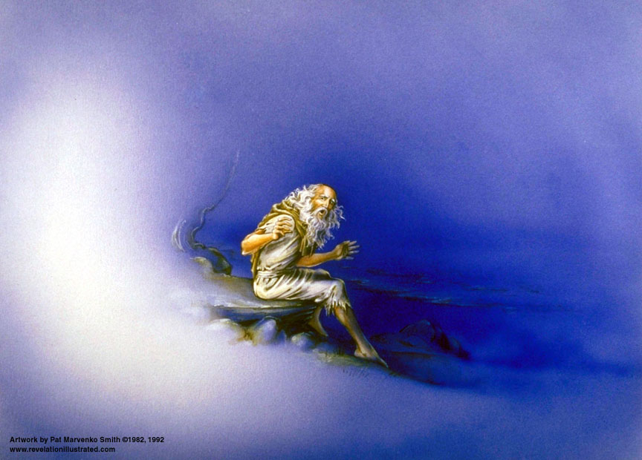

Slide 14
Rev. 1:12-16 And I turned to see the voice that was speaking with me. And having turned I saw seven golden lampstands; ¹³and in the middle of the lampstands one like a son of man, clothed in a robe reaching to the feet, and girded across His breast with a golden girdle. ¹⁴And His head and His hair were white like white wool, like snow; and His eyes were like a flame of fire; ¹⁵and His feet were like burnished bronze, when it has been caused to glow in a furnace, and His voice was like the sound of many waters. ¹⁶And in His right hand He held seven stars; and out of His mouth came a sharp two-edged sword; and His face was like the sun shining in its strength. | Exodus 25:37 "Then you shall make its lamps seven in number; and they shall mount its lamps so as to shed light on the space in front of it. Daniel 10:6 His body also was like beryl, his face had the appearance of lightning, his eyes were like flaming torches, his arms and feet like the gleam of polished bronze, and the sound of his words like the sound of a tumult. Hebrews 4:12 For the word of God is living and active and sharper than any two-edged sword, and piercing as far as the division of soul and spirit, of both joints and marrow, and able to judge the thoughts and intentions of the heart. | How is a lampstand different from a candle? Describe the Speaker.

Slide 15
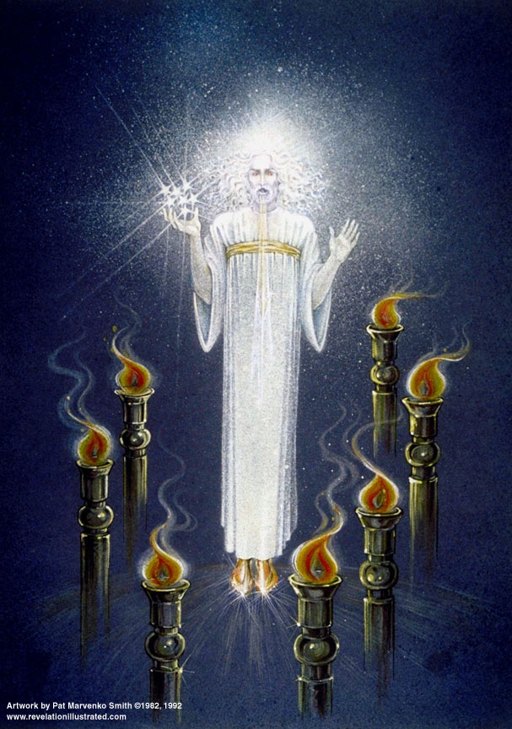

Slide 16
Rev. 1:12-16 And I turned to see the voice that was speaking with me. And having turned I saw seven golden lampstands; ¹³and in the middle of the lampstands one like a son of man, clothed in a robe reaching to the feet, and girded across His breast with a golden girdle. ¹⁴And His head and His hair were white like white wool, like snow; and His eyes were like a flame of fire; ¹⁵and His feet were like burnished bronze, when it has been caused to glow in a furnace, and His voice was like the sound of many waters. ¹⁶And in His right hand He held seven stars; and out of His mouth came a sharp two-edged sword; and His face was like the sun shining in its strength. | Exodus 25:37 "Then you shall make its lamps seven in number; and they shall mount its lamps so as to shed light on the space in front of it. Daniel 10:6 His body also was like beryl, his face had the appearance of lightning, his eyes were like flaming torches, his arms and feet like the gleam of polished bronze, and the sound of his words like the sound of a tumult. Hebrews 4:12 For the word of God is living and active and sharper than any two-edged sword, and piercing as far as the division of soul and spirit, of both joints and marrow, and able to judge the thoughts and intentions of the heart. | How is a lampstand different from a candle? Describe the Speaker.

Slide 17
Rev. 1:17-20 And when I saw Him, I fell at His feet as a dead man. And He laid His right hand upon me, saying, "Do not be afraid; I am the first and the last, ¹⁸and the living One; and I was dead, and behold, I am alive forevermore, and I have the keys of death and of Hades. ¹⁹"Write therefore the things which you have seen, and the things which are, and the things which shall take place after these things. ²⁰"As for the mystery of the seven stars which you saw in My right hand, and the seven golden lampstands: the seven stars are the angels of the seven churches, and the seven lampstands are the seven churches. | Acts 10:25-26 When Peter entered, Cornelius met him, and fell at his feet and worshiped him. ²⁶ But Peter raised him up, saying, "Stand up; I too am just a man.“ Revelation 19:10 Then I fell at his feet to worship him. But he *said to me, "Do not do that; I am a fellow servant of yours and your brethren who hold the testimony of Jesus; worship God. For the testimony of Jesus is the spirit of prophecy." | Who is the Speaker? Here is the outline of the Book of Revelation: 1.Things which you have seen 2.Things which are 3.Things which shall take place after these things

Slide 18
Take Away from Rev 1

Slide 19
Outline of Revelation
Chapters | Topic
1 | Things which you have seen ─ Glorified Christ in heaven
2-3 | Things which are ─ 7 letters to the 7 churches
4-5 | Things which shall take place ─ Introduction / background to the future — 7 sealed scroll
6 | 6 seals
7 | 1st parenthetic ─ 2 groups (144,000, multitude of gentiles in white robes
8 | 7th seal and first 4 trumpets
9 | 5th & 6th trumpets, 1st & 2nd Woes
10-11:14 | 2nd parenthetic ─ the little book, the two witnesses, end of 2nd Woe
11:15-19 | 7th trumpet, 3rd Woe
12 | 3rd parenthetic ─ important characters
13 | 3rd parenthetic ─ wicked rulers
14 | 3rd parenthetic ─ visions of Christ triumphant
15-16 | 7 bowls leading to the 2nd coming of Christ
17 | 4th parenthetic ─ Destruction of ecclesiastic Babylon
18 | 4th parenthetic ─ Destruction of political Babylon
19 | 2nd Coming of Christ, the great supper of God
20 | Millennial reign of Christ ─ Satan bound, 1000 year reign, Satan released, great white throne judgment
21 | New Jerusalem, new heaven and new earth
22 | Concluding revelations

Slide 20
Beatitudes of Revelation
Rev. 1:3 Blessed is he who reads and those who hear the words of the prophecy, and heed the things which are written in it; for the time is near.
Rev. 14:13 And I heard a voice from heaven, saying, "Write, 'Blessed are the dead who die in the Lord from now on!' " "Yes," says the Spirit, "that they may rest from their labors, for their deeds follow with them."
Rev. 16:15 ("Behold, I am coming like a thief. Blessed is the one who stays awake and keeps his garments, lest he walk about naked and men see his shame.")
Rev. 19:9 And he said to me, "Write, 'Blessed are those who are invited to the marriage supper of the Lamb.' " And he said to me, "These are true words of God."
Rev. 20:6 Blessed and holy is the one who has a part in the first resurrection; over these the second death has no power, but they will be priests of God and of Christ and will reign with Him for a thousand years.
Rev. 22:7 "And behold, I am coming quickly. Blessed is he who heeds the words of the prophecy of this book."
Rev. 22:14 Blessed are those who wash their robes, that they may have the right to the tree of life, and may enter by the gates into the city.

Slide 21
The Revelation of Jesus Christ
Preparation for 7 letters to the churches
Lsn 2 of 22
Rev. 1:3 Blessed is he who reads and those who hear the words of the prophecy, and heed the things which are written in it; for the time is near.

Slide 22
A. Some thoughts on the Course of the Church Age in Scripture
There are several purposes in the writing of the 7 letters – (Walvoord, Major Bible Prophesies, p51)
  The 7 churches in Rev 2&3 were selected because the spiritual state in each was precisely as described, and the exhortation received was perfect.
  They were also selected since they were normative and represented the various states of the local churches at that time, and throughout history.
  The messages to the churches also prove extremely valuable to the individuals in those churches as pertaining to their personal Christian walk.
  Finally, Pentecost adds, “…they foreshadowed the successive predominant phases through which the nominal Church was to pass, from the time when John saw the vision until the Lord came.” (Pentecost, Things to Come, p. 151)

Slide 23
A. Some thoughts on the Course of the Church Age in Scripture
The age from the rejection of the Messiah by Israel to His reception by Israel at His second advent is outlined in two portions of scripture: Matt 13 and Rev 2 & 3: the former from the view point of God’s kingdom program and the latter from the point of view of the Church program – (Pentecost, p 138)
Since the parables of Matt 13 and the letters to the churches in Rev 2 & 3 cover essentially the same time period we would expect there to be a parallelism in the development. We do not intend to infer that there is a one to one correspondence, rather, that there is a similarity in the progress of the course of the church age as revealed in them. (Pentecost, pp 141-144. 153)

Slide 24
B. Context of the Parables in Matt 13
Kingdom of Heaven Announced
Matt 3:1-2 Now in those days John the Baptist *came, preaching in the wilderness of Judea, saying, ² "Repent, for the kingdom of heaven is at hand."
Matt 4:17 From that time Jesus began to preach and say, "Repent, for the kingdom of heaven is at hand.“
[Matthew distinguishes between kingdom of heaven and kingdom of God. The former includes unbelievers; the latter does not. Matt 19:24 "Again I say to you, it is easier for a camel to go through the eye of a needle, than for a rich man to enter the kingdom of God."]

Slide 25
Kingdom Validated
Matt 8-10: hundreds of miracles performed fulfilling Isaiah advent of the Messiah prophesy –
Isaiah 35:5-6 Then the eyes of the blind will be opened And the ears of the deaf will be unstopped. ⁶ Then the lame will leap like a deer, And the tongue of the mute will shout for joy. For waters will break forth in the wilderness And streams in the Arabah.

Slide 26
Kingdom Preached
Matthew 10:5-6 These twelve Jesus sent out after instructing them: "Do not go in the way of the Gentiles, and do not enter any city of the Samaritans; ⁶ but rather go to the lost sheep of the house of Israel.
Kingdom Rejected
Matthew 12:10-14 … And they questioned Jesus, asking, "Is it lawful to heal on the Sabbath?"—so that they might accuse Him …¹³ Then He *said to the man, "Stretch out your hand!" He stretched it out, and it was restored to normal, like the other. ¹⁴ But the Pharisees went out and conspired against Him, as to how they might destroy Him.

Slide 27
Kingdom Delayed for Israel
(Jesus judges Israel)
Matthew 12:41-45 "The men of Nineveh will stand up with this generation at the judgment, and will condemn it because they repented at the preaching of Jonah; and behold, something greater than Jonah is here... ⁴³ "Now when the unclean spirit goes out of a man, it passes through waterless places seeking rest, and does not find it. ⁴⁴ "Then it says, 'I will return to my house from which I came'; and when it comes, it finds it unoccupied, swept, and put in order. ⁴⁵ "Then it goes and takes along with it seven other spirits more wicked than itself, and they go in and live there; and the last state of that man becomes worse than the first. That is the way it will also be with this evil generation."
Delayed for a reason! Romans 11:11 I say then, they did not stumble so as to fall, did they? May it never be! But by their transgression salvation has come to the Gentiles, to make them jealous.

Slide 28
Mystery Kingdom
Prophesied by Christ
Matthew 13 presents the 7 parables of the Kingdom of heaven in parables.
Matthew 13:10-11 And the disciples came and said to Him, "Why do You speak to them in parables?" ¹¹ Jesus answered them, "To you it has been granted to know the mysteries of the kingdom of heaven, but to them it has not been granted."

Slide 29
Thus, Christ taught about the “kingdom of heaven” in Matt 13 parables
Matt 13:3-9 – The sower
Matt 13:24-30 – The wheat and tares
Matt 13:31-32 – The mustard seed
Matt 13:33 – The leaven
Matt 13:44 – The hidden treasure
Matt 13:45-46 – The pearl of great value
Matt 13:47-50 – The drag net

Slide 30
Israel rejected Christ. What happens to the kingdom program? Since the kingdom is the result of an irrevocable covenant it cannot be abandoned. Matt 13 gives the events in the development of the mystery kingdom. Instead of the world getting better it will get worse. Evil will prevail until Christ’s second advent [Pentecost, p141-144]

Slide 31
C. On the Letters to the Churches in Rev 2 & 3
It is worthy of note that the "Messages to the Seven Churches" are inserted between Two Visions, the "Vision of Christ" in the midst of the "Seven Lampstands" in Rev 1, and the "Vision of the Four and Twenty Elders" round about the Throne, in Rev 4. (Clarence Larkin, “Dispensational Truth”)
To fill in the details of the actual history of the Church we will depend on Bruce Shelley’s The History of the Church in Plain Language

Slide 32
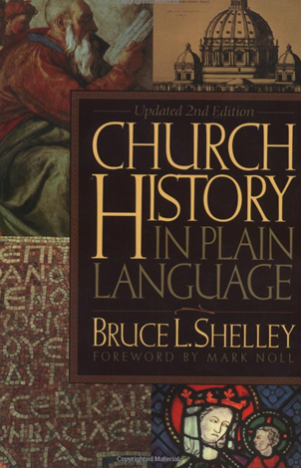
Notes on the Church periods In history are taken from Bruce Shelley’s book Church History in Plain Language.
$20 plus $4 shipping at Amazon.

Slide 33
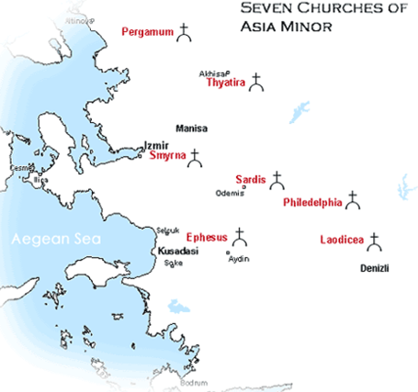

Slide 34
D. How we will study Rev 2 & 3
Interpretation: 7 actual churches in Asia
Application — Letters to the Church universal
  No letters to Troas, Miletus, Colossi, Hierapolis
  # 7 represents “completion”; used 57 times in Revelation
Application — Instruction to individual Christians
Application — General progress of Church in history from Pentecost to Rapture. (Walvoord, Revelation of Jesus Christ, p52)
  7 epochs in the progress of the Church
  Succeeding epoch does not necessarily end the preceding one
Insight – Matt 13 parables

Slide 35
Structure of the Letters
Picture of Christ
Approval
Accusation
Admonition
Alternative
Praise to overcomer

Slide 36
See Chart 1
Name Meaning
Images of Christ
Christ’s Title
Approval
Accusation
Admonition
Alternative
Praise to Overcomer
Church Period
Matt 13 Parable

Slide 37
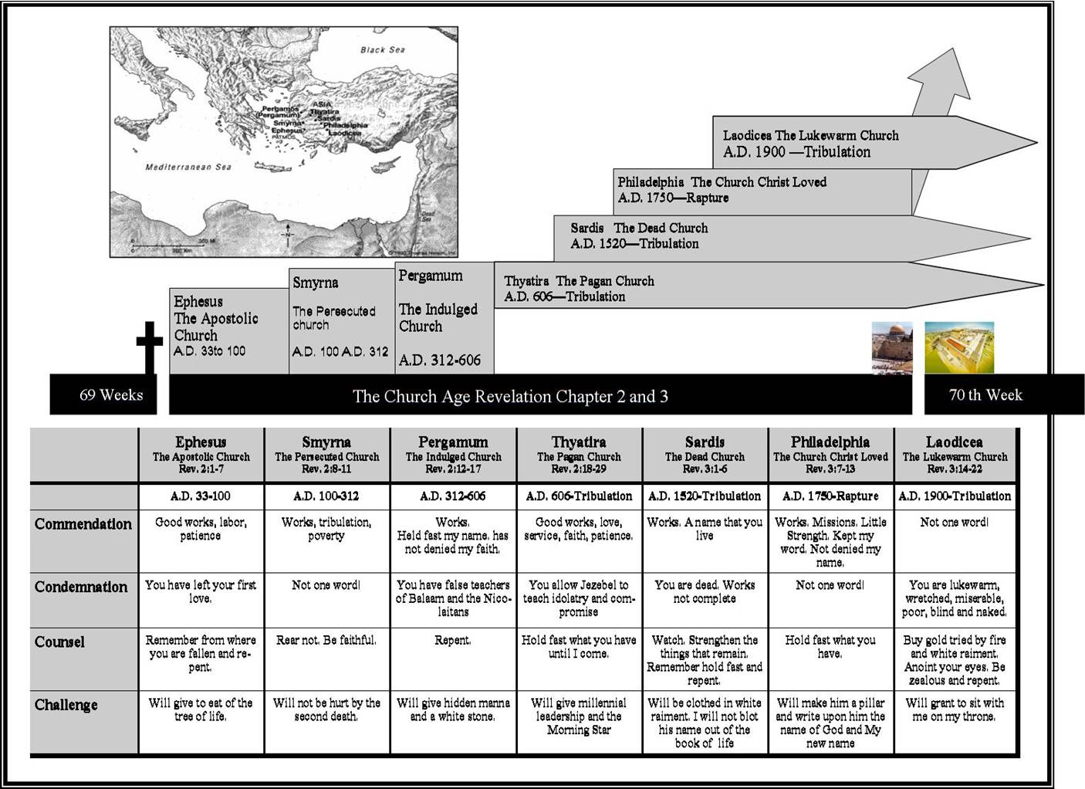

Slide 38
END

