Slide 1
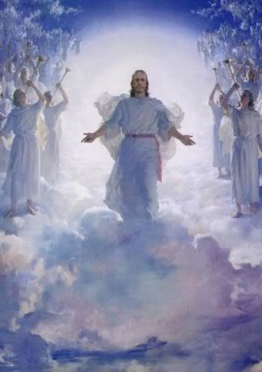
The Revelation of Jesus Christ
Review/Application of Rev1-3, & Transition to Rev 4
Rev. 1:3 Blessed is he who reads and those who hear the words of the prophecy, and heed the things which are written in it; for the time is near.

Slide 2
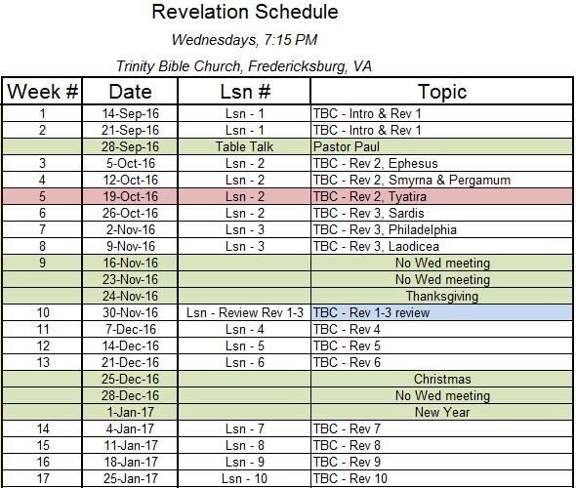

Slide 3
Outline of Revelation
Chapters | Topic
1 | Things which you have seen ─ Glorified Christ in heaven
2-3 | Things which are ─ 7 letters to the 7 churches
4-5 | Things which shall take place ─ Introduction / background to the future — 7 sealed scroll
6 | 6 seals
7 | 1st parenthetic ─ 2 groups (144,000, multitude of gentiles in white robes
8 | 7th seal and first 4 trumpets
9 | 5th & 6th trumpets, 1st & 2nd Woes
10-11:14 | 2nd parenthetic ─ the little book, the two witnesses, end of 2nd Woe
11:15-19 | 7th trumpet, 3rd Woe
12 | 3rd parenthetic ─ important characters
13 | 3rd parenthetic ─ wicked rulers
14 | 3rd parenthetic ─ visions of Christ triumphant
15-16 | 7 bowls leading to the 2nd coming of Christ
17 | 4th parenthetic ─ Destruction of ecclesiastic Babylon
18 | 4th parenthetic ─ Destruction of political Babylon
19 | 2nd Coming of Christ, the great supper of God
20 | Millennial reign of Christ ─ Satan bound, 1000 year reign, Satan released, great white throne judgment
21 | New Jerusalem, new heaven and new earth
22 | Concluding revelations

Slide 4
Rev 1 Thoughts
Rev. 1:1-3 The Revelation of Jesus Christ, which God gave Him to show to His bond-servants, the things which must shortly take place; and He sent and communicated it by His angel to His bond-servant John, ²who bore witness to the word of God and to the testimony of Jesus Christ, even to all that he saw. ³Blessed is he who reads and those who hear the words of the prophecy, and heed the things which are written in it; for the time is near.

Slide 5
Rev 1:1-20
What did John call his writing? (1:1)
For whose benefit did God intend the book of Revelation? (1:1)
What did God want us to learn from the book of Revelation? (1:1)
How much of the revelation he received did John report? (1:2)
What sources did John say were the basis of his revelation? (1:2)
What is promised to those who study this revelation? (1:3)
What is Jesus’ attitude toward Christians? (1:5)
In what way does Jesus make all believers new? (1:6)
What did God’s voice command John to do? (1:11)
What did Jesus tell John to do? (1:19)
What is your reaction when you realize that God wants you to know what the future holds?

Slide 6

The Seven Churches
Well in our day, all seven of these churches are represented. And each of them poses its own challenge. There are pure churches like Smyrna and Philadelphia. There are churches that have left their first love and need the fire of devotion back. There are churches like Pergamos that have tolerated sin and won't deal with it. They are beginning to escalate and to grow in our day...they don't want to deal with sin. They don't want to confront iniquity. There are churches like Thyatira that are in full-blown compromise with the world. There are churches like Sardis that are mostly dead and only a few believers left. And there are the apostate churches. But in every case, the Lord says to these churches with all their defects, "Please repent, please take the steps necessary to make it right.“
John MacArthur

Slide 7
Parables of the Kingdom in Matthew 13
Parables | References | Meanings
1. The Sower | 13:1-23 | The good news of the gospel will be rejected by most people.
2. The Wheat and the Tares | 13:24-30, 36-43 | People with genuine faith and people with a false profession of faith will exist together between Christ’s two Advents.
3. The Mustard Seed | 13:31-32 | Christendom, including believers and unbelievers, will grow rapidly from a small beginning.
4. The Yeast | 13:33-35 | False doctrine will corrupt the Word so that it tastes good to the professing unbelievers.
5. The Hidden Treasure | 13:44 | Christ came to purchase (redeem) Israel, God’s treasured possession.
6. The Pearl | 13:45-46 | Christ came to purchase (redeem) His bride, the Church.
7. The Net | 13:47-52 | Angels will separate the wicked from the righteous when Christ comes.
Bible Knowledge Commentary

Slide 8
Summary to date
Church | Letter | Parable | Age
Ephesus | Not tolerate evil men Test claim of being an apostle Left first love | Sower | 30-100 AD Apostolic church
Smyrna | Devil will test Be faithful unto death | Wheat & tares | 100-313 AD Persecuted church
Pergamum | Hold fast to name of Christ Tolerate unbelievers “you also have some” in error | Mustard seed | 313-500 AD Compromising church
Thyatira | Many works Tolerate false teachers “the rest ” faithful | Leaven | 500-1517 AD Corrupt church
Sardis | Name of alive, deeds incomplete You are dead “a few people” faithful | Hidden Treasure | 1517 – 1789 AD Alive/dead
Philadelphia | Little power, open door, will be kept from the hour of testing | Pearl of Great Price | 1789 – 1914 AD Faithful/Revival
Laodicea | Lukewarm, wretched, miserable, poor, blind, naked – buy gold & white garments. Open the door. | Drag net | 1914 – end times Universal church

Slide 9
Ephesus
“Desirable” – Paul ministered, silversmiths, Timothy, John
Name Meaning
Images of Christ
Christ’s Title
Approval
Accusation
Admonition
Alternative
Praise to Overcomer
Church Period
Matt 13 Parable
7 stars (sovereign) among 7 Lampstands
Sovereign Lord
Deeds, toil, perseverance; cannot endure evil; test;
endurance for His name; hate deeds of Nicolaitans
left 1st love; deliberate choice, reason for deeds is important
Remember, repent, restore 1st deeds
Removal of light, lose effectiveness
Eat of tree of life (all true believers)
Apostolic: 30 to 100 AD. Increasing doctrine, cooling love
Sower and soils

Slide 10
Rev. 2:1-7 "To the angel of the church in Ephesus write:
The One who holds the seven stars in His right hand, the One who walks among the seven golden lampstands, says this: ²'I know your deeds and your toil and perseverance, and that you cannot endure evil men, and you put to the test those who call themselves apostles, and they are not, and you found them to be false; ³and you have perseverance and have endured for My name's sake, and have not grown weary. ⁴'But I have this against you, that you have left your first love. ⁵'Remember therefore from where you have fallen, and repent and do the deeds you did at first; or else I am coming to you, and will remove your lampstand out of its place-- unless you repent. ⁶ 'Yet this you do have, that you hate the deeds of the Nicolaitans, which I also hate. ⁷'He who has an ear, let him hear what the Spirit says to the churches. To him who overcomes, I will grant to eat of the tree of life, which is in the Paradise of God.'

Slide 11
Rev 2:1-7 — Ephesus
Jesus praised the church at Ephesus for what deeds? (2:2-3)
With what in the Ephesian church was Christ unsatisfied? (2:4)
  Ephes. 1:15 For this reason I too, having heard of the faith in the Lord Jesus which exists among you, and your love for all the saints,
How did the church at Ephesus need to change? (2:5)
What warning was given to the church if it failed to obey Christ’s words? (2:5)
What can cause us to lose our “first” love?
Whom else did Jesus want to benefit from this message? (2:7)
What final promise was made to “him who overcomes”? (2:7)

Slide 12
Smyrna
“Myrrh, bitter” – beautiful; wicked; gospel opposed by pagans; abject poverty; Caesar worship; Polycarp martyred
Name Meaning
Images of Christ
Christ’s Title
Approval
Accusation
Admonition
Alternative
Praise to Overcomer
Church Period
Matt 13 Parable
First & Last; dead, now alive
Risen Lord
Withstanding: tribulation; abject poverty; blasphemy
X
do not fear suffering (prison, testing, 10 days of tribulation);
be faithful until death
X
crown of life, Jas 1:12 and 1 Cor 9:25; not hurt by 2nd death
Persecuted: 100-313 AD, suffering, seeds of evil enter
Tares sowed, left until the harvest

Slide 13
Rev. 2:8-11 "And to the angel of the church in Smyrna write:
The first and the last, who was dead, and has come to life, says this: ⁹'I know your tribulation and your poverty (but you are rich), and the blasphemy by those who say they are Jews and are not, but are a synagogue of Satan. ¹⁰'Do not fear what you are about to suffer. Behold, the devil is about to cast some of you into prison, that you may be tested, and you will have tribulation ten days. Be faithful until death, and I will give you the crown of life. ¹¹'He who has an ear, let him hear what the Spirit says to the churches. He who overcomes shall not be hurt by the second death.'

Slide 14
Rev 2:8-11 — Smyrna
What did Christ say about some so-called Jews in Smyrna? (2:9)
What did Jesus say to comfort the Christians in Smyrna? (2:10)
What prophetic warning did Christ give to the church in Smyrna? (2:10)
What kinds of persecution do you as a Christian face today?
Who else did Jesus say could benefit from the message to the church at Smyrna? (2:11)
What final promise was made to “him who overcomes”? (2:11)

Slide 15
Pergamum
“Additional Marriage” – wealthy; many temples; Satan’s throne;
civic & religious life entwined; heathen feasts (guilds);
Nicolaitans accepted, doctrine of Balaam, Christianity popular
Name Meaning
Images of Christ
Christ’s Title
Approval
Accusation
Admonition
Alternative
Praise to Overcomer
Church Period
Matt 13 Parable
2 edged sword
Warring Lord
Surviving near Satan’s throne, hold fast My Name,
not deny My faith, martyr days
teaching of Balaam: idol worship, immorality, teaching of
Nicolaitans
repent
come quickly, war with sword
hidden manna, white stone, new name
Compromising,: 313-500 AD , Constantine, state church,
pagan practices, spiritual compromise
Mustard seed, birds of air nest in tree

Slide 16
Rev. 2:12-17 "And to the angel of the church in Pergamum write:
The One who has the sharp two-edged sword says this: ¹³'I know where you dwell, where Satan's throne is; and you hold fast My name, and did not deny My faith, even in the days of Antipas, My witness, My faithful one, who was killed among you, where Satan dwells. ¹⁴'But I have a few things against you, because you have there some who hold the teaching of Balaam, who kept teaching Balak to put a stumbling block before the sons of Israel, to eat things sacrificed to idols, and to commit acts of immorality. ¹⁵'Thus you also have some who in the same way hold the teaching of the Nicolaitans. ¹⁶'Repent therefore; or else I am coming to you quickly, and I will make war against them with the sword of My mouth. ¹⁷'He who has an ear, let him hear what the Spirit says to the churches. To him who overcomes, to him I will give some of the hidden manna, and I will give him a white stone, and a new name written on the stone which no one knows but he who receives it.'

Slide 17
Rev 2:12-17 — Pergamum
For what did Jesus praise the people of the church at Pergamum? (2:13)
What were the believers at Pergamum doing wrong? (2:14-15)
What command did Christ give to this church in light of its dangerous direction? (2:16)
How can sin in others affect you?
Who else did Jesus say could benefit from the message to the church at Pergamum? (2:17)
What did Jesus promise to “him who overcomes”? (2:17)

Slide 18
Thyatira
“Unwearied (continuing) sacrifice” - small and obscure, Acts 16 Lydia converted; Baal worship (Jezebel); pagan doctrines accepted; local church likely led by woman
Name Meaning
Images of Christ
Christ’s Title
Approval
Accusation
Admonition
Alternative
Praise to Overcomer
Church Period
Matt 13 Parable
Son of God, eyes like flame of fire, feet like burnished bronze
searches mind and heart
Judging Lord
knows their deeds, love, faith, service, perseverance;
growing deeds
tolerate Jezebel, immoral idol worship, 1 Kings 21:25-26
Jer. 44:17,18,25
Christendom Christians
- repent - hold fast
- sickness & tribulation - no other burden
- pestilence, judgment
authority over nations, morning star (Rev 22:16)
Corrupted: 500-1500 AD, Dark Ages, inquisition,
Mary elevated, works
Leaven, all becomes leavened

Slide 19
Rev. 2:18-29 "And to the angel of the church in Thyatira write:
The Son of God, who has eyes like a flame of fire, and His feet are like burnished bronze, says this: ¹⁹'I know your deeds, and your love and faith and service and perseverance, and that your deeds of late are greater than at first. ²⁰'But I have this against you, that you tolerate the woman Jezebel, who calls herself a prophetess, and she teaches and leads My bond-servants astray, so that they commit acts of immorality and eat things sacrificed to idols. ^{21'}And I gave her time to repent; and she does not want to repent of her immorality. ²²'Behold, I will cast her upon a bed of sickness, and those who commit adultery with her into great tribulation, unless they repent of her deeds. ²³'And I will kill her children with pestilence; and all the churches will know that I am He who searches the minds and hearts; and I will give to each one of you according to your deeds. ²⁴'But I say to you, the rest who are in Thyatira, who do not hold this teaching, who have not known the deep things of Satan, as they call them-- I place no other burden on you. ²⁵'Nevertheless what you have, hold fast until I come. ²⁶'And he who overcomes, and he who keeps My deeds until the end, to him I will give authority over the NATIONS; ²⁷AND HE SHALL RULE THEM WITH A ROD OF IRON, as the vessels of the potter are broken to pieces, as I also have received authority from My Father; ²⁸and I will give him the morning star. ²⁹'He who has an ear, let him hear what the Spirit says to the churches.'

Slide 20
Rev 2:18-29 — Thyatira
For what did Christ praise the church at Thyatira? (2:19)
For what did Christ chastise the church at Thyatira? (2:20)
How did Christ show patience? (2:21)
What judgments did the Son of God pronounce on the one He called Jezebel? (2:22-23)
What have you been tolerating in your life that you need to reject and change?
What two gifts were promised to “him who overcomes”? (2:26-28)
In addition to the church at Thyatira, who else was commanded to pay heed to this message? (2:29)

Slide 21
Sardis
Name Meaning
Images of Christ
Christ’s Title
Approval
Accusation
Admonition
Alternative
Praise to Overcomer
Church Period
Matt 13 Parable
“Remnant”, wealthy; on trade routes; many different pagan
cults; gross depravity in worship of mother goddess Cybele;
letter starts with condemnation
7 Spirits, 7 stars
Omniscient Lord
X
dead, incomplete deeds
wake up, strengthen remaining, remember, keep, repent
come like a thief
a few righteous, will walk w/Me in white, not erase name
from Book of Life, confess name before Father and angles
Dead, Reformed, 1517-1789 AD, “protesters”; Guttenberg
Press (1436) , enlightenment, denominations, doctrines
Hidden treasure, buy the field

Slide 22
Rev. 3:1-6 "And to the angel of the church in Sardis write:
He who has the seven Spirits of God, and the seven stars, says this: 'I know your deeds, that you have a name that you are alive, but you are dead. ²'Wake up, and strengthen the things that remain, which were about to die; for I have not found your deeds completed in the sight of My God. ³'Remember therefore what you have received and heard; and keep it, and repent. If therefore you will not wake up, I will come like a thief, and you will not know at what hour I will come upon you. ⁴'But you have a few people in Sardis who have not soiled their garments; and they will walk with Me in white; for they are worthy. ⁵'He who overcomes shall thus be clothed in white garments; and I will not erase his name from the book of life, and I will confess his name before My Father, and before His angels. ⁶'He who has an ear, let him hear what the Spirit says to the churches.'

Slide 23
Rev 3:1-6 — Sardis
What was the reputation of the church at Sardis? (3:1)
How did the church’s true nature match its reputation? (3:1)
What warnings did Christ issue to the church at Sardis? (3:2)
What does it mean to “overcome” as a Christian?
What did Christ urge as the first step to restoration? (3:3)
What consequences were promised to those who refused to wake up? (3:3)
Whom else did Jesus want to benefit from this message? (3:6)

Slide 24
Philadelphia
Name Meaning
Images of Christ
Christ’s Title
Approval
Accusation
Admonition
Alternative
Praise to Overcomer
Church Period
Matt 13 Parable
“Brotherly love”, agricultural; in center of heathen world
Holy, True, Key of David, opens and shuts
Authoritative Lord
deeds, little power, kept word, not denied His name,
persevered
X
hold fast
X
unbelievers will bow, kept from hour of testing,
pillar in temple, receive name of God, name of new Jerusalem,
& Jesus’ new name
Faithful, Revival, 1789- , missionary growth
Pearl of great value

Slide 25
Rev. 3:7-13 "And to the angel of the church in Philadelphia write:
He who is holy, who is true, who has the key of David, who opens and no one will shut, and who shuts and no one opens, says this: ⁸'I know your deeds. Behold, I have put before you an open door which no one can shut, because you have a little power, and have kept My word, and have not denied My name. ⁹'Behold, I will cause those of the synagogue of Satan, who say that they are Jews, and are not, but lie-- behold, I will make them to come and bow down at your feet, and to know that I have loved you. ¹⁰'Because you have kept the word of My perseverance, I also will keep you from the hour of testing, that hour which is about to come upon the whole world, to test those who dwell upon the earth. ¹¹'I am coming quickly; hold fast what you have, in order that no one take your crown. ¹²'He who overcomes, I will make him a pillar in the temple of My God, and he will not go out from it anymore; and I will write upon him the name of My God, and the name of the city of My God, the new Jerusalem, which comes down out of heaven from My God, and My new name. ¹³'He who has an ear, let him hear what the Spirit says to the churches.'

Slide 26
Rev 3:7-13 — Philadelphia
Why did Christ put an open door before this church? (3:8)
Why will the world experience an “hour of testing”? (3:10)
What is does it mean to be kept from the “hour of testing”? (3:10)
How did Jesus instruct the believers in Philadelphia to prepare for His coming? (3:11)
In addition to the church at Philadelphia, who else was encouraged to heed this message? (3:13)

Slide 27
Laodicea
Name Meaning
Images of Christ
Christ’s Title
Approval
Accusation
Admonition
Alternative
Praise to Overcomer
Church Period
Matt 13 Parable
“Judgment of the people”, wealthy; toleration and
allowance; no special works and no departure from correct
doctrine; temporal sufficiency led to false comfort
Amen, Faithful & true witness, Origin of the creation of God
Divine Lord
X
neither hot nor cold, lukewarm, ignorant of condition
buy from Me: gold, white garment, eye salve;
be zealous, repent, hear, open the door
spit out of mouth, reject
Jesus stands at door and knocks; if you hear & open, He will
come to him, dine with him, grant to sit on His throne
Universal, End-times, 1914 – Present, rich, complacent,
twentieth century western world
Dragnet at end of age

Slide 28
Rev. 3:14-22 "And to the angel of the church in Laodicea write:
The Amen, the faithful and true Witness, the Beginning of the creation of God, says this: ¹⁵'I know your deeds, that you are neither cold nor hot; I would that you were cold or hot. ¹⁶'So because you are lukewarm, and neither hot nor cold, I will spit you out of My mouth. ¹⁷'Because you say, "I am rich, and have become wealthy, and have need of nothing," and you do not know that you are wretched and miserable and poor and blind and naked, ¹⁸I advise you to buy from Me gold refined by fire, that you may become rich, and white garments, that you may clothe yourself, and that the shame of your nakedness may not be revealed; and eye salve to anoint your eyes, that you may see. ¹⁹'Those whom I love, I reprove and discipline; be zealous therefore, and repent. ²⁰'Behold, I stand at the door and knock; if anyone hears My voice and opens the door, I will come in to him, and will dine with him, and he with Me. ²¹'He who overcomes, I will grant to him to sit down with Me on My throne, as I also overcame and sat down with My Father on His throne. ²²'He who has an ear, let him hear what the Spirit says to the churches.' "

Slide 29
Rev 3:14-22 — Laodicea
How did Jesus describe the church at Laodicea? (3:15)
What response did Jesus promise to the Laodicean church because of its behavior? (3:16)
What did the Laodicean Christians need? Why? (3:18)
What reason did Jesus give for His stern warnings? (3:19)
What invitation was given to individual Christians in Laodicea? (3:20)
Whom else did Jesus want to benefit from this message? (3:22)

Slide 30
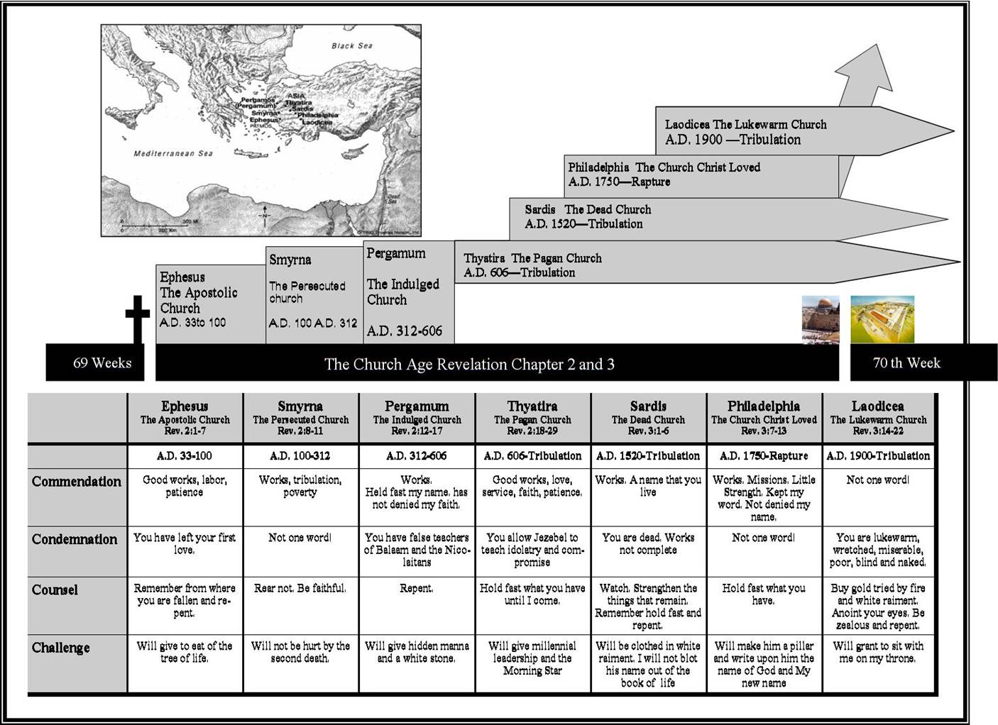
TruthNet.org
Rev. 4:1 After these things I looked, and behold, a door standing open in heaven, and the first voice which I had heard, like the sound of a trumpet speaking with me, said, "Come up here, and I will show you what must take place after these things.“

Slide 31
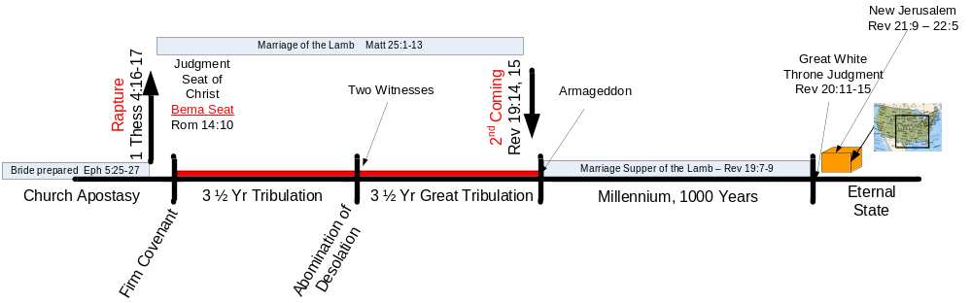
Revelation – Chap 4 to 22

Slide 32
Rapture of the Church – when?
Pre-tribulation rapture
Post-tribulation rapture
Partial-rapture
Mid-tribulation rapture
Pre-wrath rapture

Slide 33
A. Apostasy of the church precedes the Rapture
1 Tim 4:1 But the Spirit explicitly says that in later times some will fall away from the faith, paying attention to deceitful spirits and doctrines of demons,
2 Thess2:1-3 Now we request you, brethren, with regard to the coming of our Lord Jesus Christ and our gathering together to Him [rapture], ² that you not be quickly shaken from your composure or be disturbed either by a spirit or a message or a letter as if from us, to the effect that the day of the Lord has come [includes the great tribulation, the following judgment on the nations, and the time of worldwide blessing under the rule of the Messiah] ³ Let no one in any way deceive you, for it will not come unless the apostasy [rebellion] comes first, and the man of lawlessness is revealed, the son of destruction,
2 Tim 3:1-7 But realize this, that in the last days difficult times will come. ² For men will be lovers of self, lovers of money, boastful, arrogant, revilers, disobedient to parents, ungrateful, unholy, ³ unloving, irreconcilable, malicious gossips, without self-control, brutal, haters of good, ⁴ treacherous, reckless, conceited, lovers of pleasure rather than lovers of God, ⁵ holding to a form of godliness, although they have denied its power; Avoid such men as these. ⁶ For among them are those who enter into households and captivate weak women weighed down with sins, led on by various impulses, ⁷ always learning and never able to come to the knowledge of the truth.

Slide 34
B. The Rapture is for only the Church
1 Thess 4:16-17 For the Lord Himself will descend from heaven with a shout, with the voice of the archangel, and with the trumpet of God; and the dead in Christ shall rise first. ¹⁷Then we who are alive and remain shall be caught up [raptured] together with them in the clouds to meet the Lord in the air, and thus we shall always be with the Lord.
1 Cor 12:13 For by one Spirit we were all baptized into one body [this began at Pentecost], whether Jews or Greeks, whether slaves or free, and we were all made to drink of one Spirit.

Slide 35
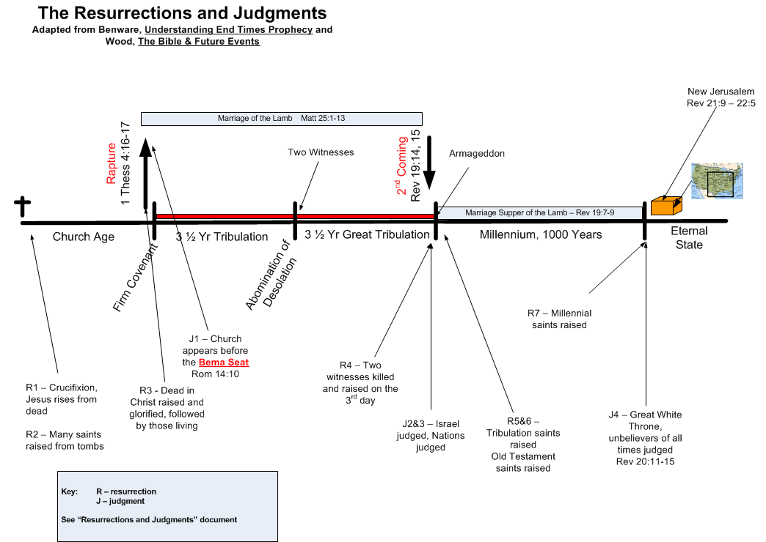

Slide 36
C. Six Arguments for the Pre-tribulation Rapture of the Church
…

Slide 37
1) The Scriptural Distinction between the Church and the Nation of Israel
Romans 11:25-27 For I do not want you, brethren, to be uninformed of this mystery—so that you will not be wise in your own estimation—that a partial hardening has happened to Israel until the fullness of the Gentiles has come in; ²⁶ and so all Israel will be saved; just as it is written, "THE DELIVERER WILL COME FROM ZION, HE WILL REMOVE UNGODLINESS FROM JACOB." ²⁷ "THIS IS MY COVENANT WITH THEM, WHEN I TAKE AWAY THEIR SINS."
God has two distinct programs – one for the gentiles and one for Israel. Based on the above verse it appears that He does not deal with the programs simultaneously, but the gentiles first and then Israel.

Slide 38
Stopped here.

Slide 39
2) Israel seems to be the focus of the tribulation period
Jeremiah 30:7 'Alas! for that day is great, There is none like it; And it is the time of Jacob's distress, But he will be saved from it.
Greatly concerned that God has forgotten His promise to restore Israel (Jer 25:11-12), Daniel prayers to God for an answer (Dan 9:4-19). Gabriel is sent to give the below response [note it is focused on Israel]…

Slide 40
Dan 9:24-27 "Seventy weeks [1 week = 7 years] have been decreed for your people and your holy city, to finish the transgression [end Israel’s disobedience], to make an end of sin [punish Israel’s disobedience], to make atonement for iniquity [cover Israel’s sins], to bring in everlasting righteousness [establish the millennial kingdom], to seal up vision and prophecy [finally fulfill all God’s promises], and to anoint the most holy place [anoint either the temple or Christ – as King]. ²⁵"So you are to know and discern that from the issuing of a decree to restore and rebuild Jerusalem until Messiah the Prince there will be seven weeks and sixty-two weeks; it will be built again, with plaza and moat, even in times of distress. ²⁶"Then after the sixty-two weeks the Messiah will be cut off and have nothing, and the people of the prince who is to come will destroy the city and the sanctuary. And its end will come with a flood; even to the end there will be war; desolations are determined. ²⁷"And he will make a firm covenant with the many for one week [this is the 70th week of “your people”], but in the middle of the week he will put a stop to sacrifice and grain offering; and on the wing of abominations will come one who makes desolate, even until a complete destruction, one that is decreed, is poured out on the one who makes desolate."

Slide 41
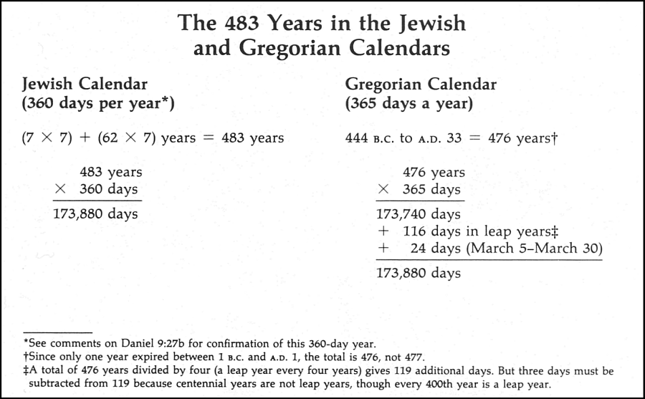
69 weeks = 483 yrs.

Slide 42
3) The tribulation has a distinct Jewish character; the focus is salvation to Israel
Mal 4:4-6 "Remember the law of Moses My servant, even the statutes and ordinances which I commanded him in Horeb for all Israel. ⁵"Behold, I am going to send you Elijah the prophet before the coming of the great and terrible day of the Lord. ⁶"And he will restore the hearts of the fathers to their children, and the hearts of the children to their fathers, lest I come and smite the land with a curse."
Deut 4:30 "When you are in distress and all these things have come upon you, in the latter days, you will return to the Lord your God and listen to His voice.
Dan 12:1 "Now at that time Michael, the great prince who stands guard over the sons of your people, will arise. And there will be a time of distress such as never occurred since there was a nation until that time; and at that time your people, everyone who is found written in the book, will be rescued.
Zech 13:8-9 "And it will come about in all the land," Declares the Lord, "That two parts in it will be cut off and perish; But the third will be left in it. ⁹"And I will bring the third part through the fire, Refine them as silver is refined, And test them as gold is tested. They will call on My name, And I will answer them; I will say, 'They are My people,' And they will say, 'The Lord is my God.' "
Dan 9:26-27 (see 2 above)
Jer 31:31 "Behold, days are coming," declares the Lord, "when I will make a new covenant with the house of Israel and with the house of Judah…
Ezek 36:24-28 , 39:25-29

Slide 43
4) The Concept of the Imminent Coming of Jesus Christ
James 5:8-9 You too be patient; strengthen your hearts, for the coming of the Lord is near [has drawn near]. ⁹ Do not complain, brethren, against one another, so that you yourselves may not be judged; behold, the Judge is standing [has stood] right at the door.
1 Thes. 1:10 …to wait for His Son from heaven [not to wait for another sign or prophesy to be fulfilled], whom He raised from the dead, that is Jesus, who rescues us from the wrath to come.

Slide 44
5) The Church is excluded from the Wrath of God
1 Thes. 5:9 For God has not destined us for wrath, but for obtaining salvation through our Lord Jesus Christ,
John 5:24 "Truly, truly, I say to you, he who hears My word, and believes Him who sent Me, has eternal life, and does not come into judgment, but has passed out of death into life.
Rom 5:9-10 Much more then, having now been justified by His blood, we shall be saved from the wrath of God through Him…
Rev. 3:10 'Because you have kept the word of My perseverance, I also will keep you from the hour of testing, that hour which is about to come upon the whole world, to test those who dwell upon the earth.

Slide 45
6) The lack of evidence of the Church’s presence during the tribulation
The church is not even hinted at in the 70th week [the tribulation period] described in Dan 9. Then Rev 2&3 are only about the church where as in all the details of Rev 6-19 [the tribulation period] there is no mention of the church.
.

Slide 46
D. The Tribulation

Slide 47
1) It is a unique time
Jer 30:7 'Alas! for that day is great, There is none like it; And it is the time of Jacob's distress, But he will be saved from it.
Dan 12:1 "Now at that time Michael, the great prince who stands guard over the sons of your people, will arise. And there will be a time of distress such as never occurred since there was a nation until that time; and at that time your people, everyone who is found written in the book, will be rescued.
Joel 2:1-2 Blow a trumpet in Zion, And sound an alarm on My holy mountain! Let all the inhabitants of the land tremble, For the day of the Lord is coming; Surely it is near, ²A day of darkness and gloom, A day of clouds and thick darkness. As the dawn is spread over the mountains, So there is a great and mighty people; There has never been anything like it, Nor will there be again after it To the years of many generations.

Slide 48
2) Great tribulation implies a lesser tribulation
Daniel 12:11 "And from the time that the regular sacrifice is abolished, and the abomination of desolation is set up, there will be 1,290 days. [Note: 1260 = 3 ½ years]
Matthew 24:15-21 "Therefore when you see the abomination of desolation which was spoken of through Daniel the prophet, standing in the holy place (let the reader understand), ¹⁶then let those who are in Judea flee to the mountains; ¹⁷let him who is on the housetop not go down to get the things out that are in his house; ¹⁸and let him who is in the field not turn back to get his cloak. ¹⁹"But woe to those who are with child and to those who nurse babes in those days! ²⁰"But pray that your flight may not be in the winter, or on a Sabbath; ²¹for then there will be a great tribulation, such as has not occurred since the beginning of the world until now, nor ever shall.

Slide 49
2) Great tribulation implies a lesser tribulation (cont’d)
Jeremiah 30:7 'Alas! for that day is great, There is none like it; And it is the time of Jacob's distress, But he will be saved from it.
Dan 7:25 'And he will speak out against the Most High and wear down the saints of the Highest One, and he will intend to make alterations in times and in law; and they will be given into his hand for a time, times, and half a time.
Daniel 12:1 "Now at that time Michael, the great prince who stands guard over the sons of your people, will arise. And there will be a time of distress such as never occurred since there was a nation until that time; and at that time your people, everyone who is found written in the book, will be rescued.
Joel 2:1-2 Blow a trumpet in Zion, And sound an alarm on My holy mountain! Let all the inhabitants of the land tremble, For the day of the Lord is coming; Surely it is near, ²A day of darkness and gloom, A day of clouds and thick darkness. As the dawn is spread over the mountains, So there is a great and mighty people; There has never been anything like it, Nor will there be again after it To the years of many generations.

Slide 50
End

