Slide 1
“I Then Shall Live”
Gloria Gaither
I then shall live as one who's been forgiven.
I'll walk with joy to know my debts are paid.
I know my name is clear before my Father;
I am His child and I am not afraid.
So, greatly pardoned, I'll forgive my brother;
The law of love I gladly will obey.
I then shall live as one who's learned compassion.
I've been so loved, that I'll risk loving too.
I know how fear builds walls instead of bridges;
I'll dare to see another's point of view.
And when relationships demand commitment,
Then I'll be there to care and follow through.
http://www.bing.com/videos/search?q=i+then+shall+live&view=detail&mid=9967CD89AC0A642734BB9967CD89AC0A642734BB&FORM=VIRE

Slide 2
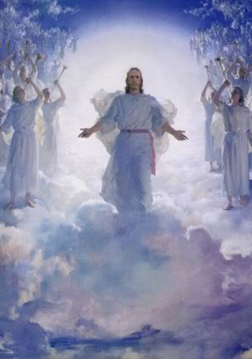
The Revelation of Jesus Christ
Finish the Transition to Rev 4
Rev. 1:3 Blessed is he who reads and those who hear the words of the prophecy, and heed the things which are written in it; for the time is near.

Slide 3
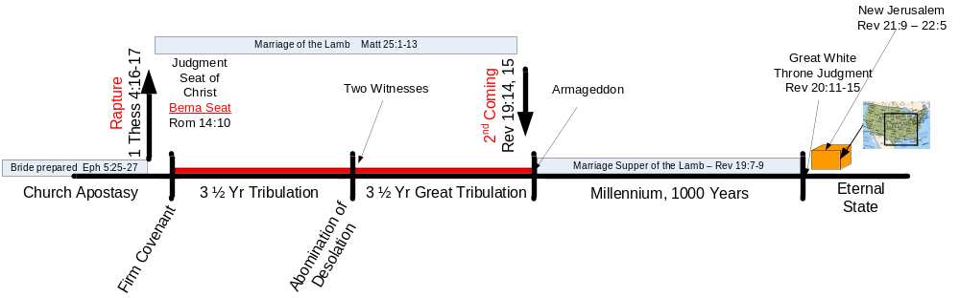
C. Six Arguments for the Pre-tribulation Rapture of the Church
…

Slide 4
1) The Scriptural Distinction between the Church and the Nation of Israel
Romans 11:25-27 For I do not want you, brethren, to be uninformed of this mystery—so that you will not be wise in your own estimation—that a partial hardening has happened to Israel until the fullness of the Gentiles has come in; ²⁶ and so all Israel will be saved; just as it is written, "THE DELIVERER WILL COME FROM ZION, HE WILL REMOVE UNGODLINESS FROM JACOB." ²⁷ "THIS IS MY COVENANT WITH THEM, WHEN I TAKE AWAY THEIR SINS."
God has two distinct programs – one for the gentiles and one for Israel. Based on the above verse it appears that He does not deal with the programs simultaneously, but the gentiles first and then Israel.

Slide 5
2) Israel seems to be the focus of the tribulation period
Jeremiah 30:7 'Alas! for that day is great, There is none like it; And it is the time of Jacob's distress, But he will be saved from it.
Greatly concerned that God has forgotten His promise to restore Israel (Jer 25:11-12), Daniel prays to God for an answer (Dan 9:4-19). Gabriel is sent to give the below response [note it is focused on Israel]…

Slide 6
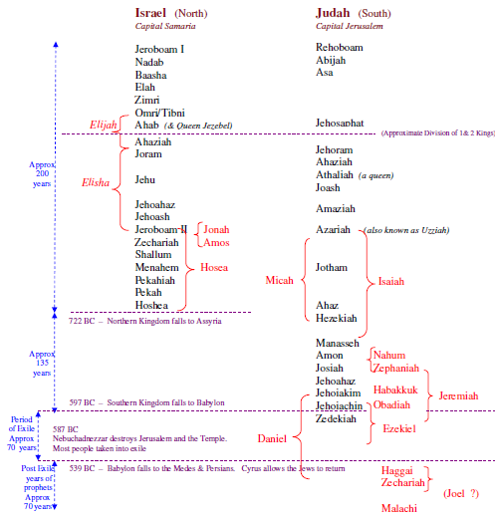

Slide 7
Dan 9:24-27 "Seventy weeks [1 week = 7 years] have been decreed for your people and your holy city, to finish the transgression [end Israel’s disobedience], to make an end of sin [punish Israel’s disobedience], to make atonement for iniquity [cover Israel’s sins], to bring in everlasting righteousness [establish the millennial kingdom], to seal up vision and prophecy [finally fulfill all God’s promises], and to anoint the most holy place [anoint either the temple or Christ – as King]. ²⁵"So you are to know and discern that from the issuing of a decree to restore and rebuild Jerusalem until Messiah the Prince there will be seven weeks and sixty-two weeks; it will be built again, with plaza and moat, even in times of distress. ²⁶"Then after the sixty-two weeks the Messiah will be cut off and have nothing, and the people of the prince who is to come will destroy the city and the sanctuary. And its end will come with a flood; even to the end there will be war; desolations are determined. ²⁷"And he will make a firm covenant with the many for one week [this is the 70th week of “your people”], but in the middle of the week he will put a stop to sacrifice and grain offering; and on the wing of abominations will come one who makes desolate, even until a complete destruction, one that is decreed, is poured out on the one who makes desolate."

Slide 8
The divisions of the 70 "sevens" (The Bible Knowledge Commentary: An Exposition of the Scriptures by Dallas Seminary Faculty)
Dan 9:25. Important revelation was given Daniel about the inception of this important time period and its divisions. The 70 "sevens" would begin, Gabriel said, with the issuing of the decree to restore and rebuild Jerusalem. This decree was the fourth of four decrees made by Persian rulers in reference to the Jews. The first was Cyrus' decree in 538 b.c. (2 Chron. 36:22-23; Ezra 1:1-4; 5:13). The second was the decree of Darius I (522-486) in 520 b.c. (Ezra 6:1, 6-12). This decree actually was a confirmation of the first decree. The third was the decree of Artaxerxes Longimanus (464-424) in 458 b.c. (Ezra 7:11-26). The first two decrees pertain to the rebuilding of the temple in Jerusalem and the third relates to finances for animal sacrifices at the temple. The fourth decree was also by Artaxerxes Longimanus, issued on March 5, 444 b.c. (Neh. 2:1-8). On that occasion Artaxerxes granted the Jews permission to rebuild Jerusalem's city walls. This decree is the one referred to in Daniel 9:25.
The end or goal of the prophecy is the appearance of the Anointed One, the Ruler. This refers to Christ Himself. God the Father anointed Christ with the Spirit at the time of His water baptism (Acts 10:38), but the anointing referred to here is the anointing of Christ as the Ruler in His kingdom. This prophecy of the 70 sevens, then, ends not with the First Advent of Christ, as some suggest, but rather with the Second Advent and the establishing of the millennial kingdom.
This 490-year period is divided into three segments; (a) 7 "sevens" (49 years), (b) 62 "sevens" (434 years), and (c) 1 "seven" (7 years). The first period of 49 years may refer to the time in which the rebuilding of the city of Jerusalem, permitted by Artaxerxes' decree, was completed (444-395 b.c.). Though Nehemiah's wall construction project took only 52 days, many years may have been needed to remove the city's debris (after being desolate for many decades), to build adequate housing, and to rebuild the streets and a trench.
Dan 9:26a. The 62 "sevens" (434 years) extend up to the introduction of the Messiah to the nation Israel. This second period concluded on the day of the Triumphal Entry just before Christ was cut off, that is, crucified.
Thus the first two segments of the important time period—the 7 sevens (49 years) and the 62 sevens (434 years)—ran consecutively with no time between them. They totaled 483 years and extended from March 5, 444 b.c. to March 30, a.d. 33. How can 444 b.c. to a.d. 33 equal 483 years? The Jewish calendar has 360 days/year and no leap years..

Slide 9
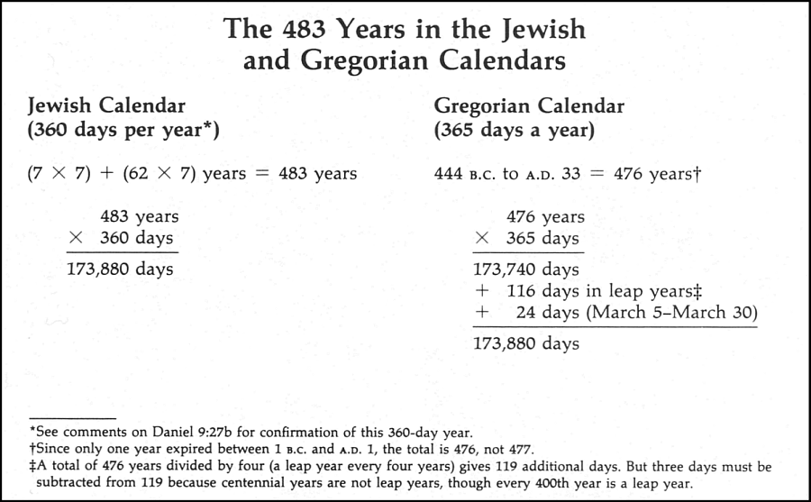

69 weeks = 483 yrs.

Slide 10
3) The tribulation has a distinct Jewish character; the focus is salvation to Israel
Mal 4:4-6 "Remember the law of Moses My servant, even the statutes and ordinances which I commanded him in Horeb for all Israel. ⁵"Behold, I am going to send you Elijah the prophet before the coming of the great and terrible day of the Lord. ⁶"And he will restore the hearts of the fathers to their children, and the hearts of the children to their fathers, lest I come and smite the land with a curse."
Deut 4:30 "When you are in distress and all these things have come upon you, in the latter days, you will return to the Lord your God and listen to His voice.
Dan 12:1 "Now at that time Michael, the great prince who stands guard over the sons of your people, will arise. And there will be a time of distress such as never occurred since there was a nation until that time; and at that time your people, everyone who is found written in the book, will be rescued.
Zech 13:8-9 "And it will come about in all the land," Declares the Lord, "That two parts in it will be cut off and perish; But the third will be left in it. ⁹"And I will bring the third part through the fire, Refine them as silver is refined, And test them as gold is tested. They will call on My name, And I will answer them; I will say, 'They are My people,' And they will say, 'The Lord is my God.' "
Dan 9:26-27 (see 2 above)
Jer 31:31 "Behold, days are coming," declares the Lord, "when I will make a new covenant with the house of Israel and with the house of Judah…
Ezek 36:24-28 , 39:25-29

Slide 11
4) The Concept of the Imminent Coming of Jesus Christ
James 5:8-9 You too be patient; strengthen your hearts, for the coming [parousia] of the Lord is near [has drawn near]. ⁹ Do not complain, brethren, against one another, so that you yourselves may not be judged; behold, the Judge is standing [has stood] right at the door.
1 Thes. 1:10 …to wait for His Son from heaven [not to wait for another sign or prophesy to be fulfilled], whom He raised from the dead, that is Jesus, who rescues us from the wrath to come.
2 Pet. 1:14 knowing that the laying aside of my earthly dwelling is imminent, as also our Lord Jesus Christ has made clear to me.

Slide 12
5) The Church is excluded from the Wrath of God
1 Thes. 5:9 For God has not destined us for wrath, but for obtaining salvation through our Lord Jesus Christ,
John 5:24 "Truly, truly, I say to you, he who hears My word, and believes Him who sent Me, has eternal life, and does not come into judgment, but has passed out of death into life.
Rom 5:9-10 Much more then, having now been justified by His blood, we shall be saved from the wrath of God through Him…
Rev. 3:10 'Because you have kept the word of My perseverance, I also will keep you from the hour of testing, that hour which is about to come upon the whole world, to test those who dwell upon the earth.

Slide 13
6) The lack of evidence of the Church’s presence during the tribulation
The church is not even hinted at in the 70th week [the tribulation period] described in Dan 9. Then Rev 2&3 are only about the church where as in all the details of Rev 6-19 [the tribulation period] there is no mention of the church.
.

Slide 14
D. The Tribulation

Slide 15
1) It is a unique time
Jer 30:7 'Alas! for that day is great, There is none like it; And it is the time of Jacob's distress, But he will be saved from [victory in time of war] it.
Dan 12:1 "Now at that time Michael, the great prince who stands guard over the sons of your people, will arise. And there will be a time of distress such as never occurred since there was a nation until that time; and at that time your people, everyone who is found written in the book, will be rescued [allowed to flee to safety].
Joel 2:1-2 Blow a trumpet in Zion, And sound an alarm on My holy mountain! Let all the inhabitants of the land tremble, For the day of the Lord is coming; Surely it is near, ²A day of darkness and gloom, A day of clouds and thick darkness. As the dawn is spread over the mountains, So there is a great and mighty people; There has never been anything like it, Nor will there be again after it To the years of many generations.
“Day of the Lord” includes the great tribulation, the following judgment on the nations, and the time of worldwide blessing under the rule of the Messiah.
Joel 2:18 Then the LORD will be zealous for His land And will have pity on His people.

Slide 16
2) Great tribulation implies a lesser tribulation
Daniel 12:11 "And from the time that the regular sacrifice is abolished, and the abomination of desolation is set up, there will be 1,290 days. [Note: 1260 = 3 ½ years]
Matthew 24:15-21 "Therefore when you see the abomination of desolation which was spoken of through Daniel the prophet, standing in the holy place (let the reader understand), ¹⁶then let those who are in Judea flee to the mountains; ¹⁷let him who is on the housetop not go down to get the things out that are in his house; ¹⁸and let him who is in the field not turn back to get his cloak. ¹⁹"But woe to those who are with child and to those who nurse babes in those days! ²⁰"But pray that your flight may not be in the winter, or on a Sabbath; ²¹for then there will be a great tribulation, such as has not occurred since the beginning of the world until now, nor ever shall.

Slide 17
2) Great tribulation implies a lesser tribulation (cont’d)
Jeremiah 30:7 'Alas! for that day is great, There is none like it; And it is the time of Jacob's distress, But he will be saved from it.
Dan 7:25 'And he will speak out against the Most High and wear down the saints of the Highest One, and he will intend to make alterations in times and in law; and they will be given into his hand for a time, times, and half a time.
Daniel 12:1 "Now at that time Michael, the great prince who stands guard over the sons of your people, will arise. And there will be a time of distress such as never occurred since there was a nation until that time; and at that time your people, everyone who is found written in the book, will be rescued.
Joel 2:1-2 Blow a trumpet in Zion, And sound an alarm on My holy mountain! Let all the inhabitants of the land tremble, For the day of the Lord is coming; Surely it is near, ²A day of darkness and gloom, A day of clouds and thick darkness. As the dawn is spread over the mountains, So there is a great and mighty people; There has never been anything like it, Nor will there be again after it To the years of many generations.

Slide 19
The Revelation of Jesus Christ
Chap 4 of 22
Rev. 22:10 And he said to me, "Do not seal up the words of the prophecy of this book, for the time is near.
The Throne in Heaven
Rev. 1:3 Blessed is he who reads and those who hear the words of the prophecy, and heed the things which are written in it; for the time is near.

Slide 20
The Narrator
Rev 19:10 Then I fell at his feet to worship him. But he *said to me, "Do not do that; I am a fellow servant of yours and your brethren who hold the testimony of Jesus; worship God. For the testimony of Jesus is the spirit of prophecy."
Rev 22:8-9 I, John, am the one who heard and saw these things. And when I heard and saw, I fell down to worship at the feet of the angel who showed me these things. ⁹ But he *said to me, "Do not do that. I am a fellow servant of yours and of your brethren the prophets and of those who heed the words of this book. Worship God.“

Slide 21
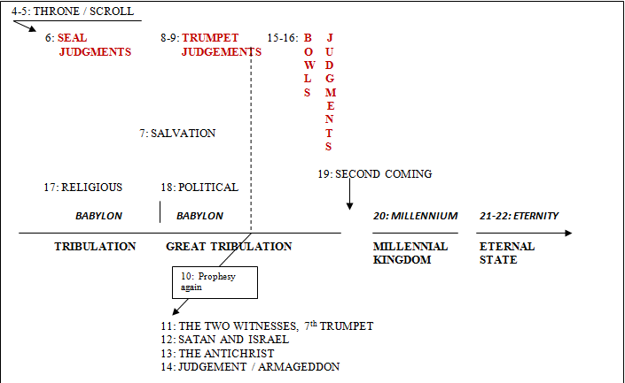
Third Major Section of Revelation: Ch 4-22
(Benware, “Understanding End Times Prophecy”)
Rev. 1:19 "Write therefore the things which you have seen, and the things which are, and the things which shall take place after these things.

Slide 22
8. Outline of Revelation
Chapters | Topic
1 | Things which you have seen ─ Glorified Christ in heaven
2-3 | Things which are ─ 7 letters to the 7 churches
4-5 | Things which shall take place ─ Introduction / background to the future — 7 sealed scroll
6 | 6 seals
7 | 1st parenthetic ─ 2 groups (144,000, multitude of gentiles in white robes)
8 | 7th seal and first 4 trumpets
9 | 5th & 6th trumpets, 1st & 2nd Woes
10-11:14 | 2nd parenthetic ─ the little book, the two witnesses, end of 2nd Woe
11:15-19 | 7th trumpet, 3rd Woe
12 | 3rd parenthetic ─ important characters
13 | 3rd parenthetic ─ wicked rulers
14 | 3rd parenthetic ─ visions of Christ triumphant
15-16 | 7 bowls leading to the 2nd coming of Christ
17 | 4th parenthetic ─ Destruction of ecclesiastic Babylon
18 | 4th parenthetic ─ Destruction of political Babylon
19 | 2nd Coming of Christ, the great supper of God
20 | Millennial reign of Christ ─ Satan bound, 1000 year reign, Satan released, great white throne judgment
21 | New Jerusalem, new heaven and new earth
22 | Concluding revelations

Slide 23
¹After these things I looked, and behold, a door standing open in heaven, and the first voice which I had heard, like the sound of a trumpet speaking with me, said, "Come up here, and I will show you what must take place after these things.” “must” – reflects the sovereign purpose of God, it is immutable, “unable to change” | Revelation 1:1 The Revelation of Jesus Christ, which God gave Him to show to His bond-servants, the things which must soon take place; and He sent and communicated it by His angel to His bond-servant John, Revelation 1:19 "Therefore write the things which you have seen, and the things which are, and the things which will take place after these things. Revelation 22:16 "I, Jesus, have sent My angel to testify to you these things for the churches… | After these things – after church age [amillennialists miss the phrase] “Church” not mentioned again until Rev 22

Slide 24
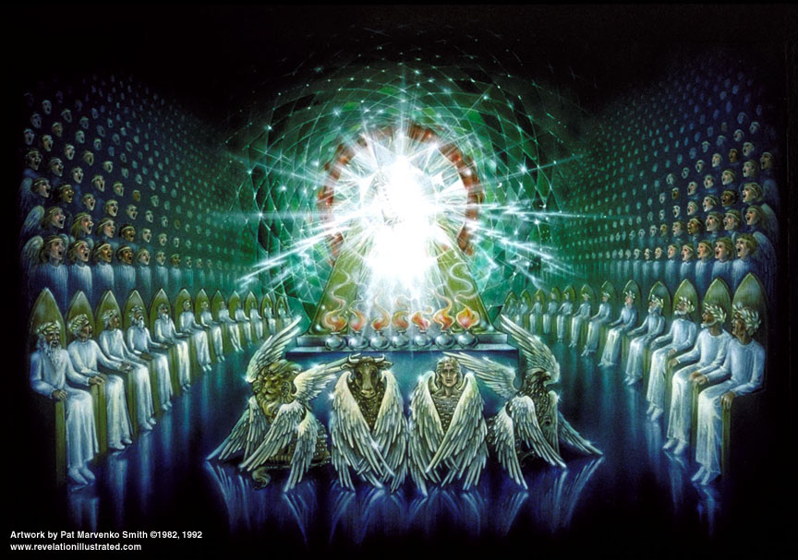
10. Rev 4 – The Throne in Heaven

Slide 25
²Immediately I was in the Spirit; and behold, a throne was standing in heaven, and One sitting on the throne. ³And He who was sitting was like a jasper stone and a sardius in appearance; and there was a rainbow around the throne, like an emerald in appearance. | Ezekiel 1:22-28 Now over the heads of the living beings there was something like an expanse, like the awesome gleam of crystal, extended over their heads. … ²⁶… something resembling a throne…a figure with the appearance of a man. ^{…28}As the appearance of the rainbow in the clouds on a rainy day, so was the appearance of the surrounding radiance. Such was the appearance of the likeness of the glory of the LORD. And when I saw it, I fell on my face… Luke 1:32-33 "He will be great, and will be called the Son of the Most High; and the Lord God will give Him the throne of His father David; ³³and he will reign over the house of Jacob forever; and His kingdom will have no end." Isaiah 54:9 "For this is like the days of Noah to Me; When I swore that the waters of Noah Should not flood the earth again, So I have sworn that I will not be angry with you, Nor will I rebuke you. ¹⁰"For the mountains may be removed and the hills may shake, But My lovingkindness will not be removed from you, And My covenant of peace will not be shaken," Says the Lord who has compassion on you. | Standing open – always opened Throne – not of grace but judgment (adjudication) Hebrews 4:16 Let us therefore draw near with confidence to the throne of grace,… Rainbow – iris (halo), covenant token, God keeps His promises… Church trials are over Earth’s redemption near Israel’s redemption near God will never rebuke Israel again.
Stones in the High Priest’s ephod:
1st, sardius – tribe of Reuben, “see, a son”, blood red, 1st Advent of suffering
4th, emerald – tribe of Judah, “praises”, tribe of the King
12th, jasper– tribe of Benjamin, “son of my right hand”, clear, 2nd Advent of righteousness

Slide 26
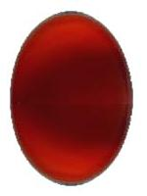
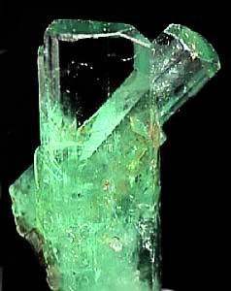

Rev 4 colors
sardius stone
Reuben
“see, a son”
1st Advent of Suffering
emerald stone
Judah
“praises”
Tribe of the King
jasper stone
Benjamin
“son of my right hand”
2nd Advent of Righteousness
& Power

Slide 27
⁴And around the throne were twenty-four thrones; and upon the thrones I saw twenty-four elders sitting, clothed in white garments, and golden crowns on their heads. Note: the Old Testament saints have not been resurrected yet, only the Church saints. Rev 5:9-10 And they *sang a new song, saying, "Worthy are You to take the book and to break its seals; for You were slain, and purchased for God with Your blood men from every tribe and tongue and people and nation. ¹⁰ "You have made them to be a kingdom and priests to our God; and they will reign upon the earth." | Rev. 19:8 And it was given to her to clothe herself in fine linen, bright and clean; for the fine linen is the righteous acts of the saints. 1 Cor 9:25 incorruptible crown - Victor 1 Thes 2:19 crown of rejoicing – Soul winner 2 Tim. 4:8 crown of righteousness – loved His appearing James 1:12 crown of life - Martyr 1 Peter 5:4 crown of glory – Elder | There were 24 “courses” of priests serving the Lord [1 Chron. 24:1-19] Elders – presbuteros Crowns – stephanos, crown of victory; not authority [diadema]

Slide 28
⁵And from the throne proceed flashes of lightning and sounds and peals of thunder. And there were seven lamps of fire burning before the throne, which are the seven Spirits of God; | Exodus 25:37 "Then you shall make its lamps seven in number; and they shall mount its lamps so as to shed light on the space in front of it.

Slide 29
⁶and before the throne there was, as it were, a sea of glass like crystal; and in the center and around the throne, four living creatures full of eyes in front and behind. ⁷And the first creature was like a lion, and the second creature like a calf, and the third creature had a face like that of a man, and the fourth creature was like a flying eagle. ⁸And the four living creatures, each one of them having six wings, are full of eyes around and within; and day and night they do not cease to say, "Holy, holy, holy, is the Lord God, the Almighty, who was and who is and who is to come." | Ezekiel 1:10 As for the form of their faces, each had the face of a man, all four had the face of a lion on the right and the face of a bull on the left, and all four had the face of an eagle. Isaiah 6:1-3 In the year of King Uzziah's death I saw the Lord sitting on a throne, lofty and exalted, … ² Seraphim stood above Him, each having six wings: with two he covered his face, and with two he covered his feet, and with two he flew. ³ And one called out to another and said, "Holy, Holy, Holy, is the LORD of hosts, The whole earth is full of His glory." Doxology | Four living creatures – [zoon] created, cherubim? Lion – Matthew Calf – Mark Man – Luke Eagle – John Four living creatures – worship who God is. Cherubim are found – In Gardin of Eden On Mercy Seat Tabernacle curtains Tabernacle veil Heb 9:5 and above it were the cherubim of glory overshadowing the mercy seat; but of these things we cannot now speak in detail.

Slide 30
Doxa – glory “Words of glory”: 1) praise, 2) eternal attributes
Logos – word
14 Doxologies in the Book of Revelation
References | The One(s) Giving the Praise | The One(s) Receiving the Praise
4:8 | 4 living creatures | God the Father
4:11 | 24 elders | God the Father
5:9-10 | 24 elders and 4 living creatures | The Lamb (Christ)
5:12 | Many angels | The Lamb
5:13 | Every creature | God the Father and the Lamb
7:10 | Tribulation martyrs | God the Father and the Lamb
7:12 | Angels, 24 elders, and 4 living creatures | God the Father
11:16-18 | 24 elders | God the Father
15:3-4 | Tribulation saints | God the Father and the Lamb
16:5-6 | Angel | God the Father
16:7 | “The altar” | God the Father
19:1-3 | A great multitude | God the Father
19:4 | 24 elders and 4 living creatures | God the Father
19:6-8 | A great multitude | God the Father

Slide 31
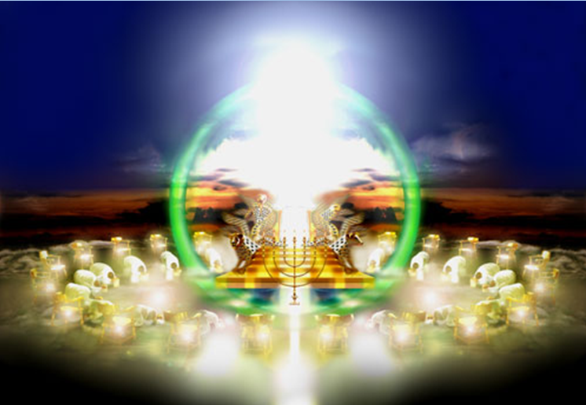
http://mattstone.blogs.com/photos/sacred_images/throne.html

Slide 32
⁹And when the living creatures give glory and honor and thanks to Him who sits on the throne, to Him who lives forever and ever, ¹⁰the twenty-four elders will fall down before Him who sits on the throne, and will worship Him who lives forever and ever, and will cast their crowns before the throne, saying, ¹¹"Worthy art Thou, our Lord and our God, to receive glory and honor and power; for Thou didst create all things, and because of Thy will they existed, and were created." | Romans 11:25 For I do not want you, brethren, to be uninformed of this mystery, lest you be wise in your own estimation, that a partial hardening has happened to Israel until the fullness of the Gentiles has come in; Doxology | Cast crowns – acknowledging that only God’s grace and salvation gave them victory over sin and death. 24 Elders – worship what God has done.
  Luke 21:24 and they will fall by the edge of the sword, and will be led captive into all the nations; and Jerusalem will be trampled under foot by the Gentiles until the times of the Gentiles be fulfilled.
  John 10:16 "And I have other sheep, which are not of this fold; I must bring them also, and they shall hear My voice; and they shall become one flock with one shepherd.

Slide 33
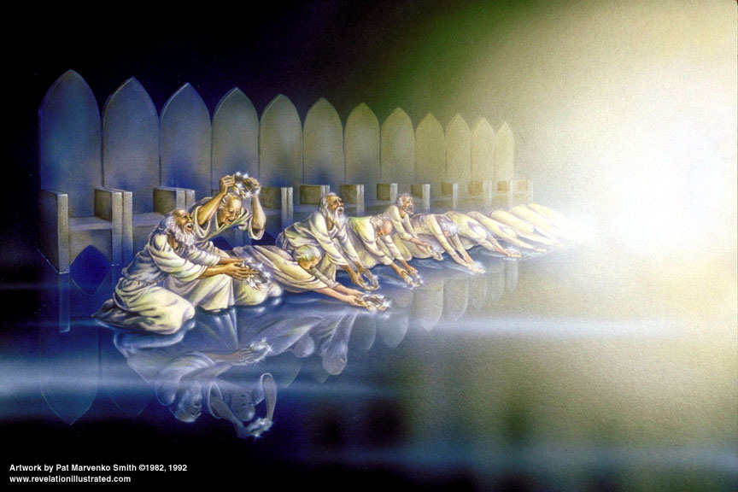

Slide 34
End

