Slide 1
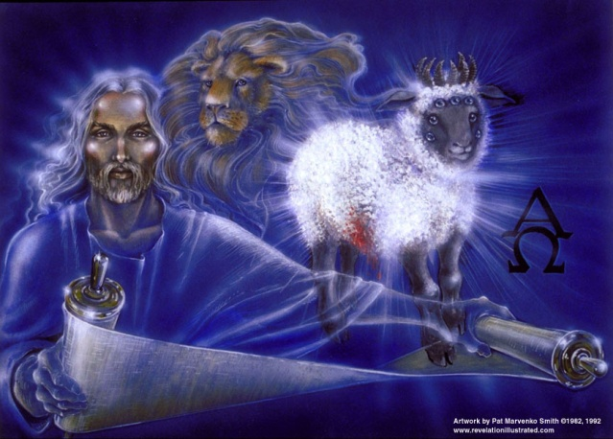
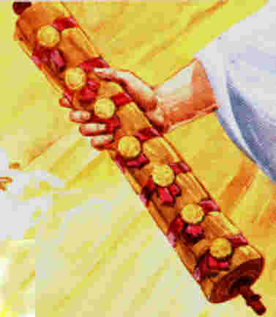
The Revelation of Jesus Christ
Chapter 5 of 22
Rev. 22:10 And he said to me, "Do not seal up the words of the prophecy of this book, for the time is near.
Rev. 1:3 Blessed is he who reads and those who hear the words of the prophecy, and heed the things which are written in it; for the time is near.

Slide 2
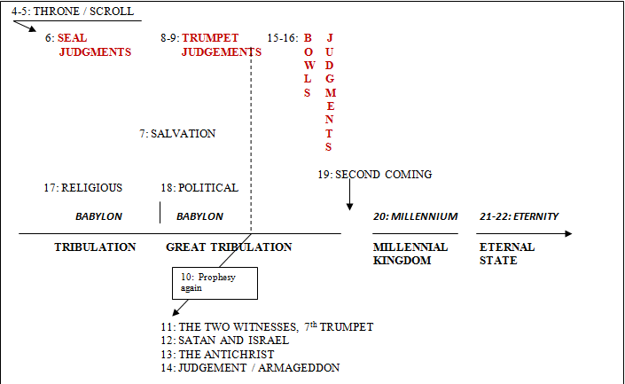
Third Major Section of Revelation: Ch 4-22
(Benware, “Understanding End Times Prophecy”)
Rev. 1:19 "Write therefore the things which you have seen, and the things which are, and the things which shall take place after these things.

Slide 3
8. Outline of Revelation
Chapters | Topic
1 | Things which you have seen ─ Glorified Christ in heaven
2-3 | Things which are ─ 7 letters to the 7 churches
4-5 | Things which shall take place ─ Introduction / background to the future — 7 sealed scroll
6 | 6 seals
7 | 1st parenthetic ─ 2 groups (144,000, multitude of gentiles in white robes)
8 | 7th seal and first 4 trumpets
9 | 5th & 6th trumpets, 1st & 2nd Woes
10-11:14 | 2nd parenthetic ─ the little book, the two witnesses, end of 2nd Woe
11:15-19 | 7th trumpet, 3rd Woe
12 | 3rd parenthetic ─ important characters
13 | 3rd parenthetic ─ wicked rulers
14 | 3rd parenthetic ─ visions of Christ triumphant
15-16 | 7 bowls leading to the 2nd coming of Christ
17 | 4th parenthetic ─ Destruction of ecclesiastic Babylon
18 | 4th parenthetic ─ Destruction of political Babylon
19 | 2nd Coming of Christ, the great supper of God
20 | Millennial reign of Christ ─ Satan bound, 1000 year reign, Satan released, great white throne judgment
21 | New Jerusalem, new heaven and new earth
22 | Concluding revelations

Slide 4
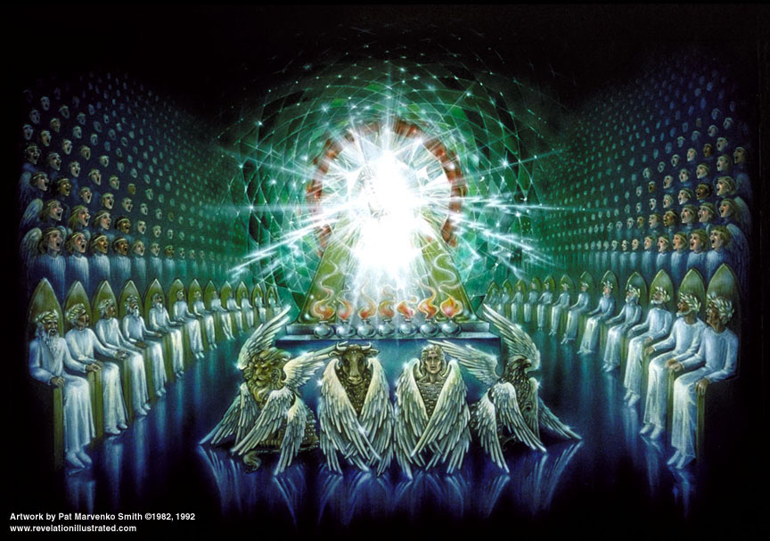
10. Rev 4 – The Throne in Heaven

Slide 5
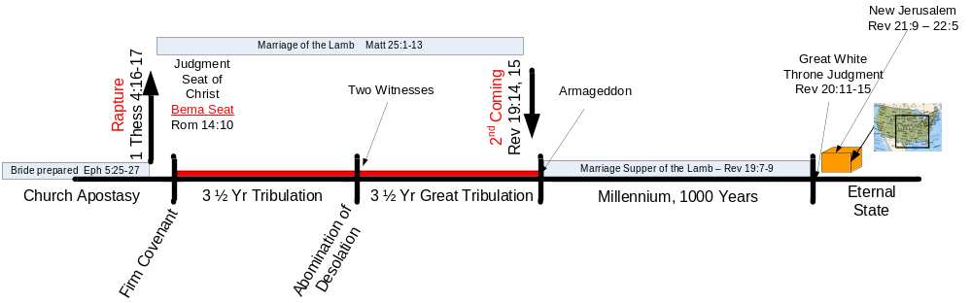
1. Remember the
Primary Focus of Tribulation
Daniel 9:2, 24 in the first year of his reign I, Daniel, observed in the books the number of the years which was revealed as the word of the Lord to Jeremiah the prophet for the completion of the desolations of Jerusalem, …²⁴ "Seventy weeks [periods of 7] have been decreed for your people and your holy city, to finish the transgression, to make an end of sin, to make atonement for iniquity, to bring in everlasting righteousness, to seal up vision and prophecy, and to anoint the most holy place.

Slide 6

Three Purposes of the Tribulation
Note: Scripture recognizes three classes of people:
1 Cor. 10:32 Give no offense either to Jews or to Greeks or to the church of God;
Daniel 9:24 "Seventy weeks have been decreed for your people and your holy city, to finish the transgression, to make an end of sin, to make atonement for iniquity, to bring in everlasting righteousness, to seal up vision and prophecy, and to anoint the most holy place. [note 7 purposes]
Matthew 24:14 "And this gospel of the kingdom shall be preached in the whole world for a witness to all the nations, and then the end shall come.
Isaiah 24:21 So it will happen in that day, That the Lord will punish the host of heaven, on high, And the kings of the earth, on earth.

Slide 7
Keys to Rev 4 - 22
Understanding God’s dealing with Israel is impossible without understanding two things…
4 of the 8 Biblical Covenants
[What needs to be fulfilled]
and
Redemption
[How it will be fulfilled]

Slide 8
2. First Key – Understand The Biblical Covenants
A. The Biblical Covenants are:
Edenic
Adamic
Noahic
Abrahamic
Mosaic
Palestinian
Davidic
New
Galatians 3:15 Brethren, I speak in terms of human relations: even though it is only a man's covenant, yet when it has been ratified, no one sets it aside or adds conditions to it.
[Also Gal 3:17]
Ephes. 2:12 remember that you were at that time separate from Christ, excluded from the commonwealth of Israel, and strangers to the covenants of promise, having no hope and without God in the world.

Slide 9
2. Biblical Covenants
Adapted from “Understanding End Times Prophecy”
by Paul Benware
Moody Press
Palestinian
Deut. 27
-30
Abrahamic
Gen. 12
Edenic
Gen. 1:26-
3:6
Adamic
Gen. 3:7-
8:19
Noahic
Gen. 8:20
-11:9
Davidic
2 Sam 7
Mosaic
Ex 20,
Gal 3
New
Jer. 31
K
I
N
G
D
O
M
Adam & Eve
Mankind
Noah
Formation
of Israel
Theocracy
Monarchy
e
x
i
l
e
Restoration
Church
Patriarchs
Moses, Joshua
Priests
Judges
Kings
Ezra
Nehemiah
Apostles
Jesus Christ

Slide 10
B. Abrahamic — EUU
1
Genesis 12:1-7; 15:5,18-21; 12:14-17; 17:7-8; 22:15-18 ⎯ unconditional – “I will”:
personal
  Father of great nation
  Abram’s name would be great
  Abram would be the father of many nations
national
  Land of Palestine/Canaan/Moriah promised to Abraham’s seed [descendents]
  Everlasting covenant with Isaac and descendents
universal
  blessing to those who bless Abraham [Gen 17:5]
  cursing to those who curse Abraham
  blessing to all families of the earth thru the Messiah
2
Gen 21:12 – promises passed to Isaac
Gen 28:4 – promises passed to Jacob

Slide 11
Everlasting
Genesis 13:15 for all the land which you see, I will give it to you and to your descendants forever.
1 Chronicles 16:16-17 The covenant which He made with Abraham, And His oath to Isaac. ¹⁷ He also confirmed it to Jacob for a statute, To Israel as an everlasting covenant,

Slide 12
Unconditional
Deuteronomy 9:5 "It is not for your righteousness or for the uprightness of your heart that you are going to possess their land, but it is because of the wickedness of these nations that the LORD your God is driving them out before you, in order to confirm the oath which the LORD swore to your fathers, to Abraham, Isaac and Jacob.
2 Kings 13:23 But the LORD was gracious to them and had compassion on them and turned to them because of His covenant with Abraham, Isaac, and Jacob, and would not destroy them or cast them from His presence until now.

Slide 13
B. Abrahamic — EUU
1
Genesis 12:1-7; 15:5,18-21; 12:14-17; 17:7-8; 22:15-18 ⎯ unconditional – “I will”:
personal
  Father of great nation
  Abram’s name would be great
  Abram would be the father of many nations
national
  Land of Palestine/Canaan/Moriah promised to Abraham’s seed [descendents]
  Everlasting covenant with Isaac and descendents
universal
  blessing to those who bless Abraham [Gen 17:5]
  cursing to those who curse Abraham
  blessing to all families of the earth thru the Messiah
2
Gen 17:19 – promises passed to Isaac
Gen 28:4 – promises passed to Jacob

Slide 14
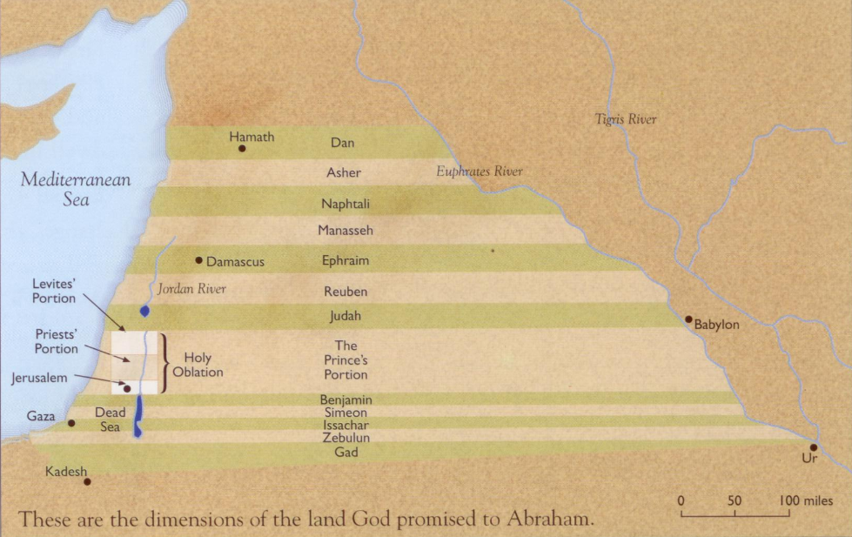
Land Promised to Abraham
Tim LaHaye
“Charting the End Times”

Slide 15
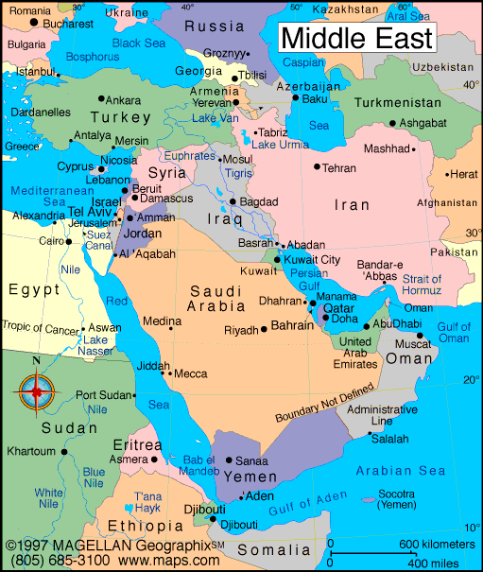
Genesis 15:18 On that day the LORD made a covenant with Abram, saying, "To your descendants I have given this land, From the river of Egypt as far as the great river, the river Euphrates:

Slide 16
C. Palestinian — EUU
Details the land aspect of the Abrahamic covenant.
Deut. 27:1, 27:12-14, 28:1, 28:15, 29:4, 29:26-29, 30:1-14
The nation will be plucked off the land for its unfaithfulness
there will be a future repentance of Israel
Israel will be restored to the land
Israel will be converted as a nation
Israel's enemies will be judged
the nation will then receive her full blessing
As an extension of the Abrahamic covenant this one is also ultimately EUU. The conditions in it are for immediate blessings, e.g. the blesssings shall come upon and overtake you.
Deut. 30:5 "And the Lord your God will bring you into the land which your fathers possessed, and you shall possess it; and He will prosper you and multiply you more than your fathers.
3

Slide 17
D. Davidic— EUU
Enlarges the seed promises of the Abrahamic covenant.
2 Samuel 7:9-17
• name great
• land forever
• unending dynasty
everlasting kingdom
2 Samuel 7:12-13 "When your days are complete and you lie down with your fathers, I will raise up your descendant after you, who will come forth from you, and I will establish his kingdom. ¹³"He shall build a house for My name, and I will establish the throne of his kingdom forever.
4

Slide 18
E. New Covenant — EUU
Develops the blessing aspect of the Abrahamic covenant.
Jeremiah 31:31-34, Luke 22:20, John 1:17 ⎯ Something new?
• Grace • regeneration
• national restoration • ministry of the Holy Spirit
full justification
Jeremiah 31:31-34 "Behold, days are coming," declares the Lord, "when I will make a new covenant with the house of Israel and with the house of Judah, … ³³"But this is the covenant which I will make with the house of Israel after those days," declares the Lord, "I will put My law within them, and on their heart I will write it; and I will be their God, and they shall be My people. ³⁴"And they shall not teach again, each man his neighbor and each man his brother, saying, 'Know the Lord,' for they shall all know Me, from the least of them to the greatest of them," declares the Lord, "for I will forgive their iniquity, and their sin I will remember no more."
5

Slide 19
2. Biblical Covenants
Adapted from “Understanding End Times Prophecy”
by Paul Benware
Moody Press
Palestinian
Deut. 27
-30
Abrahamic
Gen. 12
Edenic
Gen. 1:26-
3:6
Adamic
Gen. 3:7-
8:19
Noahic
Gen. 8:20
-11:9
Davidic
2 Sam 7
Mosaic
Ex 20,
Gal 3
New
Jer. 31
K
I
N
G
D
O
M
Adam & Eve
Mankind
Noah
Formation
of Israel
Theocracy
Monarchy
e
x
i
l
e
Restoration
Church
Patriarchs
Moses, Joshua
Priests
Judges
Kings
Ezra
Nehemiah
Apostles
Jesus Christ

Slide 20
The Point Is?
For biblical authors, “righteousness” is the fulfillment of the terms of a covenant, between God and humanity or between humans in the full range of human relationships. [Holman Bible Dictionary]
The Abrahamic, Palestinian, Davidic, and New Covenants are everlasting, unconditional, and unfilled
For God to be righteous He must keep His covenant promises! God must “redeem” Israel, redeem the land, and establish the Millennial Kingdom.

Slide 21
3. Understand Redemption
– 2nd Key to Revelation
Ga’al, the Hebrew word “to redeem” or “redeemer” or “avenger”
[ga’al] is the person with the legal responsibility to protect the rights of an endangered relative. Either to redeem or to avenge. Hence:
Ga’al is both Kinsman Redeemer and Blood Avenger
Takes life of one who killed a family member
Buys back a relative who sold himself into slavery
Marries the widow of a relative to create posterity
Buys back property lost to the family

Slide 22
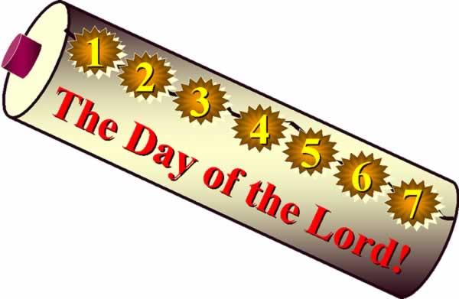
3. Understand Redemption
– 2nd Key to Revelation
A. Old Testament provided for redemption of a wife, a slave, and possessions (land).
At this point the Bride [church] has been redeemed, and we [His bond-servants] have been redeemed (raptured); but neither the earth nor Israel!
Lost land could be redeemed before the Year of Jubilee according to redemption terms. These were written on two scrolls. One was left open for all to read. The other was sealed with seven seals and kept in the temple until a kinsman redeemer gave evidence that he was willing and able to redeem the land. Later, one scroll was used and the terms written on the inside and summarized on the outside. [Lev 25, Jer 32:11, Ruth ]
Leviticus 25:23 'The land, moreover, shall not be sold permanently, for the land is Mine…
Adam “lost” his land - all of the earth
Genesis 3:17 Then to Adam He said, "Because you have listened to the voice of your wife, and have eaten from the tree about which I commanded you, saying, 'You shall not eat from it'; Cursed is the ground because of you;
Romans 8:20-22 For the creation was subjected to futility, not of its own will, but because of Him who subjected it, in hope ²¹that the creation itself also will be set free from its slavery to corruption into the freedom of the glory of the children of God. ²²For we know that the whole creation groans and suffers the pains of childbirth together until now.

Slide 23
3. Understand Redemption – Key to Revelation
Jesus Christ is the second Adam, who came to redeem that which the first Adam lost by sinning.
John 12:31 "Now judgment is upon this world; now the ruler of this world shall be cast out.”
Isaiah 11:6-9 And the wolf will dwell with the lamb, And the leopard will lie down with the kid, And the calf and the young lion and the fatling together; And a little boy will lead them… ⁹They will not hurt or destroy in all My holy mountain, For the earth will be full of the knowledge of the Lord As the waters cover the sea.
B. Jesus is the Kinsman Redeemer [ga’al]
To be “WORTHY” the kinsman redeemer must:
Be a near relative
Be Willing
Be Able
Jesus is a near relative (Son of Man)
Hebrews 7:14
Jesus is willing (to pay the price)
Hebrews 10:5-7
Jesus is able
John 1:1-3, 16:33; 1Pet 1:18-19

Slide 24
Jesus is a near relative:
Hebrews 7:14 For it is evident that our Lord was descended from Judah, a tribe with reference to which Moses spoke nothing concerning priests.
Jesus is willing:
Hebrews 10:5-7 Therefore, when He comes into the world, He says,
"Sacrifice and offering Thou hast not desired,
But A BODY Thou hast prepared for Me;
⁶In whole burnt offerings and sacrifices for sin Thou hast taken no pleasure.
⁷"Then I said, 'Behold, I have come
(In THE ROLL OF THE BOOK IT IS WRITTEN OF Me)
To do Thy will, O God.' " [Psalm 40:7-8]
As Deity, Jesus is able:
John 1:1-3 In the beginning was the Word, and the Word was with God, and the Word was God. ²He was in the beginning with God. ³All things came into being by Him, and apart from Him nothing came into being that has come into being.
John 16:33 "These things I have spoken to you, that in Me you may have peace. In the world you have tribulation, but take courage; I have overcome the world."
1 Peter 1:18-19 knowing that you were not redeemed with perishable things like silver or gold from your futile way of life inherited from your forefathers, ¹⁹ but with precious blood, as of a lamb unblemished and spotless, the blood of Christ.

Slide 25
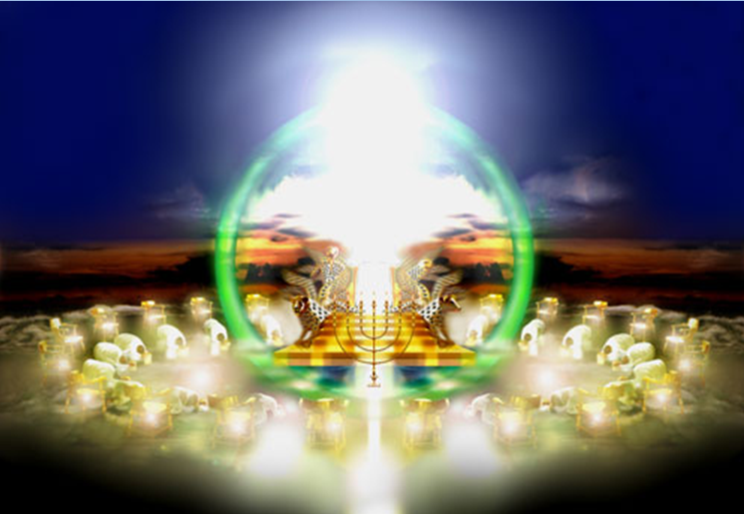
http://mattstone.blogs.com/photos/sacred_images/throne.html

Slide 26
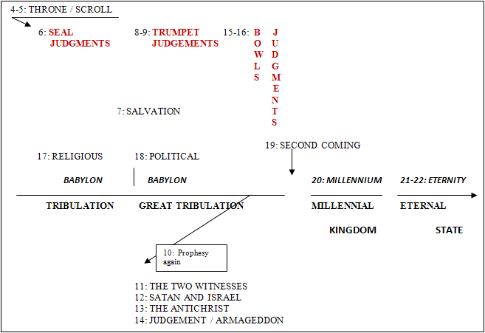
4. Rev 5 – The Lion, the Lamb, and the Scroll
(Benware, “Understanding End Times Prophecy”)
Rev. 1:19 "Write therefore the things which you have seen, and the things which are, and the things which shall take place after these things.

Slide 27
The Scroll….
The book [scroll] in Rev 5 is a book of redemption, written on both sides and with seven seals. It contains the terms of redemption.

Slide 28
¹And I saw in the right hand of Him who sat on the throne a book [scroll] written inside and on the back, sealed up with seven seals. ²And I saw a strong angel proclaiming with a loud voice, "Who is worthy to open the book and to break its seals?" ³And no one in heaven, or on the earth, or under the earth, was able to open the book, or to look into it. ⁴And I began to weep greatly, because no one was found worthy to open the book, or to look into it; ⁵and one of the elders said to me, "Stop weeping; behold, the Lion that is from the tribe of Judah, the Root of David, has overcome so as to open the book and its seven seals." ⁶And I saw between the throne (with the four living creatures) and the elders a Lamb standing, as if slain, having seven horns and seven eyes, which are the seven Spirits of God, sent out into all the earth. ⁷And He came, and He took it out of the right hand of Him who sat on the throne. | Genesis 49:9-10 "Judah is a lion's whelp; From the prey, my son, you have gone up. He couches, he lies down as a lion, And as a lion, who dares rouse him up? ¹⁰"The scepter shall not depart from Judah, Nor the ruler's staff from between his feet, Until Shiloh comes, And to him shall be the obedience of the peoples. Daniel 7:13-14 "I kept looking in the night visions, And behold, with the clouds of heaven One like a Son of Man was coming, And He came up to the Ancient of Days And was presented before Him. ¹⁴"And to Him was given dominion, Glory and a kingdom, That all the peoples, nations, and men of every language Might serve Him. His dominion is an everlasting dominion Which will not pass away; And His kingdom is one Which will not be destroyed. | Rev 5:1-7 key to all of Rev And – continue from Rev 4 Strong angel – Gabriel. See Dan 12. Worthy – as kinsman redeemer Jeremiah 32 – example of land redemption Luke 4:5-8 Satan’s domain Luke 2:38 And at that very moment she came up and began giving thanks to God, and continued to speak of Him to all those who were looking for the redemption of Jerusalem.

Slide 29
The Scroll
Robert van Kampen owns one of the world's most extensive private collections of biblical manuscripts, with many dating back to the second century. He writes in his book, "The Sign," [pre-wrath position] that of the many scrolls in his possession not one has a seal on the inside. When sealed, the scrolls are all done so from the outside. When one seal is present, it was usually placed there by the author of the scroll. When more than one seal is present it indicates a series or set of conditions that must be met before the scroll can actually be opened. He also cites that the Shrine of the Book located on the grounds of the Israel Museum in Jerusalem has many scrolls that have multiple seals placed on them, yet not one scroll has a seal on the inside.

Slide 30
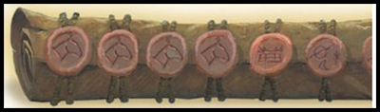
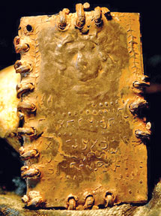

Slide 31
⁸And when He had taken the book, the four living creatures and the twenty-four elders fell down before the Lamb, having each one a harp, and golden bowls full of incense, which are the prayers of the saints. ⁹And they sang a new song, saying,” Worthy art Thou to take the book, and to break its seals; for Thou wast slain, and didst purchase for God with Thy blood men from every tribe and tongue and people and nation. ¹⁰"And Thou hast made them to be a kingdom and priests to our God; and they will reign upon the earth.“ | Rev. 1:6 and He has made us to be a kingdom, priests to His God and Father; to Him be the glory and the dominion forever and ever. Amen. Rev. 20:6 Blessed and holy is the one who has a part in the first resurrection; over these the second death has no power, but they will be priests of God and of Christ and will reign with Him for a thousand years. Doxology [5:9-10] | Priests – Who? Reign – where? Doxology – Doxa – glory Logos – words Hence “glory words” Praise plus Expression of infinite nature

Slide 32
¹¹And I looked, and I heard the voice of many angels around the throne and the living creatures and the elders; and the number of them was myriads of myriads, and thousands of thousands, ¹²saying with a loud voice, "Worthy is the Lamb that was slain to receive power and riches and wisdom and might and honor and glory and blessing." | Doxology [5:12] | 7 fold doxology – note the verb “to receive” Reign – where?

Slide 33
¹³And every created thing which is in heaven and on the earth and under the earth and on the sea, and all things in them, I heard saying, "To Him who sits on the throne, and to the Lamb, be blessing and honor and glory and dominion forever and ever." ¹⁴And the four living creatures kept saying, "Amen." And the elders fell down and worshiped. | After this glorious introduction of Jesus Christ as Lord and Kinsman Redeemer, the vision returns to earth in Rev 6 where Christ is portrayed as omnipotent Judge. Doxology [5:13] | John 5:22 "For not even the Father judges anyone, but He has given all judgment to the Son,
After this glorious introduction of Jesus Christ as Lord and Kinsman Redeemer, the vision returns to earth in Rev 6 where Christ is portrayed as omnipotent Judge.

Slide 34
You should be able to answer…
What covenant promises remain to be fulfilled?
Why?
Who made the promises?
To whom must the promises be kept?
What are the 3 requirements of a “redeemer”?
How does Jesus fulfill those requirements?

Slide 35
http://mattstone.blogs.com/photos/sacred_images/throne.html

Slide 36
End

Slide 37
After this glorious introduction of Jesus Christ as Lord and Redeemer, the vision returns to earth in Rev 6 where Christ is portrayed as omnipotent Judge.

Slide 38
http://mattstone.blogs.com/photos/sacred_images/throne.html

Slide 39
End

Slide 40
The Weight of Glory, C.S. Lewis
Church of St Mary the Virgin, Oxford, June 8, 1942
Perhaps this is why
we study Revelation
…The load, or weight, or burden of my neighbor’s glory should be laid daily on my back, a load so heavy that only humility can carry it, and the backs of the proud will be broken. It is a serious thing to live in a society of possible gods and goddesses, to remember that the dullest and most uninteresting person you talk to may one day be a creature which, if you saw it now, you would be strongly tempted to worship; or else a horror and a corruption such as you now meet, if at all, only in a nightmare.
All day long we are, in some degree, helping each other to one or the other of these destinations. It is in the light of these overwhelming possibilities, it is with the awe and the circumspection proper to them, that we should conduct all our dealings with one another — all friendships, all loves, all play, all politics. There are no ordinary people. You have never talked to a mere mortal. Nations, cultures, arts, civilization—these are mortal and their life is to ours as the life of a gnat. But it is immortals with whom we joke, work, marry, snub, and exploit — immortal horrors or everlasting splendors…

Slide 41
Tribulation Foundations
From Revelation 4
  Three purposes for the Tribulation
    Redeem Israel
    Judge the nations
    Gospel to the entire world
  The Great Tribulation references
    Jacob’s distress
    A time of distress
    The day of the Lord
    The Great Tribulation
  Defending the pre-tribulation Rapture position
    Church is not in the purpose of the Tribulation
    Jewish nature of the Tribulation
    Rev 3:10 – kept from hr of testing
    Immanency of the Rapture
From Revelation 5
  4 of 8 Biblical Covenants
    Abrahamic
    Palestinian
    Davidic
    New
  Kinsman Redeemer requirements
    Near relative
    Willing
    Able

Slide 42
Tribulation Foundations
From Revelation 4
  Three purposes for the Tribulation
    Redeem Israel
    Judge the nations
    Gospel to the entire world
  The Great Tribulation labels
    Jacob’s distress
    A time of distress
    The day of the Lord
    The Great Tribulation
  Defending the pre-tribulation Rapture position
    Church is not in the purpose of the Tribulation
    Jewish nature of the Tribulation
    Rev 3:10 – kept from hr of testing
    Immanency of the Rapture
Why studying Revelation is important
  “Weight of Glory”, C.S. Lewis
    Immortal horror, or
    Everlasting splendor
  The Revelation of Jesus Christ
From Revelation 5
  4 of 8 Biblical Covenants
    __
    __
    __
    __
  Kinsman Redeemer requirements
    __
    __
    __

Slide 43
Review Chap 4
Door standing open in heaven
Image of Person on the central throne
24 Thrones/Elders in white, with crowns
Seven lamps of fire
Four living creatures
Doxologies in verses 8 & 11

Slide 44

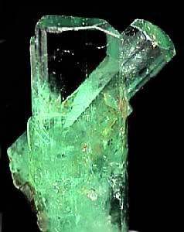
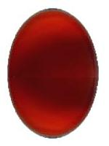
Rev 4 colors
sardius stone
jasper stone
emerald stone

Slide 45
Stones in the High Priest’s ephod
Exodus 20
1st, ruby (sardius) – tribe of Reuben, “see, a son”, blood red, 1st Advent of suffering
4th, emerald – tribe of Judah, “praises”, tribe of the King
12th, jasper– tribe of Benjamin, “son of my right hand”, clear, 2nd Advent of righteousness
John saw these in reverse order.

Slide 46
Outline of Revelation
Chapters | Topic
1 | Things which you have seen ─ Glorified Christ in heaven
2-3 | Things which are ─ 7 letters to the 7 churches
4-5 | Things which shall take place ─ Introduction / background to the future — 7 sealed scroll
6 | 6 seals
7 | 1st parenthetic ─ 2 groups (144,000, multitude of gentiles in white robes
8 | 7th seal and first 4 trumpets
9 | 5th & 6th trumpets, 1st & 2nd Woes
10-11:14 | 2nd parenthetic ─ the little book, the two witnesses, end of 2nd Woe
11:15-19 | 7th trumpet, 3rd Woe
12 | 3rd parenthetic ─ important characters
13 | 3rd parenthetic ─ wicked rulers
14 | 3rd parenthetic ─ visions of Christ triumphant
15-16 | 7 bowls leading to the 2nd coming of Christ
17 | 4th parenthetic ─ Destruction of ecclesiastic Babylon
18 | 4th parenthetic ─ Destruction of political Babylon
19 | 2nd Coming of Christ, the great supper of God
20 | Millennial reign of Christ ─ Satan bound, 1000 year reign, Satan released, great white throne judgment
21 | New Jerusalem, new heaven and new earth
22 | Concluding revelations

Slide 47
Mosaic — conditional
Exodus 19:5-8, 21:1-26 ⎯ conditional, for Israel only:
• personal conduct
• social conduct
religious conduct
Romans 7:7 What shall we say then? Is the Law sin? May it never be! On the contrary, I would not have come to know sin except through the Law; for I would not have known about coveting if the Law had not said, "You shall not COVET."

Slide 48
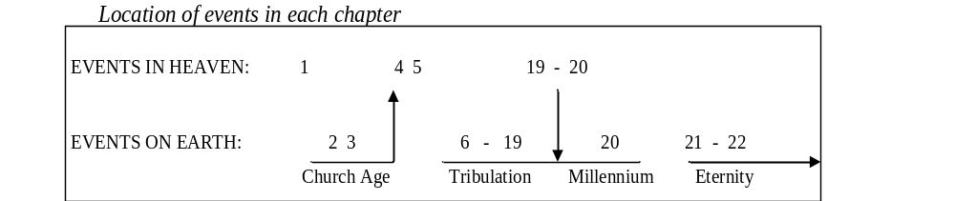
Over View of Revelation
(Benware, “Understanding End Times Prophecy”)

Slide 49
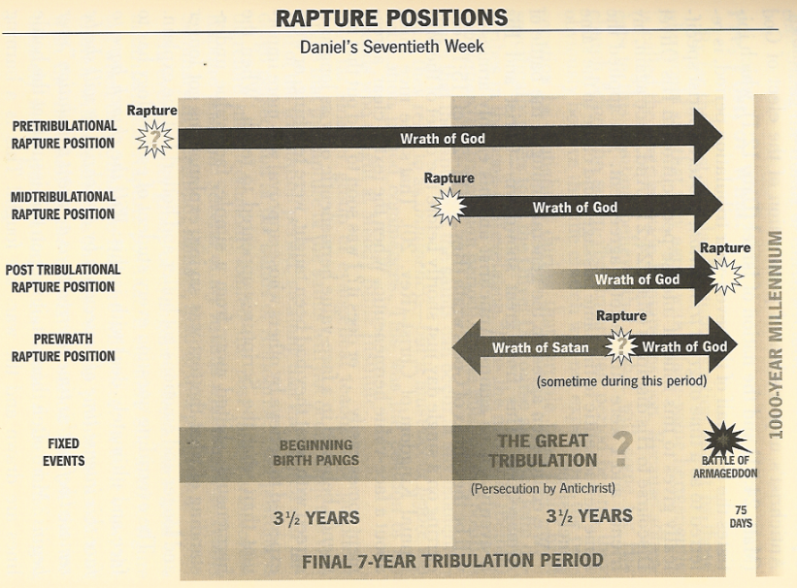
Rapture Positions
(Paul N. Benware, “Understanding End Times Prophecy”)

Slide 50
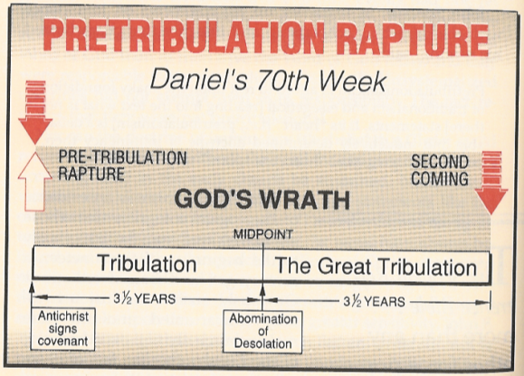
Rapture Position Details
(Robert Van Kampen, “The Rapture Question Answered, Plain & Simple”)
The white up arrowindicates the rapture of the Church.

Slide 51
Millennial Views
2nd Coming
last judgment
millennium
1. Premillennial
2nd Coming
last judgment
millennium
2. Postmillennial
2nd Coming
last judgment
Symbolic millennium
3. Amillennial

Slide 52
Premillenial Rapture Views
Rapture
2nd Coming
last judgment
7 year tribulation
millennium
1. Pre-tribulation
Rapture
2nd Coming
last judgment
7 year tribulation
millennium
2. Pre-wrath
Rapture
2nd Coming
last judgment
7 year tribulation
millennium
3. Post-tribulation

Slide 53
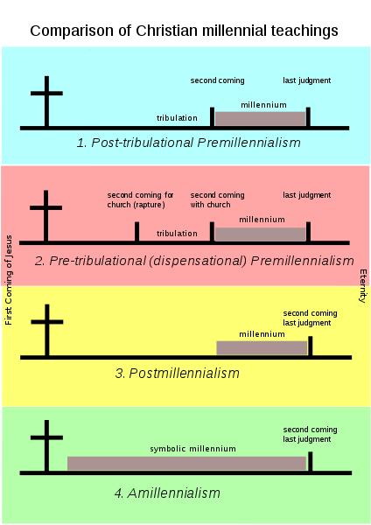

Slide 54
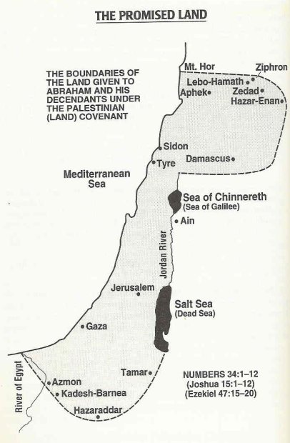

Slide 55
Some Terms
  The Rapture
  The Tribulation
  2nd Coming
  Millennium
  Millennial kingdom
  Day of the Lord
Church taken up by Christ
7 year period of trouble
Christ’s 2nd return to earth
1000 year period
Christ’s 1000 year reign
1 thru 5 above
There is debate regarding the existence and order of the above events/periods. Your view depends on several things.

Slide 56
3 Points about Biblical Prophecy
Isaiah 46:10 Declaring the end from the beginning And from ancient times things which have not been done, Saying, 'My purpose will be established, And I will accomplish all My good pleasure';
2 Peter 1:20-21 But know this first of all, that no prophecy of Scripture is a matter of one's own interpretation, ²¹for no prophecy was ever made by an act of human will, but men moved by the Holy Spirit spoke from God.
1 Peter 1:10-12 As to this salvation, the prophets who prophesied of the grace that would come to you made careful search and inquiry, ¹¹seeking to know what person or time the Spirit of Christ within them was indicating as He predicted the sufferings of Christ and the glories to follow. ¹²It was revealed to them that they were not serving themselves, but you, in these things which now have been announced to you through those who preached the gospel to you by the Holy Spirit sent from heaven-- things into which angels long to look.

Slide 57
Beatitudes of Revelation
Rev. 1:3 Blessed is he who reads and those who hear the words of the prophecy, and heed the things which are written in it; for the time is near.
Rev. 14:13 And I heard a voice from heaven, saying, "Write, 'Blessed are the dead who die in the Lord from now on!' " "Yes," says the Spirit, "that they may rest from their labors, for their deeds follow with them."
Rev. 16:15 ("Behold, I am coming like a thief. Blessed is the one who stays awake and keeps his garments, lest he walk about naked and men see his shame.")
Rev. 19:9 And he said to me, "Write, 'Blessed are those who are invited to the marriage supper of the Lamb.' " And he said to me, "These are true words of God."
Rev. 20:6 Blessed and holy is the one who has a part in the first resurrection; over these the second death has no power, but they will be priests of God and of Christ and will reign with Him for a thousand years.
Rev. 22:7 "And behold, I am coming quickly. Blessed is he who heeds the words of the prophecy of this book."
Rev. 22:14 Blessed are those who wash their robes, that they may have the right to the tree of life, and may enter by the gates into the city.

Slide 58
Eschatological Views of Revelation
  Historical
    Revelation surveys the whole of church history
  Preterist
    Revelation fulfillment was completed shortly after its writing
  Historical-Spiritual
    There is no single fulfillment, only transient principles
  Futurist
    Everything after Revelation 3 is awaiting future fulfillment

Slide 59
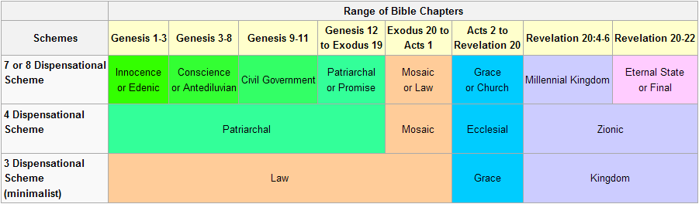

Slide 60
Symbols in Revelation
Seven stars (1:16)
Seven lampstands (1:13)
Hidden manna (2:17)
Morning star (2:28)
Key of David (3:7)
Seven lamps of fire (4:5)
Living creatures (4:7)
Seven eyes (5:6)
Odors of the golden vials (5:8)
Four horses and riders (6:1ff)
Fallen star (9:1)
Jerusalem: the great city (11:8)
Stars of heaven (12:4)
Woman and child (12:1-2)
Great dragon, old serpent (12:9, 20:2)
Time, times and a half time (12:14)
1260 days (12:6)
Beast out of the sea (13:1-10)
Beast out of the earth (13:11-17)
Harlot (17:1)
Waters (17:1)
Ten horns (17:12)
Lamb (17:14)
Fine linen (19:8)
Rider on white horse (19:11-16, 19)
Lake of fire (20:14)
Jesus Christ (22:16)

Slide 61
Symbols in Revelation (Walvoord, Every Prophecy of the Bible, p522, 523)
The seven stars (1:16) represent seven angels (1:20).
The seven lampstands (1:13) represent seven churches (1:20).
The hidden manna (2:17) speaks of Christ in glory (cf. Exodus 16:33-34; Heb. 9:4).
The morning star (2:28) refers to Christ returning before the dawn, suggesting the rapture of the church before the establishment of the Kingdom (cf. Rev. 22:16; 2 Peter 1:19).
The key of David (3:7) represents the power to open and close doors (Isa. 22:22).
The seven lamps of fire represent the sevenfold Spirit of God (4:5).
The living creatures (4:7) portray the attributes of God.
The seven eyes represent the sevenfold Spirit of God (5:6).
The odors of the golden vials symbolize the prayers of the saints (5:8).
The four horses and their riders (6:1 ff.) represent successive events in the developing tribulation.
The fallen star (9:1) is the angel of the abyss, probably Satan (9:11).
Many references are made to Jerusalem: the great city (11:8), Sodom and Egypt (11:8), which stand in contrast to the new Jerusalem, the heavenly city.
The stars of heaven (12:4) refer to fallen angels (12:9).
The woman and the child (12:1-2) seem to represent Israel and Christ (12:5-6).
Satan is variously described as the great dragon, the old serpent, and the devil (12:9; 20:2).
The time, times, and half a time (12:14) are the same as 1,260 days (12:6).
The beast out of the sea (13:1-10) is the future world ruler and his empire.
The beast out of the earth (13:11-17) is the false prophet (19:20).
The harlot (17:1) variously described as the great city (17:18), as Babylon the great (17:5), as the one who sits on seven hills (17:9), is usually interpreted as apostate Christendom.
The waters (17:1) on which the woman sits represent the peoples of the world (17:15). The ten horns (17:12) are ten kings associated with the beast (13:1; 17:3, 7, 8, 11-13, 1&-17).
The Lamb is Lord of lords and King of kings (17:14).
Fine linen is symbolic of the righteous deeds of the saints (19:8).
The rider of the white horse (19:11-16, 19) is clearly identified as Christ, the King of kings.
The lake of fire is described as the second death (20:14).
Jesus Christ is the Root and Offspring of David (22:16).

Slide 62
Future Events
Apostasy of the church
Rapture of the Church (true believers)
Judgments seat of Christ (Bema seat) ⎯ of the Church saints
The rise of a 10 nation confederacy (western kingdoms?)
Three of the nations taken over by a strong ruler
Strong ruler ascends to lead the 7 nation confederacy
Treaty between the strong leader and Israel
Scroll with 7 seals, Lion of Judah/Root of David/Lamb is the only one worthy to open it
The Tribulation begins
6 seal judgments
Wrath of the Lamb, (Day of the Lord?)
144,000 sons of Israel sealed as servants of the Lord
Great multitude of Gentiles standing before the Lamb (Rapture?)
Abomination of Desolation
The Great Tribulation begins
7th seal opened giving 7 trumpet judgments
Silence in heaven for ½ hour
3 trumpet judgments
4th trumpet - sun, moon, stars smitten: 3 woes (trumpets 5, 6, and 7)
Northern kingdom (Russia? attacks Israel, defeated by God
Southern kingdom (Egypt?) attacks Israel, confederacy conquers
Eastern kingdom (China?) attacks Israel
Two witnesses
7th trumpet (rewards to prophets and saints)
Satan thrown out of heaven
Jews flee to the wilderness
Beginning of persecution of Tribulation saints
Beast rises out of the sea (strong leader recognized as Anti-Christ)
2nd beast rises out of the earth (world religious leader ⎯ harlot, Babylon)
The everlasting gospel preached to the world
Harvesting of the earth
7 bowl (or vial) judgments
Destruction of religious Babylon
Destruction of commercial Babylon
Marriage supper of the Lamb
Christ comes in great power and glory, and with His saints
Nations gather to fight the Anti-Christ in Armageddon
Tribulation ends
Beast and false prophet thrown into the lake of fire
Dragon (Satan) bound for 1000 years
Resurrection of Old Testament and Tribulation saints
Millennium begins and ends
Great White Throne Judgment
New heaven and new earth
New Jerusalem

Slide 63
Facts about Revelation
  Only NT prophetic book
  John covers eternity past (John 1) to eternity future (Rev 22)
  There are 7 beatitudes
  It is like Union Station
  It is not new prophecy, but a culmination of God’ plan presented in prophecy
  It is Christ centered, a revelation of Jesus Christ (unveiling)
  Begins with Jesus in His current ministry (High Priest)

Slide 64
14 Doxologies in the Book of Revelation
References | The One(s) Giving the Praise | The One(s) Receiving the Praise
4:8 | 4 living creatures | God the Father
4:11 | 24 elders | God the Father
5:9-10 | 24 elders and 4 living creatures | The Lamb (Christ)
5:12 | Many angels | The Lamb
5:13 | Every creature | God the Father and the Lamb
7:10 | Tribulation martyrs | God the Father and the Lamb
7:12 | Angels, 24 elders, and 4 living creatures | God the Father
11:16-18 | 24 elders | God the Father
15:3-4 | Tribulation saints | God the Father and the Lamb
16:5-6 | Angel | God the Father
16:7 | “The altar” | God the Father
19:1-3 | A great multitude | God the Father
19:4 | 24 elders and 4 living creatures | God the Father
19:6-8 | A great multitude | God the Father

Slide 65
The Tribulation
Daniel 9:24-27 "Seventy weeks have been decreed for your people and your holy city, to finish the transgression, to make an end of sin, to make atonement for iniquity, to bring in everlasting righteousness, to seal up vision and prophecy, and to anoint the most holy place. 25"So you are to know and discern that from the issuing of a decree to restore and rebuild Jerusalem until Messiah the Prince there will be seven weeks and sixty-two weeks; it will be built again, with plaza and moat, even in times of distress. 26"Then after the sixty-two weeks the Messiah will be cut off and have nothing, and the people of the prince who is to come will destroy the city and the sanctuary. And its end will come with a flood; even to the end there will be war; desolations are determined. 27"And he will make a firm covenant with the many for one week, but in the middle of the week he will put a stop to sacrifice and grain offering; and on the wing of abominations will come one who makes desolate, even until a complete destruction, one that is decreed, is poured out on the one who makes desolate."

Slide 66
EVENTS IN REVELATION DESCRIBED ELSEWHERE IN THE BIBLE
Other Reference | Revelation Reference | Event
Ezek. 1:22-28 | Rev. 4:2-3; Rev. 10:1-3 | Glowing rainbow around God’s throne
Isaiah 53:7 | Rev. 5:6-8 | Christ is pictured as a Lamb
Psalm 96 | Rev. 5:9-14 | New song
Zech. 1:7-11; Zech. 6:1-8 | Rev. 6:1-8 | Horses and riders
Isaiah 2:19-22 | Rev. 6:12; Rev. 8:5; Rev. 11:13 | Earthquake
Joel 2:28-32; Acts 2:14-21 | Rev. 6:12 | Moon turns blood red
Mark 13:21-25 | Rev. 6:13 | Stars falling from the sky
Isaiah 34:1-4 | Rev. 6:14 | Sky rolled up like a scroll
Zeph. 1:14-18; 1 Thes. 5:1-3 | Rev. 6:15-17 | God’s inescapable wrath
Jer. 49:35-39 | Rev. 7:1 | Four winds of judgment
Luke 8:26-34 | Rev. 9:1-2; Rev. 17:3-8 | Abyss (bottomless pit)
Joel 1:2-2:11 | Rev. 9:3-11 | Plague of locusts
Other Reference | Revelation Reference | Event
Luke 21:20-24 | Rev. 11:1-2 | Trampling of the holy city of Jerusalem
Zech. 4 | Rev. 11:3-6 | Two olive trees as witnesses
Dan. 7 | Rev. 13:1-10 | A beast coming out of the sea
2 Thes. 2:7-14 | Rev. 13:11-15 | Wondrous signs and miracles done by the evil beast
Jer. 25:15-29 | Rev. 14:9-12 | Drinking the cup of God’s wrath
Isaiah 21:1-10 | Rev. 18:2-3 | “Babylon” falls
Matt. 22:1-14 | Rev. 19:5-8 | Wedding supper of the Lamb
Ezek. 38; 39 | Rev. 20:7-10 | Conflict with Gog and Magog
John 5:19-30 | Rev. 20:11-15 | Judging of all people
Ezek. 37:21-28 | Rev. 21:3 | God lives among mankind
Isaiah 25:1-8 | Rev. 21:4 | Our tears will be wiped away forever
Gen. 2:8-14 | Rev. 22:1-2 | Tree of life
1 Cor. 13:11-12 | Rev. 22:3-5 | We will see God face to face
Dan. 7:18-28 | Rev. 22:5 | Believers will reign with God forever

Slide 67
God’s Covenants
Adapted from “Understanding End Times Prophecy”
by Paul Benware
Moody Press
Palestinian
Deut. 27
-30
Abrahamic
Gen. 12
Edenic
Gen. 1:26-
3:6
Adamic
Gen. 3:7-
8:19
Noahic
Gen. 8:20
-11:9
Davidic
2 Sam 7
Mosaic
Ex 20,
Gal 3
New
Jer. 31
K
I
N
G
D
O
M
Adam & Eve
Mankind
Noah
Formation
of Israel
Theocracy
Monarchy
e
x
i
l
e
Restoration
Church
Patriarchs
Moses, Joshua
Priests
Judges
Kings
Ezra
Nehemiah
Apostles
Jesus Christ
Dispensational Theology
Pre-fall
Conscience
Government
Patriarchal
Mosaic
Church
Millennial
Covenant Theology
Covenant of Works
Covenant of Grace

Slide 68
C. Palestinian — EUU
Enlarges the land aspect of the Abrahamic covenant.
Deut. 27:1, 27:12-14, 28:1, 28:15, 29:4, 29:26-29, 30:1-14
  future and unconditional
  return to the land
  prosperity
  obedience
  Grace
As an extension of the Abrahamic covenant this one is also ultimately EUU. The conditions in it are for immediate blessings, e.g. the blesssings shall come upon and overtake you.
Deut. 30:5 "And the Lord your God will bring you into the land which your fathers possessed, and you shall possess it; and He will prosper you and multiply you more than your fathers.
3

Slide 69
The Point Is?
For biblical authors, “righteousness” is the fulfillment of the terms of a covenant, between God and humanity or between humans in the full range of human relationships. [Holman Bible Dictionary]
For God to be righteous He must keep His covenant promises! God must “redeem” Israel and the land, and establish the Millennial Kingdom

Slide 70
Stones in the High Priest’s ephod
Exodus 20
1st, ruby (sardius) – tribe of Reuben, “see, a son”, blood red, 1st Advent of suffering
4th, emerald – tribe of Judah, “praises”, tribe of the King
12th, jasper– tribe of Benjamin, “son of my right hand”, clear, 2nd Advent of righteousness & power
John saw these in reverse order.

