Slide 1
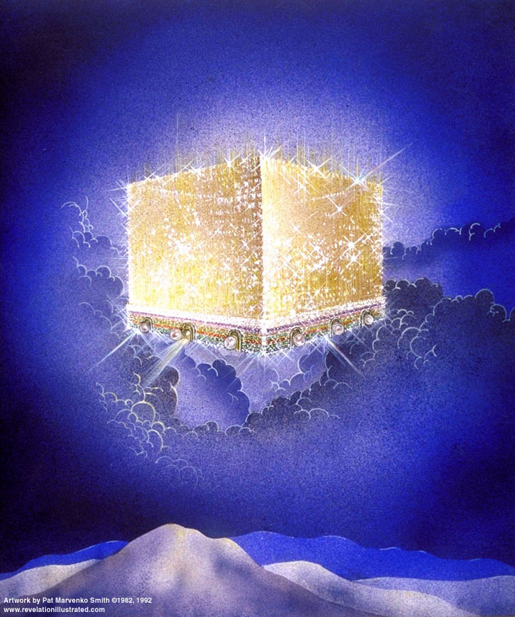

Slide 2
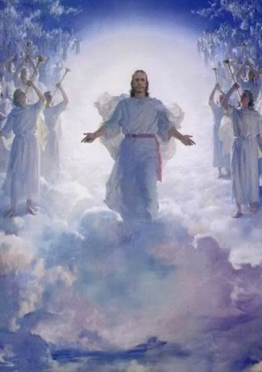
The Revelation of Jesus Christ
Rev. 22:10 And he said to me, "Do not seal up the words of the prophecy of this book, for the time is near.
Rev 21 of 22
Rev. 1:3 Blessed is he who reads and those who hear the words of the prophecy, and heed the things which are written in it; for the time is near.

Slide 3

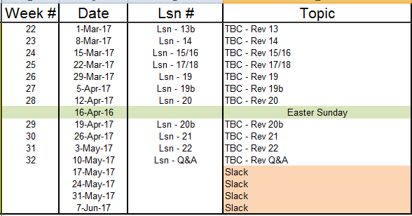
Outline of Revelation

Slide 4
Outline of Revelation
Chapters | Topic
1 | Things which you have seen ─ Glorified Christ in heaven
2-3 | Things which are ─ 7 letters to the 7 churches
4-5 | Things which shall take place ─ Introduction / background to the future — 7 sealed scroll
6 | 6 seals
7 | 1st parenthetic ─ 2 groups (144,000, multitude of gentiles in white robes
8 | 7th seal and first 4 trumpets
9 | 5th & 6th trumpets, 1st & 2nd Woes
10-11:14 | 2nd parenthetic ─ the little book, the two witnesses, end of 2nd Woe
11:15-19 | 7th trumpet, 3rd Woe
12 | 3rd parenthetic ─ important characters
13 | 3rd parenthetic ─ wicked rulers
14 | 3rd parenthetic ─ visions of Christ triumphant
15-16 | 7 bowls leading to the 2nd coming of Christ
17/18 | 4th parenthetic ─ Destruction of ecclesiastic Babylon
19 | 2nd Coming of Christ, the great supper of God
20 | Millennial reign of Christ ─ Satan bound, 1000 year reign, Satan released, great white throne judgment
21 | New Jerusalem, new heaven and new earth
22 | Concluding revelations

Slide 5
Bema Seat
“judgment seat”: bema – raised platform from which officials judge
2 Corinthians 5:10 For we must all appear before the judgment seat of Christ, so that each one may be recompensed for his deeds in the body, according to what he has done, whether good or bad.
2 Timothy 4:8 Now there is in store for me the crown of righteousness, which the Lord, the righteous Judge, will award to me on that day —and not only to me, but also to all who have longed for his appearing.
1 Corinthians 4:5 Therefore do not go on passing judgment before the time, but wait until the Lord comes who will both bring to light the things hidden in the darkness and disclose the motives of men's hearts; and then each man's praise will come to him from God.

Slide 6
When?
Luke 14:13-14 "But when you give a reception, invite the poor, the crippled, the lame, the blind, ¹⁴and you will be blessed, since they do not have the means to repay you; for you will be repaid at the resurrection of the righteous."
Isaiah 62:11 Behold, the LORD has proclaimed to the end of the earth, Say to the daughter of Zion, "Lo, your salvation comes; Behold His reward is with Him, and His recompense before Him."

Slide 7
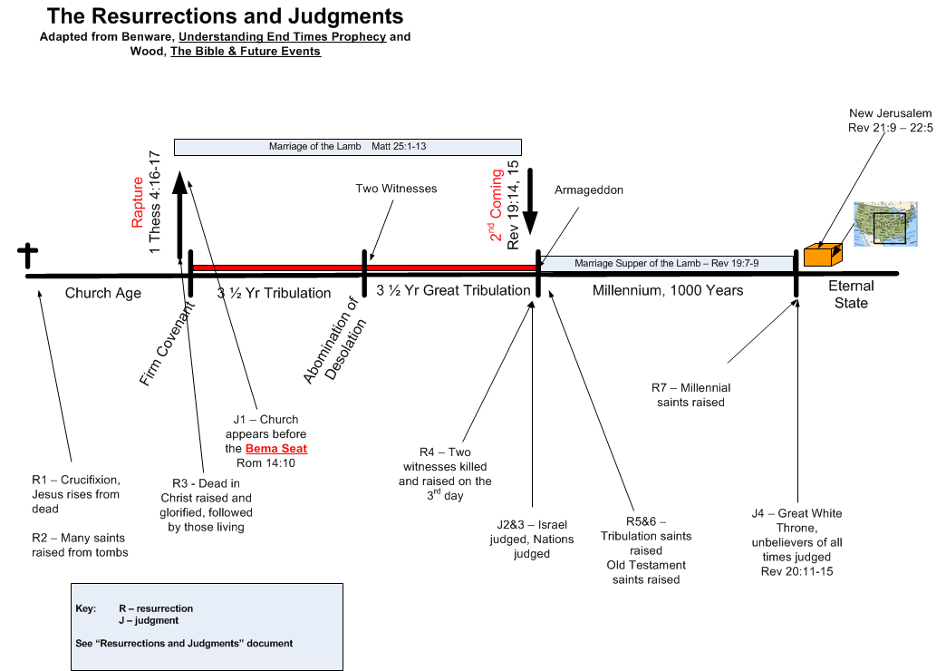
Last Resurrection
R8 -Wicked dead

Slide 8
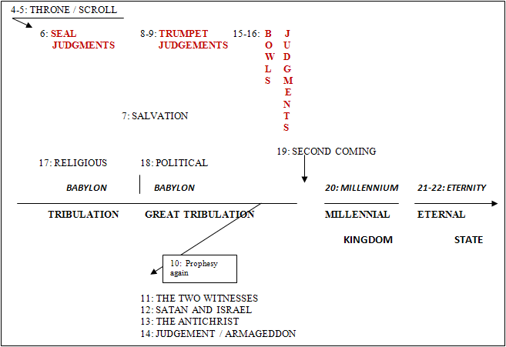
Third Major Section of Revelation: Ch 4-22
(Benware, “Understanding End Times Prophecy”)
Rev. 1:19 "Write therefore the things which you have seen, and the things which are, and the things which shall take place after these things.

Slide 9
Context of Rev 21
The Great White Throne judgment is finished
All sinners of all the ages, men and demons, are in the Lake of Fire
The entire universe has been dissolved to energy

Slide 10
  Everything connected to our spiritual life and destiny is in heaven. Our Father is there. Our Savior is there. Our Comforter is there. Our fellow believers are there. Our name is there, our life is there, our inheritance is there, our home is there, our citizenship is there, our reward is there, and our treasure is there. Everything that belongs to us is there. [John MacArthur]
  Psalm 73:25 Whom have I in heaven but Thee? And besides Thee, I desire nothing on earth.
  d, the love of the Father is not in him.
  Philip. 3:20 For our citizenship is in heaven, from which also we eagerly wait for a Savior, the Lord Jesus Christ;
  2 Peter 3:13 But according to His promise we are looking for new heavens and a new earth, in which righteousness dwells
  1 John 3:1 See how great a love the Father has bestowed upon us, that we should be called children of God; and such we are. For this reason the world does not know us, because it did not know Him.
  John 14:2-3 "In My Father's house are many dwelling places; if it were not so, I would have told you; for I go to prepare a place for you. ³"And if I go and prepare a place for you, I will come again, and receive you to Myself; that where I am, there you may be also.’

Slide 11
Rev. 21: 1-2
And I saw a new heaven and a new earth; for the first heaven and the first earth passed away, and there is no longer any sea. ²And I saw the holy city, new Jerusalem, coming down out of heaven from God, made ready as a bride adorned for her husband.

Slide 12
Rev 21 – Our Eternal Home
Verses 1-8 are intro to eternity. The details follow them. Rev 21:1 And I saw a new heaven and a new earth; for the first heaven and the first earth passed away, and there is no longer any sea. ²And I saw the holy city, new Jerusalem, coming down out of heaven from God, made ready as a bride adorned for her husband. | Isaiah 65:17-18 "For behold, I create new heavens and a new earth; And the former things shall not be remembered or come to mind. ¹⁸"But be glad and rejoice forever in what I create; For behold, I create Jerusalem for rejoicing… Revelation 3:12 'He who overcomes, I will make him a pillar in the temple of My God, … I will write on him the name of My God, and the name of the city of My God, the new Jerusalem, which comes down out of heaven from My God, and My new name. 2 Peter 3:10-13 But the day of the Lord will come like a thief, in which the heavens will pass away …,¹¹Since all these things are to be destroyed in this way, what sort of people ought you to be in holy conduct and godliness,..¹³But according to His promise we are looking for new heavens and a new earth, in which righteousness dwells. | New – as in new kind, different; not just a replacement No sea! New water?? New Jerusalem is the house Jesus promised for the Saints. Do we live in it during the Tribulation? During the Millennium?

Slide 13
Rev. 21: 3-4
³And I heard a loud voice from the throne, saying, "Behold, the tabernacle of God is among men, and He shall dwell among them, and they shall be His people, and God Himself shall be among them, ⁴and He shall wipe away every tear from their eyes; and there shall no longer be any death; there shall no longer be any mourning, or crying, or pain; the first things have passed away."

Slide 15
Rev 21 – Our Eternal Home
³And I heard a loud voice from the throne, saying, "Behold, the tabernacle of God is among men, and He shall dwell among them, and they shall be His people, and God Himself shall be among them, ⁴and He shall wipe away every tear from their eyes; and there shall no longer be any death; there shall no longer be any mourning, or crying, or pain; the first things have passed away." | John 14:23 Jesus answered and said to him, "If anyone loves Me, he will keep My word; and My Father will love him, and We will come to him and make Our abode with him.“ Isaiah 25:8 He will swallow up death for all time, And the Lord God will wipe tears away from all faces, … | How can we see God and live? [see below]

Slide 16
Rev. 21: 5-6
⁵And He who sits on the throne said, "Behold, I am making all things new." And He said, "Write, for these words are faithful and true." ⁶And He said to me, "It is done. I am the Alpha and the Omega, the beginning and the end. I will give to the one who thirsts from the spring of the water of life without cost.

Slide 17
Rev 21 – Our Eternal Home
⁶And He said to me, "It is done. I am the Alpha and the Omega, the beginning and the end. I will give to the one who thirsts from the spring of the water of life without cost. | Isaiah 55:1 "Ho! Every one who thirsts, come to the waters; And you who have no money come, buy and eat. Come, buy wine and milk without money and without cost. John 4:10-14 Jesus answered and said to her, "If you knew the gift of God, and who it is who says to you, 'Give Me a drink,' you would have asked Him, and He would have given you living water … but the water that I shall give him shall become in him a well of water springing up to eternal life.“ Rev. 7:17 for the Lamb in the center of the throne shall be their shepherd, and shall guide them to springs of the water of life; and God shall wipe every tear from their eyes." Rev 22:1 Then he showed me a river of the water of life, clear as crystal, coming from the throne of God and of the Lamb, | “It is done” – major program completed Alpha and the Omega? Rev. 1:8 "I am the Alpha and the Omega," says the Lord God, "who is and who was and who is to come, the Almighty

Slide 18
Rev 21 – Our Eternal Home
⁵And He who sits on the throne said, "Behold, I am making all things new." And He said, "Write, for these words are faithful and true." | Hebrews 12:26-27 And His voice shook the earth then, but now He has promised, saying, "Yet once more I will shake not only the earth, but also the heaven."[Hag 2:6] 27And this expression, "Yet once more," denotes the removing of those things which can be shaken, as of created things, in order that those things which cannot be shaken may remain. 2 Cor. 5:17 Therefore if any man is in Christ, he is a new creature; the old things passed away; behold, new things have come. | He who sits on the throne? “making” – not ex nihilo creating

Slide 19
Rev. 21: 7-8
⁷"He who overcomes shall inherit these things, and I will be his God and he will be My son. ⁸"But for the cowardly and unbelieving and abominable and murderers and immoral persons and sorcerers and idolaters and all liars, their part will be in the lake that burns with fire and brimstone, which is the second death."

Slide 20
Rev 21 – Our Eternal Home
⁷"He who overcomes shall inherit these things, and I will be his God and he will be My son. ⁸"But for the cowardly and unbelieving and abominable and murderers and immoral persons and sorcerers and idolaters and all liars, their part will be in the lake that burns with fire and brimstone, which is the second death." | John 10:36 do you say of Him, whom the Father sanctified and sent into the world, 'You are blaspheming,' because I said, 'I am the Son of God'? John 1:12 But as many as received Him, to them He gave the right to become children of God, even to those who believe in His name, Romans 8:16-17 The Spirit Himself testifies with our spirit that we are children of God, ¹⁷and if children, heirs also, heirs of God and fellow heirs with Christ, if indeed we suffer with Him so that we may also be glorified with Him. 1 John 3:2 Beloved, now we are children of God, and it has not appeared as yet what we will be. We know that when He appears, we will be like Him, because we will see Him just as He is. 1 Cor. 3:21 So then let no one boast in men. For all things belong to you, | Some believe prophecy is meant to be understood only by those experiencing its fulfillment. So, why the admonition to the unbelieving? What is the implication of being a son? Note that the new heaven and new earth did not affect the lake of fire. It goes on forever.

Slide 21
Rev.21: 9-11
⁹And one of the seven angels who had the seven bowls full of the seven last plagues, came and spoke with me, saying, "Come here, I shall show you the bride, the wife of the Lamb." ¹⁰And he carried me away in the Spirit to a great and high mountain, and showed me the holy city, Jerusalem, coming down out of heaven from God, ¹¹having the glory of God. Her brilliance was like a very costly stone, as a stone of crystal-clear jasper.

Slide 22
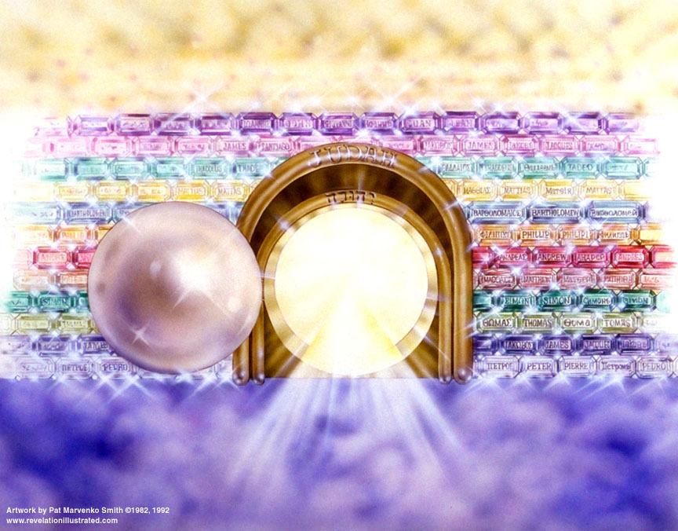

Slide 23
Rev 21 – Our Eternal Home
Verses 9-27 give details of ETERNITY ⁹And one of the seven angels who had the seven bowls full of the seven last plagues, came and spoke with me, saying, "Come here, I shall show you the bride, the wife of the Lamb." ¹⁰And he carried me away in the Spirit to a great and high mountain, and showed me the holy city, Jerusalem, coming down out of heaven from God, ¹¹having the glory of God. Her brilliance was like a very costly stone, as a stone of crystal-clear jasper. | Isaiah 54:5-7 "For your husband is your Maker, Whose name is the LORD of hosts; And your Redeemer is the Holy One of Israel, Who is called the God of all the earth. ⁶ "For the LORD has called you, Like a wife forsaken and grieved in spirit, Even like a wife of one's youth when she is rejected," Says your God. ⁷ "For a brief moment I forsook you, But with great compassion I will gather you. Hebrews 11:10 for he [Abraham] was looking for the city which has foundations, whose architect and builder is God… Hebrews 11:16 But as it is, they desire a better country, that is a heavenly one. Therefore God is not ashamed to be called their God; for He has prepared a city for them. | Who is Hebrews 11 talking about? “I believe then all the saints are collected and gathered in and so the bride becomes all encompassing” – MacArthur clear – glory of God shines everywhere

Slide 24
Rev.21: 12-14
¹²It had a great and high wall, with twelve gates, and at the gates twelve angels; and names were written on them, which are those of the twelve tribes of the sons of Israel. ¹³There were three gates on the east and three gates on the north and three gates on the south and three gates on the west. ¹⁴And the wall of the city had twelve foundation stones, and on them were the twelve names of the twelve apostles of the Lamb.

Slide 25
Rev 21 – Our Eternal Home
¹²It had a great and high wall, with twelve gates, and at the gates twelve angels; and names were written on them, which are those of the twelve tribes of the sons of Israel. ¹³There were three gates on the east and three gates on the north and three gates on the south and three gates on the west. ¹⁴And the wall of the city had twelve foundation stones, and on them were the twelve names of the twelve apostles of the Lamb. | Hebrews 1:14 Are they not all ministering spirits, sent out to render service for the sake of those who will inherit salvation? Hebrews 12:22-25 But you have come to Mount Zion and to the city of the living God, the heavenly Jerusalem, and to myriads of angels, 23to the general assembly and church of the first-born who are enrolled in heaven, and to God, the Judge of all, and to the spirits of righteous men made perfect, 24and to Jesus, the mediator of a new covenant, and to the sprinkled blood, which speaks better than the blood of Abel. Exodus 4:22 "Then you shall say to Pharaoh, 'Thus says the LORD, "Israel is My son, My firstborn." | Note the details in John’s description. Note the repetition of twelve [the # for God’s people] Heb 12:23 – who is the church of the first born? Note that the distinction between Israel and the Church is maintained here

Slide 26
Rev. 21: 15-16
¹⁵And the one who spoke with me had a gold measuring rod to measure the city, and its gates and its wall. ¹⁶And the city is laid out as a square, and its length is as great as the width; and he measured the city with the rod, fifteen hundred miles; its length and width and height are equal.

Slide 27
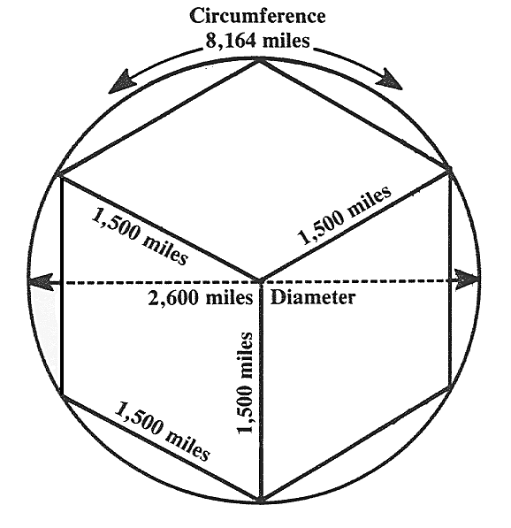
Rev 21 – Our Eternal Home
¹⁵And the one who spoke with me had a gold measuring rod to measure the city, and its gates and its wall. ¹⁶And the city is laid out as a square, and its length is as great as the width; and he measured the city with the rod, fifteen hundred miles; its length and width and height are equal. | A sphere containing New Jerusalem would be ~2600 miles in diameter. The moon is ~2160 miles in diameter. | 12000 stadia = 1500 mi. The Holy of Holies in the Tabernacle was a perfect cube, not a pyramid.

Slide 28
Rev. 21: 17-18
¹⁷And he measured its wall, seventy-two yards, according to human measurements, which are also angelic measurements. ¹⁸And the material of the wall was jasper; and the city was pure gold, like clear glass.

Slide 29
Rev 21 – Our Eternal Home
¹⁷And he measured its wall, seventy-two yards, according to human measurements, which are also angelic measurements. ¹⁸And the material of the wall was jasper; and the city was pure gold, like clear glass. | Truth = transparent, nothing hidden, “clear as glass” Seems to implicate there is nothing to hide. | What is the wall? Wall measurement is assumed to be its thickness. No privacy!!!!!

Slide 30
Rev. 21: 19-21
¹⁹The foundation stones of the city wall were adorned with every kind of precious stone. The first foundation stone was jasper; the second, sapphire; the third, chalcedony; the fourth, emerald; ²⁰the fifth, sardonyx; the sixth, sardius; the seventh, chrysolite; the eighth, beryl; the ninth, topaz; the tenth, chrysoprase; the eleventh, jacinth; the twelfth, amethyst. ²¹And the twelve gates were twelve pearls; each one of the gates was a single pearl. And the street of the city was pure gold, like transparent glass.

Slide 31
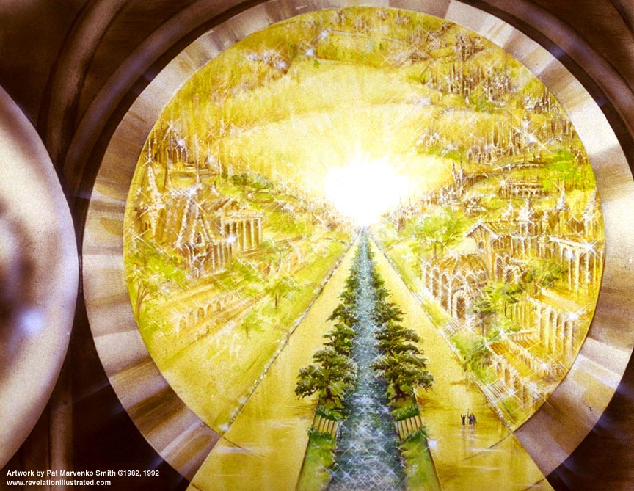

Slide 32
Rev 21 – Our Eternal Home
¹⁹The foundation stones of the city wall were adorned with every kind of precious stone. The first foundation stone was jasper; the second, sapphire; the third, chalcedony; the fourth, emerald; ²⁰the fifth, sardonyx; the sixth, sardius; the seventh, chrysolite; the eighth, beryl; the ninth, topaz; the tenth, chrysoprase; the eleventh, jacinth; the twelfth, amethyst. ²¹And the twelve gates were twelve pearls; each one of the gates was a single pearl. And the street of the city was pure gold, like transparent glass. | Ezekiel 28:13 "You were in Eden, the garden of God; Every precious stone was your covering: The ruby, the topaz, and the diamond; The beryl, the onyx, and the jasper; The lapis lazuli, the turquoise, and the emerald; And the gold, the workmanship of your settings and sockets, Was in you. On the day that you were created They were prepared. Exodus 28:17-20 "And you shall mount on it four rows of stones; the first row shall be a row of ruby, topaz and emerald; ¹⁸and the second row a turquoise, a sapphire and a diamond; ¹⁹and the third row a jacinth, an agate and an amethyst; ²⁰and the fourth row a beryl and an onyx and a jasper; they shall be set in gold filigree. | Again, John is describing what cannot be experienced today. That is no reason not to take this literally. Lucifer seems to have lost his beauty to Israel, the Church, and New Jerusalem. “the street” - singular

Slide 33
Rev. 21: 22
²²And I saw no temple in it, for the Lord God, the Almighty, and the Lamb, are its temple.

Slide 34
Rev 21 – Our Eternal Home
²²And I saw no temple in it, for the Lord God, the Almighty, and the Lamb, are its temple. | Rev. 3:12 'He who overcomes, I will make him a pillar in the temple of My God, and he will not go out from it anymore; and I will write upon him the name of My God, and the name of the city of My God, the new Jerusalem, which comes down out of heaven from My God, and My new name. | Note the pairing of God and the Lamb in vs. 22 & 23. Why? Rev 11:19, 15:5

Slide 35
Rev. 21: 23-27
²³And the city has no need of the sun or of the moon to shine upon it, for the glory of God has illumined it, and its lamp is the Lamb. ²⁴And the nations shall walk by its light, and the kings of the earth shall bring their glory into it. ²⁵And in the daytime (for there shall be no night there) its gates shall never be closed; ²⁶and they shall bring the glory and the honor of the nations into it; ²⁷and nothing unclean and no one who practices abomination and lying, shall ever come into it, but only those whose names are written in the Lamb's book of life.

Slide 36
Rev 21 – Our Eternal Home
²³And the city has no need of the sun or of the moon to shine upon it, for the glory of God has illumined it, and its lamp is the Lamb. ²⁴And the nations shall walk by its light, and the kings of the earth shall bring their glory into it. ²⁵And in the daytime (for there shall be no night there) its gates shall never be closed; ²⁶and they shall bring the glory and the honor of the nations into it; ²⁷and nothing unclean and no one who practices abomination and lying, shall ever come into it, but only those whose names are written in the Lamb's book of life. | Isaiah 60:19 "No longer will you have the sun for light by day, Nor for brightness will the moon give you light; But you will have the Lord for an everlasting light, And your God for your glory. Ephes. 2:19-20 So then you are no longer strangers and aliens, but you are fellow citizens with the saints, and are of God's household, ²⁰having been built upon the foundation of the apostles and prophets, Christ Jesus Himself being the corner stone, [Rev 21:14] 1 Cor. 2:9 but just as it is written, "Things which eye has not seen and ear has not heard, And which have not entered the heart of man, All that God has prepared for those who love Him." | “Lamb’s book of life” – only reference to it belonging to the Lamb All saints will be citizens of New Jerusalem. McGee – “God has apparently accomplished His original purpose with man -- fellowship. He now has a creature who is a free moral agent and who chooses to worship and serve Him eternally.”

Slide 37
The End and the Beginning
The final paragraph of C.S. Lewis’s book The Last Battle is a commentary on the close of Revelation: “The things that began to happen after that were so great and beautiful that I cannot write them. And for us this is the end of all the stories, and we can most truly say that they all lived happily ever after. But for them it was only the beginning of the real story. All their life in this world and all their adventures in Narnia had only been the cover and the title page: now at last they were beginning Chapter One of the Great Story which no one on earth has read: which goes on forever: in which every chapter is better than the one before.”
[C.S. Lewis, The Last Battle, New York: Macmillan, 1970, p.165]

Slide 39
End

