Slide 1
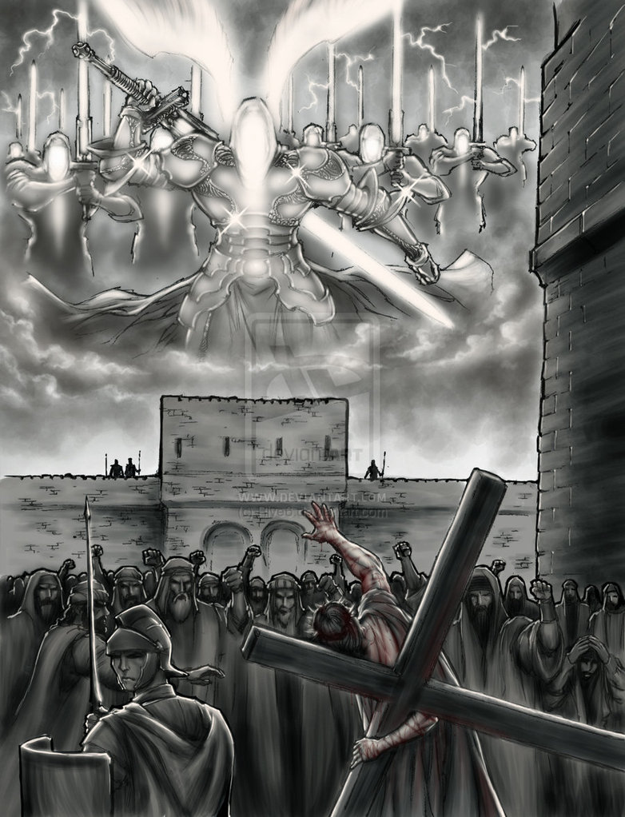

Slide 2
Matt 26:53 "Or do you think that I cannot appeal to My Father, and He will at once put at My disposal more than twelve legions of angels? "

Slide 3

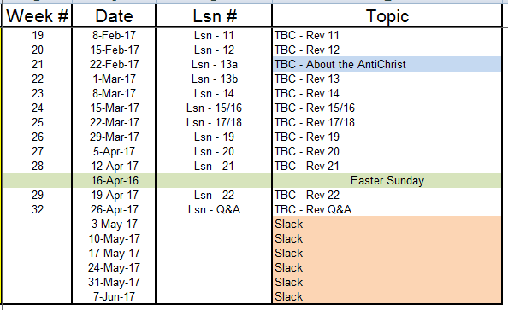
Outline of Revelation

Slide 4
Outline of Revelation
Chapters | Topic
1 | Things which you have seen ─ Glorified Christ in heaven
2-3 | Things which are ─ 7 letters to the 7 churches
4-5 | Things which shall take place ─ Introduction / background to the future — 7 sealed scroll
6 | 6 seals
7 | 1st parenthetic ─ 2 groups (144,000, multitude of gentiles in white robes
8 | 7th seal and first 4 trumpets
9 | 5th & 6th trumpets, 1st & 2nd Woes
10-11:14 | 2nd parenthetic ─ the little book, the two witnesses, end of 2nd Woe
11:15-19 | 7th trumpet, 3rd Woe
12 | 3rd parenthetic ─ important characters
13 | 3rd parenthetic ─ wicked rulers
14 | 3rd parenthetic ─ visions of Christ triumphant
15-16 | 7 bowls leading to the 2nd coming of Christ
17/18 | 4th parenthetic ─ Destruction of ecclesiastic & political Babylon
19 | 2nd Coming of Christ, the great supper of God
20 | Millennial reign of Christ ─ Satan bound, 1000 year reign, Satan released, great white throne judgment
21 | New Jerusalem, new heaven and new earth
22 | Concluding revelations

Slide 5
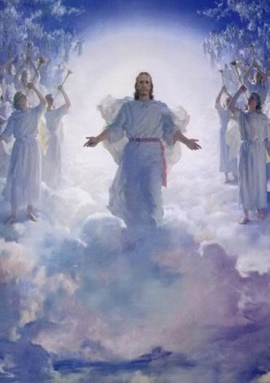
The Revelation of Jesus Christ
Hosea 6:7 But like Adam they have transgressed the covenant; There they have dealt treacherously against Me.
Ezekiel 18:4 “Behold, all souls are Mine; the soul of the father as well as the soul of the son is Mine. The soul who sins will die.”
John 3:16 “For God so loved the world, that He gave His only begotten Son, that whoever believes in Him shall not perish, but have eternal life.”
Throughout all of history, the OT and NT periods, the strangest paradox has been and is working; and it is this ― that all the way through the expression of God's wrath up until His ultimate final and eternal wrath, God is busily working to save sinners from His own wrath. [MacArthur]
Rev 15&16 of 22
Rev. 1:3 Blessed is he who reads and those who hear the words of the prophecy, and heed the things which are written in it; for the time is near.

Slide 6
The Lamb
opens the
seals.
1/3 Earth
God sends the
bowls out, full
of the wrath of
God.
Sores
1/3 Sea
Sea to blood
1
White
2
Red
3
Black
4
Ashen
5
Martyrs
6
Signs
7
Wrath
1/3 Rivers
Rivers to blood
1/3 Heavens
Sun scorches
1st Woe, Locusts
Earth in darkness
2nd Woe, 1/3 Men Die
Euphrates dried
Matt 24:8 "But all these things are merely the beginning of birth pangs.”
Angels sound
the trumpets.
3rd Woe, 7 Bowls
Earthquake, hail
Tribulation
Great Tribulation

Slide 7
Rev 15&16 – The 3rd Woe, 7 Bowls Full of the Wrath of God
¹And I saw another sign in heaven, great and marvelous, seven angels who had seven plagues, which are the last, because in them the wrath of God is finished. [All these word express the enormity of this event.] last – after seals & trumpets | Exodus 34:6 Then the Lord passed by in front of him and proclaimed, “The Lord, the Lord God, compassionate and gracious, slow to anger, and abounding in loving-kindness and truth; Rev. 12:1 And a great sign appeared in heaven: a woman clothed with the sun, … Rev. 12:3 And another sign appeared in heaven: and behold, a great red dragon … Rev 8:13 Then I looked, and I heard an eagle flying in midheaven, saying with a loud voice, "Woe, woe, woe to those who dwell on the earth, … | The last of 3 signs in Revelation great – “mega” Plagues – “floggings” or “wounds”; indicates immediate effect of the judgment 5th trumpet: Rev 9:12 The first woe is past; behold, two woes are still coming after these things. 6th trumpet: Rev. 11:14-15 The second woe is past; behold, the third woe is coming quickly. ¹⁵And the seventh angel sounded; 7th trumpet: 7 bowls, third woe

Slide 8
Rev 15&16 – The 3rd Woe, 7 Bowls Full of the Wrath of God
²And I saw, as it were, a sea of glass mixed with fire, and those who had come off victorious from the beast and from his image and from the number of his name, standing on the sea of glass, holding harps of God. | Rev. 4:6 and before the throne there was, as it were, a sea of glass like crystal; … Rev. 7:9-14 After these things I looked, and behold, a great multitude … "These are the ones who come out of the great tribulation, and they have washed their robes and made them white in the blood of the Lamb. | “mixed with fire” – judgment flows from the throne of God Those victorious – the multitude of Rev 7 who come out of the Great Tribulation

Slide 9
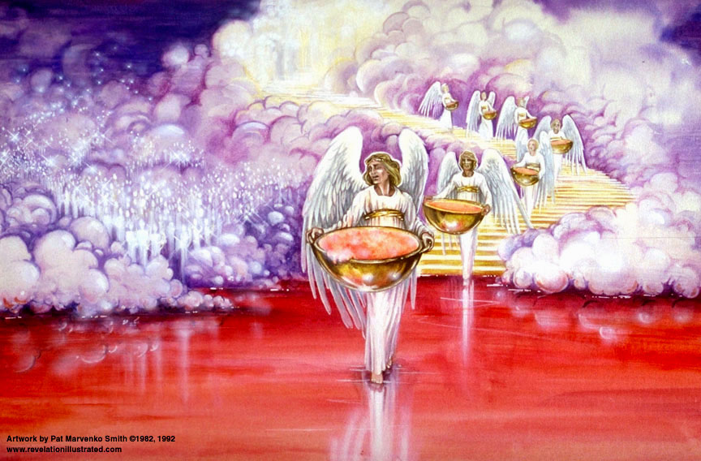

Slide 10
Rev 15&16 – The 3rd Woe, 7 Bowls Full of the Wrath of God
³And they sang the song of Moses the bond-servant of God and the song of the Lamb, saying, "Great and marvelous are Thy works, O Lord God, the Almighty; Righteous and true are Thy ways, Thou King of the nations [KJV – saints]. ⁴"Who will not fear, O Lord, and glorify Thy name? For Thou alone art holy; For all the nations will come and worship before Thee, For Thy righteous acts have been revealed." | Song of Moses: Exodus 15:2 "The Lord is my strength and song, And He has become my salvation; This is my God, and I will praise Him; My father's God, and I will extol Him. Song of the Lamb: Rev. 5:9-10 And they sang a new song, saying, "Worthy art Thou to take the book, and to break its seals; for Thou wast slain, and didst purchase for God with Thy blood men from every tribe and tongue … | In Rev 14 the 144,000 sing a “new song” Song of Moses, Ex. 15:1-21 or Deut. 32 God's deliverance, salvation, faithfulness to Israel. Song of the Lamb, Rev 5:9-12 [2 doxologies] praise to Christ as the Redeemer of all. “King of ***” Someday all nations will be “Christian” nations!! Biblical righteousness is the fulfillment of the terms of a covenant between God and humanity

Slide 11
Doxa – glory “Words of glory” which include: 1) praise, 2) eternal attributes
Logos – words
14 Doxologies in the Book of Revelation
References | The One(s) Giving the Praise | The One(s) Receiving the Praise
4:8 | 4 living creatures | God the Father
4:11 | 24 elders | God the Father
5:9-10 | 24 elders and 4 living creatures | The Lamb (Christ)
5:12 | Many angels | The Lamb
5:13 | Every creature | God the Father and the Lamb
7:10 | Tribulation martyrs | God the Father and the Lamb
7:12 | Angels, 24 elders, and 4 living creatures | God the Father
11:16-18 | 24 elders | God the Father
15:3-4 | Tribulation saints | God the Father and the Lamb
16:5-6 | Angel | God the Father
16:7 | “The altar” | God the Father
19:1-3 | A great multitude | God the Father
19:4 | 24 elders and 4 living creatures | God the Father
19:6-8 | A great multitude | God the Father

Slide 12
Rev 15&16 – The 3rd Woe, 7 Bowls Full of the Wrath of God
⁵After these things I looked, and the temple of the tabernacle of testimony in heaven was opened, ⁶and the seven angels who had the seven plagues came out of the temple, clothed in linen, clean and bright, and girded around their breasts with golden girdles. ⁷And one of the four living creatures gave to the seven angels seven golden bowls full of the wrath of God, who lives forever and ever. ⁸And the temple was filled with smoke from the glory of God and from His power; and no one was able to enter the temple until the seven plagues of the seven angels were finished. | Rev. 11:19 And the temple of God which is in heaven was opened; and the ark of His covenant appeared in His temple… Mark 15:38 And the veil of the temple was torn in two from top to bottom. Hebrews 8:5 who serve a copy and shadow of the heavenly things, just as Moses was warned by God when he was about to erect the tabernacle; for, "See," He says, "that you make all things according to the pattern which was shown you … Isaiah 6:4 And the foundations of the thresholds trembled at the voice of him who called out, while the temple was filling with smoke. | Simple outline of Revelation Church in Rev 2&3 Temple in Rev 4-19 Temple – naos, “holy of holies” Tabernacle of testimony = tabernacle of witness [against mankind], entire tabernacle Exodus 34:6 Then the Lord passed by in front of him and proclaimed, "The Lord, the Lord God, compassionate and gracious, slow to anger, and abounding in loving-kindness and truth;

Slide 13
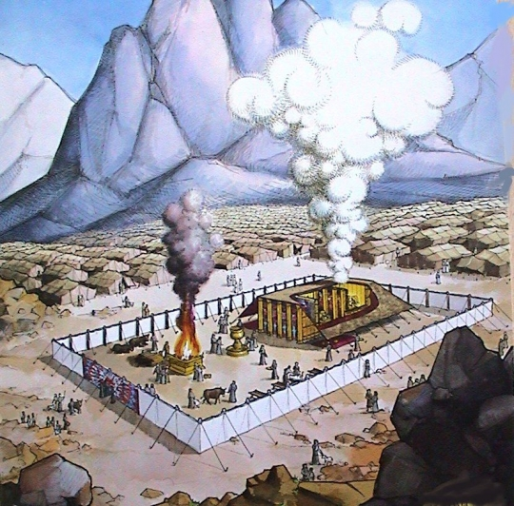

Slide 14
Rev 15&16 – The 3rd Woe, 7 Bowls Full of the Wrath of God
⁵After these things I looked, and the temple of the tabernacle of testimony in heaven was opened, ⁶and the seven angels who had the seven plagues came out of the temple, clothed in linen, clean and bright, and girded around their breasts with golden girdles. ⁷And one of the four living creatures gave to the seven angels seven golden bowls full of the wrath of God, who lives forever and ever. ⁸And the temple was filled with smoke from the glory of God and from His power; and no one was able to enter the temple until the seven plagues of the seven angels were finished. | Rev. 11:19 And the temple of God which is in heaven was opened; and the ark of His covenant appeared in His temple… Mark 15:38 And the veil of the temple was torn in two from top to bottom. Hebrews 8:5 who serve a copy and shadow of the heavenly things, just as Moses was warned by God when he was about to erect the tabernacle; for, "See," He says, "that you make all things according to the pattern which was shown you … Isaiah 6:4 And the foundations of the thresholds trembled at the voice of him who called out, while the temple was filling with smoke. | Simple outline of Revelation Church in Rev 2&3 Temple in Rev 4-19 Temple – naos, “holy of holies” Tabernacle of testimony = tabernacle of witness [against mankind], entire tabernacle Exodus 34:6 Then the Lord passed by in front of him and proclaimed, "The Lord, the Lord God, compassionate and gracious, slow to anger, and abounding in loving-kindness and truth;

Slide 15
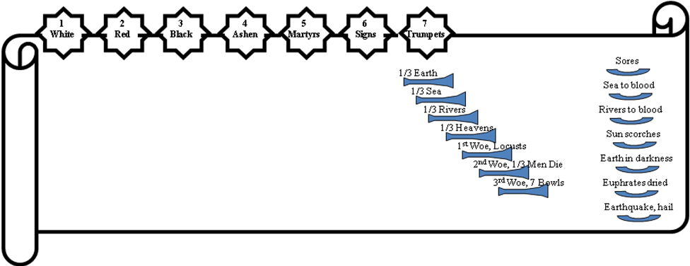
The Judgments
God sends the
bowls out, full
of the wrath
of God.
The Lamb opens
the seals.
Angels sound
the trumpets.

Slide 16
End of Rev 15

Slide 17
The Revelation of Jesus Christ
Isaiah 24:5-6 The earth is also polluted by its inhabitants, for they transgressed laws, violated statutes, broke the everlasting covenant. ⁶Therefore, a curse devours the earth, and those who live in it are held guilty. Therefore, the inhabitants of the earth are burned, and few men are left.
Isaiah 25:8-9 He will swallow up death for all time, And the Lord God will wipe tears away from all faces, And He will remove the reproach of His people from all the earth; For the Lord has spoken. ⁹And it will be said in that day, "Behold, this is our God for whom we have waited that He might save us. This is the Lord for whom we have waited; Let us rejoice and be glad in His salvation."
Rev 16 of 22
Rev. 1:3 Blessed is he who reads and those who hear the words of the prophecy, and heed the things which are written in it; for the time is near.

Slide 18
Rev 16 ⎯ 7 Bowls, “the Great day of God, the Almighty”
And I heard a loud voice from the temple, saying to the seven angels, "Go and pour out the seven bowls of the wrath of God into the earth." ²And the first angel went and poured out his bowl into the earth; and it became a loathsome and malignant sore upon the men who had the mark of the beast and who worshiped his image. | Psalm 79:6 Pour out Thy wrath upon the nations which do not know Thee, … Jeremiah 10:25 Pour out Thy wrath on the nations that do not know Thee, … Zeph. 3:8 "… My decision is to gather nations, To assemble kingdoms, To pour out on them My indignation, … | What happens in Rev 16 immediately precedes the return of Christ and fully displays how God feels about sin. This is the GREAT chapter – grk “mega” appears 12 times as “loud, fierce”, etc; watch for the color green. Did God plan the plagues of Egypt to foreshadow the last days? If so, why? [Rev 15:3-4]

Slide 19
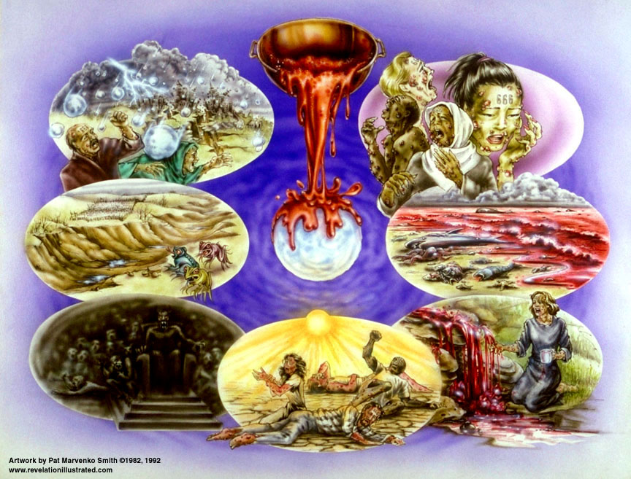

Slide 20
Rev 16 ⎯ 7 Bowls, “the Great day of God, the Almighty”
³And the second angel poured out his bowl into the sea, and it became blood like that of a dead man; and every living thing in the sea died. |  | Blood like of a dead man – “not literally human blood but corresponding in appearance and loathsomeness,” Henry Alford, The New Testament in Greek, 1861 [known as the first and best philological commentary].

Slide 22
Rev 16 ⎯ 7 Bowls, “the Great day of God, the Almighty”
⁴And the third angel poured out his bowl into the rivers and the springs of waters; and they became blood. ⁵And I heard the angel of the waters saying, "Righteous art Thou, who art and who wast, O Holy One, because Thou didst judge these things; ⁶for they poured out the blood of saints and prophets, and Thou hast given them blood to drink. They deserve it." ⁷And I heard the altar saying, "Yes, O Lord God, the Almighty, true and righteous are Thy judgments." | Luke 11:49-50 "For this reason also the wisdom of God said, 'I will send to them prophets and apostles, and some of them they will kill and some they will persecute, ⁵⁰in order that the blood of all the prophets, shed since the foundation of the world, may be charged against this generation, Matthew 27:25 And all the people answered and said, "His blood be on us and on our children!" | How do plagues 2 & 3 fit mankind’s crimes? “Righteous art thou…” and “yes” – two doxologies Those martyring the saints are given blood to drink The martyred saints respond: Souls under the altar [ Rev 6:9-11] acknowledge their prayers being answered.

Slide 24
Rev 16 ⎯ 7 Bowls, “the Great day of God, the Almighty”
⁸And the fourth angel poured out his bowl upon the sun; and it was given to it to scorch men with fire. ⁹And [the] men were scorched with fierce heat; and they blasphemed the name of God who has the power over these plagues; and they did not repent, so as to give Him glory. | Malachi 4:1 "For behold, the day is coming, burning like a furnace; and all the arrogant and every evildoer will be chaff; and the day that is coming will set them ablaze… Jeremiah 6:29-30 The bellows blow fiercely, The lead is consumed by the fire; In vain the refining goes on, But the wicked are not separated. ³⁰They call them rejected silver, Because the Lord has rejected them. | This is real climate change! “[the] men” – grammatically refers to those who worship the beast [vs. 2 and 6]; indicating believers are spared How do “[the] men” respond to the seven plagues? [Rev 16:9,11,21]

Slide 26
Rev 16 ⎯ 7 Bowls, “the Great day of God, the Almighty”
¹⁰And the fifth angel poured out his bowl upon the throne of the beast; and his kingdom became darkened; and they gnawed their tongues because of pain, ¹¹and they blasphemed the God of heaven because of their pains and their sores; and they did not repent of their deeds. | Isa. 60:2; Ez. 32:7; Joel 2:1,2,31; Amos 5:18; Zeph. 1:15 Rev. 9:6 [5th trumpet] And in those days men will seek death and will not find it; and they will long to die and death flees from them. Rev. 2:21 'And I gave her time to repent; and she does not want to repent …[Thyatira] Rom. 2:5-6 But because of your stubbornness and unrepentant heart you are storing up wrath for yourself in the day of wrath and revelation of the righteous judgment of God, ⁶ who WILL RENDER TO EACH PERSON ACCORDING TO HIS DEEDS: | The heat will be greater but the light will decrease. Faced with knowledge of God’s power and grace, they still refuse to acknowledge Him. They know the source of their torment and yet refuse to repent. 4th and last time they refuse to repent in Rev.

Slide 28
Rev 16 ⎯ 7 Bowls, “the Great day of God, the Almighty”
¹²And the sixth angel poured out his bowl upon the great river, the Euphrates; and its water was dried up, that the way might be prepared for the kings from the east. | Psalm 2:1-2 Why are the nations in an uproar, And the peoples devising a vain thing? ²The kings of the earth take their stand, And the rulers take counsel together Against the Lord and against His Anointed: … Isaiah 11:15 And the Lord will utterly destroy the tongue of the Sea of Egypt; And He will wave His hand over the River With His scorching wind; And He will strike it into seven streams, And make men walk over dry-shod. | Sea of Egypt – Gulf of Suez Euphrates River is the eastern boundary of the ancient Roman Empire as well as of the land promised to the seed of Abraham. “east” = “sun-rising”; could include Japan, China, India… Where are the other kings?

Slide 29
Rev 16 ⎯ 7 Bowls, “the Great day of God, the Almighty”
¹³And I saw coming out of the mouth of the dragon and out of the mouth of the beast and out of the mouth of the false prophet, three unclean spirits like frogs; ¹⁴for they are spirits of demons, performing signs, which go out to the kings of the whole world, to gather them together for the war of the great day of God, the Almighty. ¹⁵("Behold, I am coming like a thief. Blessed is the one who stays awake and keeps his garments, lest he walk about naked and men see his shame.") ¹⁶And they gathered them together to the place which in Hebrew is called HarMagedon [Armageddon]. | Daniel 11:40 "And at the end time the king of the South will collide with him, and the king of the North will storm against him … Joel 3:12 Let the nations be aroused And come up to the valley of Jehoshaphat, For there I will sit to judge All the surrounding nations. 1 Thes. 5:2 For you yourselves know full well that the day of the Lord will come just like a thief in the night… Zech. 14:2-3 For I will gather all the nations against Jerusalem to battle, and the city will be captured, the houses plundered, the women ravished, and half of the city exiled, but the rest of the people will not be cut off from the city. ³Then the Lord will go forth and fight against those nations, … | “And I saw…” – a short parenthetic… Demons will deceive the eastern nations into thinking they can defeat the world ruler, but Satan is drawing them to Har-Magedon in a final attempt to defeat Jesus Christ. “Blessed is the one…” - Why is this beatitude so relevant here? Taken as a whole, the sixth bowl of the wrath of God is preparation for the final act of judgment before the Second Coming [BKC] Jehoshaphat – “Yahweh will judge”

Slide 30
7 Beatitudes in Revelation
Rev. 1:3 Blessed is he who reads and those who hear the words of the prophecy, and heed the things which are written in it; for the time is near.
Rev. 14:13 And I heard a voice from heaven, saying, "Write, 'Blessed are the dead who die in the Lord from now on!' " "Yes," says the Spirit, "that they may rest from their labors, for their deeds follow with them."
Rev. 16:15 ("Behold, I am coming like a thief. Blessed is the one who stays awake and keeps his garments, lest he walk about naked and men see his shame.")
Rev. 19:9 And he said to me, "Write, 'Blessed are those who are invited to the marriage supper of the Lamb.' " And he said to me, "These are true words of God."
Rev. 20:6 Blessed and holy is the one who has a part in the first resurrection; over these the second death has no power, but they will be priests of God and of Christ and will reign with Him for a thousand years.
Rev. 22:7 "And behold, I am coming quickly. Blessed is he who heeds the words of the prophecy of this book."
Rev. 22:14 Blessed are those who wash their robes, that they may have the right to the tree of life, and may enter by the gates into the city.

Slide 32
Rev 16 ⎯ 7 Bowls, “the Great day of God, the Almighty”
¹⁷And the seventh angel poured out his bowl upon the air; and a loud voice came out of the temple from the throne, saying, "It is done." ¹⁸And there were flashes of lightning and sounds and peals of thunder; and there was a great earthquake, such as there had not been since man came to be upon the earth, so great an earthquake was it, and so mighty. ¹⁹And the great city was split into three parts, and the cities of the nations fell. And Babylon the great was remembered before God, to give her the cup of the wine of His fierce wrath. | Rev. 11:15 And the seventh angel sounded; and there arose loud voices in heaven, saying, "The kingdom of the world has become the kingdom of our Lord, and of His Christ; and He will reign forever and ever." Ezekiel 38:20 "The fish of the sea, the birds of the heavens, the beasts of the field, all the creeping things that creep on the earth, and all the men who are on the face of the earth will shake at My presence; the mountains also will be thrown down, the steep pathways will collapse and every wall will fall to the ground. | Note lead-in to 7th seal and 7th trumpet… Rev. 8:5 And the angel took the censer; and he filled it with the fire of the altar and threw it to the earth; and there followed peals of thunder and sounds and flashes of lightning and an earthquake. [7th seal] Rev. 11:19 And the temple of God which is in heaven was opened; and the ark of His covenant appeared in His temple, and there were flashes of lightning and sounds and peals of thunder and an earthquake and a great hailstorm. [7th trumpet] “It is done”, lit. it has happened – perfect tense, meaning it has been and will remain done. John 19:30 When Jesus therefore had received the sour wine, He said, "It is finished!" And He bowed His head, and gave up His spirit.

Slide 33
Rev 16 ⎯ 7 Bowls, “the Great day of God, the Almighty”
²⁰And every island fled away, and the mountains were not found. ²¹And huge hailstones, about one hundred pounds each, came down from heaven upon men; and men blasphemed God because of the plague of the hail, because its plague was extremely severe. | Leviticus 24:16 'Moreover, the one who blasphemes the name of the Lord shall surely be put to death; all the congregation shall certainly stone him. The alien as well as the native, when he blasphemes the Name, shall be put to death. Job 38:2-23 “Who is this that darkens counsel By words without knowledge? ³"Now gird up your loins like a man, And I will ask you, and you instruct Me! ⁴"Where were you when I laid the foundation of the earth? Tell Me, if you have understanding,..… ²²"Have you entered the storehouses of the snow, Or have you seen the storehouses of the hail, ²³Which, For the day of war I have reserved for the time of distress and battle? | Sever atmospheric disturbance will create 100 lb hail stones! Are these judgments “just”? The question is sometimes raised why eternal punishment is eternal. The answer is that people in the hardness of their hearts will not change; they deserve eternal punishment because they are eternally unrepentant. [BKC]

Slide 34
Chart of Tribulation Judgments
Event | Seal Judgments Rev 6, 8:6 | Trumpet Judgments Rev 8:7-9:21 | Bowl Judgments Rev 15:1-16:21
1 | White Horse (Antichrist) | Hail, fire, blood: one third of vegetation burned | Malignant sores
2 | Red Horse (Anarchy, terrorism | Great "mountain" thrown into sea: one third of sea blood | Sea turned to blood
3 | Black Horse (world-wide economy out of control) | "Star" falls into fresh water streams, one third poisoned | Fresh waters tuned to blood
4 | Pale Green Horse (Death and Hades | Sun, moon stars dimmed one third | Sun flares up scorching men
5 | Martyrs' Prayers 6. sun, moon, stars disturbed. | demonic invasion unloosed | Darkness in the land of the Beast
6 | Great earthquake | One third of mankind killed in war | Invasion of armies into the holy land
7 | Announcement of Trumpet Judgments | Temple in heaven opened, great earthquake, hailstorm | Great Earthquake, cities fall, topography of earth changed

Slide 35
Final Rev 16 Notes
The stage is set for the Second Coming of Christ. The next prophetic event is…
  Rev. 19:11 And I saw heaven opened; and behold, a white horse, and He who sat upon it is called Faithful and True; and in righteousness He judges and wages war.
But before that we learn about the fall of Babylon in Rev 17 & 18.

Slide 36
The Judgments
God sends the
bowls out, full
of the wrath
of God.
The Lamb opens
the seals.
Angels sound
the trumpets.

Slide 37
End of Rev 16

Slide 38
Revelation of Jesus Christ ⎯ Future Events
Bible Knowledge Commentary [adjusted]
Events in Italics are not necessarily in the Book of Revelation
Events in bold rust are parenthetic sections of Revelation
The Apostasy of the church
The rise of a 10 nation confederacy (countries of Christendom?)
Rapture of the Church (true believers)
Judgment seat of Christ (Bema seat) ⎯ of the Church saints
Three of the nations taken over by a strong ruler
Strong ruler ascends to lead the 7 nation confederacy
Treaty between the strong leader and Israel
The Tribulation begins
Scroll with 7 seals, Lion of Judah/Root of David/Lamb is the only one worthy to open it
6 seal judgments begin
Northern and Southern confederacies attack Israel, defeated by God
Abomination of Desolation
The Great Tribulation begins at 7th seal (Chap 8)
Parenthetic 1 - 144,000 sons of Israel sealed as servants of the Lord
Parenthetic 1 - Great multitude of Gentiles standing before the Lamb
7th seal opened giving 7 trumpet judgements
Silence in heaven for ½ hour
Wrath of the Lamb, (Day of the Lord?)
3 trumpet judgments
4th trumpet - sun, moon, stars smitten: 3 woes (trumpets 5, 6, and 7)
Eastern kingdom (China?) attacks Israel
Parenthetic 2 - The little scroll & The Two witnesses
7th trumpet (rewards to prophets and saints)
Parenthetic 3 - Satan thrown out of heaven
Parenthetic 3 - Jews flee to the wilderness
Parenthetic 3 - Beginning of persecution of Tribulation saints
Parenthetic 3 - Beast rises out of the sea (recognized as Anti-Christ)
Parenthetic 3 - 2nd beast rises out of the earth (world religious leader ⎯ the harlot, Babylon)
Parenthetic 3 - The everlasting gospel preached to the world
Parenthetic 3 - Harvesting of the earth
7 bowl (or vial) judgments
Parenthetic 4 - Destruction of religious Babylon
Parenthetic 4 - Destruction of commercial Babylon
Marriage supper of the Lamb
Nations gather to fight the Anti-Christ in Armageddon
Christ comes in great power and glory, and with His saints
The Great Tribulation ends
Beast and false prophet thrown into the lake of fire
Dragon (Satan) bound for 1000 years
Resurrection of Old Testament and Tribulation saints
The Millennium begins and ends
Great White Throne Judgement
New heaven and new earth
The New Jerusalem

Slide 39
Doxa – glory “Words of glory” which include: 1) praise, 2) eternal attributes
Logos – words
14 Doxologies in the Book of Revelation
References | The One(s) Giving the Praise | The One(s) Receiving the Praise
4:8 | 4 living creatures | God the Father
4:11 | 24 elders | God the Father
5:9-10 | 24 elders and 4 living creatures | The Lamb (Christ)
5:12 | Many angels | The Lamb
5:13 | Every creature | God the Father and the Lamb
7:10 | Tribulation martyrs | God the Father and the Lamb
7:12 | Angels, 24 elders, and 4 living creatures | God the Father
11:16-18 | 24 elders | God the Father
15:3-4 | Tribulation saints | God the Father and the Lamb
16:5-6 | Angel | God the Father
16:7 | “The altar” | God the Father
19:1-3 | A great multitude | God the Father
19:4 | 24 elders and 4 living creatures | God the Father
19:6-8 | A great multitude | God the Father

