Slide 1
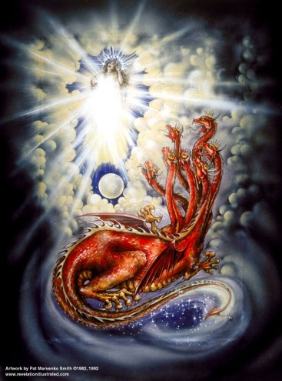
The Revelation of Jesus Christ
Rev. 22:10 And he said to me, "Do not seal up the words of the prophecy of this book, for the time is near.
Rev 13 of 22
Two Beasts
Rev. 1:3 Blessed is he who reads and those who hear the words of the prophecy, and heed the things which are written in it; for the time is near.

Slide 2

Outline of Revelation
Chapters | Topic
1 | Things which you have seen ─ Glorified Christ in heaven
2-3 | Things which are ─ 7 letters to the 7 churches
4-5 | Things which shall take place ─ Introduction / background to the future — 7 sealed scroll
6 | 6 seals
7 | 1st parenthetic ─ 2 groups (144,000, multitude of gentiles in white robes
8 | 7th seal and first 4 trumpets
9 | 5th & 6th trumpets, 1st & 2nd Woes
10-11:14 | 2nd parenthetic ─ the little book, the two witnesses, end of 2nd Woe
11:15-19 | 7th trumpet, 3rd Woe
12 | 3rd parenthetic ─ important characters
13 | 3rd parenthetic ─ wicked rulers
14 | 3rd parenthetic ─ visions of Christ triumphant
15-16 | 7 bowls leading to the 2nd coming of Christ
17 | 4th parenthetic ─ Destruction of ecclesiastic Babylon
18 | 4th parenthetic ─ Destruction of political Babylon
19 | 2nd Coming of Christ, the great supper of God
20 | Millennial reign of Christ ─ Satan bound, 1000 year reign, Satan released, great white throne judgment
21 | New Jerusalem, new heaven and new earth
22 | Concluding revelations

Slide 3
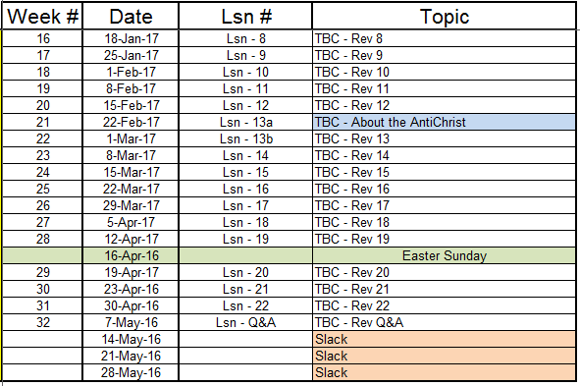

Slide 4
The Lamb
opens the
seals.
1/3 Earth
God sends the
bowls out, full
of the wrath of
God.
Sores
1/3 Sea
Sea to blood
1
White
2
Red
3
Black
4
Ashen
5
Martyrs
6
Signs
7
Wrath
1/3 Rivers
Rivers to blood
1/3 Heavens
Sun scorches
1st Woe, Locusts
Earth in darkness
2nd Woe, 1/3 Men Die
Euphrates dried
Matt 24:8 "But all these things are merely the beginning of birth pangs.”
Angels sound
the trumpets.
3rd Woe, 7 Bowls
Earthquake, hail
Tribulation
Great Tribulation

Slide 5
7 Players in the
Battle of the Ages
Rev 12
The Woman
The Red Dragon
The male Child
Michael
The rest of her offspring
Rev 13
Beast from the sea
Beast from the earth

Slide 6
Review of the Dragon of Rev 12

Slide 7
The Dragon of Rev 12
Rev. 12:3-4 And another sign appeared in heaven: and behold, a great red dragon [see vs. 9] having seven heads and ten horns, and on his heads were seven diadems. ⁴And his tail swept away a third of the stars of heaven, and threw them to the earth. And the dragon stood before the woman who was about to give birth, so that when she gave birth he might devour her child.

Slide 8
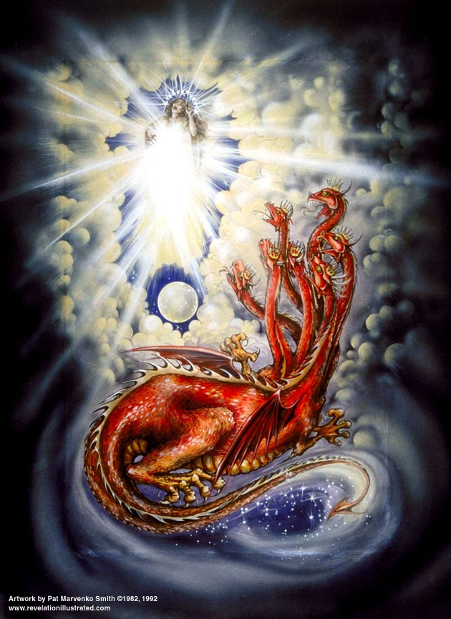

Slide 9
Interpretation
7 heads always = 7 world powers ruling consecutively
10 horns always = 10 nations reigning concurrently in the end times

Slide 10
7 World Powers
Egypt ⎯ leading nation in the Middle East during the first six books of the Bible, ~3100 B.C.
Assyria ⎯ seventh and eighth centuries B.C. Jonah sent to Nineveh, the capital. ~671 B.C.
Babylon ⎯ conquered Jerusalem 598 B.C., carried Daniel away.
Medo-Persia ⎯ captured Babylon 539 B.C.
Greece ⎯ Alexander the Great conquers Medo-Persia in 332 B.C.
Roman Empire ⎯ the greatest of past empires, 250 B.C. to 1453 A.D.
Seventh Empire ⎯ revived Rome, ?? A.D.
The 4 beasts of Dan 7 are in red. They were future when Daniel interpreted (~537 BC ) for BELSHAZZAR, king of Babylon.

Slide 11
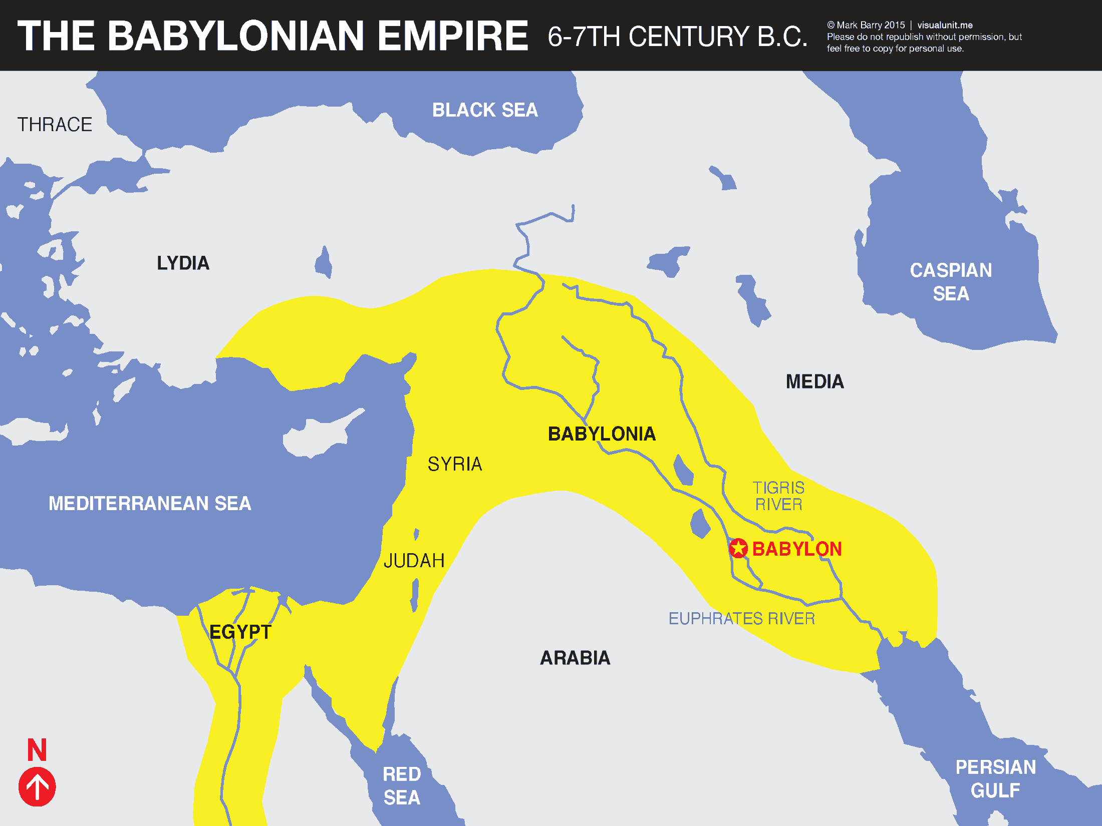

Slide 12
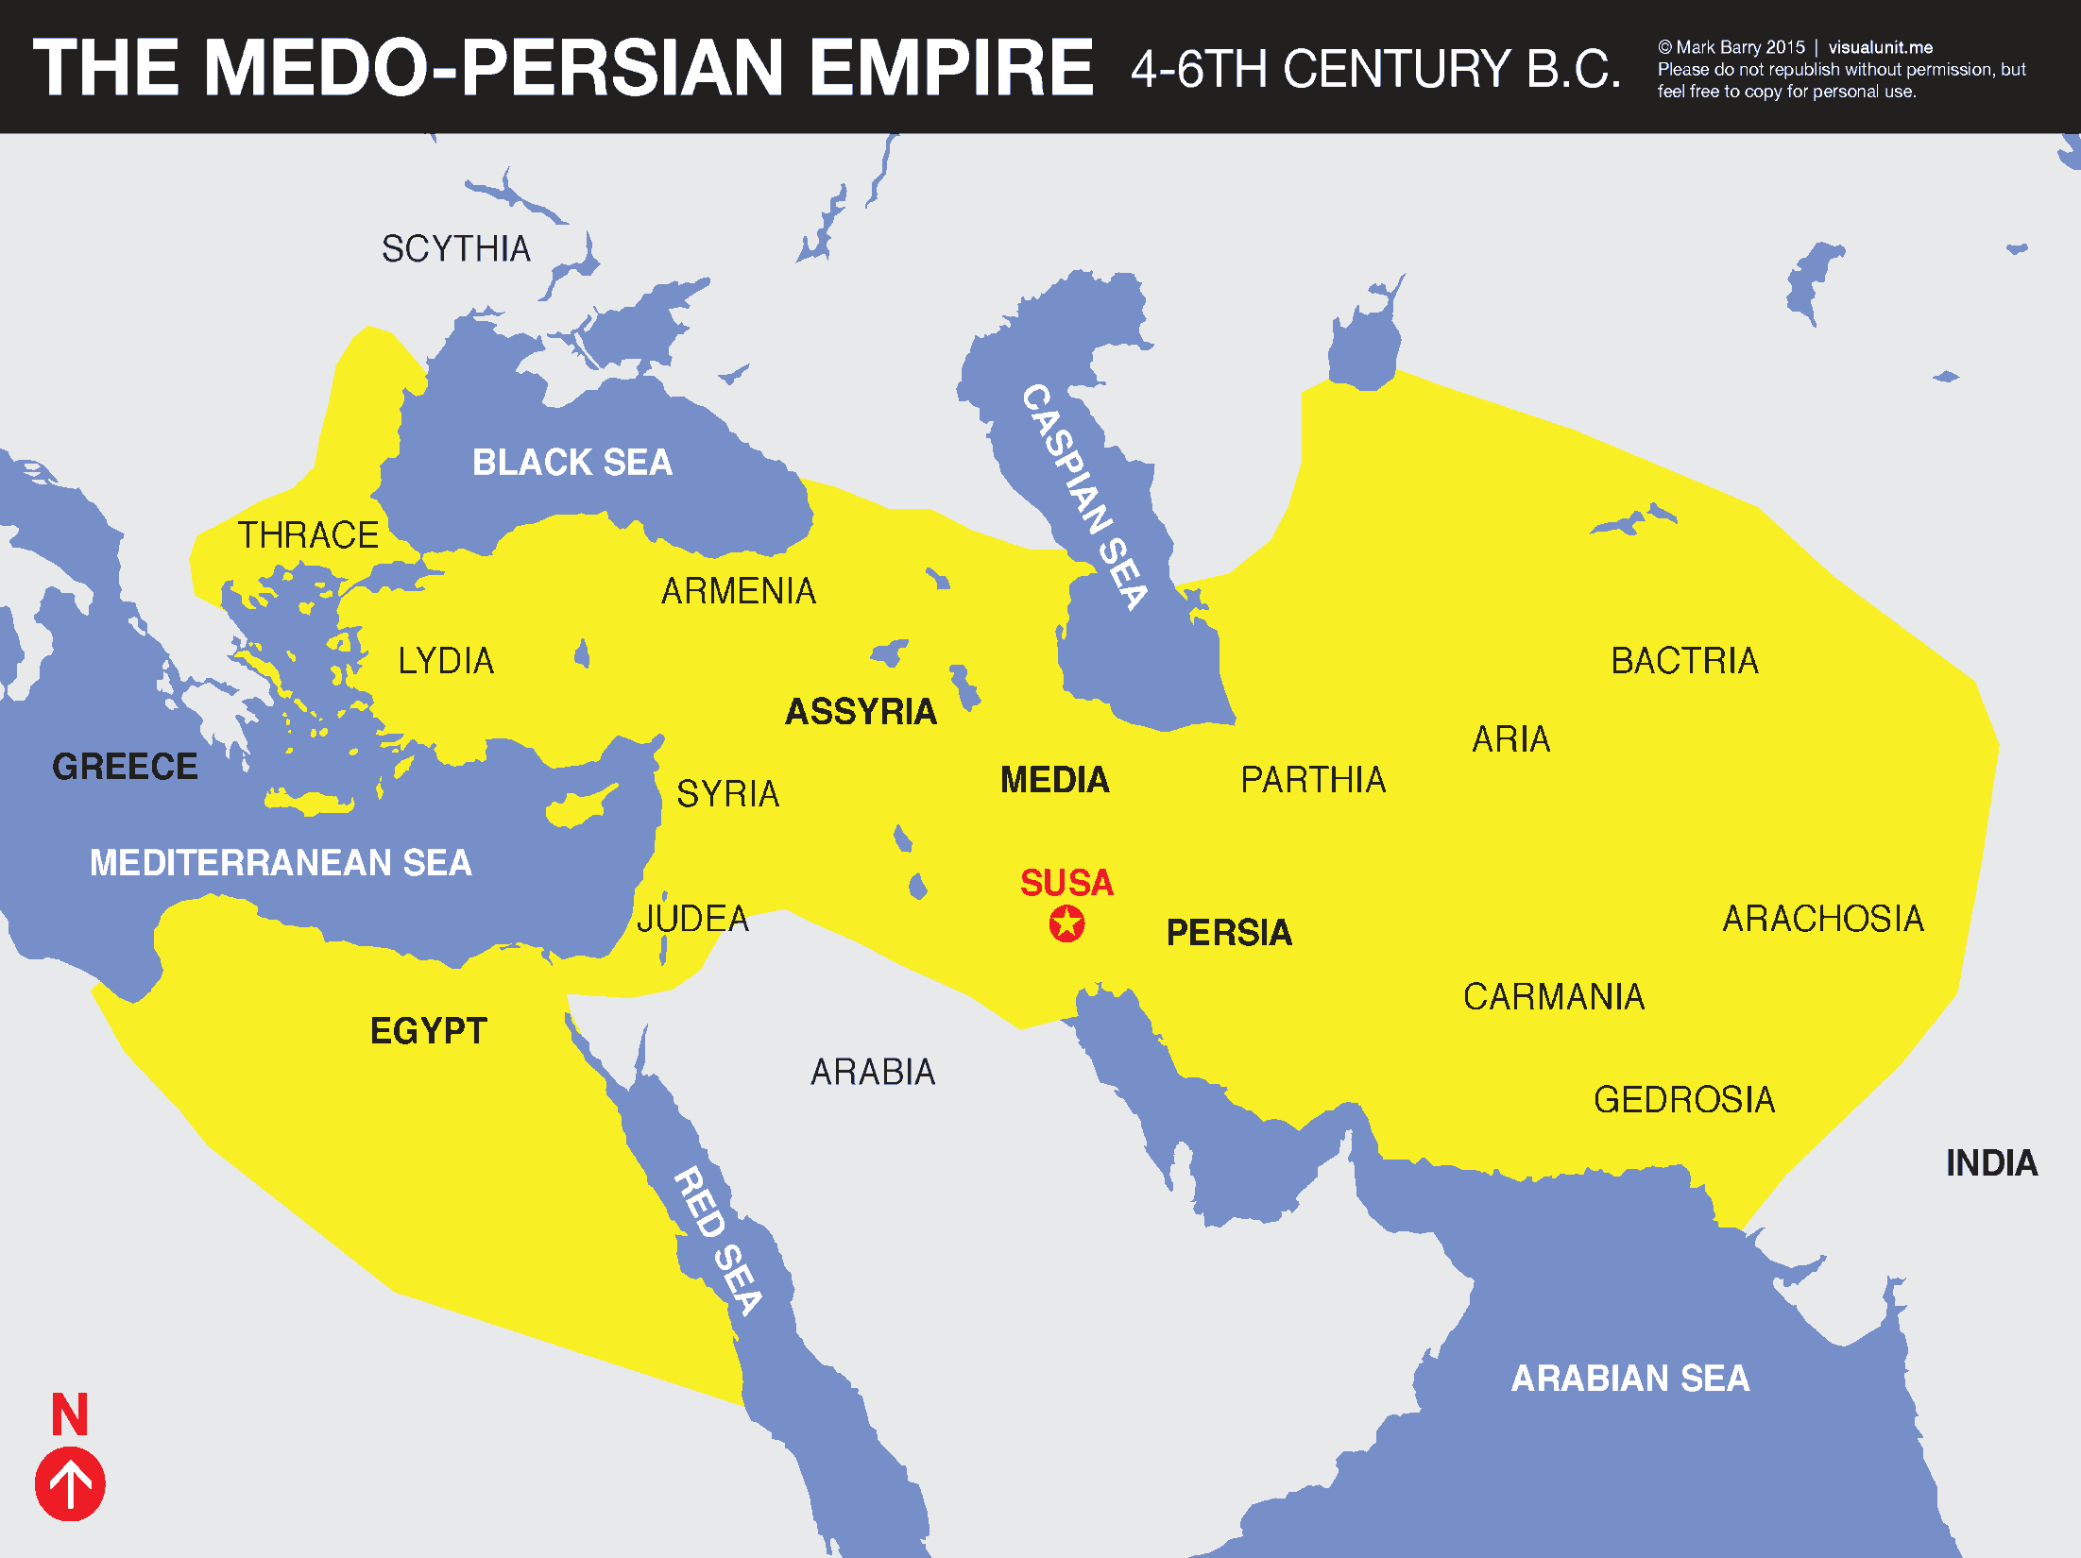

Slide 13
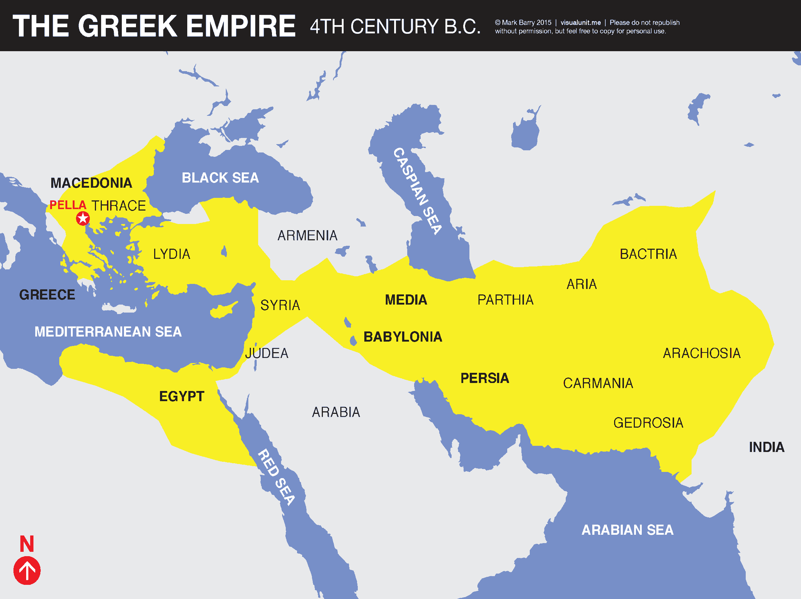

Slide 14
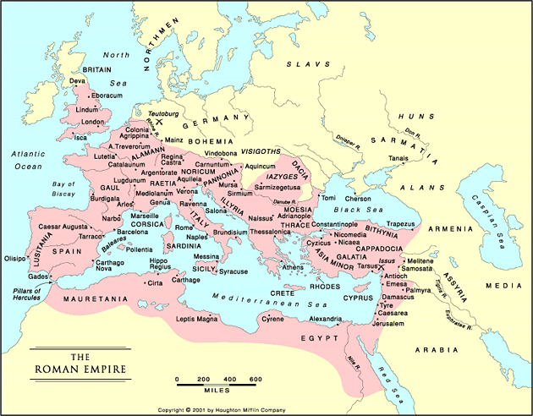

Slide 15
Rev. 12:7-17
⁷ And there was war in heaven, Michael and his angels waging war with the dragon. The dragon and his angels waged war, ⁸ and they were not strong enough, and there was no longer a place found for them in heaven. ⁹ And the great dragon was thrown down, the serpent of old who is called the devil and Satan, who deceives the whole world; he was thrown down to the earth, and his angels were thrown down with him…
¹² "For this reason, rejoice, O heavens and you who dwell in them. Woe to the earth and the sea, because the devil has come down to you, having great wrath, knowing that he has only a short time." ¹³ And when the dragon saw that he was thrown down to the earth, he persecuted the woman who gave birth to the male child. ¹⁴ But the two wings of the great eagle were given to the woman, so that she could fly into the wilderness to her place, where she *was nourished for a time and times and half a time, from the presence of the serpent…
¹⁷ So the dragon was enraged with the woman, and went off to make war with the rest of her children, who keep the commandments of God and hold to the testimony of Jesus.

Slide 16
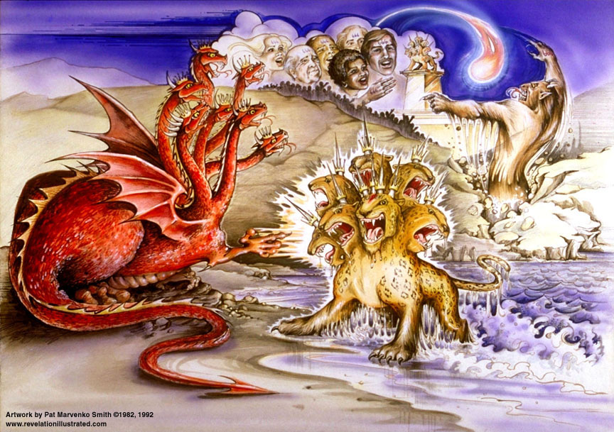

Slide 17
Rev 13 – 2 More Actors in the End Times
Rev. 13:1 And the dragon [KJV, “I”] stood on the sand of the seashore. And I [John] saw a beast coming up out of the sea, having ten horns and seven heads, and on his horns were ten diadems, and on his heads were blasphemous names. Seven heads (Rev 17:3-13) Egypt Assyria Babylonia [Lion] Medo-Persia [Bear] Greece [Leopard] Rome [aggregate of all, 4th of Daniel’s 4 beasts, Dan 7:4-7] Revived Rome Antichrist [8th of John’s kings] | Rev. 11:7 When they have finished their testimony, the beast that comes up out of the abyss will make war with them, and overcome them and kill them. Luke 22:3 And Satan entered into Judas who was called Iscariot, belonging to the number of the twelve. 1 John 2:18 Children, it is the last hour; and just as you heard that antichrist is coming, even now many antichrists have arisen; from this we know that it is the last hour. 1 John 2:22 Who is the liar but the one who denies that Jesus is the Christ? This is the antichrist, … 1 John 4:3 and every spirit that does not confess Jesus is not from God; and this is the spirit of the antichrist, … 2 John 1:7 … those who do not acknowledge Jesus Christ as coming in the flesh. This is the deceiver and the antichrist. | “sand of the seashore” – among the multitudes, the gentiles [Rev 20:8] The beast - both a person and a system – king and kingdom (the antichrist); not just false doctrine! “last hour” – began with the coming of the Messiah Sea – peoples of world; some say it is the abyss – best is both: a gentile man empowered by Satan. Ten horns – 10 nation confederacy of the revived Roman empire Rev 12:3 diadems on 7 heads?? Rev 13:1 diadems on 10 horns??

Slide 19
Rev 13 – 2 More Actors in the End Times
²And the beast which I saw was like a leopard, and his feet were like those of a bear, and his mouth like the mouth of a lion. And the dragon gave him his power and his throne and great authority. | Daniel 7:8 "While I was contemplating the horns, behold, another horn, a little one, came up among them, and three of the first horns were pulled out by the roots before it; and behold, this horn possessed eyes like the eyes of a man and a mouth uttering great boasts. | Rev 17:11 "And the beast which was and is not, is himself also an eighth, and is one of the seven, and he goes to destruction. MacArthur: This is Satan's supreme human instrument to destroy Israel – to prevent Christ from reigning – to prevent God fulfilling His covenant.

Slide 20
Rev 13 – 2 More Actors in the End Times
³And I saw one of his heads as if it had been slain, and his fatal wound was healed. And the whole earth was amazed and followed after the beast; ⁴and they worshiped the dragon, because he gave his authority to the beast; and they worshiped the beast, saying, "Who is like the beast, and who is able to wage war with him?" | Rev. 17:8-11 "The beast that you saw was and is not, and is about to come up out of the abyss and to go to destruction. And those who dwell on the earth will wonder, whose name has not been written in the book of life from the foundation of the world, when they see the beast, that he was and is not and will come. …¹¹"And the beast which was and is not, is himself also an eighth, and is one of the seven, and he goes to destruction. See verses 12 & 14 below. | “Fatal wound” meaning either: 6th kingdom, Rome, disappears and is revived as 7th kingdom or Antichrist slain and resurrected or # 2 above, but faked #3 is strongest; see Rev 13:14 below. Worship is the principle aim of Satan

Slide 21
Rev 13 – 2 More Actors in the End Times
⁵And there was given to him a mouth speaking arrogant words and blasphemies; and authority to act for forty-two months was given to him. ⁶And he opened his mouth in blasphemies against God, to blaspheme His name and His tabernacle, that is, those who dwell in heaven. | Daniel 11:36-37 "Then the king will do as he pleases, and he will exalt and magnify himself above every god, and will speak monstrous things against the God of gods; and he will prosper until the indignation is finished, for that which is decreed will be done. ³⁷"And he will show no regard for the gods of his fathers or for the desire of women, nor will he show regard for any other god; for he will magnify himself above them all. | “desire of women” – in context all references are to ”his’ worship; he will worship only himself. “Forty-two months” – ?? “Blaspheme” – not curses but slandering God

Slide 22
Rev 13 – 2 More Actors in the End Times
⁷And it was given to him to make war with the saints and to overcome them; and authority over every tribe and people and tongue and nation was given to him. | Daniel 7:21 "I kept looking, and that horn was waging war with the saints and overpowering them…” | Note that all these things are “given” to him.

Slide 23
Rev 13 – 2 More Actors in the End Times
⁸And all who dwell on the earth will worship him, everyone whose name has not been written from the foundation of the world in the book of life of the Lamb who has been slain. | Philip. 4:3 … help these women who have shared my struggle in the cause of the gospel, together with Clement also, and the rest of my fellow workers, whose names are in the book of life. Rev. 17:8 "… And those who dwell on the earth will wonder, whose name has not been written in the book of life from the foundation of the world, when they see the beast, that he was and is not and will come. Rev. 20:12-15 And I saw the dead, the great and the small, standing before the throne, and books were opened; and another book was opened, which is the book of life; and the dead were judged from the things which were written in the books, according to their deeds…¹⁵And if anyone's name was not found written in the book of life, he was thrown into the lake of fire. | “all who dwell on the earth” – unbelievers, not everyone. Mentioned 4 times in Rev 13. 1 Peter 1:18-19 knowing that you were not redeemed with perishable things like silver or gold from your futile way of life inherited from your forefathers, ¹⁹but with precious blood, as of a lamb unblemished and spotless, the blood of Christ. Christ owns the book of life.

Slide 24
NIV translation is best…
Rev 13:9-10 He who has an ear, let him hear. ¹⁰ If anyone is to go into captivity, into captivity he will go. If anyone is to be killed with the sword, with the sword he will be killed. This calls for patient endurance and faithfulness on the part of the saints.

Slide 25
Rev 13 – 2 More Actors in the End Times
⁹If anyone has an ear, let him hear. ¹⁰If anyone is destined for captivity, to captivity he goes; if anyone kills with the sword, with the sword he must be killed. Here is the perseverance and the faith of the saints. | Matthew 11:15 "He who has ears to hear, let him hear. Matthew 13:9 "He who has ears, let him hear." Matthew 13:43 "Then the righteous will shine forth as the sun in the kingdom of their Father. He who has ears, let him hear. Rev. 2:7 'He who has an ear, let him hear what the Spirit says to the churches. …[repeated for all 7 letters to churches] Daniel 7:21 "I kept looking, and that horn was waging war with the saints and overpowering them | “If anyone has an ear, let him hear” – flag noting import of statement Note missing phrase – “what the Spirit says to the churches” This exhorts believers NOT to take up arms – perseverance [hopeful endurance] Romans 8:25 But if we hope for what we do not see, with perseverance we wait eagerly for it.

Slide 26
Rev 13 – 2 More Actors in the End Times
The Final False Prophet
¹¹And I saw another beast coming up out of the earth; and he had two horns like a lamb, and he spoke as a dragon. ¹²And he exercises all the authority of the first beast in his presence. And he makes the earth and those who dwell in it to worship the first beast, whose fatal wound was healed. | Rev. 16:13 And I saw coming out of the mouth of the dragon and out of the mouth of the beast and out of the mouth of the false prophet, three unclean spirits like frogs; | “another” – of the same kind, meaning a human not an institution “Out of the earth” implies from human society, e.g. secularism, apostate religion. “lamb” – meekness and gentleness deception We have an unholy trinity now.

Slide 28
Rev 13 – 2 More Actors in the End Times
¹³And he performs great signs, so that he even makes fire come down out of heaven to the earth in the presence of men. ¹⁴And he deceives those who dwell on the earth because of the signs which it was given him to perform in the presence of the beast, telling those who dwell on the earth to make an image to the beast who had the wound of the sword and has come to life. | 2 Thes. 2:3-4 Let no one in any way deceive you, for it will not come unless the apostasy comes first, and the man of lawlessness is revealed, the son of destruction, ⁴who opposes and exalts himself above every so-called god or object of worship, so that he takes his seat in the temple of God, displaying himself as being God… Rev. 19:20 And the beast was seized, and with him the false prophet who performed the signs in his presence, by which he deceived those who had received the mark of the beast and those who worshiped his image; these two were thrown alive into the lake of fire which burns with brimstone. Matt 24:15 "Therefore when you see the ABOMINATION OF DESOLATION which was spoken of through Daniel the prophet, standing in the holy place (let the reader understand), | 2 Kings 1:10 And Elijah answered and said to the captain of fifty, "If I am a man of God, let fire come down from heaven and consume you and your fifty." Then fire came down from heaven and consumed him and his fifty. “deceives” – Greek planao, literally to cause to wander, root of the word planet

Slide 29
Rev 13 – 2 More Actors in the End Times
¹⁵And there was given to him to give breath to the image of the beast, that the image of the beast might even speak and cause as many as do not worship the image of the beast to be killed. ¹⁶And he causes all, the small and the great, and the rich and the poor, and the free men and the slaves, to be given a mark on their right hand, or on their forehead, ¹⁷and he provides that no one should be able to buy or to sell, except the one who has the mark, either the name of the beast or the number of his name. | Daniel 3:3-6 Then the satraps, the prefects and the governors, the counselors, the treasurers, the judges, the magistrates and all the rulers of the provinces were assembled for the dedication of the image that Nebuchadnezzar the king had set up; and they stood before the image that Nebuchadnezzar had set up…^{.6}"But whoever does not fall down and worship shall immediately be cast into the midst of a furnace of blazing fire.“ Deut. 11:18 "You shall therefore impress these words of mine on your heart and on your soul; and you shall bind them as a sign on your hand, and they shall be as frontals on your forehead. | “breath” – spirit or wind - “pneuma”, not “zoe” See martyrs of Rev 6:9-11; 7:13-14

Slide 30
Rev 13 – 2 More Actors in the End Times
¹⁸Here is wisdom. Let him who has understanding calculate the number of the beast, for the number is that of a man; and his number is six hundred and sixty-six. |  | “Here is wisdom” – only those alive at the time can and must determine the meaning

Slide 31
Picture What the Great Tribulation
Will Be Like
Political
Religious
Economic
Military
Hope
Remorse
Repentance??
We do not look for the Antichrist
We look for the return of Jesus Christ for His Church
Meanwhile…
Philippians 3:10 that I may know Him and the power of His resurrection and the fellowship of His sufferings, being conformed to His death;

Slide 32
Importance of Rev 13
Introduces two important players in the Great Tribulation
  Beast out of the sea – the world dictator
  Beast out of the earth – the false prophet
Gives great insight into the character of the Great Tribulation
  One world government
  One world religion
  One world economic system
  Many deceived – “those who dwell on the earth”
  Many martyred believers
Refutes the postmillennial dream of a world getting better and better through Christian effort and gospel preaching – this is not supported in the Bible

Slide 33
Questions

Slide 34
End

