Slide 1
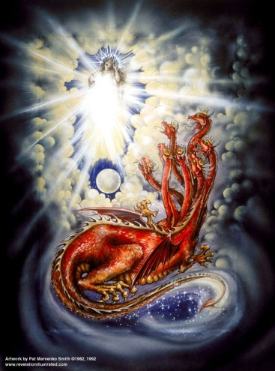
The Revelation of Jesus Christ
Rev. 22:10 And he said to me, "Do not seal up the words of the prophecy of this book, for the time is near.
Rev 12 of 22
Ending the Conflict of the Ages
Rev. 1:3 Blessed is he who reads and those who hear the words of the prophecy, and heed the things which are written in it; for the time is near.

Slide 2

Outline of Revelation
Chapters | Topic
1 | Things which you have seen ─ Glorified Christ in heaven
2-3 | Things which are ─ 7 letters to the 7 churches
4-5 | Things which shall take place ─ Introduction / background to the future — 7 sealed scroll
6 | 6 seals
7 | 1st parenthetic ─ 2 groups (144,000, multitude of gentiles in white robes
8 | 7th seal and first 4 trumpets
9 | 5th & 6th trumpets, 1st & 2nd Woes
10-11:14 | 2nd parenthetic ─ the little book, the two witnesses, end of 2nd Woe
11:15-19 | 7th trumpet, 3rd Woe
12 | 3rd parenthetic ─ important characters
13 | 3rd parenthetic ─ wicked rulers
14 | 3rd parenthetic ─ visions of Christ triumphant
15-16 | 7 bowls leading to the 2nd coming of Christ
17 | 4th parenthetic ─ Destruction of ecclesiastic Babylon
18 | 4th parenthetic ─ Destruction of political Babylon
19 | 2nd Coming of Christ, the great supper of God
20 | Millennial reign of Christ ─ Satan bound, 1000 year reign, Satan released, great white throne judgment
21 | New Jerusalem, new heaven and new earth
22 | Concluding revelations

Slide 3
Rev. 11: 14-19
Beginning of the end of the Great Tribulation
¹⁴The second woe is past; behold, the third woe is coming quickly. ¹⁵And the seventh angel sounded; and there arose loud voices in heaven, saying, "The kingdom of the world has become the kingdom of our Lord, and of His Christ; and He will reign forever and ever." ¹⁶And the twenty-four elders, who sit on their thrones before God, fell on their faces and worshiped God, ¹⁷saying, "We give Thee thanks, O Lord God, the Almighty, who art and who wast, because Thou hast taken Thy great power and hast begun to reign. ¹⁸"And the nations were enraged, and Thy wrath came, and the time came for the dead to be judged, and the time to give their reward to Thy bond-servants the prophets and to the saints and to those who fear Thy name, the small and the great, and to destroy those who destroy the earth.” ¹⁹And the temple of God which is in heaven was opened; and the ark of His covenant appeared in His temple, and there were flashes of lightning and sounds and peals of thunder and an earthquake and a great hailstorm.

Slide 4
The Lamb
opens the
seals.
1/3 Earth
God sends the
bowls out, full
of the wrath of
God.
Sores
1/3 Sea
Sea to blood
1
White
2
Red
3
Black
4
Ashen
5
Martyrs
6
Signs
7
Wrath
1/3 Rivers
Rivers to blood
1/3 Heavens
Sun scorches
1st Woe, Locusts
Earth in darkness
2nd Woe, 1/3 Men Die
Euphrates dried
Matt 24:8 "But all these things are merely the beginning of birth pangs.”
Angels sound
the trumpets.
3rd Woe, 7 Bowls
Earthquake, hail
Tribulation
Great Tribulation

Slide 5
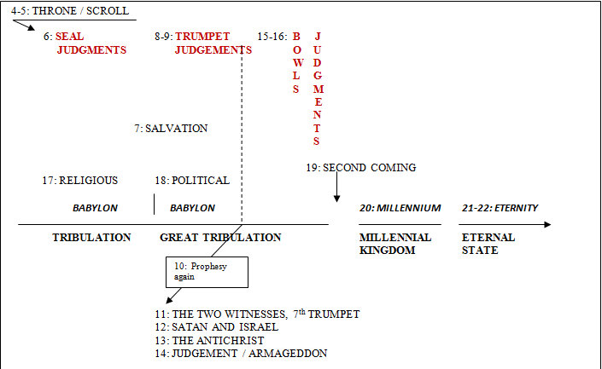
Third Major Section of Revelation: Ch 4-22
(Benware, “Understanding End Times Prophecy”)
Rev. 1:19 "Write therefore the things which you have seen, and the things which are, and the things which shall take place after these things.

Slide 6
7 Players in the
Battle of the Ages
Rev 12
The Woman
The Red Dragon
The male Child
Michael
The rest of her offspring
Rev 13
Beast from the sea
Beast from the earth

Slide 8
Rev. 12: 1-2
And a great sign appeared in heaven: a woman clothed with the sun, and the moon under her feet, and on her head a crown of twelve stars; ²and she was with child; and she cried out, being in labor and in pain to give birth.

Slide 9
Rev 12 – 5 of 7Actors in the End Times (2 more in Rev 13)
Rev. 12:1 And a great sign appeared in heaven: a woman clothed with the sun, and the moon under her feet, and on her head a crown of twelve stars; ²and she was with child; and she cried out, being in labor and in pain to give birth. Isaiah 9:6 For a child will be born to us, a son will be given to us; And the government will rest on His shoulders; And His name will be called Wonderful Counselor, Mighty God, Eternal Father, Prince of Peace. | Sign = “portending remarkable events soon to happen” The mark of Israel –> sun, moon, stars: Genesis 37:9 Now he [Joseph] had still another dream, and related it to his brothers, and said, "Lo, I have had still another dream; and behold, the sun and the moon and eleven stars were bowing down to me." Isaiah 66:7-8 "Before she travailed, she brought forth; Before her pain came, she gave birth to a boy. ⁸"Who has heard such a thing? Who has seen such things? Can a land be born in one day? Can a nation be brought forth all at once? As soon as Zion travailed, she also brought forth her sons. | 7 Actors Rev 12 the woman (1 of 4 in Rev) the red dragon the male child Michael the saved remnant Rev 13 the beast from the sea the beast from the earth McGee - "If you tell me your interpretation of the woman in Rev 12, then I'll tell you your interpretation of prophecy." Who is the woman?... Roman church say the virgin Mary Reformed protestants say the Church Dispensational protestants say Israel

Slide 10
Rev. 12: 3-4
³And another sign appeared in heaven: and behold, a great red dragon having seven heads and ten horns, and on his heads were seven diadems. ⁴And his tail swept away a third of the stars of heaven, and threw them to the earth. And the dragon stood before the woman who was about to give birth, so that when she gave birth he might devour her child

Slide 11
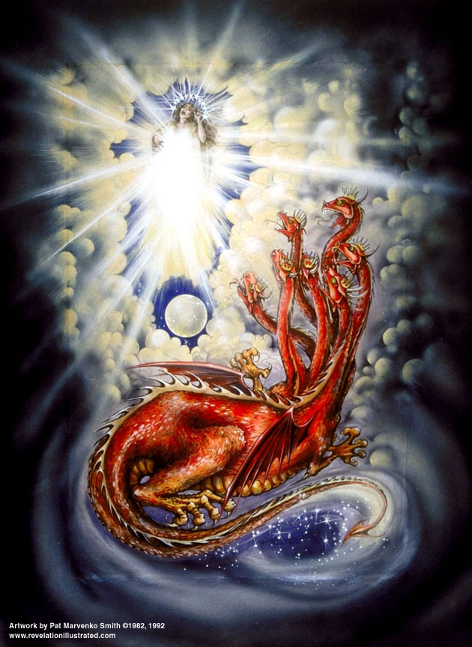

Slide 12
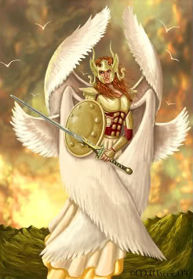
John 12:31 "Now judgment is upon this world; now the ruler of this world will be cast out.

Slide 13
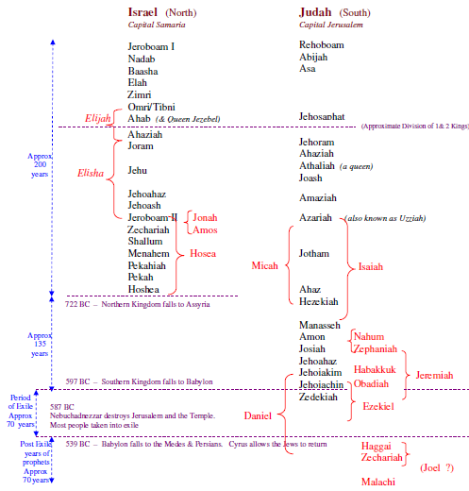

Slide 14
7 World Powers
Egypt ⎯ leading nation in the Middle East during the first six books of the Bible, ~3100 B.C.
Assyria ⎯ seventh and eighth centuries B.C. Jonah sent to Nineveh, the capital. ~671 B.C.
Babylon ⎯ conquered Jerusalem 598 B.C., carried Daniel away.
Daniel ~ 605 B.C. - 537 B.C.
Medo-Persia ⎯ captured Babylon 539 B.C.
Greece ⎯ Alexander the Great conquers Medo-Persia in 332 B.C.
Roman Empire [Daniel’s 4th Kingdom] ⎯ the greatest of past empires, 146 B.C. to 476 A.D.
Seventh Empire ⎯ revived Rome, ?? A.D.
The 4 beasts of Dan 7 are in red. They were future when Daniel had visions (~537 BC ) for BELSHAZZAR, king of Babylon; interpreted by Gabriel.

Slide 15
4 Beasts of Daniel 7
Daniel 7:3-6 "And four great beasts were coming up from the sea, different from one another. ⁴ "The first was like a lion …⁵ "And behold, another beast, a second one, resembling a bear. …⁶ "After this I kept looking, and behold, another one, like a leopard, …

Slide 16
4th Beast of Daniel 7
Daniel 7:7-8 "After this I kept looking in the night visions, and behold, a fourth beast, … and it had ten horns. ⁸"While I was contemplating the horns, behold, another horn, a little one, came up among them, and three of the first horns were pulled out by the roots before it; and behold, this horn possessed eyes like the eyes of a man and a mouth uttering great boasts.
7 heads always = 7 world powers ruling consecutively
10 horns always = 10 nations reigning concurrently in the end times
Little horn is the Antichrist

Slide 17
Rev 12 – 5 of 7Actors in the End Times (2 more in Rev 13)
³And another sign appeared in heaven: and behold, a great red dragon [see vs. 9] having seven heads and ten horns, and on his heads were seven diadems. ⁴And his tail swept away a third of the stars of heaven, and threw them to the earth. And the dragon stood before the woman who was about to give birth, so that when she gave birth he might devour her child. | Ezekiel 28:12 … 'Thus says the Lord God, "You had the seal of perfection, Full of wisdom and perfect in beauty. Genesis 3:15 And I will put enmity Between you and the woman, And between your seed and her seed; He shall bruise you on the head, And you shall bruise him on the heel." Matthew 2:16 Then when Herod saw that he had been tricked by the magi, he became very enraged, and sent and slew all the male children … Daniel 7:7-8 "After this I kept looking in the night visions, and behold, a fourth beast, … and it had ten horns. ⁸ "While I was contemplating the horns, behold, another horn, a little one, came up among them, and three of the first horns were pulled out by the roots before it; and behold, this horn possessed eyes like the eyes of a man and a mouth uttering great boasts.

Slide 18
Rev 12 – 5 of 7Actors in the End Times (2 more in Rev 13)
³And another sign appeared in heaven: and behold, a great red dragon [see vs. 9] having seven heads and ten horns, and on his heads were seven diadems. ⁴And his tail swept away a third of the stars of heaven, and threw them to the earth. And the dragon stood before the woman who was about to give birth, so that when she gave birth he might devour her child. | Rev. 13:1-2 And he stood on the sand of the seashore. And I saw a beast coming up out of the sea, having ten horns and seven heads, and on his horns were ten diadems, and on his heads were blasphemous names. ²And the beast which I saw was like a leopard, and his feet were like those of a bear, and his mouth like the mouth of a lion. And the dragon gave him his power and his throne and great authority. Rev. 17:3-13 And he carried me away in the Spirit into a wilderness; and I saw a woman sitting on a scarlet beast, full of blasphemous names, having seven heads and ten horns…. ⁹"Here is the mind which has wisdom. The seven heads are seven mountains on which the woman sits, ¹⁰and they are seven kings; five have fallen, one is, the other has not yet come; and when he comes, he must remain a little while. ¹¹"And the beast which was and is not, is himself also an eighth, and is one of the seven, and he goes to destruction. ¹²"And the ten horns which you saw are ten kings, who have not yet received a kingdom, but they receive authority as kings with the beast for one hour. ¹³"These have one purpose and they give their power and authority to the beast.

Slide 19
7 World Powers
Egypt ⎯ leading nation in the Middle East during the first six books of the Bible, ~3100 B.C.
Assyria ⎯ seventh and eighth centuries B.C. Jonah sent to Nineveh, the capital. ~671 B.C.
Babylon ⎯ conquered Jerusalem 598 B.C., carried Daniel away.
Daniel ~ 605 B.C. - 537 B.C.
Medo-Persia ⎯ captured Babylon 539 B.C.
Greece ⎯ Alexander the Great conquers Medo-Persia in 332 B.C.
Roman Empire [Daniel’s 4th Kingdom] ⎯ the greatest of past empires, 146 B.C. to 476 A.D.
Seventh Empire ⎯ revived Rome, ?? A.D.
The 4 beasts of Dan 7 are in red. They were future when Daniel had visions (~537 BC ) for BELSHAZZAR, king of Babylon; interpreted by Gabriel.

Slide 20
More from Dan 7
Daniel 7:23-25 "Thus he said: 'The fourth beast will be a fourth kingdom on the earth, which will be different from all the other kingdoms, and it will devour the whole earth and tread it down and crush it. ²⁴'As for the ten horns, out of this kingdom ten kings will arise; and another will arise after them, and he will be different from the previous ones and will subdue three kings. ²⁵'And he will speak out against the Most High and wear down the saints of the Highest One, and he will intend to make alterations in times and in law; and they will be given into his hand for a time, times, and half a time.

Slide 21
Rev. 12: 5-6
⁵And she gave birth to a son, a male child, who is to rule all the nations with a rod of iron; and her child was caught up to God and to His throne. ⁶And the woman fled into the wilderness where she had a place prepared by God, so that there she might be nourished for one thousand two hundred and sixty days.

Slide 22
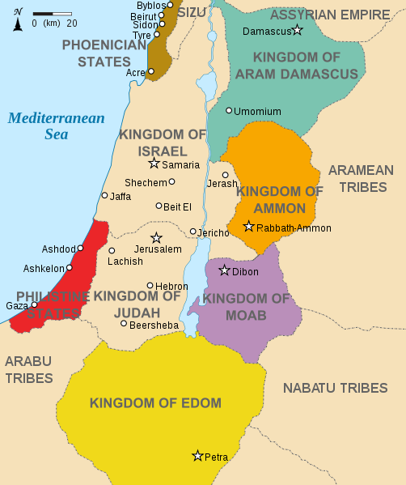
Daniel 11:40-41 "At the end time the king of the South will collide with him, and the king of the North will storm against him with chariots, with horsemen and with many ships; and he will enter countries, overflow them and pass through. ⁴¹ "He will also enter the Beautiful Land, and many countries will fall; but these will be rescued out of his hand: Edom, Moab and the foremost of the sons of Ammon.

Slide 23
Rev 12 – 5 of 7Actors in the End Times (2 more in Rev 13)
⁵And she gave birth to a son, a male child, who is to rule all the nations with a rod of iron; and her child was caught up to God and to His throne. ⁶And the woman fled into the wilderness where she had a place prepared by God, so that there she might be nourished for one thousand two hundred and sixty days. | Psalm 2:9 'Thou shalt break them with a rod of iron, Thou shalt shatter them like earthenware.' " Mark 13:14 "But when you see the abomination of desolation standing where it should not be (let the reader understand), then let those who are in Judea flee to the mountains. | She = _______________ Male child = _________ 1 Thess. 4:17 “caught up” Fled- see vs. 14. 3 ½ yrs = Great Tribulation

Slide 24
Rev. 12: 7-9
⁷And there was war in heaven, Michael and his angels waging war with the dragon. And the dragon and his angels waged war, ⁸and they were not strong enough, and there was no longer a place found for them in heaven. ⁹And the great dragon was thrown down, the serpent of old who is called the devil and Satan, who deceives the whole world; he was thrown down to the earth, and his angels were thrown down with him.

Slide 25
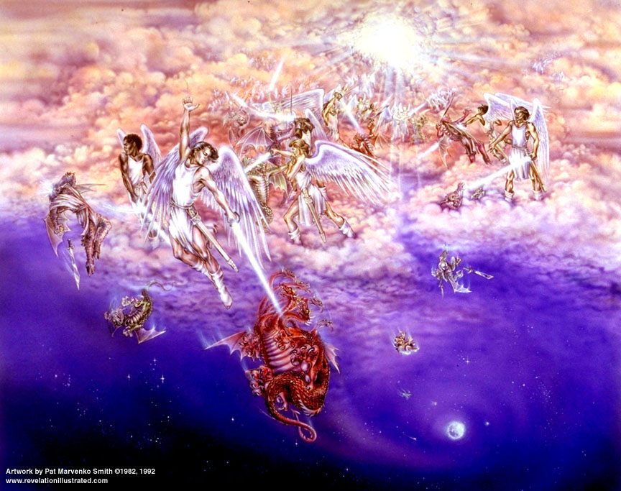

Slide 26
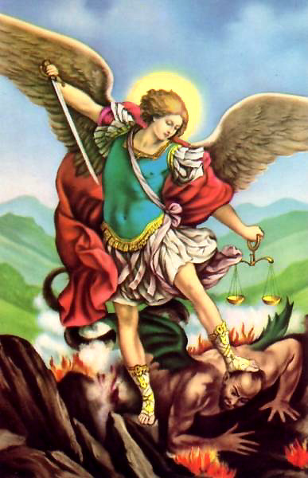

Slide 27
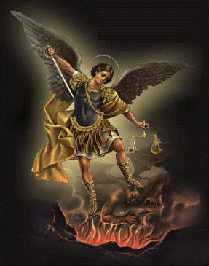

Slide 28
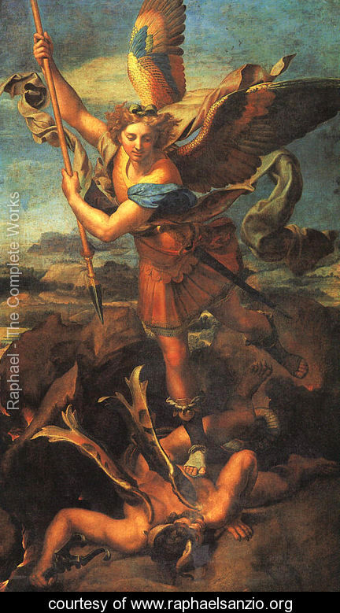

Slide 29
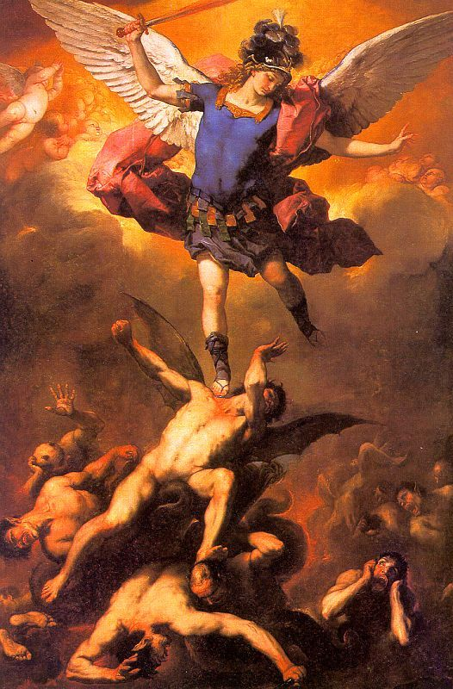

Slide 30
Rev 12 – 5 of 7Actors in the End Times (2 more in Rev 13)
⁷And there was war in heaven, Michael and his angels waging war with the dragon. And the dragon and his angels waged war, ⁸and they were not strong enough, and there was no longer a place found for them in heaven. ⁹And the great dragon was thrown down, the serpent of old who is called the devil and Satan, who deceives the whole world; he was thrown down to the earth, and his angels were thrown down with him. | Jude 1:9 But Michael the archangel… Daniel 12:1 "Now at that time Michael, the great prince who stands guard over the sons of your people, will arise. And there will be a time of distress such as never occurred since there was a nation until that time; and at that time your people, everyone who is found written in the book, will be rescued. Luke 10:18 And He said to them, "I was watching Satan fall from heaven like lightning. Daniel 10:21 "… there is no one who stands firmly with me against these forces except Michael your prince. | “At that time” – after the antichrist pitches his tents by Jerusalem. Michael is associated with war and conflict. He is not a messenger angel, he is a warrior. Prince of Israel.

Slide 31
Rev. 12: 10-12
¹⁰And I heard a loud voice in heaven, saying, "Now the salvation, and the power, and the kingdom of our God and the authority of His Christ have come, for the accuser of our brethren has been thrown down, who accuses them before our God day and night. ¹¹"And they overcame him because of the blood of the Lamb and because of the word of their testimony, and they did not love their life even to death. ¹²"For this reason, rejoice, O heavens and you who dwell in them. Woe to the earth and the sea, because the devil has come down to you, having great wrath, knowing that he has only a short time."

Slide 32
Rev 12 – 5 of 7Actors in the End Times (2 more in Rev 13)
¹⁰And I heard a loud voice in heaven, saying, "Now the salvation, and the power, and the kingdom of our God and the authority of His Christ have come, for the accuser of our brethren has been thrown down, who accuses them before our God day and night. ¹¹"And they overcame him because of the blood of the Lamb and because of the word of their testimony, and they did not love their life even to death. ¹²"For this reason, rejoice, O heavens and you who dwell in them. Woe to the earth and the sea, because the devil has come down to you, having great wrath, knowing that he has only a short time." | Rev. 6:10 and they (from under the altar) cried out with a loud voice, saying, "How long, O Lord, holy and true, wilt Thou refrain from judging and avenging our blood on those who dwell on the earth?" Rev. 7:9-14 … behold, a great multitude [before the throne], which no one could count, from every nation and all tribes and peoples and tongues, … ¹⁰and they cry out with a loud voice, saying, "Salvation to our God who sits on the throne, and to the Lamb… [an elder says] "These are the ones who come out of the great tribulation, and they have washed their robes and made them white in the blood of the Lamb…” 1 John 2:1 My little children, I am writing these things to you that you may not sin. And if anyone sins, we have an Advocate with the Father, Jesus Christ the righteous; Matthew 10:33 "But whoever shall deny Me before men, I will also deny him before My Father who is in heaven. | 4 great blood bought victories __________ __________ __________ __________ based on 3 sources __________ __________ __________

Slide 33
Rev. 12: 13-14
¹³And when the dragon saw that he was thrown down to the earth, he persecuted the woman who gave birth to the male child. ¹⁴And the two wings of the great eagle were given to the woman, in order that she might fly into the wilderness to her place, where she was nourished for a time and times and half a time, from the presence of the serpent.

Slide 34
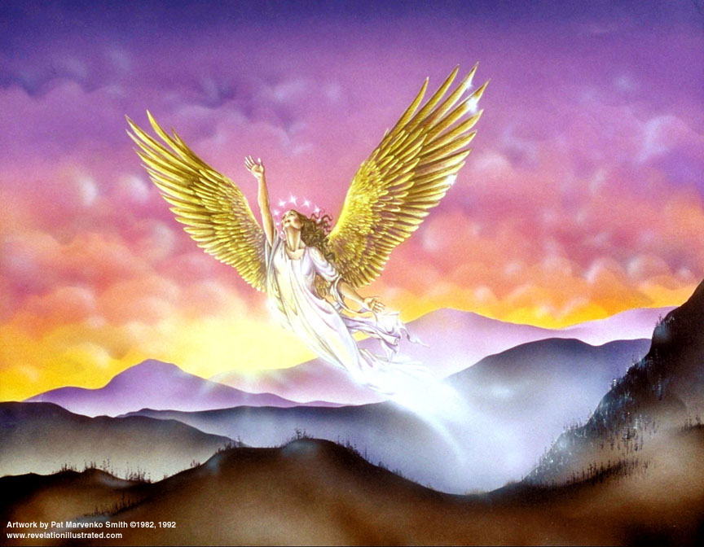

Slide 35
Rev 12 – 5 of 7Actors in the End Times (2 more in Rev 13)
¹³And when the dragon saw that he was thrown down to the earth, he persecuted the woman who gave birth to the male child. ¹⁴And the two wings of the great eagle were given to the woman, in order that she might fly into the wilderness to her place, where she was nourished for a time and times and half a time, from the presence of the serpent. | Genesis 3:15 And I will put enmity Between you and the woman, And between your seed and her seed; He shall bruise you on the head, And you shall bruise him on the heel." Exodus 19:4 'You yourselves have seen what I did to the Egyptians and how I bore you on eagles' wings, and brought you to Myself. Matthew 24:15-16 "Therefore when you see the abomination of desolation which was spoken of through Daniel the prophet, standing in the holy place (let the reader understand), ¹⁶then let those who are in Judea flee to the mountains; | Beginning of the Great Tribulation Then…Sheep and Goat Judgment Matthew 25:34-40 "Then the King will say to those on His right, 'Come, you who are blessed of My Father, inherit the kingdom prepared for you from the foundation of the world. ³⁵ 'For I was hungry, and you gave Me something to eat; I was thirsty, and you gave Me drink… ³⁷"Then the righteous will answer Him, saying, 'Lord, when did we see You hungry, and feed You, or thirsty, and give You drink?... ⁴⁰"And the King will answer and say to them, 'Truly I say to you, to the extent that you did it to one of these brothers of Mine, even the least of them, you did it to Me.'

Slide 36
Rev. 12: 15-17
¹⁵And the serpent poured water like a river out of his mouth after the woman, so that he might cause her to be swept away with the flood. ¹⁶And the earth helped the woman, and the earth opened its mouth and drank up the river which the dragon poured out of his mouth. ¹⁷And the dragon was enraged with the woman, and went off to make war with the rest of her offspring, who keep the commandments of God and hold to the testimony of Jesus.

Slide 37
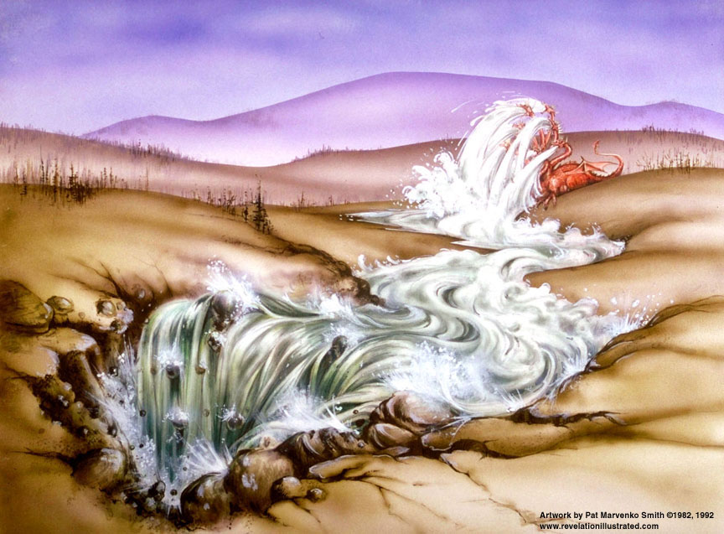

Slide 38
Rev 12 – 5 of 7Actors in the End Times (2 more in Rev 13)
¹⁵And the serpent poured water like a river out of his mouth after the woman, so that he might cause her to be swept away with the flood. ¹⁶And the earth helped the woman, and the earth opened its mouth and drank up the river which the dragon poured out of his mouth. ¹⁷And the dragon was enraged with the woman, and went off to make war with the rest of her offspring, who keep the commandments of God and hold to the testimony of Jesus. | Daniel 9:26 "Then after the sixty-two weeks the Messiah will be cut off and have nothing, and the people of the prince who is to come will destroy the city and the sanctuary. And its end will come with a flood; even to the end there will be war; desolations are determined. Isaiah 8:7-8 "Now therefore, behold, the Lord is about to bring on them the strong and abundant waters of the Euphrates, Even the king of Assyria and all his glory; And it will rise up over all its channels and go over all its banks. ⁸ "Then it will sweep on into Judah, it will overflow and pass through, It will reach even to the neck; And the spread of its wings will fill the breadth of your land, O Immanuel. Ezekiel 38:18-19 "And it will come about on that day, when Gog comes against the land of Israel," declares the Lord God, "that My fury will mount up in My anger. ¹⁹"And in My zeal and in My blazing wrath I declare that on that day there will surely be a great earthquake in the land of Israel. | Psalm 124 waters = enemies “rest of her offspring who keep the commandments of God” – the 144,000 + 2 witnesses who are protected plus those who have accepted Jesus as the Messiah of Israel. Numbers 16:30-32 "But if the LORD brings about an entirely new thing and the ground opens its mouth and swallows them up with all that is theirs, and they descend alive into Sheol, then you will understand that these men have spurned the LORD… and the earth opened its mouth and swallowed them up, and their households, and all the men who belonged to Korah with their possessions.

Slide 39
7 Players in the
Battle of the Ages
The Woman
The Red Dragon
The male Child
Michael
The rest of her offspring
Beast from the sea
Beast from the earth

Slide 40
The Lamb
opens the
seals.
1/3 Earth
God sends the
bowls out, full
of the wrath of
God.
Sores
1/3 Sea
Sea to blood
1
White
2
Red
3
Black
4
Ashen
5
Martyrs
6
Signs
7
Wrath
1/3 Rivers
Rivers to blood
1/3 Heavens
Sun scorches
1st Woe, Locusts
Earth in darkness
2nd Woe, 1/3 Men Die
Euphrates dried
Matt 24:8 "But all these things are merely the beginning of birth pangs.”
Angels sound
the trumpets.
3rd Woe, 7 Bowls
Earthquake, hail
Tribulation
Great Tribulation

Slide 41
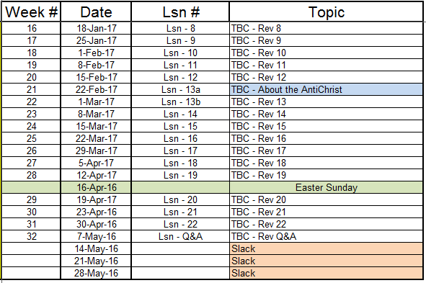

Slide 42
End

