Slide 1
Outline of Revelation
Chapters | Topic
1 | Things which you have seen ─ Glorified Christ in heaven
2-3 | Things which are ─ 7 letters to the 7 churches
4-5 | Things which shall take place ─ Introduction / background to the future — 7 sealed scroll
6 | 6 seals
7 | 1st parenthetic ─ 2 groups (144,000, multitude of gentiles in white robes
8 | 7th seal and first 4 trumpets
9 | 5th & 6th trumpets, 1st & 2nd Woes
10-11:14 | 2nd parenthetic ─ the little book, the two witnesses, end of 2nd Woe
11:15-19 | 7th trumpet, 3rd Woe
12 | 3rd parenthetic ─ important characters
13 | 3rd parenthetic ─ wicked rulers
14 | 3rd parenthetic ─ visions of Christ triumphant
15-16 | 7 bowls leading to the 2nd coming of Christ
17 | 4th parenthetic ─ Destruction of ecclesiastic Babylon
18 | 4th parenthetic ─ Destruction of political Babylon
19 | 2nd Coming of Christ, the great supper of God
20 | Millennial reign of Christ ─ Satan bound, 1000 year reign, Satan released, great white throne judgment
21 | New Jerusalem, new heaven and new earth
22 | Concluding revelations

Slide 2
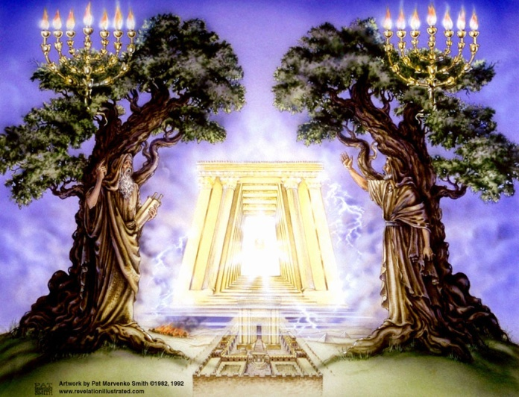
The Revelation of Jesus Christ
Rev. 22:10 And he said to me, "Do not seal up the words of the prophecy of this book, for the time is near.
Rev 11 of 22
Rev. 1:3 Blessed is he who reads and those who hear the words of the prophecy, and heed the things which are written in it; for the time is near.

Slide 3
The Lamb
opens the
seals.
1/3 Earth
God sends the
bowls out, full
of the wrath of
God.
Sores
1/3 Sea
Sea to blood
1
White
2
Red
3
Black
4
Ashen
5
Martyrs
6
Signs
7
Wrath
1/3 Rivers
Rivers to blood
1/3 Heavens
Sun scorches
1st Woe, Locusts
Earth in darkness
2nd Woe, 1/3 Men Die
Euphrates dried
Matt 24:8 "But all these things are merely the beginning of birth pangs.”
Angels sound
the trumpets.
3rd Woe, 7 Bowls
Earthquake, hail
Tribulation
Great Tribulation

Slide 4
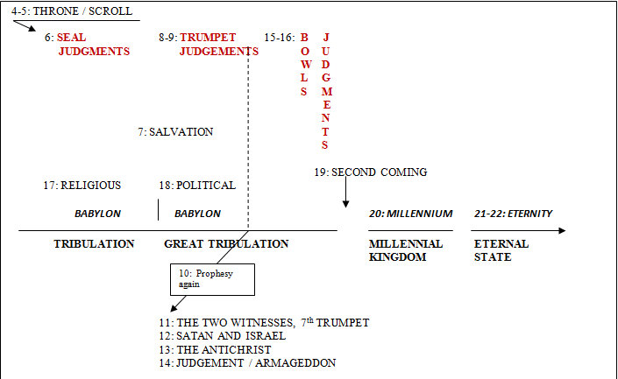
We have covered Rev 4 thru 10 so far…

Slide 5
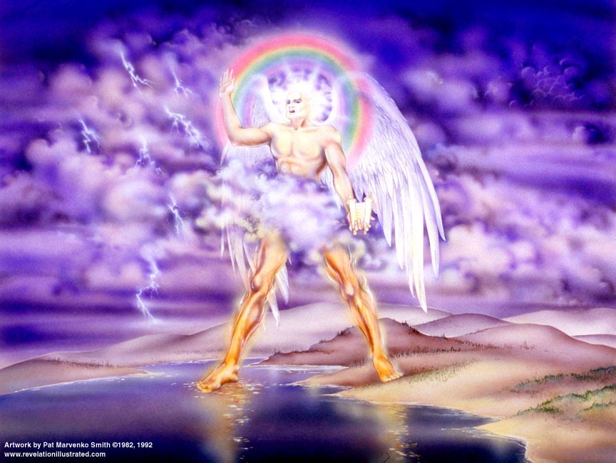

Slide 6
Rev. 10: 8-11
⁸And the voice which I heard from heaven, I heard again speaking with me, and saying, "Go, take the book which is open in the hand of the angel who stands on the sea and on the land." ⁹And I went to the angel, telling him to give me the little book. And he said to me, "Take it, and eat it; and it will make your stomach bitter, but in your mouth it will be sweet as honey." ¹⁰And I took the little book out of the angel's hand and ate it, and it was in my mouth sweet as honey; and when I had eaten it, my stomach was made bitter.
¹¹And they said to me, "You must prophesy again concerning many peoples and nations and tongues and kings."

Slide 7
Rev. 11: 1-2
¹And there was given me a measuring rod like a staff; and someone said, "Rise and measure the temple of God, and the altar, and those who worship in it. ²"And leave out the court which is outside the temple, and do not measure it, for it has been given to the nations; and they will tread under foot the holy city for forty-two months.

Slide 8

measuring - judgment or construction/possession
Isaiah 28:17 "I will make justice the measuring line And righteousness the level; Then hail will sweep away the refuge of lies And the waters will overflow the secret place.
Jeremiah 13:25 "This is your lot, the portion measured to you From Me," declares the LORD, "Because you have forgotten Me And trusted in falsehood.
Zechariah 1:16 ~'Therefore thus says the LORD, "I will return to Jerusalem with compassion; My house will be built in it," declares the LORD of hosts, "and a measuring line will be stretched over Jerusalem."'

Slide 9
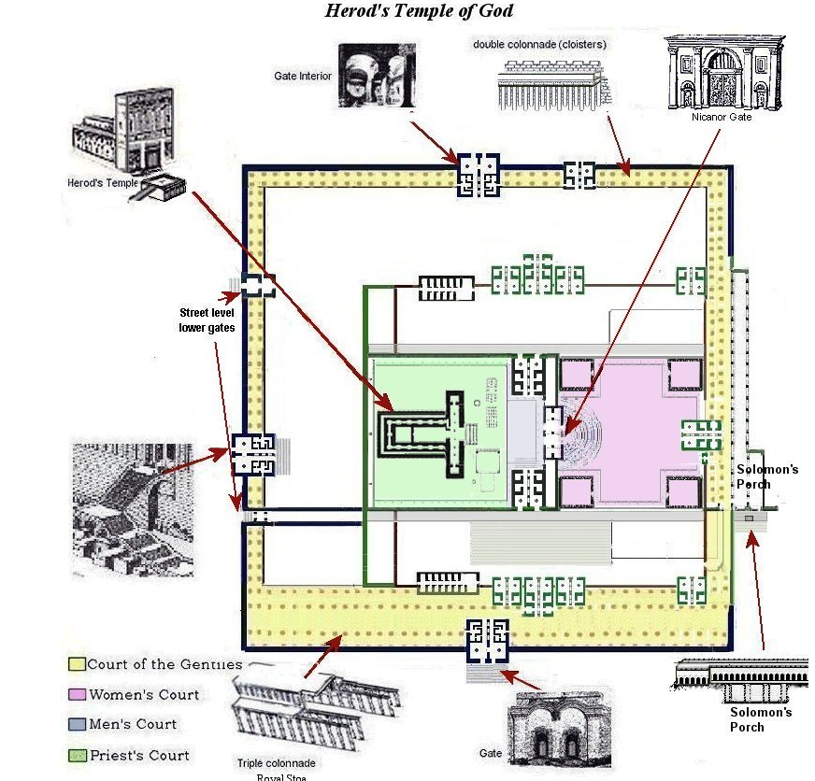
http://templemountlocation.com/HerodTempleCourts.html

Slide 10
Another sidetrack -
Clarence Larkin," The Book of Revelation”
“This then must be a future temple that is to be built at Jerusalem…the Temple that the Jews will build on their return to Jerusalem will probably be destroyed by the Earthquake that…”
copyright 1919
Rev Larkin died in 1924
Israel proclaimed a nation on May 14, 1948

Slide 11
Rev 11 – Measure Temple, 2 Witnesses, 7th Trumpet
¹And there was given me a measuring rod like a staff; and someone said, "Rise and measure the temple of God, and the altar, and those who worship in it. ²"And leave out the court which is outside the temple, and do not measure it, for it has been given to the nations; and they will tread under foot the holy city for forty-two months. Luke 21:24 and they will fall by the edge of the sword, and will be led captive into all the nations; and Jerusalem will be trampled under foot by the Gentiles until the times of the Gentiles are fulfilled. | Ezekiel 36:22-28 "Therefore say to the house of Israel, 'Thus says the Lord God, "It is not for your sake, O house of Israel, that I am about to act, but for My holy name, which you have profaned among the nations where you went… ²⁴ "For I will take you from the nations, gather you from all the lands and bring you into your own land. ²⁵ "Then I will sprinkle clean water on you, and you will be clean; I will cleanse you from all your filthiness and from all your idols. … ²⁸ "You will live in the land that I gave to your forefathers; so you will be My people, and I will be your God. | Most difficult chapter in Revelation – Take as literally as possible Chapter 11’s focus is Israel and God’s faithfulness in fulfilling His Covenants. - Temple destroyed in 70 AD. - Revelation written ~ 92 AD. No temple when John wrote To measure → judgment or construction/possession Why leave out the court? 42 months = 3 ½ yrs, the Great Tribulation

Slide 12
Rev. 11: 3
³"And I will grant authority to my two witnesses, and they will prophesy for twelve hundred and sixty days, clothed in sackcloth." ⁴These are the two olive trees and the two lampstands that stand before the Lord of the earth.”
Prophesy: “forth-tell of the divine will”

Slide 13
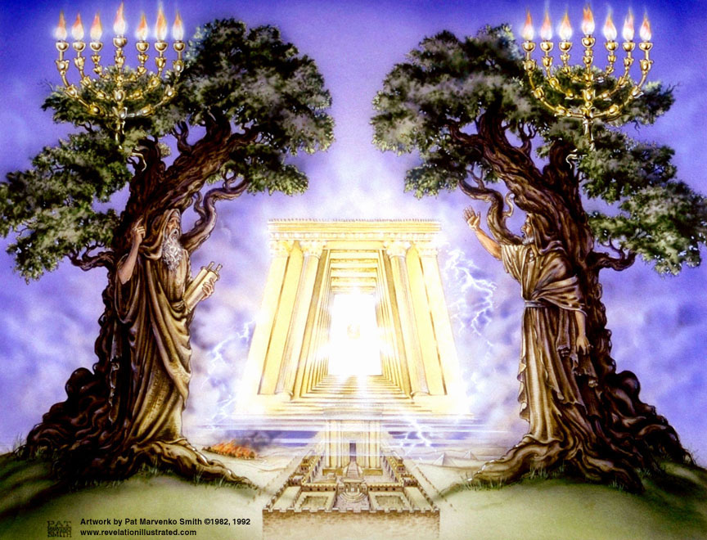

Slide 14
The Bible Knowledge Commentary
The two olive branches and two gold pipes are mentioned for the first time in the vision in 4:12. The two branches with olives poured their oil into the gold pipes, which flowed into the bowl and then through the 49 channels to the seven lamps. The interpreting angel removed Zechariah's confusion regarding the two olive trees (vv. 3, 11) by indicating that their two oil-supplying branches represent the two who are anointed to serve the Lord of all the earth (v. 14). The branches refer to the anointing of priests and kings, with particular allusion to Joshua and Zerubbabel who typify the Messiah as both Priest and King. The lampstand, then, seems to represent Israel as a light to the nations (cf. Isa. 42:6; 49:6), potentially in Zechariah's time, but will be actually so during the millennial reign of Christ. Another fulfillment, partial at least, of Zechariah 4:11-14 is found in the two witnesses in the future Tribulation period (Rev. 11:3-6, esp. v. 4).

Slide 15
Rev 11 – Measure Temple, 2 Witnesses, 7th Trumpet
³"And I will grant authority to my two witnesses [Greek - martys], and they will prophesy [preach] for twelve hundred and sixty days, clothed in sackcloth." ⁴These are the two olive trees and the two lampstands that stand before the Lord of the earth. Identity? Duty? Attitude? Time period? | Deuteronomy 17:6 On the evidence of two witnesses or three witnesses, he who is to die shall be put to death; he shall not be put to death on the evidence of one witness. Where else have you seen two witnesses? Two witnesses, empowered by the Holy Spirit, are not identified and best left that way. However… Others’ analysis on “who”: Hebrews 9:27 And inasmuch as it is appointed for men to die once and after this comes judgment, 2 Kings 2:11 … And Elijah went up by a whirlwind to heaven. Hebrews 11:5 By faith Enoch was taken up so that he should not see death; … However: a. Enoch was a gentile. b. Everyone resurrected so far have died twice:

Slide 16
Non-eternal Resurrections
The widow's son by Elijah (1 Kings 17:19-24)
The Shunammite's son by Elisha (2 Kings 4:32-35).
A man whose body had been placed in Elisha's tomb (2 Kings 13:21).
Lazarus by Jesus Christ (John 11:43-44).
The ruler's daughter by Jesus Christ (Matthew 9:23-26).
A number of people at the moment of the death of Jesus Christ (Matthew 27:51-53)
Eutychus raised to life by Paul after he fell out of a third-floor window (Acts 20:9-10).
Tabitha by Peter (Acts 9:36-43)

Slide 17
Rev 11 – Measure Temple, 2 Witnesses, 7th Trumpet
³"And I will grant authority to my two witnesses [Greek - martys], and they will prophesy [preach] for twelve hundred and sixty days, clothed in sackcloth." ⁴These are the two olive trees and the two lampstands that stand before the Lord of the earth. Identity? Duty? Attitude? Time period? | McGee thought the two witnesses might be Elijah and John the Baptist. Sackcloth - prophets used it when prophesying judgment – humility, sadness, sorrow

Slide 18
Rev 11 – Measure Temple, 2 Witnesses, 7th Trumpet
³"And I will grant authority to my two witnesses [Greek - martys], and they will prophesy [preach] for twelve hundred and sixty days, clothed in sackcloth." ⁴These are the two olive trees and the two lampstands that stand before the Lord of the earth. Identity? Duty? Attitude? Time period? | MacArthur’: analysis on “who”: Zech. 4:5-6 So the angel who was speaking with me answered and said to me, "Do you not know what these [golden lampstand and bowls] are?" And I said, "No, my lord." ⁶Then he answered and said to me, "This is the word of the Lord to Zerubbabel saying, 'Not by might nor by power, but by My Spirit,' says the Lord of hosts. Zech. 4:12-14 And I answered the second time and said to him, "What are the two olive branches which are beside the two golden pipes, which empty the golden oil from themselves?" ¹³So he answered me saying, "Do you not know what these are?" And I said, "No, my lord." ¹⁴Then he said, "These are the two anointed ones, who are standing by the Lord of the whole earth." [branches supplying oil (Holy Spirit]) to the lampstand – Israel] Deut. 18:15 "The Lord your God will raise up for you a prophet like me [Moses] from among you, from your countrymen, you shall listen to him. Malachi 4:5 "Behold, I am going to send you Elijah the prophet before the coming of the great and terrible day of the Lord. John 1:21 And they asked him, "What then? Are you Elijah?" And he said, "I am not." "Are you the Prophet?" And he answered, "No." Matthew 17:2-3 And He was transfigured before them; and His face shone like the sun, and His garments became as white as light. ³And behold, Moses and Elijah appeared to them, talking with Him. Moses represents The LAW, Elijah the Prophets.

Slide 19
Rev. 11: 5-6
⁵And if anyone desires to harm them, fire proceeds out of their mouth and devours their enemies; and if anyone would desire to harm them, in this manner he must be killed. ⁶These have the power to shut up the sky, in order that rain may not fall during the days of their prophesying; and they have power over the waters to turn them into blood, and to smite the earth with every plague, as often as they desire.

Slide 20
Rev 11 – Measure Temple, 2 Witnesses, 7th Trumpet
⁵And if anyone desires to harm them, fire proceeds out of their mouth and devours their enemies; and if anyone would desire to harm them, in this manner he must be killed. ⁶These have the power to shut up the sky, in order that rain may not fall during the days of their prophesying; and they have power over the waters to turn them into blood, and to smite the earth with every plague, as often as they desire. | Exodus 7:19 Then the Lord said to Moses, "Say to Aaron, 'Take your staff and stretch out your hand over the waters of Egypt, … that they may become blood; ...' " 2 Kings 1:10 And Elijah answered and said to the captain of fifty, "If I am a man of God, let fire come down from heaven and consume you and your fifty." Then fire came down from heaven and consumed him and his fifty. 1 Kings 17:1 Now Elijah the Tishbite, who was of the settlers of Gilead, said to Ahab, "As the Lord, the God of Israel lives, before whom I stand, surely there shall be neither dew nor rain these years, except by my word." | - Protection? - Power? Moses’ Plagues: Plague of Blood: Ex. 7:14–25 Plague of Frogs: Ex. 7:25–8:11 Plague of Lice: Ex. 8:16–19 Plague of Flies: Ex. 8:20–32 Plague of Livestock Death: Ex. 9:1–7 Plague of Boils: Ex. 9:8–12 Plague of Hail: Ex. 9:13–35 Plague of Locusts: Ex. 10:1–20 Plague of Darkness: Ex. 10:21–29 Firstborn Death: Ex. 11:1–12:36

Slide 21
Rev. 11: 7-10
⁷And when they have finished their testimony, the beast that comes up out of the abyss will make war with them, and overcome them and kill them. ⁸And their dead bodies will lie in the street of the great city which mystically is called Sodom and Egypt, where also their Lord was crucified. ⁹And those from the peoples and tribes and tongues and nations will look at their dead bodies for three and a half days, and will not permit their dead bodies to be laid in a tomb. ¹⁰And those who dwell on the earth will rejoice over them and make merry; and they will send gifts to one another, because these two prophets tormented those who dwell on the earth.

Slide 22
Rev 11 – Measure Temple, 2 Witnesses, 7th Trumpet
⁷And when they have finished their testimony, the beast that comes up out of the abyss will make war with them, and overcome them and kill them. ⁸And their dead bodies will lie in the street of the great city which mystically is called Sodom and Egypt, where also their Lord was crucified. ⁹And those from the peoples and tribes and tongues and nations will look at their dead bodies for three and a half days, and will not permit their dead bodies to be laid in a tomb. ¹⁰And those who dwell on the earth will rejoice over them and make merry; and they will send gifts to one another, because these two prophets tormented those who dwell on the earth. | Rev. 17:8 "The beast that you saw was and is not, and is about to come up out of the abyss and to go to destruction. And those who dwell on the earth will wonder, whose name has not been written in the book of life from the foundation of the world, when they see the beast, that he was and is not and will come. Isaiah 30:9-11 For this is a rebellious people, false sons, Sons who refuse to listen To the instruction of the Lord; ¹⁰Who say to the seers, "You must not see visions"; And to the prophets, "You must not prophesy to us what is right, Speak to us pleasant words, Prophesy illusions. ¹¹Get out of the way, turn aside from the path, Let us hear no more about the Holy One of Israel." | Beast – the Antichrist [Ryrie, MacArthur, McGee] Satan [Walvoord] Death! “Satanic Christmas”

Slide 23
Rev. 11: 11-13
¹¹And after the three and a half days the breath of life from God came into them, and they stood on their feet; and great fear fell upon those who were beholding them. ¹²And they heard a loud voice from heaven saying to them, "Come up here." And they went up into heaven in the cloud, and their enemies beheld them. ¹³And in that hour there was a great earthquake, and a tenth of the city fell; and seven thousand people were killed in the earthquake, and the rest were terrified and gave glory to the God of heaven.

Slide 24
Rev 11 – Measure Temple, 2 Witnesses, 7th Trumpet
¹¹And after the three and a half days the breath of life from God came into them, and they stood on their feet; and great fear fell upon those who were beholding them. ¹²And they heard a loud voice from heaven saying to them, "Come up here." And they went up into heaven in the cloud, and their enemies beheld them. ¹³And in that hour there was a great earthquake, and a tenth of the city fell; and seven thousand people were killed in the earthquake, and the rest were terrified and gave glory to the God of heaven. | Two possible responses: Rev. 14:7 and he said with a loud voice, "Fear God, and give Him glory, …" or… B. Rev. 16:9 And men were scorched with fierce heat; and they blasphemed the name of God who has the power over these plagues; and they did not repent, so as to give Him glory. | Resurrection! Luke 16:31 "But he said to him, 'If they do not listen to Moses and the Prophets, they will not be persuaded even if someone rises from the dead.'" Literally “seven thousand names of men”… an idiom indicating men of prominence. “the rest” – remaining Jews; “all Israel will be saved”

Slide 25
Overview of Resurrections

Slide 26
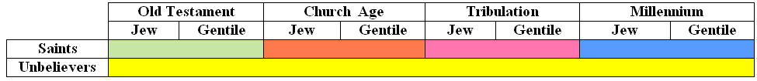
High Level View of Man’s Relationships with God Over Time

Slide 28
The Lamb
opens the
seals.
1/3 Earth
God sends the
bowls out, full
of the wrath of
God.
Sores
1/3 Sea
Sea to blood
1
White
2
Red
3
Black
4
Ashen
5
Martyrs
6
Signs
7
Wrath
1/3 Rivers
Rivers to blood
1/3 Heavens
Sun scorches
1st Woe, Locusts
Earth in darkness
2nd Woe, 1/3 Men Die
Euphrates dried
Matt 24:8 "But all these things are merely the beginning of birth pangs.”
Angels sound
the trumpets.
3rd Woe, 7 Bowls
Earthquake, hail
Tribulation
Great Tribulation

Slide 29
Rev. 11: 14-18
Beginning of the end of the Great Tribulation
¹⁴The second woe is past; behold, the third woe is coming quickly. ¹⁵And the seventh angel sounded; and there arose loud voices in heaven, saying, "The kingdom of the world has become the kingdom of our Lord, and of His Christ; and He will reign forever and ever." ¹⁶And the twenty-four elders, who sit on their thrones before God, fell on their faces and worshiped God, ¹⁷saying, "We give Thee thanks, O Lord God, the Almighty, who art and who wast, because Thou hast taken Thy great power and hast begun to reign. ¹⁸"And the nations were enraged, and Thy wrath came, and the time came for the dead to be judged, and the time to give their reward to Thy bond-servants the prophets and to the saints and to those who fear Thy name, the small and the great, and to destroy those who destroy the earth."

Slide 30
Rev 11 – Measure Temple, 2 Witnesses, 7th Trumpet
¹⁴The second woe is past; behold, the third woe is coming quickly. ¹⁵And the seventh angel sounded; and there arose loud voices in heaven, saying, "The kingdom of the world has become the kingdom of our Lord, and of His Christ; and He will reign forever and ever." ¹⁶And the twenty-four elders, who sit on their thrones before God, fell on their faces and worshiped God, ¹⁷saying, "We give Thee thanks, O Lord God, the Almighty, who art and who wast, because Thou hast taken Thy great power and hast begun to reign. ¹⁸"And the nations were enraged [orgizo – made angry], and Thy wrath [orge - anger] came, and the time came for the dead to be judged, and the time to give their reward to Thy bond-servants the prophets and to the saints and to those who fear Thy name, the small and the great, and to destroy those who destroy the earth." | Isaiah 2:2-3 Now it will come about that In the last days The mountain of the house of the LORD Will be established as the chief of the mountains, And will be raised above the hills; And all the nations will stream to it. ³ And many peoples will come and say, "Come, let us go up to the mountain of the LORD, To the house of the God of Jacob; That He may teach us concerning His ways And that we may walk in His paths." For the law will go forth from Zion And the word of the LORD from Jerusalem. Rev. 20:4 … I saw the souls of those who had been beheaded because of the testimony of Jesus and because of the word of God, and those who had not worshiped the beast or his image, and had not received the mark upon their forehead and upon their hand; and they came to life and reigned with Christ for a thousand years. Daniel 12:11-13 "And from the time that the regular sacrifice is abolished, and the abomination of desolation is set up, there will be 1,290 days. ¹²"How blessed is he who keeps waiting and attains to the 1,335 days! ¹³"But as for you, go your way to the end; then you will enter into rest and rise again for your allotted portion at the end of the age [days]." | Full results of the 7th trumpet in Rev 16. Rev. 4:10 Glory to Creator Rev. 5:9 Glory to Redeemer Rev 11:17 Glory to… it drops "who is to come King Psalm 2:1-9 Why are the nations in an uproar, And the peoples devising a vain thing? ²The kings of the earth take their stand, And the rulers take counsel together Against the Lord and against His Anointed…'Thou shalt break them with a rod of iron, thou shalt shatter them like earthenware.' " Resurrection of the OT Saints and the Tribulation Saints at the end of the Great Tribulation Revelation 15:1 Then I saw another sign in heaven, great and marvelous, seven angels who had seven plagues, which are the last, because in them the wrath of God is finished.

Slide 31
Rev. 11: 19
¹⁹And the temple of God which is in heaven was opened; and the ark of His covenant appeared in His temple, and there were flashes of lightning and sounds and peals of thunder and an earthquake and a great hailstorm.

Slide 32
Rev 11 – Measure Temple, 2 Witnesses, 7th Trumpet
¹⁹And the temple of God which is in heaven was opened; and the ark of His covenant appeared in His temple, and there were flashes of lightning and sounds and peals of thunder and an earthquake and a great hailstorm. | God is here dealing with Israel’s worship and access to God (JVM) This is the temple used as a pattern for Moses. There is no temple in New Jerusalem “arc of His covenant” reminds us that God is now going to keep His promises And He continues to deal with the nations …judgment to come… Joel 3:12 Let the nations be aroused And come up to the valley of Jehoshaphat, For there I will sit to judge All the surrounding nations.

Slide 33
The Lamb
opens the
seals.
1/3 Earth
God sends the
bowls out, full
of the wrath of
God.
Sores
1/3 Sea
Sea to blood
1
White
2
Red
3
Black
4
Ashen
5
Martyrs
6
Signs
7
Wrath
1/3 Rivers
Rivers to blood
1/3 Heavens
Sun scorches
1st Woe, Locusts
Earth in darkness
2nd Woe, 1/3 Men Die
Euphrates dried
Matt 24:8 "But all these things are merely the beginning of birth pangs.”
Angels sound
the trumpets.
3rd Woe, 7 Bowls
Earthquake, hail
Tribulation
Great Tribulation

Slide 34
Third Major Section of Revelation: Ch 4-22
(Benware, “Understanding End Times Prophecy”)
Rev. 1:19 "Write therefore the things which you have seen, and the things which are, and the things which shall take place after these things.

Slide 35
Rev 12 & 13
7 Players in the Battle of the Ages
The Woman
The Red Dragon
The male Child
Michael
The rest of her offspring
__________________
Beast from the sea
Beast from the earth

Slide 36
End

