Slide 1

THE 2026 MILO CUP AT MILLARD NORTH HIGH SCHOOL
SPEAKER AND OVERALL AWARDS
Tournament and Millard North Staff:
Director for Debate, Dylan Sutton
Tabroom Director, Carly Persell
Assistant Director for Debate, Amrit Ammanamanchi
Assistant Coaches:
Ian Matuszeski, LD
Benjamin Hoover, LD
Victor Thoms, CX
Adiel Garcia, CX
Sriman Dooshety, PF
Abhi Karri, PF

Slide 2
Special Awards and Sweepstakes

Slide 3
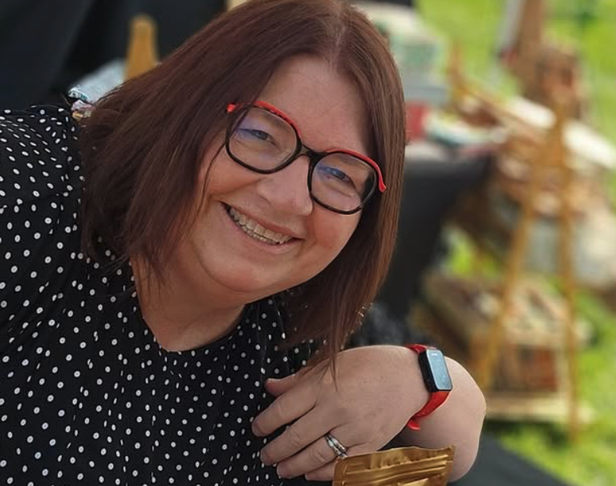

The Raskin Friend of Debate Award
The Raksin Award is given to a coach, judge, or volunteer that has dedicated themselves to the advancement of debate in high schools. The award is named in honor of Millard North alumni Alex Raksin and his monumental support for debate and the Millard North squad. Raksin’s vision of the life-changing power of debate affirms the essential importance of our activity, and he actively dedicates himself to making debate accessible to as many students as possible.
The recipient of this year’s Raskin Friend of Debate Award is Toni L. Heimes, Head Coach for Lincoln Southwest High School in Lincoln, Nebraska.

Slide 4
The Milo Cup
The Milo Cup will be presented to the team that finishes first in sweepstakes in honor of former Millard North debate coach Scott "Milo” Milliken. Mr. Milliken was the coach at MNHS for a stretch of time that covered 3 decades, and under his leadership and tutelage, thousands of students learned, competed, and grew. Mr. Milliken retired in 2014, and it is our privilege to honor his legacy by presenting The Milo Cup as an annual tradition.
The following slides list the Top 3 Schools for Overall Sweeps. Congratulations to the Champion and all teams!

Slide 5
Third Place
Strake Jesuit College Preparatory
From Houston, Texas
Coached by Jerry Crist, Murvin Auzenne, Brock Scheller, Jennifer Jumalon, Travis Smith, Peter Turrentine, Christ Castillo, Frank Lieggi, and Lynn Chen

Slide 6
Runner Up
Lincoln East High School
From Lincoln, Nebraska
Coached by John Holen, Jesse Nguyen, Skyler Stefanski, Brooke Meints, and Yakub Islamov

Slide 7
The 2026 Milo Cup at Millard North Champion
Harrison High School
From Harrison, New York
Coached by Chetan Hertzig

Slide 8
Speaker Awards

Slide 9
Public Forum
Dharshan Vijayakumar, East Ridge NV
  Recipient of the Schlessinger-Schuller Award for Top Speaker in Public Forum
Laon Namgung, East Ridge NV
Gregory Kozlov, Acton-Boxborough KE
Grant Gargas, Mira Loma GK
Abhiram Eadala, Acton-Boxborough KE
Tobin Wilson, McLean WL
Siddharth Kate, Mira Loma GK
Lucas Neamu, Lincoln East NB
Brad Bobaru, Lincoln East NB
Sophia Xiong, Northwood XB
Aarav Saini, Strake Jesuit SS
Katherine Wu, Seven Lakes JW

Slide 10
Lincoln Douglas
Michelle Lee, Woodlands
    Recipient of the Lauren Burdt Award for Top Speaker in Lincoln Douglas
Albert Cai, Barrington
Isaac Love, Flintridge Prep
Jacob Brace, City Honors
Ibraheem Mushtaq, Southlake Carroll
Vidushi Sinha, Millburn
Paul Buermann, Pine View
Atharv Gandhi, Harrison
Alexander Zhang, Awty International AZ
Alexandra Ghile, Bronx Science
Rezin Mwiathi, Lincoln Southwest
Owen Reed, Washington

Slide 11
Policy
Emery Jobst, Lincoln East YJ
Jed Anglo, Bronx Science AS
Jay Sarvaiya, Bronx Science AS
Chase Yang, Bronx Science QuYa
Jackson Littrell, Lincoln East KL
Yichen Qu, Bronx Science QuYa
Siena Hom, Bronx Science HQ
James Yu, Lincoln East YJ
Chloe Qian, Bronx Science HQ
Arav Kaushal, Lincoln East KL
Jordan Matya, Millard North ZM
Aum Naik, Omaha Westside NM

Slide 12
Congressional Debate Presiding Officers
Semifinals
  Chamber 1: Apollo Grimes, Stratford Prep
  Chamber 2, Arush Mandhare, Cary Academy
Finals
  Arush Mandhare, Cary Academy
  Cesar Duran-Oropeza, Dowling Catholic

Slide 13
Public Forum Double Octafinals

Slide 14
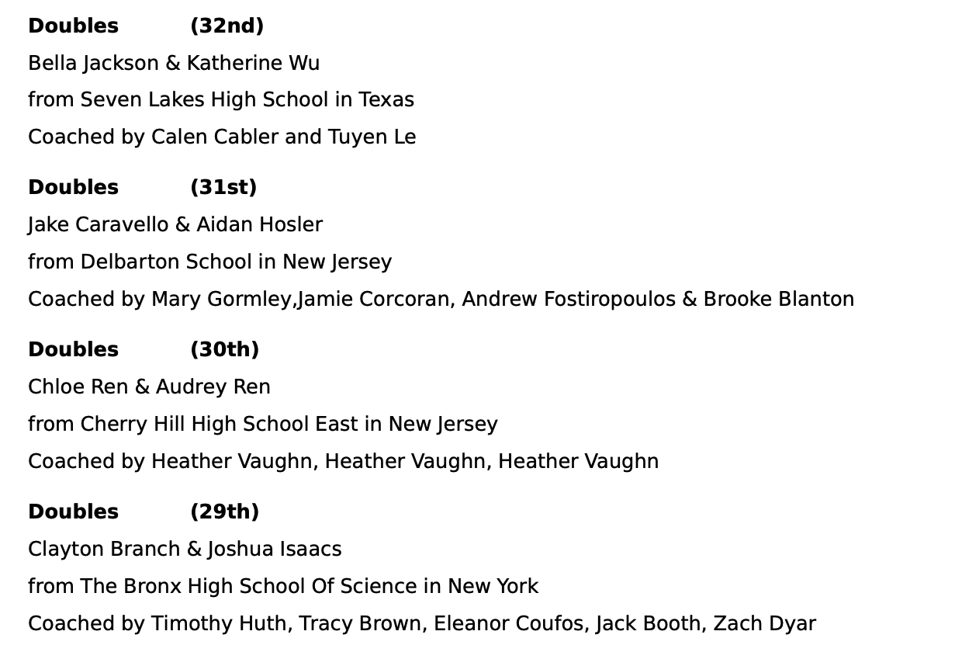
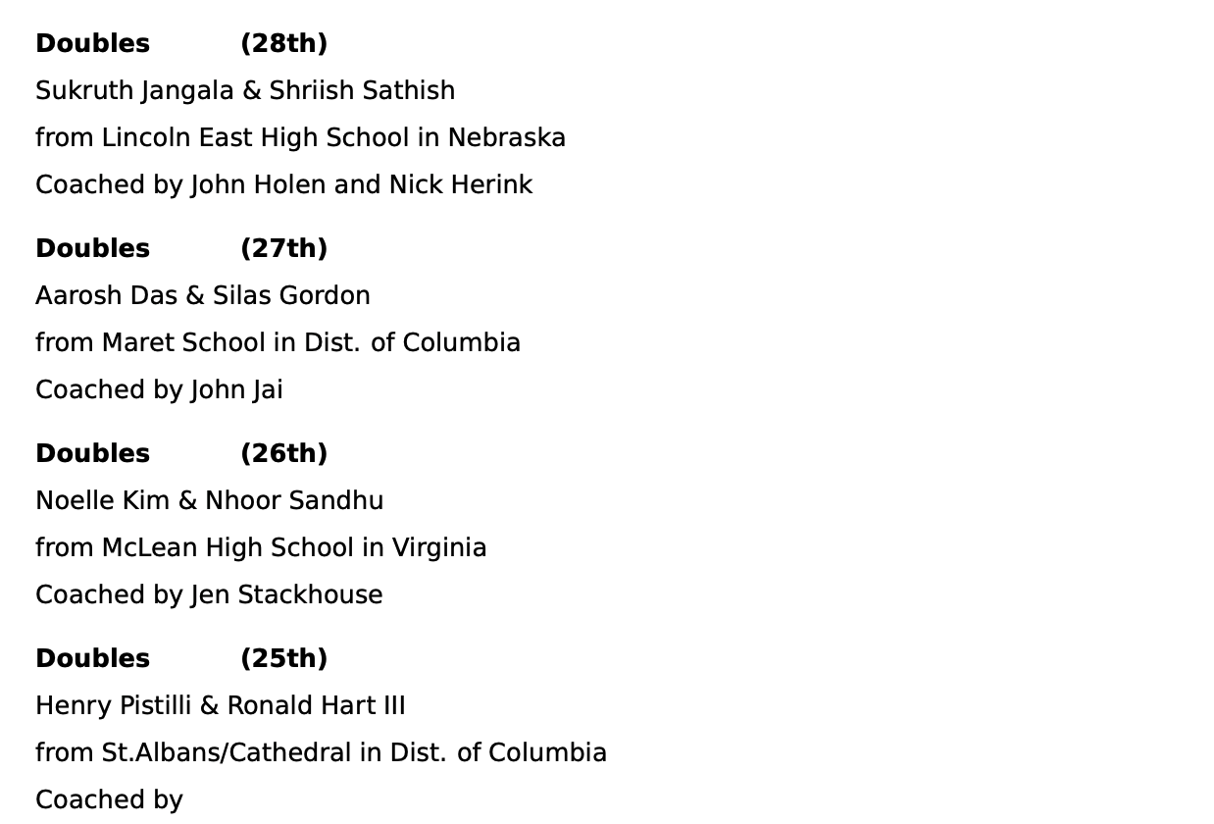
32nd through 25th

Slide 15
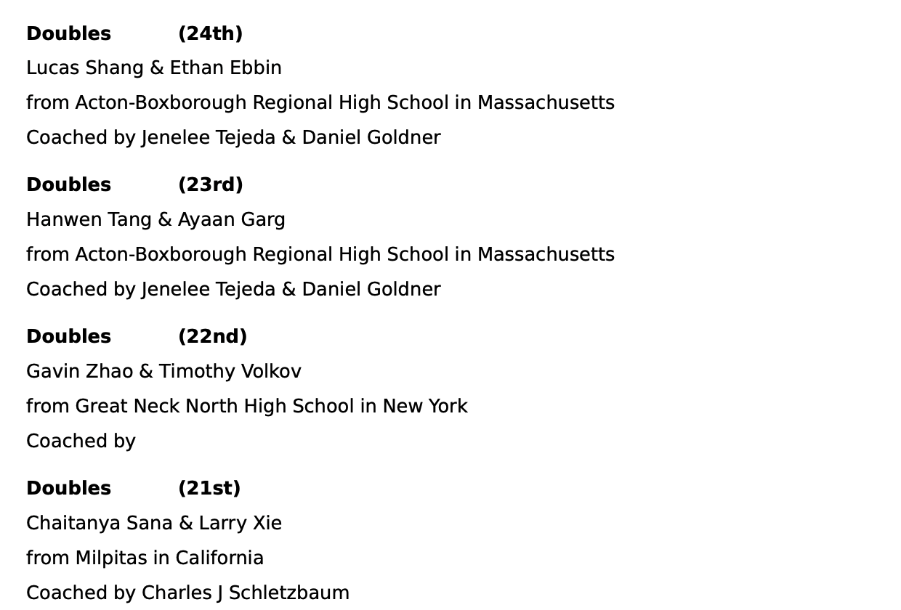
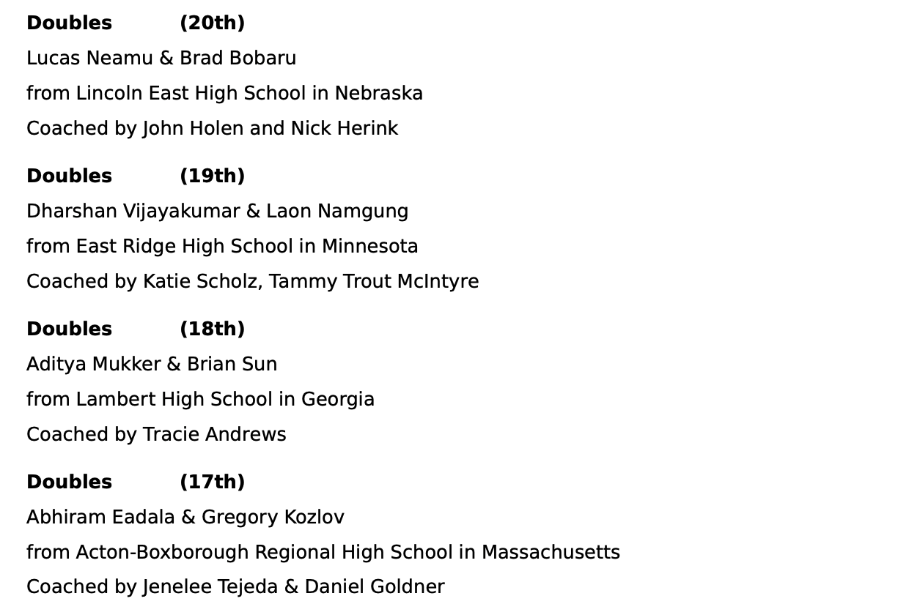
24th through 17th

Slide 16
Public Forum Octafinals

Slide 17
16th through 13th
16th: Jingxi (Lily) Zhang & Meher Kulkarni
From the Nueva School in California
Coached by Leslie Phillips and Julie Herman
15th: Mahati Mudgal & Willow Tham
From Summit HS in New Jersey
Coached by Anne Poyner
14th: Connor Li & Neel Gupta
From Livingston High School in New Jersey
Coached by Max Diaz
13th: Siddharth Kate & Grant Gargas
From Mira Loma High School in California
Coached by Josh Stinson

Slide 18
12th through 9th
12th: Vivaan Sadare & Aarav Saini
From Strake Jesuit College Preparatory in Texas
11th: Aditya Arora & Ava Zahtila
From Summit HS in New Jersey
Coached by Anne Poyner
10th: Ethan Cui & Ray Tian
From Thomas Jefferson HSST in Virginia
Coached by Theresa Ohanian, Aaron Trujillo, Cody Salenga
9th: Sophia Xiong & Diya Bhootra
From Northwood High School in California
Coached by Sarah Riggan

Slide 19
Public Forum Quarterfinals

Slide 20
8th and 7th
8th: Flora Tu & Josh Zhou
From VDA- Vancouver Debate Academy in British Columbia, Canada
7th: Arnav Maheshwari and Varun Shenoy
From West Windsor Plainsboro South in New Jersey
Coached by Patrick Hartmann

Slide 21
6th and 5th
6th: Ankith Gundimeda & Akshat Singh
From Mira Loma High School in California
Coached by Josh Stinson
5th: Teddy Gardner-Berg & Oliver Rosenfelt
From Oakwood School in California
Coached by Sergio Martinez

Slide 22
Public Forum Semifinals

Slide 23
Semifinalists
4th: Graham Turk & Ike Turk
From Oakwood School in California
Coached by Sergio Martinez
3rd: Arnav Agarwal & Ronav Ganesh
From Lincoln East High School in Nebraska
Coached by John Holen, Brooke Meints, and Yakub Islamov

Slide 24
Public Forum Finals

Slide 25
Runner-Up
Vaughn McIver & Bianka Chilongo
From Theodore Roosevelt High School in Iowa
Coached by Parker Klyn

Slide 26
Champion
Ethan Zhang & Samay Nistala
From Livingston High School in New Jersey
Coached by Max Diaz

Slide 27
Lincoln Douglas
Partial Double Octafinals

Slide 28
23rd through 20th
23rd: Sophie Hao
From The Pingry School in New Jersey
Coached by Ted Corvino
22nd: Ayaan Yakoob
From Strake Jesuit College Preparatory in Texas
21st: Kevin Iwanski
From Harrison in New York
Coached by Chetan Hertzig
20th: Diego Villareal
From Strake Jesuit College Preparatory in Texas

Slide 29
19th through 17th
19th: Paige Bianchini
From the Harrison in New York
Coached by Chetan Hertzig
18th: Owen Reed
From Washington HS in South Dakota
Coached by Heather Edmunds Reed and Samuel Markley
17th: Rezin Mwiathi
From Lincoln Southwest HS in Nebraska
Coached by Toni Heimes

Slide 30
Lincoln Douglas Octafinals

Slide 31
16th through 13th
16th: Albert Cai
From the Barrington High School in Illinois
Coached by Amy Lovi and Megan Twadell
15th: Joseph Assalian
From Piedmont HS in California
Coached by Holden Carrillo, Will White, and Eduardo Wolbert
14th: James Gong
From The Hill School in Pennsylvania
Coached by Nick Malinak
13th: Sebastian Engle
From Harrison in New York
Coached by Chetan Hertzig

Slide 32
12th through 9th
12th: Sreethan Karna
From Southlake Carroll in Texas
Coached by Anthony Brown
11th: Michelle Lee
From The Woodlands High School in Texas
Coached by Ashley Velasquez and Dodie Spencer
10th: Alexander Zhang
From The Awty International School in Texas
9th: Isaac Love
From Flintridge Preparatory in California
Coached by Nicole Dalton and Maggie Woodward

Slide 33
Lincoln Douglas Quarterfinals

Slide 34
8th and 7th
8th: Jacob Brace
From City Honors in New York
Coached by Ethan Chen, Dallas Beige
7th: Eric Xiong
From Strake Jesuit College Preparatory in Texas

Slide 35
6th and 5th
6th: Jordan Blake
From Harrison in New York
Coached by Chetan Hertzig
5th: Bayne Yoakam
From Lansing HS in Kansas
Coached by Natalie Akers, Sarah DaMetz, and Allyson Regehr

Slide 36
Lincoln Douglas Semifinals

Slide 37
Semifinalists
4th: Atharv Gandhi
From Harrison in New York
Coached by Chetan Hertzig
3rd: Claire Bloomingdale
From Millard North High School in Nebraska
Coached by Dylan Sutton, Ian Matuszeski, and Benjamin Hoover

Slide 38
Lincoln Douglas Finals

Slide 39
Runner-Up
Ibraheem Mushtaq
From Southlake Carroll in Texas
Coached by Anthony Brown

Slide 40
Champion
Aaron Choi
From Northern Valley in New Jersey

Slide 41
Policy
Semifinals

Slide 42
Semifinalist
3rd: Siena Hom & Chloe Qian
From The Bronx High School of Science in New York
Coached by Timothy Huth, Tracy Brown, Eleanor Coufos, Jack Booth, and Zach Dyar
(Walked Over by Same School)

Slide 43
Policy
Finals

Slide 44
Runner-Up
Jed Anglo & Jay Sarvaiya
From The Bronx High School of Science in New York
Coached by Timothy Huth, Tracy Brown, Eleanor Coufos, Jack Booth, and Zach Dyar

Slide 45
Champion
James Yu & Emery Jobst
From Lincoln East High School in Nebraska
Coached by John Holen and Jesse Nguyen

Slide 46
Congressional Debate
Semifinals

Slide 47
18th through 15th
18th: Ella Recker
From Lincoln East HS in Nebraska
Coached by John Holen and Skyler Stefanski
17th: Tristan Saathoff-Salas
From Lincoln East HS in Nebraska
Coached by John Holen and Skyler Stefanski
16th: Christian Williamson
From Loyola High School in California
15th: Charles Harvey
From Loyola High School in California

Slide 48
14th through 11th
14th: Cora Jones
From Lincoln East HS in Nebraska
Coached by John Holen and Skyler Stefanski
13th: Rolando Tomasini
From Western High School in Florida
Coached by Brian Lynn
12th: Yena Oh
From The Bronx High School of Science in New York
Coached by Timothy Huth, Tracy Brown, Eleanor Coufos, Jack Booth, and Zach Dyar
11th: Alejandro Zepeda
From Loyola High School in California

Slide 49
Congressional Debate
Finals

Slide 50
10th through 7th
10th: Alexis Jamal
From Millard North High School in Nebraska
Coached by Dylan Sutton and Amrit Ammanamanchi
9th: Pramiti Paraskar
From Texas Academy of Mathematics and Science in Texas
8th: Jackson Lynch
From Lincoln East HS in Nebraska
Coached by John Holen and Skyler Stefanski
7th: Arush Mandhare
From Cary Academy in North Carolina
Coached by Richard J. Pellicciotta, Willie Warren, Caleb Horowitz, Paxton Sheppard, Caleb Chen, Adam Levin, and Diya Kaleh

Slide 51
6th and 5th
6th: Zitian Qiao
From The Village High School in Texas
Coached by Heather Huffman
5th: Cesar Duran-Oropeza
From Dowling Catholic HS in Iowa
Coached by Simon Sheaff

Slide 52
4th and 3rd
4th: Apollo Grimes
From Stratford Preparatory High School in California
Coached by Marvin Pascua, Frank Garcia, and Ming Mou
3rd: Isabelle D’Mello
From Clovis North High School in California
Coached by Chad Hayden

Slide 53
Runner-Up
Armaan Seth
From The Frazer School in Florida
Coached by Cyris Lim

Slide 54
The Charles V. Fisher Champion in Congressional Debate
Pranavi Prakash
From Millard North High School in Nebraska
Coached by Dylan Sutton, Amrit Ammanamanchi, and Abby Chan

Slide 55
Thank you all so much for a fantastic tournament. Best of luck with the rest of the season, and we look forward to seeing you in 2027!

