Slide 1
Federal Way Invitational Debate Awards

Slide 2
Special Thanks
Sarah Sherry – Puyallup
Chris Coovert – Gig Harbor
Erika Moore – Auburn-Riverside
Parents, Coaches, Judges, Competitors

Slide 3

World Schools: Places
1st Place: Gig Harbor Parman & Phillips & Hambrick

Slide 4
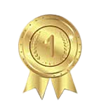
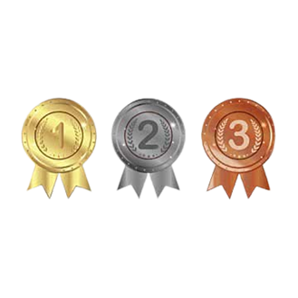
Worlds – Top Speakers
1st Place: Gig Harbor Autumn Coovert
2nd Place: Mountlake Terrace Sicily Weitz
3rd Place: Anacortes Greyson Ross
4th Place: Mountlake Terrace Sana Ramdani
5th Place: Gig Harbor Ryan Parman

Slide 5
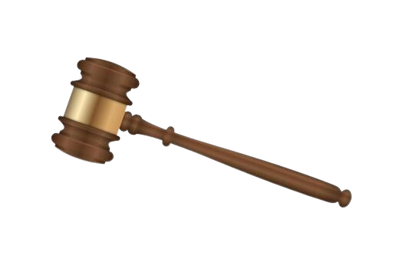
Congress
1st Place: Auburn Summer Spah
2nd Place: Gig Harbor Mia Colombo
3rd Place: Kentridge Gurshaan Chakkal
4th Place: Kentridge Mehar Dhami
5th Place: Puyallup Elle Farmer
Top PO: Gig Harbor Mia Colombo

Slide 6
LD – Top Speakers
1st Place: Anacortes Colton Hong
2nd Place: Vashon Iylaf AlMustafa
3rd Place: Anacortes Penelope Reichert
4th Place: Vashon Emily Rock
5th Place: Auburn Lily Wagner

Slide 7
LD – Places
Co-Champions: Anacortes Colton Hong and Peninsula Mars Burton
Semifinalists: Bellevue Nicolas Powell and Vashon Iylaf AlMustafa
Quarterfinalist: Tahoma Shivam Lyalka

Slide 8
PF – Top Speakers
1st Place: Puyallup Aiden Gadberry
2nd Place: Lincoln K-k Hohmann
3rd Place: Lincoln Wilbert Zhu
4th Place: Jackson Yucheng Qi
5th Place: Bellevue Rohail Khan

Slide 9
PF – Places
1st Place: Bellevue Khan & Kho
2nd Place: Lincoln Zhu & Hohmann
Semifinalists: Puyallup Lappin & Singh and Puyallup Mercado & Gadberry

Slide 10
Thanks

