Slide 1
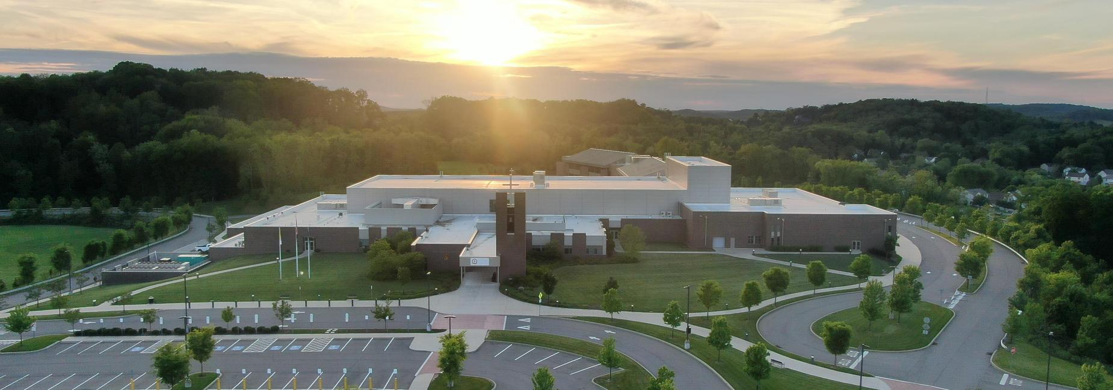
The 51st Annual
North Catholic Tournament
2025
Results

Slide 2

Thanks!
To all the North Catholic parents and alumni who helped make this day happen!
To all North Catholic alumni who judged and tabbed.
Notes:
Top 4 in no particular order

Slide 3
Sock it to us!
Thank you for
your donations!
Fairview
Notes:
Top 4 in no particular order

Slide 4
Async
Programmed Oral Interpretation
2nd - Sai Krishna Karthikeya Ramadugu
North Allegheny
1st - Aundra Sheridan
Oakland Catholic
Notes:
Top 4 in no particular order

Slide 5
Async
Informative Speaking
3rd - Serena Thomas
    North Allegheny
2nd - Natasha Karki
    North Allegheny
1st - Dariana Chiosea
    North Allegheny
Notes:
Top 4 in no particular order

Slide 6
Async
Storytelling
3rd - Sophia Muoio
    Our Lady of the Sacred Heart
2nd - Bridget Fogle
    Our Lady of the Sacred Heart
1st - Eve Amendola
    Our Lady of the Sacred Heart
Notes:
Top 4 in no particular order

Slide 7
Async
Pro Con Challenge
3rd - Suhavi Singh
    Upper St. Clair
2nd - Sophia Muoio
    Our Lady of the Sacred Heart
1st - Arth Italiya
    Upper St. Clair
Notes:
Top 4 in no particular order

Slide 8
Async
Declamation
3rd T - Maddie Debbis
    Seton La Salle
3rd T- Shoaib Essa
    Fairview
2nd - Grace Liu
    Fairview
1st - Max Hawkins
    Mercer
Notes:
Top 4 in no particular order

Slide 9
Parliamentary Debate
55th - Li & Wang*
Fox Chapel
4th - Menon & Paudel*
North Allegheny
3rd - Kamat & Italiya *
Upper St. Clair
2nd - Shah & Ranganath*
North Allegheny
1st - Mendhi & Pham*
Upper St. Clair
* Receiving a bid to States
Notes:
Top 4 in no particular order

Slide 10
Congress: Chamber 1
3rd - Abigail Shah
  North Catholic
2nd - Shaurya Kapoor*
  Moon
1st - Daniyal Badaruddin*
  Upper St. Clair
* Receiving a bid to States
Notes:
Top 4 in no particular order

Slide 11
Congress: Chamber 2
3rd - Sofiya Gorban
  Upper St. Clair
2nd - Katelyn Golembeski*
  North Catholic
1st - Noah Ulrich*
  Pittsburgh Allderdice
* Receiving a bid to States
Notes:
Top 4 in no particular order

Slide 12
Congress: Chamber 3
3rd- Amanda Gates
  West Allegheny
2nd - Ulyana Hoja*
  Fairview
1st - Jenna Parker*
  Pittsburgh Allderdice
* Receiving a bid to States
Notes:
Top 4 in no particular order

Slide 13
Congress: Chamber 4
3rd - Chloe Smith
  Fairview
2nd - Ayana Singh*
  North Allegheny
1st - Alina Abbasi*
  North Allegheny
* Receiving a bid to States
Notes:
Top 4 in no particular order

Slide 14
Dramatic Interpretation
5th - Ashlesha Sumant
North Allegheny
4th - Adithi Senthilkumar
North Allegheny
3rd - Finnegan Stafford
Upper St. Clair
2nd - Anna Stumm*
North Catholic
1st - Eve Amendola*
Our Lady of the Sacred Heart
* Receiving a bid to States
Notes:
Top 4 in no particular order

Slide 15
Duo Interpretation
5th - Marcovitz & Kottler
Mt. Lebanon
4th - Happold & Goel
Fox Chapel
3rd - Gunderson & Presley
West Allegheny
2nd - Slovick & Sutton *
West Allegheny
1st - Dyrud & Braun*
Mt. Lebanon
* Receiving a bid to States
Notes:
Top 4 in no particular order

Slide 16
Humorous Interpretation
5th - Hansika Yanamadala
Upper St. Clair
4th - Kailyn Minner
Mercer
3rd - Aida Seybert
Mercer
2nd - Abby Sohyda*
Mt. Lebanon
1st - Aundra Sheridan*
Oakland Catholic
* Receiving a bid to States
Notes:
Top 4 in no particular order

Slide 17
Impromptu
5th - Tela Serenyi
Peters Township
4th - Aradhya Neema
North Allegheny
3rd - Anna Pohl
North Catholic
2nd - Yuvaan Kaneri
North Allegheny
1st - Saanvi Santpure
Pine Richland
Notes:
Top 4 in no particular order

Slide 18
Original Oratory
5th - Anoushka Barve
Upper St. Clair
4th - Anvi Damarla
Upper St. Clair
3rd - Aarav Madan*
North Allegheny
2nd - Raana Parchuri*
Upper St. Clair
1st - Sri Sri Kashyap Aaluri*
Fairview
* Receiving a bid to States
Notes:
Top 4 in no particular order

Slide 19
Poetry
5th - Hannah Walker
Mt. Lebanon
4th - Maddie Debbis*
Seton La Salle
3rd - Jack Davison*
North Catholic
2nd - Hannah Parker*
North Catholic
1st - Julia Miller*
Seton La Salle
* Receiving a bid to States
Notes:
Top 4 in no particular order

Slide 20
Prose
5th - Arnav Deokule
North Allegheny
4th - Grace Rebholz*
Seton La Salle
3rd - Leo Martino*
North Allegheny
2nd - Kiera Trunick*
Seton La Salle
1st - Macaria Stall*
North Catholic
* Receiving a bid to States
Notes:
Top 4 in no particular order

Slide 21
Sweepstakes
Small School Sweepstakes
  2nd Pittsburgh Central Catholic
  1st Seton La Salle
Large School Sweepstakes
  2nd North Allegheny
  1st Upper St. Clair
Notes:
Top 4 in no particular order

Slide 22
The 51st Annual
North Catholic Tournament
2025
Thank you for attending
STAY SAFE!

