Slide 1

Awards
Inland Empire
National Qualifying
Tournament
March 7-8, 2025

Slide 2







Slide 3
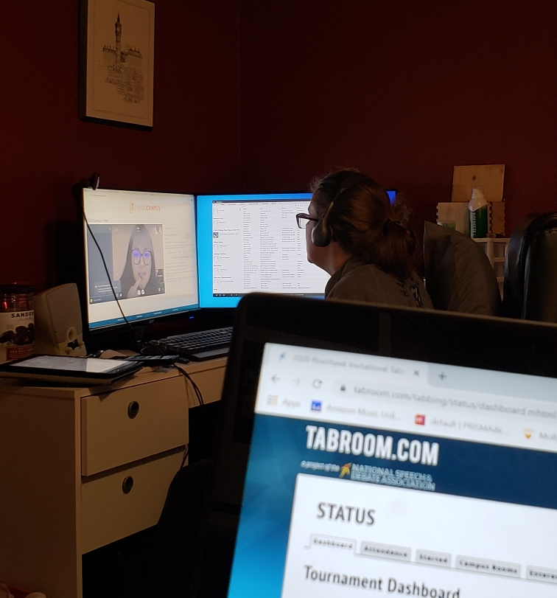
District Committee:
Vicky Hyde, Committee Chair
David Smith
Sara Hyde
Katie Haynes
Brittany Lewis

Slide 4
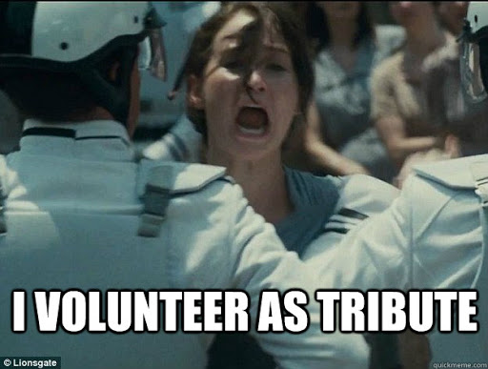
Thank you…
Coaches
Judges
All those who volunteered as tribute so that others could earn a spot at Nationals. This isn’t about schools; this is about the Inland Empire District. We may be small, but we are here for each other.

Slide 5
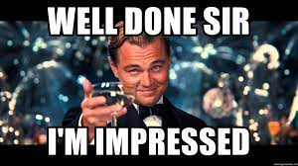
We’re impressed!
Asynch ballots sent at 8:00 a.m.—the first two were judged by 11!

Slide 6

And, most importantly…
Thank you. All of you. We know that these aren’t the ideal circumstances, and yet we are so grateful that we are able to compete. Thank you for your patience as technology is a wonderful thing…until it’s not. It is the commitment of the coaches, judges, and competitors that makes this possible.

Slide 7

Special Awards
The committee loves to read your nominations and regrets that we can only choose one for each award. Think ahead to who you want to nominate next year!

Slide 8
Volunteer of the Year-Previous
2025--??
2024—Judith Hunger
2023—Lorraine DeGarmeaux
2022 —Morgan DeWinter
2021 —Natalie Soderquist
2020—Alena Johnson
2019—Marcos Naves
2018—Robyn Johnson

Slide 9
Volunteer of the Year 2025
Drea Luther doesn’t have a kid on the team. She doesn’t work at the school. So why has she been such a faithful judge? Because, having been a speech and debate kid, she believes in the activity. Despite health issues, she shows up at nearly every tournament. Frequently, she travels on her own dime. She is passionate about our activity and does all she can to promote and support it. She even roped her husband into becoming a regular judge. Tournaments=dates, right?

Slide 10
Alumnus of the Year-Previous
2024—Chloe Pargmann
2021 —Willow Smith
2020—Sam Normington
2019—Nick Higgins
2018—Jared Costanzo

Slide 11
Communicator of the Year-Previous
2024—Emily Goodell
2021 —Linh Truong
2020—Tracci Dial

Slide 12
Administrator of the Year-previous
2024—KC Bennion
2023—Brett Stauffer
2021 —Ken VanSickle
2020—Michelle Whitney
2019—John Wallwork
2018—Phil Koestner

Slide 13
Assistant Coach of the Year-Previous
2023—Morgan DeWinter
2021—Caleb Palmquist
2020—Vann Berryman, Wenatchee
2018—Sara Hyde, Chiawana

Slide 14
New Coach of the Year-Previous
2024—Kevin Chollman
2023—Sara Hyde
2022—Jessi Robledo, Kamiakin
2020—Albert Miller, Thorp HS

Slide 15
Coach of the Year-Previous
2024—Vicky Hyde, Chiawana
2021 —Maclean Andrews, Gonzaga Prep
2020—David Smith, University
2019—Katie Haynes, Toppenish
2018—Stuart McCurdy, Eisenhower

Slide 16
Student of the Year-Previous
2024—Alecx Naungayan
2023—Lorena Vegas
2022—Kylie Heaton
2021—Audra Totten
2020—Saige Johnson
2019—Betsaida Rodriguez
2018—Malene Garcia

Slide 17
Student of the Year 2025
From needing six takes to video her first speech (and bursting into tears), Parker Alvarez was one of the lucky ones who started with virtual competition. But with the transition to in-person competition, Parker found her niche in short preps, a side trip into Duo, and Original Oratory. As a first-generation American, Parker learned to navigate not just speech and debate, but high school in general and—soon—college. Over the years, Parker has taken on more responsibility on the team, becoming a squad captain and this year’s team captain. That’s not all though. She is also the secretary of the National Honor Society, the yearbook editor, and a regular columnist for La Voz Hispana newspaper.
Soon, she’ll move on to a new Speech and Debate challenge: Whitworth Forensics.

Slide 18
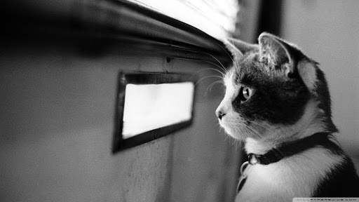
Results

Slide 19
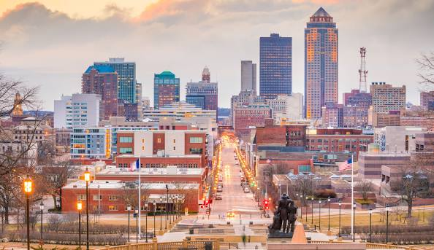
How this works
Qualifiers get to compete live in Des Moines this June 15-20. Each school can also enter two students who competed at districts (but didn’t qualify) to compete in supplementals.
If you did not qualify at this tournament, NSDA is holding a free nationwide last-chance tournament live online April 24-26. Enter by April 17.

Slide 20
How this works
We are announcing only the Qualifier and alternate.
Many of you qualified in two events! You can only go in one. Preferences were submitted before the tournament.
Full rankings and other alternates can be seen after the tournament in the results.

Slide 21
Qualified but can’t attend?
Every year, people qualify for nationals but are ultimately unable to attend. There are alternates who are eager for that opportunity, but if you wait until the national decline deadline to vacate your spot, it is often too late for those schools to purchase plane tickets and hotel rooms.
We respectfully request that, out of consideration for other competitors, you vacate qualifications as quickly as possible once registration for the National tournament is available.

Slide 22
Lincoln-Douglas Debate
Ayden Hicks Delta
National Qualifier
Sarah Elbusaidy Delta
Alternate

Slide 23
Public Forum Debate
Emely Acosta and Noe Lima Ponce Chiawana
National Qualifiers
Marcus Meinecke and Sienna Martinez Delta Alternates

Slide 24
Dramatic Interpretation
Ryan Abastillas Chiawana
National Qualifier
Nadia Alfaro Toppenish
Alternate

Slide 25
Dual Interpretation
Reed Sekaquaptewa/
Jodeci Godina Toppenish
National Qualifier
Canna Hyde/Lilly Esplin Chiawana
Alternate

Slide 26
Humorous Interpretation
Rylee Hein A. C. Davis
National Qualifier
O’Raziel Meza Brandon Chiawana
Alternate

Slide 27
Informative Speaking
Zoey Bailey Wenatchee
National Qualifier
Makenna Babb University
Alternate

Slide 28
Original Oratory
Rylin Clark Chiawana
National Qualifier
Makenna Babb
University
Alternate

Slide 29
Program Oral Interpretation
Selah Gutierrez Chiawana
National Qualifier
Canna Hyde Chiawana
Alternate

Slide 30
United States Extemp
Parker Alvarez Chiawana
National Qualifier
Sienna Martinez Delta
Alternate

Slide 31
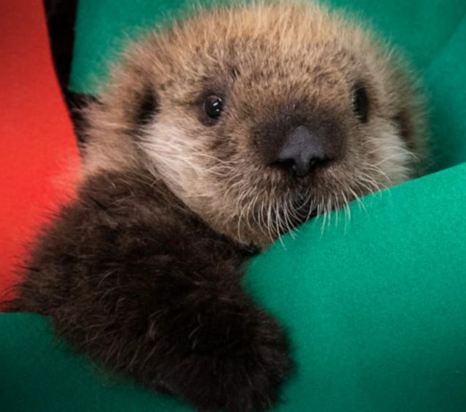
Sweeps

Slide 32
Sweepstakes (full points will be published on Tabroom)
Debate Delta
Speech Chiawana High School
Overall Chiawana High School

