Slide 1
Using Tabroom
to judge Speech Rounds
image from pngtree.com

Slide 2
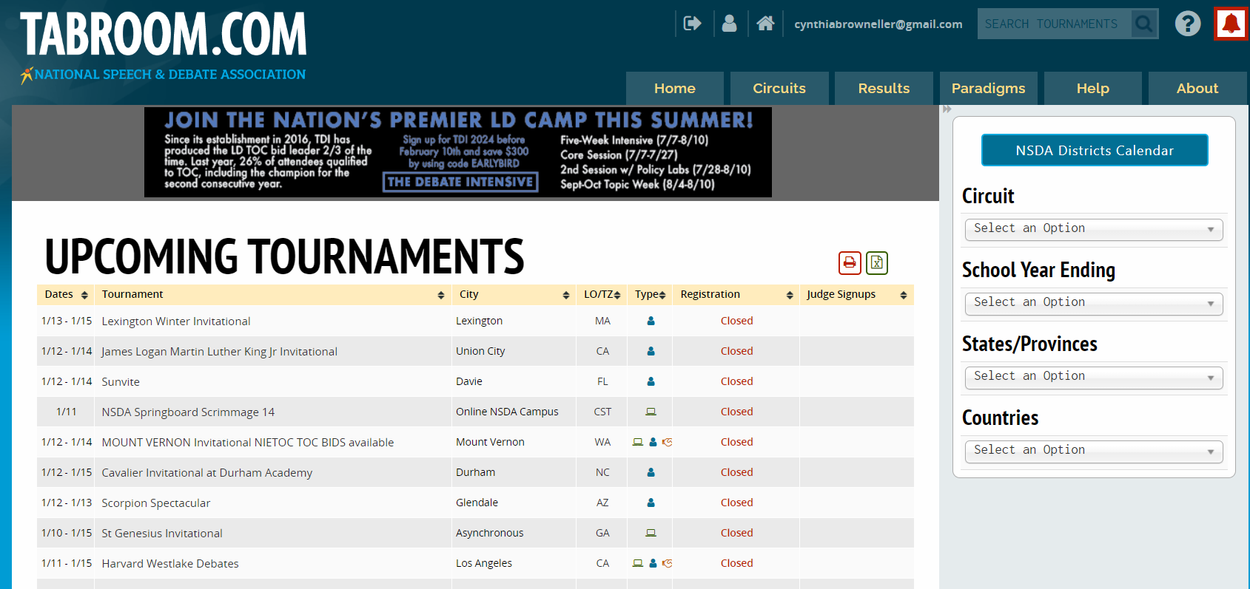
This is the tabroom homepage, from here click your email in the top right corner.

Slide 3
Clicking on your email will show your current ballots. Refresh this page by clicking on your email again between rounds while waiting for new ballots to become available. From this page you can also enter past ballots to add or edit feedback, this will be included in a later slide.

Slide 4
When you have a ballot, click Start Round before heading to your room. This lets the people running the tournament know you have seen your ballot and are on the way to the room.
The ballot will tell you what room you are in, what competitors you will be judging, and what event you are judging. Elimination rounds will have multiple judges. Please be sure all judges are present before beginning.

Slide 5
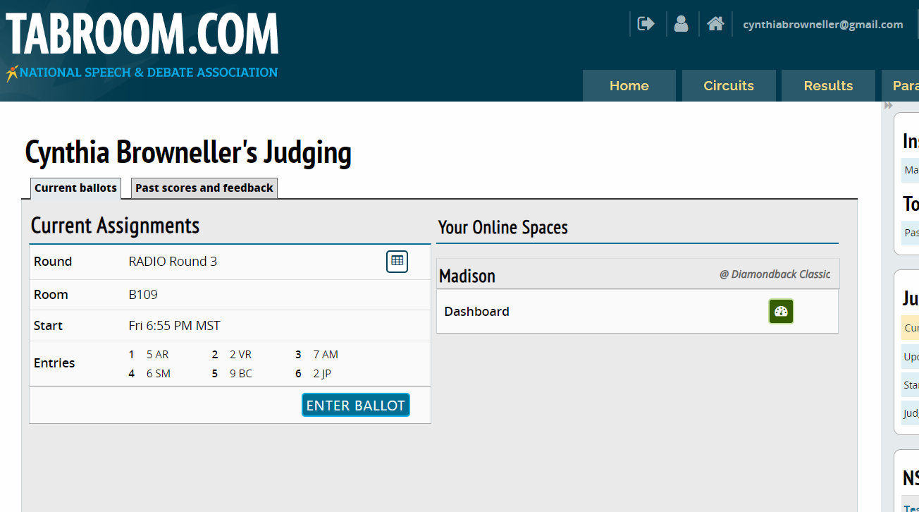
When you have arrived to your room, click enter ballot to begin the round.

Slide 6
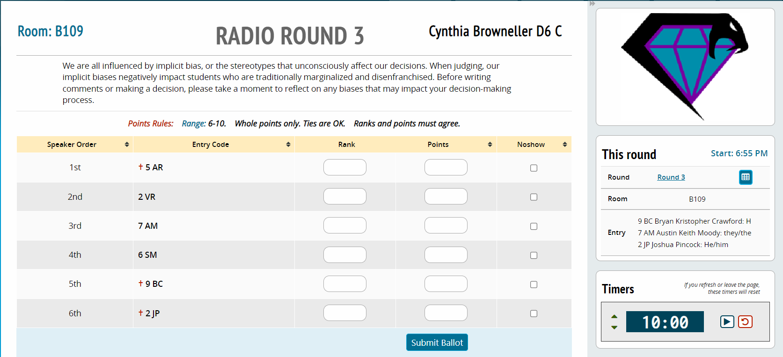
Your ballot will look similar to this, the following slides will break it down further.

Slide 7
When you arrive to your room, you may enter and get set up. Students will join you shortly or may already be waiting outside. Before you let them start presenting, take a quick roll call using these codes. In Speech, you may begin before all presenters are in the room. After a speech has finished other students may enter. Make sure to ask the code before each presenter to be sure points and rank are awarded correctly.
For Radio, Extemp, and Retold Story students will arrive one at a time beginning 30 minutes after you receive your ballot.
If you see this symbol next to a competitor’s code, this means they are entered in more than one speech event. They may come late to the round or need to leave after presenting.

Slide 8
The above section will give you instructions from the tournament. These will often include rules for the specific event. The tournament usually has a new judges packet with more information on each event.
On the right side of the screen will be a timer. Each event has specific time limits. These should be noted on the ballot and/or can be found in the Judge’s packet. You may need to adjust the preset time entered to be correct for your event.

Slide 9
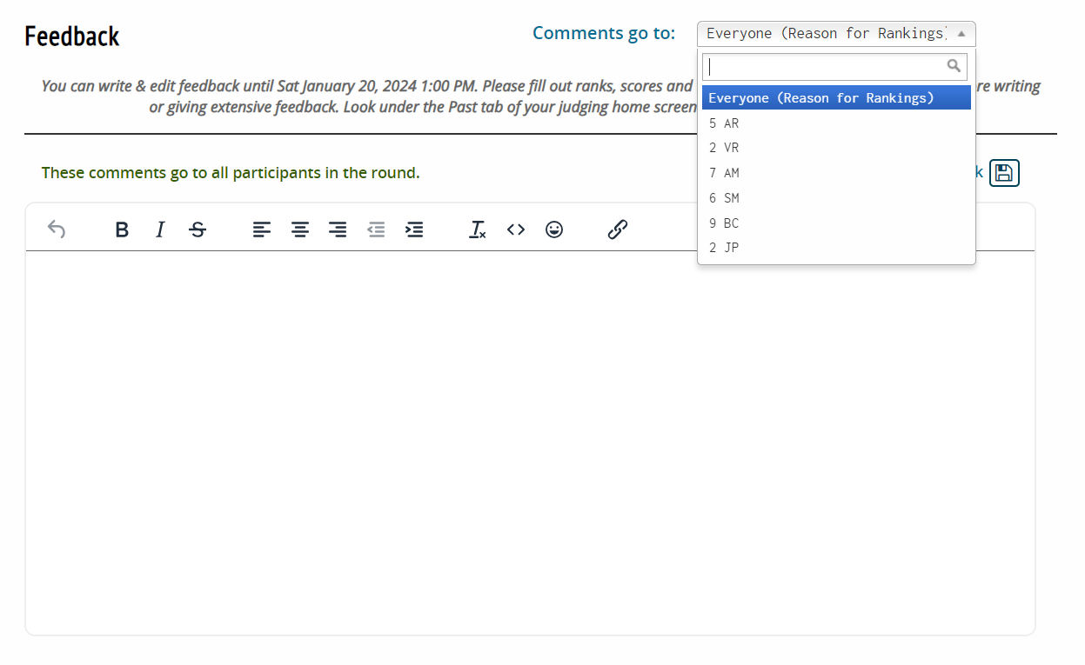
As you scroll down the screen you will find a place for feedback. There is a drop down menu for selecting who the feedback goes to. Reason for Rankings will go to all competitors. Specific feedback for each person goes in their respective tabs.
Feedback can and should be left for competitors while they are speaking and it is fresh in your mind. This also keeps the tournament running on time.

Slide 10
Feedback
Students rely on feedback to improve. Be kind, but please provide constructive thoughts on things that you feel would have helped them win or would have improved their performance.
Do not provide oral feedback, leave all feedback written on the ballot. (The exception to this is if the tournament hosts request oral feedback during the judge meeting.)
Do not leave comments on clothing, hairstyles, piercings, or any other appearance related opinions. Feedback should be limited to the presentation of ideas, performance of event, and if the competitor met the requirements for the event. For example: maybe their commercial in Radio needed to be longer.
Balanced feedback is ideal. These are the things you did great. These are the things you can improve next time.
Reason for Rankings helps the competitors know which performances were the most effective. It’s the place to tell why you made the decision you did.
If you have concerns about something that happened during the round, please speak with your school’s coach or someone working in the Tab room after the round has ended.

Slide 11
Each speaker (or team if judging Duo) is awarded points for their performance during the round. The range will be set by the tournament but is usually 6-10, with 10 being highest. Each tournament will provide a range, and if ties in points are ok. Even when the points are tied, you must still select a winner.
In most cases, Ranks will be 1-6. Assign the person you felt did the best performance the rank of 1. Next best is 2, and so on. Points must agree with rank. You can’t have someone ranked 1 with 8 points while someone else is ranked 2 with 10 points. The highest points awarded has to go to rank 1. You can tie with points but ranks must be different.
Once you have entered your decision, click submit ballot.

Slide 12
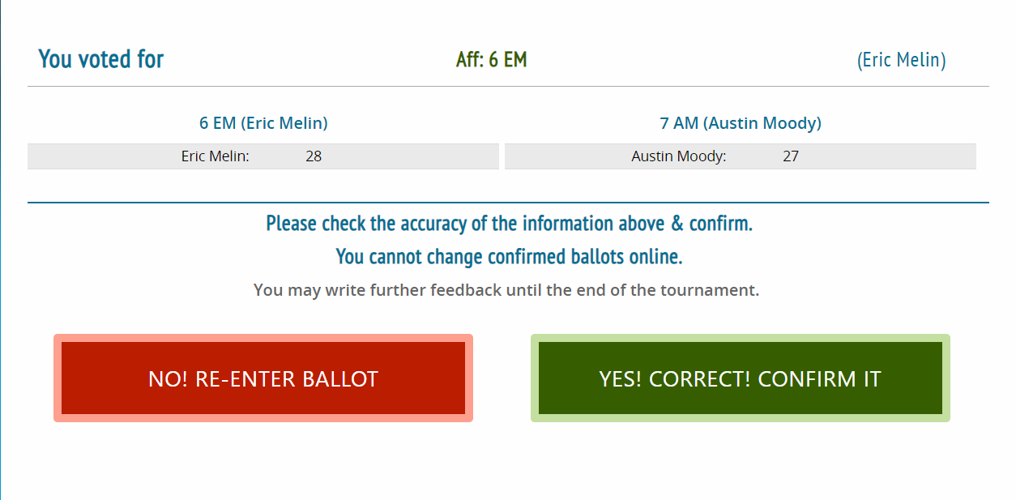
After clicking submit ballot you will be taken to a final page where you can double check your Rank and Points selection. If it looks correct, confirm your decision.
Most tournaments request that you submit your decisions quickly so the next rounds can get started. Feedback can be edited or added to after a decision has been submitted until the end of the tournament. Points and Ranks cannot be changed after being submitted.

Slide 13
To re-enter a past ballot, click on your email in the top right corner. That will bring you back to this page. Select the past scores and feedback tab.

Slide 14
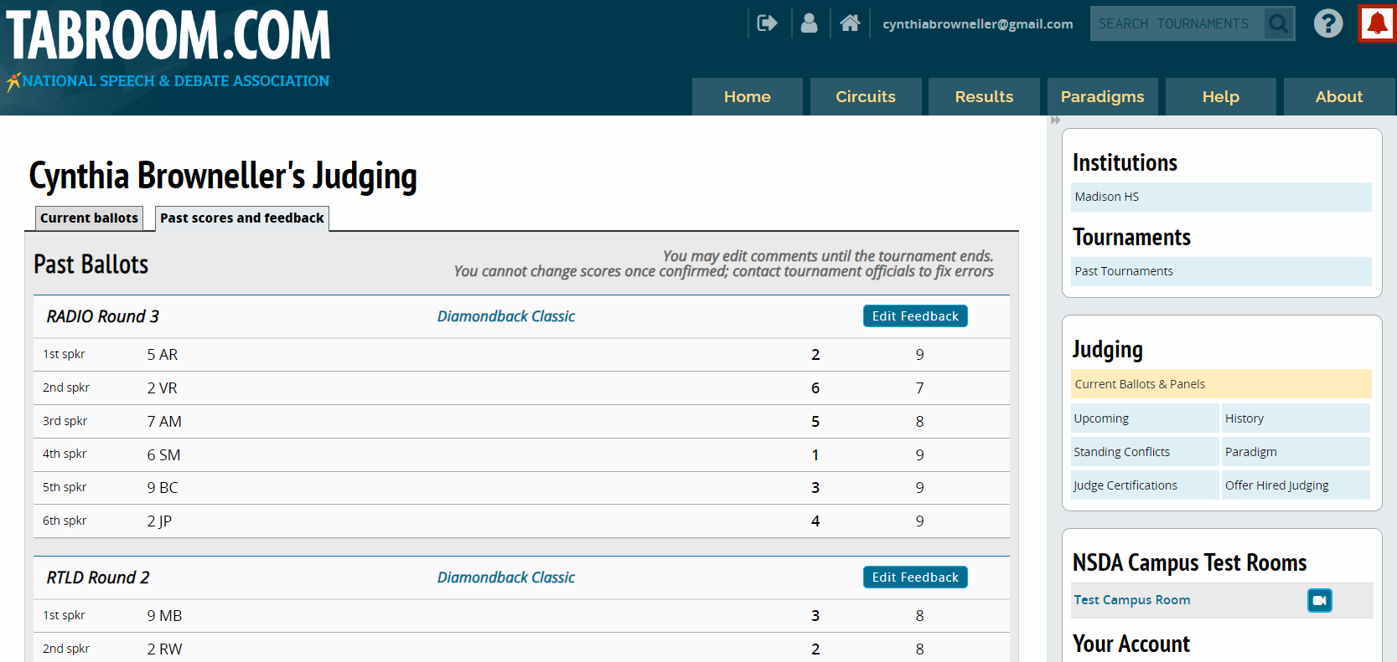
Once in past scores and feedback, you may re-enter a ballot and add or change written feedback. Scroll through the list to find the correct round. Speaker points and rankings cannot be changed. This is only available until the tournament ends.

Slide 15
Using Tabroom
to judge Congress
image from pngtree.com

Slide 16
This is the tabroom homepage, from here click your email in the top right corner.

Slide 17
Clicking on your email will show your current ballots. Refresh this page by clicking on your email between rounds while waiting for new ballots to become available. From this page you can also enter past ballots to add or edit feedback.

Slide 18
When you have a ballot, click Start Round before heading to your room. This lets the people running the tournament know you have seen your ballot and are on the way to the room. When judging Congress, you will be given a binder to assist you.
The ballot will tell you what room you are in, what teams you will be judging, and what event you are judging. Congress will have multiple adults in the room, a Parliamentarian (Parley) and 2 or more judges. Please be sure all adults are present before beginning your round.

Slide 19
When you have arrived to your room, click enter ballot to begin the round.

Slide 20
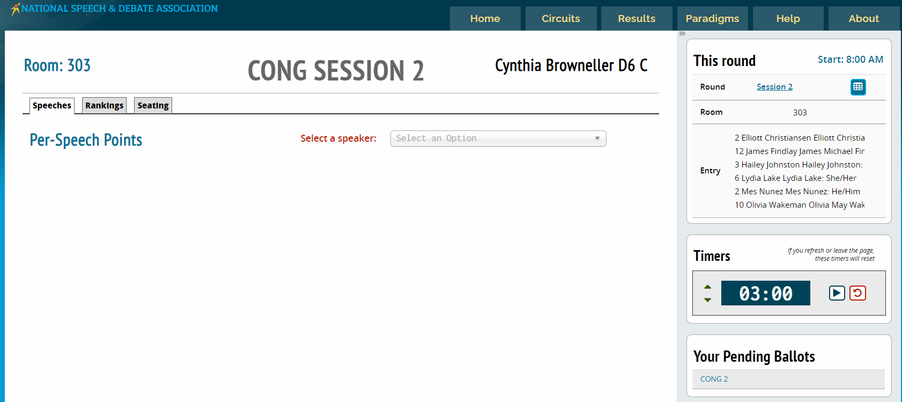
Your ballot will look similar to this, the following slides will break it down further.

Slide 21
There are three tabs on a congress ballot, you will spend most of your time in the speeches tab.

Slide 22
Seating for the Speakers is assigned. You may receive a paper copy of the seating chart and you can also find it here.

Slide 23
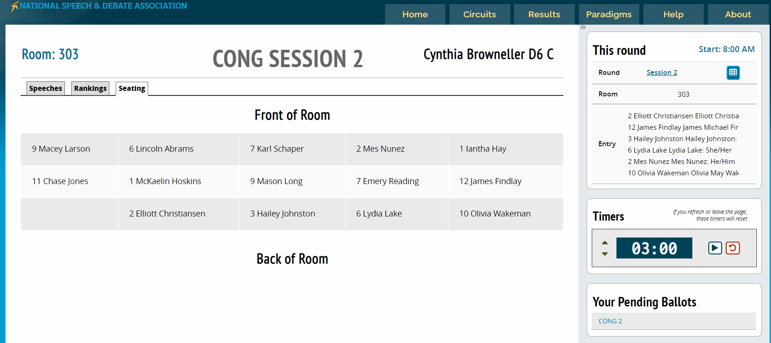

Slide 24
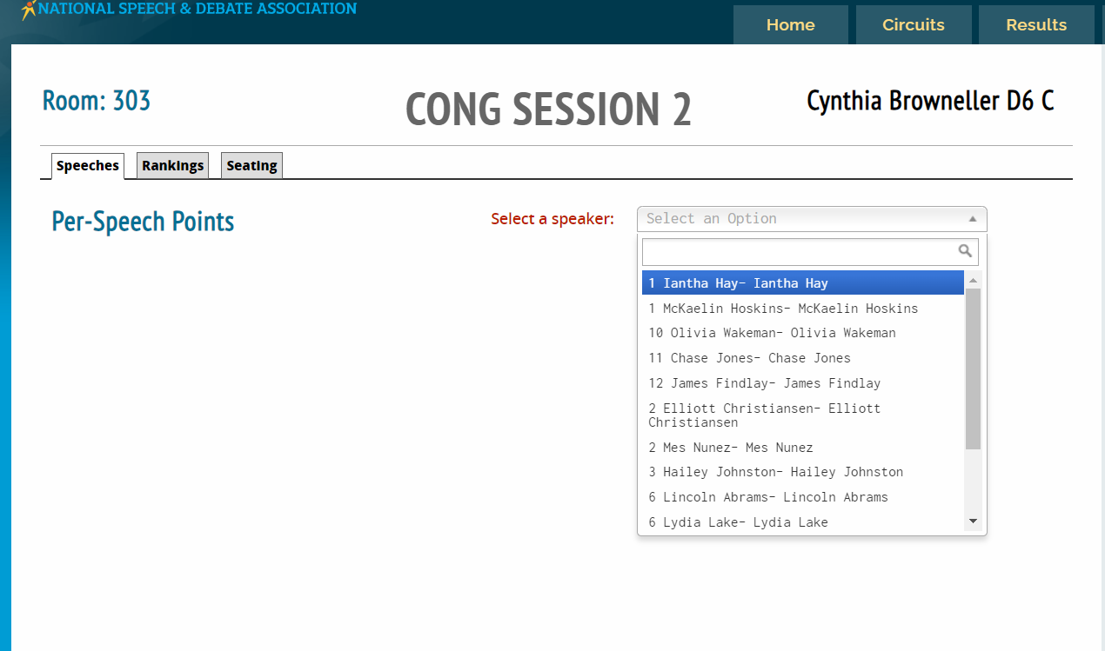
You will judge each competitor multiple times, once for each speech given. Use the drop down menu to find the correct representative.
The representatives will state their names when the begin speaking. You may need to scroll through the drop down menu to find them.

Slide 25
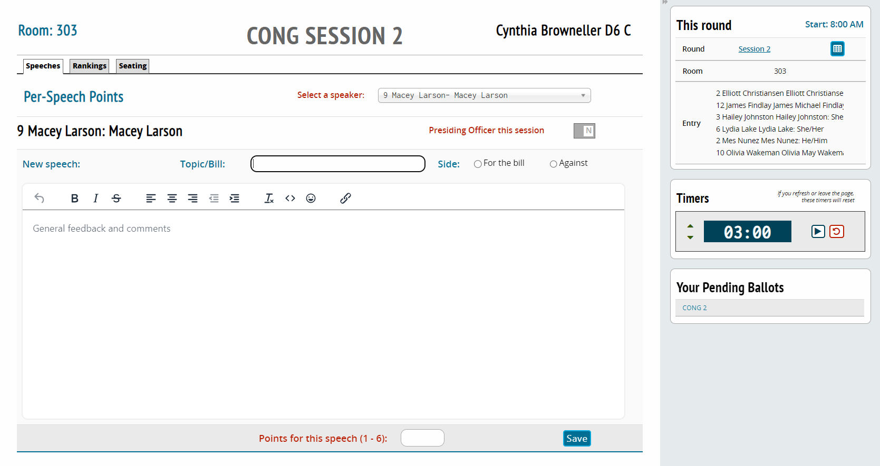
You can provide written feedback for their speech here. Make sure to enter the Bill name and select if the Speaker is for or against the bill. Bill names can be shortened as long as it is clear which bill was being debated.
Speeches are 3 minutes. You can use this timer to keep track, but the PO will also be timing. You do not need to stop a speaker.

Slide 26
Feedback
Students rely on feedback to improve. Be kind, but please provide constructive thoughts on things that you feel would have helped them win or would have improved their performance.
Do not provide oral feedback, leave all feedback written on the ballot. (The exception to this is if the tournament hosts request oral feedback during the judge meeting.)
Do not leave comments on clothing, hairstyles, piercings, or any other appearance related opinions. Feedback should be limited to the communication of ideas, maybe they needed to focus harder on a specific argument instead of the one they focused on.
Balanced feedback is ideal. These are the things you did great. These are the things you can improve next time.
Reason for Decision (RFD) helps the competitors know which things made the most impact on you as a judge, what worked and what didn’t. It’s the place to tell why you made the decision you did. RFD may or may not be available in the Speaker Drop down, it will depend on the tournament.
If you have concerns about something that happened during the round, please speak with your school’s coach or someone working in the Tab room after the round has ended.

Slide 27
Once the speaker has finished you need to score the speech. The congress binder you were given at the start of the round will include a metric you can use to determine how many points the speech is worth.
Once done, save your feedback.

Slide 28
When the next speaker is called, use the drop down menu at the top right of the ballot to select the next speaker. When you move to a new speaker it will start a new speech for that Representative. Continue this process for each speech.

Slide 29
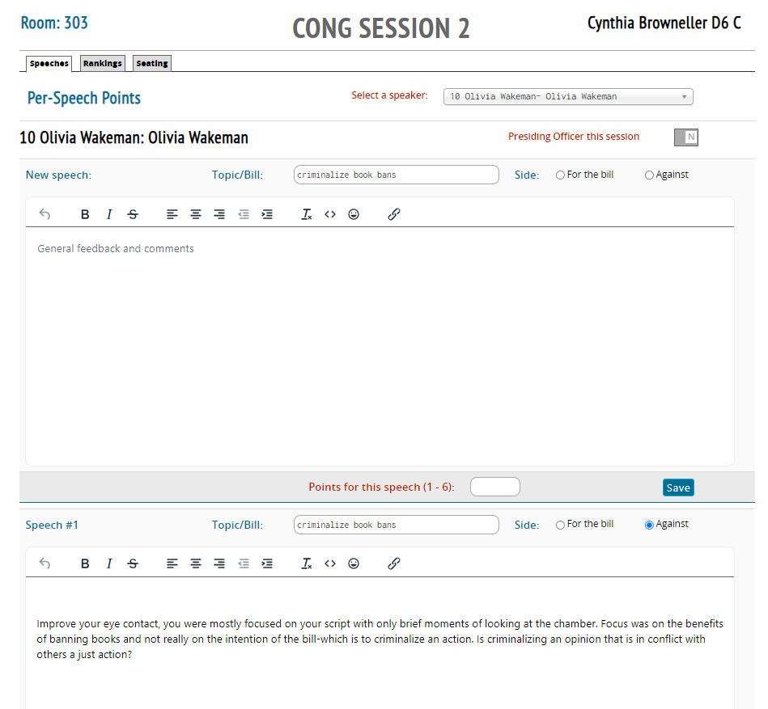
If needed, scroll down on the speech page to see past speeches given by a Representative in this session.

Slide 30
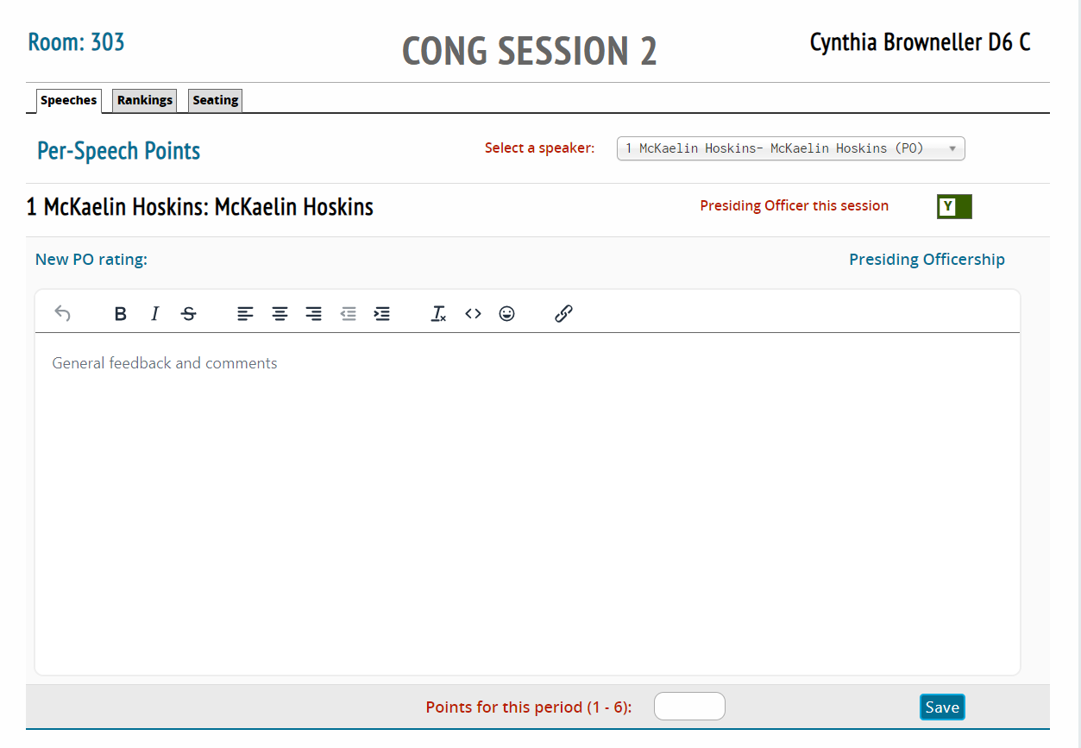
One Representative will have been elected to be the Presiding Officer or PO. They will be responsible for calling on speakers and questioners, keeping time, and making sure procedures are followed.
Once an hour, find them in the speaker drop down and give a score and feedback. Make sure the toggle in the top right is clicked to Y for the PO. The metric for scoring the PO can be found in the binder given to you at the beginning of the round. Once done, save your feedback.

Slide 31
When the session has ended, it is time to rank the Speakers in order of how well you think they did. Click on the rankings tab.

Slide 32
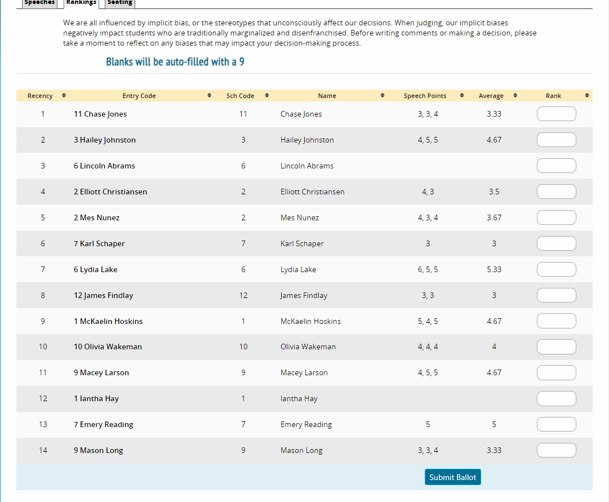
The ranking page will list each Speaker and have some other information to help you decide how you would like to rank them.

Slide 33
The speech points will tell you what score you have given to each speaker for each speech. You can see that some Speakers have 3 scores, that is because they gave 3 speeches. Next you will see the average score you assigned each speaker. Finally, provide a rank of 1-8 for who you believe are the top 8 speakers. All other speakers will be ranked a 9 (unless instructed otherwise by the tournament. That information is also found at the top of the ranking page.)

Slide 34
Once you have ranked each Speaker, click submit ballot.

Slide 35
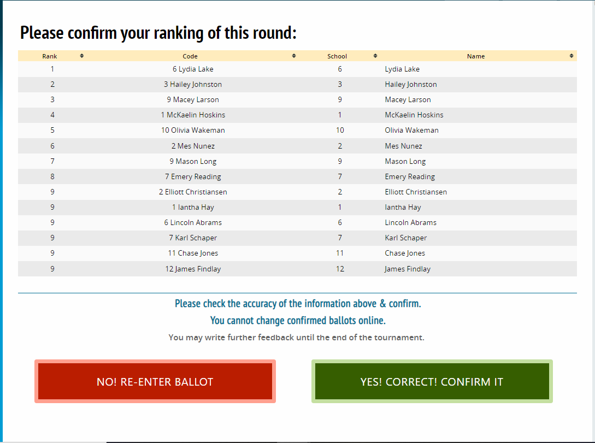
After clicking submit, you will be taken to a confirmation screen. Double check that your entries were recorded correctly, and then confirm your ballot. Once confirmed you may edit feedback but you may not change speech scores or rankings.

Slide 36
To re-enter a past ballot, click on your email in the top right corner. That will bring you back to this page. Select the past scores and feedback tab.

Slide 37
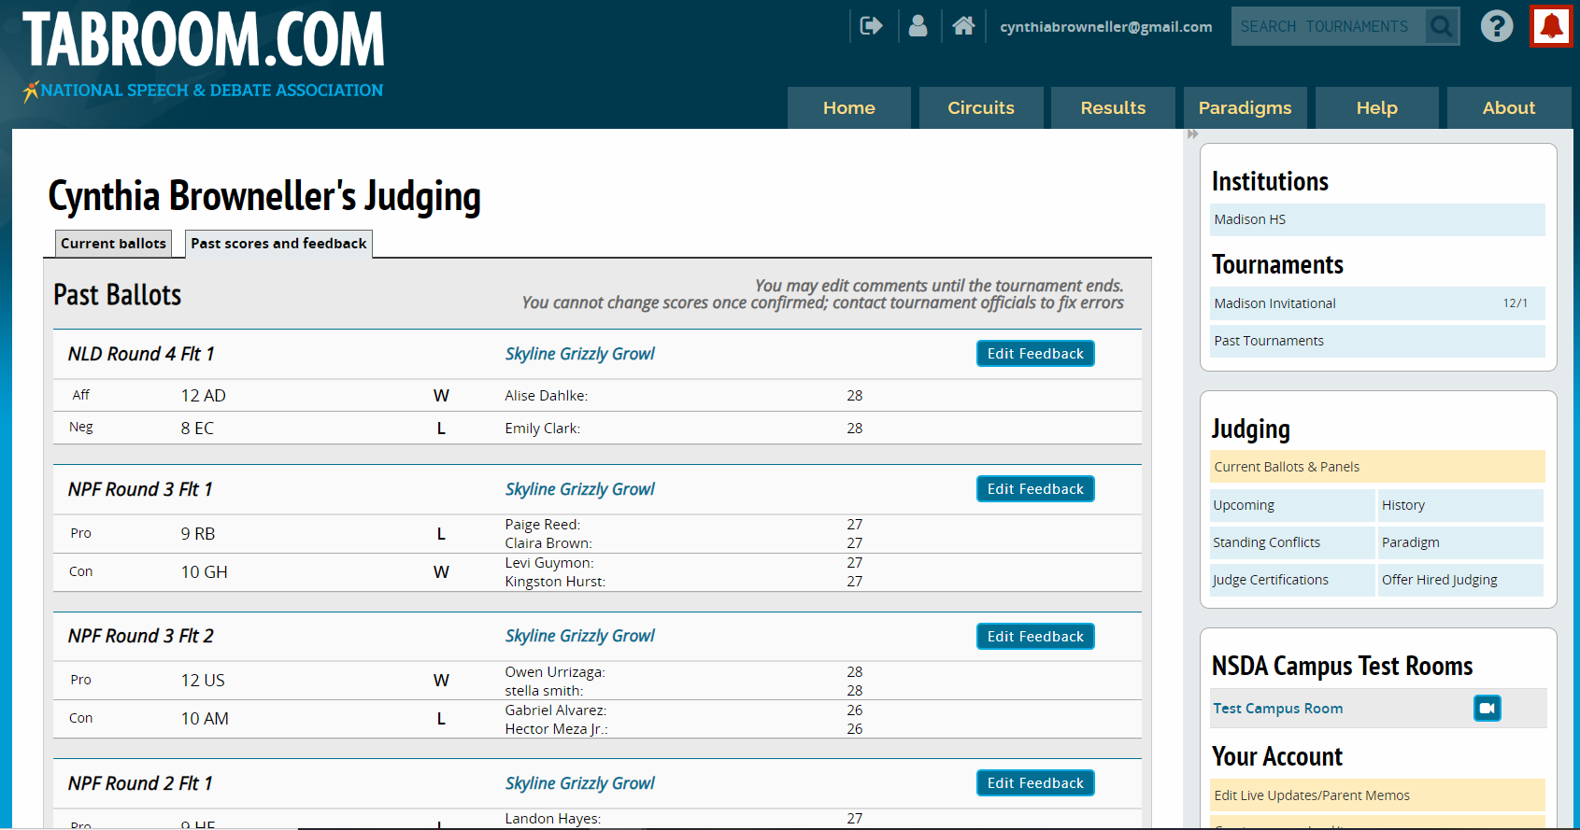
Once in past scores and feedback, you may re-enter a ballot and add or change written feedback. Scroll through the list to find the correct round. Speaker points and rankings cannot be changed. This is only available until the tournament ends.

Slide 38
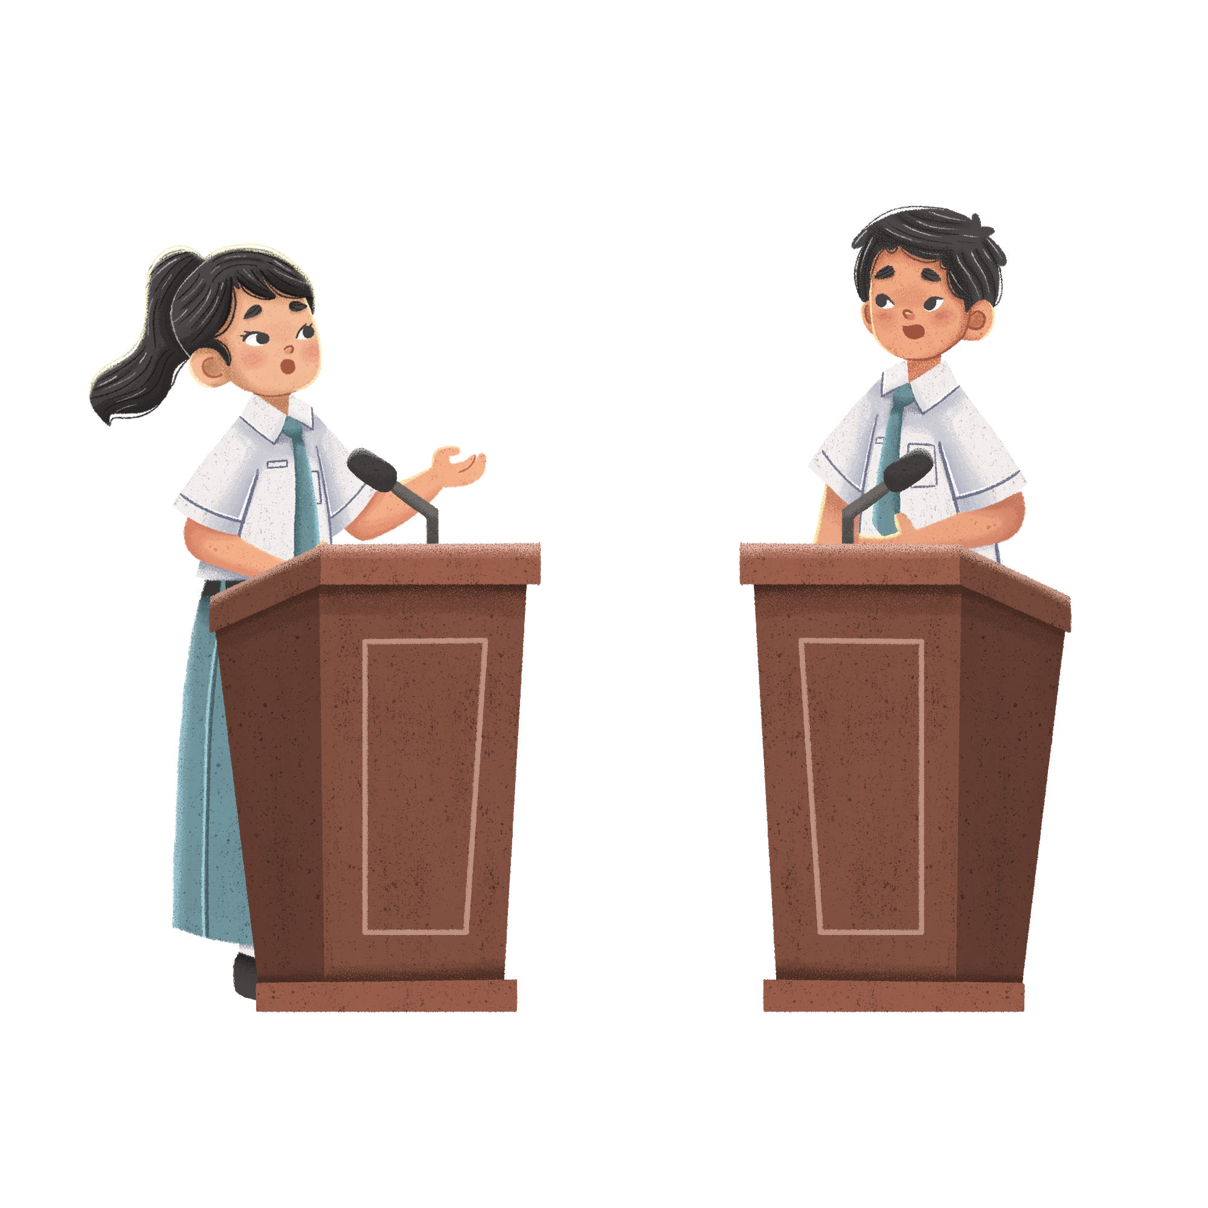
Using
Tabroom
image from pngtree.com
to judge Debate Rounds:
Lincoln Douglas, Public Forum, Policy (CX), Big Questions

Slide 39
This is the tabroom homepage, from here click your email in the top right corner.

Slide 40
Clicking on your email will show your current ballots. Refresh this page by clicking on your email between rounds while waiting for new ballots to become available. From this page you can also enter past ballots to add or edit feedback.

Slide 41
When you have a ballot, click Start Round before heading to your room. This lets the people running the tournament know you have seen your ballot and are on the way to the room.
The ballot will tell you what room you are in, what teams you will be judging, and what event you are judging. If you are judging Lincoln Douglas or Public Forum Debate you may have two ballots. These events are flighted, make sure to proceed with flight 1 first.
Elimination rounds will have multiple judges. Please be sure all judges are present before beginning.

Slide 42
When you have arrived to your room, click enter ballot to begin the debate.

Slide 43
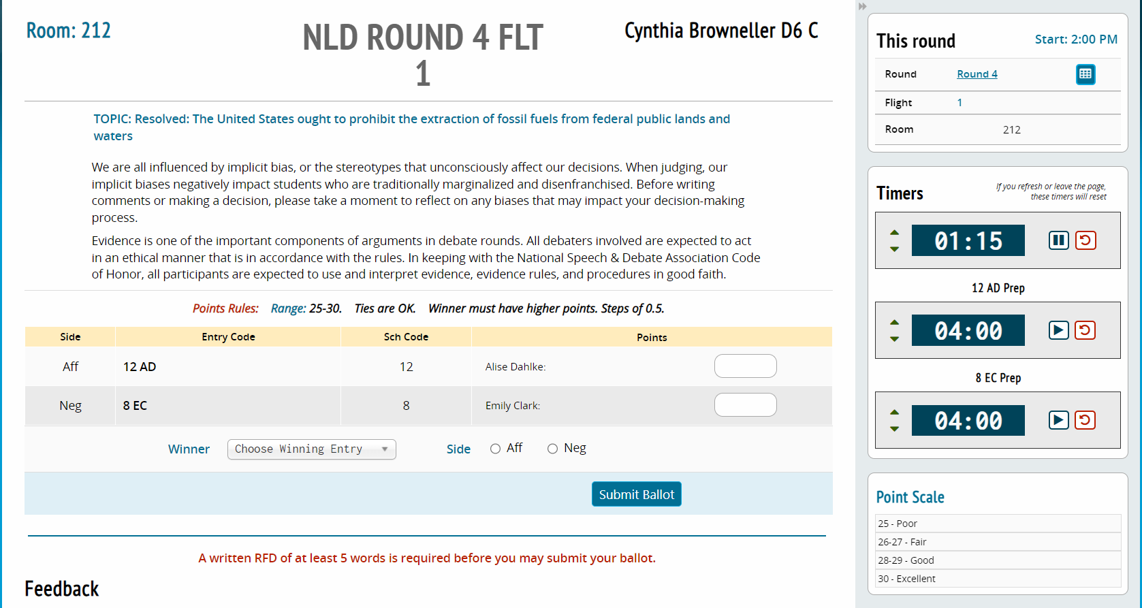
Your ballot will look similar to this. The following slides will break it down further.

Slide 44
When you arrive to your room, you may enter and get set up. Students will join you shortly or may already be waiting outside. Before you let them start debating, take a quick roll call using these codes. If both teams are correct, you can proceed.

Slide 45
In Public Forum debate the sides are not pre-assigned. After determining you have the correct teams in the room, the teams will flip a coin. One team flips and the other calls. The winner gets to decide if the want to be Pro/Con or if they want to speak first or second. After they choose, their opponent gets to make the other choice.
In your ballot, you will need to use drop down menus to assign the speaker order and the side of the debate.
For example: If the coin toss winner selects second speaker, the other team gets to decide if they want to argue Pro or Con.
Some semi-final and final rounds for other debate styles will also have the competitors flip for sides.

Slide 46
The Right side of the screen has timers for keeping track of speeches and prep times. Speech times should be located below the point scale if you scroll down or can be found on the next slide.

Slide 47
Lincoln Douglas Times
1AC- 6mins
CX- 3mins
1NC- 7mins
CX- 3mins
1AR- 4mins
1NR- 6mins
2AR- 3mins
4mins prep time for each side
Public Forum Times
1C- 4mins
2C- 4mins
Crossfire- 3mins
1R- 4mins
2R- 4mins
Crossfire- 3mins
1S- 3mins
2S- 3mins
Grand Cross- 3mins
1FF- 2mins
2FF- 2mins
3mins prep time for each team
Policy (CX) times
1AC- 8mins
CX- 3mins
1NC- 8mins
CX-3 mins
2AC- 8mins
CX- 3mins
2NC- 8mins
CX- 3mins
1NR- 5mins
1AR- 5mins
2NR- 5mins
2AR- 5mins
8mins prep for each team
Big Questions Times
1AC- 5mins
1NC- 5mins
CX- 3mins
1AR- 4mins
1NR- 4mins
CX- 3mins
1AC- 3mins
1NC- 3mins
1AR- 3mins
1NR- 3mins
3mins prep for each side

Slide 48
In Policy (CX) and Public Forum, debates are comprised of two 2 person teams. Speaker points are awarded individually. Make sure you get last names for each team so speaker points are awarded to the correct person.
Enter points here
Each debater is awarded Speaker points for their performance during the round. The point scale is an indicator for how to assign the points. Each tournament will provide a range, and if ties in speaker points are ok. Even when the points are tied, you must still select a winner. The winning team must have equal or higher points.

Slide 49
This is where you will find the Topic that the teams will debate, as well as instructions for removing and recognizing personal biases. The goal is to judge how well the students debated and communicated the topic, not if they know as much as you. I try to base my entire decision on only topics that were discussed by the teams, sometimes the winning team has it completely wrong, but if their opponent doesn’t address it, then they get to win because their opponent is the one debating them, not me.

Slide 50
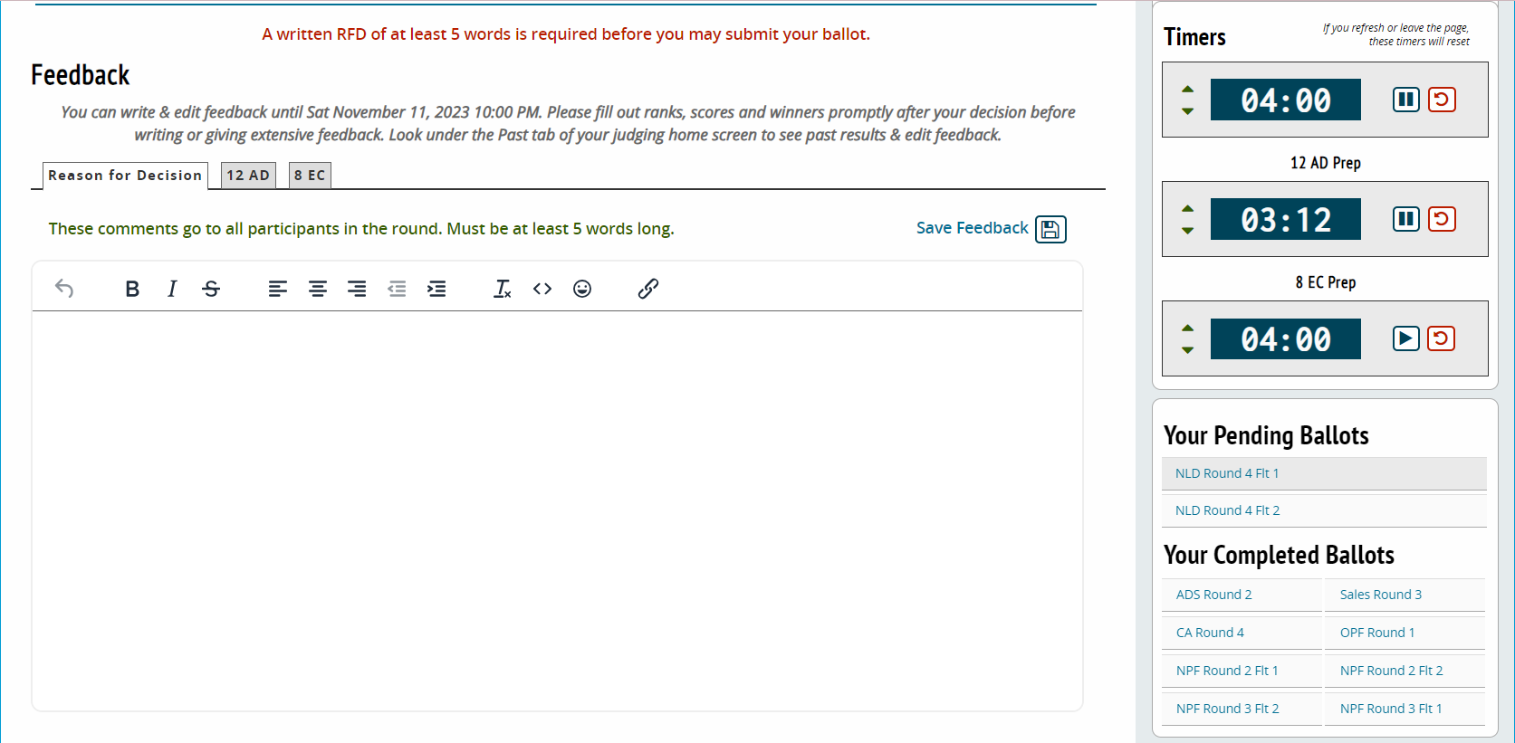
As you scroll down the screen you will find a place for feedback. There are tabs for selecting who the feedback goes to. Reason for Decision will go to both teams and their coaches. Specific feedback for each team goes in their respective tabs.
At the start of a round I like to type into each tab if the team is AFF or NEG so that I don’t accidentally give feedback to the wrong team. This is especially important for Public Forum, in those rounds I include speaker order and side. For example: Pro speaking second.

Slide 51
Feedback
Students rely on feedback to improve. Be kind, but please provide constructive thoughts on things that you feel would have helped them win or would have improved their performance.
Do not provide oral feedback, leave all feedback written on the ballot. (The exception to this is if the tournament hosts request oral feedback during the judge meeting.)
Do not leave comments on clothing, hairstyles, piercings, or any other appearance related opinions. Feedback should be limited to the communication of ideas, maybe they needed to focus harder on a specific argument instead of the one they focused on.
Balanced feedback is ideal. These are the things you did great. These are the things you can improve next time.
Reason for Decision (RFD) helps the competitors know which arguments worked and which didn’t. It’s the place to tell why you made the decision you did.
If you have concerns about something that happened during the round, please speak with your school’s coach or someone working in the Tab room after the round has ended.

Slide 52
Each tournament will have different word counts needed before a ballot can be submitted.
Feedback can be edited or added to until the tournament ends, you will find specific times for when feedback must be finalized on the ballot.

Slide 53
Feedback can be filled out while students are speaking, I find that when they are in prep time it is a great time for me to add notes. If you are 5 minutes passed the students finishing, please submit the ballot with speaker points and your decision then return to the ballot to fill out additional feedback. Submitting decisions allows the tournament managers to pair the next round and keep things moving on time. For debates that are flighted, please submit the first ballot before beginning the next debate.
When the debate is over you can review your notes and make your decision on who you believe was successful in proving their point. Award speaker points and then from the drop down menu select your winner. Click if the winning team was Aff or Neg. (or Pro/Con in Public Forum debate)

Slide 54
After clicking submit ballot you will be taken to a final page where you can double check who won and speaker points selection. If it looks correct, confirm your decision.
Most tournaments request that you submit your decisions quickly so the next rounds can get started. Feedback can be edited or added to after a decision has been submitted until the end of the tournament. Points and win or loss cannot be changed after being submitted.

Slide 55
To re-enter a past ballot, click on your email in the top right corner. That will bring you back to this page. Select the past scores and feedback tab.

Slide 56
Once in past scores and feedback, you may re-enter a ballot and add or change written feedback. Scroll through the list to find the correct round. Speaker points and winner cannot be changed. This is only available until the tournament ends.

