Slide 1

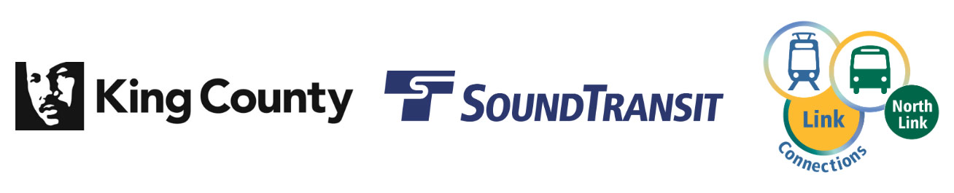
North Link Connections Mobility Project Launch
Metro Transit Department
July 1, 2019
Moving forward together

Slide 2
Introduction
What is the North Link Connections Mobility Project?
Respond to changing mobility needs and integration with 3 new Link light rail stations opening in 2021
Metro’s largest service restructure since March 2016 U-Link extension
Partnership with ST, SDOT, UW, and other partners
Moving forward together
Notes:
In 2021, Sound Transit opening 3 new Link stations in north Seattle, extending from the current terminus at UW– Husky Stadium to Northgate Transit Center
Metro is initiating a mobility project in north Seattle and north King County, along with ST, SDOT, UW, Community Transit, and other partners to prepare for Northgate Link opening, respond to changing mobility needs, and improve mobility and access for historically underserved populations
Metro’s largest service restructure since March 2016 U-Link extension
Either March or September 2021 implementation, whichever most closely follows the opening of the Link light rail extension

Slide 3
Project Goals
What are we trying to do through this effort?
Improve mobility for historically un(der)served populations, centering on people of color
Equitably inform, engage, and empower current and potential customers traveling in the project area
Deliver integrated service that responds to Link expansion and meets customer needs
Moving forward together

Slide 4
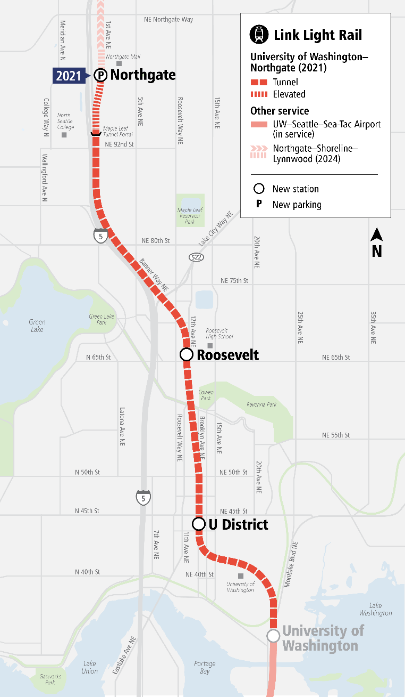
Sound Transit Integration
Sound Transit Northgate Link Extension
Open: 2021
Length: 4.3 miles; 3 stations
Service: Every 4-6 minutes during peak hours.
Projected travel times:
  Northgate to University of Washington - 7 minutes
  U District to Westlake - 8 minutes
Moving forward together

Slide 5
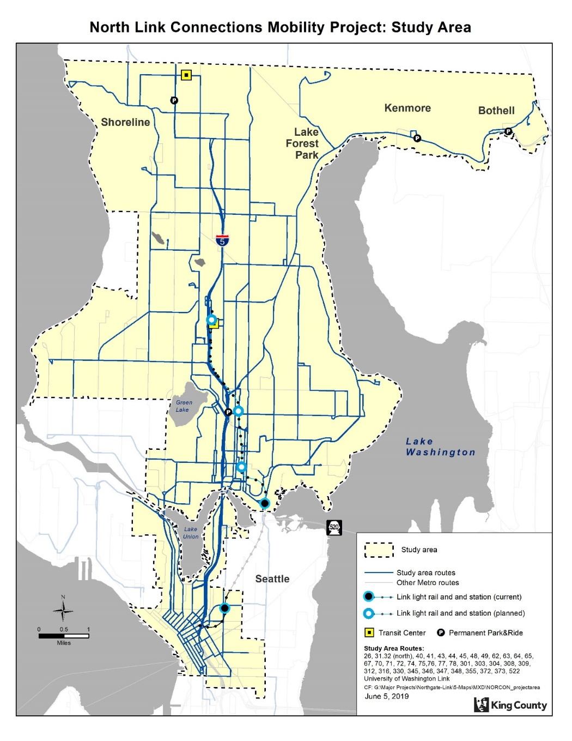
Project Scope
Where would service change or be impacted?
Focused on:
  Seattle, Shoreline, Kenmore, Lake Forest Park, Bothell
Over 30 Routes
Community Connections project areas
  New areas and solutions identified during outreach
Moving forward together
Notes:
Routes 26, 31, 32, 41, 45, 62, 63, 64, 65, 67, 71, 73, 74, 75, 76, 77, 78, 301, 303, 304, 308, 309, 312, 316, 330, 345, 346, 348, 355, 372, 373

Slide 6
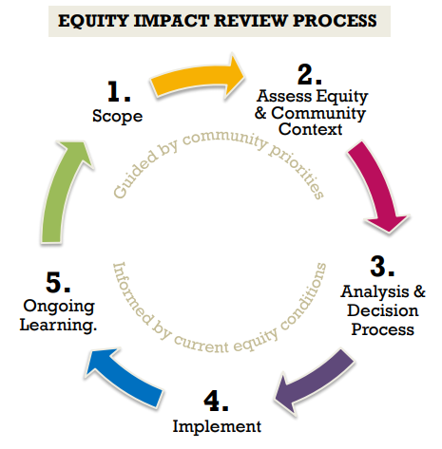
Equity Impact Review (EIR)
Moving forward together
Notes:
The Equity Impact Review (EIR) process merges empirical (quantitative) data and community engagement findings (qualitative) to inform planning, decision-making and implementation of actions which affect equity in King County.

Slide 7
Community Engagement Overview
Community Needs & Priorities,
Mobility Board workshopping
Iterative, Community-Driven Concept Design
Final trade-off decisions,
Prepare proposal
Continue being present in community
Moving forward together
Notes:
Project goal conversations with jurisdictions, King County Council, Executive’s Office, Institutions, and Community Based Organizations
• Inform & engage with community within project area of goals and opportunities to shape decision-making
• Recruit Mobility Board, and identify and collect community priorities
• Develop draft network concepts based on Mobility Board recommendation
• Engage with community more broadly to further modify/improve draft network
• Engage with Mobility Board to make final trade-off decisions
• Site qualitative and quantitative data gathered from community engagement for significant network choices
• Communicate final network concept and next steps to community (with Mobility Board)
• Continue to be present in the community at events and meetings to continue to build relationships
• Update communications as needed
Stakeholders and general public aware of project scope, goals, and what their role may be in the outreach and engagement process
Mobility Board convened and developed list of priorities and needs related to a transit network based on community input
A transparent and iterative concept drafting process where the community and major stakeholders understand where and how changes are being made, as well as how and why their feedback was or was not incorporated
Trade-offs are understandable and the ability to choose between priorities is achievable by both Service Planning and the community at large
Communities affected understand how their feedback has shaped final outcome and what next steps are
Planners prepared to make recommendation with knowledge of risks/benefits
Community and Community Based Organization stakeholders trust and see Metro as a partner
Metro is prepared for Northgate Link light rail extension implementation
Council adopts service changes

Slide 8
Next Steps & More Information
What’s happening now?
Preparing for a public launch of Phase 1 of the project
  Website, community events, street team, and intercept survey opportunities scheduled, published online, Mobility Board applications
Moving forward together
Notes:
Inform our riders and communities
Find ways to engage and gather input
Meeting with County and jurisdiction leadership to build project support

Slide 9
Northgate Link Extension
7/1/19

Slide 10
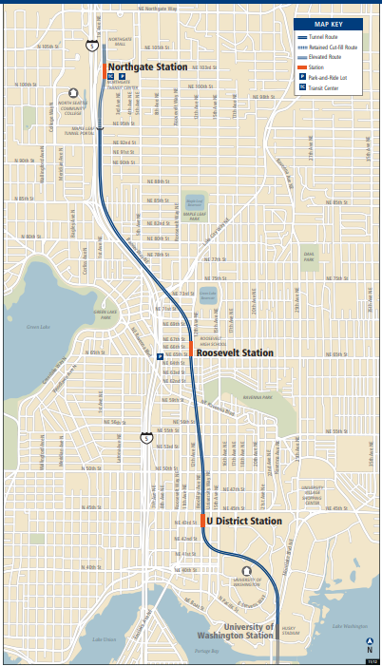
Northgate Link Extension
Overview
4.3-mile extension of the Red Line adds three new stations in Seattle:
    U District - underground
    Roosevelt - underground
    Northgate – elevated; features frequent bus connections, a park-and-ride and a bicycle/pedestrian bridge to North Seattle College

Slide 11
Northgate Link Extension
Facts
Station construction nearing completion.
Service starts in 2021.
Riders will experience reliable, traffic-free travel between Northgate and downtown Seattle in just 14 minutes; and between Northgate and University of Washington in 7 minutes.
Four-car trains will run every 4-6 minutes during peak hours.

Slide 12
Sound Transit Bus Restructure Outreach Process
Jul – Sept: Alternatives Development
Oct – Nov: Outreach Phase 1
Nov – Jan: Preferred Alternative
Mar – Apr: Outreach Phase II
Spring or Fall 2020: Board Adoption process

Slide 13

Mobility Project Contacts
Dave VanderZee
Project Manager, North Link Connections Mobility Project
(206) 477-0091
David.VanderZee@kingcounty.gov
Shelby Cramer
Community Engagement Planner, North Link Connections Mobility Project
(206) 263-1109
SCramer@kingcounty.gov

