Slide 1
Validation of Clinical Classification Schemes for Predicting Stroke
Results From the National Registry of Atrial Fibrillation
Gage et. al. JAMA 2001; 285(22)
Eric L. Bonno, MD
Alfred Buxton, MD
Beth Israel Deaconess Medical Center
January 12, 2012

Slide 2
In plain English.........
where did CHADS₂ come from?

Slide 3
Outline
Introduction and background from prior studies
Goal of this study
Methods
Results
Conclusions
Strengths, limitations
Subsequent studies and evolution of CHADS₂
Discussion

Slide 4
Introduction
AFib is common (5% of population by age 65yo and 10% by 75-80yo) and an independent risk factor for stroke
Warfarin reduces this risk by ~66%¹
Aspirin (ASA) reduces this risk by 21% (controversial) ²⁻⁴
The absolute risk reduction depends on the underlying risk for stroke
How do you predict the level of risk?

Slide 5
Atrial Fibrillation Investigators (AFI)
In 1994, AFI pooled data from 5 randomized trials comparing Warfarin vs ASA vs control¹
Analyzed for stroke risk factors (RF’s) in the control arm
Stroke risk ↑ by 1.4 for:
  Each decade of age
  Clinical RF’s: HTN, prior stroke or TIA, DM

Slide 6
Atrial Fibrillation Investigators (AFI)
Clinical RF’s: HTN, prior strokes, DM
Highest risk = ≥ 1 of the 3 clinical RF’s
  5.9 to 10.4 strokes per 100 pt – yrs
Moderate risk = ≥ 65 yo but had no RF’s
  2.7 to 4.3 stokes per 100 pt – yrs
Lowest risk = < 65 yo and no RF’s
  1.0 to 1.8 strokes per 100 pt - yrs
Even lower if no CAD or CHF (“equivocal RF’s”)
  Up to 1.6 strokes per 100 pt – yrs

Slide 7
Stroke Prevention and Atrial Fibrillation (SPAF)
In 1995, SPAF investigators report a classification scheme based on SPAF I and II⁵
Analyzed stroke RF’s in those treated with ASA
4 independent RF’s
  BP > 160 mm Hg
  Prior cerebral ischemia
  Recent HF (active within past 100 days) or documented by echo
  Combination of >75 yo + female sex

Slide 8
Stroke Prevention and Atrial Fibrillation (SPAF)
Clinical RF’s: SBP > 160 mm Hg, prior cerebral ischemia, recent HF or documented by echo, combination of >75 yo + female sex
SPAF III undertaken to identify those at the lowest risk while taking aspirin⁶
  Analyzed stroke rate for those with none of the 4 RF’s above
    Allowed a history of HTN
  If only h/o HTN:
    3.2 to 3.6 annual stroke rate per 100 pt – yrs
  If no h/o HTN:
    1.1 annual stroke rate per 100 pt – yrs

Slide 9
Problems with these 2 Stroke Risk Classification Schemes
Both have equivocal risk factors that affect risk of stroke in low-risk patients
Conflicts in their estimation of risk
  Low risk in one scheme is moderate or high in another
Ambiguity
Average age was only 69 yo

Slide 10
Goal of Current Study
To validate these 2 existing schemes in an independent sample
To find a convenient and accurate classification scheme estimating stroke risk in Medicare-aged patients with non-rheumatic AFib not on Warfarin

Slide 11
Methods – Creation of CHADS₂
Amalgamated the 2 risk scores into “CHADS₂”
  Prior cerebral ischemia
  HTN – history of HTN, not just SBP >160
  DM
  CHF – recent CHF exacerbation, not any h/o CHF
  Age > 75 yo
Prior cerebral ischemia ↑ RR for stroke equal to two other RF’s combined (based on prior studies)^{1,7-10} → therefore, given 2 points

Slide 12
Methods – Creation of National Registry of Atrial Fibrillation (NRAF)
Anonymous records gathered by 5 quality improvement / peer review organizations in 7 states
ICD-9 codes used in Medicare Part A claims records (MEDPAR) to identify pts with chronic or recurrent AFib

Slide 13
Methods – Creation of National Registry of Atrial Fibrillation (NRAF)
Charts reviewed to identify
    Chronic / recurrent AFib
    Stroke risk factors
    Comorbid conditions
    Antithrombotic therapy at discharge
Data entered onto standardized abstraction forms
De-identified data sent to central location for inclusion into NRAF data set

Slide 14
Methods – Exclusion from NRAF Data Set
Acute AFib
Death during hospitalization
Rheumatic heart disease
Mitral stenosis
Recent surgery
Trauma
Transfer to another acute care facility
< 65 yo or > 95 yo
Warfarin on discharge

Slide 15
Methods – Outcomes
Study outcome was hospitalization for ischemic stroke by Medicare claims
Chart abstractions from index hospitalization were linked to MEDPAR using ICD-9 codes for:
  Occlusion of cerebral arteries
  Transient cerebral ischemia
  Acute, but ill-defined cerebrovascular disease

Slide 16
Methods – Outcomes
Minimum of 365 days of follow up claims for all beneficiaries
Beneficiaries censored:
  At time of non-stroke death or
  1000 days after index hospitalization
If multiple strokes, excluded events after index event

Slide 17
Methods – Statistical Analysis
Exponential survival model used to:
  To calculate stroke rate as function of CHADS₂
  Measure how hazard rate for stroke was affected by:
    Each 1 point ↑ in CHADS₂
    Prescription of Aspirin
RR reduction for aspirin calculated as 1 minus relative hazard of prescribing ASA

Slide 18
Methods – Statistical Analysis
Time-to-event analyses to determine predictive validity
  Calculated stroke rates for each risk group of each of the 3 classification schemes
  C-statistic used to quantify predictive validity of the schemes

Slide 19
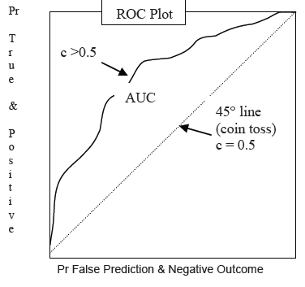
A Word on the C-statistic
The area under the curve (AUC) in a Receiver Operating Characteristic (ROC) curve shows the tradeoffs between sensitivity and specificity of a given diagnostic test
  The 45˚ line represents pairs of sensitivity and specificity that offset each other
  Above this line, true predictions > false predictions
http://www2.sas.com/proceedings/forum2008/143-2008.pdf

Slide 20
A Word on the C-statistic
If every point in ROC of “Model A” is > every point of ROC for “Model B” → Model A is better
The concordance C-statistic is a single summary measurement of a model’s accuracy
http://www2.sas.com/proceedings/forum2008/143-2008.pdf

Slide 21
Results
3932 Medicare beneficiaries
with documented AFib
2199 excluded for
reasons stated above
1733 patients with non-rheumatic AFib
65-95 yrs old
Not prescribed Warfarin at discharge

Slide 22
Results – Clinical Characteristics
NRAF patients:
  Older
  More women
  More comorbidities
 | NRAF | Mean AFI & SPAF
Age, mean, years | 81 | 69
Female | 58 | 31
CHF | 56 | 21
HTN | 56 | 49
DM | 23 | 15
H/o CVA | 25 | 13
Data presented as percents, except age
Gage et. al. JAMA. 2001; 285
Notes:
Prescribed ASA: NRAF 31% AFI 38% SPAF 100%
NRAF mean CHADS2 was: 2.1 for those with NO antithrombotic therapy and 2.3 for those given ASA

Slide 23
Results – Stroke Rates
Stroke rate ↑ by ~1.5 (95% CI 1.3-1.7) for each 1-point ↑ in CHADS2
P < 0.001
“Adjusted stroke rate” assumes no ASA was taken
  ASA had 20% RR reduction (P = 0.27)
CHADS2 score | No. pts | NRAF adjusted stroke rate (95% CI)
0 | 120 | 1.9 (1.2–3.0)
1 | 463 | 2.8 (2.0–3.8)
2 | 523 | 4.0 (3.1–5.1)
3 | 337 | 5.9 (4.6–7.3)
4 | 220 | 8.5 (6.3–11.1)
5 | 65 | 12.5 (8.2–17.5)
6 | 5 | 18.2 (10.5–27.4)
Gage et. al. JAMA. 2001; 285

Slide 24
Results – Comparisons of Schemes
303 (17%) pts in NRAF were identified as SPAF “low risk”
  NRAF stroke rate was 1.5%
  Similar to SPAF’s reported rate of 1.1% with aspirin therapy
SPAF risk category | Actual NRAF stroke rate | Prior published SPAF stroke rate
Low No RF’s | 1.5 | 1.1
Moderate HTN | 3.3 | 3.2-3.6
High F, >75yo, recent CHF or EF<25%, SBP>160 | 5.7 | 5.9-7.9
Gage et. al. JAMA. 2001; 285

Slide 25
Results – Comparisons of Schemes
490 (27%) pts in NRAF identified as AFI “medium risk”
  NRAF stroke rate was 2.2%
  Similar to AFI’s reported rate of 2.7 - 4.3%
Excluding those >75 yo from medium risk cohort lowered risk to 1.1%
  Only small number of pts left though
AFI risk category | Actual NRAF stroke rate | Prior published AFI stroke rate
Low No RF’s | ---- | 1.0-1.8
Moderate >65yo | 2.2 | 2.7-4.3
High Prior CVA, HTN, DM | 5.4 | 5.9-10.4
Gage et. al. JAMA. 2001; 285

Slide 26
Results – Comparisons of Schemes
Variations of the classification schemes did not improve predictive accuracy:
  Including pts >75 yo as high risk in AFI
  Including DM in as moderate risk in SPAF
  Including any CHF in CHADS₂ (not only as primary Dx)
Scheme | C-statistic ( 95% CI )
AFI | 0.68 (0.65 – 0.71)
SPAF | 0.74 (0.71 – 0.76)
CHADS2 | 0.82 (0.80 – 0.84)
Gage et. al. JAMA. 2001; 285

Slide 27
Results – Post hoc analyses
CHADS₂ still more accurate than AFI / SPAF regardless of receiving ( n = 529 ) or not receiving ASA ( n = 1204 )
Collapse of CHADS₂’s 7 strata did not improve C-statistic
  3 strata: Low (0-1), moderate (2-3), and high risk (4-6)
    C statistic was 0.78 → 0.4 less than with 7 strata
  2 strata: 0-1 and 2-6
    C statistic was 0.71

Slide 28
Conclusions
CHADS₂ identified a low risk cohort with adjusted stroke rate of 1.5 per 100 pt – yrs
  Helps clinicians identify low risk patients who do not need Warfarin
CHADS₂ had greater predictive accuracy than AFI and SPAF
20% risk reduction with ASA not significant in this study, but when combined with other research – suggests ASA is suitable for those not amenable to Warfarin

Slide 29
Strengths
Charts were reviewed to document AFib, stroke risk factors, and ASA on discharge
Geographic diversity – 7 states in 5 regions
CHADS₂ derived from prior studies, then validated in the NRAF data set
Given patient characteristics, CHADS₂ more generalizable to more elderly, frail population

Slide 30
Limitations
Did not have access to echo results which could have potentially improved accuracy
Differences in the NRAF vs AFI / SPAF cohorts (older, sicker vs younger, healthier)
Chart review was at one time point, may have missed risks that developed after
Stroke outcomes assessed based on Medicare claims, may not have captured all events
May underestimate stroke risk in other high risk populations
  Mitral stenosis, cardiac thrombus, mechanical valves, recent anterior MI, high grade carotid stenosis

Slide 31
Moving Forward.....
Criticism of the original CHADS₂ were:
  >60% were categorized as intermediate risk¹²⁻¹⁷
    No clear recommendations to treat with Warfarin or ASA
    Underwent revision so that intermediate changed from 1-2 RF’s to 1 RF, but not formally validated¹²
  Omitted other potential thromboembolic risk factors¹⁸⁻²³
    Female sex
    Age 65-74
    CAD
    Myocardial infarction
    Peripheral artery disease
    Complex aortic plaque
Therefore, other schemes were devised – for example...

Slide 32
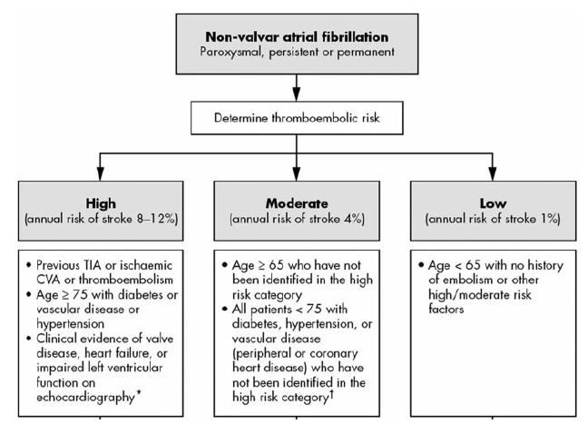
Birmingham Risk Stratification Scheme
In 2006, the original AFI scheme was refined for a Birmingham, UK primary care population
It took into account age > 65 and vascular disease
Lip et. al. Stroke. 2006; 37

Slide 33
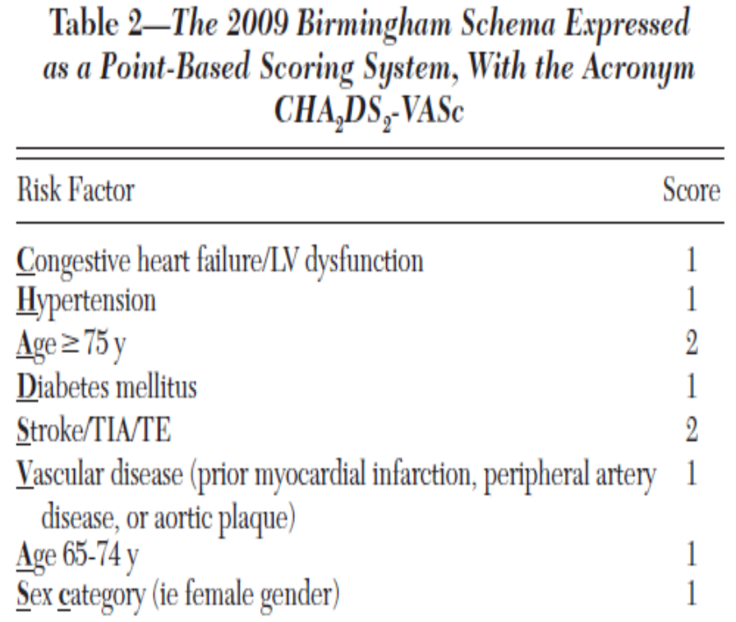
CHA₂DS₂ - VASc
In 2009, the Euro Heart Survey on Atrial Fibrillation set out to:
  Refine this 2006 Birmingham model with creation of CHA₂DS₂ - VASc
  Compare it to the existing schema
Lip et. al. Chest. 2010; 137

Slide 34
CHA₂DS₂ - VASc
High risk =
  Age >75 yo
  Prior CVA
  Combination of 2 other RF’s (HTN, DM, 65-74 yo, female gender, vascular disease)
Intermediate risk =
  1 RF (HTN, DM 65-74 yo, female gender, vascular disease)
Lip et. al. Chest. 2010; 137

Slide 35
CHA₂DS₂ - VASc
 | Low | Interm. | High
CHADS₂ classic % in risk category TE rate | 20.4 1.4% | 61.9 2.4% | 17.7 3.2%
CHADS₂ revised % in risk category TE rate | 20.4 1.4% | 34.9 1.9% | 44.7 3.1%
Birmingham 2009 % in risk category TE rate | 9.2 0% | 15.1 0.6% | 75.7 3.0%
  Take home point: addition of the RF’s in CHA₂DS₂ – VASc improves ability to identify low risk patients
Lip et. al. Chest. 2010; 137

Slide 36
CHA₂DS₂ - VASc
 | C-statistic 95% CI | P value
CHADS₂ classic | 0.561 (0.450 – 0.672) | 0.296
CHADS₂ revised | 0.586 (0.477 – 0.695) | 0.140
Birmingham 2009 | 0.606 (0.513 – 0.699) | 0.070
  However, predictive values for the schemes were modest, and P values not reaching significance
Lip et. al. Chest. 2010; 137

Slide 37
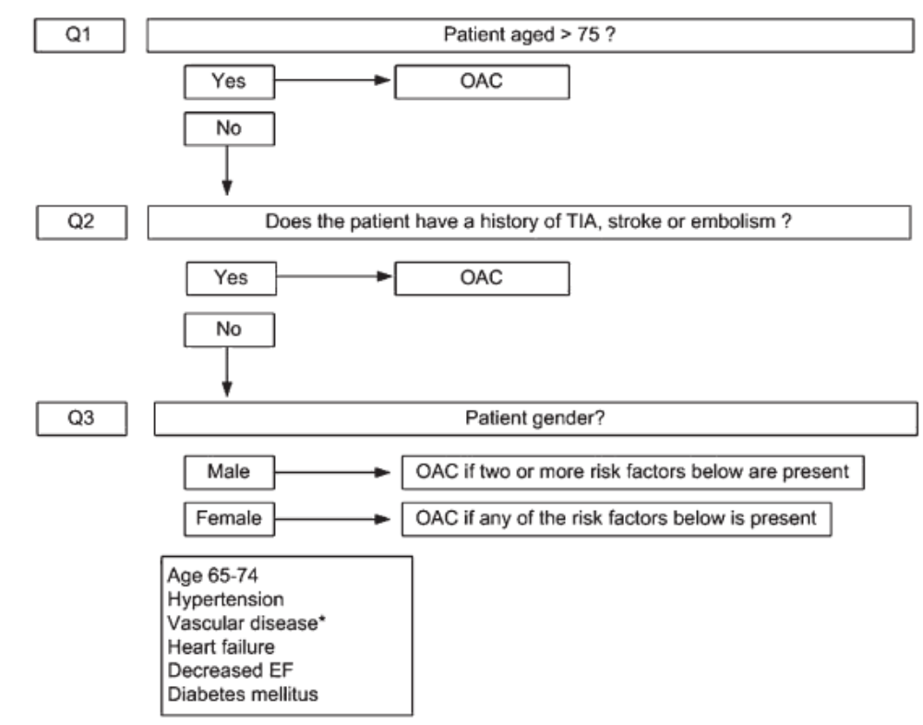
CHA₂DS₂ - VASc
Recommendations: Warfarin definitely for ≥2 (one definitive RF or 2+ combinations RF’s)
If intermediate risk, give Warfarin when possible
Lip et. al. Chest. 2010; 137

Slide 38
Discussion
1. Is there a stroke rate difference between those with paroxysmal vs sustained AFib?
2. Increasing evidence against using Aspirin for “intermediate” risk?

Slide 39
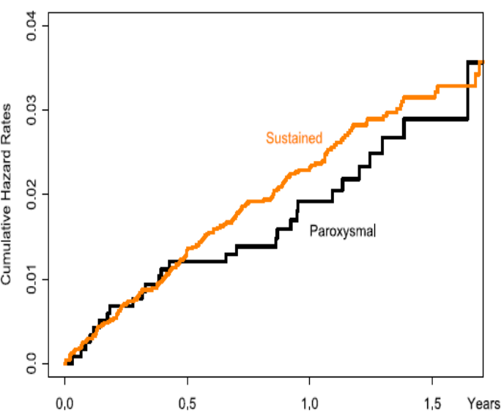
 | Parox. stroke rate | Sustain. stroke rate | RR parox. vs sustained (95% CI) | P value
Overall | 2.0% | 2.2% | 0.87 (0.59-1.3) | 0.496
ASA + Plavix | 2.4% | 3.0% | 0.79 (0.48-1.3) | 0.346
Anti-coag | 1.5% | 1.5% | 1.03 (0.54-1.97) | 0.936
Regarding question 1:
  No differences in crude or adjusted rates of stroke between sustained and paroxysmal
Hohnloser SH et. al. JACC 2007 50(22)

Slide 40
References
1. Atrial fibrillation investigators. Risk factors for stroke and efficacy of antithrombotic therapy in atrial fibrillation: analysis of pooled data from five randomized controlled trials. Arch Intern Med. 1994; 154:1449-1457
2. Atrial fibrillation investigators. The efficacy of aspirin in patients with atrial fibrillation: analysis of pooled data from three randomized trials. Arch Intern Med. 1997;157:1237-1240
3. Lip GY et. al. Atrial fibrillation and stroke prevention. Lancet Neurol. 2007;6(11):981-993
4. Sato H et. al. Japan Atrial Fibrillation Stroke Trial Group. Low-dose aspirin for prevention of stroke in low-risk patients with atrial fibrillation. Stroke. 2006;37(2):447-451
5. Stroke Prevention in Atrial Fibrillation Investigators. Risk factors for thromboembolism during aspirin therapy in patients with atrial fibrillation. J Stroke Cerebrovasc Dis 1995;5:147-157
6. Stroke Prevention in Atrial Fibrillation III Writing Committee. Patients with nonvalvular atrial fibrillation at low risk of stroke during treatment with aspirin. JAMA. 1998;279:1273-1277
7. Stroke Prevention in Atrial Fibrillation Investigators. Predictors of thromboembolism in atrial fibrillation, I: clinical features of patients at risk. Ann Intern Med. 1992; 116:1-5
8. Van Latum JC et. al. Predictors of major vascular events in patients with a transient ischemic attack or minor ischemic stroke and with nonrheumatic atrial fibrillation. Stroke. 1995;26:801-806
9. Stroke Prevention in Atrial Fibrillation Investigators. Predictors of thromboembolism in atrial fibrillation, II: Echocardiographic features of patients at risk. Ann Intern Med. 1992;116:6-12
10. Moulton AW et. al. Risk factors for stroke in patients with nonrheumatic atrial fibrillation: a case-control study. Am J Med. 1991;91:156-161

Slide 41
References
11. www2.sas.com/proceedings/forum2008/143-2008.pdf
12. Lip GY et. al. Refining clinical risk stratification for predicting stroke and thromboembolism an atrial fibrillation using a novel risk factor-based approach. Chest 2010; 132(2): 263-272
13. Stroke risk in atrial fibrillation working group. Comparison of 12 risk stratification schemes to predict stroke in patients with nonvalvular atrial fibrillation. Stroke 2008; 39(5):1901-1910
14. Baruch L. et. al. Can patients at elevated risk of stroke treated with anticoagulants be further risk stratified? Stroke 2007; 38(9):2459-2463
15. Poli D et. al. Stroke risk in atrial fibrillation patients on warfarin. Predictive ability of risk stratification schemes for primary and secondary prevention. Thromb Haemost. 2009;101(2):367-372
16. Lip GY et. al. Additive role of plasma Von Willebrand factor levels to clinical factors for risk stratification of patients with atrial fibrillation. Stroke 2006; 37:2294-2300
17. Fang MC et. al. Comparison of risk stratification schemes to predict thromboemobolism in people with nonvalvular atrial fibrillation. J Am Coll Cardiol. 2008;51(8):810-815
18. Fuster V et. al. ACC/AHA/ESC 2006 guidelines for the management of patients with atrial fibrillation. Europace 2006; 8:651-745
19. Schmitt J et. al. Atrial fibrillation in acute myocardial infarction: a systematic review of the incidence, clinical features, and prognostic implications. Eur Heart J 2009; 30(9):1038-1045
20. Conway DS et. al. Comparison of outcomes of patients with symptomatic peripheral artery disease with and without atrial fibrillation (the West Birmingham Atrial Fibrillation Project). Am J Cardiol 2004; 93(11):1422-1425
21. Siu CW et. al. Transient atrial fibrillation complicating acute inferior myocardial infarction: implications for future risk of ischemic stroke. Chest 2007; 132(1):44-49
22. Lip GY. Coronary artery disease and ischemic stroke in atrial fibrillation. Chest 2007; 132(1):8-10
23. The Stroke Prevention in Atrial Fibrillation Investigators Committee on Echocardiogrpahy. Transesophageal echocardiography correlates of thromboembolism in high-risk patients with nonvalvular atrial fibrillation. Ann Intern Med 1998; 128(8): 639-647
24. Hohnloser SH et. al. Incidence of stroke in paroxysmal versus sustained atrial fibrillation in patients taking oral anticoagulation or combined antiplatelet therapy: an ACTIVE W substudy. JACC 2007; 50(22): 2156-2163

Slide 42
Acknowledgments
Dr. Alfred Buxton
Dr. Gordon Strewler
Dr. Kevin Selby
Chief residents and co-residents

