Slide 1
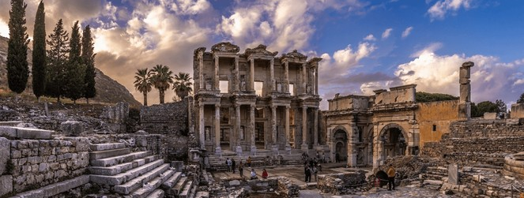
faithful in church Unity Ephesians 4:1-16
Joint Heirs T.E.A.

Slide 2
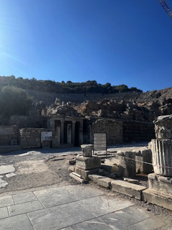
author
The Apostle Paul wrote this letter to the believers in Ephesus while under house arrest in Rome
audience
Ephesians is one of Paul’s “prison epistles” along with Philippians, Colossians, and Philemon, all written around 60-62 AD
purpose
Paul wrote to encourage unity in the early church through a shared commitment to the cause of Christ and service to others

Slide 3
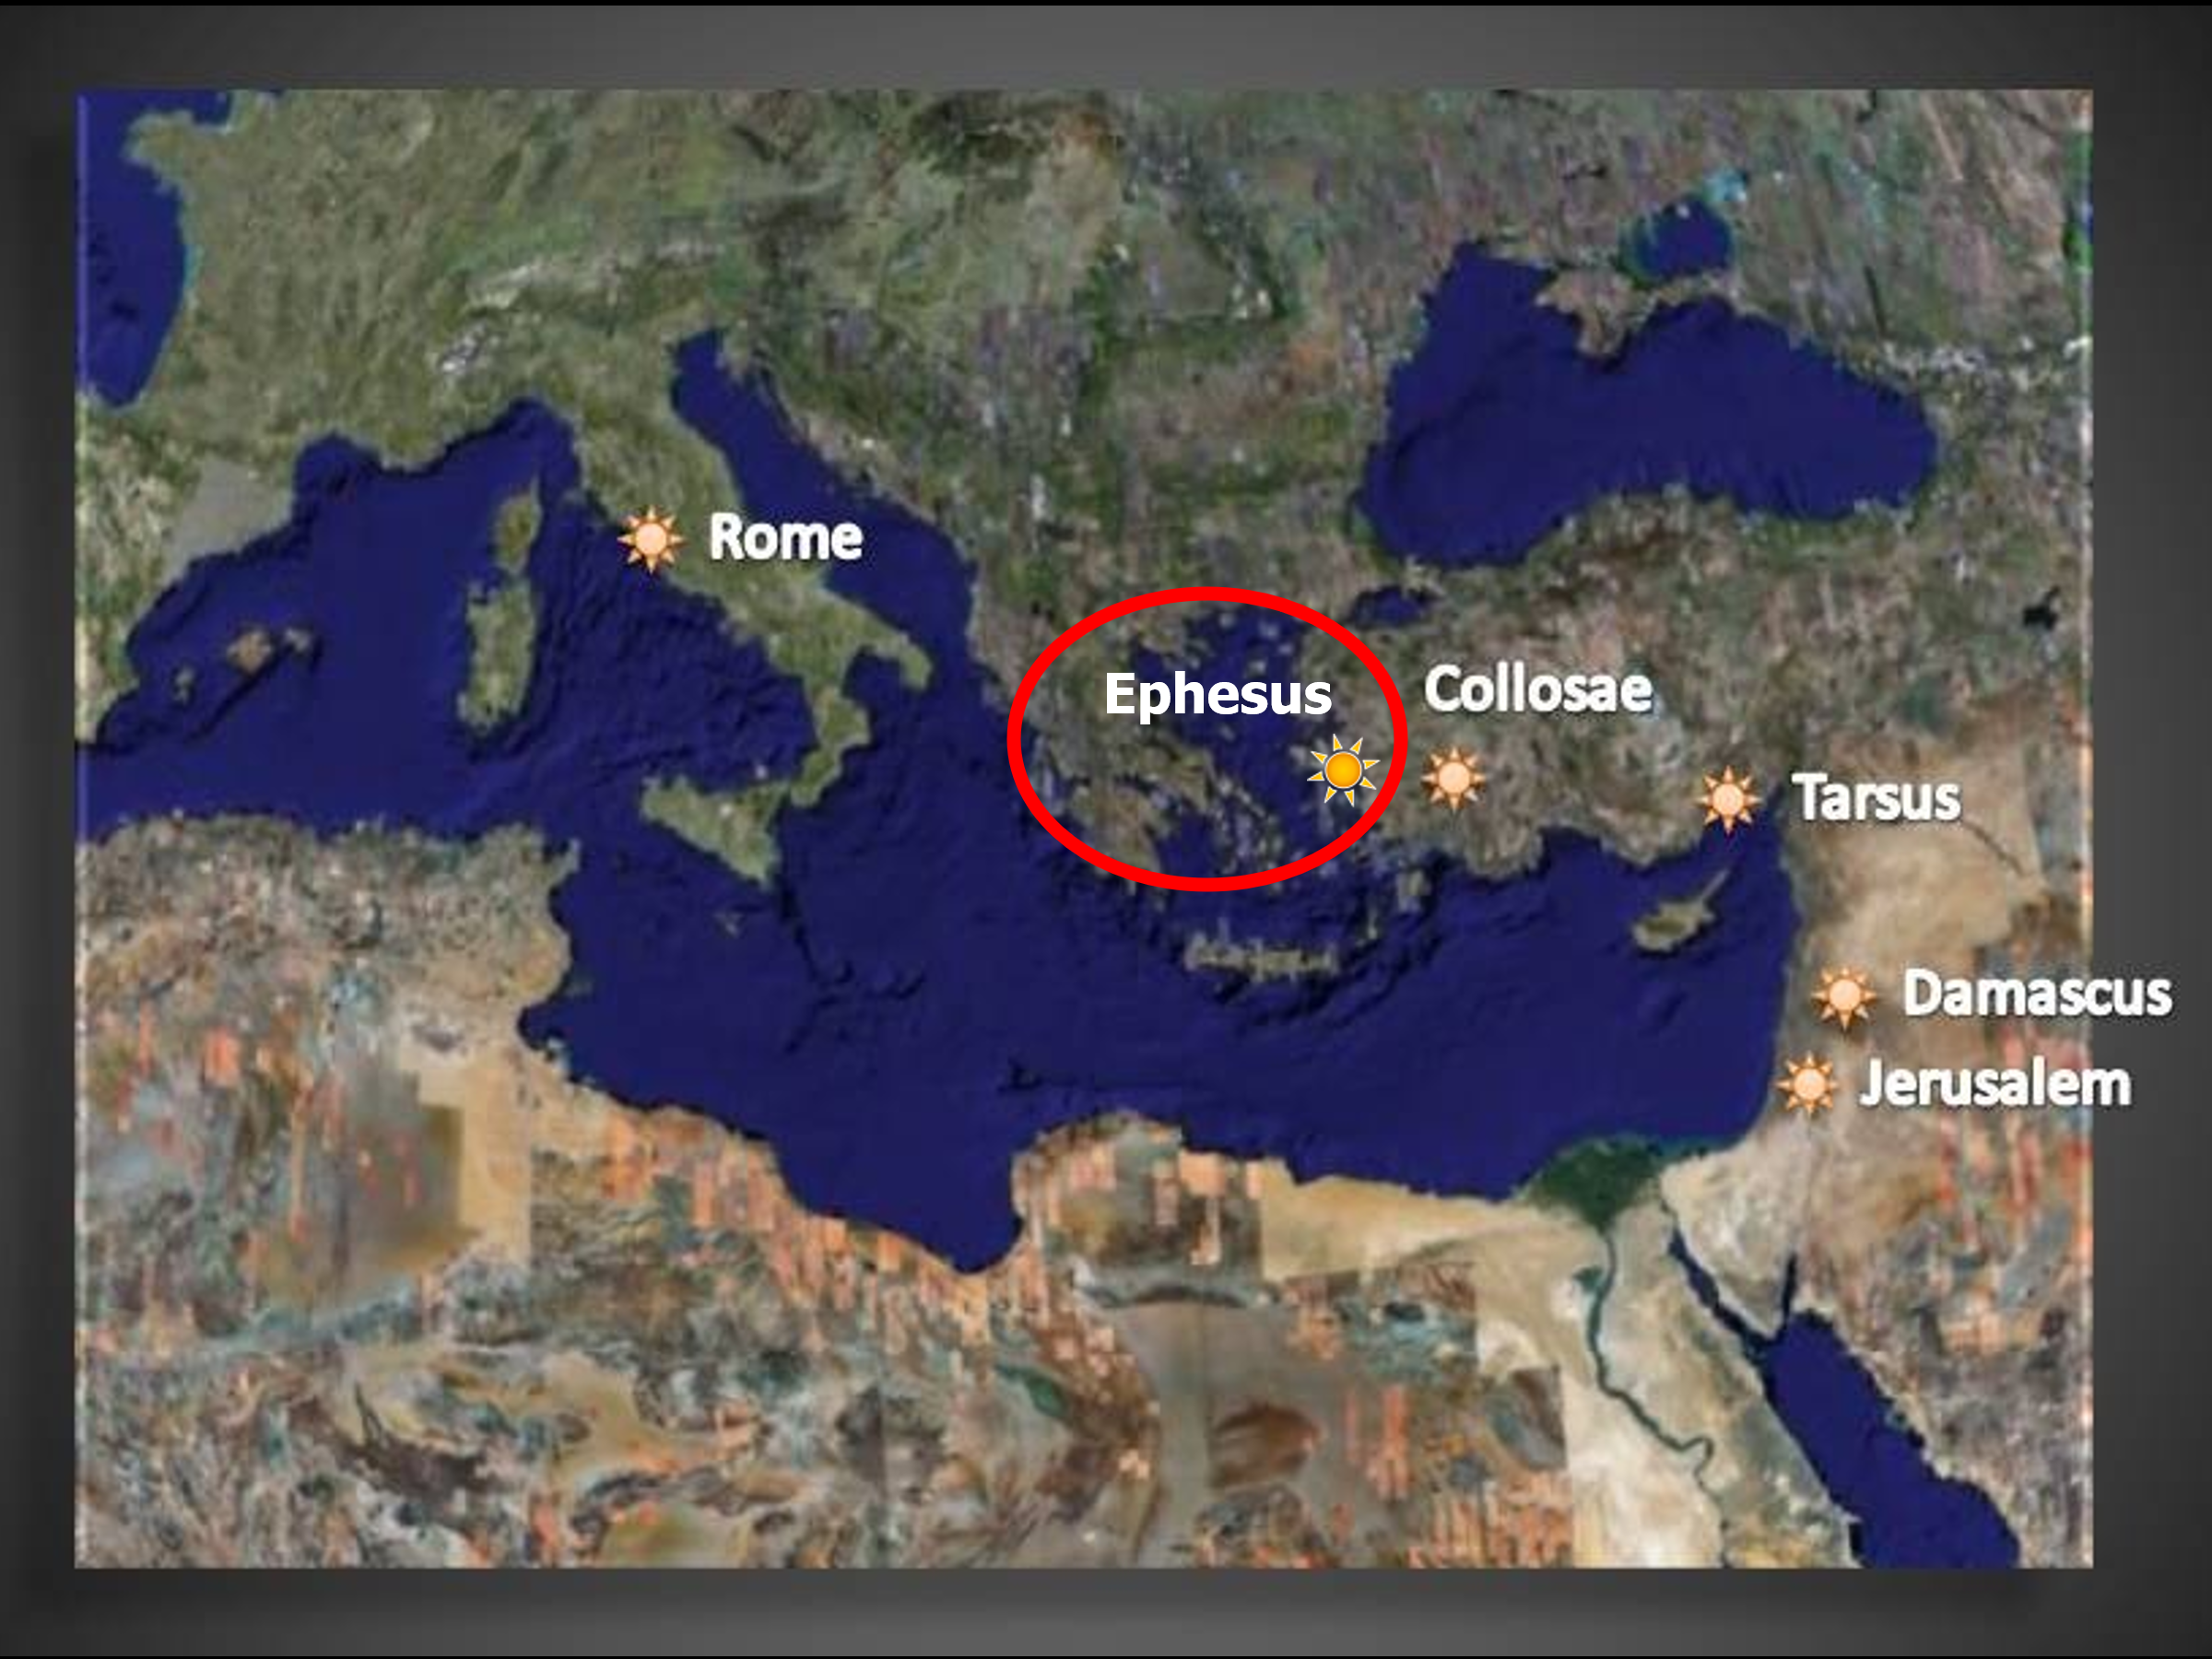

Slide 4
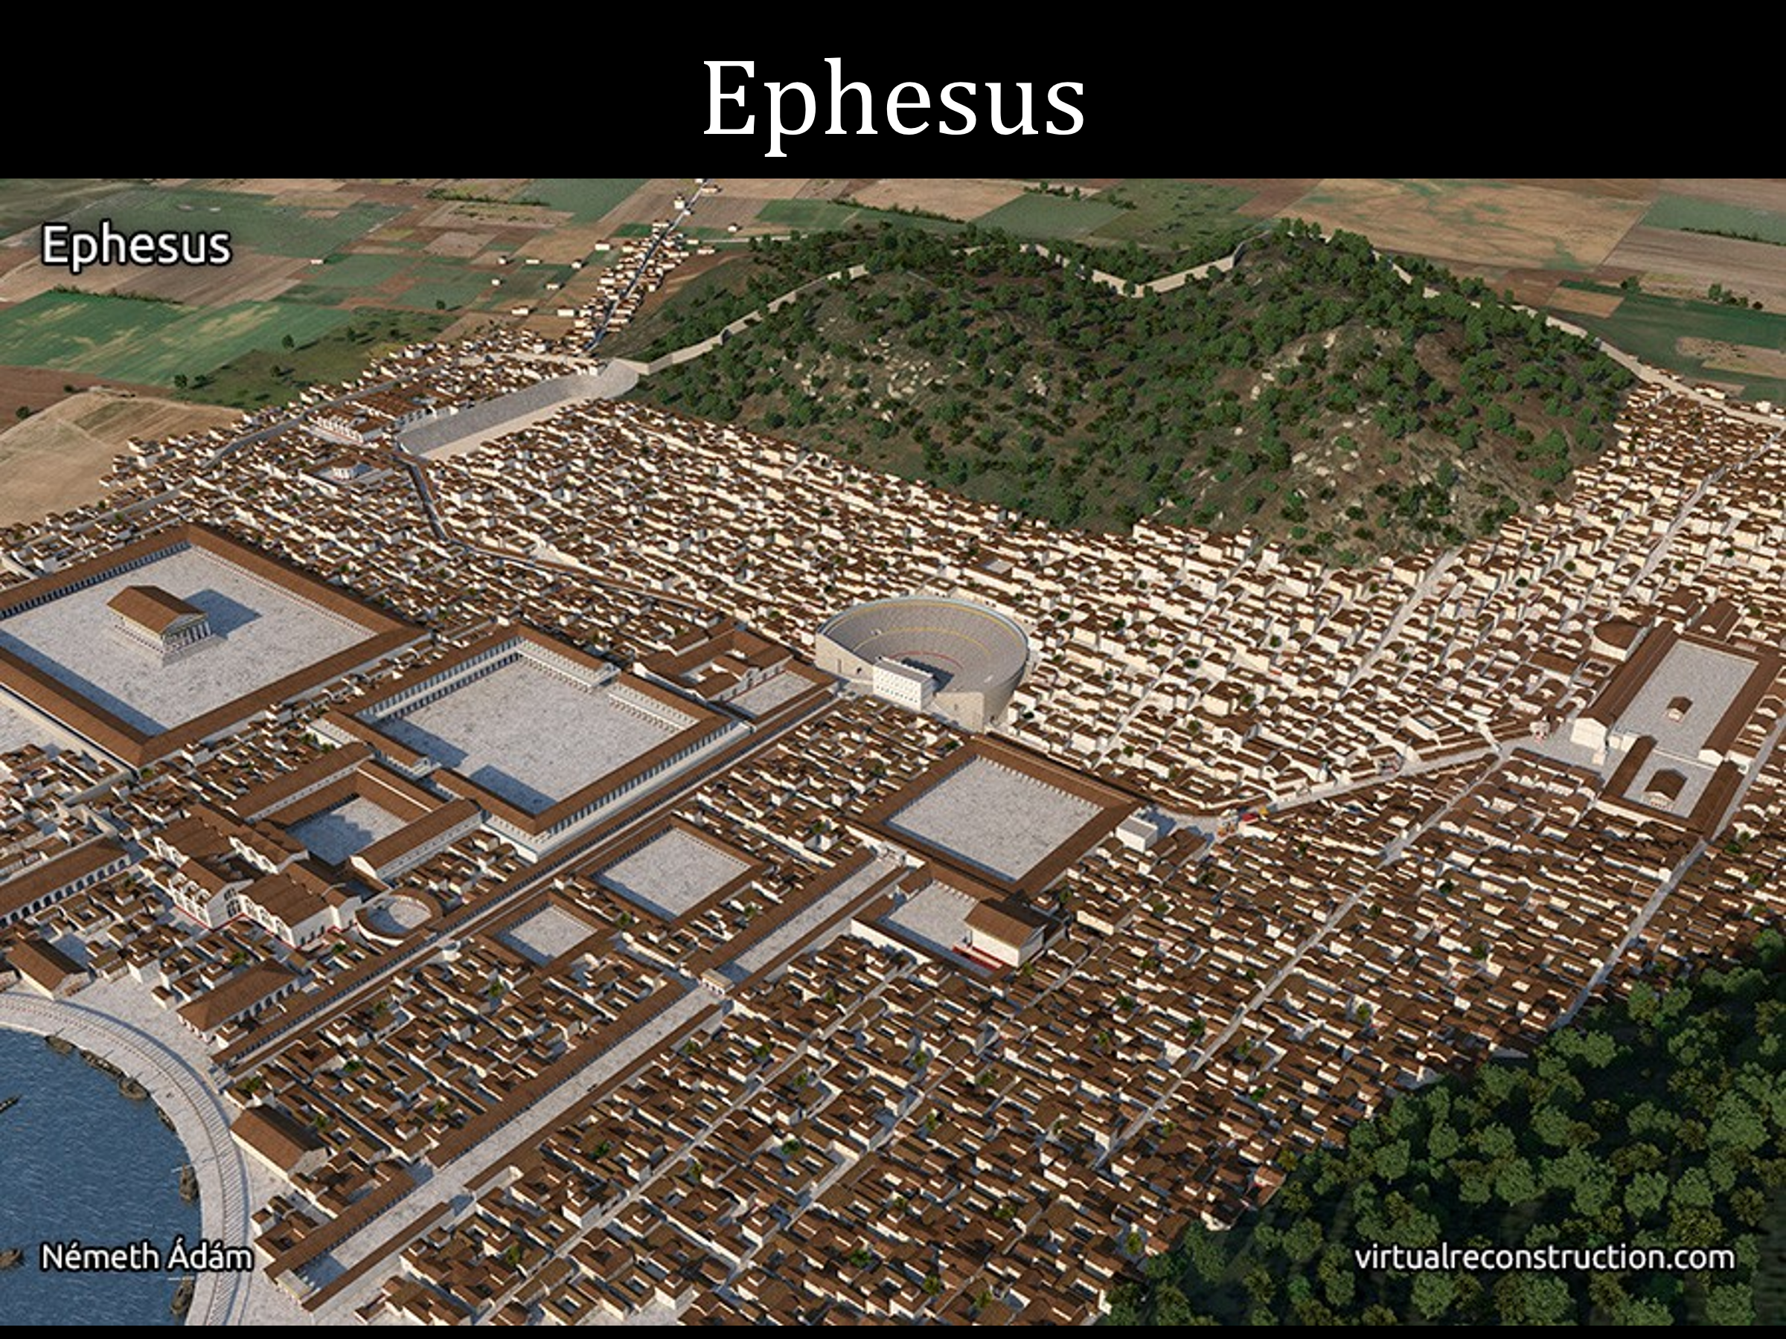

Slide 5
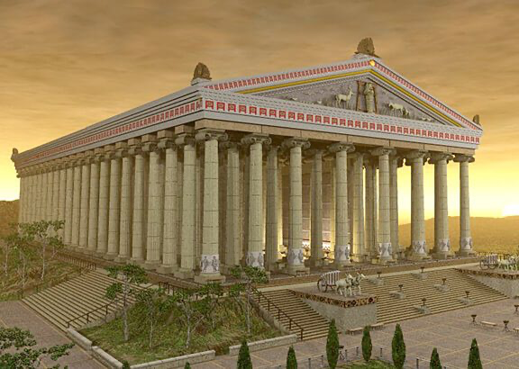

Slide 6
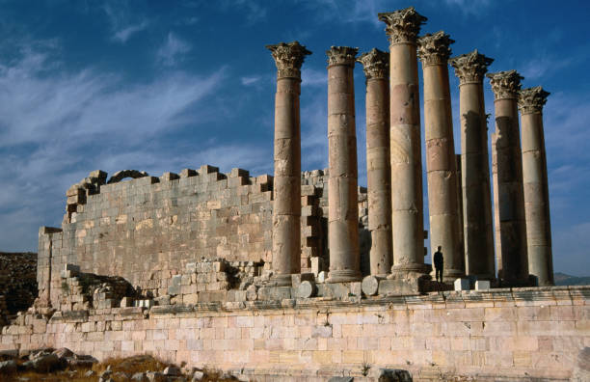

Slide 7
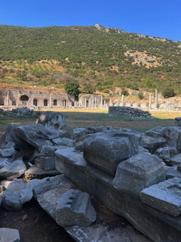

Slide 8
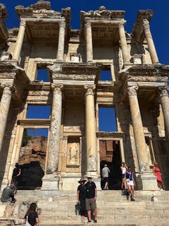

Slide 9
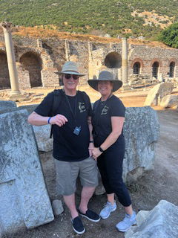

Slide 10
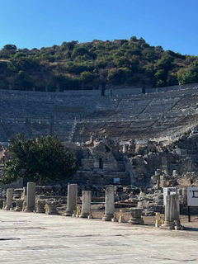

Slide 11


Slide 12
“…early in my time here, about the first year that I was here, I was challenged by the Holy Spirit in my own thinking to teach the book of Ephesians. All that I had ever dreamed a church could be came to crystallization in my mind as I studied Ephesians. It formed, for me, the whole pattern of the church: what it is, how it operates, everything just came together in the study of Ephesians.
John MacArthur

Slide 13
Grace Community Church is a church built on the principles of the book of Ephesians… It’s a book that I absolutely love. I’ve taught it many, many times in other situations, and the riches of this book are unlimited. Really, more than any other book in the Bible, I feel this book was the catalyst that launched Grace Church.
John MacArthur

Slide 14
And, people, if you’re a part of Grace Church, you are a part of something that is indeed unusual… It’s just really an incredible thing, and it isn’t due to one individual; it’s due to the will of God, but it’s due also to an understanding of the principles of the book of Ephesians.”
John MacArthur

Slide 15
Spiritual unity results from one’s devotion to Christ, humble submission to church leaders, and service to others.
Ephesians 4:1-16

Slide 16
Faithful in Church Unity
1. The Basis of Unity in the Church
Ephesians 4:1-6
2. The Behavior of Unity in the Church
Ephesians 4:7-14
3. The Blessings of Unity in the Church
Ephesians 4:15-16

Slide 17
I. The Basis of Unity in the Church 1. Exhortation to Unity – vv. 1-3 2. Expressions of Unity – vv. 4-6
Ephesians 4:1-6

Slide 18
II. The Behavior of Unity in the Church 1. Christ’s Victory – vv. 7-10 2. Unity is Not Uniformity – vv. 11-14
Ephesians 4:7-14

Slide 19
III. The Blessings of Unity in the Church 1. Individual Maturity – v. 15 2. Growth for the Church – v. 16
Ephesians 4:15-16

