Slide 1
2 Corinthians
An Emotional story about a pastor and his former congregation
Notes:
Everybody loves a good story
And the story of 2nd Corinthians does not disappoint
however, because of the sensitive nature of the book
And Paul’s determination to reconcile with an estranged congregation
But his commitment not to say too much about their conflict makes the book a bit difficult to follow
This is why an overview of the whole book is a wise move before you begin studying the book.

Slide 2
A Broad outline:

Slide 3
A Broad outline:
Reconciliation over a conflict (chs. 1-7)

Slide 4
A Broad outline:
Reconciliation over a conflict (chs. 1-7)
Collection for the poor (chs. 8-9)

Slide 5
A Broad outline:
Reconciliation over a conflict (chs. 1-7)
Collection for the poor (chs. 8-9)
Apostolic Authority (Chs. 10-13)

Slide 6
Historical and Geographical Background:

Slide 7
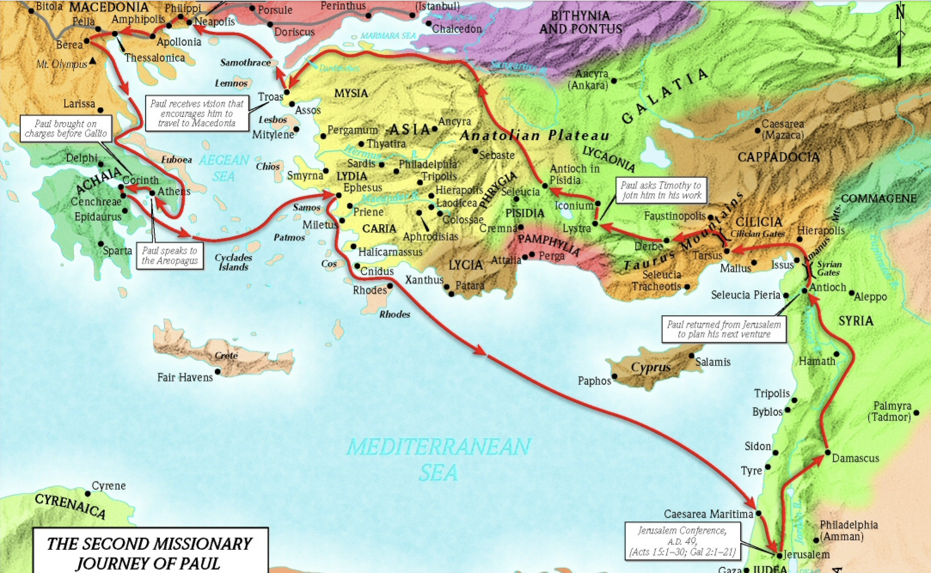
Paul’S SECOND MISSIONARY JOURNEY
Brisco, Thomas V. 1998. Holman Bible Atlas. Holman Reference. Nashville, TN
1:1
Notes:
Paul’s second Missionary Journey began in Antioch

Slide 8
Paul’S SECOND MISSIONARY JOURNEY
Brisco, Thomas V. 1998. Holman Bible Atlas. Holman Reference. Nashville, TN
1:1
Notes:
Paul’s visited the churches in Galatia from his first missionary journey and then headed east to Troas

Slide 9
Paul’S SECOND MISSIONARY JOURNEY
Brisco, Thomas V. 1998. Holman Bible Atlas. Holman Reference. Nashville, TN
1:1
Notes:
Now, I want you to imagine that you are a first century person living in Troas, and you are reading the book of Acts.
Macedonian Call

Slide 10
Paul’S SECOND MISSIONARY JOURNEY
Acts 16:8-9 …and passing by Mysia, they came down to Troas. And a vision appeared to Paul in the night: a man of Macedonia was standing and appealing to him, and saying, “Come over to Macedonia and help us.”
1:1
Notes:
So, poor Troas
The town that was a coulda, woulda, shoulda
We shouldn’t say coulda, woulda, shoulda
God is sovereign,
But one just wonders what might would have happened in Troas, if Paul wouldn’t have been called to macedonia

Slide 11
Paul’S SECOND MISSIONARY JOURNEY
Brisco, Thomas V. 1998. Holman Bible Atlas. Holman Reference. Nashville, TN
1:1
Notes:
So Paul leaves Troas and goes to Macedonia

Slide 12
Paul’S SECOND MISSIONARY JOURNEY
Brisco, Thomas V. 1998. Holman Bible Atlas. Holman Reference. Nashville, TN
1:1
Notes:
Macedonia is just north of Greece
In includes Philipi, Thessalonica, and Berea
After Paul spreads the gospel in Macedonia, he heads down to Corinth

Slide 13
Paul’S SECOND MISSIONARY JOURNEY
Brisco, Thomas V. 1998. Holman Bible Atlas. Holman Reference. Nashville, TN
1:1
Notes:
Let’s zoom in a bit

Slide 14
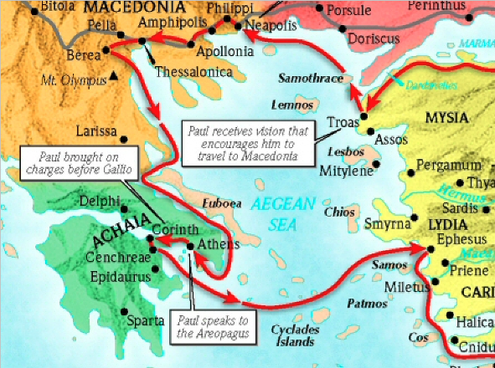
Paul’S SECOND MISSIONARY JOURNEY
Brisco, Thomas V. 1998. Holman Bible Atlas. Holman Reference. Nashville, TN
1:1
Notes:
Notice that Corinth is on a small strip of land inbetween Northern Greece and Southern Greece (isthmus)

Slide 15
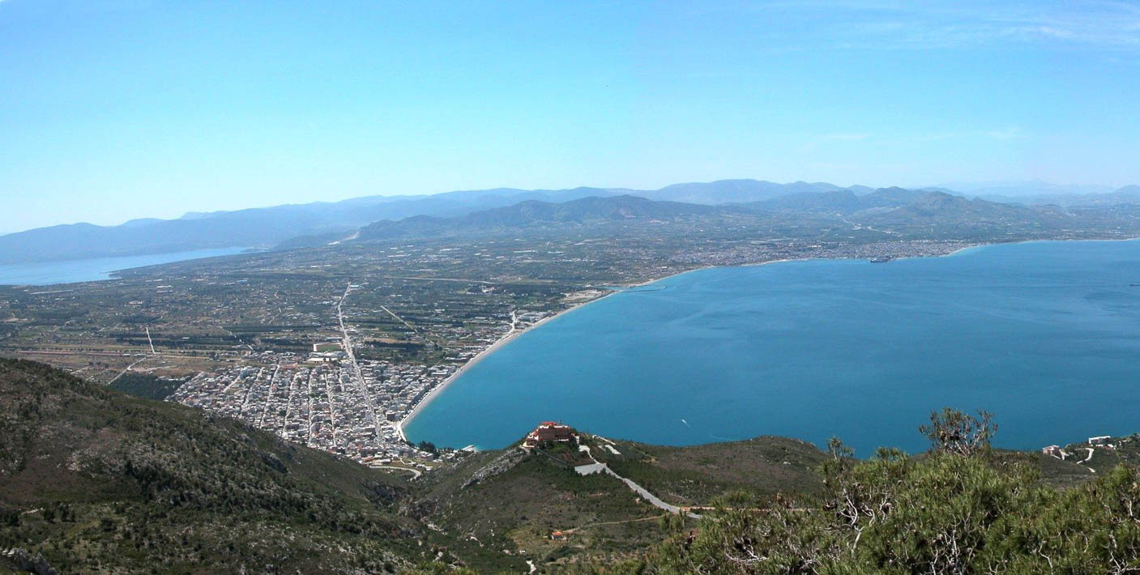
The Grecian Isthmus at Corinth
Corinth
Corinth canal
Gulf of Corinth
Panoramic view of the Gulf of Corinth and isthmus - BiblePlaces.com
1:16
Notes:
This is a modern day photo of that narrow Strip of land
You can see Corinth on the north side of the gulf
And today there is a canal

Slide 16
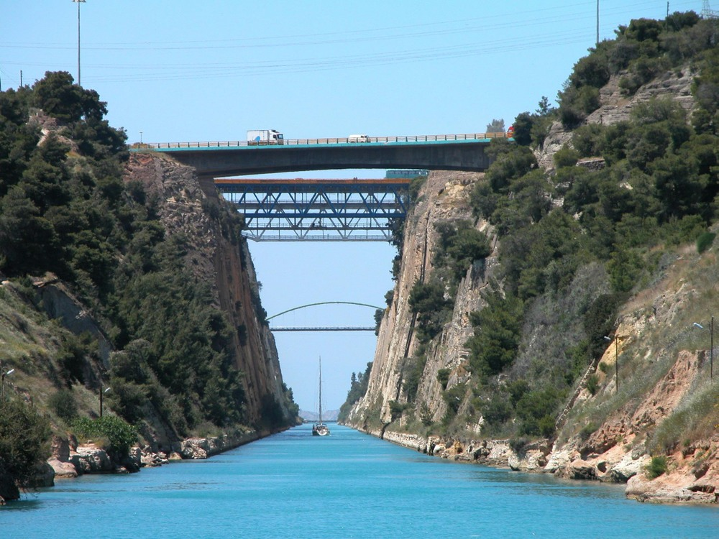
To the church of God which is at Corinth
Corinth Canal (from the east) - BiblePlaces.com
1:2
Notes:
Several rulers in antiquity dreamed of cutting through the Corinthian Isthmus
The emperor Nero was the first to actually attempt to it in AD 67
It wasn’t completed until Ottoman Empire in 1830
it took them eleven years

Slide 17
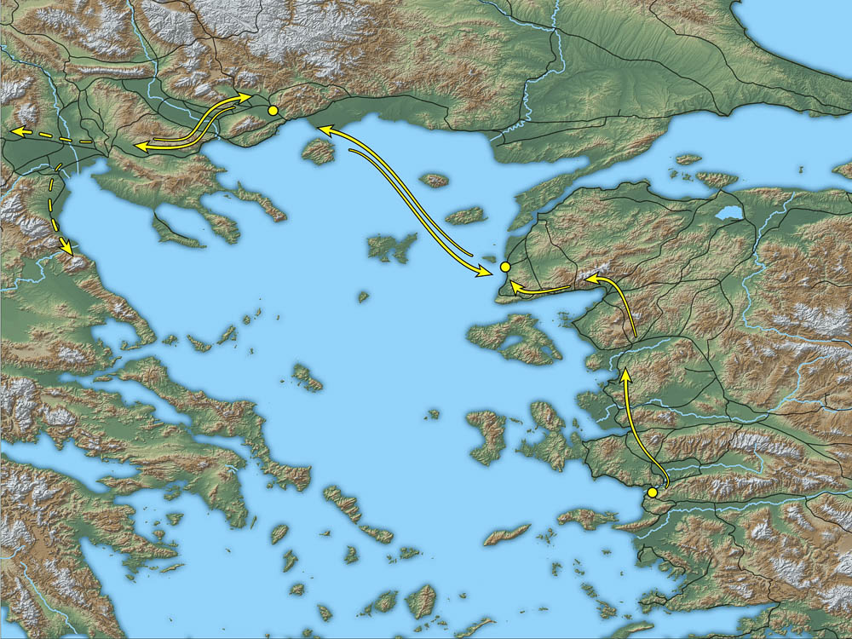
Walking from Ephesus to Corinth – 25-30 days
Philippi
Macedonia
Troas
Greece
Corinth
Ephesus
Brisco, Thomas V. 1998. Holman Bible Atlas. Holman Reference. Nashville, TN
1:1
Notes:
It took about 25-30 days to walk across the Macedonian bridge
Sailing was much faster
(could be as fast as 2-4 days with favorable weather conditions
But it was still dangerous
And because of winter storms
Sailing was usually not an option between November and April
It was just too dangerous

Slide 18
Paul’S SECOND MISSIONARY JOURNEY
Acts 18:8-11
…and many of the Corinthians when they heard were believing and being baptized. And the Lord said to Paul …“Do not be afraid …for I am with you, and no man will lay a hand on you in order to harm you, for I have many people in this city.” And he stayed there a year and six months, teaching the word of God among them.
1:1
Notes:
On Paul’s second missionary journey, he spent 1½ years in Corinth.

Slide 19
Paul’s Correspondence and visits to Corinth
After Paul left Corinth
He wrote to them
1 Corinthians 5:9 - I wrote you in my letter not to associate with sexually immoral people;
hree Sixteen Publishing.
1:1

Slide 20
Paul’s Correspondence and visits to Corinth
After Paul left Corinth
They wrote him back because of a number of issues
They were confused about not associating with immoral people.
1 Corinthians 5:10-11 - I did not at all mean with the sexually immoral people of this world…But …not to associate with any so-called brother if he is a sexually immoral person…
1:1

Slide 21
Paul’s Correspondence and visits to Corinth
After Paul left Corinth
So 1 Corinthians was actually his second letter to them.
1:1

Slide 22
Paul’s Correspondence and visits to Corinth
At the end of 1 Corinthians, Paul said he planned to come and visit them again.
- 1 Corinthians 16:5-6 But I will come to you after I go through Macedonia…and perhaps I will stay with you, or even spend the winter, so that you may send me on my way wherever I may go.
1:1

Slide 23
Paul’s Correspondence and visits to Corinth
At some point, Paul had said he would visit them twice.
- 2 Corinthians 1:15-16 And in this confidence I intended at first to come to you, so that you might receive grace twice; that is, to pass your way into Macedonia, and again from Macedonia to come to you, and by you to be helped on my journey to Judea.
1:1

Slide 24
Paul’s Correspondence and visits to Corinth
And it is clear that part of the conflict was a misunderstanding:
- 2 Corinthians 1:17-18 Therefore, was I vacillating when I intended to do this? Or what I purpose, do I purpose according to the flesh, so that with me there will be yes, yes and no, no at the same time?
But as God is faithful, our word to you is not yes and no.
1:1

Slide 25
Paul’s Correspondence and visits to Corinth
And it is clear that part of the conflict was a misunderstanding:
- 2 Corinthians 1:17-18 Therefore, was I vacillating when I intended to do this? Or what I purpose, do I purpose according to the flesh, so that with me there will be yes, yes and no, no at the same time?
But as God is faithful, our word to you is not yes and no.
1:1

Slide 26
Paul’s Correspondence and visits to Corinth
So why did Paul not come to visit them twice?
1:1

Slide 27
Paul’s Correspondence and visits to Corinth
So why did Paul not come to visit them twice?
- 2 Corinthians 1:23 But I call God as witness to my soul, that to spare you I did not come again to Corinth.
1:1

Slide 28
Paul’s Correspondence and visits to Corinth
What Does Paul mean by “spare you?”
1:1

Slide 29
Paul’s Correspondence and visits to Corinth
What Does Paul mean by “spare you?”
2 Corinthians 13:1-2 This is the third time I am coming to you. By the mouth of two or three witnesses every matter shall be confirmed. I have previously said when present the second time, and though now absent I say in advance to those who have sinned in the past and to all the rest as well, that if I come again I will not spare anyone,
1:1
Notes:
Paul Quotes Deuteronomy 19:15 because he is talking about discipline.
Paul also mentions that he would be coming to see them a third time
- So we know that there was a second visit
- so he did go there a second time, but he obviously didn’t stay long
- and we know why, because they were acting so sinfully towards him
- that he would have had to discipline them if he stayed.
So he decided to leave and write another letter instead.

Slide 30
Paul’s Correspondence and visits to Corinth
2 Corinthians 2:1-3 - But I determined this for my own sake, that I would not come to you again in sorrow. For if I cause you sorrow, who then makes me glad but the one whom I made sorrowful? 3 And this is the very thing I wrote you, so that when I came, I would not have sorrow from those who ought to make me rejoice; having confidence in you all that my joy would be the joy of you all.
1:1

Slide 31
Paul’s Correspondence and visits to Corinth
2 Corinthians 2:4-5 - For out of much affliction and anguish of heart I wrote to you with many tears; not so that you would be made sorrowful, but that you might know the love which I have abundantly for you.
Forgive and Love the Sinner. But if any has caused sorrow, he has caused sorrow not to me, but in some degree—in order not to say too much—to all of you.
1:1

Slide 32
Paul’s Correspondence and visits to Corinth
2 Corinthians 2:6-8 - Sufficient for such a one is this punishment which was inflicted by the majority, so that on the contrary you should rather graciously forgive and comfort him, lest such a one be swallowed up by excessive sorrow. Therefore I encourage you to reaffirm your love for him.
1:1

Slide 33
Paul’s Correspondence and visits to Corinth
2 Corinthians 2:9-11 - For to this end also I wrote, so that I might know your proven character, whether you are obedient in all things. But one whom you graciously forgive anything, I graciously forgive also. For indeed what I have graciously forgiven, if I have graciously forgiven anything, I did it for your sakes in the presence of Christ, so that no advantage would be taken of us by Satan, for we are not ignorant of his schemes.
1:1

Slide 34
Paul’s Correspondence and visits to Corinth
2 Corinthians 2:12-13 - Now when I came to Troas for the gospel of Christ and when a door was opened for me in the Lord, I had no rest for my spirit, not finding Titus my brother. But saying farewell to them, I went on to Macedonia.
1:1

Slide 35
Walking from Ephesus to Corinth – 25-30 days
Philippi
Macedonia
Troas
Greece
Corinth
Ephesus
Brisco, Thomas V. 1998. Holman Bible Atlas. Holman Reference. Nashville, TN
1:1
Notes:
It took about 25-30 days to walk across the Macedonian bridge
Sailing was much faster
(could be as fast as 2-4 days with favorable weather conditions
But it was still dangerous
And because of winter storms
Sailing was usually not an option between November and April
It was just too dangerous

Slide 36
Walking from Ephesus to Corinth – 25-30 days
Philippi
Macedonia
Troas
Greece
Corinth
Ephesus
Brisco, Thomas V. 1998. Holman Bible Atlas. Holman Reference. Nashville, TN
1:1
Notes:
Do you remember Troas
This is the second time, that we know of that Paul visited Troas
First he got the Macedonian Call on his 2nd missionary journey.
Now, Paul is in Ephesus on his 3rd missionary journey
And a door was opened for him in Troas
The little town that coulda, woulda, shoulda
The next time he passes through Troas, Eutichus falls out of a 3rd story window and dies.

Slide 37
Paul’s Correspondence and visits to Corinth
2 Corinthians 2:12-13 - Now when I came to Troas for the gospel of Christ and when a door was opened for me in the Lord, I had no rest for my spirit, not finding Titus my brother. But saying farewell to them, I went on to Macedonia.
1:1
Notes:
Something confusing happens in verse 14
If you are reading this, you lose the story entirely.
Paul says in verse 14.

Slide 38
Paul’s Correspondence and visits to Corinth
2 Corinthians 2:12-13, 14 - Now when I came to Troas for the gospel of Christ and when a door was opened for me in the Lord, I had no rest for my spirit, not finding Titus my brother. But saying farewell to them, I went on to Macedonia. 14 But thanks be to God, who always leads us in triumphal procession in Christ, and manifests through us the aroma of the knowledge of Him in every place.
Sixteen Publishing.
1:1
Notes:
Does your husband ever get distracted.
Paul was telling a story but now he starts talking about what a privilege to be serving Christ in the ministry.

Slide 39
The Ministry:
The Triumph of the Ministry (2:14-17
The Foundation of Ministry (New Covenant) (3:1-18)
The Trials of Ministry (4:1-18)
The Motivation of the Ministry (5:1-21)
The Conduct of the Ministry (6:1-18)
The AFFECTION OF THE MINISTRY (BELIEVERS) 7:1-4)
Notes:
You might be asking, where does this fit into our broad outline?

Slide 40
A Broad outline:
Reconciliation over a conflict (chs. 1-7)
Collection for the poor (chs. 8-9)
Apostolic Authority (Chs. 10-13)

Slide 41
A Broad outline:
Reconciliation over a conflict (chs. 1-7)
(The Great Digression – The Ministry – 2:14-7:4)
(The Ministry’s Triumph, Foundaton,
Trials, Motivation, Conduct, and Affection)
Collection for the poor (chs. 8-9)
Apostolic Authority (Chs. 10-13)
Notes:
Have you ever heard your husband tell a story, and then he digresses to a related subject and it seems forever until he comes back to it?
That is what happens here.

Slide 42
Homer Kent on the Great Digression:
“At this point in the letter (2:13), Paul interrupts the description of his search for Titus, not resuming until 7:5. Nevertheless, the content of this section is pertinent to the discussion, for it reveals paul’s attitude of confidence in God’s leading, even in times of disappointment.”
Notes:
Let’s take a look at the way this book would read without the break between 2:13 and 7:5.

Slide 43
A Broad outline:
Reconciliation over a conflict (chs. 1-7)
(The Great Digression – The Ministry – 2:14-7:4)
(The Ministry’s Triumph, Foundaton,
Trials, Motivation, Conduct, and Affection)
Collection for the poor (chs. 8-9)
Apostolic Authority (Chs. 10-13)
Notes:
Have you ever heard your husband tell a story, and then he digresses to a related subject and it seems forever until he comes back to it?
That is what happens here.

Slide 44
Paul’s Correspondence and visits to Corinth
2 Corinthians 2:12-13 - Now when I came to Troas for the gospel of Christ and when a door was opened for me in the Lord, I had no rest for my spirit, not finding Titus my brother. But saying farewell to them, I went on to Macedonia. Sixteen Publishing.
1:1
Notes:
Does your husband ever get distracted.
Paul was telling a story but now he starts talking about what a privilege to be serving Christ in the ministry.

Slide 45
Paul’s Correspondence and visits to Corinth
2 Corinthians 2:12-13 - Now when I came to Troas for the gospel of Christ and when a door was opened for me in the Lord, I had no rest for my spirit, not finding Titus my brother. But saying farewell to them, I went on to Macedonia. Sixteen Publishing.
2 Corinthians 7:5-6 - For even when we came into Macedonia our flesh had no rest, but we were afflicted on every side … But God, who comforts the humbled, comforted us by the coming of Titus;
1:1
Notes:
So, anyway, back to my story about looking for Titus.

Slide 46
A Beautiful story of Reconcilliation
2 Corinthians 7:8-9 For though I caused you sorrow by my letter, I do not regret it, though I did regret it—for I see that that letter caused you sorrow, though only for a while—I now rejoice, not that you were made sorrowful, but that you were made sorrowful to repentance. For you were made to have godly sorrow, so that you might not suffer loss in anything through us.
1:1
Notes:
We learn here about the difference between Godly repentance and worldly repentance

Slide 47
A Beautiful story of Reconcilliation
2 Corinthians 7:10-11 - For godly sorrow produces a repentance without regret, leading to salvation, but the sorrow of the world brings about death. For behold what earnestness this very thing—this godly sorrow—has brought about in you: what vindication of yourselves, what indignation, what fear, what longing, what zeal, what avenging of wrong! In everything you demonstrated yourselves to be innocent in the matter.
1:1
Notes:
Take a look at the difference between true repentance and false repentance

Slide 48
2 Cor. 7:11 -- Genuine Repentance |  | False
What earnestness | “eagerness” “swiftness of action” – | Slow to act
What vindication | sorrow that defended their heart | Unclear where the heart is at
What Indignation | “anger” over their sin | Hatred of the situation
What Fear | “reverence” they had for the truth | Afraid of exposure
What Longing | “deep desire” they had to be restored | Doesn’t care about reconciling
What Zeal | “devoted” to Paul and had a “deep concern” for him. | Only cares about himself
What Avenging of Wrong | “doing justice” – Making things right. | Desires that things appear to be right

Slide 49
A Broad outline:
Reconciliation over a conflict (chs. 1-7)
(The Great Digression – The Ministry – 2:14-7:4)
(The Ministry’s Triumph, Foundaton,
Trials, Motivation, Conduct, and Affection)
Collection for the poor (chs. 8-9)
Apostolic Authority (Chs. 10-13)
Notes:
A Beautiful story about Reconcilliartion

Slide 50
II. Collection for the Poor (Chs. 8-9):

Slide 51
II. Collection for the Poor (Chs. 8-9):
The Pattern For Giving (8:1-9)

Slide 52
II. Collection for the Poor (Chs. 8-9):
The Pattern For Giving (8:1-9)
The Purpose of Giving (8:10-15)

Slide 53
II. Collection for the Poor (Chs. 8-9):
The Pattern For Giving (8:1-9)
The Purpose of Giving (8:10-15)
The Procedures of Giving (8:16-9:5)

Slide 54
II. Collection for the Poor (Chs. 8-9):
The Pattern For Giving (8:1-9)
The Purpose of Giving (8:10-15)
The Procedures of Giving (8:16-9:5)
The Promise of Giving (9:6-15)
Outline from the MacArthur Study Bible

Slide 55
II. Collection for the Poor (Chs. 8-9):
The Pattern For Giving (8:1-9)
2 Cor. 8:1 Now brothers, we make known to you the grace of God which has been given in the churches of Macedonia, that in a great testing by affliction their abundance of joy and their deep poverty abounded unto the richness of their generosity. For I testify that according to their ability, and beyond their ability, they gave of their own accord, begging us with much urging for the grace of sharing in the ministry to the saints,

Slide 56
II. Collection for the Poor (Chs. 8-9):
The Pattern For Giving (8:1-9)
The Purpose of Giving (8:10-15)
2 Cor. 8:13-14 For this is not for the relief of others and for your affliction, but by way of equality—at this present time your abundance being a supply for their need, so that their abundance also may become a supply for your need, that there may be equality.

Slide 57
II. Collection for the Poor (Chs. 8-9):
The Pattern For Giving (8:1-9)
The Purpose of Giving (8:10-15)
The Procedures of Giving (8:16-9:5)
2 Cor. 9:5 So I regarded it necessary to encourage the brothers that they would go on ahead to you and arrange beforehand your previously promised blessing, so that the same would be ready as a blessing and not as a begrudging obligation.

Slide 58
II. Collection for the Poor (Chs. 8-9):
The Pattern For Giving (8:1-9)
The Purpose of Giving (8:10-15)
The Procedures of Giving (8:16-9:5)
The Promise of Giving (9:6-15)
2 Cor. 9:6 …he who sows sparingly will also reap sparingly, and he who sows with blessing will also reap with blessing.
Outline from the MacArthur Study Bible

Slide 59
A Broad outline:
Reconciliation over a conflict (chs. 1-7)
(The Great Digression – The Ministry – 2:14-7:4)
(The Ministry’s Triumph, Foundaton,
Trials, Motivation, Conduct, and Affection)
Collection for the poor (chs. 8-9)
Apostolic Authority (Chs. 10-13)
Notes:
A Beautiful story about Reconcilliartion

Slide 60
III. Apostolic Authority:
A. Paul’s Classification (10:1-18)
B. Paul’s Conduct (11:1-15)
C. Paul’s Credentials (11:16-13:14)
Notes:
A Beautiful story about Reconcilliartion

Slide 61
III. Apostolic Authority:
A. Paul’s Classification (10:1-18)
2 Cor. 10:9-10 for I do not wish to seem as if I would terrify you by my letters. For they say, “His letters are weighty and strong, but his personal presence is weak and his words contemptible.”
Notes:
A Beautiful story about Reconcilliartion

Slide 62
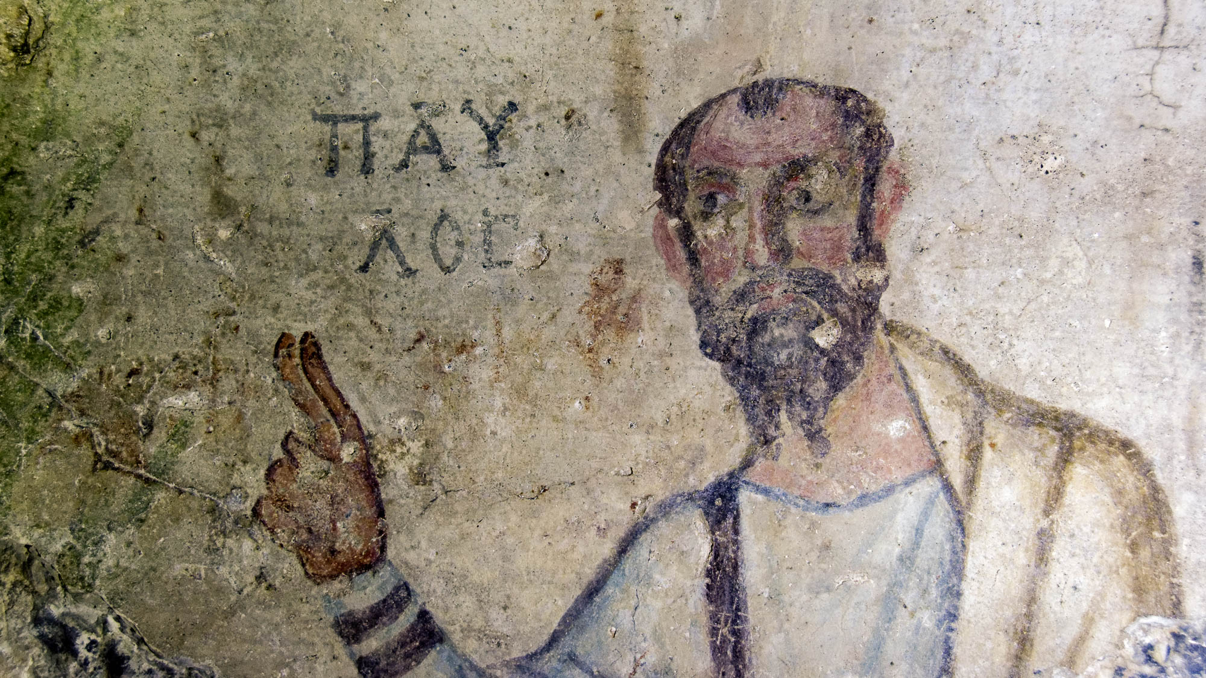
Paul, an apostle of Jesus Christ by the will of God
Painting of Paul from a cave at Ephesus, late 5th or early 6th centuries AD. BiblePlaces.com
1:1
Notes:
This is one of the earliest known depictions of Paul. (late 5th century)
This fresco is located in a cave known as the Grotto of Saint Paul in the foothills on the southern side of ancient Ephesus.
It depicts the apostle with upraised hand, two fingers extended.

Slide 63
A Description of Paul from the 2nd century:
“Paul was a man small of stature with a bald head and crooked legs…with eyebrows meeting and a nose somewhat hooked.”
- The Acts of Paul and Thecla
Notes:
A Beautiful story about Reconcilliartion

Slide 64
Paul, an apostle of Jesus Christ by the will of God
Painting of Paul from a cave at Ephesus, late 5th or early 6th centuries AD. BiblePlaces.com
1:1
Notes:
Maybe he got better looking as he got older.

Slide 65
III. Apostolic Authority:
A. Paul’s Classification (10:1-18)
2 Cor. 10:17-18 But he who boasts is to boast in the Lord. For it is not the one who commends himself that is approved, but the one whom the Lord commends.

Slide 66
III. Apostolic Authority:
A. Paul’s Classification (10:1-18)
B. Paul’s Conduct (11:1-15)
2 Cor. 11:5-6 For I consider myself in no way inferior to the most-eminent apostles. But even if I am unskilled in word, yet I am not so in knowledge; in fact, in every way we have made this evident to you in all things.
Notes:
A Beautiful story about Reconcilliartion

Slide 67
III. Apostolic Authority:
A. Paul’s Classification (10:1-18)
B. Paul’s Conduct (11:1-15)
2 Cor. 11:13-14 For such men are false apostles, deceitful workers, disguising themselves as apostles of Christ. And no wonder, for even Satan disguises himself as an angel of light.
Notes:
A Beautiful story about Reconcilliartion

Slide 68
III. Apostolic Authority:
A. Paul’s Classification (10:1-18)
B. Paul’s Conduct (11:1-15)
C. Paul’s Credentials (11:16-13:14)
2 Cor. 11:21 To my shame I must say that we have been weak by comparison. But in whatever respect anyone else is daring—I speak in foolishness—I am just as daring myself …
Notes:
A Beautiful story about Reconcilliartion

Slide 69
III. Apostolic Authority:
2 Cor. 11:22-25 Are they Hebrews? So am I. Are they Israelites? So am I. Are they Abraham’s seed? So am I. Are they ministers of Christ?—I speak as if insane—I more so; in far more labors, in ^{c}far more imprisonments, in beatings without number, in frequent danger of death. Five times I received from the Jews forty lashes less one. Three times I was beaten with rods, once I was stoned, three times I was shipwrecked—a night and a day I have spent in the deep …
Notes:
A Beautiful story about Reconcilliartion

Slide 70
III. Apostolic Authority:
2 Cor. 11:26-30 I have been on frequent journeys, in dangers from rivers, dangers from robbers, dangers from my countrymen, dangers from the Gentiles, dangers in the city, dangers in the desolate places, dangers on the sea, dangers among false brothers. have been in labor and hardship, in many sleepless nights, in starvation and thirst, often hungry, in cold and without enough clothing. Apart from such external things, there is the daily pressure on me of concern for all the churches. Who is weak without my being weak? Who is made to stumble without my burning concern? If I have to boast, I will boast of what pertains to my weakness.
Notes:
A Beautiful story about Reconcilliartion

Slide 71
A Broad outline:
Reconciliation over a conflict (chs. 1-7)
(The Great Digression – The Ministry – 2:14-7:4)
Collection for the poor (chs. 8-9)
Apostolic Authority (Chs. 10-13)

Slide 72
2 Corinthians
An Emotional story about a pastor and his former congregation
Notes:
Everybody loves a good story
And the story of 2nd Corinthians does not disappoint
however, because of the sensitive nature of the book
And Paul’s determination to reconcile with an estranged congregation
But his commitment not to say too much about their conflict makes the book a bit difficult to follow
This is why an overview of the whole book is a wise move before you begin studying the book.

Slide 73
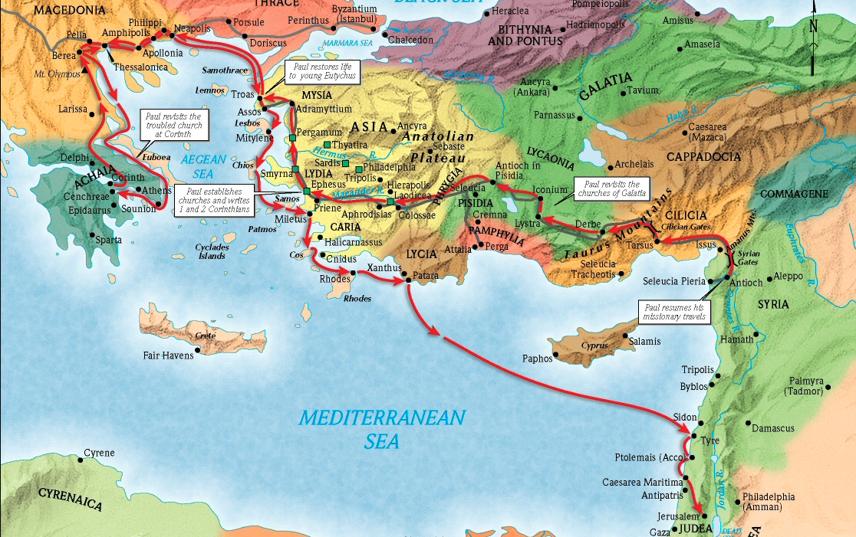
Paul’S third MISSIONARY JOURNEY
Brisco, Thomas V. 1998. Holman Bible Atlas. Holman Reference. Nashville, TN
1:1
Notes:
Regarding the place from which Paul wrote 2 Corinthians, several factors may be noted.
It is apparent from 1 Corinthians 16:5-6 that Paul was planning to leave Ephesus (from which he wrote 1 Corinthians), travel through Macedonia, spend the winter in Corinth (from which he most likely wrote Romans), and then travel back to Jerusalem to deliver the financial gift from the churches he had visited. Paul seems to have written this letter sometime between leaving Ephesus and his arrival at Corinth.
In this letter, Paul recounts how he had looked for Titus in Troas (2 Cor 2:12-13) but later met up with him in Macedonia (2 Cor 7:5-6). It is not specified where exactly in Macedonia they reunited. However, that he found Titus “when” he came to Macedonia (2 Cor 7:6) may indicate that it was at Paul’s landing point in Macedonia, Philippi, or its port city Neapolis. This is the route he had taken previously (Acts 16:8-12), although details are not specified for this particular trip (Acts 20:1-2).
Therefore, it may have been the good news from Corinth brought by Titus when he met Paul at Philippi that prompted the writing of 2 Corinthians. This would make sense of the positive tone of 2 Corinthians 1–9. However, in light of the change in tone in chapters 10–13, some suggest that these chapters were added later in the journey upon receiving further news that the situation at Corinth had once again soured.
See the following slides for photos of the Via Egnatia, Neapolis, and Philippi.
This map was created by A.D. Riddle, RiddleMaps.com. Data sources: Ancient World Mapping Center shapefiles were used for road lines, under Open Database License (ODbL 1.0; http://awmc.unc.edu/wordpress/map-files/). ASTER-GDEM 2 or SRTM data were used to render the terrain (https://asterweb.jpl.nasa.gov/gdem.asp and https://www2.jpl.nasa.gov/srtm/). Natural Earth was used for streams and inland water bodies. Their data have been placed in the public domain. https://www.naturalearthdata.com/about/terms-of-use/.

Slide 74
Paul, an apostle of Jesus Christ by the will of God
Philippi
Macedonia
Troas
Greece
Corinth
Ephesus
Map showing Paul’s route from Ephesus to Macedonia and back
1:1
Notes:
Regarding the place from which Paul wrote 2 Corinthians, several factors may be noted.
It is apparent from 1 Corinthians 16:5-6 that Paul was planning to leave Ephesus (from which he wrote 1 Corinthians), travel through Macedonia, spend the winter in Corinth (from which he most likely wrote Romans), and then travel back to Jerusalem to deliver the financial gift from the churches he had visited. Paul seems to have written this letter sometime between leaving Ephesus and his arrival at Corinth.
In this letter, Paul recounts how he had looked for Titus in Troas (2 Cor 2:12-13) but later met up with him in Macedonia (2 Cor 7:5-6). It is not specified where exactly in Macedonia they reunited. However, that he found Titus “when” he came to Macedonia (2 Cor 7:6) may indicate that it was at Paul’s landing point in Macedonia, Philippi, or its port city Neapolis. This is the route he had taken previously (Acts 16:8-12), although details are not specified for this particular trip (Acts 20:1-2).
Therefore, it may have been the good news from Corinth brought by Titus when he met Paul at Philippi that prompted the writing of 2 Corinthians. This would make sense of the positive tone of 2 Corinthians 1–9. However, in light of the change in tone in chapters 10–13, some suggest that these chapters were added later in the journey upon receiving further news that the situation at Corinth had once again soured.
See the following slides for photos of the Via Egnatia, Neapolis, and Philippi.
This map was created by A.D. Riddle, RiddleMaps.com. Data sources: Ancient World Mapping Center shapefiles were used for road lines, under Open Database License (ODbL 1.0; http://awmc.unc.edu/wordpress/map-files/). ASTER-GDEM 2 or SRTM data were used to render the terrain (https://asterweb.jpl.nasa.gov/gdem.asp and https://www2.jpl.nasa.gov/srtm/). Natural Earth was used for streams and inland water bodies. Their data have been placed in the public domain. https://www.naturalearthdata.com/about/terms-of-use/.

Slide 75
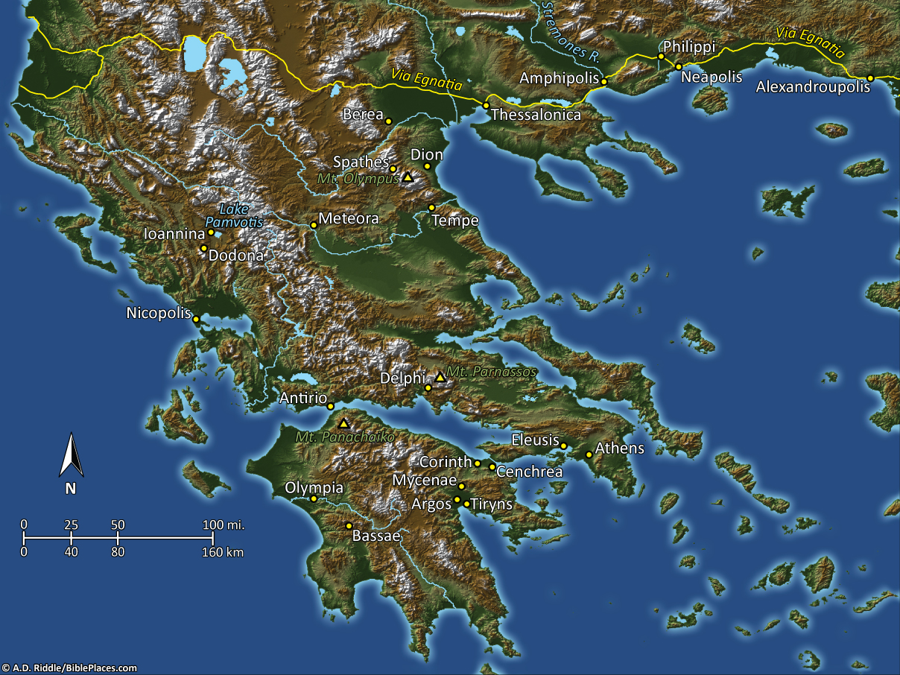
To the church of God which is at Corinth
Map showing Corinth in geographical context
1:1
Notes:
Corinth had a long history as a city even before the time of Paul. Evidence of occupation goes back at least to the 10th century BC. The Dorians founded the Classical city, which was one of the major commercial centers of the ancient world beginning in the 8th century BC. Its importance spanned both the Greek and Roman empires, for it was perfectly situated at the narrowest part of the Isthmus, a level stretch of limestone 4 miles (6.5 km) wide that connected mainland Greece with the southern peninsula (Peloponnesus). Corinth had a port on either side of the Isthmus—Lechaion on the Corinth Gulf and Cenchrea on the Saronic Gulf—and thus controlled the crossroads between the land and seas.
Corinth served as the headquarters for the Greeks during the Persian War. It remained a prominent city but was inferior to Athens. Kypselos and Periander ruled Corinth in the 7th and early 6th centuries BC, and the Macedonians held power in the 4th and 3rd centuries BC. Corinth was a member of the Achaean League during that time, but was defeated in a number of battles during the 4th through 2nd centuries BC.
Occupation of the city came to an end in 146 BC when Corinth was defeated by Rome. Julius Caesar founded a Roman colony here in 44 BC. Most of its citizens were former slaves from Rome, but some businessmen also came. The city grew to economic and cultural prosperity as the capital city of the Roman province of Achaia in the 2nd century AD. It held its own during the attacks of the Herulians in the 3rd century AD, but Alaric took Corinth in AD 396. Earthquakes devastated the city in AD 522 and 551, initiating what was to become a steady decline.
This map was created by A.D. Riddle and comes from the Pictorial Library of Bible Lands, volume 11, Greece.

