Slide 1
Faith Without Fear
Jesus’ Response to Our Anxiety
Ben Trowbridge (btrowbridge@tms.edu)

Slide 2
ANXIETY STATISTICS
359 million diagnosed with anxiety disorder in 2021
Adults 18-29 diagnosed at a higher rate
11% of children ages 3-17 diagnosed in 2022
60% of college counseling cases are due to anxiety
Statistics taken from World Health Organization, Centers for Disease Control, American Psychiatric Association, and Journal for Psychiatric Research websites

Slide 3
WHY DO WE WORRY?
Mental Illness - medical condition that disrupts a person’s thinking, mood or behavior
“Anxiety disorders develop from a complex set of risk factors, including genetics, personality and life events” - ADAA
“Anxiety disorders, like other mental health conditions, result from a complex interaction of social, psychological and biological factors. Anyone can have an anxiety disorder, but people who have lived through abuse, severe losses or other adverse experiences are more likely to develop one.” - W.H.O.

Slide 4
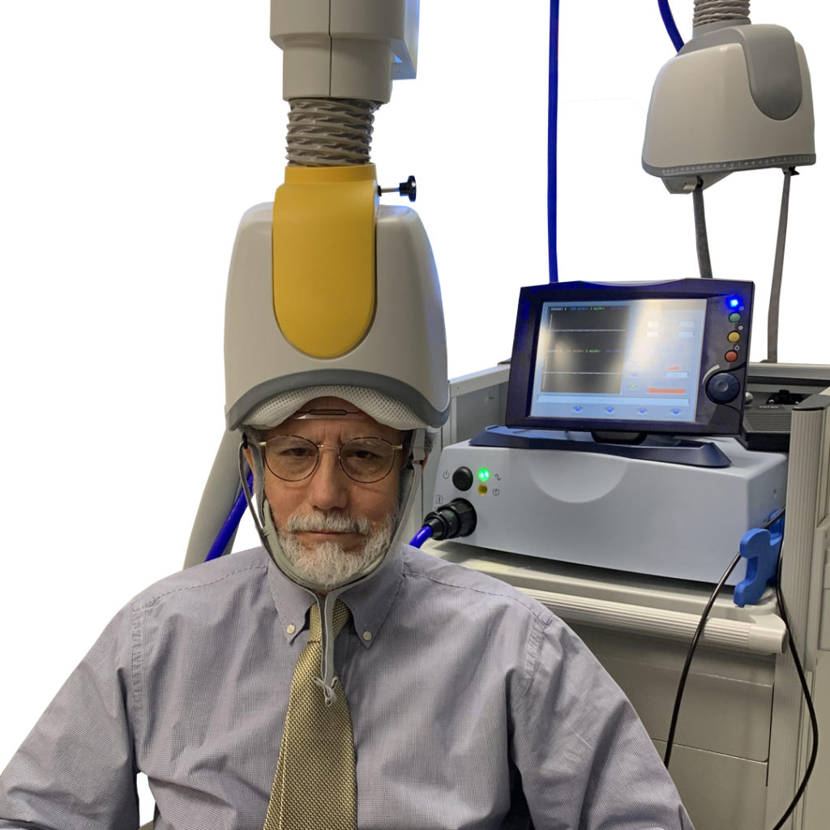

TREATMENTS FOR ANXIETY DISORDERS
Medication (SSRI, SNRI, Benzodiazepines, TCAs)
Theropy
Transcranial Magnetic Stimulation
(TMS)

Slide 5
WORLDS UNDERSTANDING OF ANXIETY
Anxiety is a normal part of life
Anxiety is an illness
Anxiety outside of our control
Anxiety should diagnosed and treated by professionals
Anxiety may never be cured

Slide 6
The Cure for Anxiety
25 “For this reason I say to you, do not be worried about your life, as to what you will eat or what you will drink; nor for your body, as to what you will put on. Is not life more than food, and the body more than clothing?
26 “Look at the birds of the air, that they do not sow, nor reap nor gather into barns, and yet your heavenly Father feeds them. Are you not worth much more than they?
27 “And who of you by being worried can add a single hour to his life?
28 “And why are you worried about clothing? Observe how the lilies of the field grow; they do not toil nor do they spin,
29 yet I say to you that not even Solomon in all his glory clothed himself like one of these.
30 “But if God so clothes the grass of the filed, which is alive today and tomorrow is thrown into the furnace, will He not much more clothe you? You of little faith!
31 “Do not worry then saying, ‘What will we eat?’ Or ‘What will we drink?’ Or ‘What will we wear for clothing?’
32 “For the Gentiles eagerly seek all these things; for your heavenly Father knows that you need all these things.
33 “But seek first His kingdom and His righteousness, and all these things will be added to you.
34 “So do not worry about tomorrow; for tomorrow will care for itself. Each day his enough thought of its own.

Slide 7

The Cure for Anxiety
25 “For this reason I say to you, do not be worried about your life, as to what you will eat or what you will drink; nor for your body, as to what you will put on. Is not life more than food, and the body more than clothing?
26 “Look at the birds of the air, that they do not sow, nor reap nor gather into barns, and yet your heavenly Father feeds them. Are you not worth much more than they?
27 “And who of you by being worried can add a single hour to his life?
28 “And why are you worried about clothing? Observe how the lilies of the field grow; they do not toil nor do they spin,
29 yet I say to you that not even Solomon in all his glory clothed himself like one of these.
30 “But if God so clothes the grass of the filed, which is alive today and tomorrow is thrown into the furnace, will He not much more clothe you? You of little faith!
31 “Do not worry then saying, ‘What will we eat?’ Or ‘What will we drink?’ Or ‘What will we wear for clothing?’
32 “For the Gentiles eagerly seek all these things; for your heavenly Father knows that you need all these things.
33 “But seek first His kingdom and His righteousness, and all these things will be added to you.
34 “So do not worry about tomorrow; for tomorrow will care for itself. Each day his enough thought of its own.

Slide 8
1. GOD’S PROHIBITION ON MY LIFE
The Cure for Anxiety
25 “For this reason I say to you, do not be worried about your life, as to what you will eat or what you will drink; nor for your body, as to what you will put on. Is not life more than food, and the body more than clothing?
26 “Look at the birds of the air, that they do not sow, nor reap nor gather into barns, and yet your heavenly Father feeds them. Are you not worth much more than they?
27 “And who of you by being worried can add a single hour to his life?
28 “And why are you worried about clothing? Observe how the lilies of the field grow; they do not toil nor do they spin,
29 yet I say to you that not even Solomon in all his glory clothed himself like one of these.
30 “But if God so clothes the grass of the filed, which is alive today and tomorrow is thrown into the furnace, will He not much more clothe you? You of little faith!
31 “Do not worry then saying, ‘What will we eat?’ Or ‘What will we drink?’ Or ‘What will we wear for clothing?’
32 “For the Gentiles eagerly seek all these things; for your heavenly Father knows that you need all these things.
33 “But seek first His kingdom and His righteousness, and all these things will be added to you.
34 “So do not worry about tomorrow; for tomorrow will care for itself. Each day his enough thought of its own.

Slide 9
1. GOD’S PROHIBITION ON MY LIFE
The Cure for Anxiety
25 “For this reason I say to you, do not be worried about your life, as to what you will eat or what you will drink; nor for your body, as to what you will put on. Is not life more than food, and the body more than clothing?
26 “Look at the birds of the air, that they do not sow, nor reap nor gather into barns, and yet your heavenly Father feeds them. Are you not worth much more than they?
27 “And who of you by being worried can add a single hour to his life?
28 “And why are you worried about clothing? Observe how the lilies of the field grow; they do not toil nor do they spin,
29 yet I say to you that not even Solomon in all his glory clothed himself like one of these.
30 “But if God so clothes the grass of the filed, which is alive today and tomorrow is thrown into the furnace, will He not much more clothe you? You of little faith!
31 “Do not worry then saying, ‘What will we eat?’ Or ‘What will we drink?’ Or ‘What will we wear for clothing?’
32 “For the Gentiles eagerly seek all these things; for your heavenly Father knows that you need all these things.
33 “But seek first His kingdom and His righteousness, and all these things will be added to you.
34 “So do not worry about tomorrow; for tomorrow will care for itself. Each day his enough thought of its own.

Slide 10
1. GOD’S PROHIBITION ON MY LIFE
The Cure for Anxiety
25 “For this reason I say to you, do not be worried about your life, as to what you will eat or what you will drink; nor for your body, as to what you will put on. Is not life more than food, and the body more than clothing?
26 “Look at the birds of the air, that they do not sow, nor reap nor gather into barns, and yet your heavenly Father feeds them. Are you not worth much more than they?
27 “And who of you by being worried can add a single hour to his life?
28 “And why are you worried about clothing? Observe how the lilies of the field grow; they do not toil nor do they spin,
29 yet I say to you that not even Solomon in all his glory clothed himself like one of these.
30 “But if God so clothes the grass of the filed, which is alive today and tomorrow is thrown into the furnace, will He not much more clothe you? You of little faith!
31 “Do not worry then saying, ‘What will we eat?’ Or ‘What will we drink?’ Or ‘What will we wear for clothing?’
32 “For the Gentiles eagerly seek all these things; for your heavenly Father knows that you need all these things.
33 “But seek first His kingdom and His righteousness, and all these things will be added to you.
34 “So do not worry about tomorrow; for tomorrow will care for itself. Each day his enough thought of its own.

Slide 11
1. GOD’S PROHIBITION ON MY LIFE
The Cure for Anxiety
25 “For this reason I say to you, do not be worried about your life, as to what you will eat or what you will drink; nor for your body, as to what you will put on. Is not life more than food, and the body more than clothing?
26 “Look at the birds of the air, that they do not sow, nor reap nor gather into barns, and yet your heavenly Father feeds them. Are you not worth much more than they?
27 “And who of you by being worried can add a single hour to his life?
28 “And why are you worried about clothing? Observe how the lilies of the field grow; they do not toil nor do they spin,
29 yet I say to you that not even Solomon in all his glory clothed himself like one of these.
30 “But if God so clothes the grass of the filed, which is alive today and tomorrow is thrown into the furnace, will He not much more clothe you? You of little faith!
31 “Do not worry then saying, ‘What will we eat?’ Or ‘What will we drink?’ Or ‘What will we wear for clothing?’
32 “For the Gentiles eagerly seek all these things; for your heavenly Father knows that you need all these things.
33 “But seek first His kingdom and His righteousness, and all these things will be added to you.
34 “So do not worry about tomorrow; for tomorrow will care for itself. Each day his enough thought of its own.

Slide 12
1. GOD’S PROHIBITION ON MY LIFE
Anxiety is not an illness
Anxiety is within our control
Anxiety doesn’t require outside intervention
God doesn’t want us to be anxious

Slide 13
1. GOD’S PROHIBITION ON MY LIFE
The Cure for Anxiety
25 “For this reason I say to you, do not be worried about your life, as to what you will eat or what you will drink; nor for your body, as to what you will put on. Is not life more than food, and the body more than clothing?
26 “Look at the birds of the air, that they do not sow, nor reap nor gather into barns, and yet your heavenly Father feeds them. Are you not worth much more than they?
27 “And who of you by being worried can add a single hour to his life?
28 “And why are you worried about clothing? Observe how the lilies of the field grow; they do not toil nor do they spin,
29 yet I say to you that not even Solomon in all his glory clothed himself like one of these.
30 “But if God so clothes the grass of the filed, which is alive today and tomorrow is thrown into the furnace, will He not much more clothe you? You of little faith!
31 “Do not worry then saying, ‘What will we eat?’ Or ‘What will we drink?’ Or ‘What will we wear for clothing?’
32 “For the Gentiles eagerly seek all these things; for your heavenly Father knows that you need all these things.
33 “But seek first His kingdom and His righteousness, and all these things will be added to you.
34 “So do not worry about tomorrow; for tomorrow will care for itself. Each day his enough thought of its own.

Slide 14
2. GOD’S POWER OVER MY LIFE
2. GOD’S POWER OVER MY LIFE
The Cure for Anxiety
25 “For this reason I say to you, do not be worried about your life, as to what you will eat or what you will drink; nor for your body, as to what you will put on. Is not life more than food, and the body more than clothing?
26 “Look at the birds of the air, that they do not sow, nor reap nor gather into barns, and yet your heavenly Father feeds them. Are you not worth much more than they?
27 “And who of you by being worried can add a single hour to his life?
28 “And why are you worried about clothing? Observe how the lilies of the field grow; they do not toil nor do they spin,
29 yet I say to you that not even Solomon in all his glory clothed himself like one of these.
30 “But if God so clothes the grass of the filed, which is alive today and tomorrow is thrown into the furnace, will He not much more clothe you? You of little faith!
31 “Do not worry then saying, ‘What will we eat?’ Or ‘What will we drink?’ Or ‘What will we wear for clothing?’
32 “For the Gentiles eagerly seek all these things; for your heavenly Father knows that you need all these things.
33 “But seek first His kingdom and His righteousness, and all these things will be added to you.
34 “So do not worry about tomorrow; for tomorrow will care for itself. Each day his enough thought of its own.

Slide 15
2. GOD’S POWER OVER MY LIFE
The Cure for Anxiety
25 “For this reason I say to you, do not be worried about your life, as to what you will eat or what you will drink; nor for your body, as to what you will put on. Is not life more than food, and the body more than clothing?
26 “Look at the birds of the air, that they do not sow, nor reap nor gather into barns, and yet your heavenly Father feeds them. Are you not worth much more than they?
27 “And who of you by being worried can add a single hour to his life?
28 “And why are you worried about clothing? Observe how the lilies of the field grow; they do not toil nor do they spin,
29 yet I say to you that not even Solomon in all his glory clothed himself like one of these.
30 “But if God so clothes the grass of the filed, which is alive today and tomorrow is thrown into the furnace, will He not much more clothe you? You of little faith!
31 “Do not worry then saying, ‘What will we eat?’ Or ‘What will we drink?’ Or ‘What will we wear for clothing?’
32 “For the Gentiles eagerly seek all these things; for your heavenly Father knows that you need all these things.
33 “But seek first His kingdom and His righteousness, and all these things will be added to you.
34 “So do not worry about tomorrow; for tomorrow will care for itself. Each day his enough thought of its own.

Slide 16
3. GOD’S PROVISION IN MY LIFE
The Cure for Anxiety
25 “For this reason I say to you, do not be worried about your life, as to what you will eat or what you will drink; nor for your body, as to what you will put on. Is not life more than food, and the body more than clothing?
26 “Look at the birds of the air, that they do not sow, nor reap nor gather into barns, and yet your heavenly Father feeds them. Are you not worth much more than they?
27 “And who of you by being worried can add a single hour to his life?
28 “And why are you worried about clothing? Observe how the lilies of the field grow; they do not toil nor do they spin,
29 yet I say to you that not even Solomon in all his glory clothed himself like one of these.
30 “But if God so clothes the grass of the filed, which is alive today and tomorrow is thrown into the furnace, will He not much more clothe you? You of little faith!
31 “Do not worry then saying, ‘What will we eat?’ Or ‘What will we drink?’ Or ‘What will we wear for clothing?’
32 “For the Gentiles eagerly seek all these things; for your heavenly Father knows that you need all these things.
33 “But seek first His kingdom and His righteousness, and all these things will be added to you.
34 “So do not worry about tomorrow; for tomorrow will care for itself. Each day his enough thought of its own.

Slide 17
4. GOD’S PREDETERMINATION OF MY LIFE
The Cure for Anxiety
25 “For this reason I say to you, do not be worried about your life, as to what you will eat or what you will drink; nor for your body, as to what you will put on. Is not life more than food, and the body more than clothing?
26 “Look at the birds of the air, that they do not sow, nor reap nor gather into barns, and yet your heavenly Father feeds them. Are you not worth much more than they?
27 “And who of you by being worried can add a single hour to his life?
28 “And why are you worried about clothing? Observe how the lilies of the field grow; they do not toil nor do they spin,
29 yet I say to you that not even Solomon in all his glory clothed himself like one of these.
30 “But if God so clothes the grass of the filed, which is alive today and tomorrow is thrown into the furnace, will He not much more clothe you? You of little faith!
31 “Do not worry then saying, ‘What will we eat?’ Or ‘What will we drink?’ Or ‘What will we wear for clothing?’
32 “For the Gentiles eagerly seek all these things; for your heavenly Father knows that you need all these things.
33 “But seek first His kingdom and His righteousness, and all these things will be added to you.
34 “So do not worry about tomorrow; for tomorrow will care for itself. Each day his enough thought of its own.
The Cure for Anxiety
25 “For this reason I say to you, do not be worried about your life, as to what you will eat or what you will drink; nor for your body, as to what you will put on. Is not life more than food, and the body more than clothing?
26 “Look at the birds of the air, that they do not sow, nor reap nor gather into barns, and yet your heavenly Father feeds them. Are you not worth much more than they?
27 “And who of you by being worried can add a single hour to his life?
28 “And why are you worried about clothing? Observe how the lilies of the field grow; they do not toil nor do they spin,
29 yet I say to you that not even Solomon in all his glory clothed himself like one of these.
30 “But if God so clothes the grass of the filed, which is alive today and tomorrow is thrown into the furnace, will He not much more clothe you? You of little faith!
31 “Do not worry then saying, ‘What will we eat?’ Or ‘What will we drink?’ Or ‘What will we wear for clothing?’
32 “For the Gentiles eagerly seek all these things; for your heavenly Father knows that you need all these things.
33 “But seek first His kingdom and His righteousness, and all these things will be added to you.
34 “So do not worry about tomorrow; for tomorrow will care for itself. Each day his enough thought of its own.

Slide 18
4. GOD’S PREDETERMINATION OF MY LIFE
The Cure for Anxiety
25 “For this reason I say to you, do not be worried about your life, as to what you will eat or what you will drink; nor for your body, as to what you will put on. Is not life more than food, and the body more than clothing?
26 “Look at the birds of the air, that they do not sow, nor reap nor gather into barns, and yet your heavenly Father feeds them. Are you not worth much more than they?
27 “And who of you by being worried can add a single hour to his life?
28 “And why are you worried about clothing? Observe how the lilies of the field grow; they do not toil nor do they spin,
29 yet I say to you that not even Solomon in all his glory clothed himself like one of these.
30 “But if God so clothes the grass of the filed, which is alive today and tomorrow is thrown into the furnace, will He not much more clothe you? You of little faith!
31 “Do not worry then saying, ‘What will we eat?’ Or ‘What will we drink?’ Or ‘What will we wear for clothing?’
32 “For the Gentiles eagerly seek all these things; for your heavenly Father knows that you need all these things.
33 “But seek first His kingdom and His righteousness, and all these things will be added to you.
34 “So do not worry about tomorrow; for tomorrow will care for itself. Each day his enough thought of its own.
The Cure for Anxiety
25 “For this reason I say to you, do not be worried about your life, as to what you will eat or what you will drink; nor for your body, as to what you will put on. Is not life more than food, and the body more than clothing?
26 “Look at the birds of the air, that they do not sow, nor reap nor gather into barns, and yet your heavenly Father feeds them. Are you not worth much more than they?
27 “And who of you by being worried can add a single hour to his life?
28 “And why are you worried about clothing? Observe how the lilies of the field grow; they do not toil nor do they spin,
29 yet I say to you that not even Solomon in all his glory clothed himself like one of these.
30 “But if God so clothes the grass of the filed, which is alive today and tomorrow is thrown into the furnace, will He not much more clothe you? You of little faith!
31 “Do not worry then saying, ‘What will we eat?’ Or ‘What will we drink?’ Or ‘What will we wear for clothing?’
32 “For the Gentiles eagerly seek all these things; for your heavenly Father knows that you need all these things.
33 “But seek first His kingdom and His righteousness, and all these things will be added to you.
34 “So do not worry about tomorrow; for tomorrow will care for itself. Each day his enough thought of its own.

Slide 19
4. GOD’S PREDETERMINATION OF MY LIFE
[man’s] days are determined, the number of his months is with you; And his limits You have set so that he cannot pass - Job 14:5
Your eyes have seen my unformed substance; And in Your book were all written the days that were ordained for me, When as yet there was not one of them - Psalm 139:16

Slide 20
4. GOD’S PREDETERMINATION OF MY LIFE
The Cure for Anxiety
25 “For this reason I say to you, do not be worried about your life, as to what you will eat or what you will drink; nor for your body, as to what you will put on. Is not life more than food, and the body more than clothing?
26 “Look at the birds of the air, that they do not sow, nor reap nor gather into barns, and yet your heavenly Father feeds them. Are you not worth much more than they?
27 “And who of you by being worried can add a single hour to his life?
28 “And why are you worried about clothing? Observe how the lilies of the field grow; they do not toil nor do they spin,
29 yet I say to you that not even Solomon in all his glory clothed himself like one of these.
30 “But if God so clothes the grass of the filed, which is alive today and tomorrow is thrown into the furnace, will He not much more clothe you? You of little faith!
31 “Do not worry then saying, ‘What will we eat?’ Or ‘What will we drink?’ Or ‘What will we wear for clothing?’
32 “For the Gentiles eagerly seek all these things; for your heavenly Father knows that you need all these things.
33 “But seek first His kingdom and His righteousness, and all these things will be added to you.
34 “So do not worry about tomorrow; for tomorrow will care for itself. Each day his enough thought of its own.
The Cure for Anxiety
25 “For this reason I say to you, do not be worried about your life, as to what you will eat or what you will drink; nor for your body, as to what you will put on. Is not life more than food, and the body more than clothing?
26 “Look at the birds of the air, that they do not sow, nor reap nor gather into barns, and yet your heavenly Father feeds them. Are you not worth much more than they?
27 “And who of you by being worried can add a single hour to his life?
28 “And why are you worried about clothing? Observe how the lilies of the field grow; they do not toil nor do they spin,
29 yet I say to you that not even Solomon in all his glory clothed himself like one of these.
30 “But if God so clothes the grass of the filed, which is alive today and tomorrow is thrown into the furnace, will He not much more clothe you? You of little faith!
31 “Do not worry then saying, ‘What will we eat?’ Or ‘What will we drink?’ Or ‘What will we wear for clothing?’
32 “For the Gentiles eagerly seek all these things; for your heavenly Father knows that you need all these things.
33 “But seek first His kingdom and His righteousness, and all these things will be added to you.
34 “So do not worry about tomorrow; for tomorrow will care for itself. Each day his enough thought of its own.

Slide 21
The Cure for Anxiety
25 “For this reason I say to you, do not be worried about your life, as to what you will eat or what you will drink; nor for your body, as to what you will put on. Is not life more than food, and the body more than clothing?
26 “Look at the birds of the air, that they do not sow, nor reap nor gather into barns, and yet your heavenly Father feeds them. Are you not worth much more than they?
27 “And who of you by being worried can add a single hour to his life?
28 “And why are you worried about clothing? Observe how the lilies of the field grow; they do not toil nor do they spin,
29 yet I say to you that not even Solomon in all his glory clothed himself like one of these.
30 “But if God so clothes the grass of the filed, which is alive today and tomorrow is thrown into the furnace, will He not much more clothe you? You of little faith!
31 “Do not worry then saying, ‘What will we eat?’ Or ‘What will we drink?’ Or ‘What will we wear for clothing?’
32 “For the Gentiles eagerly seek all these things; for your heavenly Father knows that you need all these things.
33 “But seek first His kingdom and His righteousness, and all these things will be added to you.
34 “So do not worry about tomorrow; for tomorrow will care for itself. Each day his enough thought of its own.
5. GOD’S PURPOSE FOR MY LIFE

Slide 22
The Cure for Anxiety
25 “For this reason I say to you, do not be worried about your life, as to what you will eat or what you will drink; nor for your body, as to what you will put on. Is not life more than food, and the body more than clothing?
26 “Look at the birds of the air, that they do not sow, nor reap nor gather into barns, and yet your heavenly Father feeds them. Are you not worth much more than they?
27 “And who of you by being worried can add a single hour to his life?
28 “And why are you worried about clothing? Observe how the lilies of the field grow; they do not toil nor do they spin,
29 yet I say to you that not even Solomon in all his glory clothed himself like one of these.
30 “But if God so clothes the grass of the filed, which is alive today and tomorrow is thrown into the furnace, will He not much more clothe you? You of little faith!
31 “Do not worry then saying, ‘What will we eat?’ Or ‘What will we drink?’ Or ‘What will we wear for clothing?’
32 “For the Gentiles eagerly seek all these things; for your heavenly Father knows that you need all these things.
33 “But seek first His kingdom and His righteousness, and all these things will be added to you.
34 “So do not worry about tomorrow; for tomorrow will care for itself. Each day his enough thought of its own.
5. GOD’S PURPOSE FOR MY LIFE

Slide 23
The Cure for Anxiety
25 “For this reason I say to you, do not be worried about your life, as to what you will eat or what you will drink; nor for your body, as to what you will put on. Is not life more than food, and the body more than clothing?
26 “Look at the birds of the air, that they do not sow, nor reap nor gather into barns, and yet your heavenly Father feeds them. Are you not worth much more than they?
27 “And who of you by being worried can add a single hour to his life?
28 “And why are you worried about clothing? Observe how the lilies of the field grow; they do not toil nor do they spin,
29 yet I say to you that not even Solomon in all his glory clothed himself like one of these.
30 “But if God so clothes the grass of the filed, which is alive today and tomorrow is thrown into the furnace, will He not much more clothe you? You of little faith!
31 “Do not worry then saying, ‘What will we eat?’ Or ‘What will we drink?’ Or ‘What will we wear for clothing?’
32 “For the Gentiles eagerly seek all these things; for your heavenly Father knows that you need all these things.
33 “But seek first His kingdom and His righteousness, and all these things will be added to you.
34 “So do not worry about tomorrow; for tomorrow will care for itself. Each day his enough thought of its own.
5. GOD’S PURPOSE FOR MY LIFE

Slide 24
The Cure for Anxiety
25 “For this reason I say to you, do not be worried about your life, as to what you will eat or what you will drink; nor for your body, as to what you will put on. Is not life more than food, and the body more than clothing?
26 “Look at the birds of the air, that they do not sow, nor reap nor gather into barns, and yet your heavenly Father feeds them. Are you not worth much more than they?
27 “And who of you by being worried can add a single hour to his life?
28 “And why are you worried about clothing? Observe how the lilies of the field grow; they do not toil nor do they spin,
29 yet I say to you that not even Solomon in all his glory clothed himself like one of these.
30 “But if God so clothes the grass of the filed, which is alive today and tomorrow is thrown into the furnace, will He not much more clothe you? You of little faith!
31 “Do not worry then saying, ‘What will we eat?’ Or ‘What will we drink?’ Or ‘What will we wear for clothing?’
32 “For the Gentiles eagerly seek all these things; for your heavenly Father knows that you need all these things.
33 “But seek first His kingdom and His righteousness, and all these things will be added to you.
34 “So do not worry about tomorrow; for tomorrow will care for itself. Each day his enough thought of its own.
5. GOD’S PURPOSE FOR MY LIFE

Slide 25
The Cure for Anxiety
25 “For this reason I say to you, do not be worried about your life, as to what you will eat or what you will drink; nor for your body, as to what you will put on. Is not life more than food, and the body more than clothing?
26 “Look at the birds of the air, that they do not sow, nor reap nor gather into barns, and yet your heavenly Father feeds them. Are you not worth much more than they?
27 “And who of you by being worried can add a single hour to his life?
28 “And why are you worried about clothing? Observe how the lilies of the field grow; they do not toil nor do they spin,
29 yet I say to you that not even Solomon in all his glory clothed himself like one of these.
30 “But if God so clothes the grass of the filed, which is alive today and tomorrow is thrown into the furnace, will He not much more clothe you? You of little faith!
31 “Do not worry then saying, ‘What will we eat?’ Or ‘What will we drink?’ Or ‘What will we wear for clothing?’
32 “For the Gentiles eagerly seek all these things; for your heavenly Father knows that you need all these things.
33 “But seek first His kingdom and His righteousness, and all these things will be added to you.
34 “So do not worry about tomorrow; for tomorrow will care for itself. Each day his enough thought of its own.
6. GOD’S PRESCRIPTION THROUGH MY LIFE

Slide 26
The Cure for Anxiety
25 “For this reason I say to you, do not be worried about your life, as to what you will eat or what you will drink; nor for your body, as to what you will put on. Is not life more than food, and the body more than clothing?
26 “Look at the birds of the air, that they do not sow, nor reap nor gather into barns, and yet your heavenly Father feeds them. Are you not worth much more than they?
27 “And who of you by being worried can add a single hour to his life?
28 “And why are you worried about clothing? Observe how the lilies of the field grow; they do not toil nor do they spin,
29 yet I say to you that not even Solomon in all his glory clothed himself like one of these.
30 “But if God so clothes the grass of the filed, which is alive today and tomorrow is thrown into the furnace, will He not much more clothe you? You of little faith!
31 “Do not worry then saying, ‘What will we eat?’ Or ‘What will we drink?’ Or ‘What will we wear for clothing?’
32 “For the Gentiles eagerly seek all these things; for your heavenly Father knows that you need all these things.
33 “But seek first His kingdom and His righteousness, and all these things will be added to you.
34 “So do not worry about tomorrow; for tomorrow will care for itself. Each day his enough thought of its own.
6. GOD’S PRESCRIPTION THROUGH MY LIFE

Slide 27
The Cure for Anxiety
25 “For this reason I say to you, do not be worried about your life, as to what you will eat or what you will drink; nor for your body, as to what you will put on. Is not life more than food, and the body more than clothing?
26 “Look at the birds of the air, that they do not sow, nor reap nor gather into barns, and yet your heavenly Father feeds them. Are you not worth much more than they?
27 “And who of you by being worried can add a single hour to his life?
28 “And why are you worried about clothing? Observe how the lilies of the field grow; they do not toil nor do they spin,
29 yet I say to you that not even Solomon in all his glory clothed himself like one of these.
30 “But if God so clothes the grass of the filed, which is alive today and tomorrow is thrown into the furnace, will He not much more clothe you? You of little faith!
31 “Do not worry then saying, ‘What will we eat?’ Or ‘What will we drink?’ Or ‘What will we wear for clothing?’
32 “For the Gentiles eagerly seek all these things; for your heavenly Father knows that you need all these things.
33 “But seek first His kingdom and His righteousness, and all these things will be added to you.
34 “So do not worry about tomorrow; for tomorrow will care for itself. Each day his enough thought of its own.
PROHIBITION
POWER
PROVISION
PREDETERMINATION
PURPOSE
PRESCRIPTION

