Slide 1
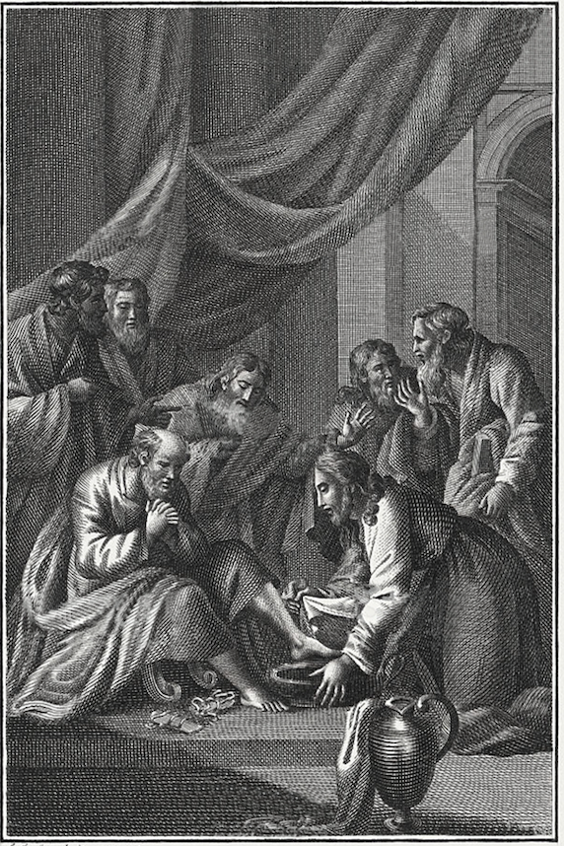
The
Gospel of
John

Slide 2
John 3:22-36
²²After these things Jesus and His disciples came into the land of Judea, and there He was spending time with them and baptizing.²³And John also was baptizing in Aenon near Salim, because there was much water there; and people were coming and were being baptized—²⁴for John had not yet been thrown into prison.
²⁵Therefore there arose a debate between John’s disciples and a Jew about purification.²⁶And they came to John and said to him, “Rabbi, He who was with you beyond the Jordan, to whom you have borne witness, behold, He is baptizing and all are coming to Him.”

Slide 3
John 3:22-36
²⁷John answered and said, “A man can receive nothing unless it has been given him from heaven.²⁸“You yourselves are my witnesses that I said, ‘I am not the Christ,’ but, ‘I have been sent ahead of Him. ²⁹“He who has the bride is the bridegroom; but the friend of the bridegroom, who stands and hears him, rejoices greatly because of the bridegroom’s voice. So this joy of mine has been made full.³⁰“He must increase, but I must decrease.

Slide 4
John 3:22-36
³¹“He who comes from above is above all, he who is of the earth is from the earth and speaks of the earth. He who comes from heaven is above all.³²“What He has seen and heard, of that He bears witness; and no one receives His witness.³³“He who has received His witness has set his seal to this, that God is true.³⁴“For He whom God has sent speaks the words of God; for He gives the Spirit without measure.³⁵“The Father loves the Son and has given all things into His hand.³⁶“He who believes in the Son has eternal life; but he who does not obey the Son will not see life, but the wrath of God abides on him.”

Slide 5
The Superior Ministry of Jesus
Superior Baptism v. 22-26
Superior Position v. 27-30

Slide 6
You must…
Jn. 3:7—you must be born again
Jn. 3:14, 12:34—the Son of Man must be lifted up
Jn. 4:4 —he must pass thru Samaria to be recognized as the Savior of the world
Jn. 4:20, 24—You must worship God in spirit
Jn. 9:4 —Jesus must do the work of the Father who sent Him
Jn. 10:16 — Jesus must bring in other sheep not of this fold
Jn. 20:9 — Jesus must rise from the dead

Slide 7
The Superior Ministry of Jesus
Superior Baptism v. 22-26
Superior Position v. 27-30
Superior Origin v. 31-34

Slide 8
Rejection vs Reception of Jesus
Jn. 1:11-12—He came to what was His own, and those who were His own did not receive Him. But as many as received Him…
Jn. 3:11—“Truly, truly, I say to you, we speak of what we know and bear witness of what we have seen, and you do not accept our witness.
Jn. 5:43— “I have come in My Father’s name, and you do not receive Me; if another comes in his own name, you will receive him.”
Jn. 12:37—But though He had done so many signs before them, they still were not believing in Him

Slide 9
The Superior Ministry of Jesus
Superior Baptism v. 22-26
Superior Position v. 27-30
Superior Origin v. 31-34
Superior Authority v. 35-36

Slide 10
Jesus Overall all things
Jn. 1:3—He is the only creator of everything
Jn. 1:7—He brings the light to everyone
Jn. 5:22—the Father has given all judgment to the Son
Jn. 13:3—Jesus knows that the Father had given all things into His hands
Jn. 16:15—all things that the Father has are mine
Jn. 17:2—Father gave Him authority over all flesh

Slide 11
The Superior Ministry of Jesus
Superior Baptism v. 22-26
Superior Position v. 27-30
Superior Origin v. 31-34
Superior Authority v. 35-36

Slide 12
Jonathan Edwards
“Sermon on Christ’s Agony in Luke 22:44”
Jesus had then a near view of that furnace of wrath, into which He was to be cast; He was brought to the mouth of the furnace that He might look into it, and stand and view its raging flames, and see the glowings of its heat, that He might know where He was going and what He was about to suffer. So, why does Jesus continue going to the cross, knowing that He will be cast into a dreadful furnace of God’s wrath?

Slide 13
Jonathan Edwards
“Sermon on Christ’s Agony in Luke 22:44”
The anguish of Christ’s soul at that time (in Gethsemane) was so strong as to cause that…effect on His body (sweating drops of blood). But His love to His enemies, poor and unworthy as they were, was stronger still. The heart of Christ at that time was full of distress, but it was fuller of love…His sorrows abounded, but His love did much more abound. Christ’s soul was overwhelmed with a deluge of grief, but this was from a deluge of love to sinners in His heart sufficient to overflow the world, and overwhelm the highest mountains of its sins. Those great drops of blood that fell down to the ground were a manifestation of an ocean of love in Christ’s heart.

Slide 14
Jonathan Edwards
“Sermon on Christ’s Agony in Luke 22:44”
There is the furnace into which you are to be cast, if they are to be saved; either they must perish, or you must endure this for them.… Christ’s soul was overwhelmed with the thought; His feeble human nature shrunk at the dismal sight. It put Him into this dreadful agony which you have heard described; but His love to sinners held out.

Slide 15
Jonathan Edwards
“Sermon on Christ’s Agony in Luke 22:44”
Christ would not undergo these sufferings needlessly, if sinners could be saved without. If there was not an absolute necessity of His suffering them in order to their salvation, He desired that the cup might pass from Him. But if sinners, on whom He had set His love, could not, agreeably to the will of God, be saved without His drinking it, He chose that the will of God should be done. He chose to go on and endure the suffering, awful as it appeared to Him…Still He finally resolved that He would bear it, rather than those poor sinners whom He had loved from all eternity should perish.

Slide 16
In Christ Alone
Till on that cross as Jesus died,
The wrath of God was satisfied;
For ev’ry sin on Him was laid —
Here in the death of Christ I live

Slide 17
The
Gospel of
John

Slide 18
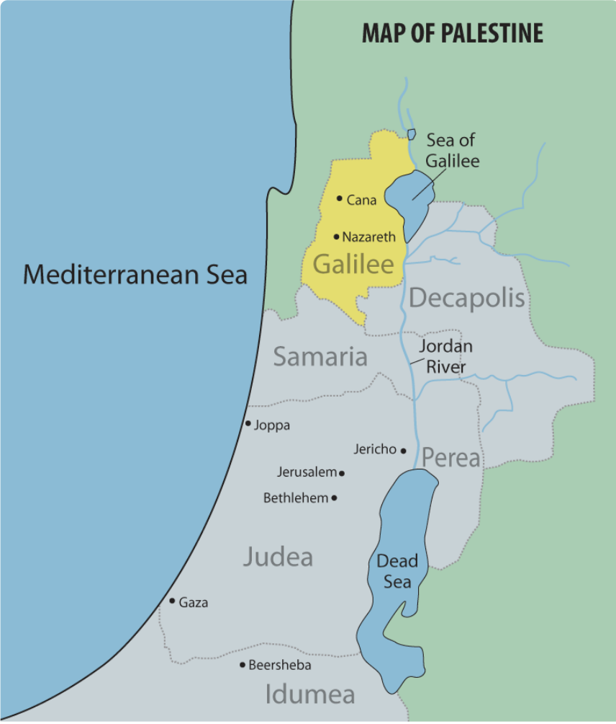
Map of Galilee
Cana & Nazareth

Slide 19
“on the next day” (1:35)
1:19-28 — previous day (first)
1:29 — next day (second)
1:35-42 — next day (third)
1:43-51 — next day (fourth)
2:1-11 — on the third day (sixth)
“Since God created in six days, and the Gospel started out with a reference to the Word’s agency in creation (1:3), it is likely that the first week of Jesus’s ministry is presented as part of John’s new creation theology.” (Kostenberger)

Slide 20
Seven Signs in John
1—Water into Wine → Cana (2:1-11)
2—Temple Cleansing → Jerusalem (2:13-22)
3—Healing Centurion’s Son → Cana (4:46-54)
4—Healing of the Lame Man → Jerusalem (5:1-18)
5—Feeding of the 5,000 → Galilee (6:1-14)
6—Healing of the Blind Man → Jerusalem (9:1-41)
7—Raising of Lazarus → Bethany (11:1-47)

