Slide 1
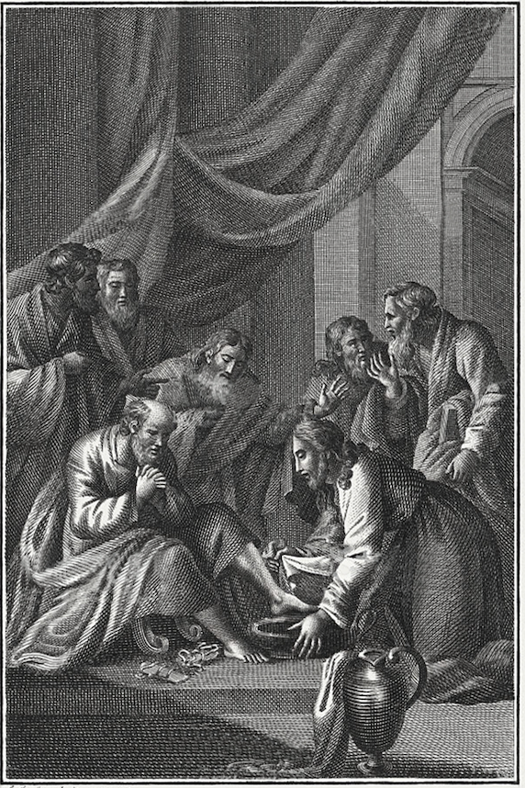
The
Gospel of
John

Slide 2
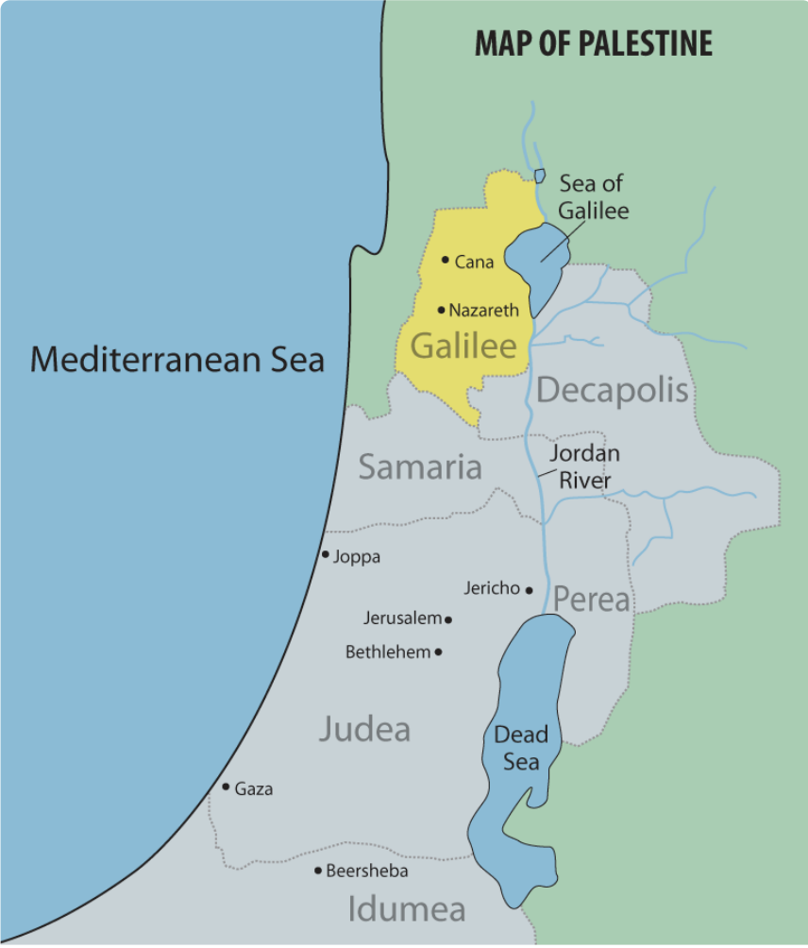
Map of Galilee
Cana & Nazareth

Slide 3
“on the next day” (1:35)
1:19-28 — previous day (first)
1:29 — next day (second)
1:35-42 — next day (third)
1:43-51 — next day (fourth)
2:1-11 — on the third day (sixth)
“Since God created in six days, and the Gospel started out with a reference to the Word’s agency in creation (1:3), it is likely that the first week of Jesus’s ministry is presented as part of John’s new creation theology.” (Kostenberger)

Slide 4
The First Sign and the Manifestation of the Son’s Glory
The Request that Unveils His Glory (2:1-5)
The Resolution that Affirms His Glory (2:6-10)

Slide 5
Seven Signs in John
1—Water into Wine → Cana (12:1-11)
2—Temple Cleansing → Jerusalem (2:13-22)
3—Healing Centurion’s Son → Cana (4:46-54)
4—Healing of the Lame Man → Jerusalem (5:1-18)
5—Feeding of the 5,000 → Galilee (6:1-14)
6—Healing of the Blind Man → Jerusalem (9:1-41)
7—Raising of Lazarus → Bethany (11:1-47)

Slide 6
The First Sign and the Manifestation of the Son’s Glory
The Request that Unveils His Glory (2:1-5)
The Resolution that Affirms His Glory (2:6-10)
The Response that Acknowledges His Glory (2:11)

Slide 7
Isaiah 25
6 And Yahweh of hosts will prepare a lavish banquet for all peoples on this mountain; A banquet of aged wine, choice pieces with marrow, And refined, aged wine.
8 He will swallow up death for all time, And Lord Yahweh will wipe tears away from all faces, And He will remove the reproach of His people from all the earth; For Yahweh has spoken.
9 And it will be said in that day, “Behold, this is our God in whom we have hoped that He would save us. This is Yahweh in whom we have hoped; Let us rejoice and be glad in His salvation.”

Slide 8
Spurgeon
“There will come a time when … the Church be perfect and complete; no one member will be missing. There will be no spot or wrinkle remaining in her. Then it shall come to pass that Christ will celebrate this marriage supper, which will be the bringing of the people of God into the closest and happiest union with Christ their Lord in glory…Oh, the ineffable brightness when we shall see the face of Jesus! Oh, the unspeakable sweetness when we shall hear his voice! Oh, the amazing bliss when he shall manifest himself to us in all his glory!

Slide 9
Spurgeon
“That feast will be, like most other marriage suppers, the fulfilment of long expectation. Our Lord has waited long for his perfected Church. He espoused himself to her before ever the earth was; but there was much to be done ere she was prepared for the marriage. The Bridegroom, too, had to leave his Father, and become one with his Bride by taking upon himself our humanity. For our sake, he did quit the thrones and royalties of heaven that he might be bone of our bone, and flesh of our flesh; and here was he born, and here he lived, and here he died.”

Slide 10
Spurgeon
“O beloved, you do not know the longings of the heart of Christ for that day of glory! For this he lived; for this he died; for this he continually pleads that all for whom he shed his precious blood might be his in that day. That day is fast coming, and when it arrives, then will be the wedding feast above.”

Slide 11
The
Gospel of
John

