Slide 1
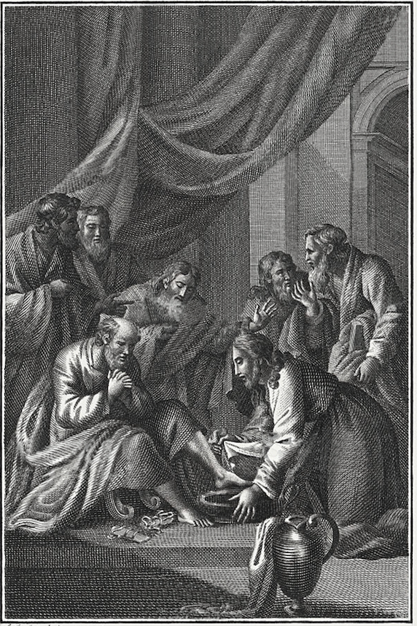
The
Gospel of
John

Slide 2
“on the next day” (1:35)
1:19-28 — previous day (first)
1:29 — next day (second)
1:35-42 — next day (third)
1:43-51 — next day (fourth)
2:1-11 — on the third day (sixth)
“Since God created in six days, and the Gospel started out with a reference to the Word’s agency in creation (1:3), it is likely that the first week of Jesus’s ministry is presented as part of John’s new creation theology.” (Kostenberger)

Slide 3
The Marks of a Follower of Jesus
  Recognize His Identity (1:35-51)
  Remain in His Presence (1:38-39)
  Reach Others for Him (1:40-42)
  Respond to His Mission (1:43-51)

Slide 4
Spurgeon “Come and See”
“Come and see;” for mark you, the best way of knowing about Christ is to try him, to experience him, and since you want to know if he can forgive sins, trust him to forgive yours. You want to know if he can change the human heart; trust him to change yours. You long to know if there be a peace that passeth all understanding, which will still the throbs of your guilty heart; try him and see. You pant to learn if there be a joy which can gild your darkest hours with sunlight…try him and see...

Slide 5
Spurgeon “Come and See”
Oh, if you trust Jesus Christ, you shall “Come and see” that sin is mastered as well as pardoned, that the guilty conscience is pacified for ever, and that your joy and peace can begin this side the grave… Oh, pass not by; neglect not the exhibition of divine love and grace; but “Come,” oh, “come and see.”…Over the cross, hangs the motto, and from the mount of Calvary rings the silvery trumpet-note, “Come and see, Come and see.”

Slide 6
The
Gospel of
John

