Slide 1
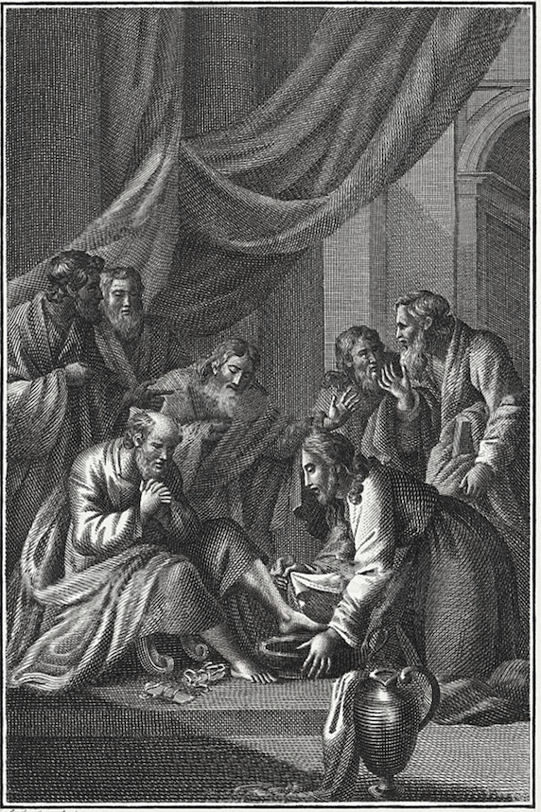
The
Gospel of
John

Slide 2
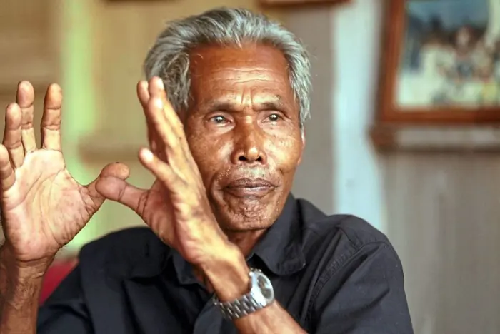
Ariffin Mohammed

Slide 3
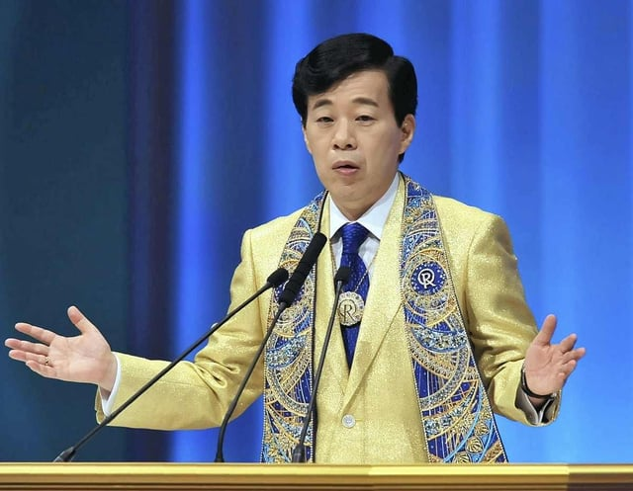
Ryuho Okawa

Slide 4
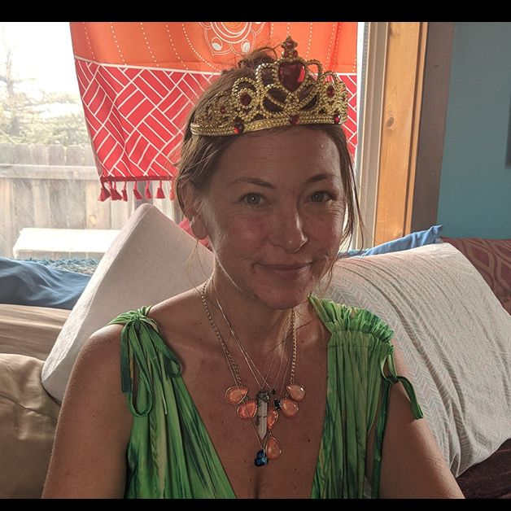
Amy Carlson

Slide 5
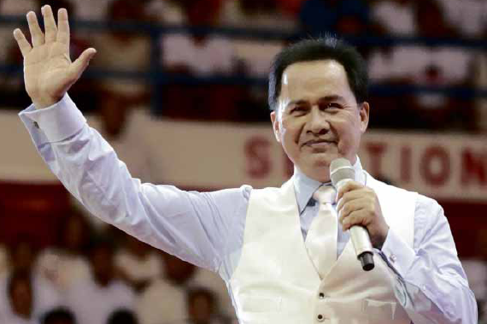
Apollo Quiboloy

Slide 6
The
Gospel of
John

Slide 7
John 1:1-18
1 In the beginning was the Word, and the Word was with God, and the Word was God.
2 He was in the beginning with God. 3 All things came into being through Him, and apart from Him nothing came into being that has come into being.
4 In Him was life, and the life was the Light of men.
5 And the Light shines in the darkness, and the darkness did not overtake it. 6 There was a man having been sent from God, whose name was John.
7 He came as a witness, to bear witness about the Light, so that all might believe through him.

Slide 8
John 1:1-18
8 He was not the Light, but he came to bear witness about the Light. 9 There was the true Light which, coming into the world, enlightens everyone.
10 He was in the world, and the world was made through Him, and the world did not know Him.
11 He came to what was His own, and those who were His own did not receive Him.
12 But as many as received Him, to them He gave the right to become children of God, even to those who believe in His name, 13 who were born, not of blood nor of the will of the flesh nor of the will of man, but of God.

Slide 9
John 1:1-18
14 And the Word became flesh, and dwelt among us, and we beheld His glory, glory as of the only begotten from the Father, full of grace and truth.
15 John bore witness about Him and cried out, saying, “This was He of whom I said, ‘He who comes after me has been ahead of me, for He existed before me.’”
16 For of His fullness we have all received, and grace upon grace. 17 For the Law was given through Moses; grace and truth came through Jesus Christ.
18 No one has seen God at any time; the only begotten God who is in the bosom of the Father, He has explained Him.

Slide 10
The Gospel of John
1–12 — Public Ministry of Jesus
13–17 — Private Ministry of Jesus
18–21 — Passion and Resurrection of Jesus

Slide 11
The “beginning” in the Gospels
Matt 1:1 — The book of the genealogy/beginning of Jesus Christ
Mark 1:1 —The beginning of the gospel of Jesus Christ
Luke 2:1 — those, who from the beginning were eyewitnesses
John 1:1 — In the beginning was the Word

Slide 12
The Arrival of the Word
Identity of the Word (vv.1-2)

Slide 13
John 1
1 In the beginning was the Word, and the Word was with God, and the Word was God.
2 He was in the beginning with God.
3 All things came into being through Him, and apart from Him nothing came into being that has come into being.
4 In Him was life, and the life was the Light of men.

Slide 14
John 1:1
  In the beginning was the Word, and the Word was with God, and the Word was God.
  was the Word = preexistence
  Word was with God = presence
  was God = person

Slide 15
The Arrival of the Word
Identity of the Word (vv.1-2)
Work of the Word (vv. 3-5)

Slide 16
John 1
5 And the Light shines in the darkness, and the darkness did not overtake it.
6 There was a man having been sent from God, whose name was John.
7 He came as a witness, to bear witness about the Light, so that all might believe through him.
8 He was not the Light, but he came to bear witness about the Light.
9 There was the true Light which, coming into the world, enlightens everyone.
10 He was in the world, and the world was made through Him, and the world did not know Him.
14 And the Word became flesh, and dwelt among us…

Slide 17
The Arrival of the Word
Identity of the Word (vv.1-2)
Work of the Word (vv. 3-5)
Witness to the Word (vv. 6-8)
Response to the Word (vv. 9-13)

Slide 18
The Arrival of the Word
A. Word with God (v. 1-2)
  B. What came to be through the Word: Creation (v. 3)
  C. What we have received from the Word: Life (v. 4-5)
  D. John sent to testify (v. 6-8)
  E. Incarnation & Response of the World (v. 9-10)
  F. The Word and His Own (v. 11)
  G. Those who accepted the Word (v. 12a)
  H. BECAME CHILDREN OF GOD (v. 12b)
  G. Those who believed in the Word (v. 12c)
  F. The Word and His Own (v. 13)
  E. Incarnation & Response of the Community (v. 14)
  D. John’s Testimony (v. 15)
  C. What we have received from the Word: Grace (v. 16)
  B. What came to be through the Word: Grace and Truth (v. 17)
A. Word with God (v. 18)

Slide 19
The Arrival of the Word
Identity of the Word (vv.1-2)
Work of the Word (vv. 3-5)
Witness to the Word (vv. 6-8)
Response to the Word (vv. 9-13)

Slide 20
J. I. Packer
Were I asked to focus the New Testament message in three words, my proposal would be adoption through propitiation.

Slide 21
J. I. Packer
If you want to judge how well a person understands Christianity, find out how much he makes of the thought of being God's child, and having God as his Father. If this is not the thought that prompts and controls his worship and prayers and his whole outlook on life, it means that he does not understand Christianity very well at all.

Slide 22
J. I. Packer
For everything that Christ taught, everything that makes the New Testament new, and better than the Old, everything that is distinctively Christian as opposed to merely Jewish, is summed up in the knowledge of the Fatherhood of God. 'Father' is the Christian name for God. Our understanding of Christianity cannot be better than our grasp of adoption.

Slide 23
J. I. Packer
Adoption is the highest privilege of the gospel. The traitor is forgiven, brought in for supper, and given the family name. To be right with God the Judge is a great thing, but to be loved and cared for by God the Father is greater.

Slide 24
The Arrival of the Word
Identity of the Word (vv. 1-2)
Work of the Word (vv. 3-5)
Witness to the Word (vv. 6-8)
Response to the Word (vv. 9-13)
Incarnation of the Word (vv. 14-18)

Slide 25
The
Gospel of
John

Slide 26
The Gospel of John
The Mission of Jesus (1:1-18)
The Ministry of Jesus (1:19-20:31)
  Public Ministry (1:19-12)
  Private Ministry (1:13-17)
  Passion and Resurrection (1:18-20)
The Ministers of Jesus (21:1-25)

Slide 27
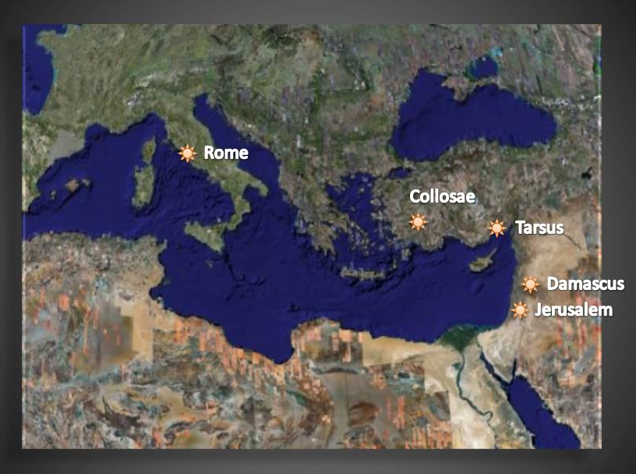

Ephesus

Slide 28
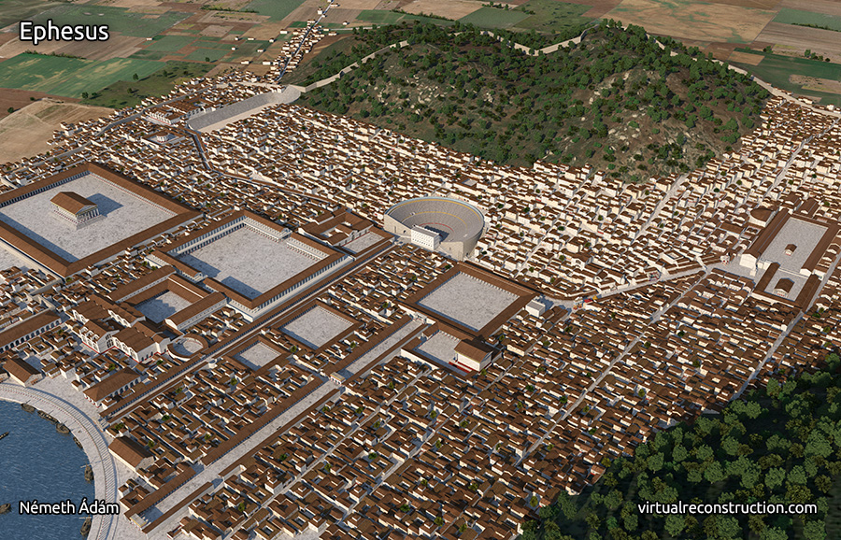
Ephesus

Slide 29
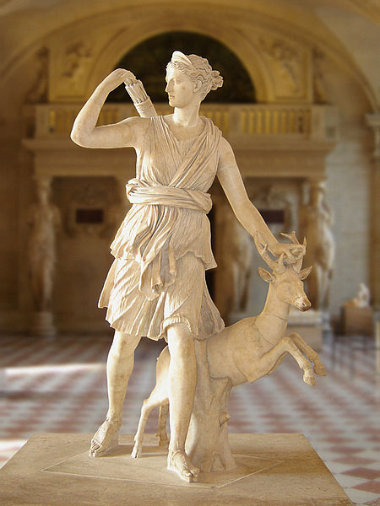
Diana/Artemis

Slide 30
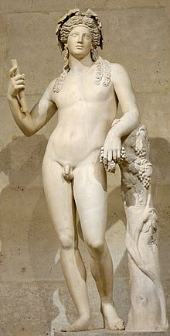
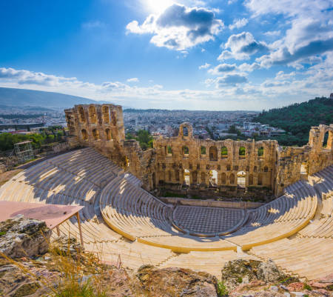
Liber Bacchus/Dionysus,

