Slide 1
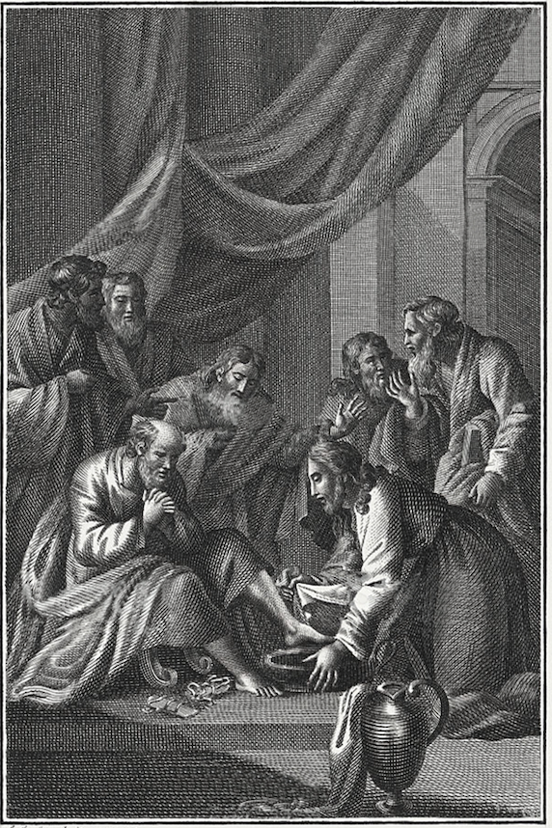
The
Gospel of
John

Slide 2
OT Citations in John
John | OT | Text
1:23 | Isa 40:3 | The voice of one calling out, “Clear the way for the Lord in the wilderness; Make straight in the desert a highway for our God.
2:17 | Ps 69:9 | For zeal for Your house has consumed me, And the taunts of those who taunt You have fallen on me.
6:31 | Ps 78:24 | He rained down manna upon them to eat, And gave them food from heaven.
6:45 | Isa 54:14 | In righteousness you will be established; You will be far from oppression, for you will not fear; And from terror, for it will not come near you.
10:34 | Ps 82:6 | I said, “You are gods, And all of you are sons of the Most High.

Slide 3
12:13-15 | Ps 118:26 Zech 9:9 Zeph 3:15 | Blessed is the one who comes in the name of the Lord; We have blessed you from the house of the Lord. Fear not daughter of Zion, behold your king is coming to you seated on a donkey’s colt.
12:38 | Isa 53:1 | Who has believed our report? And to whom has the arm of the Lord been revealed?
12:40 | Isa 6:10 | Make the hearts of this people insensitive, Their ears dull, And their eyes blind, So that they will not see with their eyes, Hear with their ears, Understand with their hearts, And return and be healed.
13:18 | Ps 41:9 | Even my close friend in whom I trusted, Who ate my bread, Has lifted up his heel against me.
15:25 | Ps 35:19 or 69:4 | Do not let those who are wrongfully my enemies rejoice over me; Nor let those who hate me for no reason wink maliciously. Those who hate me without a cause are more than the hairs of my head; Those who would destroy me are powerful, those who oppose me with lies; What I did not steal, I then have to restore.

Slide 4
19:24 19:28 | Ps 22:18 Ps 69:21 | They divide my garments among them, And they cast lots for my clothing. And for my thirst, they gave me vinegar to drink.
19:36 | Ex 12:46 Num 9:12 Ps 34:20 | It is to be eaten in a single house; you are not to bring any of the meat outside of the house, nor are you to break any bone of it. They shall not leave any of it until morning, nor break a bone of it; they shall celebrate it in accordance with the whole statute of the Passover. He protects all his bones, Not one of them is broken.
19:37 | Zech 12:10 | And I will pour out on the house of David and on the inhabitants of Jerusalem the Spirit of grace and of pleading, so that they will look at Me whom they pierced; and they will mourn for Him, like one mourning for an only son, and they will weep bitterly over Him like the bitter weeping over a firstborn.

Slide 5
Prov 8:22-31
22 “Yahweh possessed me at the beginning of His way,
Before His deeds of old.
23 From everlasting I was installed,
From the beginning, from the earliest times of the earth.
24 When there were no depths I was brought forth,
When there were no springs heavy with water.
25 Before the mountains were settled,
Before the hills I was brought forth;
26 While He had not yet made the earth and the fields outside,
Nor the first dust of the world.
When He established the heavens, I was there,
When He marked out a circle on the face of the deep,

Slide 6
Prov 8:22-31
28 When He made firm the skies above,
When the springs of the deep became strong,
29 When He set for the sea its boundary
So that the water would not pass over His command,
When He marked out the foundations of the earth;
30 Then I was beside Him, as a master workman;
And I was a daily delight, Rejoicing always before Him,
31 Rejoicing in the world, His earth,
My delight is in the sons of men.

Slide 7
Purpose Statement: John 20:31
These have been written so that you may believe that Jesus is the Christ, the Son of God; and that by believing you may have life in His name.

Slide 8
Purpose Statement: John 20:31
Christ
Ps 2:2— The kings of the earth take their stand And the rulers take counsel together Against the Lord and against His Anointed, saying
Son of God
Ps 2:7— the Lord: He said to Me, ‘You are My Son, Today I have begotten You
Life
Isa 55:3— Incline your ear and come to Me. Listen, that you may live
His name
Isa 54:5— Whose name is the Lord of hosts; And your Redeemer is the Holy One of Israel, Who is called the God of all the earth
Isa 43:11—“I, even I, am the Lord, And there is no savior besides Me

Slide 9
John 5:39—44 You search the Scriptures because you think that in them you have eternal life; it is these that testify about Me; and you are unwilling to come to Me so that you may have life…. How can you believe, when you receive glory from one another and you do not seek the glory that is from the one and only God
Isaiah 55:3—7 Incline your ear and come to Me. Listen, that your soul may live… Because of Yahweh your God, even the Holy One of Israel; For He has adorned you with beautiful glory…Seek Yahweh while He may be found; Call upon Him while He is near Let the wicked forsake his way And the unrighteous man his thoughts; And let him return to Yahweh, And He will have compassion on him, And to our God, For He will abundantly pardon

Slide 10
Isaiah 56:3—7
The one who joins himself to the lord To minister to Him, and to love the name of Yahweh, and to choose what pleases Him God says to them I will give in My house and within My walls a memorial, an everlasting name which will not be cut off. I will bring him to My holy mountain And make them glad in My house of prayer.

Slide 11
10 Messianic Themes Developed & Fulfilled in John
The Divine Identity of Jesus
1:1-2—In the beginning was the Word, and the Word was with God, and the Word was God. He was in the beginning with God.

Slide 12
John 5:21-26
For just as the Father raises the dead and gives them life, even so the Son also gives life to whom He wishes. 22 For not even the Father judges anyone, but He has given all judgment to the Son, 23 so that all will honor the Son even as they honor the Father. He who does not honor the Son does not honor the Father who sent Him…26 For just as the Father has life in Himself, even so He gave to the Son also to have life in Himself.
5:21—he gives life to whomever he wishes
5:22—he possess all judgment
5:23—he receives worship/honor
5:26—he has life in himself

Slide 13
Rev 19:10 (22:8-9)
Then I fell at his feet to worship him (angel). But he said to me, Do not do that! I am a fellow slave with you and your brothers who have the witness of Jesus. Worship God! For the witness of Jesus is the spirit of prophecy.

Slide 14
Isaiah 45:5, 7, 18
5 — I am the Lord, and there is no other; Besides Me there is no God…
7 — The One forming light and creating darkness
18 — For thus says Yahweh, who created the heavens (He is the God who formed the earth and made it; He established it and did not create it a formless place, but formed it to be inhabited), “I am Yahweh, and there is none else.

Slide 15
John 14:9
He who has seen Me has seen the Father.
John 12:45
He who sees Me sees the One who sent Me.
Col 2:9
For in Him all the fullness of Deity dwells bodily.

Slide 16
“I AM” in Isaiah
41:4 — ‘I, God, am the first; and the last, I am He.’
43:10 — So that you may know and believe Me And understand that I am He. Before Me there was no god formed, And there will be none after Me.
43:13 — Even from eternity I am He, And there is none who can deliver out of My hand; I act and who can reverse it?
43:25 — I am, I am, the one who wipes out your transgressions for My own sake, And I will not remember your sins.

Slide 17
“I AM” in Isaiah
45:8 — Drip down, O heavens, from above, And let the clouds pour down righteousness; Let the earth open up and salvation bear fruit, And righteousness spring up with it. I am, the Lord, have created it.
45:18 — I am the Lord, and there is none else.
45:19 — I am, I am the Lord, speak righteousness, Declaring things that are upright.

Slide 18
“I AM” in Isaiah
45:22 — Turn to Me and be saved, all the ends of the earth; For I am God, and there is no other.
46:4 — Even to your old age I am, And even to your graying years I am, I will bear you! I have done it, and I will carry you; And I will bear you, and I will rescue you.
46:9 — Remember the former things long past, For I am God, and there is no other; and there is no one like Me.
48:12 — Listen to Me, O Jacob, even Israel whom I called; I am the first, I am also the last.

Slide 19
“I AM” in Isaiah
48:17 — I am the Lord your God, who teaches you to profit, Who leads you in the way you should go.
51:12 — I am, I am He who comforts you.
52:6 — Therefore My people shall know My name; therefore in that day I am the one who is speaking, ‘Here I am.’
61:8 — For I am the Lord, love justice [ἐγὼ γάρ εἰμι].

Slide 20
“I AM” & Jesus
Thru these sayings, this is Jesus’ way to “express his unique and exclusive participation in God’s unique and exclusive deity. Just as ‘I am’ in the Hebrew Bible sums up what it is to be truly God, so in John it identifies Jesus as truly God in the fullest sense.” (Richard Bauckham)

Slide 21
Seven “I AM” Statements
I am the Bread of Life (6:35)
I am the Light of the World (8:12)
I am the Door (10:9)
I am the Good Shepherd (10:11-14)
I am the Resurrection and the Life (11:25)
I am the Way and the Truth and the Life (14:6)
I am the Vine (15:1-5)

Slide 22
10 Messianic Themes Developed & Fulfilled in John
The Divine Identity of Jesus
The Revelation of God’s Name
1:18—to explain God
4:34—my food is to do the will of Him who sent me and to accomplish His work
5:17—My Father is working until now, and I Myself am working.

Slide 23
10 Messianic Themes Developed & Fulfilled in John
The Divine Identity of Jesus
The Revelation of God’s Name
The Lamb of God
The Prophet
The Anointed
Son of God
Son of Man

Slide 24
10 Messianic Themes Developed & Fulfilled in John
7. Son of Man
  Dan 7:13-14
  I kept looking in the night visions, And behold, with the clouds of heaven One like a son of man was coming, And He came up to the Ancient of Days And was presented before Him. And to Him was given dominion, Honor, and a kingdom, So that all the peoples, nations, and populations of all languages Might serve Him. His dominion is an everlasting dominion Which will not pass away; And His kingdom is one Which will not be destroyed.

Slide 25
10 Messianic Themes Developed & Fulfilled in John
The Divine Identity of Jesus
The Revelation of God’s Name
The Lamb of God
The Prophet
The Anointed
Son of God
Son of Man
The Shepherd
The Suffering Messiah

Slide 26
10 Messianic Themes Developed & Fulfilled in John
9. The Suffering Messiah
Jn 2:17 with Psa 69:9
Jn 12:38-40 with Isa 6:10, 53:1
Jn 13:18 with Psa 41:9
Jn 15:25 with Psa 35:19, 69:4
Jn 19:24 with Psa 22:18
Jn 19:28 with Psa 69:21
Jn 19:36-37 with Ex 12:46; Num 9:12; Psa 34:20; Zech 12:10

Slide 27
10 Messianic Themes Developed & Fulfilled in John
The Divine Identity of Jesus
The Revelation of God’s Name
The Lamb of God
The Prophet
The Anointed
Son of God
Son of Man
The Shepherd
The Suffering Messiah
The King of Israel

Slide 28
Genesis | John
1:1 In the beginning God created the heavens and the earth… God separated the light from the darkness. | 1:1-5 In the beginning was the Word… All things came into being through Him… Light shines in the darkness
2:1-4 Thus the heavens and the earth were finished… God finished His work which He had done [LXX] | 17:4 having finished the work which You have given Me to do 19:30 it is finished
2:4 This is the book of the beginning of the heavens and the earth when they were created, in the day that the Lord God made earth and heaven [LXX] | 20:30 many other signs Jesus also did in the presence of the disciples, which are not written in this book

