Slide 1
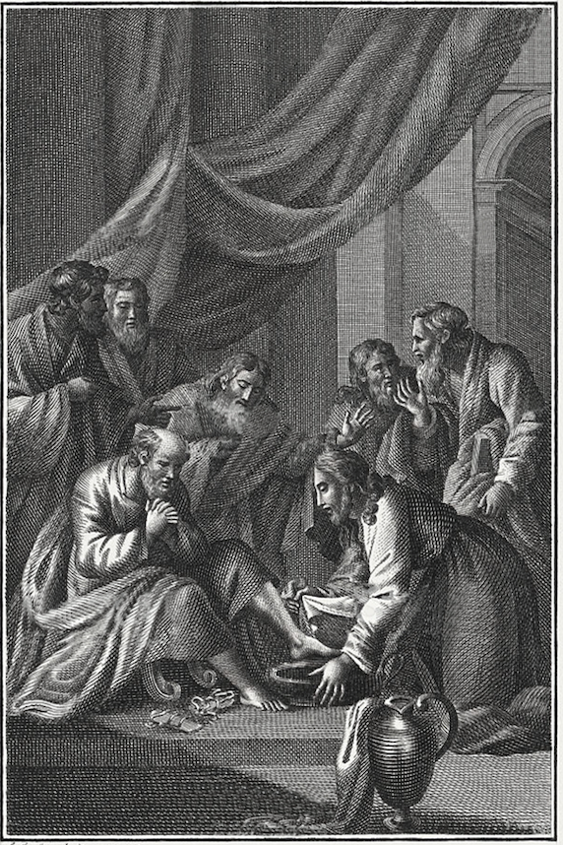
The
Gospel of
John

Slide 2
The Gospel of John
Clement of Alexandria— John, last of all, was moved by the Spirit composed a spiritual Gospel.
Kruger—The most popular Gospel within early Christianity.
D.L. Moody—The Gospel of John opens with Jesus Christ in the bosom of God and closes with the sinner in the bosom of Jesus Christ.

Slide 3
The Gospel of John
R. A. Torrey—The best book in the world to put into the hands of the one who desires to know about Jesus and to be saved is the Gospel of John.
Luther—Uniquely tender and accurate gospel.
German scholars—John Presents Jesus as God who strides over the earth.
Lee—“The Gospel has a mysterious quality to it: easily graspable, in one sense, but profoundly elusive in another.”

Slide 4
Variations in John
Missing: Infancy narrative
Missing: Satan’s temptation
Missing: Demon being cast out
Missing: List of 12 disciples’ names
Missing: Prayer in Gethsemane
Missing: Transfiguration
Passover in Jerusalem
  SG = 1x & John = 3x
Cleansing at the temple
  FG - beginning & SG - end
Focus on Dualistic imagery
  light/darkness, truth/lies, life/death, being from above/below
Missing: Sadducees & tax collectors
7 “I am” sayings
7 signs (not called miracles)
New Conversations & Wonders
  Wedding at Cana
  Nicodemus
  Samaritan Woman
  Lame Man for 38 years
  Blind man (Ch 9)
  Lazarus resurrection
Farewell discourse
High priestly prayer
Running to the tomb
Breakfast after the resurrection

Slide 5
Dietrich Bonhoeffer
“When Christ calls a man, he bids him come and die.”
“Suffering…is the badge of true discipleship…Following Christ means suffering…. Discipleship means allegiance to the suffering Christ, and it is therefore not at all surprising that Christians should be called upon to suffer.”

Slide 6
The Purpose of John 20:30-31
Therefore, many other signs Jesus also did in the presence of the disciples, which are not written in this book; but these have been written so that you may believe that Jesus is the Christ, the Son of God; and by continuing to believe you may have life in His name.

Slide 7
Rewards of Discipleship
Family of God Membership | Fellowship with the Trinity | Friendship with Jesus
Life Love Knowledge of God Knowledge of the truth Freedom from sin Walking in the light Salvation Avoidance of judgment, destruction Resurrection Protection Performance of great works Confirmation of genuine discipleship Honor Glory Unity/oneness with Father/Son/Spirit Unity with other disciples | Paraclete Love Peace Joy Avoidance of judgment Answered prayers Performance of great works Confirmation of genuine discipleship | Love Knowledge of Father Spiritual fruit Joy Answered prayers

Slide 8
Johannine Discipleship
Johannine discipleship is devotion to Jesus that is characterized by continuous belief derived from rational and relational knowledge of the Father and Son as sustained by the Spirit, resulting in confession of Jesus as Messiah and a life of obedience to His teaching.

Slide 9
Characteristics of a Faithful Follower of Jesus
Believe
Love
Obey
Bear fruit
Abide
Witness
Hate your life

Slide 10
CT Studd
Two little lines I heard one day,
Traveling along life’s busy way;
Bringing conviction to my heart,
And from my mind would not depart;
Only one life, twill soon be past,
Only what’s done for Christ will last.
Only one life, yes only one,
Soon will its fleeting hours be done;
Then, in ‘that day’ my Lord to meet,
And stand before His Judgement seat;
Only one life, ’twill soon be past,
Only what’s done for Christ will last.
Give me Father, a purpose deep,
In joy or sorrow Thy word to keep;
Faithful and true what e’er the strife,
Pleasing Thee in my daily life;
Only one life, ’twill soon be past,
Only what’s done for Christ will last.
Oh let my love with fervor burn,
And from the world now let me turn;
Living for Thee, and Thee alone,
Bringing Thee pleasure on Thy throne;
Only one life, “twill soon be past,
Only what’s done for Christ will last.

Slide 11
CT Studd
Only one life, yes only one,
Now let me say, “Thy will be done”;
And when at last I’ll hear the call,
I know I’ll say “‘twas worth it all”;
Only one life, ‘twill soon be past,
Only what’s done for Christ will last.

Slide 12
The
Gospel of
John

